Slide 1
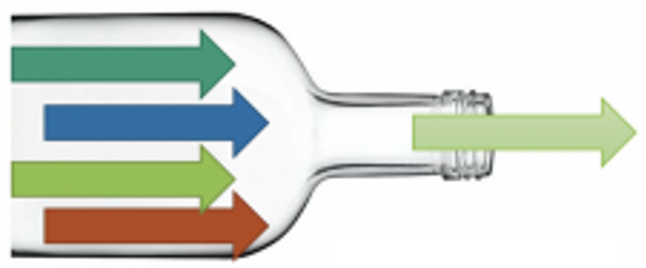
Cognition
Perception

