Slide 1

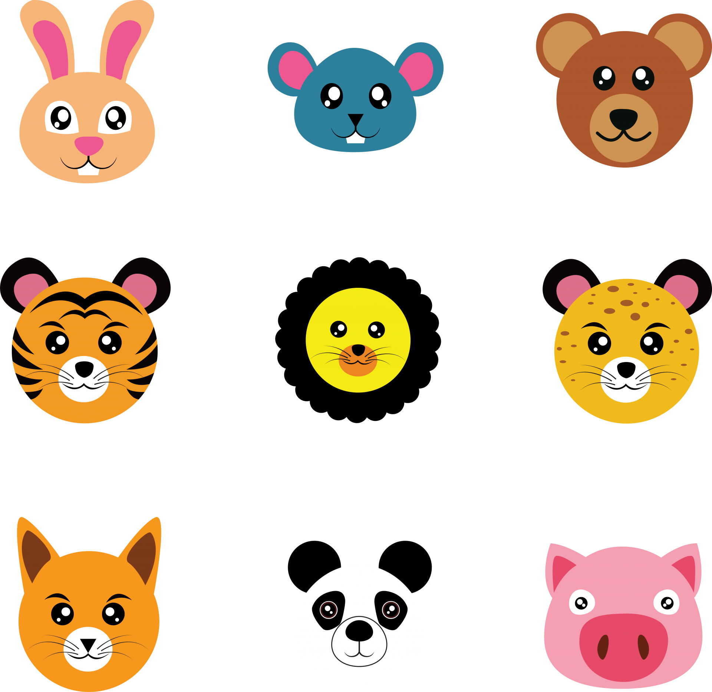
?
?
?
?
Stimulus onset
Cueing 4 targets
Tracking

Slide 2
?
?
?
?
Time 1: Stimulus onset
Time 2: Cueing
Time 3: Tracking

Slide 3
Time 1
Time 2: Cueing
Time 3: Tracking

Slide 4
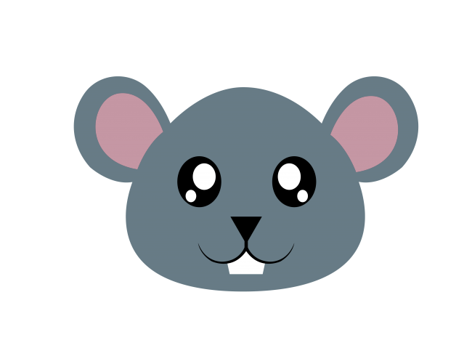
?
?
?
?
?
?
?

Slide 5
Notes:
https://www.publicdomainpictures.net/en/view-image.php?image=362275&picture=cartoon-animal-faces

