Slide 1

Money in Politics: The relationship between contributions and congressional voting
By: Alex Hubbard

Slide 2
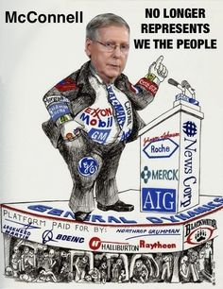
Project Overview:
Publications:
Pigs at the Trough: How Corporate Greed and Political Corruption Are Undermining
- Arianna Huffington
Who Wants to Buy a Politician?
– NYT
Research Question:
What is the true relationship between campaign contributions and voting results?
Can politicians be bought?

Slide 3
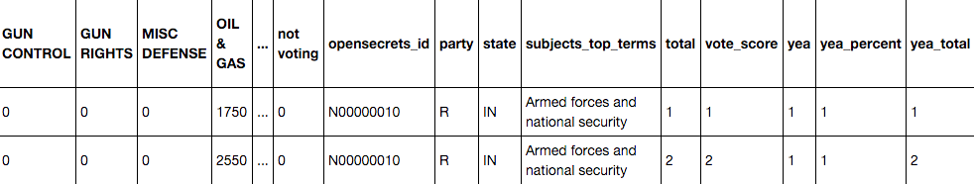
Data Set
Collection:
All bill from the 101st to the 114th congress - 1989 to present (subset for project, Armed Forces and Nation Security ) (api: govtrack.us)
How each official voted on a bill (api: govtrack.us)
Contributions to each political official since 1981 (bulk export)
https://sunlightlabs.github.io/datacommons/bulk_data.html
Not using all variables for this analysis. Plan to continue working with this data set.

Slide 4
Cleaning
Cleaned:
A lot of cleaning was necessary
Bill id was used to find voting information
Voting information found officials from government id
Government id was used to find campaign id
Campaign id was used to find campaign contributions
Campaign funding industries were condense from 400+ to 115
Rolling tally of money collected, and voting history
Cleaning:
Choose new contribution industries as features
Rolling tally (script finished after presentation was made)
???

Slide 5
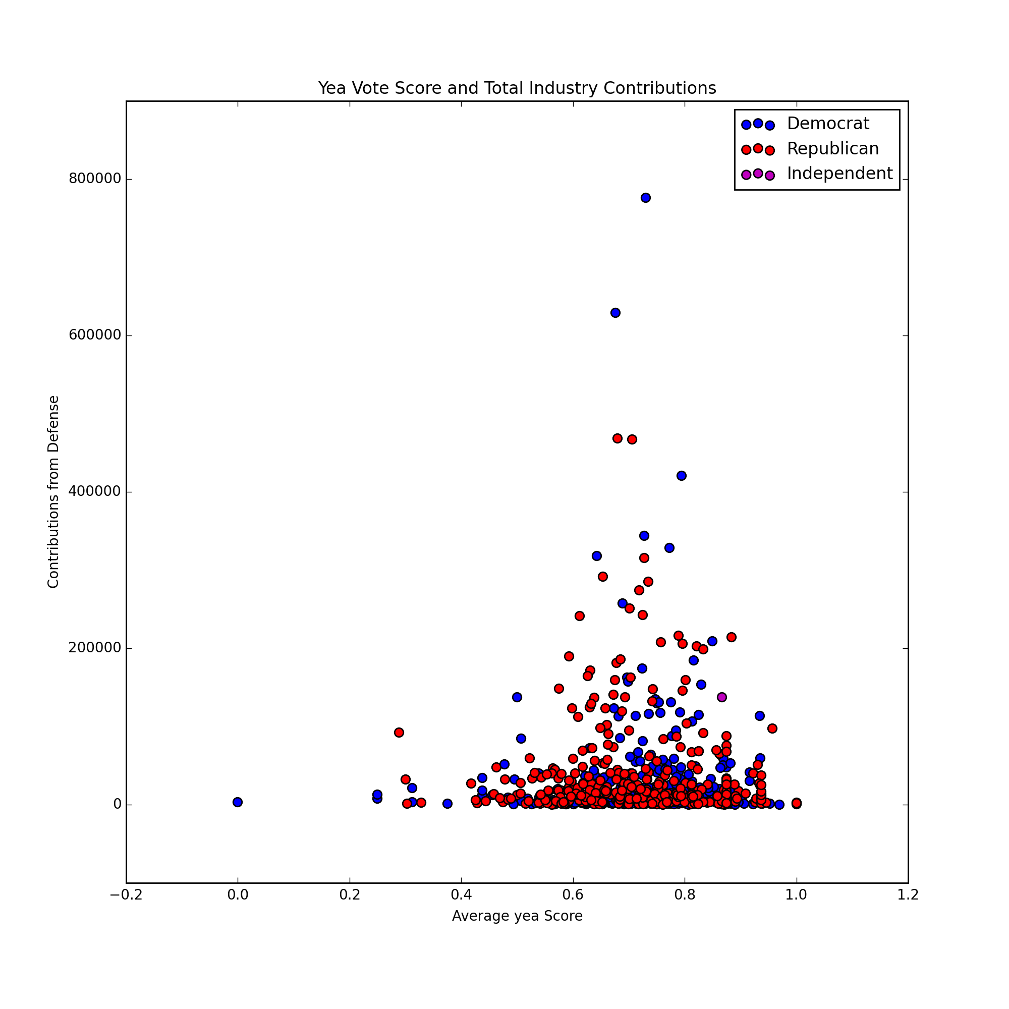
Exploration and Beyond
Exploration:
Initial:
Used groupby function to get holistic view
Not provide much detail because aggregated analysis
Future:
Analysis on rolling tally of data
Enough data?
Yes, more than enough
Modeling:
Explore Baysian because of the probability
Explore clustering to find groups
Random Forest

Slide 6
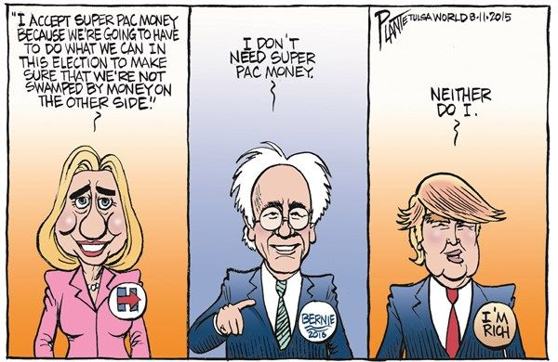
Question?

