Slide 1
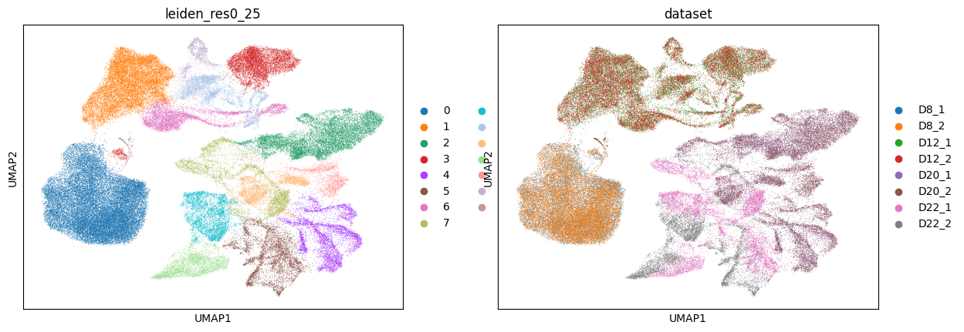
Cluster by day, at least replicates are together

Slide 2
