Slide 1
ArtWorld Gems
Coord teacher sl. dr. ing. Mitrea Dan Alexandru
Nica Alexia-Stefania
Group: 1211EA

Slide 2
Contents of this Web Application
Programming Languages Used | A list with all the programming languages I used to implement the application
Comparison | A comparison between my app and similar ones
Inovation | What is new to my application compared to others
Objectives | The obiectives that I want to achieve with this app
Presentation of the app | The features and advantages of the app
Conclusion | Next steps to improve the app

Slide 3
Programming Languages Used
01
02
03
04
Html
CSS
PHP
JavaScrip
05
MySQL

Slide 4
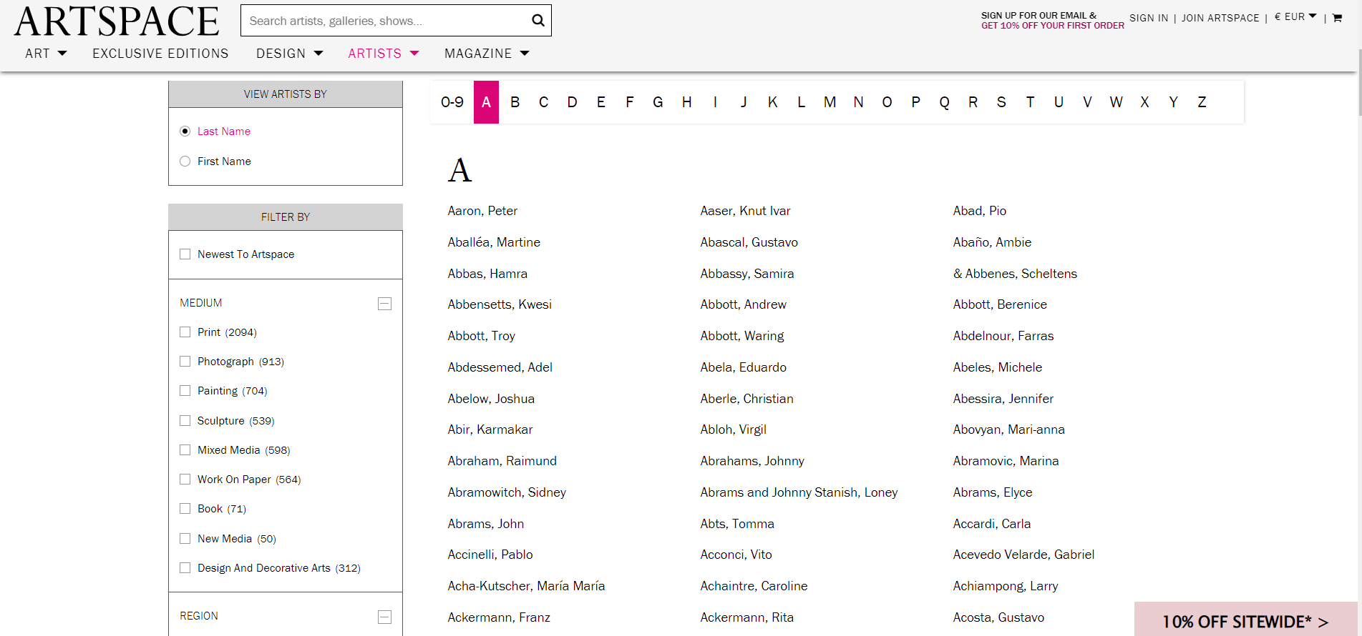
Comparison
ARTSPACE site

Slide 5
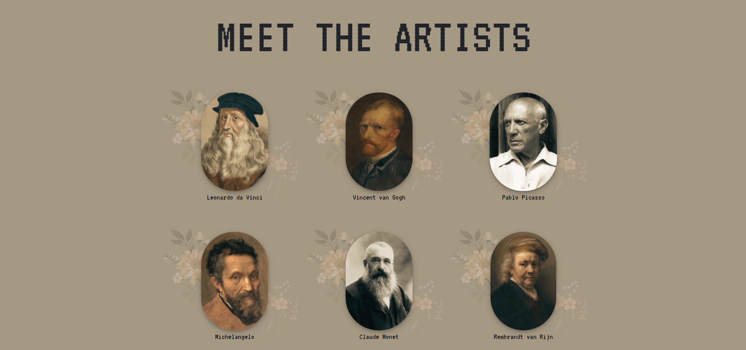
Comparison
My ArtWorld Gems site

Slide 6
Comparison
As you have seen in the ARTSPACE site, the artist list that they have it is much longer than mine, but I have thought of a much more attractive design. By putting a picture of each artist, they can be easily recognized.

Slide 7
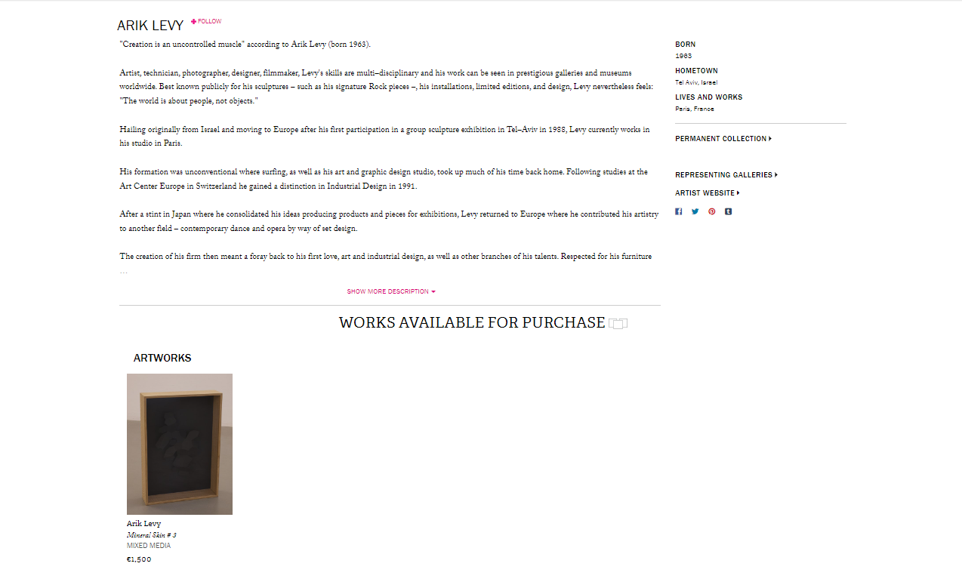
Comparison
ARTSPACE site

Slide 8
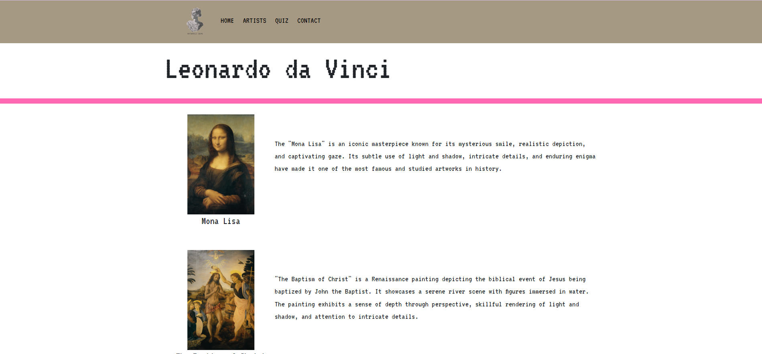
Comparison
My ArtWorld Gems site

Slide 9
Comparison
The principal ARTSPACE site is intended for selling art while mine is just for visualization

Slide 10
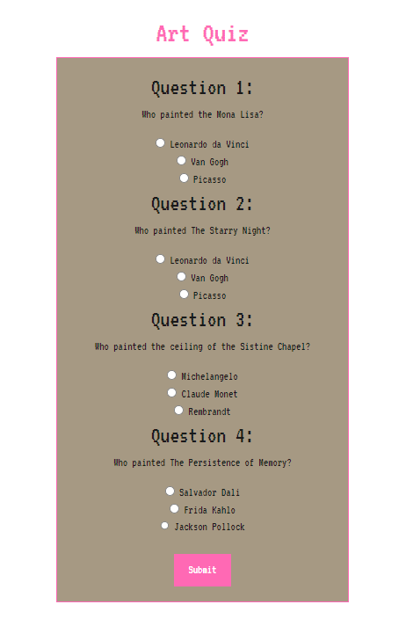
Inovation
Quiz – little game for testing your knowledge on artwork

Slide 11
Objectives
This site is created for those interested in art. Also the layout design is made to inspire, is a combination between vintage and and modern times.

Slide 12
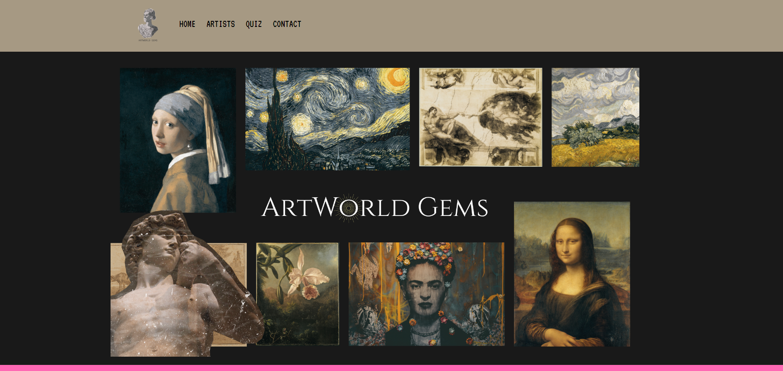
Presentation of the app
The home page

Slide 13
Presentation of the app
The artists section

Slide 14
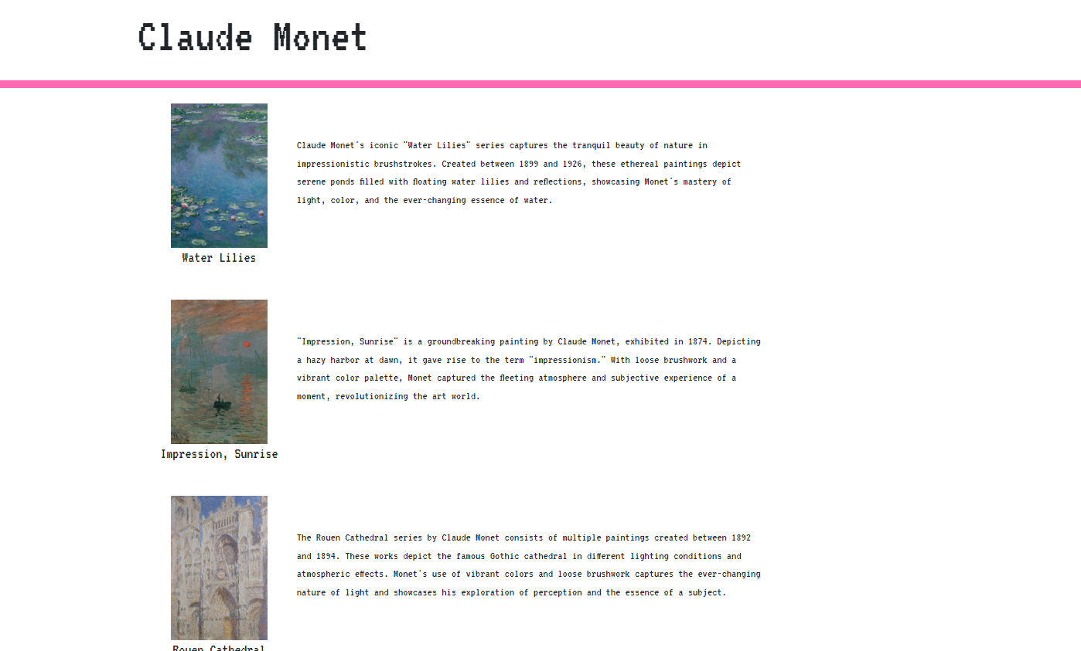
Presentation of the app
The page of the artist

Slide 15
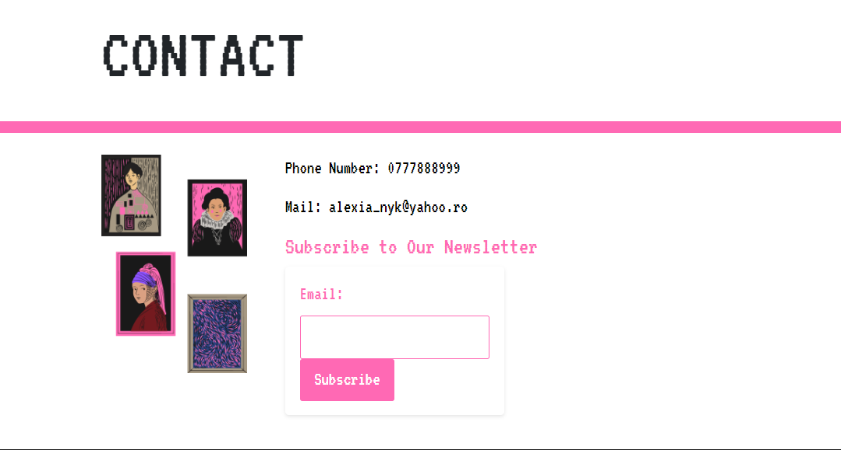
Presentation of the app
The contact page

Slide 16
Advantages
Disadvantages
Database for those who wants to receive a notification whenever we post something new on our website
The list of the artists is not very large and neither are the artworks of each artist

Slide 17
Conclusion - Next Steps
Add more artists and artworks
More interesting mini-games
Add a new section for art enthusiasts to show their artwork and interact with eachother

