Slide 1
DH2026 - Reclaiming Epistemic Agency in AI-Assisted Research: A Recommender System That Reveals, Rather Than Hides, IR Logic
Alexia Schneider
Marcello Vitali-Rosati
Pierre Levy

Slide 2
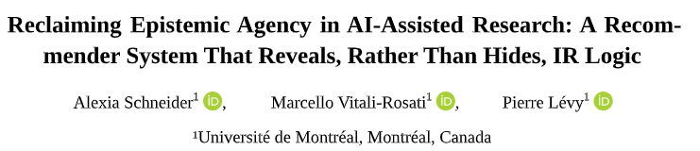

Slide 3
Presentation outline
Introduction
Brief SOTA
Demonstration
Evaluation
Conclusion

Slide 4
Introduction
Larger context of the research: Scientific documentary research (esp. for SSH researchers)
Recommendation systems have changed: from algorithms that extracted “you might also like” suggestions alongside search engine results to tools that support natural language queries and provide full reports.

Slide 5
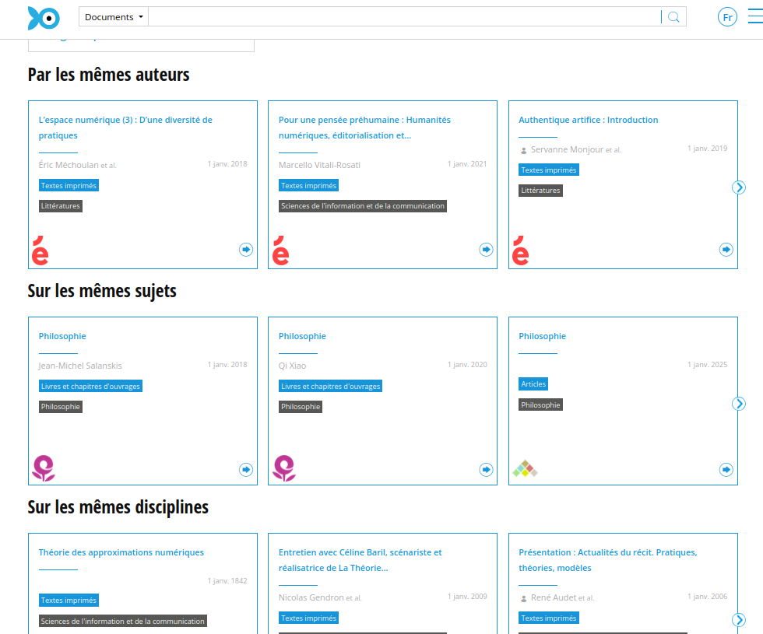
Screenshot of Isidore and standard suggested article functions

Slide 6
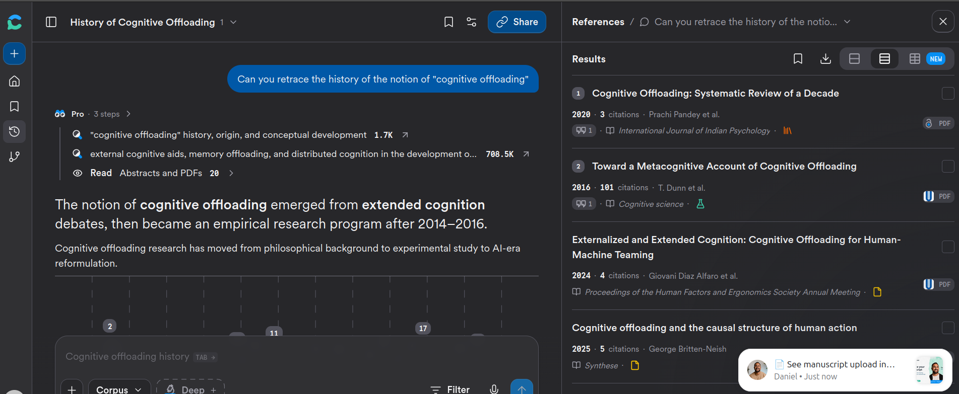
Screenshot of Consensus.app. Support for natural language queries, combining all research steps (retrieval, ranking, synthesis)

Slide 7
Problem Statement
With the current adoption of these “AI research assistants” we are seeing a change in research practices. With it comes certain aspects that we have still to grapple with:
A focus on ‘findability’ i.e. finding what we already know we know as opposed to ‘serendipity’: finding what we didn’t know -> risk of increasing confirmation bias (Underwood 2014) with natural language querying.
Blurring of different cognitive tasks: search and analysis (Finn et al. 2026; DeRewal 2025).
Still complex evaluation of an opaque and quickly-changing tools: opacity of ranking, filtering, and synthesis (when applicable) (Archambault and Rincón 2024; Patterson et al. 2025; Tay 2025).
Opacity of the systems themselves: citation concentration (Matthew effect (Merton 1968)) with potential reduction of the epistemic space for discovery (Nielsen and Andersen 2021; Varga 2022).
Incentives to maintain authoritative tools and rely on long documented persuasiveness of algorithms and computer outputs (Dijkstra, Liebrand, and Timminga 1998; Logg, Minson, and Moore 2019; Vicente and Matute 2023).

Slide 8
Research Question
How can we design explainable systems situated at the center of an environment that fosters critical exploration and enables intellectual engagement with the algorithm?

Slide 9
Examples of Alternative Recommendation Systems
Bridger by Portenoy et al. (2022) exposes researchers to authors outside their usual intellectual networks to promote disciplinary cross-pollination.
VITALITY by Narechania et al. (2022) proposes a literature review approach based on visualization of word embedding space from a seed article.
STAK by Martin, Greenspan, and Quan-Haase (2017) was inspired by the material affordances of physical libraries, attempting to recreate spatialized navigation environments.

Slide 10
IEML
Semantic Facet | Value
Theme/root | theory (s.y.-g.-o.p.-’)
What | edition or publishing (t.a.-b.a.-p.-’)
Who | -
To whom | -
By which means | *has property ~multiple process
When | -
Where | -
Why | -
How | -
Information Economy MetaLanguage (IEML) (Lévy 2023) != YAML
Sentence or higher level of conceptualisation
IEML decomposition matrix based on 9 semantic facets for the keyword editorialisation

Slide 11
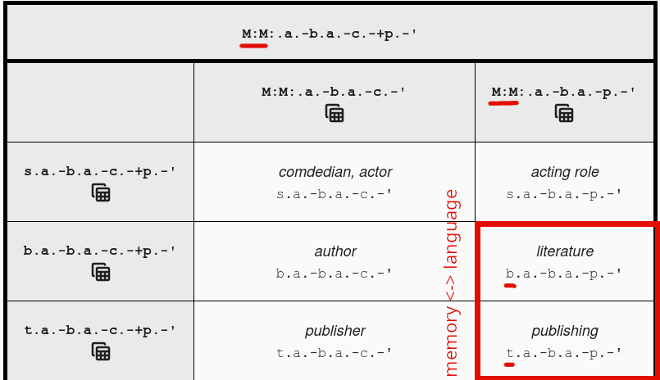
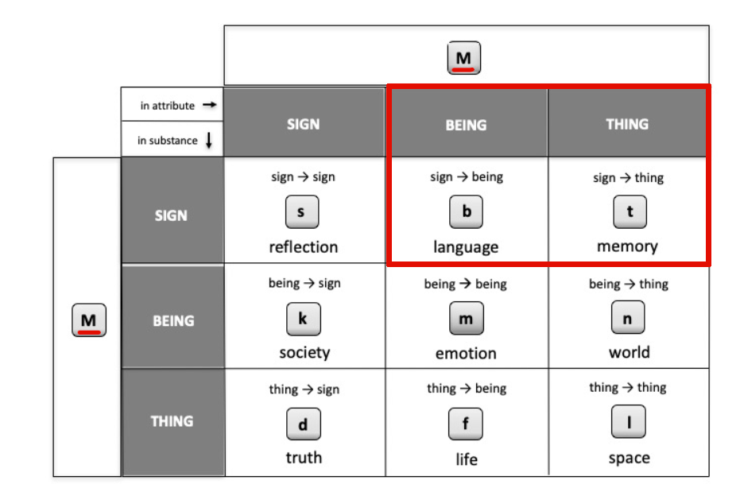
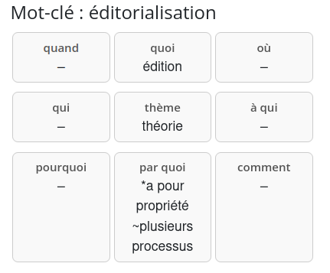
Rules :
the grid doesn’t have to be filled
flexions are represented with *, ~
le concepts have to be in the IEML dictionnary: https://ieml.intlekt.io/
Lexical level of deeper level of conceptualisation
publishing: t.a.-b.a.-p.-’
Rules:
Any concept can be described from the combination of 6 ‘primitives’: E (emptiness), U (virtual), A (actual), S (sign), B (being), and T (thing).
A combination between two ‘primitives’ is a lowercase letter: there are 26 symbols.
There are up to 6 layers of semantic desambiguisation represented with punctuation (ex: the dot is the first layer).
Each layer is represented by a triad following the syntax: substance (role 1), attribute (role 2), and mode (role 3). An empty space in a layer is simply not represented.
Visualization of the grid in the IEML-RS plugin
Modulation of the primitive M
Modulation of the primitive M on the first segment shifts meaning from b associated with ‘language’ in literature to a t meaming ‘memory’ and creating publishing

Slide 12
Demonstration

Slide 13
Summary of Main Features
Exploration and extansion of a semantic field thanks to IEML starting from a keyword describing the seed article.
Automatic generation and correction (human-in-the-loop) of missing ‘translations’.
Construction of a query sent to the search engine Isidore.
Side by side comparison of article lists retrieved from the user-selected keywords and an LLM-augmented query from those same keywords.

Slide 14
Prompts

Slide 15
“Translation” Prompt into IEML
English version:
You are a semantics expert. You must semantically decompose the keyword “${keyword}” based on the following 9 values: ‘theme, who, what, to whom, by what means, when, where, why, how’ ## Examples ${examples}
## Dictionary Words You must use the words below to define the keyword “${keyword}”: ${context}
Your response must take the form of a CSV with 9 columns; the column headers are: ‘theme, who, what, to whom, by what means, when, where, why, how’ It is not necessary to fill all fields. A field can remain empty between two commas, as in the examples. Respond only with a final CSV line, without explanation.
Original in French:
Tu es un expert en sémantique. Tu dois décomposer sémantiquement le mot-clé "${keyword}" à partir des 9 valeurs suivantes :
'thème, qui, quoi, à qui, par quoi, quand, où, pourquoi, comment'
## Exemples
${examples}
## Mots du dictionnaire
Tu dois utiliser les mots ci-dessous pour définir le mot-clé "${keyword}":
${context}
Ta réponse prendra la forme d'un CSV à 9 colonnes, les entêtes de colonnes sont:
'thème, qui, quoi, à qui, par quoi, quand, où, pourquoi, comment'
Il n'est pas nécessaire de remplir tous les champs. Un champs peut rester vide entre deux virgules, comme dans les exemples.
Répond uniquement avec une ligne CSV finale, sans explication.

Slide 16
Query Augmentation Prompt
English version:
Generate 10 variants of the following Boolean query “${keywords}”. Combine the proposed queries using the OR operator as in the example:
Keywords: “impact of climate change on biodiversity”.
Response: “(climate change biodiversity impact) OR (effects of climate change on ecosystems) OR (biodiversity loss due to climate change) OR (climate change species extinction) OR (impact of global warming on wildlife) OR (effects of climate change on ecosystems and species diversity) OR (how climate change impacts wildlife and biodiversity) OR (climate change consequences for biological diversity) OR (relationship between climate change and loss of biodiversity) OR (climate change threats to flora and fauna diversity) OR (impact of climate change on biodiversity) Now it is your turn with”${keywords}“.
Respond only with the query without giving any explanation.
Original in French::
Produit 10 variants de la requête booléenne suivante "${keywords}". Combine les requêtes proposées à l'aide de l'opérateur OU comme dans l'exemple : Mots-clés: "impact of climate change on biodiversity". Réponse: "
(climate change biodiversity impact) OU (effects of climate change on ecosystems) OU (biodiversity loss due to climate change) OU (climate change species extinction) OU (impact of global warming on wildlife) OU (effects of climate change on ecosystems and species diversity) OU (how climate change impacts wildlife and biodiversity) OR (climate change consequences for biological diversity) OU (relationship between climate change and loss of biodiversity) OU (climate change threats to flora and fauna diversity) OU (impact of climate change on biodiversity)
C'est à ton tour avec "${keywords}". Répond uniquement avec la requête sans donner d'explication.

Slide 17
Evaluations
Quantitative evaluation of the translation produced by the LLM in IEML (RAG to anchor translations in IEML dictionary words).
Qualitative evaluation (user study) of the application as a whole.

Slide 18
Evaluation of Automatic Translation into IEML
Expected translation

Slide 19
Examples of translations produced by rag-llama-fewshot.
LLMs still do not perform well for structured meaning representation e.g. with Abstract Meaning Representation (AMR) (Ettinger et al. 2023).

Slide 20
Evaluation Summary
model/strategy | BLEU | Cosine | avg
baseline | 0.056 | 0.515 | 0.286
llama_fewshot | 0.0222 | 0.555 | 0.289
gemma_fewshot | 0.020 | 0.491 | 0.255
openai_fewshot | 0.0167 | 0.498 | 0.257
llama_zeroshot | 0.0129 | 0.514 | 0.263
gemma_zeroshot | 0.0160 | 0.479 | 0.248
openai_zeroshot | 0.016 | 0.493 | 0.254
Models (via Together AI API):
Meta-Llama-3-70B-Instruct-Turbo
Gemma-3n-E4B-it
GPT-oss-20B
Table of model evaluation for automatic translation

Slide 21
The context (i.e., dictionary entries) marginally improves performance.
Limits:
BLEU and cosine are meant for the evaluation of natural language translation therefore are ill-suited for structured semantic language parsing.
the retrieval part of the RAG makes choices that can potentially go against the principles of IEML representation. For instance the IR for ‘editorialisation’ will very likely retrieve from the IEML dictionnary ‘publishing’ with a vector-base search or ‘edition’ with BM25 but probably not ‘theory’ as these are farther apart. But the main advantage of IEML lies in its ability to bridge faraway concepts from common denominators.

Slide 22
Qualitative Evaluation of IEML-RS
6 users (PhD in Digital Humanities). Demonstration followed by 10 minutes of usage observation and a 15-minute interview.
Criteria:
User-friendliness,
Usefulness.
Features:
Navigation (keywords and concepts),
Translation into IEML,
Comparison of article list panels.

Slide 23
User Study
Ease of use:
  Confusion regarding the integration of concepts into the query,
  Automatic translation and validation: initial hurdle (limited database),
Usefulness:
  Reveals strong disparities in user research practices (network and contextual IR vs. keyword search),
  Strength: comparative panels,
  Mixed-quality translation encourages user agency and dialogic and collaborative work with LLMs (Schneider 2026).

Slide 24
Conclusion and Perspectives
Example of an environment design fostering serendipity.
Tools being developed in Digital Humanities:
Barista from the Impresso project: query building assistant (Finn et al. 2026)
Ongoing developments at Isidore for RAG limited to specific use cases (Sacy et al. 2025)

Slide 25
Acknowledgements
Research funded by the SSHRC through the Revue3.0 partnership project, as well as a fellowship from the Circé Network and the Publica Coalition for mutualization and research on scientific journals.

Slide 26
Thank you for your attention!
Link to download the Firefox plugin:

Slide 27
Bibliographie
Archambault, Susan, and José Rincón. 2024. “An Evaluation of Cutting-Edge AI Research Tools Using the REACT Framework.” Computers in Libraries 44 (8).
DeRewal, Tiffany. 2025. “Evaluating LLM ‘Research Assistants’ and Their Risks for Novice Researchers.” Critical AI 3 (2). https://doi.org/10.1215/2834703X-12095982.
Dijkstra, Jaap J., Wim B. G. Liebrand, and Ellen Timminga. 1998. “Persuasiveness of Expert Systems.” Behaviour & Information Technology 17 (3): 155–63. https://doi.org/10.1080/014492998119526.
Ettinger, Allyson, Jena D. Hwang, Valentina Pyatkin, Chandra Bhagavatula, and Yejin Choi. 2023. “"You Are An Expert Linguistic Annotator": Limits of LLMs as Analyzers of Abstract Meaning Representation.” In EMNLP 2023 Findings. arXiv. https://doi.org/10.48550/ARXIV.2310.17793.
Finn, Finola, Donal Khosrowi, Caio Mello, Marten Düring, and Danielle Guido. 2026. “Shaping History, Responsibly: Seven Principles to Guide the Design of Archival AI Assistants for Cultural Heritage Collections.” In ACM FAccT. Montréal.
Lévy, Pierre. 2023. “Semantic Computing with IEML.” Collective Intelligence 2 (4): 26339137231207634. https://doi.org/10.1177/26339137231207634.
Logg, Jennifer M., Julia A. Minson, and Don A. Moore. 2019. “Algorithm Appreciation: People Prefer Algorithmic to Human Judgment.” Organizational Behavior and Human Decision Processes 151 (March): 90–103. https://doi.org/10.1016/j.obhdp.2018.12.005.
Martin, Kim, Brian Greenspan, and Anabel Quan-Haase. 2017. “STAK – Serendipitous Tool for Augmenting Knowledge: A Conceptual Tool for Bridging Digital and Physical Resources.” Digital Studies / Le Champ Numérique 6 (1). https://doi.org/10.16995/dscn.265.
Merton, R. K. 1968. “The Matthew Effect in Science. The Reward and Communication Systems of Science Are Considered.” Science (New York, N.Y.) 159 (3810): 56–63.
Narechania, Arpit, Alireza Karduni, Ryan Wesslen, and Emily Wall. 2022. “VITALITY: Promoting Serendipitous Discovery of Academic Literature with Transformers & Visual Analytics.” IEEE Transactions on Visualization and Computer Graphics 28 (1): 486–96. https://doi.org/10.1109/TVCG.2021.3114820.
Nielsen, Mathias Wullum, and Jens Peter Andersen. 2021. “Global Citation Inequality Is on the Rise.” Proceedings of the National Academy of Sciences 118 (7): e2012208118. https://doi.org/10.1073/pnas.2012208118.
Patterson, Brandon, Carlos Flores, Nick Hauschild, and Jared Branch. 2025. “Which AI Tools Work Best for Research? Using Librarian and Student Perspectives to Inform a Rating Rubric.” Journal of Electronic Resources in Medical Libraries 22 (3): 133–38. https://doi.org/10.1080/15424065.2025.2546052.
Portenoy, Jason, Marissa Radensky, Jevin D West, Eric Horvitz, Daniel S Weld, and Tom Hope. 2022. “Bursting Scientific Filter Bubbles: Boosting Innovation via Novel Author Discovery.” CHI Conference on Human Factors in Computing Systems, April, 1–13. https://doi.org/10.1145/3491102.3501905.
Sacy, Antoine Silvestre De, Adam Faci, Léa Maronet, and Stéphane Pouyllau. 2025. “Lire à Différentes Échelles. Une Analyse Multiscalaire de La Retrieval-Augmented Generation En Sciences Humaines Et Sociales.” Humanités Numériques 12. https://doi.org/10.4000/15icj.
Schneider, Alexia. 2026. “An Imperfect AI to Uphold Human Agency : Vindicating the ‘Yes but’ of This World.” Short {{Talk}}. Montréal.
Tay, Aaron. 2025. “The Reproducibility and Interpretability of Academic AI Search Engines Like Primo Research Assistant, Web of Science Research Assistant, Scopus AI and More.” Blog. Aaron Tay’s Musings about Librarianship.
Underwood, Ted. 2014. “Theorizing Research Practices We Forgot to Theorize Twenty Years Ago.” Representations 127 (1): 64–72. https://doi.org/10.1525/rep.2014.127.1.64.
Varga, Attila. 2022. “The Narrowing of Literature Use and the Restricted Mobility of Papers in the Sciences.” Proceedings of the National Academy of Sciences 119 (17): e2117488119. https://doi.org/10.1073/pnas.2117488119.
Vicente, Lucía, and Helena Matute. 2023. “Humans Inherit Artificial Intelligence Biases.” Scientific Reports 13 (1): 15737. https://doi.org/10.1038/s41598-023-42384-8.

Slide 28
Screenshots

Slide 29
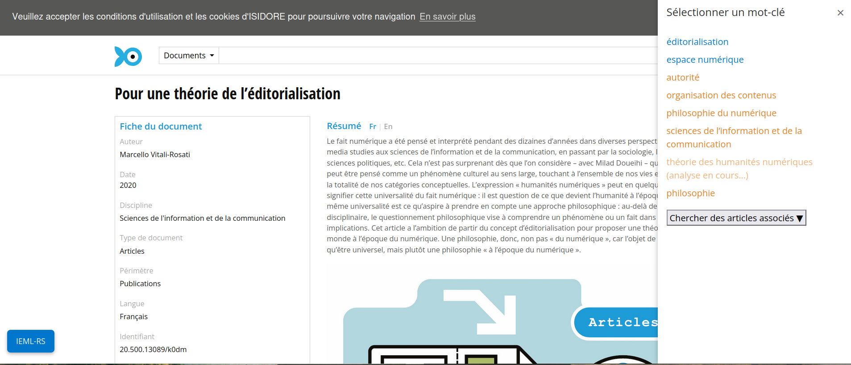
First step: from seed article, the panel opens and retrieves the article keywords

Slide 30
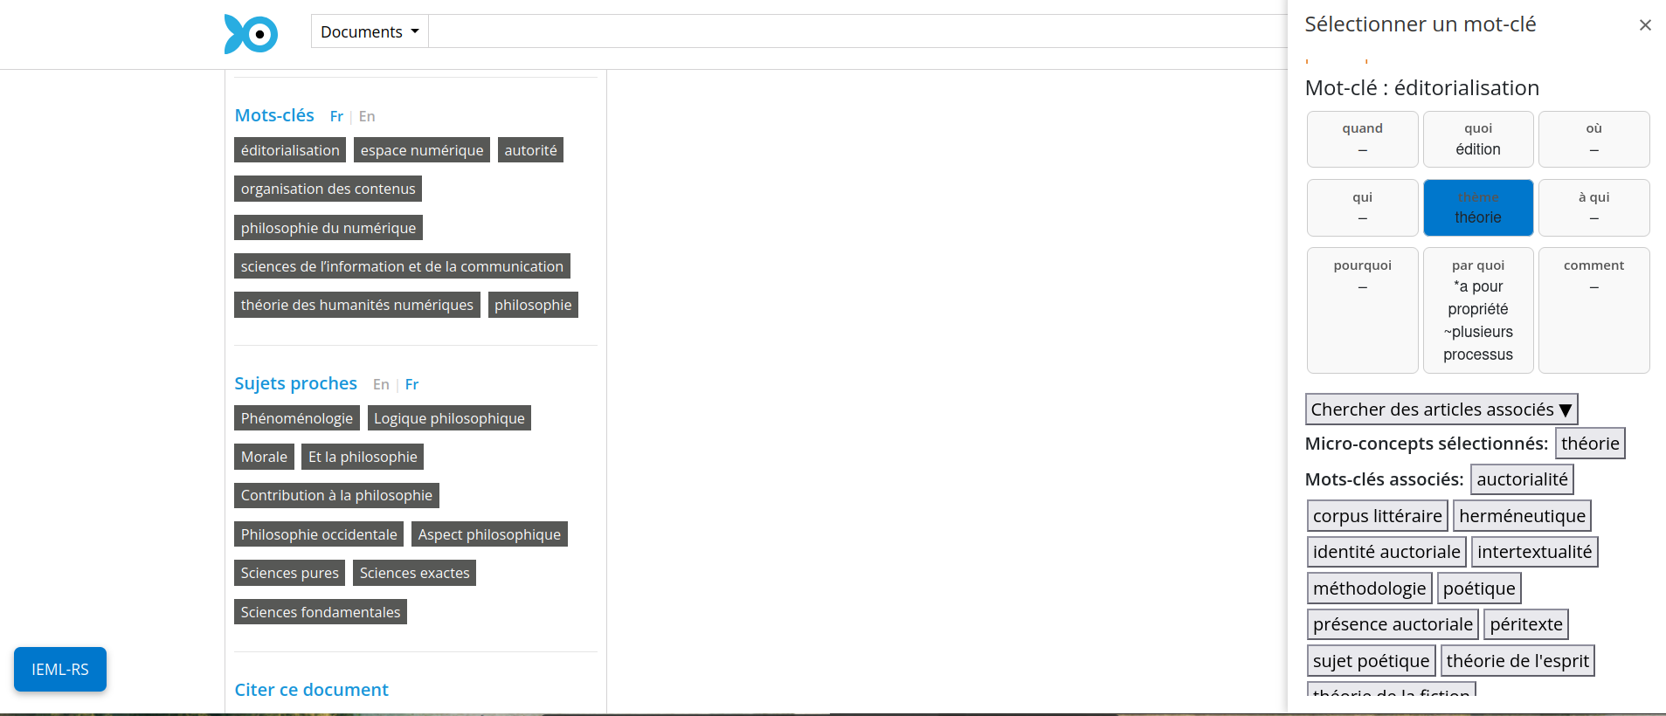
User can select a keyword already translated in IEML (in blue), displaying the grid containing concepts defining the keyword

Slide 31
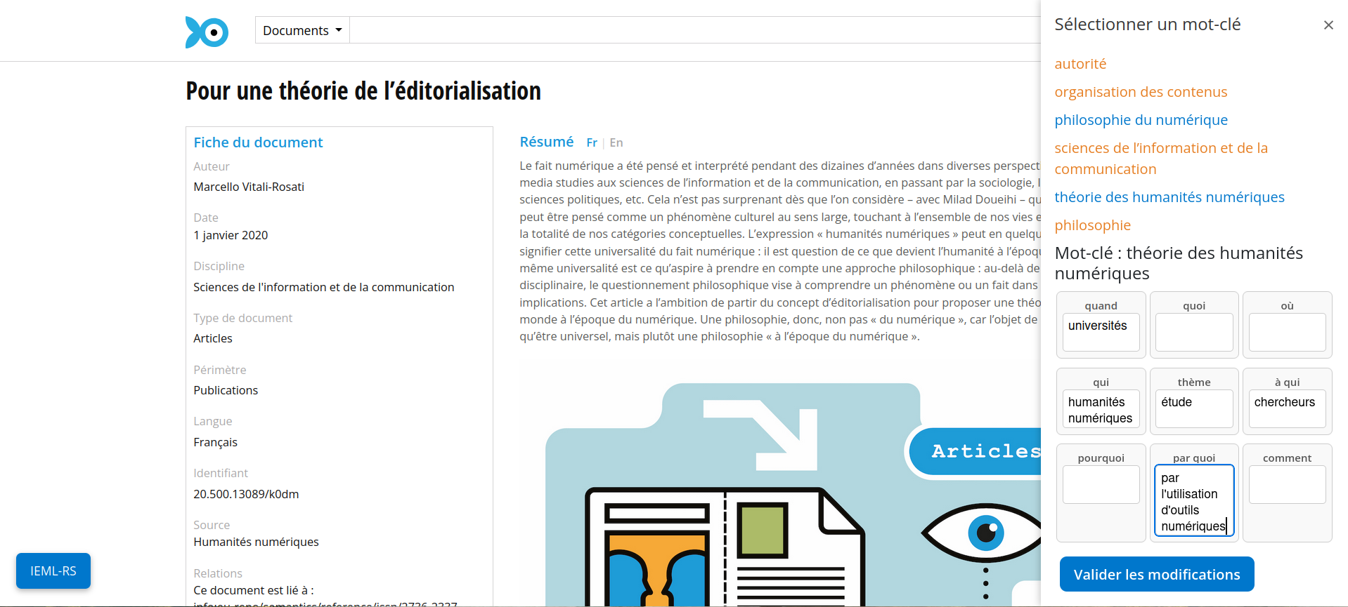
If the keyword hasn’t been translated a LLM translation is suggested (from the IEML dictionnary) and user can modify it

Slide 32
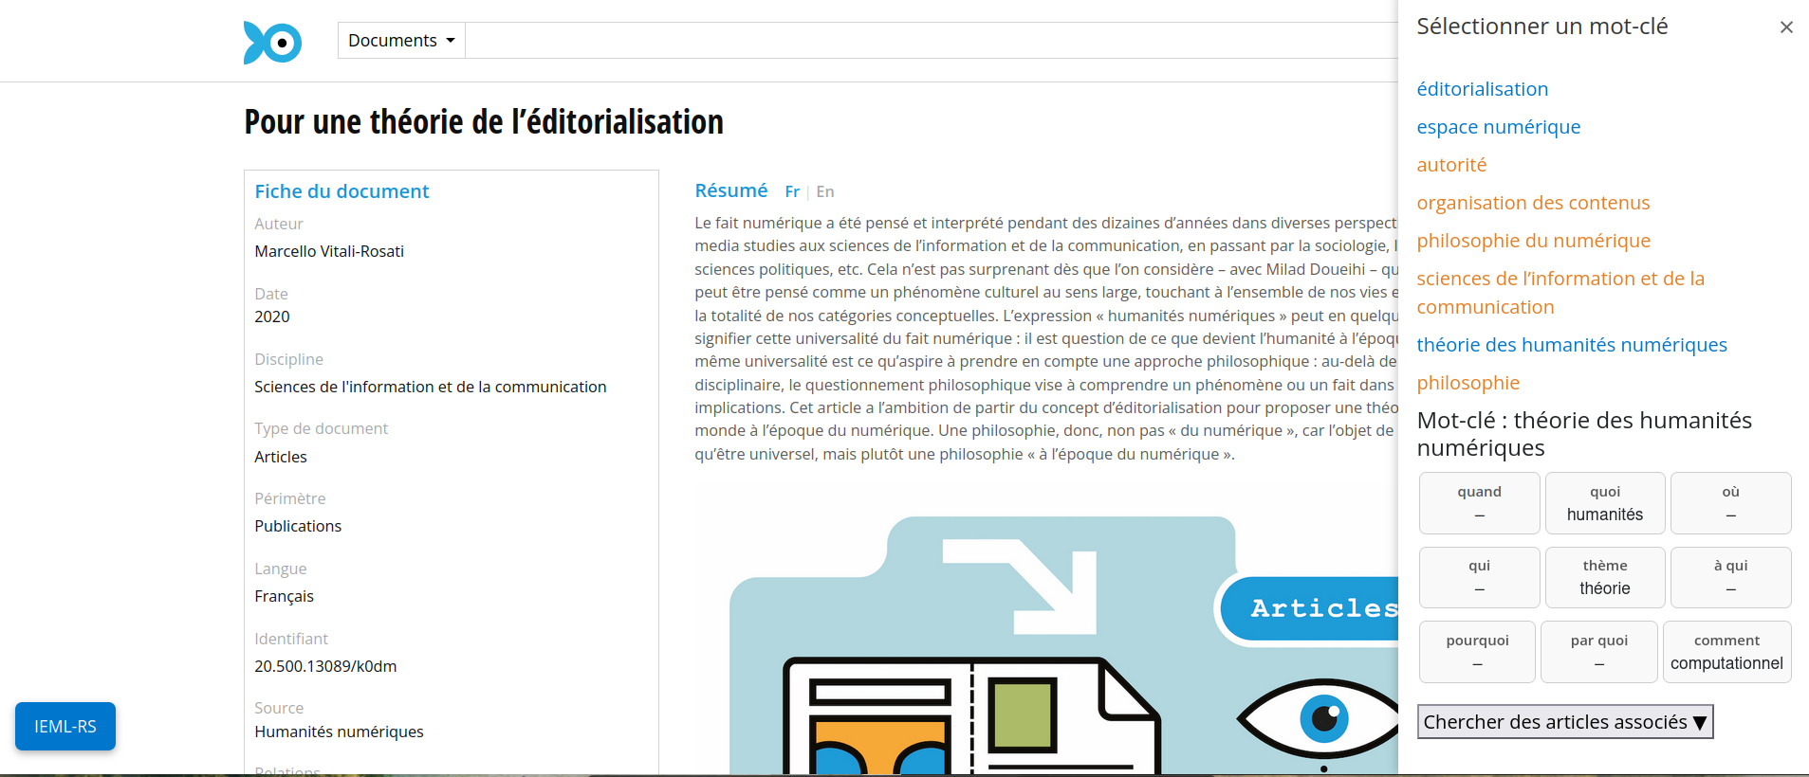
After validation of the translation, the translation is added to the IEML database

Slide 33
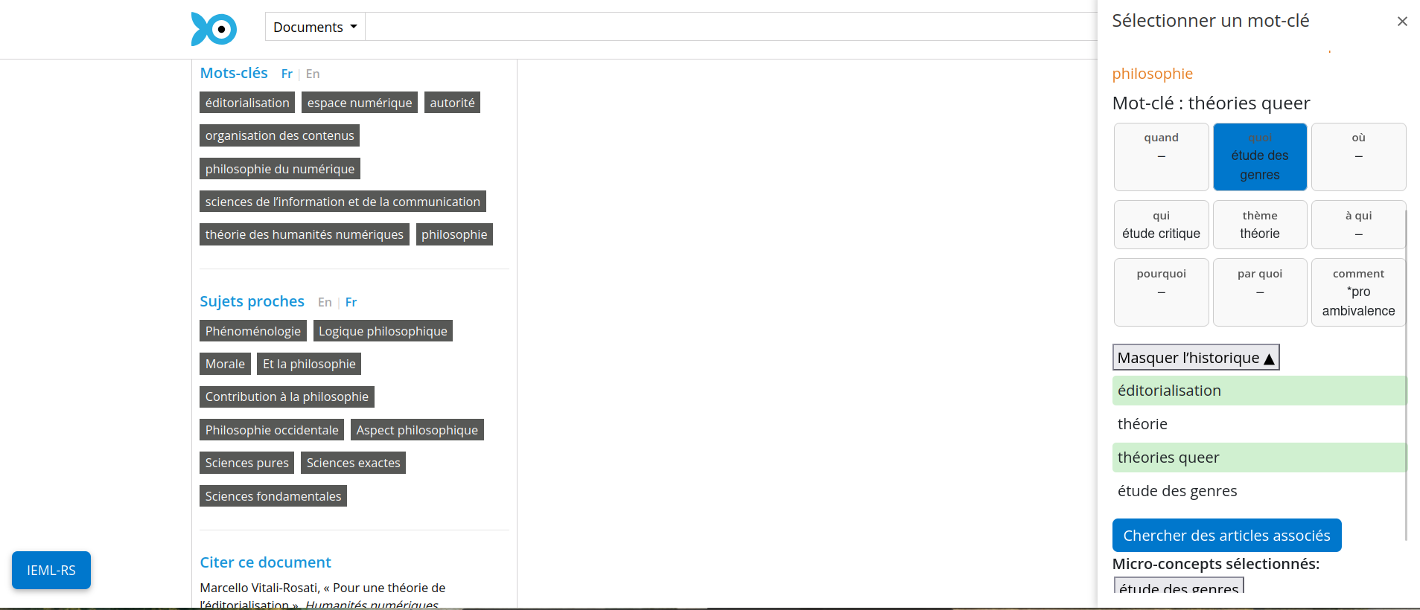
User can build a query from selected concepts and keywords

Slide 34
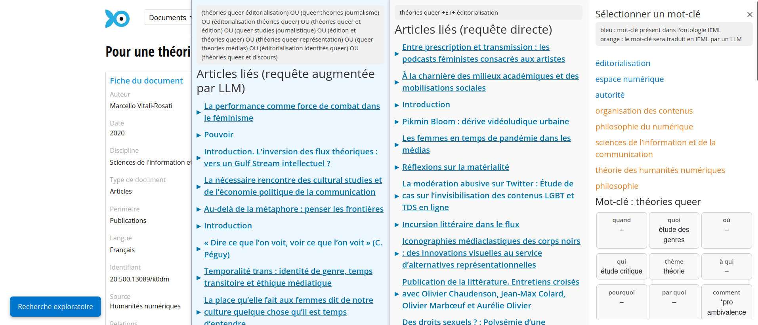
The query returns 2 lists of articles, one from the keywords selected and one from a query augmentation of those keywords

