Slide 1
DH2026 - Reclaiming Epistemic Agency in AI-Assisted Research: A Recommender System That Reveals, Rather Than Hides, IR Logic
Alexia Schneider Marcello Vitali-Rosati Pierre Levy

Slide 2
Presentation outline
Introduction
brief SOTA
Demonstration
Evaluation
Conclusion

Slide 3
Introduction
Context: Scientific documentary research.
Recommendation systems have transformed: from algorithms that extracted “you might also like” suggestions alongside search engine results to tools that support natural language queries.

Slide 4
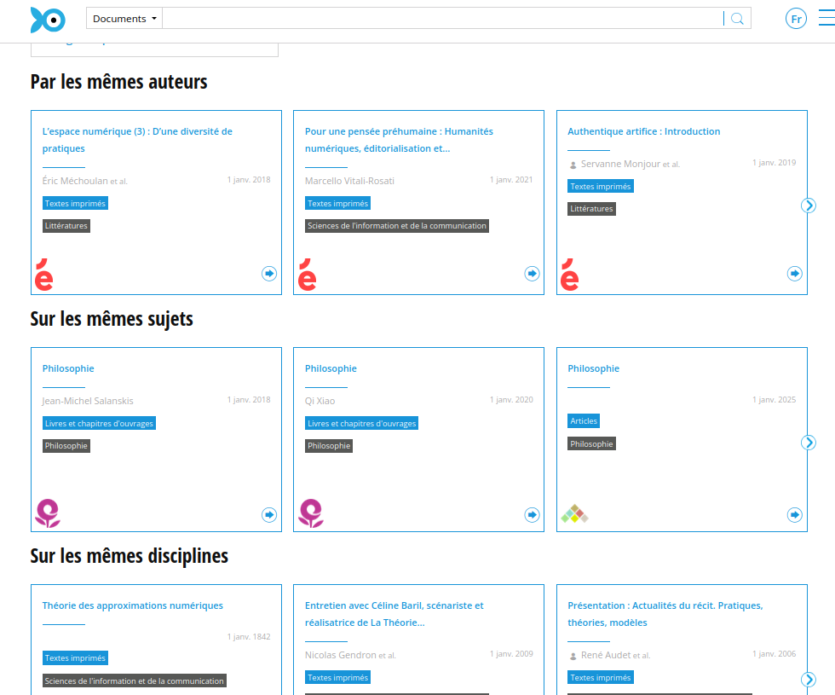
Screenshot of Isidore and standard suggested article functions

Slide 5
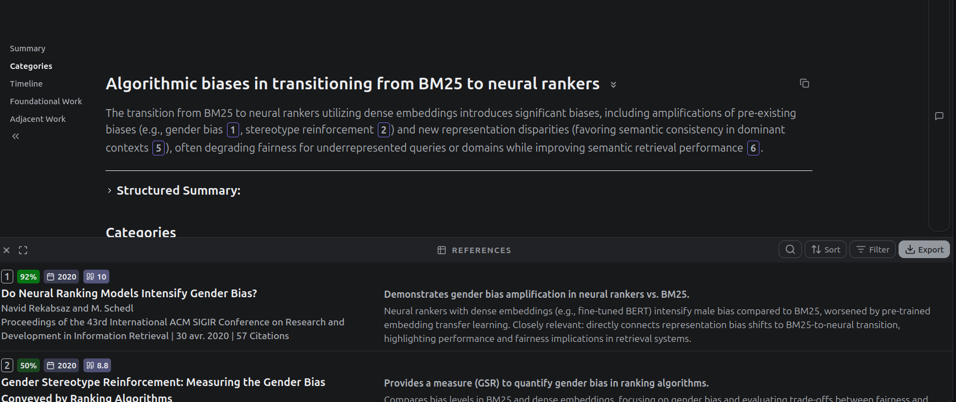
Screenshot of Undermind.ai. Support for natural language queries, combining all research steps (retrieval, ranking, synthesis)

Slide 6
Problem Statement
Citation concentration (Matthew effect (Merton 1968)), filter bubbles (Pariser 2011), and confirmation bias (Underwood 2014): reduction of the epistemic space for discovery (Nielsen and Andersen 2021; Varga 2022).
Opacity of ranking, filtering, and synthesis (when applicable) (Archambault and Rincón 2024; Patterson et al. 2025; Tay 2025).

Slide 7
Research Question
How can we design explainable systems situated at the center of an environment that fosters critical exploration and enables intellectual engagement with the algorithm?

Slide 8
Examples of Alternative Recommendation Systems
Bridger by Portenoy et al. (2022) exposes researchers to authors outside their usual intellectual networks to promote disciplinary cross-pollination.
VITALITY by Narechania et al. (2022) proposes a literature review approach based on visualization.
STAK by Martin, Greenspan, and Quan-Haase (2017) was inspired by the material affordances of physical libraries, attempting to recreate spatialized navigation environments.

Slide 9
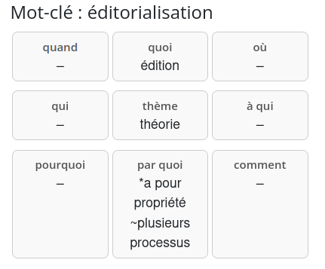
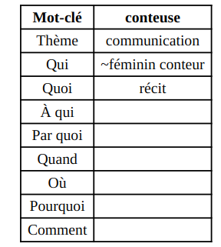
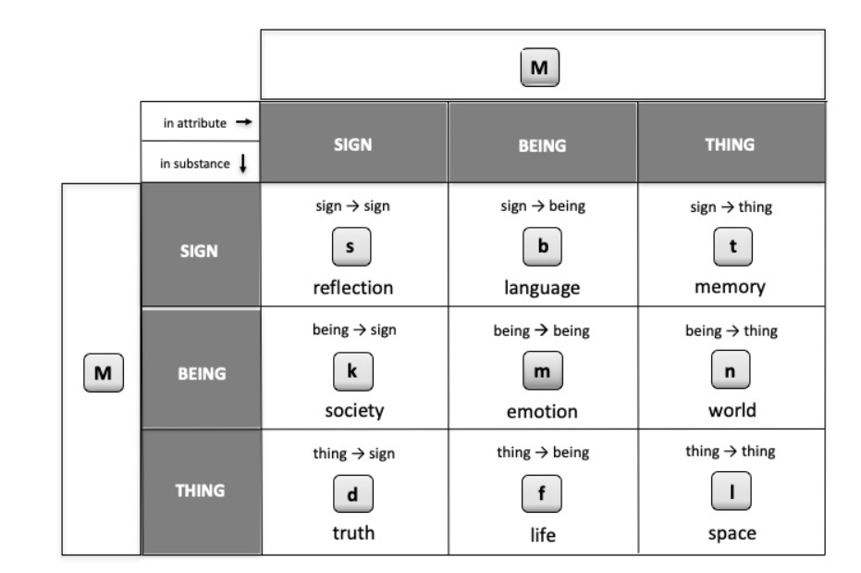
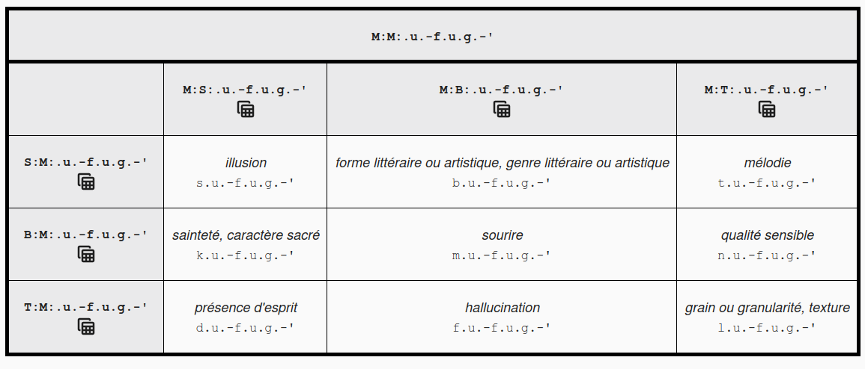
IEML
Dictionary of terms translated into IEML https://ieml.intlekt.io/
E (emptiness), U (virtual), A (actual), S (sign), B (being), and T (thing).
Lowercase letters: combinations of two primitives: 26 symbols.
Punctuation: represents one of the six layers of the concept.
Each layer is represented by a triad following the syntax: substance (role 1), attribute (role 2), and mode (role 3).
Information Economy MetaLanguage (IEML) (Lévy 2023) != YAML
IEML decomposition matrix based on 9 semantic facets
Visualization of the grid in the IEML-RS plugin
Modulation of the primitive M
Table of the semiotic functions paradigm (selection around the concept of “melody”)

Slide 10
Demonstration

Slide 11
Summary of Main Features
Exploration of an expanded semantic field thanks to IEML starting from a keyword.
Automatic generation and correction (human-in-the-loop) of missing translations.
Construction of a query sent to Isidore.
Comparison of article lists sent based on a simple query and an LLM-augmented query.

Slide 12
Prompts

Slide 13
“Translation” Prompt into IEML
You are a semantics expert. You must semantically decompose the keyword "${keyword}" based on the following 9 values: 'theme, who, what, to whom, by what means, when, where, why, how' ## Examples ${examples} ## Dictionary Words You must use the words below to define the keyword "${keyword}": ${context} Your response must take the form of a CSV with 9 columns; the column headers are: 'theme, who, what, to whom, by what means, when, where, why, how' It is not necessary to fill all fields. A field can remain empty between two commas, as in the examples. Respond only with a final CSV line, without explanation.

Slide 14
Query Augmentation Prompt
Produce 10 variants of the following Boolean query "${keywords}". Combine the proposed queries using the OR operator as in the example: Keywords: "impact of climate change on biodiversity". Response: " (climate change biodiversity impact) OR (effects of climate change on ecosystems) OR (biodiversity loss due to climate change) OR (climate change species extinction) OR (impact of global warming on wildlife) OR (effects of climate change on ecosystems and species diversity) OR (how climate change impacts wildlife and biodiversity) OR (climate change consequences for biological diversity) OR (relationship between climate change and loss of biodiversity) OR (climate change threats to flora and fauna diversity) OR (impact of climate change on biodiversity) Now it is your turn with "${keywords}". Respond only with the query without giving any explanation.

Slide 15
Evaluations
Quantitative evaluation of the translation produced by the LLM in IEML (RAG to anchor translations in IEML dictionary words).
Qualitative evaluation (user study) of the application as a whole.

Slide 16
Evaluation of Automatic Translation into IEML
Expected translation

Slide 17
Examples of translations produced by rag-llama-fewshot

Slide 18
Evaluation Summary
model/strategy | BLEU | Cosine | avg
baseline | 0.056 | 0.515 | 0.286
llama_fewshot | 0.0222 | 0.555 | 0.289
gemma_fewshot | 0.020 | 0.491 | 0.255
openai_fewshot | 0.0167 | 0.498 | 0.257
llama_zeroshot | 0.0129 | 0.514 | 0.263
gemma_zeroshot | 0.0160 | 0.479 | 0.248
openai_zeroshot | 0.016 | 0.493 | 0.254
Models (via Together AI API):
Meta-Llama-3-70B-Instruct-Turbo
Gemma-3n-E4B-it
GPT-oss-20B
Table of model evaluation for automatic translation

Slide 19
The context (i.e., dictionary entries) marginally improves performance.

Slide 20
Qualitative Evaluation of IEML-RS
6 users (PhD in Digital Humanities). Demonstration followed by 10 minutes of usage observation and a 15-minute interview.
Criteria:
User-friendliness,
Usefulness.
Features:
Navigation (keywords and concepts),
Translation into IEML,
Comparison of article list panels.

Slide 21
User Study
Ease of use:
Confusion regarding the integration of concepts into the query,
Automatic translation and validation: initial hurdle (limited database),
Usefulness:
Reveals strong disparities in user research practices (network and contextual IR vs. keyword search),
Strength: comparative panels,
Mixed-quality translation encourages user agency and dialogic and collaborative work with LLMs (Schneider 2026).

Slide 22
Conclusion and Perspectives
Example of an environment design fostering serendipity.
Tools being developed in Digital Humanities:
Barista from the Impresso project: query building assistant (Finn et al. 2026),
Ongoing developments at Isidore for RAG limited to specific use cases (Sacy et al. 2025),
Evidence-RAG from the JDH (to assist in the evaluation of reviewer comments during the peer review process) (Guérard et al. 2026).

Slide 23
Acknowledgements
Research funded by the SSHRC through the Revue3.0 partnership project, as well as a fellowship from the Circé Network and the Publica Coalition for mutualization and research on scientific journals.

Slide 24
Thank you for your attention!
Link to download the Firefox plugin:

Slide 25
Bibliographie
Archambault, Susan, and José Rincón. 2024. “An Evaluation of Cutting-Edge AI Research Tools Using the REACT Framework.” Computers in Libraries 44 (8).
Finn, Finola, Donal Khosrowi, Caio Mello, Marten Düring, and Danielle Guido. 2026. “Shaping History, Responsibly: Seven Principles to Guide the Design of Archival AI Assistants for Cultural Heritage Collections.” In ACM FAccT. Montréal.
Guérard, Élisabeth, Mehrdad Almasi, Marion Salaün, and Frédéric Clavert. 2026. “Towards an Interactive ‘Evidence-RAG’ Peer- Review Workspace for the Journal of Digital History.” Long {{Talk}}. Esch-sur-Alzette.
Lévy, Pierre. 2023. “Semantic Computing with IEML.” Collective Intelligence 2 (4): 26339137231207634. https://doi.org/10.1177/26339137231207634.
Martin, Kim, Brian Greenspan, and Anabel Quan-Haase. 2017. “STAK – Serendipitous Tool for Augmenting Knowledge: A Conceptual Tool for Bridging Digital and Physical Resources.” Digital Studies / Le Champ Numérique 6 (1). https://doi.org/10.16995/dscn.265.
Merton, R. K. 1968. “The Matthew Effect in Science. The Reward and Communication Systems of Science Are Considered.” Science (New York, N.Y.) 159 (3810): 56–63.
Narechania, Arpit, Alireza Karduni, Ryan Wesslen, and Emily Wall. 2022. “VITALITY: Promoting Serendipitous Discovery of Academic Literature with Transformers & Visual Analytics.” IEEE Transactions on Visualization and Computer Graphics 28 (1): 486–96. https://doi.org/10.1109/TVCG.2021.3114820.
Nielsen, Mathias Wullum, and Jens Peter Andersen. 2021. “Global Citation Inequality Is on the Rise.” Proceedings of the National Academy of Sciences 118 (7): e2012208118. https://doi.org/10.1073/pnas.2012208118.
Pariser, Eli. 2011. “The Filter Bubble: What the Internet Is Hiding from You.” In.
Patterson, Brandon, Carlos Flores, Nick Hauschild, and Jared Branch. 2025. “Which AI Tools Work Best for Research? Using Librarian and Student Perspectives to Inform a Rating Rubric.” Journal of Electronic Resources in Medical Libraries 22 (3): 133–38. https://doi.org/10.1080/15424065.2025.2546052.
Portenoy, Jason, Marissa Radensky, Jevin D West, Eric Horvitz, Daniel S Weld, and Tom Hope. 2022. “Bursting Scientific Filter Bubbles: Boosting Innovation via Novel Author Discovery.” CHI Conference on Human Factors in Computing Systems, April, 1–13. https://doi.org/10.1145/3491102.3501905.
Sacy, Antoine Silvestre De, Adam Faci, Léa Maronet, and Stéphane Pouyllau. 2025. “Lire à Différentes Échelles. Une Analyse Multiscalaire de La Retrieval-Augmented Generation En Sciences Humaines Et Sociales.” Humanités Numériques 12. https://doi.org/10.4000/15icj.
Schneider, Alexia. 2026. “An Imperfect AI to Uphold Human Agency : Vindicating the ‘Yes but’ of This World.” Short {{Talk}}. Montréal.
Tay, Aaron. 2025. “The Reproducibility and Interpretability of Academic AI Search Engines Like Primo Research Assistant, Web of Science Research Assistant, Scopus AI and More.” Blog. Aaron Tay’s Musings about Librarianship.
Underwood, Ted. 2014. “Theorizing Research Practices We Forgot to Theorize Twenty Years Ago.” Representations 127 (1): 64–72. https://doi.org/10.1525/rep.2014.127.1.64.
Varga, Attila. 2022. “The Narrowing of Literature Use and the Restricted Mobility of Papers in the Sciences.” Proceedings of the National Academy of Sciences 119 (17): e2117488119. https://doi.org/10.1073/pnas.2117488119.

Slide 26
Screenshots

Slide 27
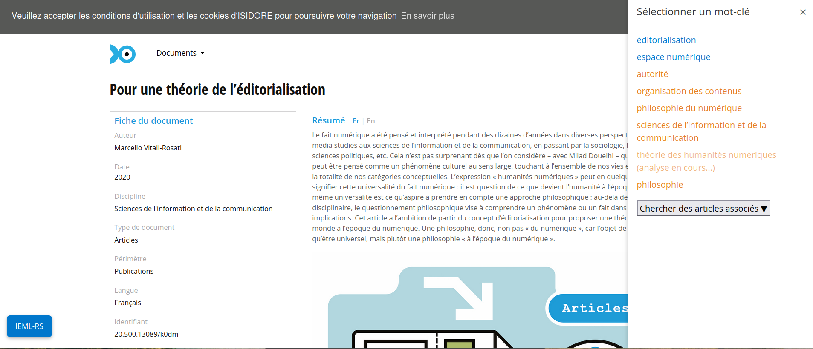
First step: from seed article, the panel opens and retrieves the article keywords

Slide 28
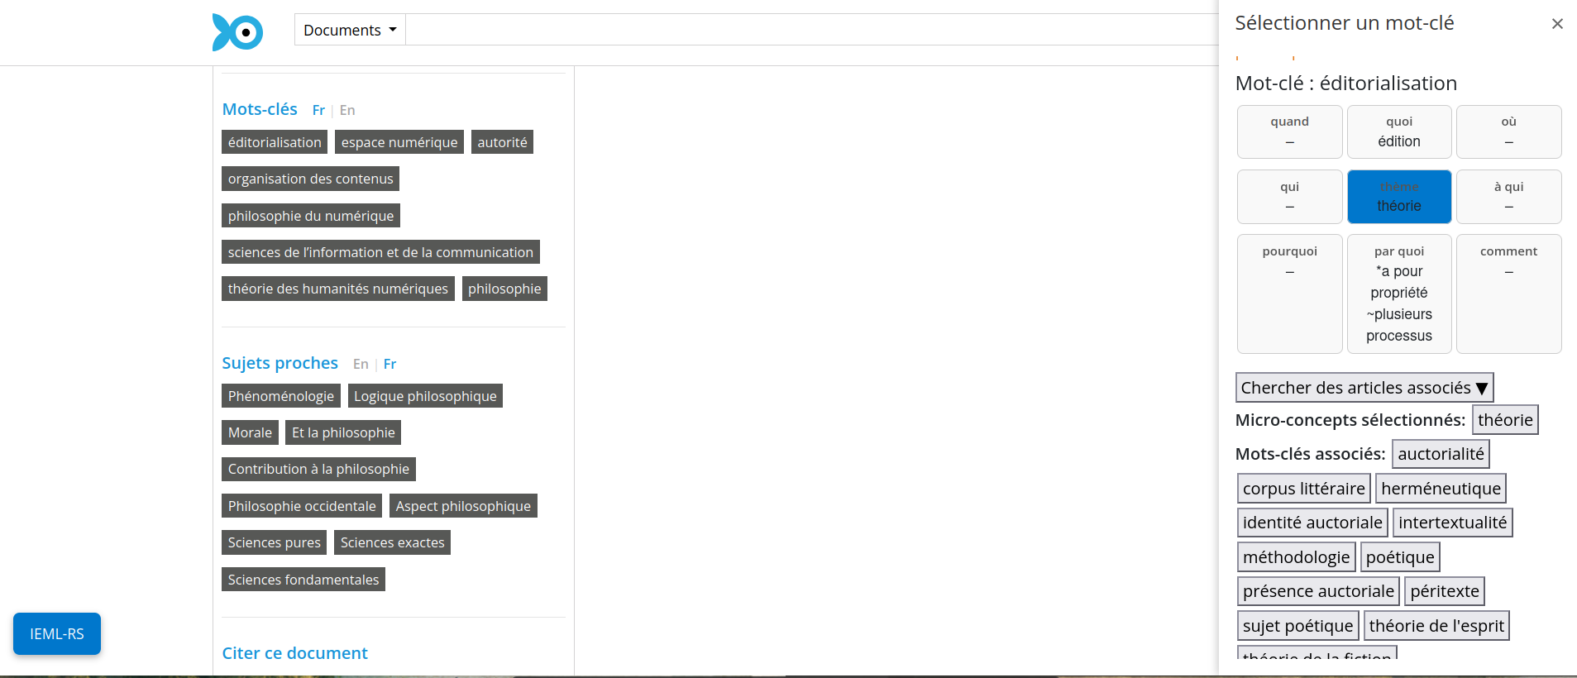
User can select a keyword already translated in IEML (in blue), displaying the grid containing concepts defining the keyword

Slide 29
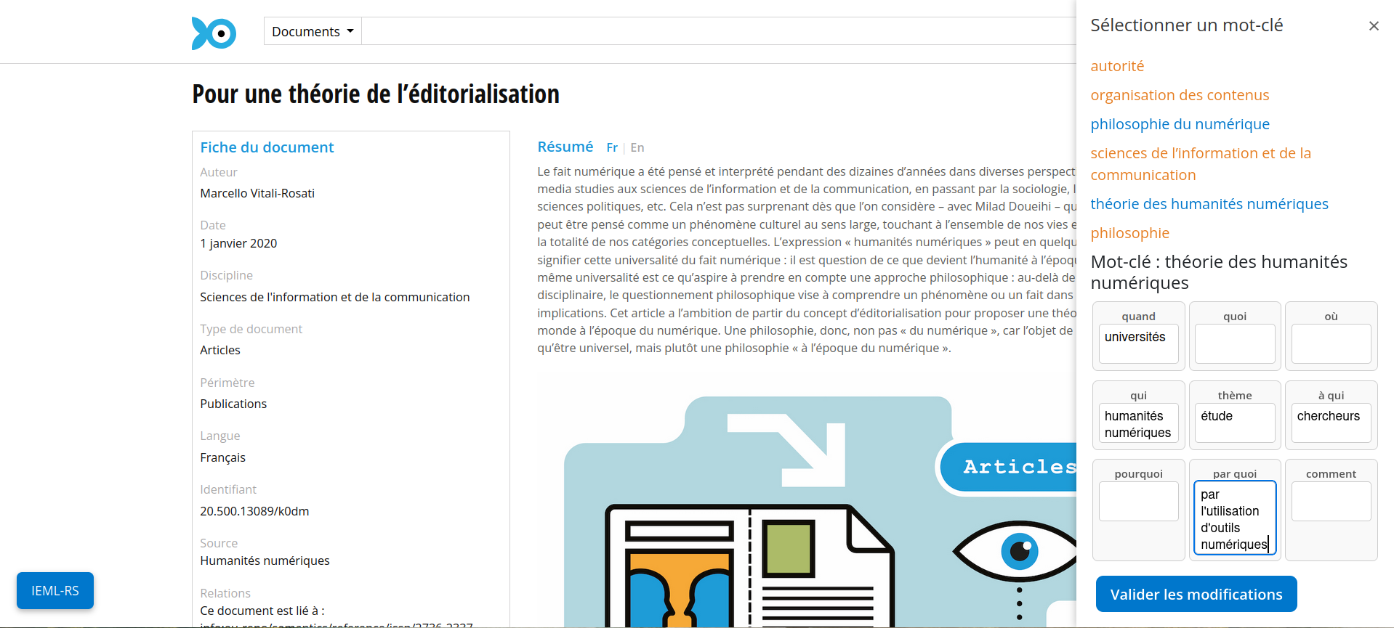
If the keyword hasn’t been translated a LLM translation is suggested (from the IEML dictionnary) and user can modify it

Slide 30
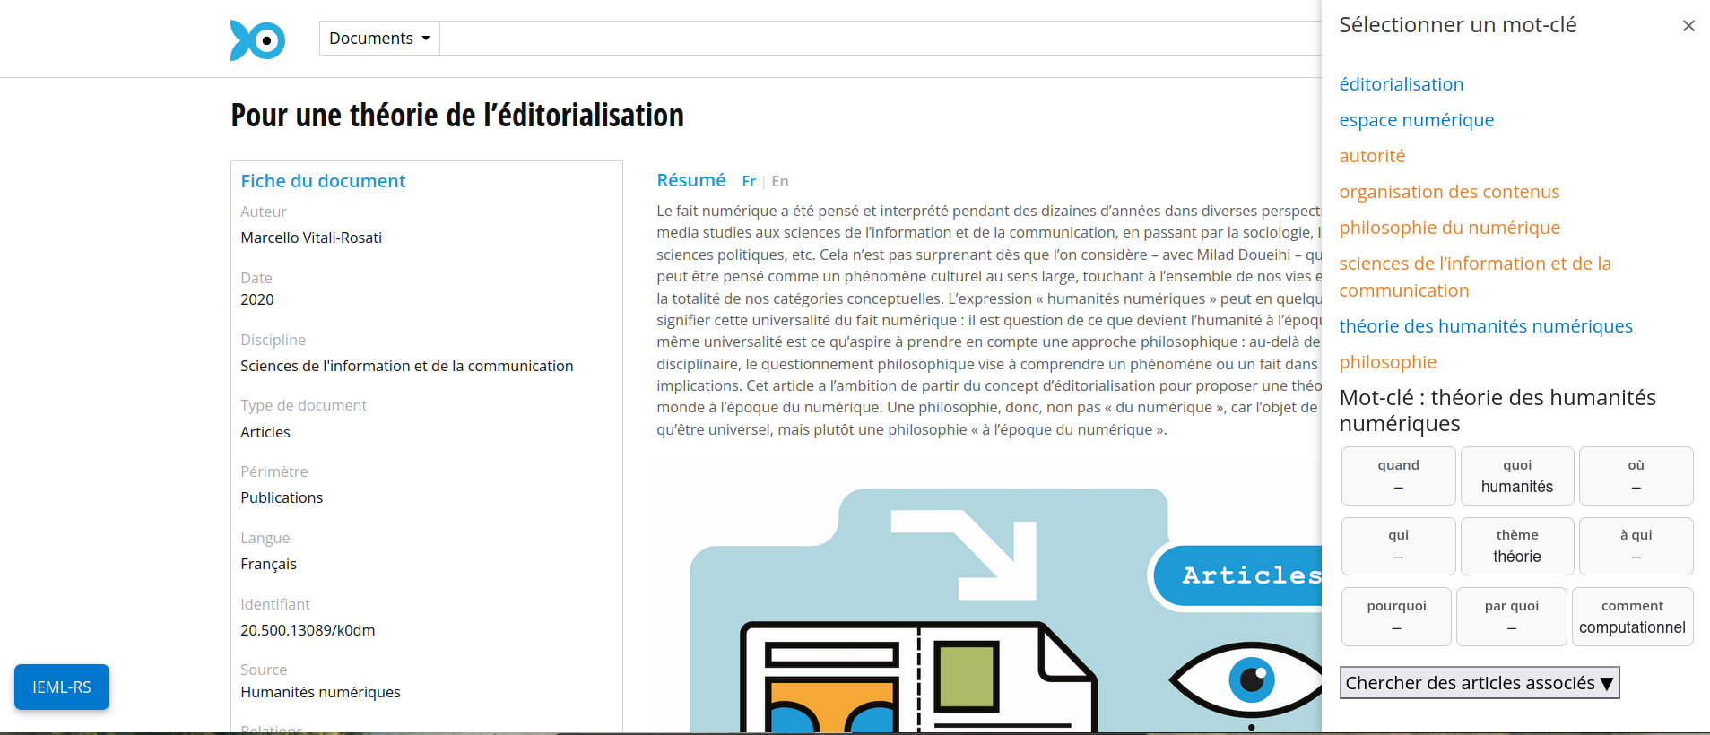
After validation of the translation, the translation is added to the IEML database

Slide 31
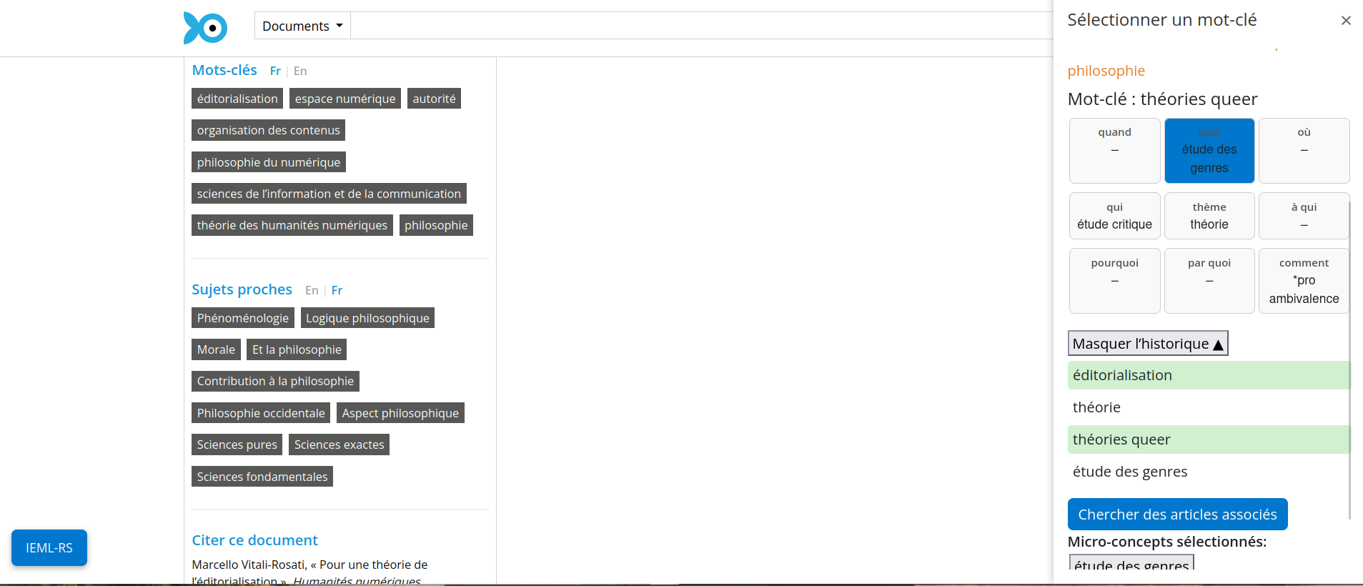
User can build a query from selected concepts and keywords

Slide 32
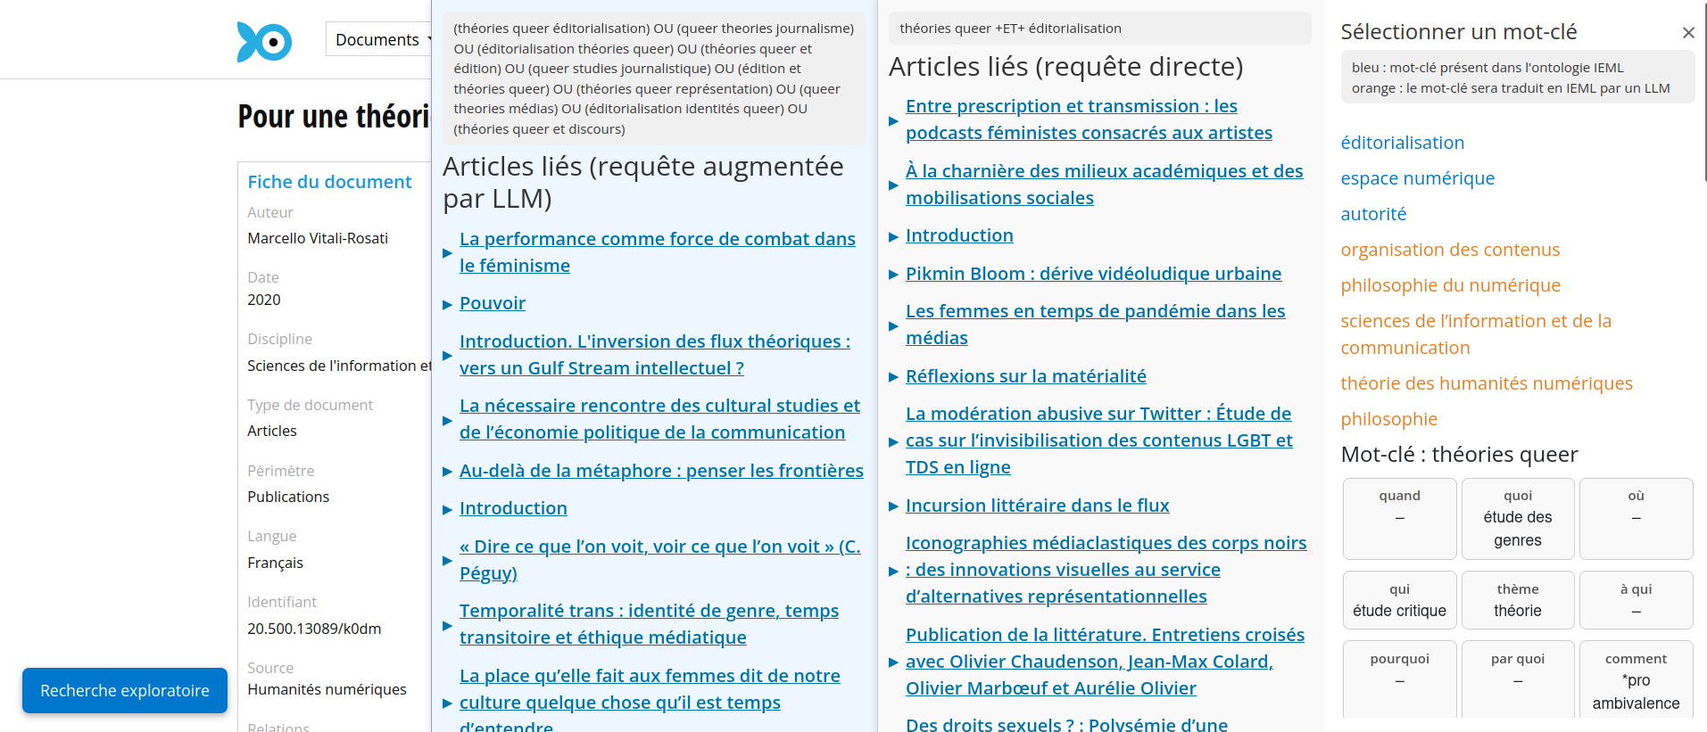
The query returns 2 lists of articles, one from the keywords selected and one from a query augmentation of those keywords

