Slide 1
MUSICMAGAL
ITC FELLOWS 2017-2018
PERSONAL CHALLENGE
DANIEL FRANCH & ALEX INGBERG

Slide 2





Song recommendation
Single user recommendation
GROUP RECOMMENDATION
Recommend songs to a group of people to listen it together.
Challenge: match everyone’s taste and not a singular personal preference.

Slide 3
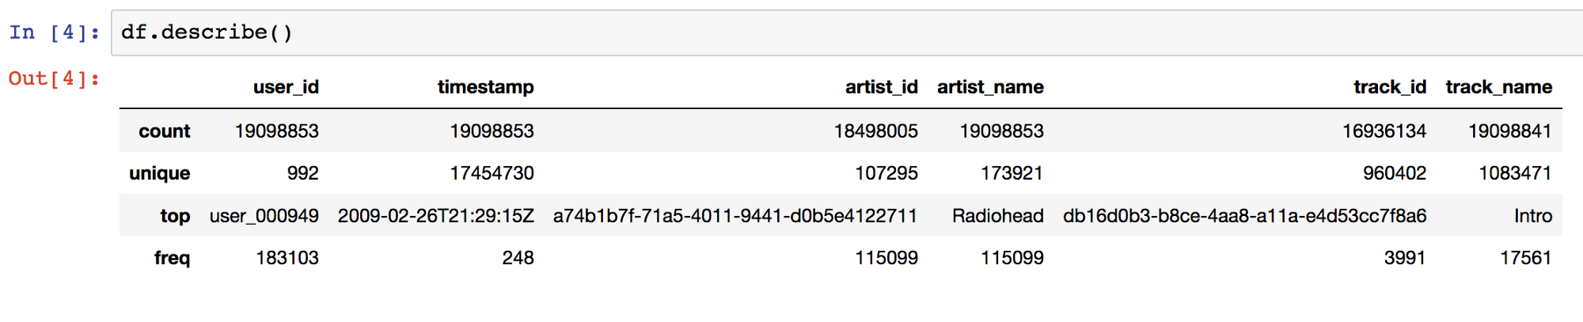
Our Dataset
We got data from ~1K users
There’s ~960K different tracks which makes it pretty diverse for a recommendation system
~107K different artists
~19M entries in the dataset (!!!)

Slide 4
Utility matrix
In a recommendation-system application there are two classes of entities, which we shall refer to as users and items.
Data itself is represented as a utility matrix, giving for each user-item pair, a value that represents what is known about the degree of preference of that user for that item. (In our case, times listened for each user and track)
HYPER SPARSE MATRIX!!!!!!!

Slide 5
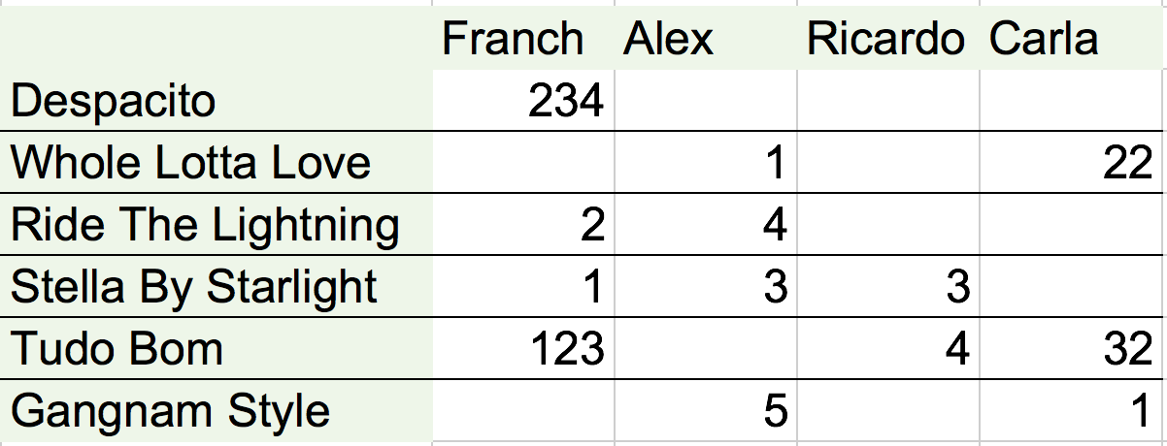
PROBLEM!!
This methods are usually based around the concept of RATINGS.
Our matrix is based around implicity.
It reflects quantity, not quality.

Slide 6
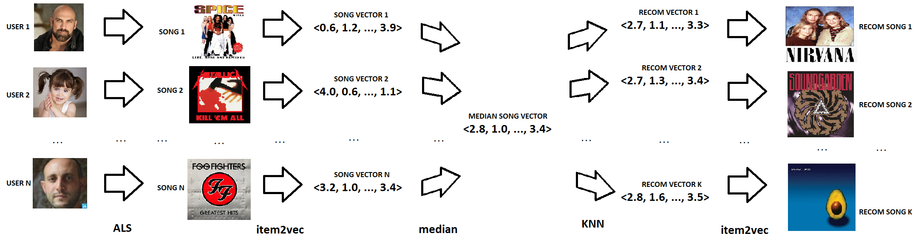
OUR SOLUTION

Slide 7
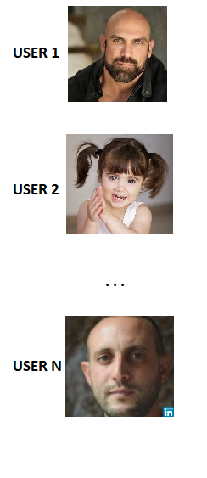

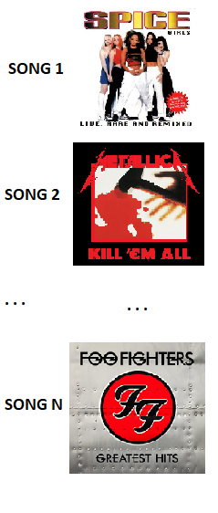

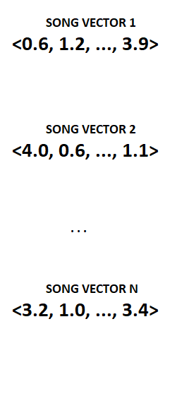


OUR SOLUTION

Slide 8

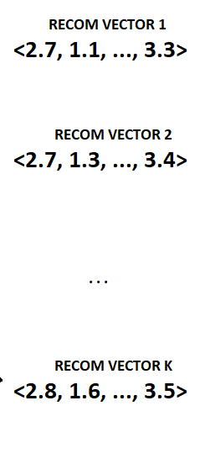

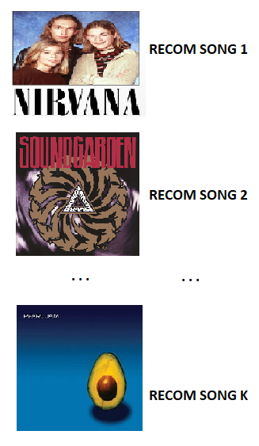
OUR SOLUTION

Slide 9
OUR SOLUTION

Slide 10
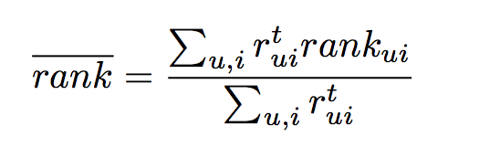
Evaluation metric

Slide 11
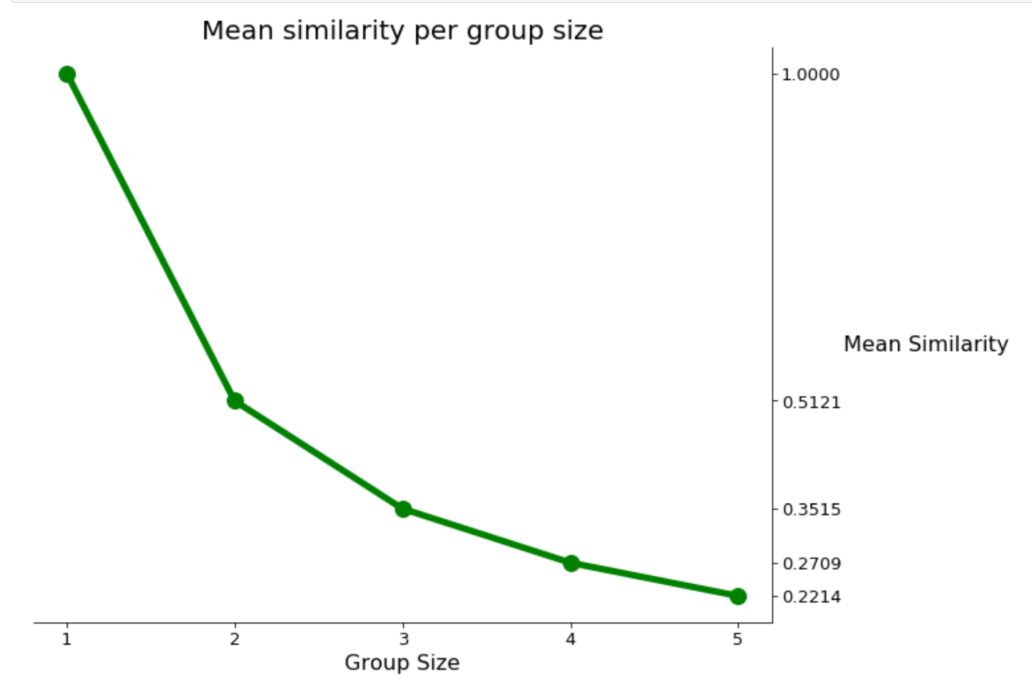
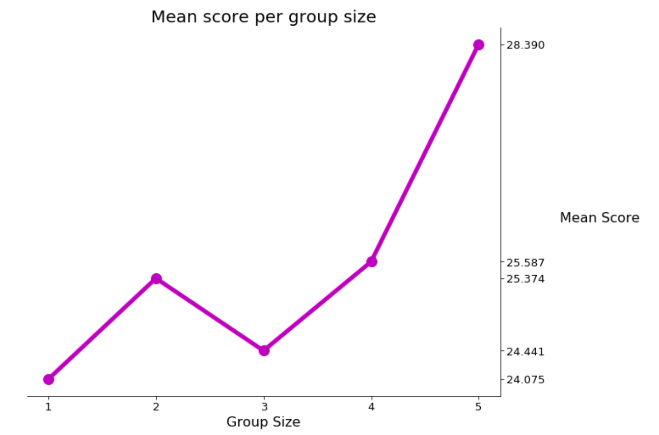
Results

Slide 12
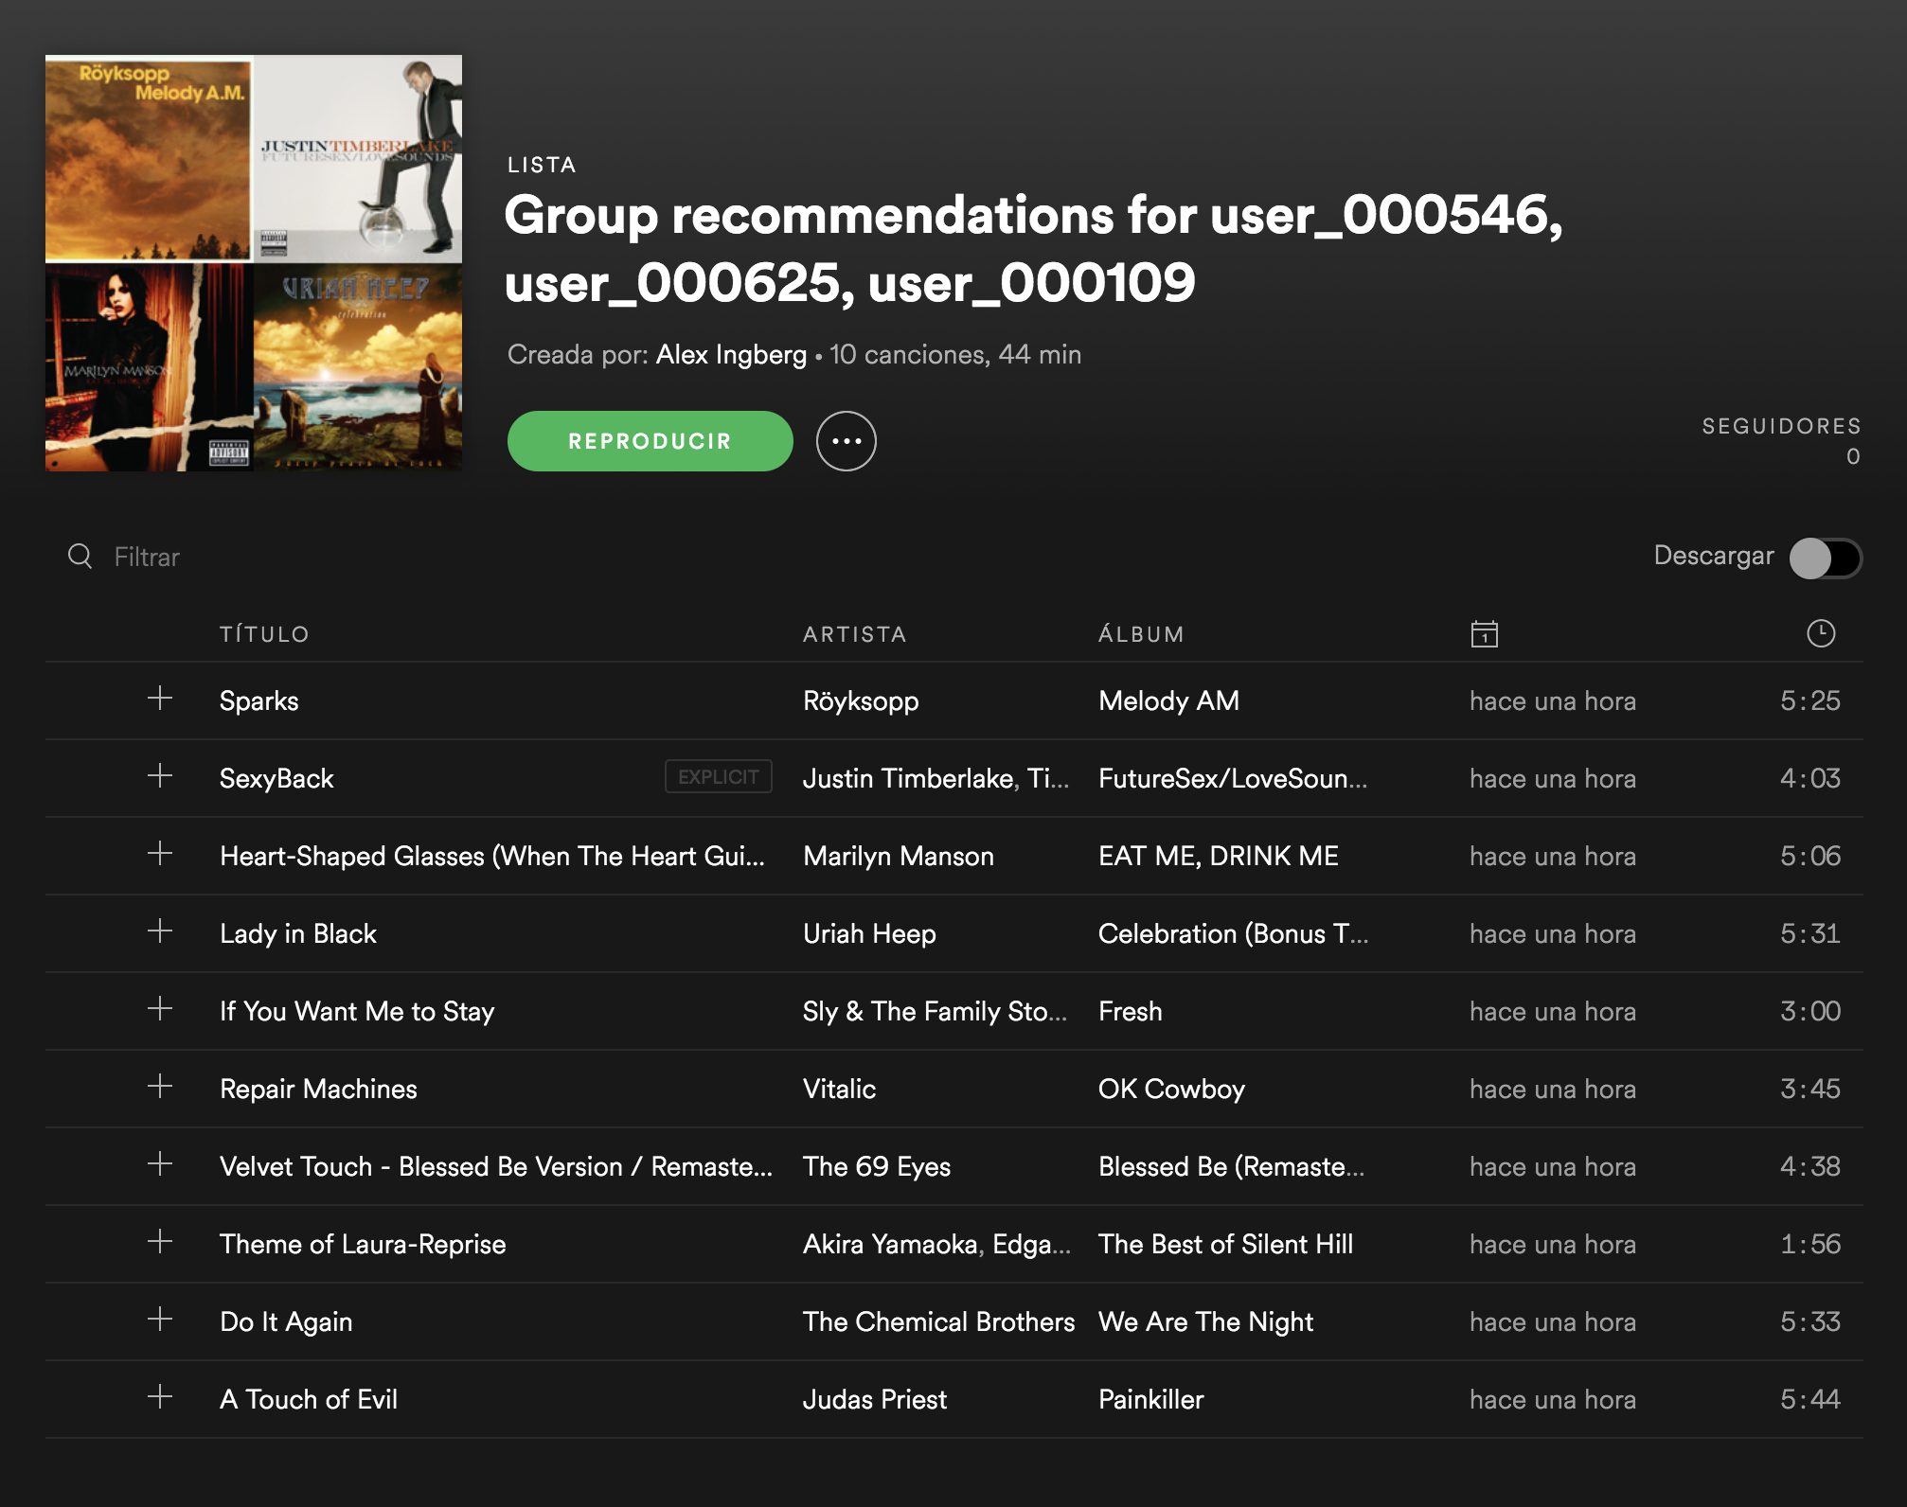

Slide 13

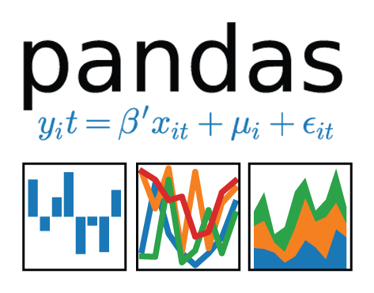


TOOLS
Implicit
Fast Python Collaborative Filtering for Implicit Datasets.
https://github.com/benfred/implicit

Slide 14
references
[1] Mezei, Zsolt, and Carsten Eickhoff. "Evaluating Music Recommender Systems for Groups." arXiv preprint arXiv:1707.09790 (2017).
[2] Yoshii, Kazuyoshi, et al. "Hybrid Collaborative and Content-based Music Recommendation Using Probabilistic Model with Latent User Preferences." ISMIR. Vol. 6. 2006.
[3] Parra, Denis, et al. "Implicit feedback recommendation via implicit-to-explicit ordinal logistic regression mapping." Proceedings of the CARS-2011 (2011).
[4] Hu, Yifan, Yehuda Koren, and Chris Volinsky. "Collaborative filtering for implicit feedback datasets." Data Mining, 2008. ICDM'08. Eighth IEEE International Conference on. Ieee, 2008.
[5] Barkan, Oren, and Noam Koenigstein. "Item2vec: neural item embedding for collaborative filtering." Machine Learning for Signal Processing (MLSP), 2016 IEEE 26th International Workshop on. IEEE, 2016.
[6] Leskovec, Jure, Anand Rajaraman, and Jeffrey David Ullman. Mining of massive datasets. Cambridge university press, 2014.

Slide 15
DOMO ARIGATO MISTER ROBOTO
Questions?

