Slide 1
MUSICMAGAL
ITC FELLOWS 2017-2018
PERSONAL CHALLENGE
DANIEL FRANCH & ALEX INGBERG

Slide 2





MOTIVATION
LOTS OF MUSIC RECOMMENDATION SYSTEMS IN THE MARKET.
ALL OF THEM ARE DEDICATED TO INDIVIDUAL USER-BASED RECCOMENDATION

Slide 3
MUSIC GROUP RECOMMENDATIONS
WHAT IS IT?
Group recommendation is a new task in which an item is recommended to a group of users who will consume it together.
The challenge in such a task is modeling and matching the taste of the entire group even though only individual preferences may be known.

Slide 4

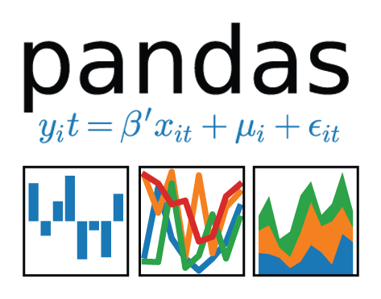


TOOLS
Implicit
Fast Python Collaborative Filtering for Implicit Datasets.
https://github.com/benfred/implicit

Slide 5
Our Dataset
Last.fm Dataset - 1K users (user full listening history)
This dataset contains <user-id, timestamp, artist-mbid, artist-name, song-mbid, song-title> tuples collected from Last.fm API, using the user.getRecentTracks() method. The dataset represents the full listening history (till May, 5th 2009) for nearly 1,000 users.
(Source: http://www.dtic.upf.edu/~ocelma/MusicRecommendationDataset/)

Slide 6
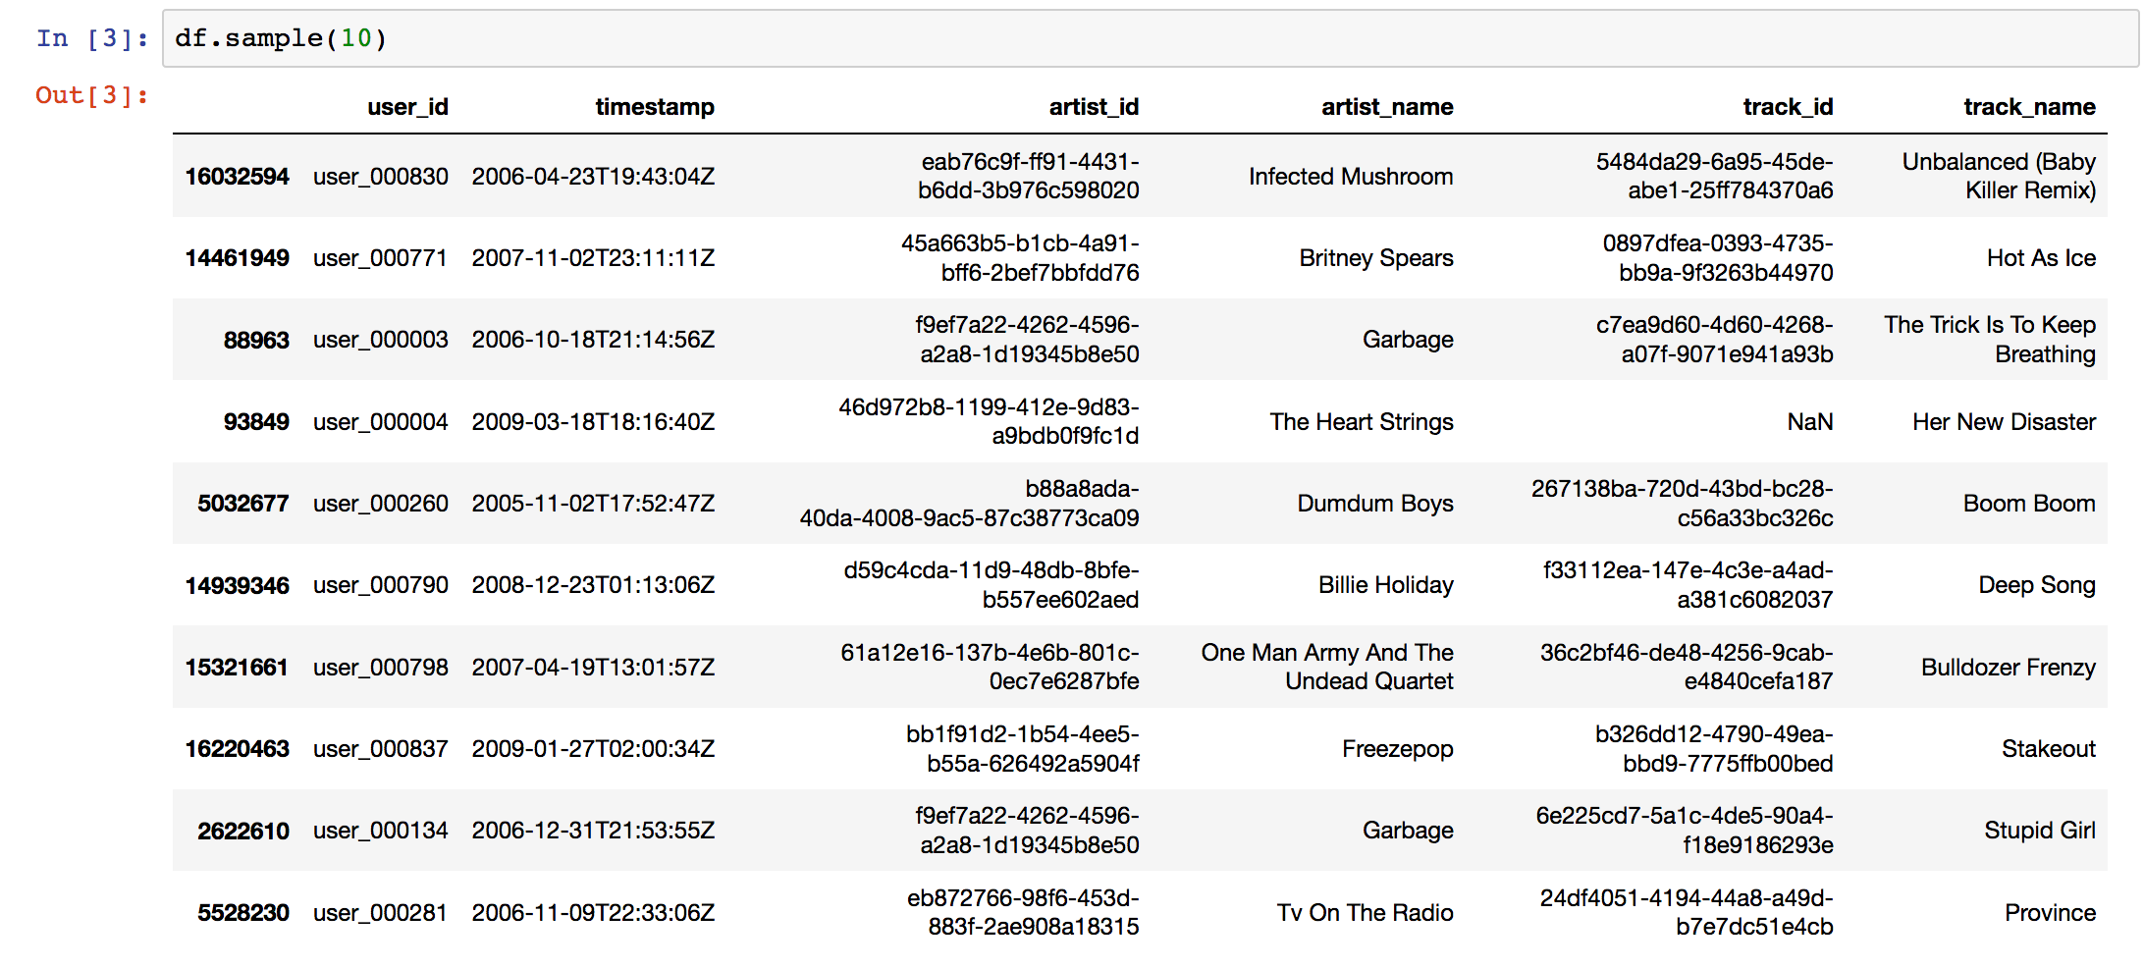
Data insights

Slide 7
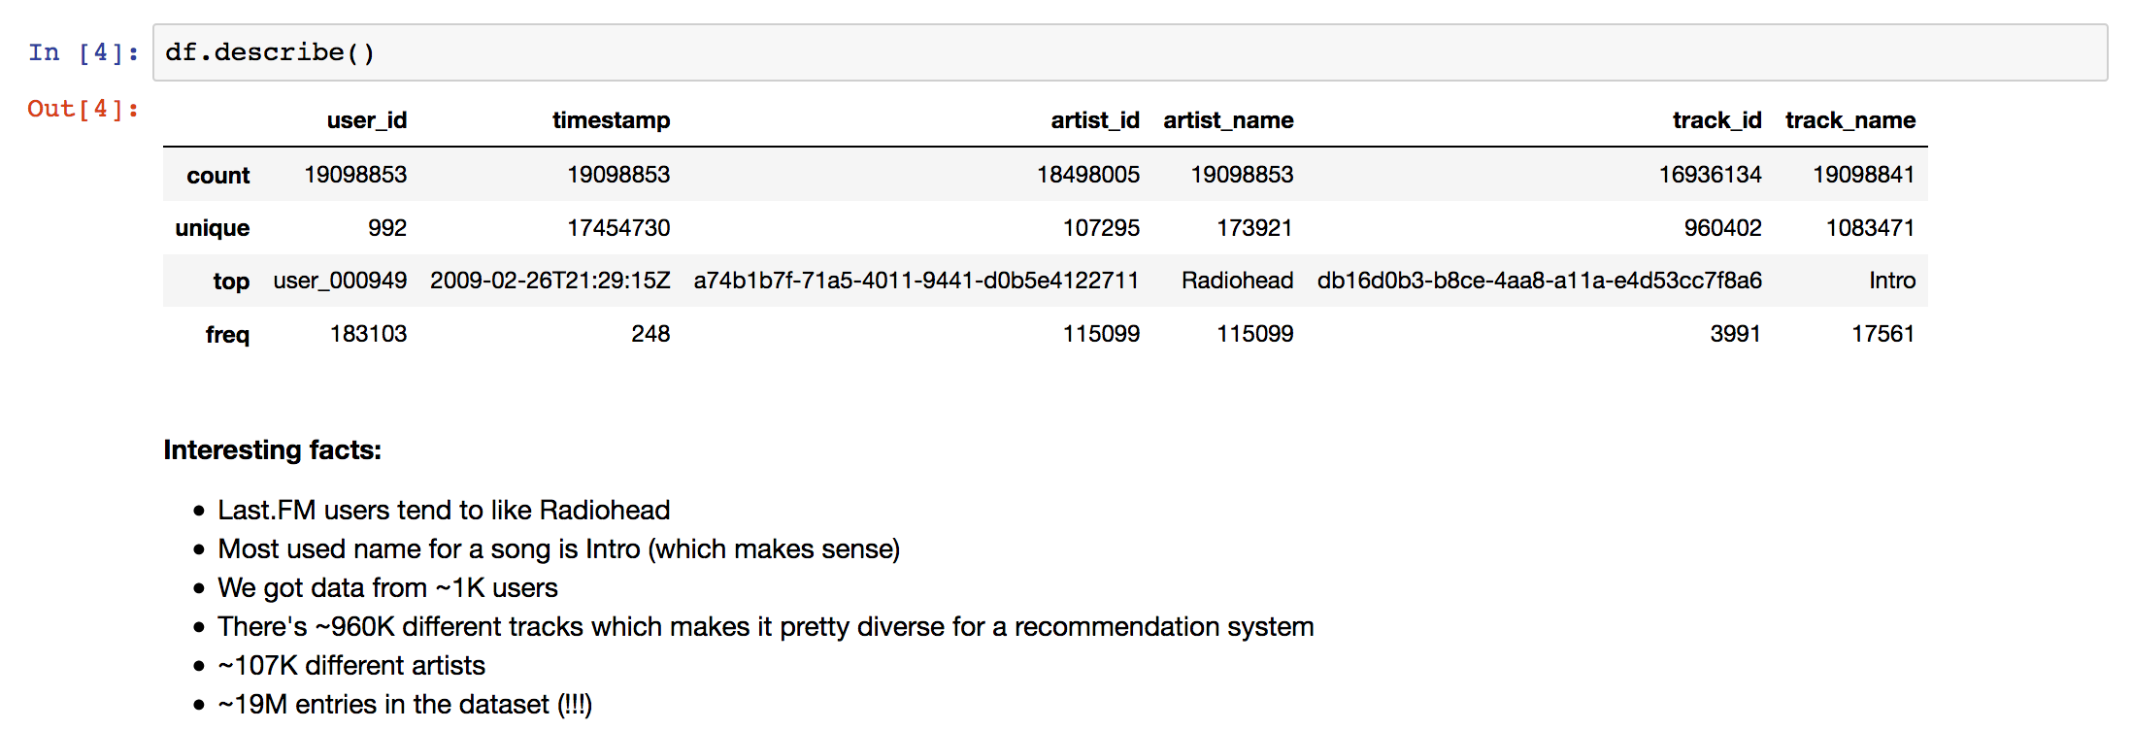

Slide 8
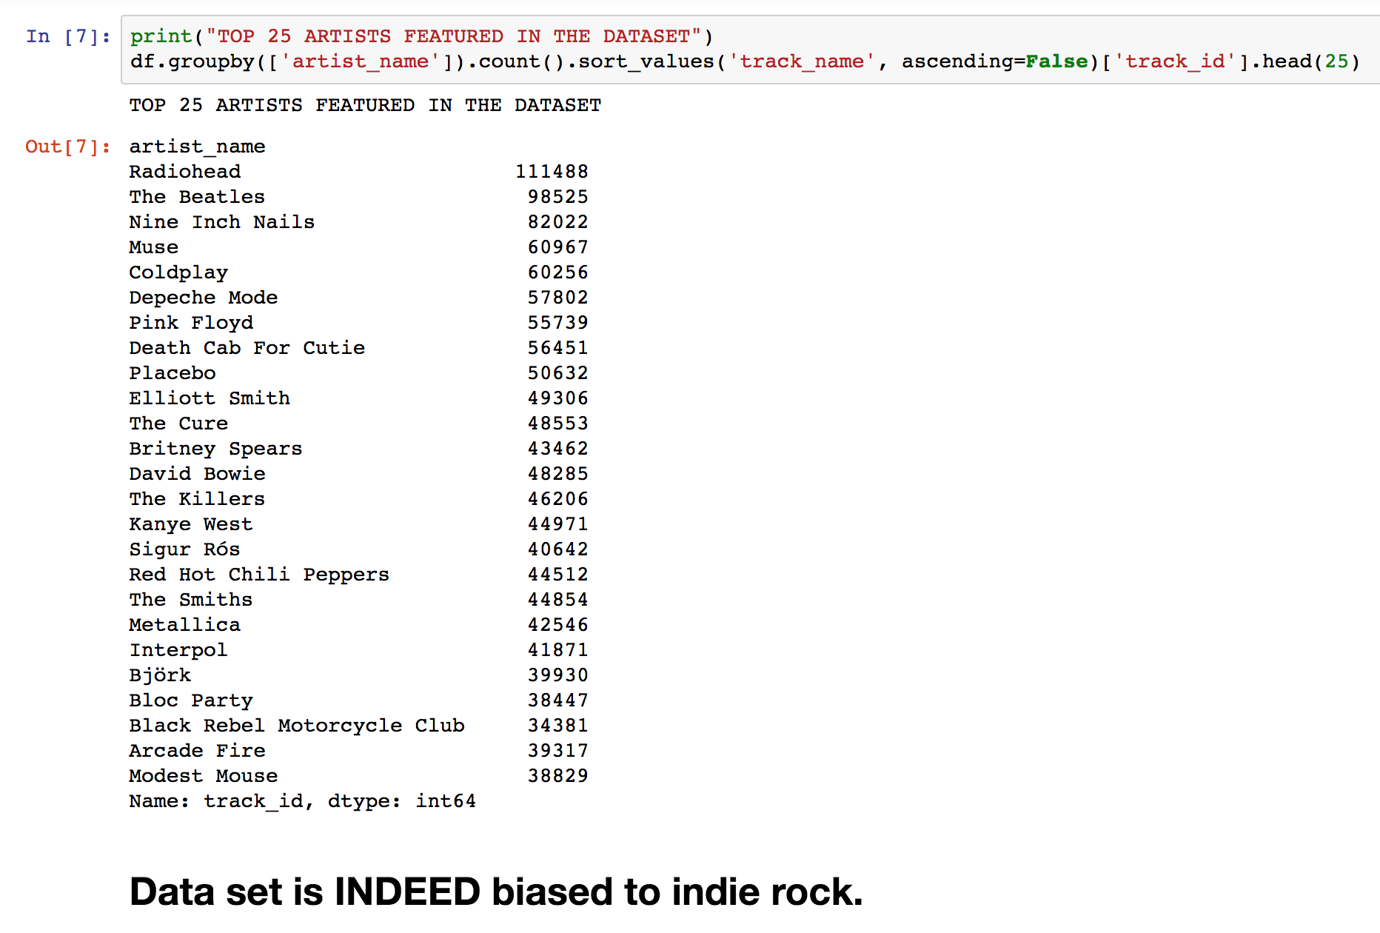

Slide 9
Utility matrix
In a recommendation-system application there are two classes of entities, which we shall refer to as users and items.
Data itself is represented as a utility matrix, giving for each user-item pair, a value that represents what is known about the degree of preference of that user for that item. (In our case, times listened for each user and track)
HYPER SPARSE MATRIX!!!!!!!

Slide 10
REGULAR METHODS
Content-Based Recommendations
Focus on properties of items. Similarity of items is determined by measuring the similarity in their properties.
e.g. If you like The Lord Of The Rings, you’ll probably like Game Of Thrones
Collaborative-Filtering
Focus on the relationship between users and items. Similarity of items is determined by the similarity of the ratings of those items by the users who have rated both items.
e.g. If you like The Lord Of The Rings, Game Of Thrones and Harry Potter; and Bob likes TLoTR and GoT, then he’ll probably like HP too.

Slide 11
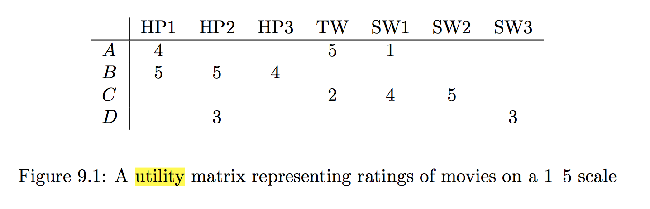
PROBLEM!!
This methods are usually based around the concept of RATINGS.
In the fig, users A, B, C and D rate Harry Potter, Twilight and Star Wars movies in this utility matrix.
Our matrix looks like that one too: BUT integers reflect quantity, not quality.

Slide 12
OUR SOLUTION

Slide 13
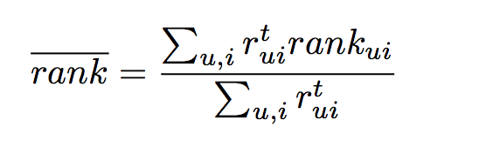
RESULTS
Evaluating our model
r_{ui} indicates the amount of times user u listend to song i; e.g. the R[u,i] if R is the utility matrix
rank_{ui} is the percentile-ranking of song i within the ordered list of all programs prepared for user u.
Lower values of rank are more desirable, as they indicate ranking actually listened songs closer to the top of the recommendation lists. Notice that for random predictions, the expected value of rank_{ui} is 50% (placing i in the middle of the sorted list). Thus, rank 50% indicates an algorithm no better than random.

