Slide 1
GameBoy
Project
Alexandru IONITA
Marcel FEIER

Slide 2
CONTENTS
Project Goals
Hardware
Software
Live Demo

Slide 3
Project Goals
Create a retro-style game console with the following features:
  Wi-Fi selection and connection
  Game Library
  Ability to download and install games

Slide 4
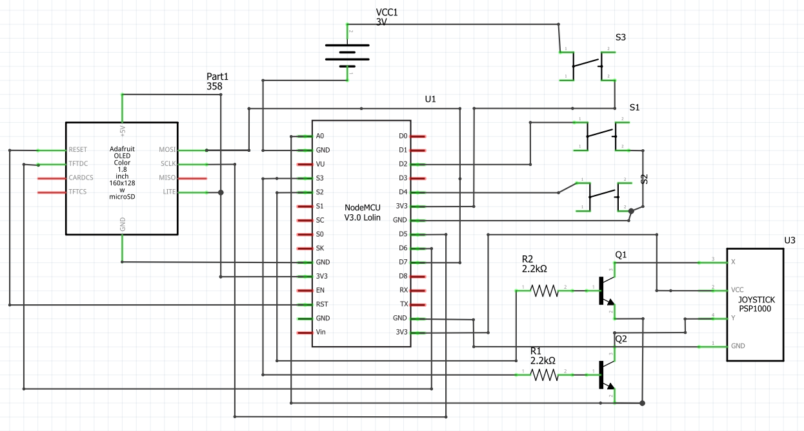
Hardware

Slide 5
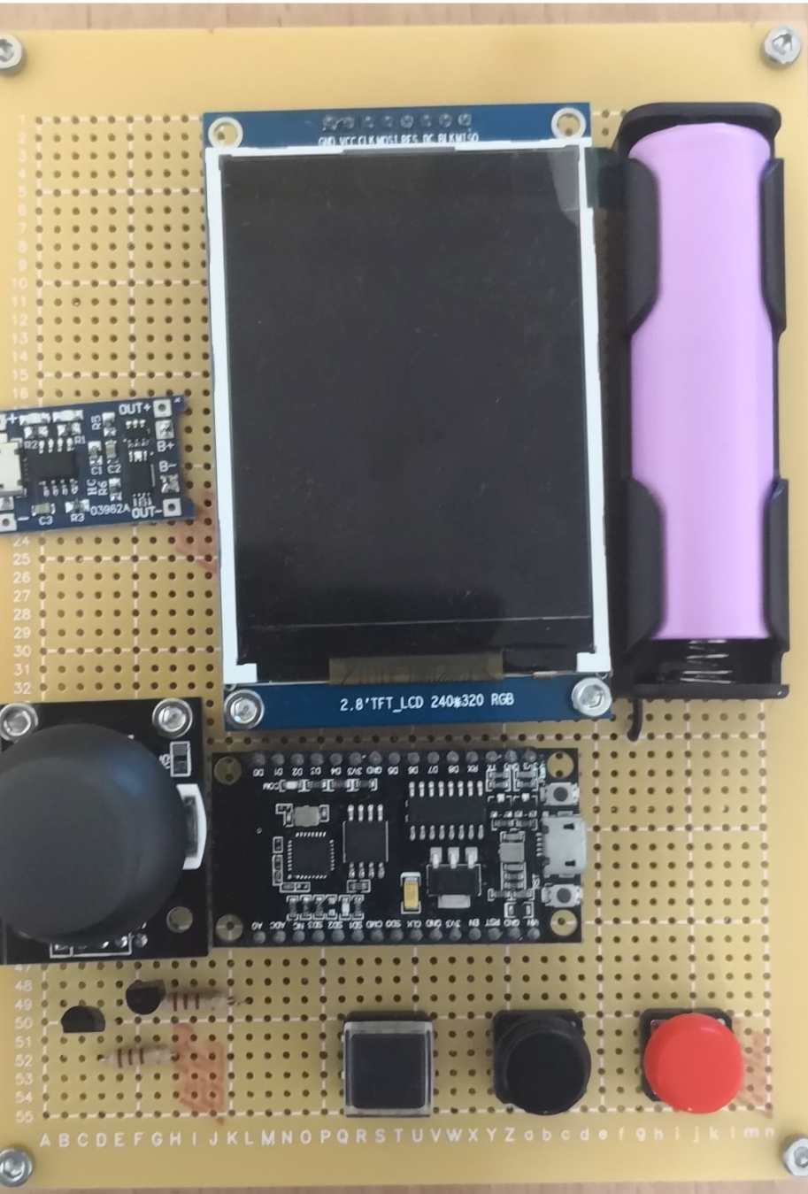

Slide 6
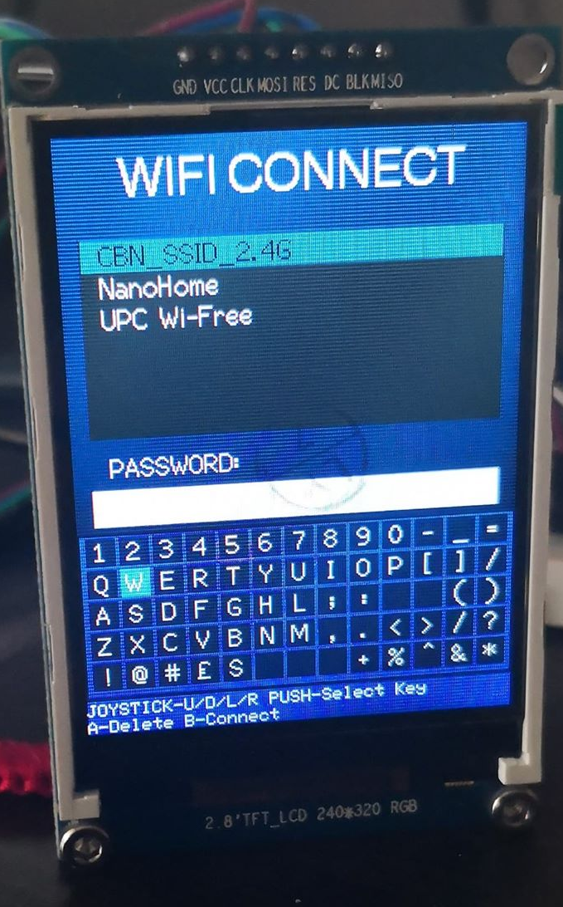
Software
The software part consists in sub-modules:
  Graphics
    Display Driver
    Shape Renderer
    Text Renderer
  Input Controller
  Core
    Wi-Fi Manager
    Game Manager
    OnScreen Keyboard
    UI Controls
      ListBox
      TextBox
      Header
      Footer

Slide 7
Live Demo

