Slide 1



dMVX: Secure and Efficient Multi-Variant Execution in a Distributed Setting
Alexios Voulimeneas, Dokyung Song, Per Larsen, Michael Franz, Stijn Volckaert

Slide 2
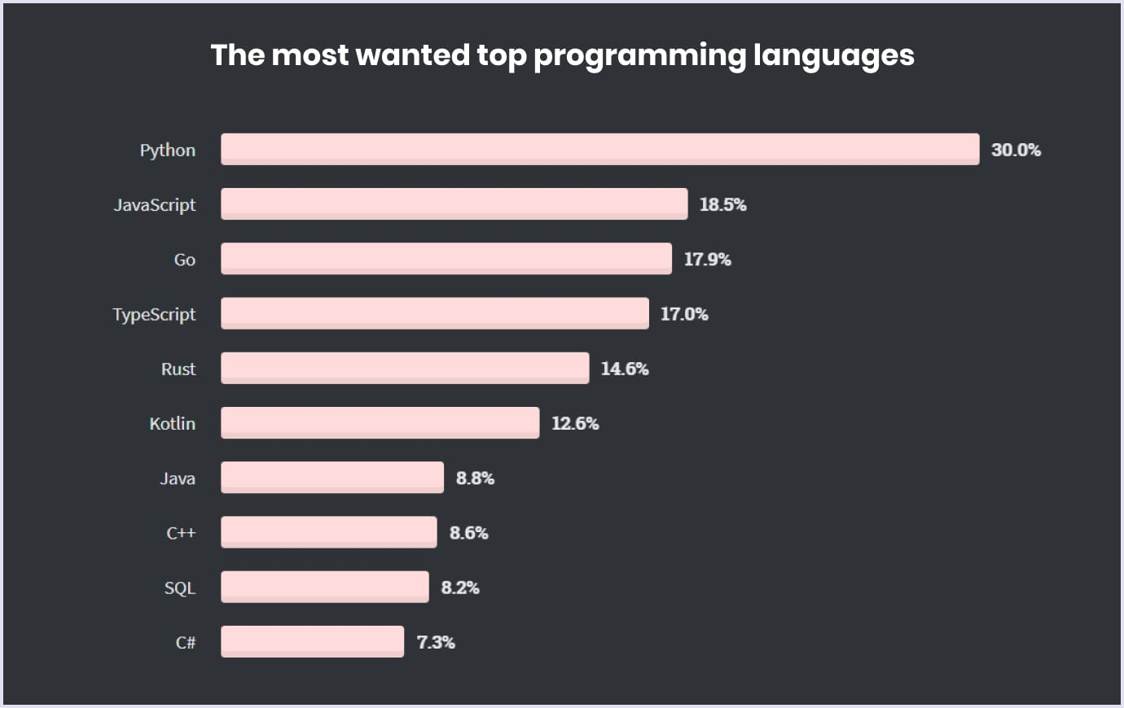
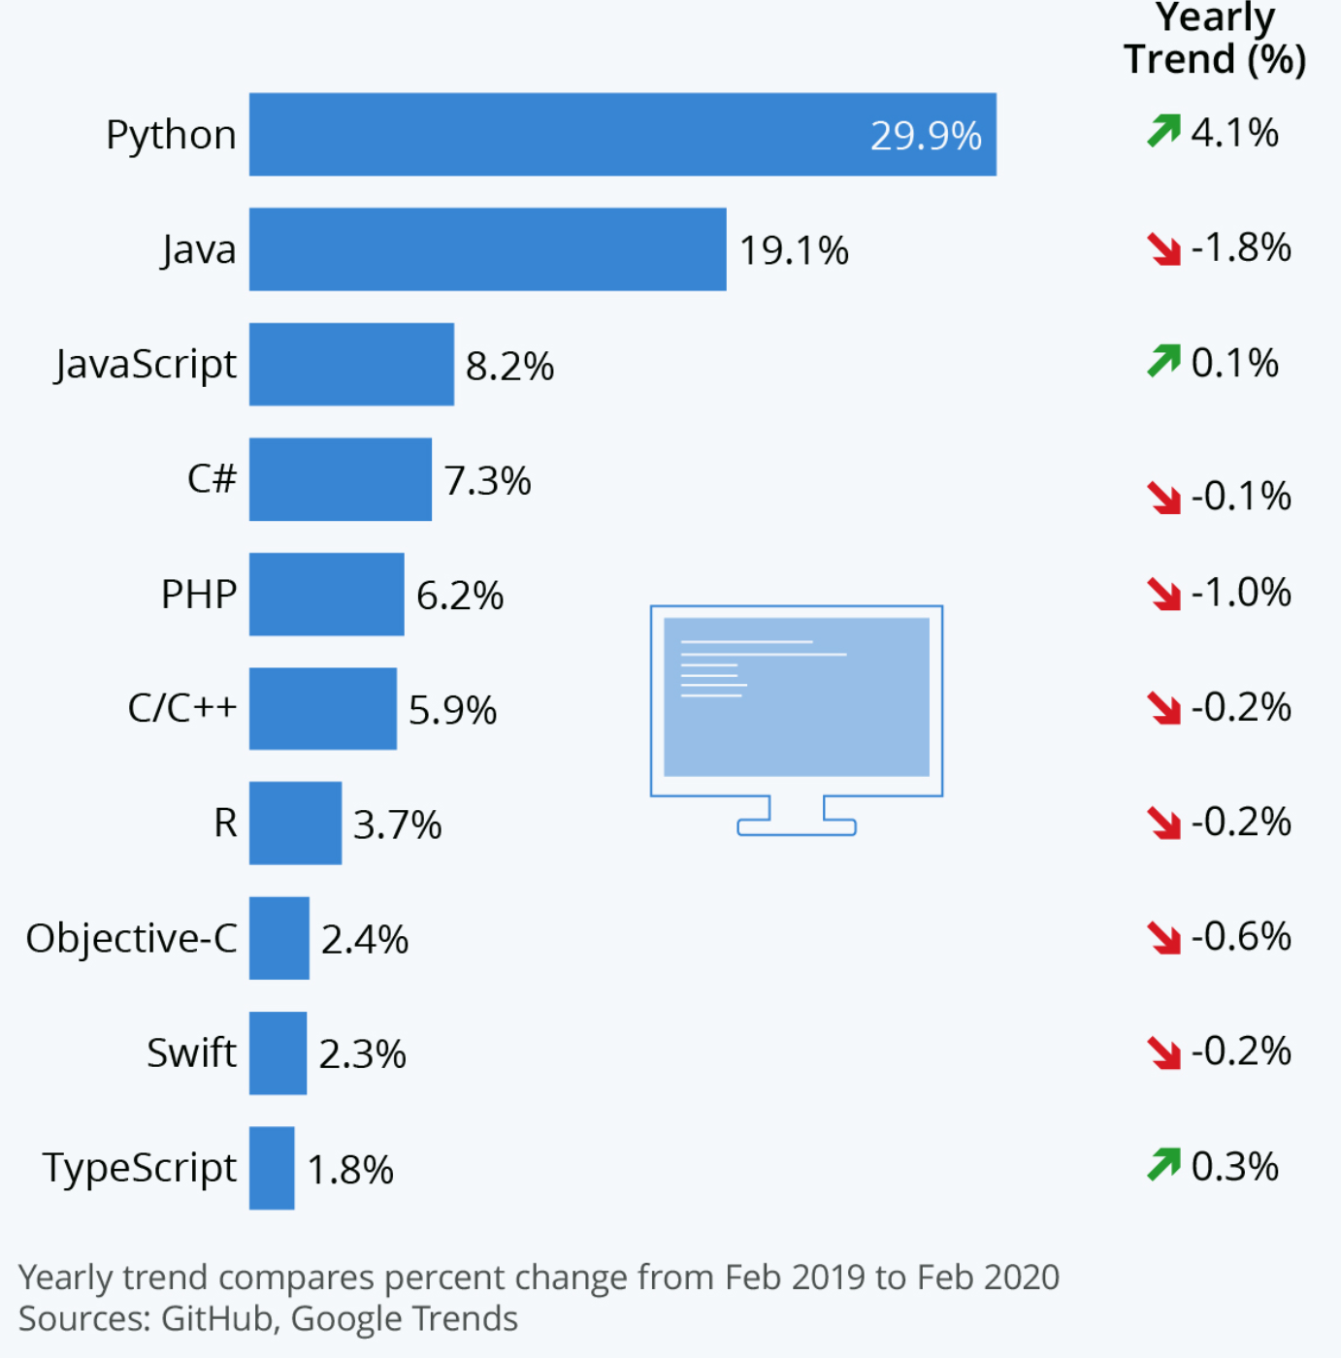
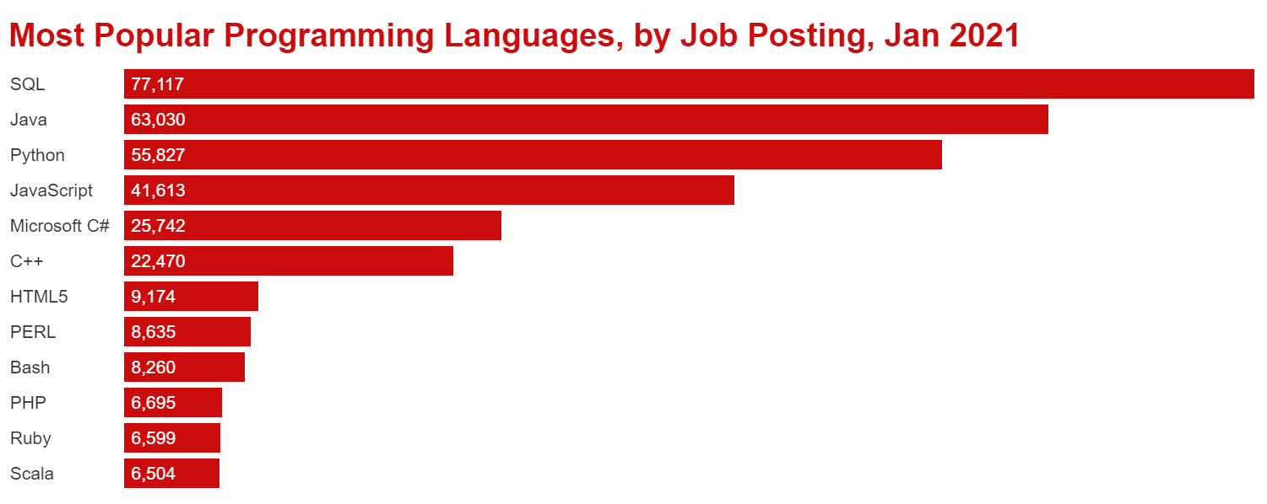

Slide 3
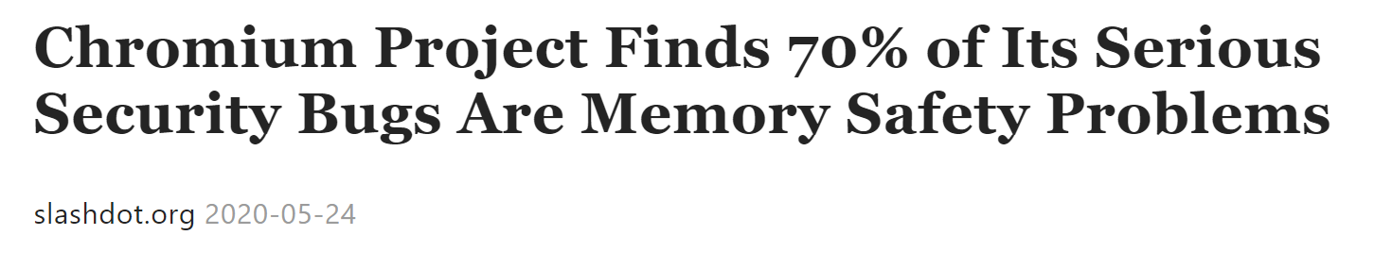
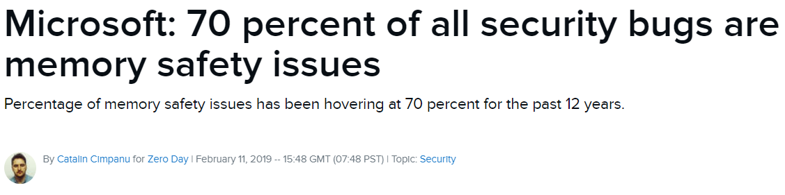

Slide 4
Solutions
Memory-Safe Programming Languages (e.g. Rust)
Mitigations:
Integrity Enforcement (e.g. CFI)
Software Diversity (e.g. ASLR)
Multi-Variant eXecution (MVX)

Slide 5
Multi-Variant eXecution (MVX)
In a nutshell:
Run multiple diversified program variants in lockstep on identical inputs
Suspend them at every system call
Compare system call numbers/arguments
Replicate I/O results
Leader
Variant
Follower Variant
t
t
brk
write
brk
write
Monitor
Kernel

Slide 6
MVX Systems Security (1)
Protection against attacks that rely on knowledge of absolute addresses
Protection against attacks that attempt to acquire knowledge through information leakage
Bruschi et al. “Diversified process replicae for defeating memory error exploits.” In IPCCC, 2007.
Volckaert et al. “Cloning your gadgets: Complete ROP attack immunity with multi-variant execution.” In TDSC, 2012.
Lu et al. “Stopping memory disclosures via diversification and replicated execution.” In TDSC, 2018.

Slide 7
MVX Systems Security (2)
Vulnerable to attacks that use relative memory locations
Data-only attacks are still possible
Hu et al. “Data-oriented programming: On the expressiveness of non-control data attacks.” In S&P, 2016.
Göktas et al. “Position-independent code reuse: On the eectiveness of ASLR in the absence of information disclosure.” In EuroS&P, 2018.

Slide 8

Observation: Diversity is limited to what a single platform can offer.

Slide 9

DMON (DIMVA 2020)
Leader
Variant
Follower
Variant
syscall (...)
syscall (...)
Inter-Monitor Communication via Network
Monitor
Monitor
Kernel
Kernel
Physical host 1
Physical host 2

Slide 10
Distributed Heterogeneous N-Variant Execution
Variants run on different physical machines
Leverage ISA and ABI heterogeneity to increase diversity

Slide 11

ISA-Heterogeneity
Additional Diversity
ABI-Heterogeneity
Machine instructions
Endianness
Register set
Pointer width
Available system calls
Size of primitive data types
Structs layout
Packing
Alignment
Padding
Constants
System call numbers
Flags and modes
Calling conventions

Slide 12

Performance (?)
System Call Interception
Monitoring and Replication

Slide 13
DMON (DIMVA 2020)
Leader Variant
Follower Variant
syscall
Monitor
Monitor
Kernel
Kernel
Physical host 1
Physical host 2

Slide 14
ReMon (ATC 2016)
Hybrid MVX design
- Cross-process monitor (CP-MON)
- In-process monitor (IP-MON)
Classification of system calls
CP-MON handles security-sensitive system calls (e.g. execve)
IP-MON handles non-sensitive system calls (e.g., getpid)

Slide 15
Distributed Hybrid Design
Leader Variant
Follower Variant
DIP-MON
DIP-MON
getpid
execve
DCP-MON
DCP-MON
Kernel
Kernel
Syscall Broker
Syscall Broker
Physical host 1
Physical host 2

Slide 16
Distributed Hybrid Design
Leader Variant
Follower Variant
DIP-MON
DIP-MON
getpid
execve
DCP-MON
DCP-MON
Kernel
Kernel
Syscall Broker
Syscall Broker
Physical host 1
Physical host 2

Slide 17


dMVX Design
Leader Variant
CB
CB
Follower Variant
DIP-MON
DIP-MON
CONNECTOR
CONNECTOR
getpid
execve
DCP-MON
DCP-MON
Kernel
Kernel
Syscall Broker
Syscall Broker
Physical host 1
Physical host 2

Slide 18
Core Components
Leader Variant
CB
CB
Follower Variant
DIP-MON
DIP-MON
CONNECTOR
CONNECTOR
getpid
execve
DCP-MON
DCP-MON
Kernel
Kernel
Syscall Broker
Syscall Broker
Physical host 1
Physical host 2

Slide 19
Core Components
Leader Variant
CB
CB
Follower Variant
DIP-MON
DIP-MON
CONNECTOR
CONNECTOR
execve
DCP-MON
DCP-MON
Kernel
Kernel
Syscall Broker
Syscall Broker
Physical host 1
Physical host 2

Slide 20
Core Components
Leader Variant
CB
CB
Follower Variant
DIP-MON
DIP-MON
CONNECTOR
CONNECTOR
getpid
DCP-MON
DCP-MON
Kernel
Kernel
Syscall Broker
Syscall Broker
Physical host 1
Physical host 2

Slide 21
Core Components
Leader Variant
CB
CB
Follower Variant
DIP-MON
DIP-MON
CONNECTOR
CONNECTOR
getpid
DCP-MON
DCP-MON
Kernel
Kernel
Syscall Broker
Syscall Broker
Physical host 1
Physical host 2

Slide 22
Core Components
Leader Variant
CB
CB
Follower Variant
DIP-MON
DIP-MON
CONNECTOR
CONNECTOR
getpid
DCP-MON
DCP-MON
Kernel
Kernel
Syscall Broker
Syscall Broker
Physical host 1
Physical host 2

Slide 23
Core Components
Leader Variant
CB
CB
Follower Variant
DIP-MON
DIP-MON
CONNECTOR
CONNECTOR
getpid
DCP-MON
DCP-MON
Kernel
Kernel
Syscall Broker
Syscall Broker
Physical host 1
Physical host 2

Slide 24

Additional Optimizations
Replication is still expensive
Asynchronous replication
Avoid replication when possible

Slide 25
Replication
Leader Variant
Follower Variant
Expensive replication of results through network
DIP-MON
DIP-MON
syscall
DCP-MON
DCP-MON
Kernel
Kernel
Syscall Broker
Syscall Broker
Physical host 1
Physical host 2

Slide 26
Asynchronous Replication
Leader Variant
CB
CB
Follower Variant
DIP-MON
DIP-MON
CONNECTOR
CONNECTOR
getpid
DCP-MON
DCP-MON
Kernel
Kernel
Syscall Broker
Syscall Broker
Physical host 1
Physical host 2

Slide 27
Asynchronous Replication
Leader Variant
CB
CB
Follower Variant
DIP-MON
DIP-MON
CONNECTOR
CONNECTOR
getpid
DCP-MON
DCP-MON
Kernel
Kernel
Syscall Broker
Syscall Broker
Physical host 1
Physical host 2

Slide 28

Asynchronous Replication
Leader Variant
CB
CB
Follower Variant
DIP-MON
DIP-MON
CONNECTOR
CONNECTOR
getpid
DCP-MON
DCP-MON
Kernel
Kernel
Syscall Broker
Syscall Broker
Physical host 1
Physical host 2

Slide 29
Selective Replication (1)
Files that are not changed by an external process.
Leader Variant
Follower Variant
DIP-MON
Each Variant uses its own copy of the file for I/O operations.
DIP-MON
read/write
read/write
DCP-MON
DCP-MON
Kernel
Kernel
Syscall Broker
Syscall Broker
Physical host 1
Physical host 2

Slide 30
Selective Replication (2)
System calls with “expected” results.
Leader Variant
Follower Variant
DIP-MON
Use metadata to predict result.
DIP-MON
syscall
syscall
DCP-MON
DCP-MON
Kernel
Kernel
Syscall Broker
Syscall Broker
Physical host 1
Physical host 2

Slide 31
Security of dMVX
Security-sensitive system calls are always monitored
CONNECTOR is a separate process
Information hiding to protect the in-process monitors and sensitive values

Slide 32
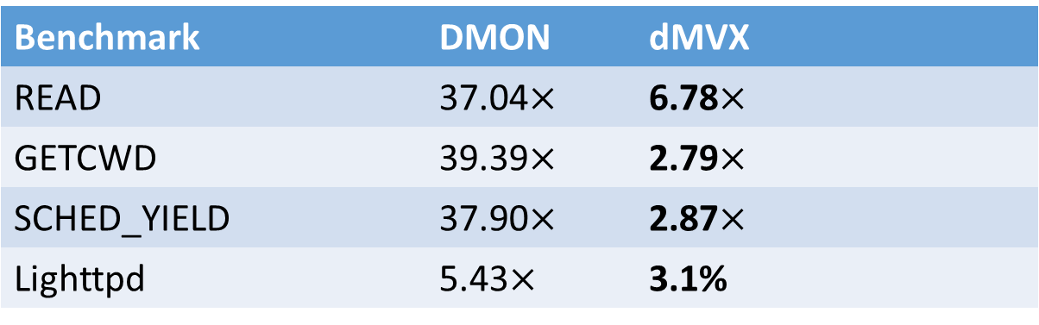
Case Studies
Benchmark | DMON | dMVX
READ | 37.04$×$ | 6.78$×$
GETCWD | 39.39$×$ | 2.79$×$
SCHED_YIELD | 37.90$×$ | 2.87$×$
Lighttpd | 5.43$×$ | 3.1%

Slide 33
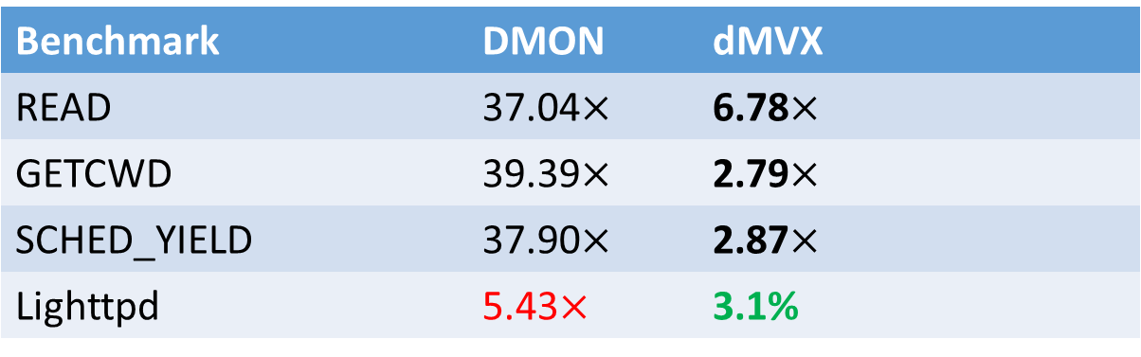
Case Studies
Benchmark | DMON | dMVX
READ | 37.04$×$ | 6.78$×$
GETCWD | 39.39$×$ | 2.79$×$
SCHED_YIELD | 37.90$×$ | 2.87$×$
Lighttpd | 5.43$×$ | 3.1%

Slide 34
Conslusion
dMVX: new distributed hybrid MVX design
- Low system call interception cost
- Avoid monitoring and replication when possible
- Provide similar security guarantees with other distributed MVX systems
Evaluation
- Microbenchmarks
- Lighttpd

Slide 35


Alexios Voulimeneas
Email: alex.voulimeneas@kuleuven.be

