Slide 1

Building the Next Generation of Security Focused NVX Systems: Addressing Limitations in N-Variant Execution
PhD Defense
Alexios Voulimeneas
Dissertation Committee: Prof. Michael Franz (Chair)
Prof. Alex Nicolau
Prof. Qi Alfred Chen
Prof. Joshua Garcia
Prof. Stijn Volckaert

Slide 2
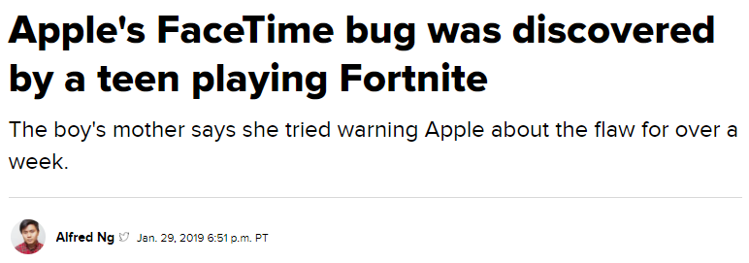
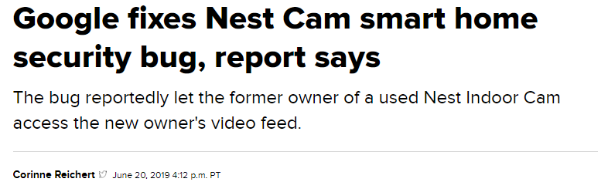
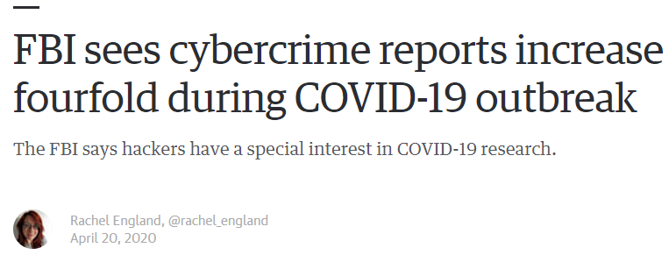
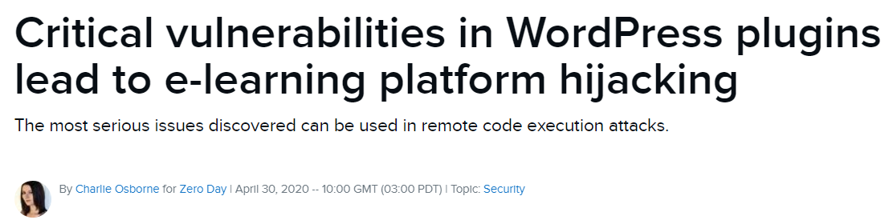
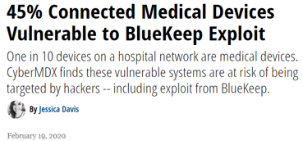
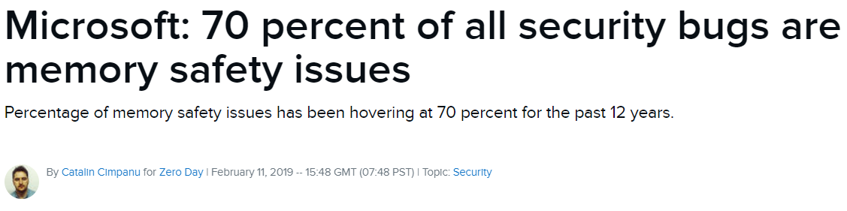

Slide 3


Eternal War in Memory
BOP
Hardware assisted CFI
PIROP
Execute-only memory
DOP
Information Disclosure
CPI
Fine-grained Randomization
ROP
Format Strings
CFI
Shadow Stacks
Heap Overflows
ASLR
Ret2libc
DEP
Smashing the Stack
Stack Canaries
VS
Szekeres et al. “Sok: Eternal war in memory.” In S&P, 2013.

Slide 4
Eternal War in Memory
BOP
Hardware assisted CFI
PIROP
Execute-only memory
DOP
Information Disclosure
CPI
Fine-grained Randomization
ROP
Format Strings
CFI
Shadow Stacks
Heap Overflows
ASLR
Ret2libc
DEP
Smashing the Stack
Stack Canaries
VS
Szekeres et al. “Sok: Eternal war in memory.” In S&P, 2013.

Slide 5
Eternal War in Memory
BOP
Hardware assisted CFI
PIROP
Execute-only memory
DOP
Information Disclosure
CPI
Fine-grained Randomization
ROP
Format Strings
CFI
Shadow Stacks
Heap Overflows
ASLR
Ret2libc
DEP
Smashing the Stack
Stack Canaries
VS
Szekeres et al. “Sok: Eternal war in memory.” In S&P, 2013.

Slide 6
Eternal War in Memory
BOP
Hardware assisted CFI
PIROP
Execute-only memory
DOP
Information Disclosure
CPI
Fine-grained Randomization
ROP
Format Strings
CFI
Shadow Stacks
Heap Overflows
ASLR
Ret2libc
DEP
Smashing the Stack
Stack Canaries
VS
Szekeres et al. “Sok: Eternal war in memory.” In S&P, 2013.

Slide 7
Eternal War in Memory
BOP
Hardware assisted CFI
PIROP
Execute-only memory
DOP
Information Disclosure
CPI
Fine-grained Randomization
ROP
Format Strings
CFI
Shadow Stacks
Heap Overflows
ASLR
Ret2libc
DEP
Smashing the Stack
Stack Canaries
VS
Szekeres et al. “Sok: Eternal war in memory.” In S&P, 2013.

Slide 8
Eternal War in Memory
BOP
Hardware assisted CFI
PIROP
Execute-only memory
DOP
Information Disclosure
CPI
Fine-grained Randomization
ROP
Format Strings
CFI
Shadow Stacks
Heap Overflows
ASLR
Ret2libc
DEP
Smashing the Stack
Stack Canaries
VS
Szekeres et al. “Sok: Eternal war in memory.” In S&P, 2013.

Slide 9
Eternal War in Memory
BOP
Hardware assisted CFI
PIROP
Execute-only memory
DOP
Information Disclosure
CPI
Fine-grained Randomization
ROP
Format Strings
CFI
Shadow Stacks
Heap Overflows
ASLR
Ret2libc
DEP
Smashing the Stack
Stack Canaries
VS
Szekeres et al. “Sok: Eternal war in memory.” In S&P, 2013.

Slide 10
N-Variant eXecution (NVX)

Slide 11
N-Variant eXecution (NVX)
Follower Variant
In a nutshell:
Run multiple diversified program variants in parallel
Execute these variants in lockstep on identical inputs
Suspend them at every system call
Compare system call numbers/arguments
I/O replication for transparency and identical inputs
Leader
Variant
t
t
brk
write
brk
write
Monitor
Kernel
Salamat et al. “Orchestra: intrusion detection using parallel execution and monitoring of program variants in user-space. In EuroSys 2009.

Slide 12


Program
Program
Stack
Stack
gadget1
gadget2
gadget3
gadget1
gadget2
gadget3
main + 2
main + 2
Volckaert et al. “Cloning your gadgets: Complete ROP attack immunity with multi-variant execution.” In TDCS, 2016.

Slide 13
Monitor Design
NVX monitor
shared memory
Ring 3
kernel
Ring 0

Slide 14
Monitor Design
NVX monitor
shared memory
Ring 3
kernel
Ring 0
Monitor
Pros
Implicit, fast system call interception
Cons
Dangerous and difficult to implement correctly
Significant increase of TCB
Maintenance of huge kernel patches and/or modules
Cox et al. “A secretless framework for security through diversity.” In USENIX Security, 2006.

Slide 15
Monitor Design
NVX monitor
Monitor
shared memory
Ring 3
kernel
Ring 0
Monitor
Pros
Easier Implementation
Isolation of monitor
Cons
Slow system call interception
Lorenzo Cavallaro. Comprehensive Memory Error Protection via Diversity and Taint-Tracking. PhD thesis, PhD dissertation, Universita Degli Studi Di Milano, 2007.
M. Maurer and D. Brumley. TACHYON: Tandem execution for efficient live patch testing. In USENIX Security Symposium, 2012.
P. Hosek and C. Cadar. Safe software updates via multi-version execution. In International Conference on Software Engineering (ICSE), 2013.

Slide 16
Monitor Design
Variant 2
NVX monitor
Variant 1
shared memory
Monitor
Monitor
Monitor
Ring 3
kernel
Ring 0
Monitor
Pros
Fast system call interception
Cons
Weak security guarantees
Hosek et al. “Varan the unbelievable: An efficient n-version execution framework.” In ASPLOS, 2015.

Slide 17

Limitations of NVX Systems
Cross-process NVX designs have good security characteristics but incur high overhead
In-process NVX designs are efficient but provide weak security guarantees
Place variants in a single physical machine
Diversity is limited to what a single platform can offer
Bypassed by non-control data and modern code-reuse attacks

Slide 18

Thesis
A new NVX design can be efficient without sacrificing security
A distributed heterogeneous NVX design
Variants run in different physical machines
Leverage ISA and ABI heterogeneity to increase diversity
Challenges coming from the distributed and the heterogeneous setting

Slide 19
Hybrid NVX Design

Slide 20
Hybrid Design
Program
Program
Split-Monitor Design:
Handle security-sensitive system calls in Cross-Process Monitor (CP-MON)
Handle non-sensitive system calls in In-Process Monitor (IP-MON)
Configurable relaxation policies
In-Process Monitor
In-Process Monitor
getpid
open
Cross-Process Monitor
Kernel
Syscall Broker
MANUAL PAGES, O. pledge - restrict system operations. http://www.openbsd.org/cgi-bin/man.cgi/ OpenBSD-current/man2/pledge.2.

Slide 21
Core Components
Program
Program
System Call Broker:
Intercept system calls as they enter kernel
Forward them to appropriate monitor based on active relaxation policy
Authenticate system calls when resumed by monitor
IP-MON
IP-MON
getpid
open
CP-MON
Kernel
Syscall Broker

Slide 22
Core Components
Program
Program
In-Process Monitor:
Authorized to execute forwarded calls w/o intervention by cross-process monitor
Replicates system call results through shared buffer
IP-MON
IP-MON
RB
getpid
CP-MON
Kernel
Syscall Broker

Slide 23
Core Components
Program
Program
Cross-Process Monitor:
Standard ptrace-based monitor
Completely isolated from variants
IP-MON
IP-MON
RB
RB
open
CP-MON
Kernel
Syscall Broker
Volckaert et al. “GHUMVEE: efficient, selective, and flexible replication.” In FPS, 2012.

Slide 24

In-Process Monitor Security
Program
Program
No abuse of monitor privileges:
Monitor cannot execute system calls that did not pass through the broker first
Broker generates authentication key and loads it into register when forwarding call to monitor
Key must be intact to finish execution of forwarded call
IP-MON
IP-MON
RB
getpid
CP-MON
Kernel
Syscall Broker

Slide 25
In-Process Monitor Security
Program
Program
No tampering with monitor data:
Locations of monitor and shared buffer are only known to broker
Pointers to monitor and buffer are never visible in user space
IP-MON
IP-MON
RB
getpid
CP-MON
Kernel
Syscall Broker

Slide 26
In-Process Monitor Security
Program
Program
Leak Prevention:
Sensitive values (e.g. pointers, authorization key) only stored in registers and never leaked or spilled
Monitor has no indirect branches => control flow cannot be diverted to malicious code
IP-MON
IP-MON
RB
getpid
CP-MON
Kernel
Syscall Broker

Slide 27
Performance Evaluation
Benchmark | CP-MON only | Hybrid
SPEC CPU 2006 | 6.37% | 3%
PARSEC 2.1 | 22% | 11%
SPLASH-2x | 29% | 10%
Server Benchmarks | up to 1249% | <3.5%

Slide 28
Performance Evaluation
Benchmark | CP-MON only | Hybrid
SPEC CPU 2006 | 6.37% | 3%
PARSEC 2.1 | 22% | 11%
SPLASH-2x | 29% | 10%
Server Benchmarks | up to 1249% | <3.5%

Slide 29
What Secure NVX Systems can do
Protect Against
Attacks that rely on knowledge of the target's absolute virtual address space layout
Attacks that attempt to acquire that knowledge through information leakage
Bruschi et al. “Diversified process replicae for defeating memory error exploits.” In IPCCC, 2007.
Volckaert et al. “Cloning your gadgets: Complete ROP attack immunity with multi-variant execution.” In TDSC, 2012.
Lu et al. “Stopping memory disclosures via diversification and replicated execution.” In TDSC, 2018.

Slide 30
What Secure NVX Systems cannot do
Protect Against
✗ Attacks that build on knowledge of the program's internal geometry (e.g., khrelative data/instruction layouts) and/or data representation

Slide 31
ProFTPD SSL Private Key Leak (DOP)
Hu et al. build an information disclosure attack on ProFTPD
Traverse 6 data structures using only data-only gadgets, ultimately reaching a private key
Hu et al. “Data-oriented programming: On the expressiveness of non-control data attacks.” In S&P, 2016.

Slide 32
Position-independent Code Reuse (PIROP)
Göktas et al. construct code-reuse exploits that use relative locations in memory
Attackers could locate PIROP gadgets even in diversified programs
Göktas et al. “Position-independent code reuse: On the eectiveness of ASLR in the absence of information disclosure.” In EuroS&P, 2018.

Slide 33

Problem: Diversity is limited to what a single platform can offer.
Can we do better?

Slide 34
Distributed Heterogeneous
N-Variant Execution

Slide 35
Distributed Heterogeneous N-Variant Execution
The first distributed heterogeneous NVX design
Variants run in different physical machines
- Leverage ISA and ABI heterogeneity to increase diversity

Slide 36
Sources of Additional Diversity (ISA-Heterogeneity)
Machine instructions
Endianness
Register set
Pointer width
Available system calls

Slide 37
Sources of Additional Diversity (ABI-Heterogeneity)
Size of primitive data types
Structs layout
Packing
Alignment
Padding
Constants
System call numbers
Flags and modes
Calling conventions

Slide 38

Distributed Heterogeneous NVX Design
Leader
Variant
Follower
Variant
syscall (...)
syscall (...)
Inter-Monitor Communication via Network
Monitor
Monitor
Kernel
Kernel
Physical host 1
Physical host 2

Slide 39

Challenges
False Alarms
Performance

Slide 40

ISA-Heterogeneity
False Alarms
ABI-Heterogeneity
Machine instructions
Endianness
Register set
Pointer width
Available system calls
Size of primitive data types
Structs layout
Packing
Alignment
Padding
Constants
System call numbers
Flags and modes
Calling conventions

Slide 41

ISA-Heterogeneity
Additional Diversity
ABI-Heterogeneity
Machine instructions
Endianness
Register set
Pointer width
Available system calls
Size of primitive data types
Structs layout
Packing
Alignment
Padding
Constants
System call numbers
Flags and modes
Calling conventions

Slide 42
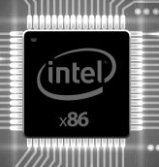
Monitoring the system call interface (NVX)
NVX System
?
Extracted system call state
Extracted system call state
=
Variant 1
Variant 2

Slide 43
Monitoring the System Call Interface (NVX)
NVX System
?
Extracted system call state
Extracted system call state
=
Variant 1
Variant 2

Slide 44
Monitoring the System Call Interface (NVX)
NVX System
Extracted system call state
Extracted system call state
F
Variant 1
Variant 2

Slide 45
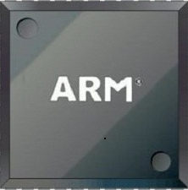
Monitoring the System Call Interface (NVX)
NVX System
?
Extracted system call state
Extracted system call state
=
Variant 1
Variant 2

Slide 46
Monitoring the System Call Interface (NVX)
NVX System
Extracted system call state
Extracted system call state
✗
Variant 1
Variant 2

Slide 47

Monitoring the System Call Interface (NVX)
NVX System
?
Canonicalized system call state
Canonicalized system call state
=
Extracted system call state
Extracted system call state
Variant 1
Variant 2

Slide 48
Monitoring the System Call Interface (NVX)
NVX System
Canonicalized system call state
F
Canonicalized system call state
Extracted system call state
Extracted system call state
Variant 1
Variant 2

Slide 49
Differences at System Call Interface
System call numbers
System calls
Struct layout
Flags and modes

Slide 50
Anatomy of a System Call State
system call state
constant parameters
variable parameters
syscall number
flags and modes
simple variables
complex structures

Slide 51
Platform-Independent State Canonicalization (PISC)
Canonicalize constants
Canonicalize struct layout
Use semantic equivalence rules (for a few cases)

Slide 52
Semantic Equivalence Rules (PISC)
Variant 1
open(filepath, flags, mode)
Physical host 1
Variant 2
openat(dir, filepath, flags, mode)
Physical host 2

Slide 53
Semantic Equivalence Rules (PISC)
Variant 1
open(filepath, flags, mode)
False Alarm
Physical host 1
Variant 2
openat(dir, filepath, flags, mode)
Physical host 2

Slide 54
Semantic Equivalence Rules (PISC)
Variant 1
open(filepath, flags, mode)
Functional Equivalent
Physical host 1
Variant 2
openat(dir, filepath, flags, mode)
Physical host 2

Slide 55
Semantic Equivalence Rules (PISC)
Variant 1
open(filepath, flags, mode)
False Alarm
Physical host 1
Variant 2
openat(dir, filepath, flags, mode)
Physical host 2

Slide 56
Semantic Equivalence Rules (PISC)
Variant 1
open(filepath, flags, mode)
Resolve absolute file paths before checking
Physical host 1
Variant 2
openat(dir, filepath, flags, mode)
Physical host 2

Slide 57
Semantic Equivalence Rules (PISC)
Variant 1
open(filepath, flags, mode)
False Alarm
Physical host 1
Variant 2
openat(dir, filepath, flags, mode)
Physical host 2

Slide 58
Semantic Equivalence Rules (PISC)
Variant 1
open(filepath, flags, mode)
Constant Canonicalization
Physical host 1
Variant 2
openat(dir, filepath, flags, mode)
Physical host 2

Slide 59
Challenges
False Alarms
Performance

Slide 60
Expensive Inter-Monitor Communication
Latency
TCP
Reliable UDP
Custom TCP/IP stack
Roundtrip time
- Avoid inter-monitor communication (when possible)

Slide 61
Optimizations
Monitoring and replication are expensive
Avoid monitoring and replication when possible
Selective Monitoring
Selective Replication

Slide 62
Monitoring
Leader
Variant
Follower
Variant
syscall
syscall
Expensive monitoring through the network
Monitor
Monitor
Kernel
Kernel
Physical host 1
Physical host 2

Slide 63
Selective Monitoring
Leader
Variant
Follower
Variant
Security Sensitive System Call
syscall
syscall
Expensive monitoring through the network
Monitor
Monitor
Kernel
Kernel
Physical host 1
Physical host 2

Slide 64
Selective Monitoring
Leader
Variant
Follower
Variant
Non-Sensitive System Call
syscall
syscall
No monitoring
Monitor
Monitor
Kernel
Kernel
Physical host 1
Physical host 2

Slide 65
Replication
Leader
Variant
Follower
Variant
syscall
syscall
Expensive replication of results through the network
Monitor
Monitor
Kernel
Kernel
Physical host 1
Physical host 2

Slide 66
Selective Replication (1)
Leader
Variant
Follower
Variant
read-only file
read
read
Each Variant uses its own copy of the file for read-only operations.
Monitor
Monitor
Kernel
Kernel
Physical host 1
Physical host 2

Slide 67
Selective Replication (2)
Leader
Variant
Follower
Variant
Reads immutable state
syscall
syscall
The monitor caches the immutable state
Monitor
Monitor
Kernel
Kernel
Physical host 1
Physical host 2

Slide 68

Security Performance

Slide 69
Case Study: ProFTPD SSL Private Key Leak
Hu et al. demonstrated an information disclosure attack on ProFTPD
Traverse 6 data structures using data-only gadgets, ultimately reaching a private key
A distributed heterogeneous NVX raises the bar
4/6 pointer fields needed for this attack are located in different offsets

Slide 70
Struct Layout Diversity
Benchmark | Artificial | DMON
Nginx 1.14.2 | 14.52% | 91.78%
Lighttpd 1.4.52 | 12.93% | 81.90%
Redis 5.0.1 | 27.27% | 75.60%
ProFTPD 1.3.0 | 27.38% | 85.71%

Slide 71
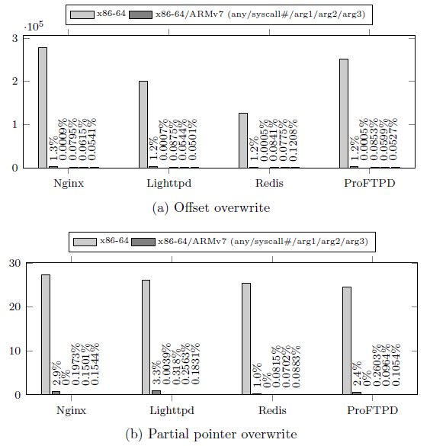
PIROP Gadget Reduction
Less than 3.3% of PIROP gadgets survive
Almost eliminating PIROP ABI-dependent gadgets (0%-0.318%)

Slide 72
Server Benchmarks

Slide 73
Server Benchmarks (High-End Hardware)

Slide 74
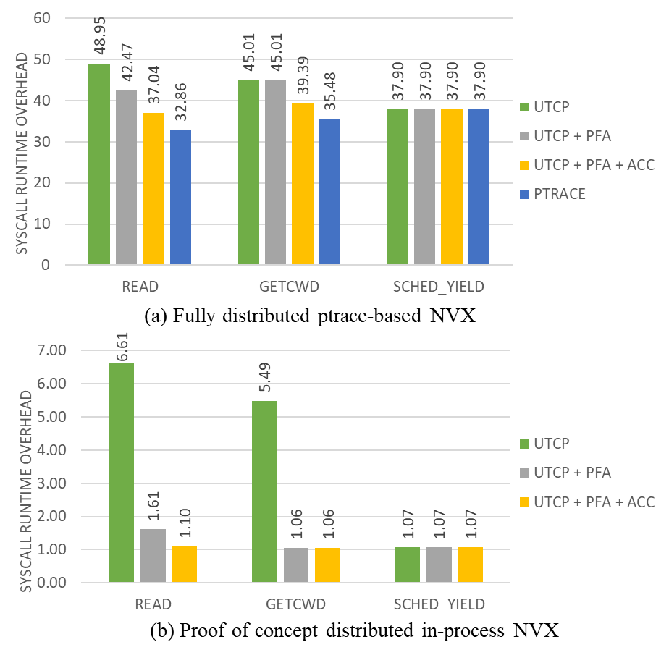
Microbenchmarks
Three different system calls
Measure per system call overhead
Measure the overhead of PTRACE
PoC distributed in-process monitor

Slide 75
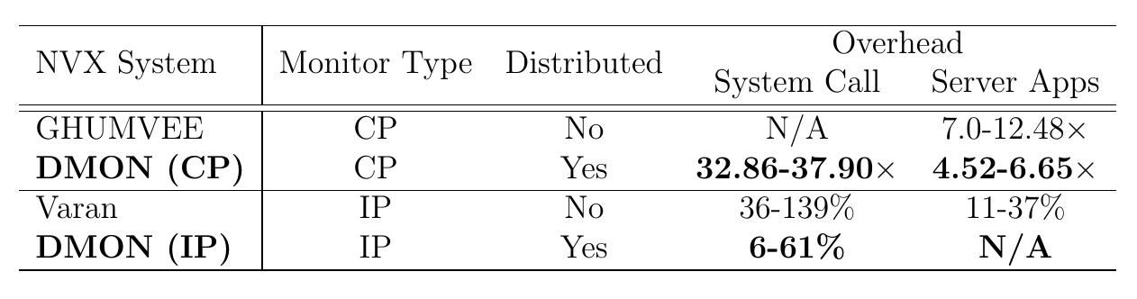
Comparison With Other NVX Systems

Slide 76

Overhead Analysis
Our optimizations reduce significantly the overhead
Most overhead is attributed to the ptrace API
Question: Can we reduce the overhead even more?

Slide 77
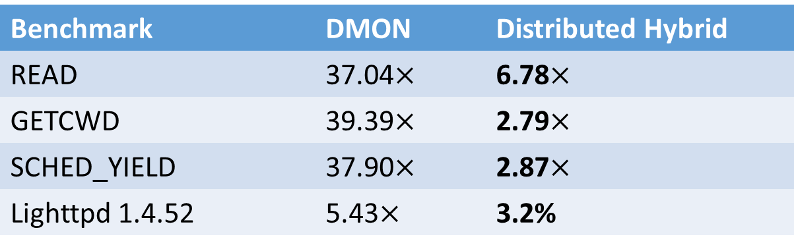
Performance Evaluation
Benchmark | DMON | Distributed Hybrid
READ | 37.04$×$ | 6.78$×$
GETCWD | 39.39$×$ | 2.79$×$
SCHED_YIELD | 37.90$×$ | 2.87$×$
Lighttpd 1.4.52 | 5.43$×$ | 3.2%

Slide 78
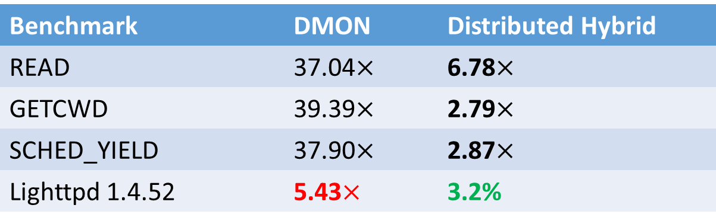
Performance Evaluation
Benchmark | DMON | Distributed Hybrid
READ | 37.04$×$ | 6.78$×$
GETCWD | 39.39$×$ | 2.79$×$
SCHED_YIELD | 37.90$×$ | 2.87$×$
Lighttpd 1.4.52 | 5.43$×$ | 3.2%
Notes:
for lighttpd the overhead

Slide 79

Conclusion
A hybrid NVX design unifies strengths of previous approaches
We constructed the first distributed heterogeneous NVX design and provided solutions to the major challenges that come from this setting
A distributed hybrid NVX design reduces the overhead of a distributed setting even more

Slide 80

Thank You! Q&A

