Slide 1


Distributed Heterogeneous N-Variant Execution
Alexios Voulimeneas, Dokyung Song, Fabian Parzefall, Yeoul Na, Per Larsen, Michael Franz, Stijn Volckaert

Slide 2
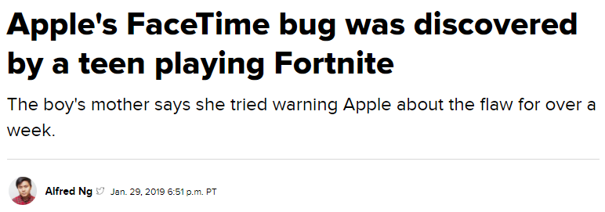
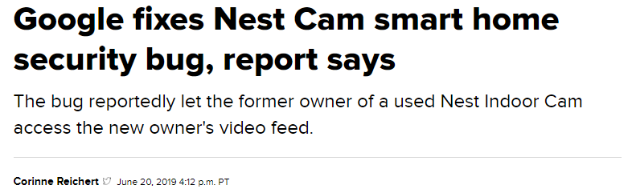
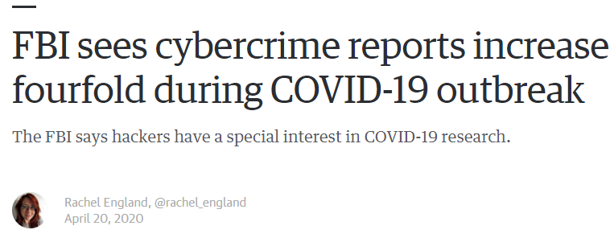
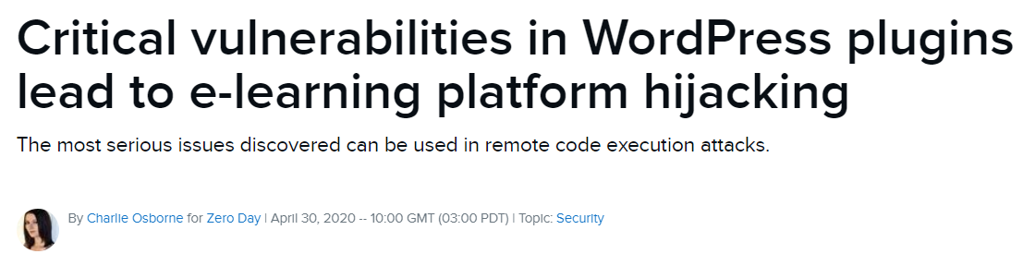
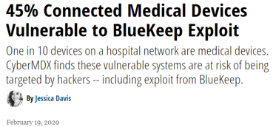
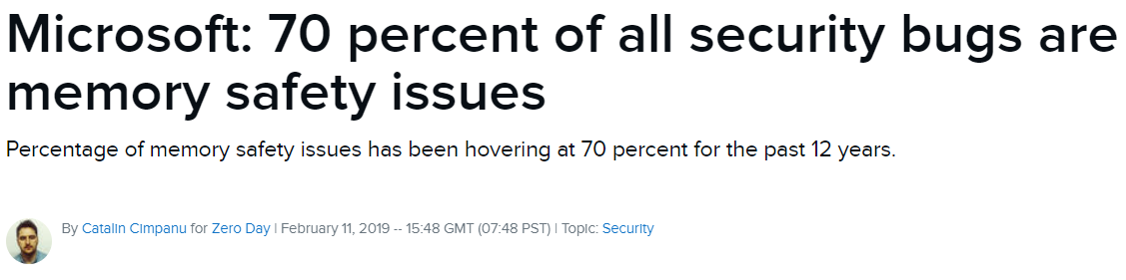

Slide 3
Solutions
Type-Safe Programming Languages (e.g. Rust)
Type-Safe Programming Languages (e.g. Rust)
Mitigations:
Mitigations:
Integrity Enforcement (e.g. CFI)
Software Diversity (e.g. ASLR)
Integrity Enforcement (e.g. CFI)
Software Diversity (e.g. ASLR)
N-Variant eXecution (NVX)

Slide 4
N-Variant eXecution (NVX)
Follower Variant
In a nutshell:
Run multiple diversified program variants in parallel
Execute these variants in lockstep on identical inputs
Suspend them at every system call
Compare system call numbers/arguments
I/O replication for transparency and identical inputs
Leader
Variant
t
t
brk
write
brk
write
Monitor
Kernel

Slide 5
What NVX Systems can do
Protect Against
Attacks that rely on knowledge of the target's absolute virtual address space layout
Attacks that attempt to acquire that knowledge through information leakage

Slide 6
What NVX Systems cannot do
Protect Against
✗ Attacks that build on knowledge of the program's internal geometry (e.g., khrelative data/instruction layouts) and/or data representation

Slide 7
ProFTPD SSL Private Key Leak (DOP)
Hu et al. build an information disclosure attack on ProFTPD
Traverse 6 data structures using only data-only gadgets, ultimately reaching a private key

Slide 8
Position-independent Code Reuse (PIROP)
Göktas et al. construct code-reuse exploits that use relative locations in memory
Attackers could locate PIROP gadgets even in diversified programs

Slide 9

Problem: Diversity is limited to what a single platform can offer.
Can we do better?

Slide 10
Distributed Heterogeneous N-Variant Execution
The first distributed heterogeneous NVX design
Variants run in different physical machines
- Leverage ISA and ABI heterogeneity to increase diversity

Slide 11
Sources of Additional Diversity (ISA-Heterogeneity)
Machine instructions
Endianness
Register set
Pointer width
Available system calls

Slide 12
Sources of Additional Diversity (ABI-Heterogeneity)
Size of primitive data types
Structs layout
Packing
Alignment
Padding
Constants
System call numbers
Flags and modes
Calling conventions

Slide 13

Distributed Heterogeneous NVX Design
Leader
Variant
Follower
Variant
syscall (...)
syscall (...)
Inter-Monitor Communication via Network
Monitor
Monitor
Kernel
Kernel
Physical host 1
Physical host 2

Slide 14

Challenges
False Alarms
Performance

Slide 15

ISA-Heterogeneity
False Alarms
ABI-Heterogeneity
Machine instructions
Endianness
Register set
Pointer width
Available system calls
Size of primitive data types
Structs layout
Packing
Alignment
Padding
Constants
System call numbers
Flags and modes
Calling conventions

Slide 16

ISA-Heterogeneity
Additional Diversity
ABI-Heterogeneity
Machine instructions
Endianness
Register set
Pointer width
Available system calls
Size of primitive data types
Structs layout
Packing
Alignment
Padding
Constants
System call numbers
Flags and modes
Calling conventions

Slide 17
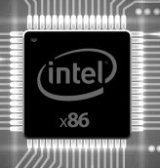
Monitoring the system call interface (NVX)
NVX System
?
Extracted system call state
Extracted system call state
=
Variant 1
Variant 2

Slide 18
Monitoring the System Call Interface (NVX)
NVX System
?
Extracted system call state
Extracted system call state
=
Variant 1
Variant 2

Slide 19
Monitoring the System Call Interface (NVX)
NVX System
Extracted system call state
Extracted system call state
F
Variant 1
Variant 2

Slide 20

Monitoring the System Call Interface (NVX)
NVX System
?
Extracted system call state
Extracted system call state
=
Variant 1
Variant 2

Slide 21
Monitoring the System Call Interface (NVX)
NVX System
Extracted system call state
Extracted system call state
✗
Variant 1
Variant 2

Slide 22

Monitoring the System Call Interface (NVX)
NVX System
?
Canonicalized system call state
Canonicalized system call state
=
Extracted system call state
Extracted system call state
Variant 1
Variant 2

Slide 23
Monitoring the System Call Interface (NVX)
NVX System
Canonicalized system call state
F
Canonicalized system call state
Extracted system call state
Extracted system call state
Variant 1
Variant 2

Slide 24
Anatomy of a System Call State
system call state
constant parameters
variable parameters
syscall number
flags and modes
simple variables
complex structures

Slide 25
Differences at System Call Interface
System call numbers
System calls
Struct layout
Flags and modes

Slide 26
Platform-Independent State Canonicalization (PISC)
Canonicalize constants
Canonicalize struct layout
Use semantic equivalence rules

Slide 27
Semantic Equivalence Rules (PISC)
Variant 1
open(filepath, flags, mode)
Physical host 1
Variant 2
openat(dir, filepath, flags, mode)
Physical host 2

Slide 28
Semantic Equivalence Rules (PISC)
Variant 1
open(filepath, flags, mode)
False Alarm
Physical host 1
Variant 2
openat(dir, filepath, flags, mode)
Physical host 2

Slide 29
Semantic Equivalence Rules (PISC)
Variant 1
open(filepath, flags, mode)
Functional Equivalent
Physical host 1
Variant 2
openat(dir, filepath, flags, mode)
Physical host 2

Slide 30
Semantic Equivalence Rules (PISC)
Variant 1
open(filepath, flags, mode)
False Alarm
Physical host 1
Variant 2
openat(dir, filepath, flags, mode)
Physical host 2

Slide 31
Semantic Equivalence Rules (PISC)
Variant 1
open(filepath, flags, mode)
Resolve absolute file paths before checking
Physical host 1
Variant 2
openat(dir, filepath, flags, mode)
Physical host 2

Slide 32
Semantic Equivalence Rules (PISC)
Variant 1
open(filepath, flags, mode)
False Alarm
Physical host 1
Variant 2
openat(dir, filepath, flags, mode)
Physical host 2

Slide 33
Semantic Equivalence Rules (PISC)
Variant 1
open(filepath, flags, mode)
Constant Canonicalization
Physical host 1
Variant 2
openat(dir, filepath, flags, mode)
Physical host 2

Slide 34
Challenges
False Alarms
Performance

Slide 35
Expensive Inter-Monitor Communication
Latency
TCP
Reliable UDP
Custom TCP/IP stack
Roundtrip time
- Avoid inter-monitor communication (when possible)

Slide 36
Optimizations
Monitoring and replication are expensive
Avoid monitoring and replication when possible
Selective Monitoring
Selective Replication

Slide 37
Monitoring
Leader
Variant
Follower
Variant
syscall
syscall
Expensive monitoring through the network
Monitor
Monitor
Kernel
Kernel
Physical host 1
Physical host 2

Slide 38
Selective Monitoring
Leader
Variant
Follower
Variant
Security Sensitive System Call
syscall
syscall
Expensive monitoring through the network
Monitor
Monitor
Kernel
Kernel
Physical host 1
Physical host 2

Slide 39
Selective Monitoring
Leader
Variant
Follower
Variant
Non-Sensitive System Call
syscall
syscall
No monitoring
Monitor
Monitor
Kernel
Kernel
Physical host 1
Physical host 2

Slide 40
Replication
Leader
Variant
Follower
Variant
syscall
syscall
Expensive replication of results through the network
Monitor
Monitor
Kernel
Kernel
Physical host 1
Physical host 2

Slide 41
Selective Replication (1)
Leader
Variant
Follower
Variant
read-only file
read
read
Each Variant uses its own copy of the file for read-only operations.
Monitor
Monitor
Kernel
Kernel
Physical host 1
Physical host 2

Slide 42
Selective Replication (2)
Leader
Variant
Follower
Variant
Reads immutable state
syscall
syscall
The monitor caches the immutable state
Monitor
Monitor
Kernel
Kernel
Physical host 1
Physical host 2

Slide 43

Security Performance

Slide 44
Case Study: ProFTPD SSL Private Key Leak
Hu et al. demonstrated an information disclosure attack on ProFTPD
Traverse 6 data structures using data-only gadgets, ultimately reaching a private key
A distributed heterogeneous NVX raises the bar
4/6 pointer fields needed for this attack are located in different offsets

Slide 45
Struct Layout Diversity
Benchmark | Artificial | DMON
Nginx 1.14.2 | 14.52% | 91.78%
Lighttpd 1.4.52 | 12.93% | 81.90%
Redis 5.0.1 | 27.27% | 75.60%
ProFTPD 1.3.0 | 27.38% | 85.71%

Slide 46
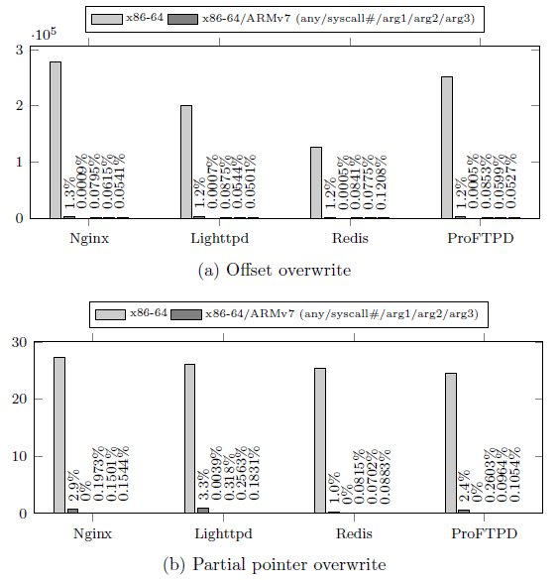
PIROP Gadget Reduction
Less than 3.3% of PIROP gadgets survive
Almost eliminating PIROP ABI-dependent gadgets (0%-0.318%)

Slide 47
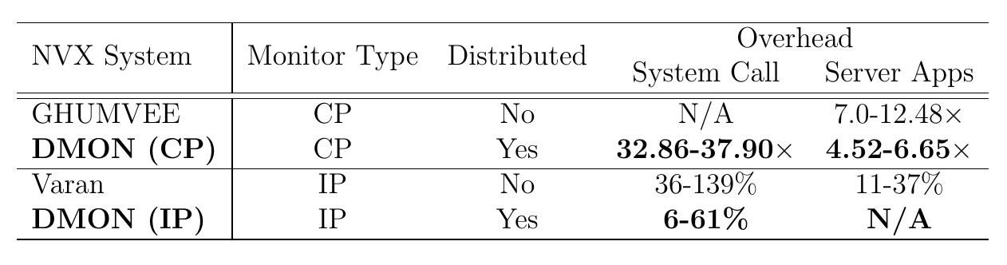
Comparison With Other NVX Systems

Slide 48

Alexios Voulimeneas
Email: avoulime@uci.edu

