Slide 1
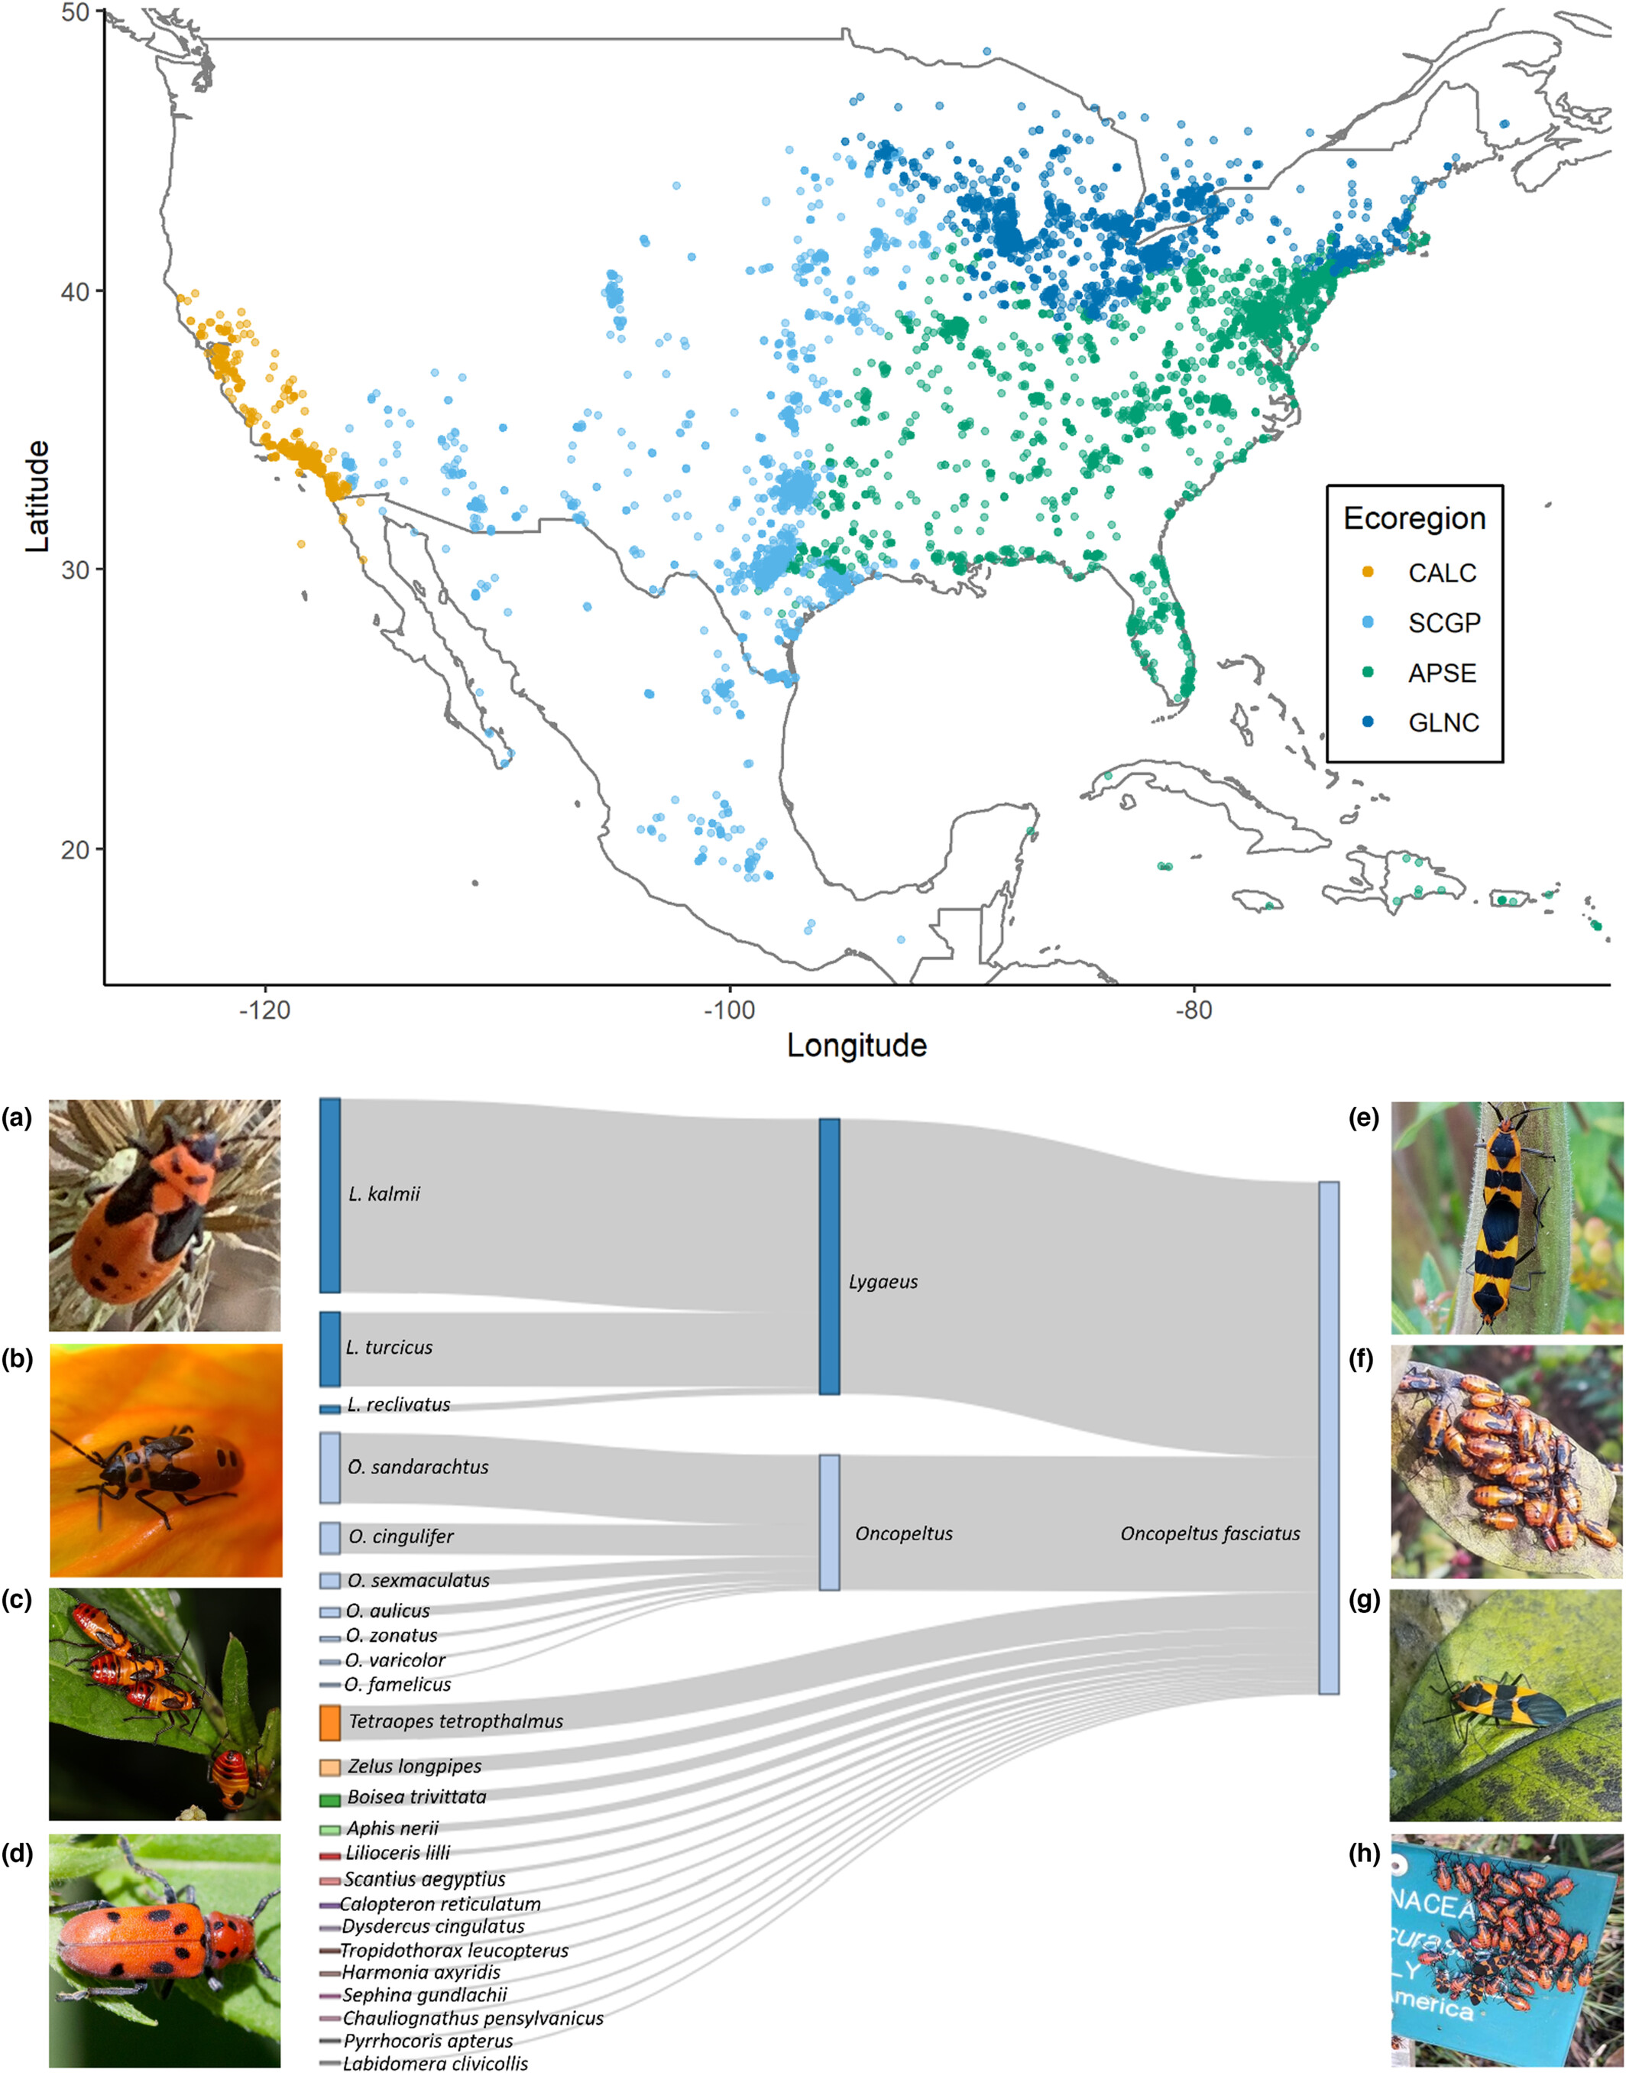
Citizen science data reveal regional heterogeneity in phenological response to climate in the large milkweed bug, Oncopeltus fasciatus
Ecology and Evolution, Volume: 13, Issue: 7, First published: 10 July 2023, DOI: (10.1002/ece3.10213)
Notes:
Map locations for all 11,224 iNaturalist observations of Oncopeltus fasciatus (top) colored by ecoregions (see Section 2). iNaturalist photos (bottom) on the left are examples of species to which users often first assign O. fasciatus observations: (a) Lygaeus kalmii nymph by cazotea, (b) Lygaeus turcicus nymph by arachnoto, (c) Oncopeltus sandarachtus nymphs by Judy Gallagher, (d) Tetraopes tetrophthalmus adult by Glenn Berry. The center Sankey diagram shows the proportion of identifications initially incorrectly classified (n = 1356), then updated to O. fasciatus. iNaturalist photos on the right represent observations of O. fasciatus: (e) mating adults on closed pod by iNaturalist user lotteryd, (f) nymphal cluster on leaf, (g) single adult on a leaf, (h) cluster of nymphs and adults on a manmade object by Andy Kleinhesselink.
IF THIS IMAGE HAS BEEN PROVIDED BY OR IS OWNED BY A THIRD PARTY, AS INDICATED IN THE CAPTION LINE, THEN FURTHER PERMISSION MAY BE NEEDED BEFORE ANY FURTHER USE. PLEASE CONTACT WILEY'S PERMISSIONS DEPARTMENT ON PERMISSIONS@WILEY.COM OR USE THE RIGHTSLINK SERVICE BY CLICKING ON THE 'REQUEST PERMISSIONS' LINK ACCOMPANYING THIS ARTICLE. WILEY OR AUTHOR OWNED IMAGES MAY BE USED FOR NON-COMMERCIAL PURPOSES, SUBJECT TO PROPER CITATION OF THE ARTICLE, AUTHOR, AND PUBLISHER.

