Slide 1
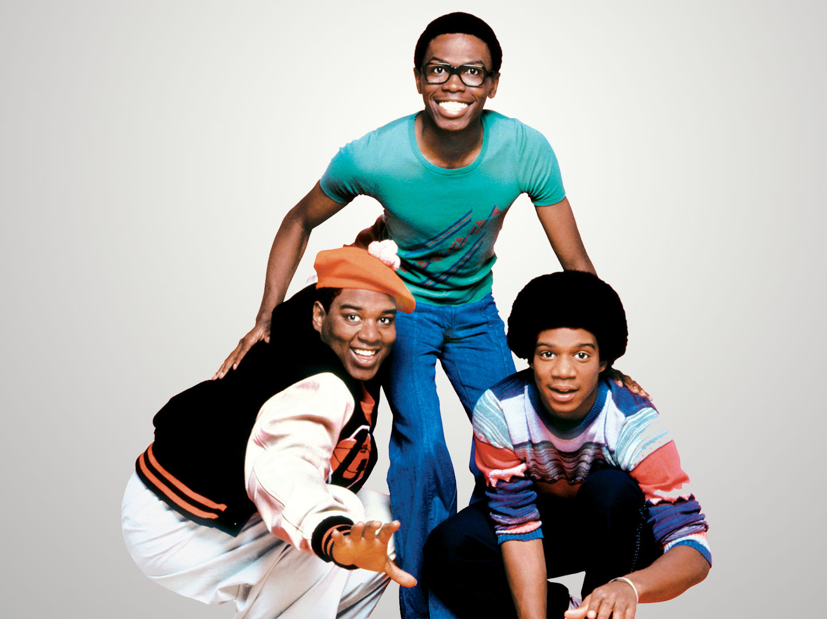
Watt’s Happening!!
Alexis Fisher
Adam Vail
Ben Bramble
Nick Burek

Slide 2
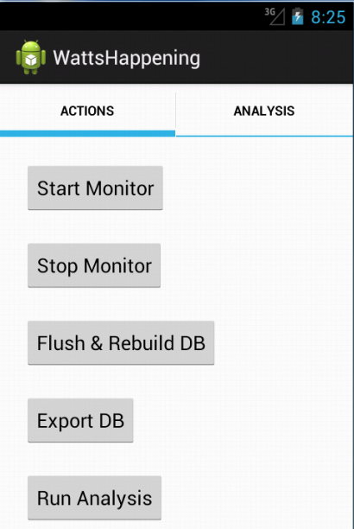
Overview
Motivation
Logging
Analyzing
Recommending
Future Work
Questions

Slide 3
Logging
-Structure of Code
-Android uses SQLITE
-How to access tables
-How often logging (alarm ensures constant logging every x minutes)
-Example tables (What data and how to get it)

Slide 4

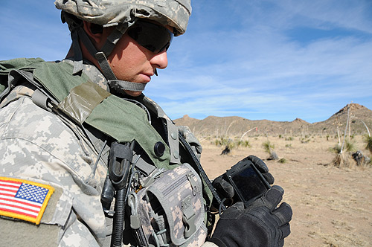
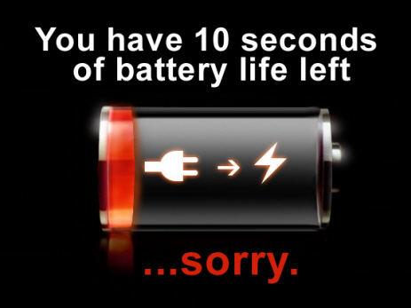
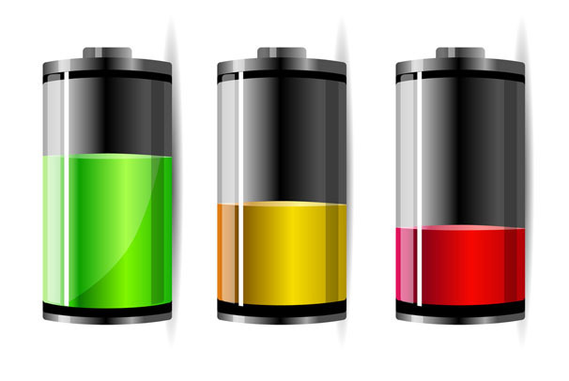
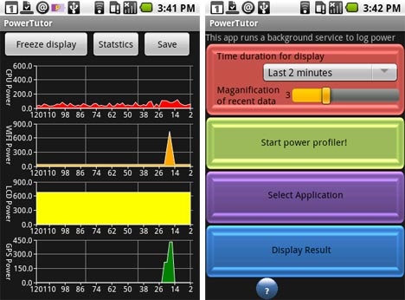

Motivation
Notes:
Mobile devices, including smart phones and tablets, are nearly ubiquitous, and function as an integral part of modern life.
These devices are capable of performing an ever-increasing array of tasks.
Unfortunately, short battery life severely limits the full potential of mobile devices.
As battery technology lags behind increasing demands, devices need to intelligently use power resources.
Unfortunately, many application developers do not take into account these power limitations, or even realize the power draws of their applications on disparate devices.
A user may experience erratic power surges based on different applications and might not know if his or her device will last until the next opportunity to recharge.
While power analyzing applications exist, many are intended to aid application developers rather than end users
Of the power saving applications available for users, some complain of the applications being too intrusive.
These applications disable important features of the phone without user knowledge and make practical usage of the device very difficult.
Compounding this problem, common users remain blissfully unaware of their power use until their phone reaches a minimum battery threshold.
This need for an application to inform the user of high usage applications is what motivated the work behind \emph{Watt's Happening}.

Slide 5
Logging Decisions
Pull vs continuously monitoring
Alarm system
Time between pulls
Passive pull (GPS, bluetooth)
Short running apps (see paper)

Slide 6
Code Structure
Start Monitor
Monitor Service
Hardware Status Logger
Battery Status Logger
Network Status Logger
Application Logger
Wifi Manager
Location Manager
Power Manager
Battery Manager
Connectivity Manager
Activity Manager
CPU Ticks
Voltage
Temp
State
GPS State
Screen State
Running App Info
Network Traffic
Level
Scale
Availability

Slide 7
ID | Timeslice_ID | Voltage | Temp | Percentage
1 | 1 | 4144.0 | 220.0 | 0.9
2 | 2 | 4131.0 | 220.0 | 0.9
Battery Table
ID | Timeslice_ID | Name | Enabled | Status
1101 | 276 | Bluetooth | 0 | , Scanmode: None
1102 | 276 | WIFI | 0 | Disabled
Hardware Table
ID | Timeslice_ID | Name | State | Connection
3320 | 277 | Ethernet | IDLE | IsAvailable: 1 IsConnected: 0
3321 | 277 | Mobile_supl | IDLE | IsAvailable: 1 IsConnected: 0
Network
Table
ID | Timeslice_ID | Name | App_ID | CPU | RX_Bytes | TX_Bytes
13053 | 277 | Maps | 10008 | 481.0 | 4933.0 | 2120.0
13054 | 277 | Contacts | 10005 | 310.0 | 0.0 | 0.0
App Table
ID | App_UID | Hist_CPU | Hist_Net | Hist_HW | #_of_Updates
210 | 10207 | 0.0 | 0.0 | 0.0 | 120
211 | 10221 | 0.0 | 19908.0 | 0.0 | 98
Aggregate
App Table

Slide 8
We have to estimate time remaining before bat dies b/c goal
2 issues: over and under est
Overestimation: too much time
Under est: dies sooner
Short term = (only % point granularity) why 5 minutes (only logging every 5 minutes, don’t want
to go shorter, haven’t tried longer) Long time = miss too many apps, shorter = not yield
significantly more information
Long term = minimal usage or idle
We make this calc by looking at bat level over time
Naïve way: look at change over time (graphs with slopes) leads to over estimation
We must look at most recent usage: currently using it = good chance you will continue to use
Assumption short term will continue
If we have data in short term window, use solely as basis in prediction for a conservative estimate
ELSE, no short term data so we fall back on long term (past usage = future usage)

Slide 9
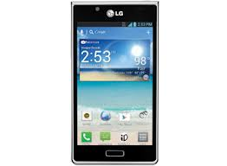



Analyzing Application Usage
How do we know which applications are more intensive?
Rank based on hardware usage
CPU usage
Network traffic usage

Slide 10
Our Metrics
CPU Usage
CPU ticks used by application
CPU ticks used in total
Gives the % of CPU used by the application over that time
Track that average over long periodsc
Network Usage
Number of RX and TX bytes
Which network is currently active
Gives the data transfer rates over time
Possible to correlate this with which network is active

Slide 11
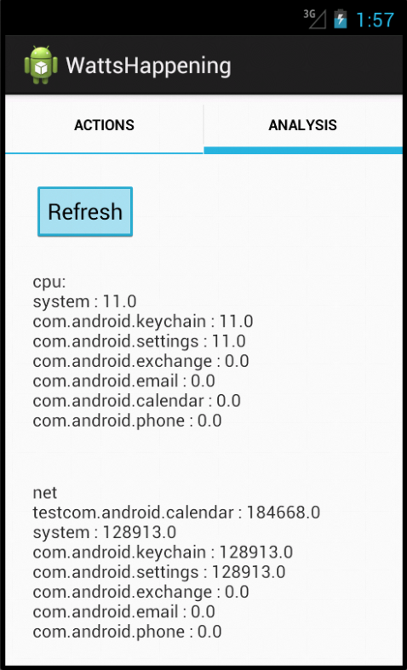
Showing High Usage
Applications
Rank by CPU usage
Rank by Network
Usage

Slide 12
Possible Application
Power Model of Hardware
Could give us battery usage of an application
Determine a user’s historic usage model to recommend hardware settings
Recommend which applications to kill to make it to a certain time without your battery dying

Slide 13
Questions?

