Slide 1
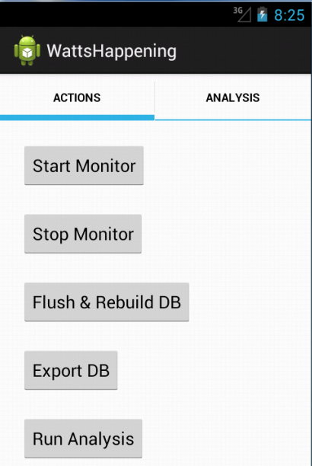
Watt’s Happening:
A Battery Monitoring Application
Created By:
Alexis Fisher
Adam Vail
Nick Burek
Ben Bramble

Slide 2
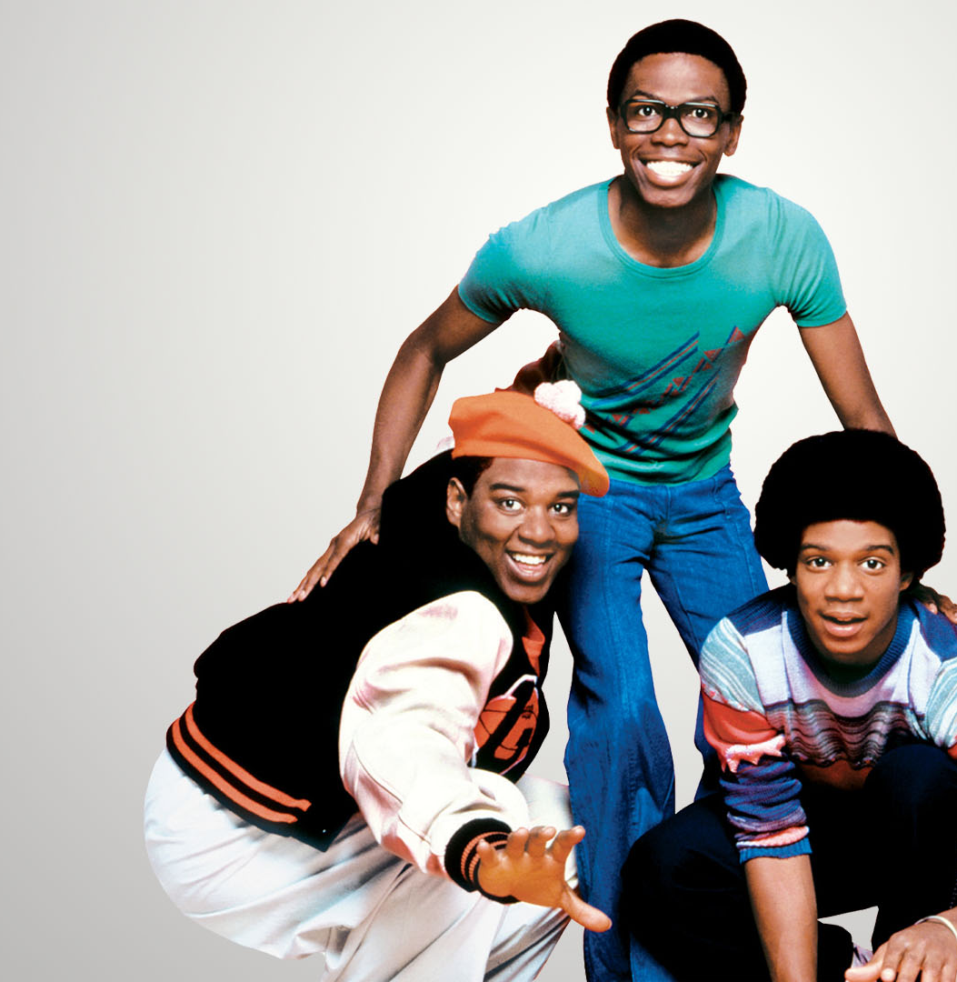
Overview
Motivation
Logging
Analyzing
Recommending
Future Work
Questions

Slide 3

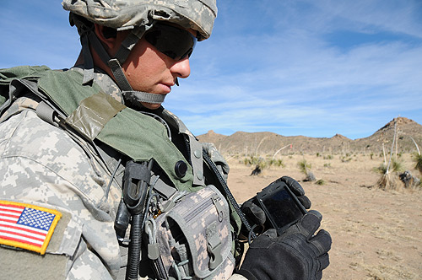
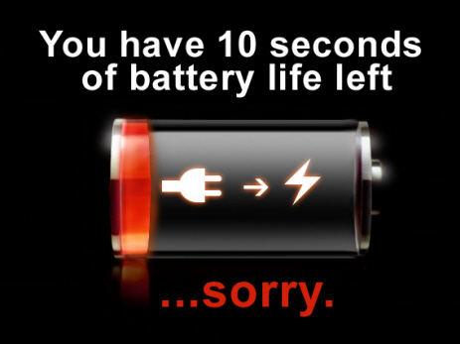
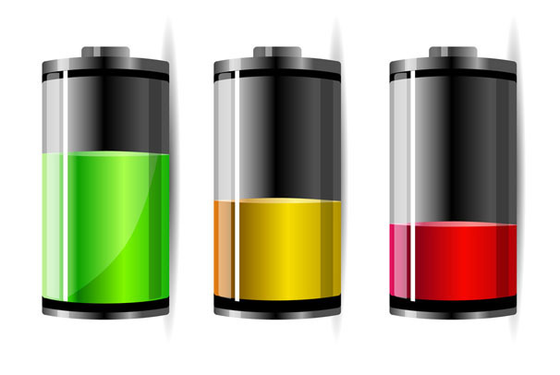
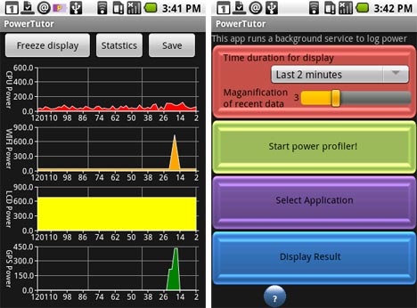

Motivation
Notes:
Mobile devices including smart phones and tablets are becoming an increasing presence in the lives of many people.
These devices are capable of performing a myriad of tasks ranging from business, to entertainment, to navigation
Unfortuntely, technology and size requirements are lagging behind these demaands
The result is that users are blissfully unaware of the time that they can continue to use their phone and make it through the day to their next recharging opportunity
Several applications (Power Tutor) exist that allow programmers to analyze their applications to conserve device resources. However, as most of the grad students in this room can verify, programmers are often greedy or lazy in their resource consumption
There are also some user level power sources (), but typically they turn on/off resources without user involvement. Watt’s Happening seeks to collect user usage information, analyze overzealous applications, and predict the remaining battery life for the user

Slide 4
Logging Decisions
Poll vs. Continuously Monitoring
Passive Pull (GPS, Bluetooth)
Alarm System
Time Between Pulls
Short running Applications
Notes:
When possible we pull information such as passive listening in GPS or waking up to poll information such as getallnetworkinfo()
Since we want to stay as a background service to conserve power, we set an ongoing alarm that wakes up every so many minutes to pull information from the Android OS.
We set five minutes as the time to set the alarm and log data for two main reasons. Battery life & data base size
Battery Life: More often you wake up the system and poll information, the more CPU time our program is taking up which is anti-productive
Data base size: Log too often and the data base table grows out of control
Problem: Some applications are shorter running that 5 minutes which mean they have the potential to fall outside of our polling times. We assume that applications like that will happen multiple times which increase our ability to catch them. In addition, their CPU and battery poll are accumulated over the long term.

Slide 5
Code Structure
Start Monitor
Monitor Service
Hardware Status Logger
Battery Status Logger
Network Status Logger
Application Logger
Wifi Manager
Location Manager
Power Manager
Battery Manager
Connectivity Manager
Activity Manager
CPU Ticks
Voltage
Temp
State
GPS State
Screen State
Running App Info
Network Traffic
Availability
Level
Scale
Notes:
We start the monitor on Watt’s Happening with a button. This activates the monitor service which on android runs in the background to allow the user to run other applications concurrently.
The service sets the aforementioned alarms which pulls primarily from these four areas: Hardware, Battery Status, Network, and Application
Each logger typically has a manager which is maintained by the OS. For the most part, all we have to do is poll the manager for information such as network connectivity, running application, hardware state and the like

Slide 6
Example Tables
ID | Timeslice_ID | Voltage | Temp | Percentage
1 | 1 | 4144.0 | 220.0 | 0.9
2 | 2 | 4131.0 | 220.0 | 0.9
Battery Table
ID | Timeslice_ID | Name | Enabled | Status
1101 | 276 | Bluetooth | 0 | , Scanmode: None
1102 | 276 | WIFI | 0 | Disabled
Hardware Table
ID | Timeslice_ID | Name | State | Connection
3320 | 277 | Ethernet | IDLE | IsAvailable: 1 IsConnected: 0
3321 | 277 | Mobile_supl | IDLE | IsAvailable: 1 IsConnected: 0
Network
Table
ID | Timeslice_ID | Name | App_ID | CPU | RX_Bytes | TX_Bytes
13053 | 277 | Maps | 10008 | 481.0 | 4933.0 | 2120.0
13054 | 277 | Contacts | 10005 | 310.0 | 0.0 | 0.0
App Table
ID | App_UID | Hist_CPU | Hist_Net | Hist_HW | #_of_Updates
210 | 10207 | 0.0 | 0.0 | 0.0 | 120
211 | 10221 | 0.0 | 19908.0 | 0.0 | 98
Aggregate
App Table
Notes:
Here is a short example of our five tables with the information that they retain. Of note is the timeslice ID which simplifies a timestamp to a specific window which makes it easier to determine which programs were occurring at the same time because. The last table collects combined data over the duration of the running period which will be used for the analyzer.

Slide 7
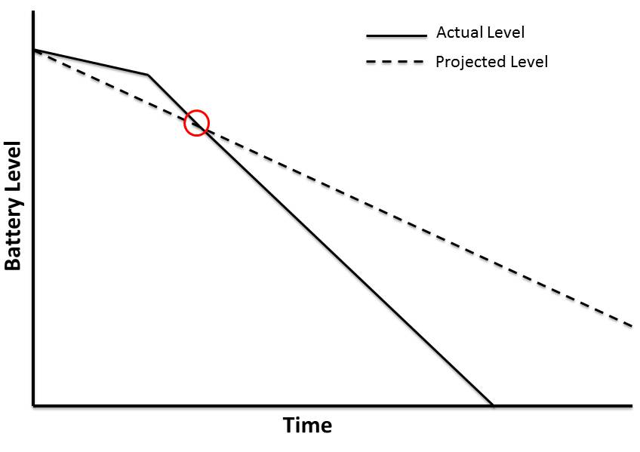
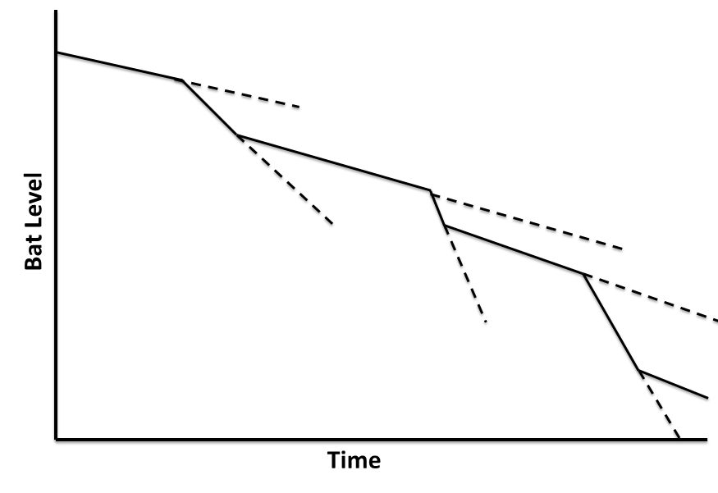
Estimated Time Remaining
Goal: Estimate the amount of time remaining before the battery dies.
Problem: overestimation and underestimation
Overestimation: Estimating that the time remaining is longer than the actual remaining battery life.
Underestimation: Estimating that the time remaining is less than the actual remaining battery life.
Which outcome is more desirable?
Estimation Calculation

Slide 8
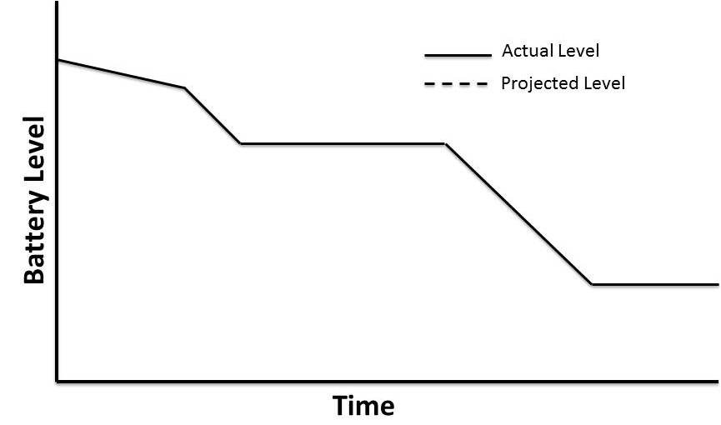
Long Term: Use when there is no short term data
Short Term:
Why would there be no short term data?

Slide 10
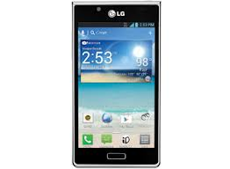



Analyzing Application Usage
How do we know which applications are more intensive?
Rank based on hardware usage
CPU usage
Network traffic usage

Slide 11
Our Metrics
CPU Usage
CPU ticks used by application
CPU ticks used in total
Gives the % of CPU used by the application over that time
Track that average over long periodsc
Network Usage
Number of RX and TX bytes
Which network is currently active
Gives the data transfer rates over time
Possible to correlate this with which network is active

Slide 12
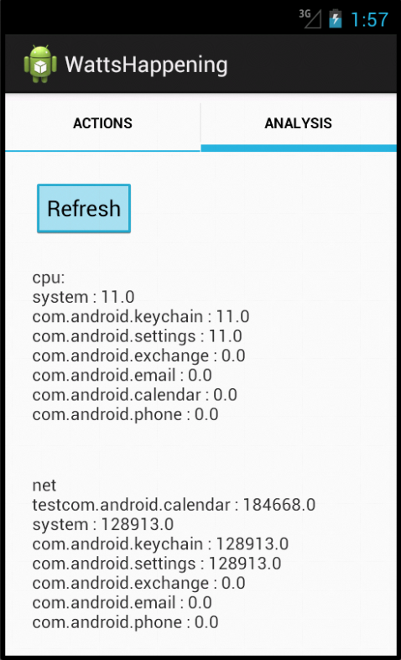
Showing High Usage Applications
Rank by CPU usage
Rank by Network
Usage

Slide 13
Possible Application
Power Model of Hardware
Could give us battery usage of an application
Determine a user’s historic usage model to recommend hardware settings
Recommend which applications to kill to make it to a certain time without your battery dying

Slide 14
Questions?

