Slide 1
The Importance of the Normality Assumption in Large Public Health Data Sets
Thomas Lumley, Paula Diehr, Scott Emerson, and Lu Chen
Presented by: Alexis J. Carr
Department of Biostatistics, University of Washington, Box 357232, Seattle, Washington 98195; e-mail: tlumley@u.washington.edu
Notes:
Intro yourself:
• Good afternoon. As some of you know, I’m Alexis Carr and I’m a masters student here in the College of Medicine.
• I’m here today to present Thomas Lumley's 2002 review "The Importance of the Normality Assumption in Large Public Health Data Sets"

Slide 2
Introduction
Definitions and Theoretical Issues
Simulations
Alternatives to Least-Squares Approaches
Reasons for Choosing an Estimator or Test
Summary and Conclusions
Notes:
To get us started I have an outline.
° First I'll go over the introduction of the problem that this review is trying to address, namely how we can use some of the tests we learned about in this class on heavily skewed data.
° Next, I'll briefly define the t-test and the linear regression methods that are the main focus of this paper, and briefly describe the hole that the authors are trying to close with this review.
° I'll then go into the simulations that the authors of this paper carried out to demonstrate said hole.
° And lastly I'll briefly go over the alternative methods to both ordinary linear regression and the t-test, before talking about reasons to choose an estimator or test.

Slide 3
Introduction
The normality of population data is NOT necessary for the validity of the t-test and least squares regression
This may be in mind from early stats classes
“Normal in normal out” thinking
Seeing normal distribution makes it easy to choose test
BUT, in large data sets typical in public health research, most statistical methods rely on the Central Limit Theorem, NOT the normality assumption
average of a large number of independent random variables is approximately normally distributed around the true population mean.
Notes:
° One thing that a lot of don't appreciate is that The normality of population data is NOT necessary for the validity of the t-test and least squares regression
° We need to get rid of this thinking, because these tests can be very useful for data with non-normal distribution.
°

Slide 4
Goals
Re-emphasize that t-test and linear regression validity in sufficiently large samples depend only on assumptions about the variance.
Discuss some alternatives to the t-test and least squares regression
Present criteria for deciding which summary measure to estimate and what statistical technique to use.

Slide 5
Definitions and Theoretical Issues
The t-test
Linear Regression

Slide 6




A “Tail” of Two t-tests
Two different versions of the two-sample t-test:
two groups have the same variance
the other does not assume this
Notes:
° Two different versions of the two-sample t-test:
° two groups have the same variance
° two groups with differing variances
° For the one that doesn’t assume same variance:
Central Limit Theorem shows this is normally distributed with unit variance when the sample size is large,
no matter what distribution Y has.
Thus, this version of the t-test will always be appropriate for large enough samples.
° The one with same variance: more general version, but useful in illustrating the problem of heteroscedasticity.
° heteroscedasticity: the circumstance in which the variability of a variable is unequal across the range of values of a second variable that predicts it.
° Let’s suppose: n1 is much larger than n2.
° the denominator of the t-statistic in Equation 1 can be seen to be primarily a function of s_2^2, while the denominator of the t-statistic in Equation 2 is primarily a function of s_1^2
° If the variances in the two groups are different, this can result in the two t-statistics having different denominators.
° This can cause problems later on down the line with the different equations being off from each other by a factor of two or more and
° result in the possibility of Equation 2 being “normally distributed,” as is guaranteed by the CLT, but not having a variance = 1.
° Since we can always use Equation 1 for large data, this isn’t as much of a problem as it can be with linear regression.

Slide 7


Linear Regression
We’ve all probably seen this in Excel if not in a statistics class.
Assume Y in normally distributed conditional on X
Differences in the variance of Y for different values of X (heteroscedasticity) result in:
coefficient estimates, β , that still have a normal distribution
possibly incorrect variance estimates

Slide 8
Simulations
Theirs and mine.
Notes:
The simulations in much of the statistical literature we reviewed refer to sample sizes far smaller than those commonly encountered in public health research. In an effort to fill part of this gap, this section describes some simulations that we performed with larger samples.

Slide 9
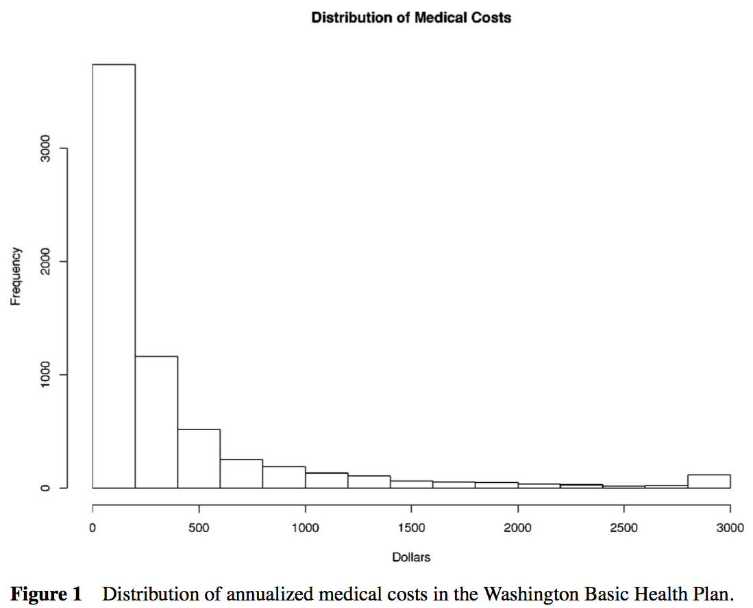
Notes:
We used data from the evaluation of Washington State’s Basic Health Plan, which provided subsidized health insurance for low- income residents, starting in 1989 (10, 19). The 6918 subjects
standardized skewness is 8.8, and standardized kurtosis is 131.

Slide 10
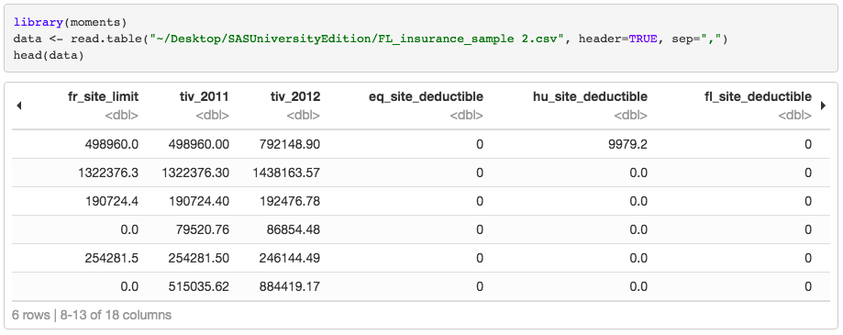

Slide 11
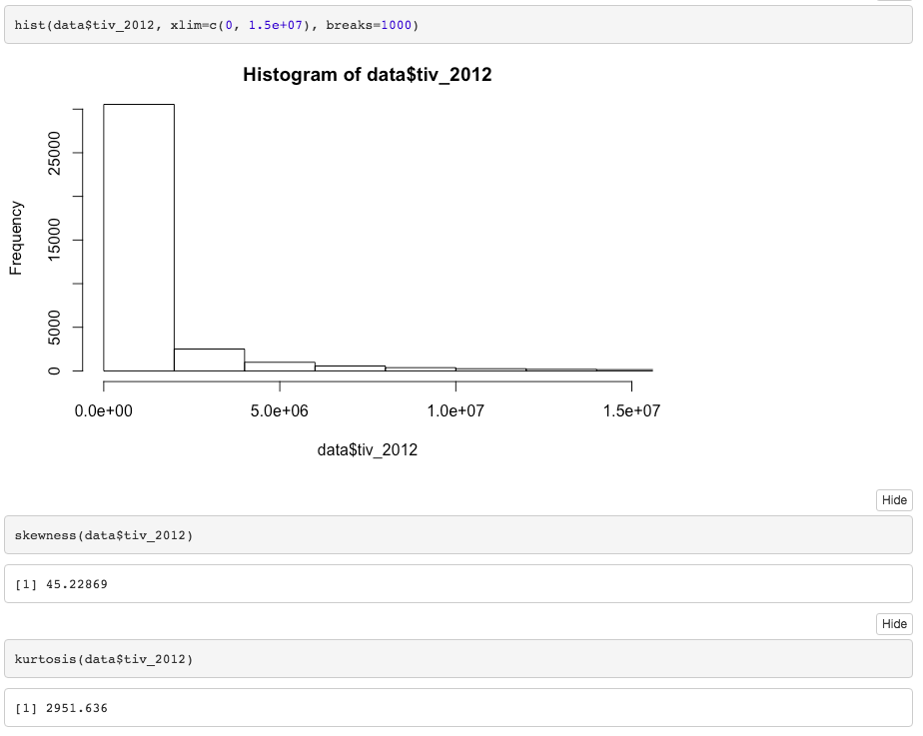

Slide 12
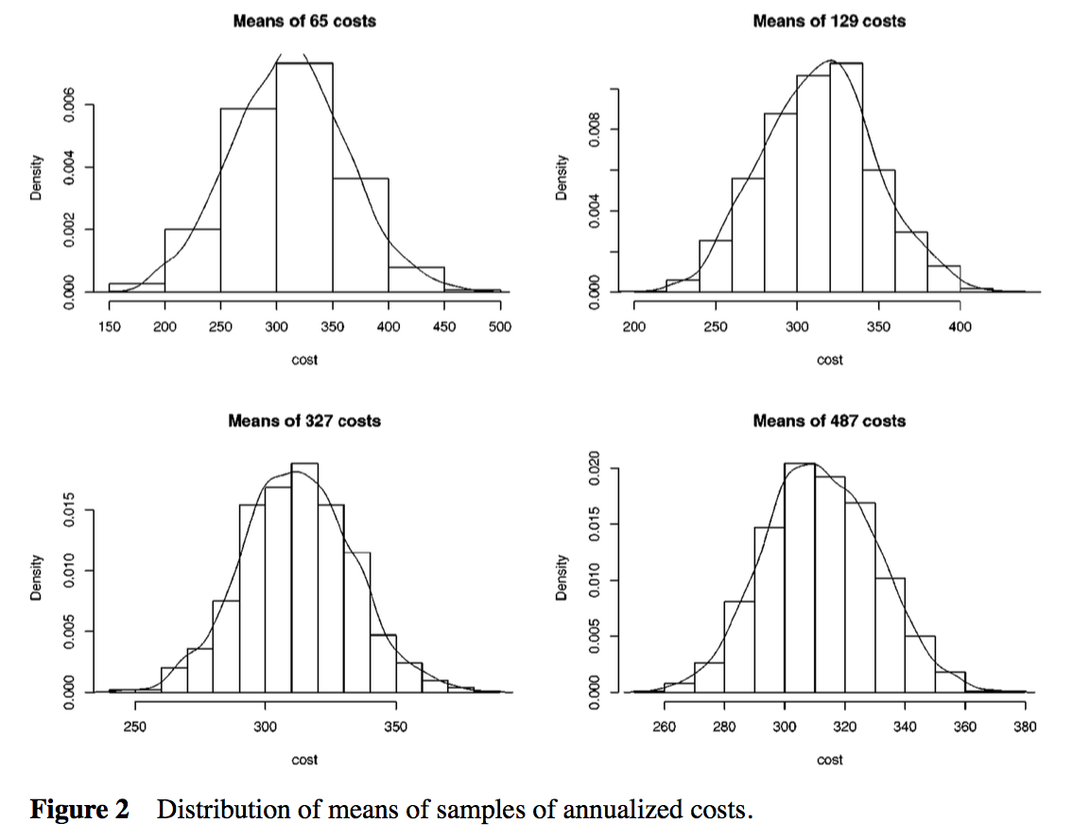
Notes:
° They drew 1000 n% samples from the population (with n being approximately 1%, 2%, 5%, and 7.5% of the population) and plotted a histogram of the means.
° The graph shows a histogram and a smooth estimate of the distribution for each sample size. It is clear that the means are close to Normally distributed even with these very extreme data and with sample sizes as low as 65.

Slide 13
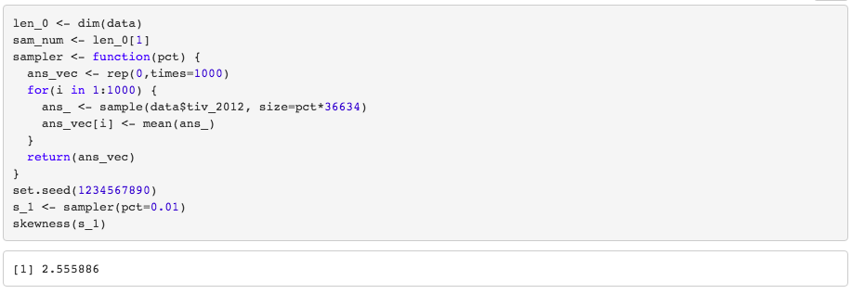

Slide 14
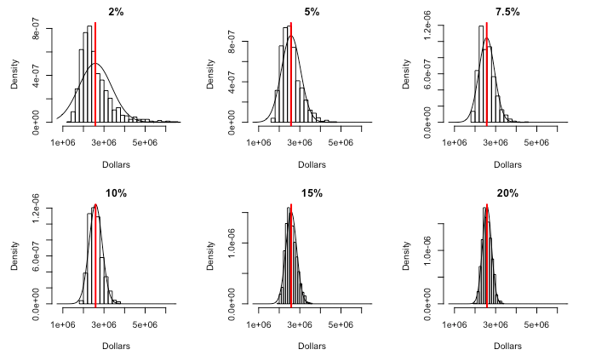
Notes:
Instead of coding a smooth estimate of the distribution for each sample size, I plotted the normal distribution for that mean and sd over the histogram and eyeballed it.

Slide 15
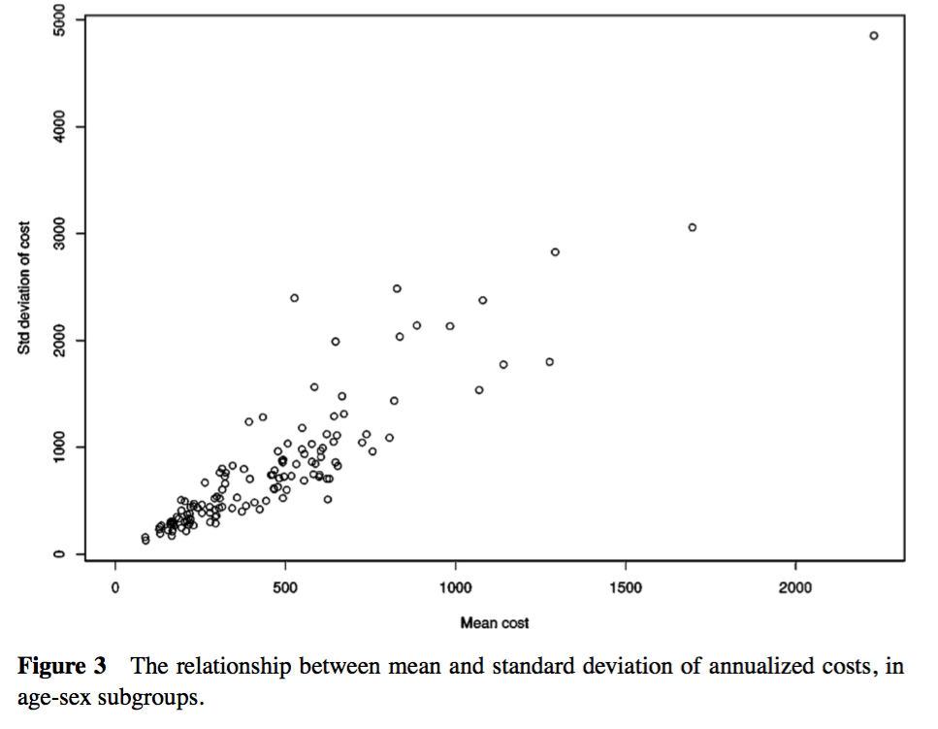
Notes:
See std dev has positive relationship with mean, shows heteroscedacity
In addition, there is substantial heteroscedasticity and a somewhat linear relation between the mean and variance. In Figure 3 we divided subjects into groups by age and sex and calculated the mean and standard deviation of cost for each group. It is clear that the standard deviation increases strongly as the mean increases. The data are as far from being Normal and homoscedastic as can be found in any real examples.

Slide 16
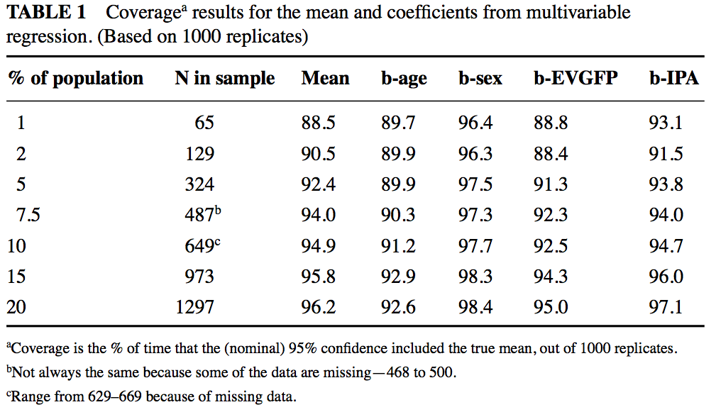
Notes:
We used these data to determine how large a sample would be needed for the Central Limit Theorem to provide reliable results.
° They drew 1000 n% samples from the population.
° For each sample they calculated the regression of cost on age, sex, self-rated health, and HMO (IPA = 0) versus Fee for Service (IPA = 1).
° For each parameter in the regression model they calculated a 95% confidence interval and
° checked to see whether the confidence interval contained the true value.
°With The percent of times that the confidence interval included the value computed from the entire population being an estimate of the true amount of confidence (coverage)
° would be 95% if the data had been Normal to start with.
° For samples of size 65 and 129, some of the confidence interval coverages are below 90%. That means that the true alpha level would be 10% or more, when the investigator believed it to be 5%, yielding too many significant regression coefficients.
° Note that for sample sizes of about 500 or more, the coverage for all regression coefficients is quite close to 95%. Thus, even with these very extreme data, least-squares regression performed well with 500 or more observations.

Slide 17
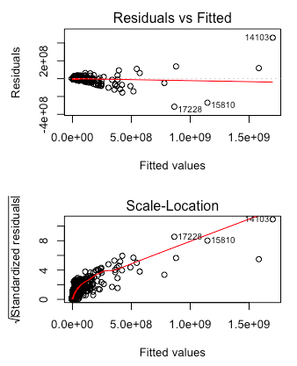
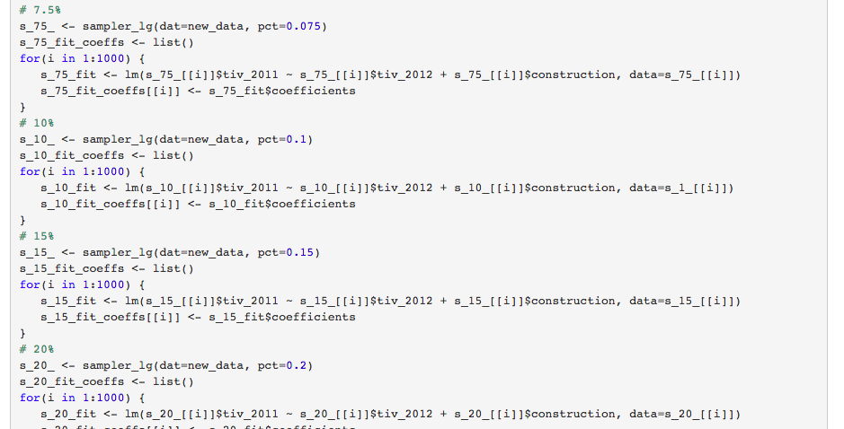
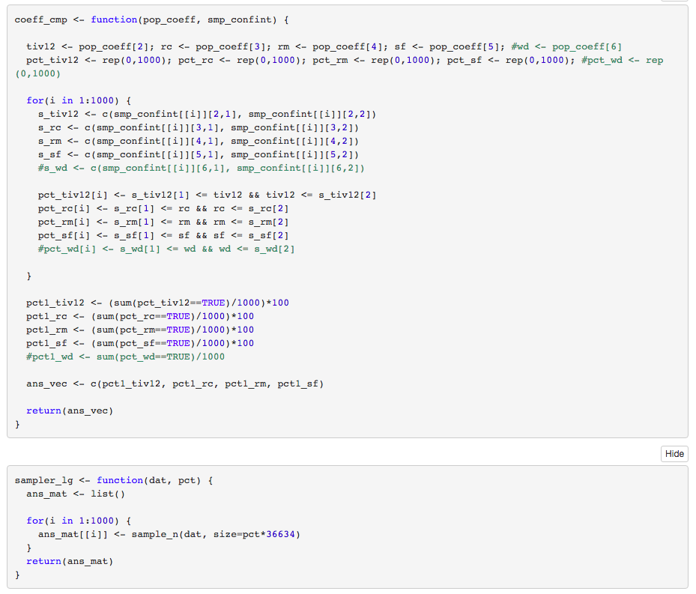
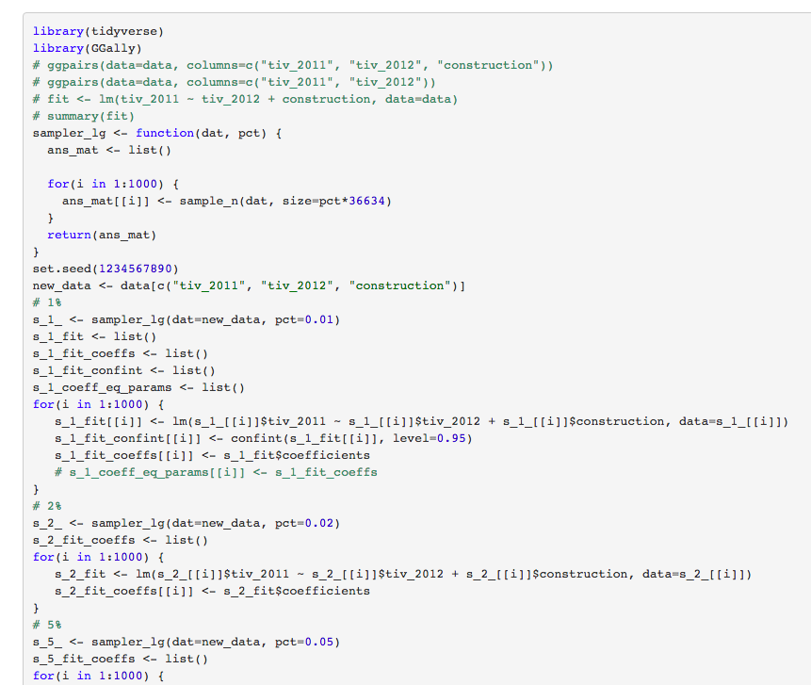
Notes:
[1] 2.6 5.8 14.7 3.3
[1] 2.3 6.1 17.1 4.0
[1] 1.6 9.2 24.5 4.5
[1] 2.0 9.9 28.6 4.4
[1] 2.6 5.8 14.7 3.3
[1] 1.7 10.3 29.2 5.3
[1] 1.8 11.3 34.3 5.1

Slide 18
Alternatives to Least-Squares Approaches

Slide 19
Wilcoxon Rank Sum Test vs. t-test
Wilcoxon Test
t-test
No assumed distribution
Ranks data and calculates sum of ranks for one of the groups
Tests how likely that sum would be under the null hypothesis that the two distributions were identical
More powerful than t-test when
distribution in the two groups has long tails
each group same shape, but shifted in location
Can assumed normal distribution, but not necessary
Can provide useful descriptive statistics.
Less powerful than t-test when
groups differ in number and magnitude of extreme outlying distributions
Notes:
the t-test and linear regression are valid only for Normally distributed outcomes. This belief leads to the use of rank tests for which confidence intervals are very hard to obtain and interpret and to cumbersome data-dependent procedures where different transformations are examined until a distributional test fails to reject Normality.
*** A lot of the alternative tests were nonparametric tests and didn’t yield as much as the t or ols tests, so they were there to just bolster their point that these tests can be very powerful with this type of data.

Slide 20
Logistic Regression vs. Linear Regression
Logistic Regression
Linear Regression

Slide 21
Reasons for Choosing an Estimator or Test
Notes:
In situations where estimation and comparison of means with the t-test and linear regression is difficult because of extreme data distributions, it is important to consider whether the mean is the primary target of estimation or whether some other summary measure would be just as appropriate.

Slide 22
Worry about heteroscedasticity in linear regression,
but their example shows a good linear regression with significant heteroscedasticity [?]
Know what measure you’re interested in (i.e. mean, median, percentage below a threshold)
clinical or scientific relevance of the summary measure
scientific plausibility that the groups would differ with respect to the summary measure
statistical precision with which the groups can be compared using the summary measure.

Slide 23

Summary and Conclusions
Introduction
Definitions and Theoretical Issues
Literature Review
Simulations
Alternatives to Least-Squares Approaches
Reasons for Choosing and Estimator or Test

Slide 24
Lumley, T., Diehr, P., Emerson, S., & Chen, L. (2002). The importance of the normality assumption in large public health data sets. Annual review of public health, 23(1), 151-169.
https://www.clipartmax.com/download/m2i8H7d3i8H7H7d3_tails-clip-art-sonic-adventure-2-official-soundtrack/

