Slide 1


Telecom Company
Bussiness Analysis
Friday, August 27th, 2:00pm

Slide 2

Introduction
This project was given to us by Ayiti Analytics as part of an intensive training in data analysis. In this context, we downloaded data on the Telcom on the website kaggle. This project was to help the marketing and customer team to find a solution to retain customers because this month the company has been experiencing an increasing rate of churn.

Slide 3

Problem
The leading telecom company of this region has discover that a important number of his customers are cancelling their subscriptions.
They hypothesize that this can be due to the fact that other telecom companies are stealing those clients.
They are trying to discover the main characteristics of those that are likely to cancel there subscriptions.

Slide 4

STAKEHOLDERS
The stakeholders involved in the problem:
The customers
The competitors
The partners, the shareholders
The employees
The main stakeholders are the shareholders who risk to lose their investment, the employees specifically the teams of customer and marketing.
After that, the problem affects the clients because they churn. Finally, it can affect all the employees because they risk losing their jobs if the telecom goes bankrupt.

Slide 5
Methodology
Firstly, we will collect data for the analysis. We will use the data related to the customers of the company.
Secondly, We will start by treating the data with python (pandas, numpy, scipy,...) and then we will look for the quantity of churn and the profile of the churn customers. We will evaluate losses with the total charge.
And then, we will use mathematics and statistics tools such as average, sum, to see the churn by category and gender based on the churn information.

Slide 6
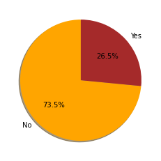
Results
There are more than 25% of customer who churn. It's huge! We are looking for more insight in the given database.
So we have about 27% of monthly churners. Let'see how much the revenues are affected.

Slide 7
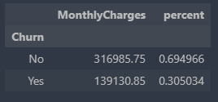
Results
So because of the Churn, the company has lost about 30.5% of the revenue it makes from monthly charges. It's more than 25% of the monthly salary.
The management team, especially the Marketing team and the customer service team want to know why and how they can improve the quality of services…

Slide 8
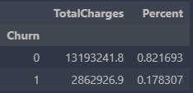
Result
The churn represents 17.8% of the total charges. A company cannot survive in this conditions. It's why we‘re looking for the relevant factors of the churn

Slide 9
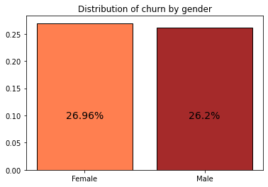
Results
Distribution of churn by gender
More than 25% of each gender have churned. The proportion of churned customer is statistically the same in both gender (p-value = 0.49 > 0.05)

Slide 10
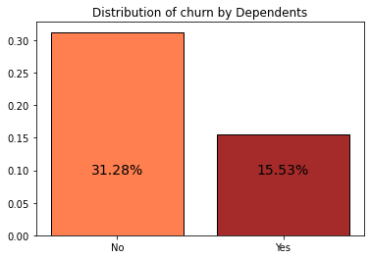
Results
Distribution of churn by dependents
The proportion of churned customer is statistically higher in the customers that are not dependent (31.28%) compare to those that are dependents(15.53%)
(p-value =2.01e-42 < 0.05)

Slide 11
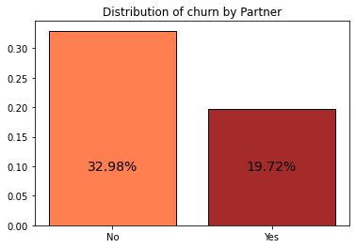
Results
Distribution of churn by partner
The proportion of churned customer is statistically higher in those that don’t have partner (32.98%) compare to those that have one(19.72%).(p-value=3.97e-36 < 0.05)

Slide 12
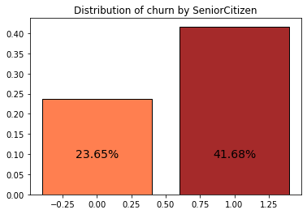
Results
Distribution of churn by Senior Citizen
The proportion of churned customer is statistically higher in those that are senior citizen (41.68%) compare to those that are not (23.65%).
(p-value =2.47e-36 < 0.05)

Slide 13
Results
Distribution of churn by Senior Citizen
The proportion of churned customer is statistically the same for those who have a phone service (25%) and those who don’t 26.75%) (p-value =0.35 >0.05)

Slide 14
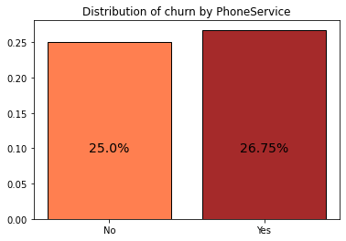
Result
Distribution of churn Phone Service
The percentage of churn for the customers who have phone service is 26.75%, and for the ones who don't have phone service 25%. It's not so relevant.

Slide 15
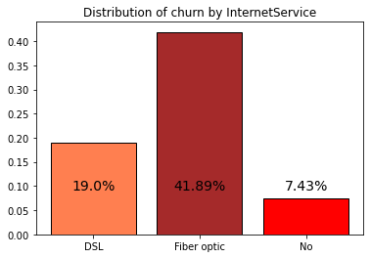
Result
Distribution of churn by Internet Service
We can see that more than 19% of the customers who have an internet service especially DSL service have churned and 41.89% of the ones who have Fiber optic have churned. On the other hand, only 7.43% of the one who don't have phone service churned. It's very relevant! Most of the people who have churned have an internet service.

Slide 16
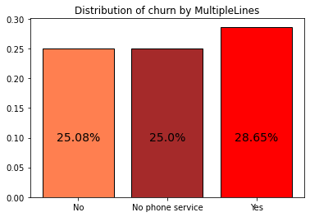
Result
Distribution of churn by multiples Lines
This graph shows the percentage of churn for each groups. It's not so pertinent! We can see in the category of customers who uses multiples lines services there are more than 20% who churned. The percent of customers who did not churn is almost the same as the customers who have no phone service.

Slide 17
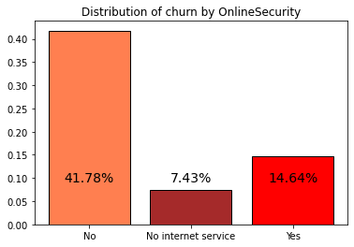
Result
Distribution of churn by Online Security
Among this category, we have 41.77% of customer who don't use an online security are churn customers and 14.64% are not.

Slide 18
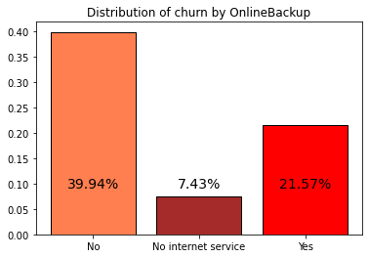
Result
Distribution of churn by Online Backup
We can see that 39.94% is the percentage of customer churn who don't use an online backup. 7.43% of the total customer in the online backup service don’t have internet and 21.57% of this category did not churn.

Slide 19
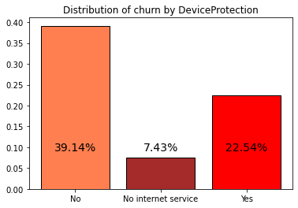
Result
Distribution of churn by Device Protection
The customer who do not use the device protection service are more to churn (39.14%), but if we look at the customer who churn and take this service, we can say that the percent is important like 22.54%.

Slide 20

Result
Distribution of churn by Tech Support
Customer who don't have the service of tech Support are more to churn, 41.65% of customer who don't have a tech support are churn customer.

Slide 21
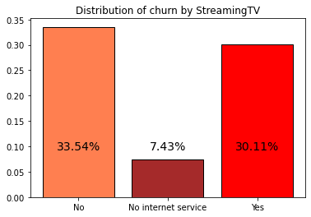
Result
Distribution of churn by streaming TV
Customers who don't use streaming TV are more to churn than customers who use it, though the difference is not really great, 33.54% and 30.11% respectively

Slide 22
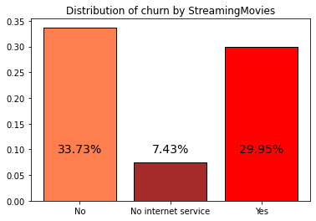
Result
This graph shows that 33.73% of customer who churn among the 50.19% don’t use streaming movies service and 29.95% use the streaming movie service. The difference between the two groups is not very big so this information is important for the category of streaming service customers who have churn

Slide 23
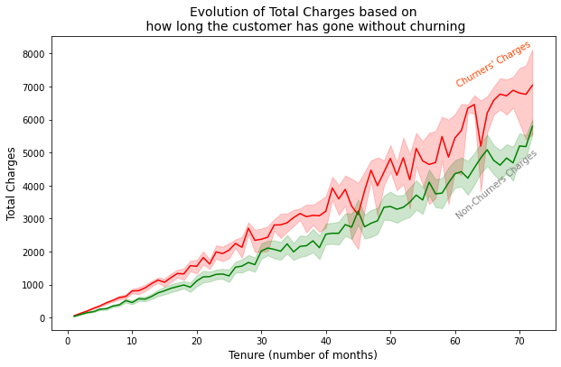
Result
This graph shows the trend of total charged based on the tenure of the customer. The more a customer last longer, the more the total of churner's charges tends to increase. It is the same trend for the total non churner's charges.

Slide 24
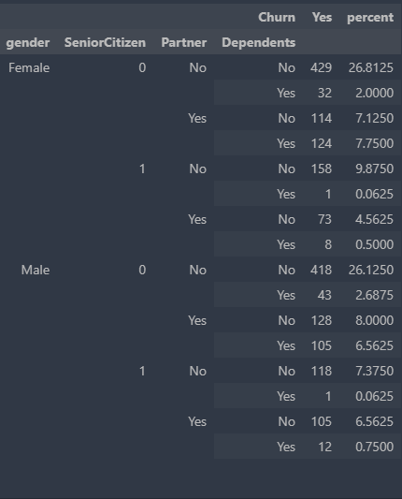
Table
To find the percentage of churn based on the demographics data

Slide 25

Results
The results for the marketing team
The churning is not related to gender
Those who churn are usually not dependent
Those who churn usually don’t have partners
Those who churn usually are senior citizen
The results for the customer service team
They usually have internet service and mostly use optic fiber
Those who churn usually have paperless billing and their contract are month to month

Slide 26
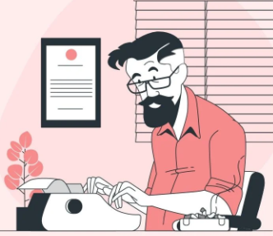
SWOT
Strengths
Massive market share
Record of each customer
Multiple services
Weaknesses
No significant opportunities to grow with new customers
The services don’t really affect the customers
Lack of information on the market
Opportunity
Organize a market research based on a survey to segment the market
They can use the result of the business analysis to improve their services and create new services
Adjust their business to the market trends
Threats
Negative impact of the new services
A considerable loss
Lack in the business analysis
Bankruptcy

Slide 27

Discussion & Proposed Solution
MAIN SOLUTION
By analyzing the data to propose a solution, we can conclude that the Telecom has a churn problem. There are some marketing and customer service problems. The churn percentage is 25.6%. It is very difficult for an organization to survive without management in general. For this reason, we can believe that with great marketing and an amelioration of customer services or a drop of a certain services, the enterprise can survive much longer. In that case, there are our recommendations.

Slide 28
SWOT OF THE SOLUTION
The enterprise has to upgrade some important services. The churn and these services are dependent but we can’t stop them because they are useful:
1- They have to upgrade the phone service because more than 90% of the customer who were using this service have churned, even when the churn is independent of this service. But I think it generates the majority of the profit of the company.
Strength of this solution
The phone service, which is one of the most common and most used service will help them retain more customers. This will increase their revenue.
Weaknesses of the organization
Lack of information on the market
We can consider the lack of information on the market as a weakness. If they don’t do market research, they won’t have pertinent data.

Slide 29
Solution(2)
2-For the internet service, we can see that more than 41% of the customer who were using Fiber Optic have churned. For this service we recommend that they delete this service and to upgrade the DLS service.
Strength
It will increase their profit and they will manage better
Weaknesses
Clients who use fiber optic for internet service might get upset. Especially because DLS could be more inexpensive.

Slide 30
Solution(3)
3- People who are using multiple lines and fiber optic for their internet service tends to churn more than the others. They have to put in place some policies to retain the customers. Such as put in place politics to decrease the number of customer using both of the services
More than 45% of the customers who are using electronic check have churned. So I will recommend them to reduce the number of transactions.

Slide 31
References & Appendices
www.marketsandmarketsblog.com
What is Business Analysis? | Global Standard for Business Analysis Certification | IIBA®
Strength, Weakness, Opportunity, and Threat (SWOT) Analysis Definition (investopedia.com)
Python - Pearson's Chi-Square Test - GeeksforGeeks

Slide 32



Meet our team members
Raphael Boni ALEXANDRE
Gothie Ridgina PASTEUR
Linxsly ALEXIS
Jackyvens CAMILLE

