Slide 1


ALEXIS Linxsly
Project Submission
Due Friday, June 27th at 11:59pm

Slide 2

PLAN
Problem
Methodology
Results
Proposed solution
References and appendices
Team members

Slide 3


Problem
Ayiti Analytics, an organization which evolves in differents areas such as Education, Consulting and Research wants to expand its training centers throughout all the communes of the country.
Their objective or the work I was asked to do is to know which three communes of the country will be the most likely to expand its training centers. Knowing that each cohort must have 30 students.

Slide 4
Stakeholders
Ayiti Analytics
Ayiti Analytics, as an organization that evolves in different fields is the first one impacted by this problem. They want to educate people as describe in their objectives, and now they wants to expand the organization in different regions of the country. They don’t know which commune will be better in order to expand the organization in order to form more students and to make profits too.
The population aimed
If Ayiti Analytics chose to stay with only one cohort, many young who want to learn Data Science will find their chance to be accepted reduced. This decision will affect everyone who is eligible and who have the desire to learn data science.
The country will be affected too, because it’s the era of technology, data and if Ayiti Analytics helps us by giving us this formation so precious, it will be benefits for the country. Not only for the country in general, but also for the organizations which are in need of Data Scientists to solve some problems in their companies...

Slide 5


Methodology
Firstly, I’ve received the dataset of the current cohort for the analysis. We will use the data related to students, to the communes, their access to the internet, their access to internet at home, their gender, the number of applications, their quest id, and so one...

Slide 6

Methodology
Secondly, we will use python to manipulate the dataset. We will start by cleaning the dataset and then we will look for the columns that are the same in order to merge the dataset after dropping the unnecessaries columns . I will answer all the question that Ayiti Analytics asked me.

Slide 7


Methodology
And then, I will use mathematics and statistics tools such as probability, average, sum and so one to make calculations based on the informations on their dataset. I will calculate the probability for each questions and I will do a graph that shows some insights that will guide my propositions. To determine where will be more profitable for them so that they can implant 3 new training centers.

Slide 8
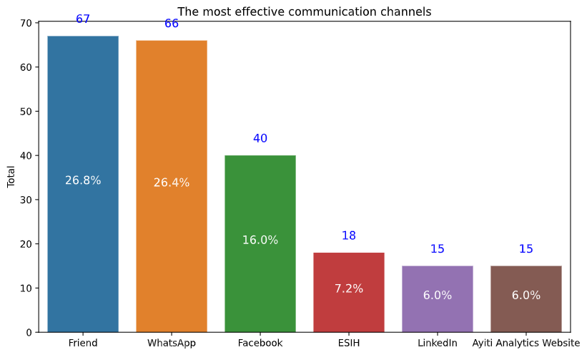

The most effective communication channels
The most effective communication channels that will allow a student to be susceptible to selection are Friend's channel with 26.8% and Whatsapp's channel with 26.4%. Below, we can see the top six most effective communication channels.

Slide 9
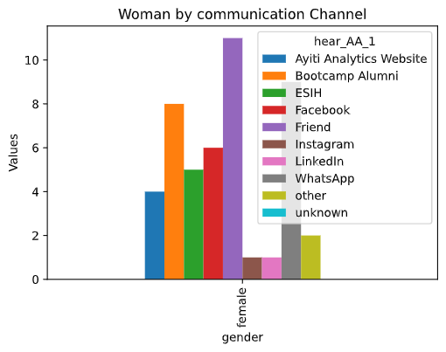

Most effective communication channel that can allow a woman to be selected
This graph distributes the number of participants by gender and the communication channel they were using before selection. As we can notice, for the female gender, the communication channel they had used the most is the Friend's channel because its level is higher than any other. We can conclude that a women have to use this communication channel if she wants to increase her chance to be admitted in the new cohort.

Slide 10
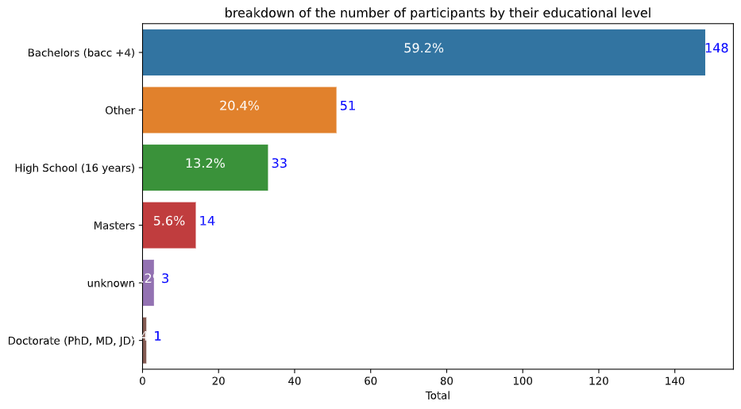
Average number of university students who should participate in this program
Our analysis is based on the fact that if someone isn't at an university he is not a student. We will count only those who have a university degree.
The average frequency of university students who should participate in this program is 65.2% (masters, bachelors and Doctorate (PhD, MD, JD))
But, the average number of university students who should participate in this program is 734 (masters, bachelors and Doctorate (PhD, MD, JD))

Slide 11
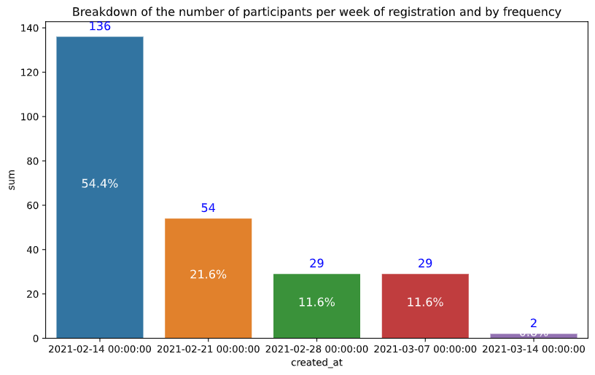
Average number of applications per week that we could have
This graph shows the frequency of application per week. As we can see, the first week there was an amount of applications 136 that represents 54.4% of the quantity of application's student. The average number of applications per week that we could have will be 50.

Slide 12

The extend delay to having 60 selected students per commune
If we want to have 60 selected students per commune , and if we have the same average application per week ,the new delay before closing the applications will be 45 weeks.

Slide 13
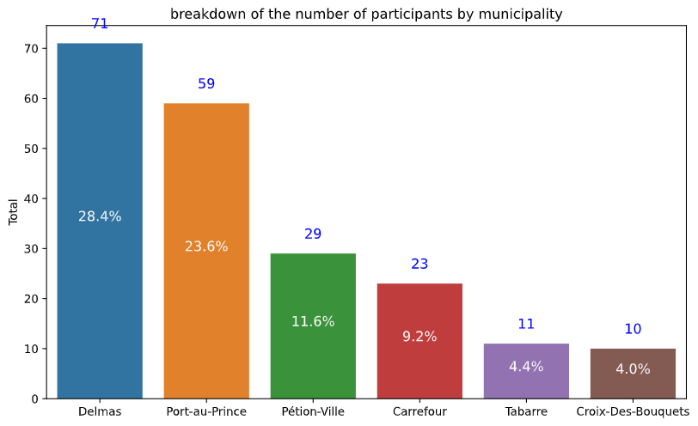
Breakdown of the applicants by commune
Based on this graph, after the univariate analysis, we can notice that Delmas is the municipality with the highest frequency is Delmas with 28.4%. That means 71 applicants were living at Delmas during the process.
The second one is Port-au-Prince with 23.6%. And the third one is Petion-Ville with 11.6% of the 250 applicants. We can already notice that these 3 communes are the best places to put 3 others if we don't take care of the others variable. After that we're going to do some multivariate analysis so that we will ensure that they respond to some pertinent criterias.

Slide 14
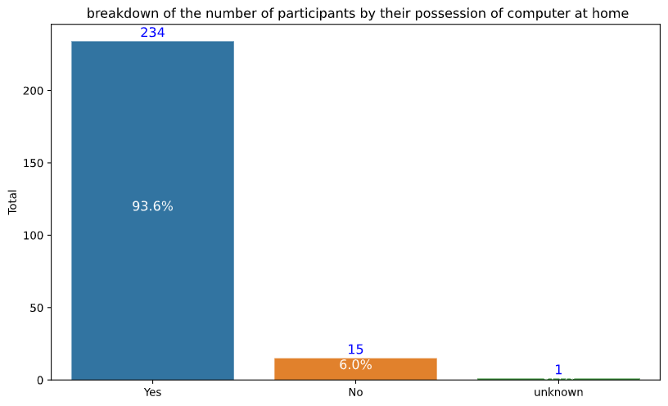
Breakdown of the participants by their possession of a computer at home
Based on this graph, we can notice that 93.6% of the applicants have a computer at home. That means if the education has to be done by distance they won’t have a laptop problem.

Slide 15
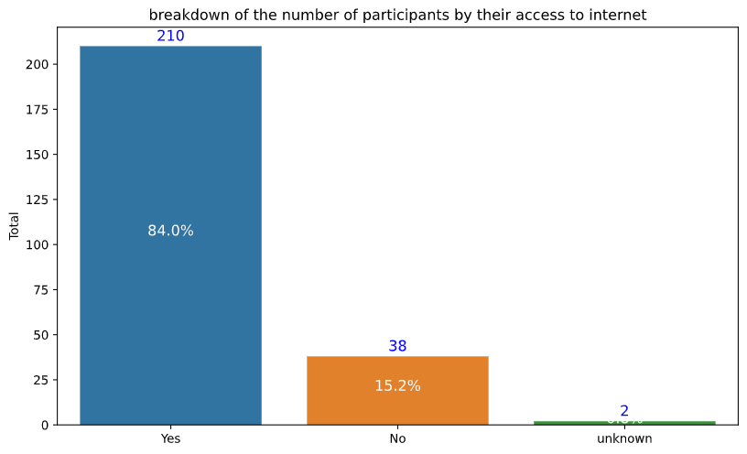
Breakdown of the applicants by their access to internet
Based on this graph, we can notice that 84% of the applicants have a computer at home. That means if the education has to be done by distance they won’t have a problem of internet.

Slide 16
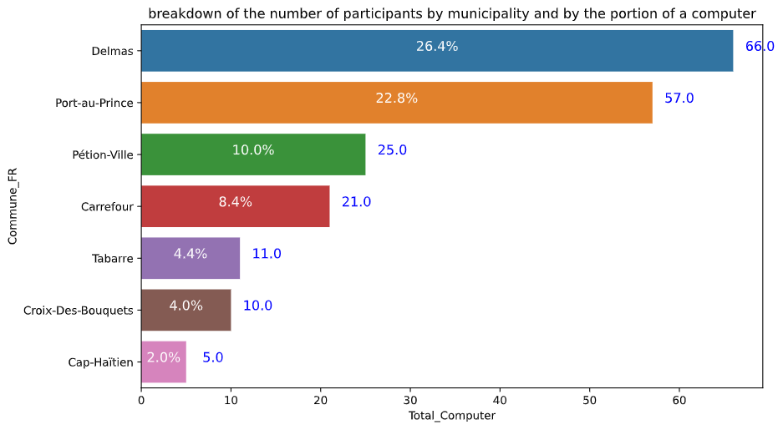
Breakdown of the applicants by their commune and their possession of a computer
In this graph we can notice that the three departments in which the number of applicants who have computer at home is higher are Delmas(26.4%) , Port-au-Prince(22.8%) and Pétion-Ville(10%).

Slide 17
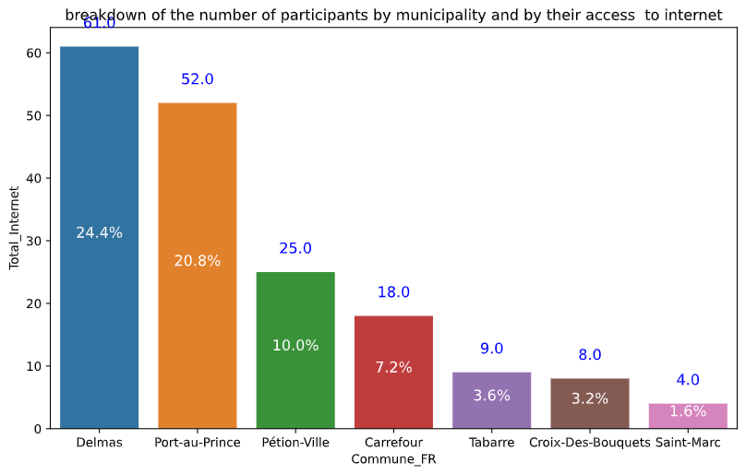
Breakdown of the applicants by their commune and their access to internet
In this graph we can notice that the three departments in which the number of applicants who have internet access is higher are Delmas(24.4%) , Port-au-Prince(20.8%) and Pétion-Ville(10%).

Slide 18
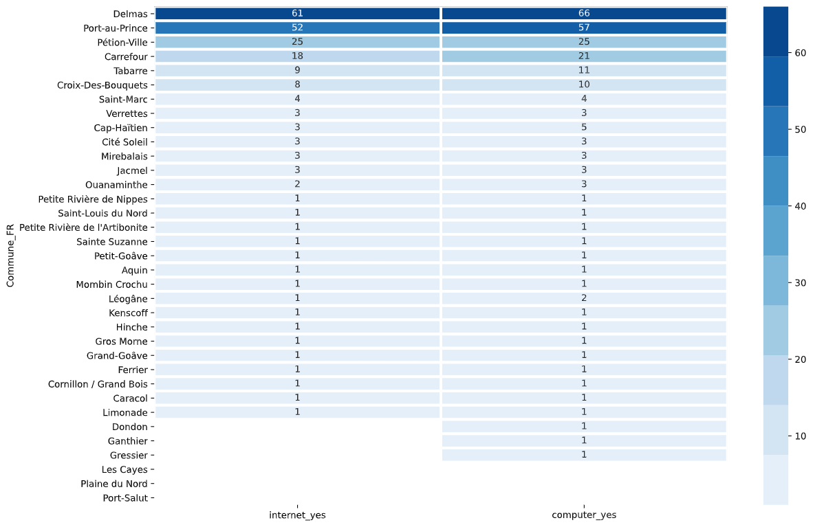
Breakdown of the applicants by commune and both at the same time, computer at home and their access to internet
In this heatmap we can notice that the three department in which the number of applicants who have both, internet at home and computer is higher are Delmas, Port-au-Prince and Pétion-Ville.

Slide 19
Number of future applications needed if we want to select 25% women for each cohorts on average , with 3 cohorts of 30 selected students
Total quantity of future applicants selected : 90
Total number of future women selected : 23
Actual selected women ratio : 20.0 %
Future women application number needed: 265
Number of future applications needed if we want to select 25% women for each cohorts on average , with 3 cohorts of 30 selected students : 1410

Slide 20
SWOT
Opportunities | Threats
Organize a market research based on a survey to diversify the formation( programmation bootcamp... ) They can use the result of the business analysis to implement the optimal solution | Insecurity Covid-19
Strengths | Weaknesses
Multiple fields They have ressources( HR, Money, Time...) They have an organized management team with multiple skills | 1. They have only bootcamp for data science 2. Lack of informations on the market 3. They don’t have an emplacement yet

Slide 21
Discussion
The different graphics above show the breakdown of the different data on the dataset of the current cohort of Ayiti Analytics. They want to expand their training centers throughout all the communes of the country. But they don't know where will be the best location. They also want to increase the number of selected students. And to finish they wants to increase the number of selected women.
To find the solution multiple variables were analyzed, such as the gender, the commune, the communication channels, the access to internet and so one for each applicant of the current cohort. All this, just to have good insight of the actual situation to find the optimal solution.

Slide 22
Proposed solution
Based on our analysis, we can conclude that the 3 best communes to place place other training centers are Delmas, Port-au-prince and Pétion-ville. For the applicants who are living in Petion-Ville we notice that they all have both, internet access and computer at home.
After that, if they want to select 25% women for each cohort, I suggest them to fix a quota. Or they can favorise the applicants who are women.
I also suggest them to do a market analysis, in order to know which formation the applicants really wants and how they can fix the organization to give them what they want.
Then, they can also reschedule the application, if after the market analysis they notice that many people are interested in learning what they are offering.

Slide 23
References & Appendices
www.marketsandmarketsblog.com
Strength, Weakness, Opportunity, and Threat (SWOT) Analysis Definition (investopedia.com)
Ayiti Analytics dataset of the current cohort

Slide 24

Prepared by
Linxsly ALEXIS

