Slide 1

Energy Conversion I
alexis.martin@ensea.fr
Desk D216

Slide 2
What to learn ?
Converters study
Example of converter
What to learn ?

Slide 3
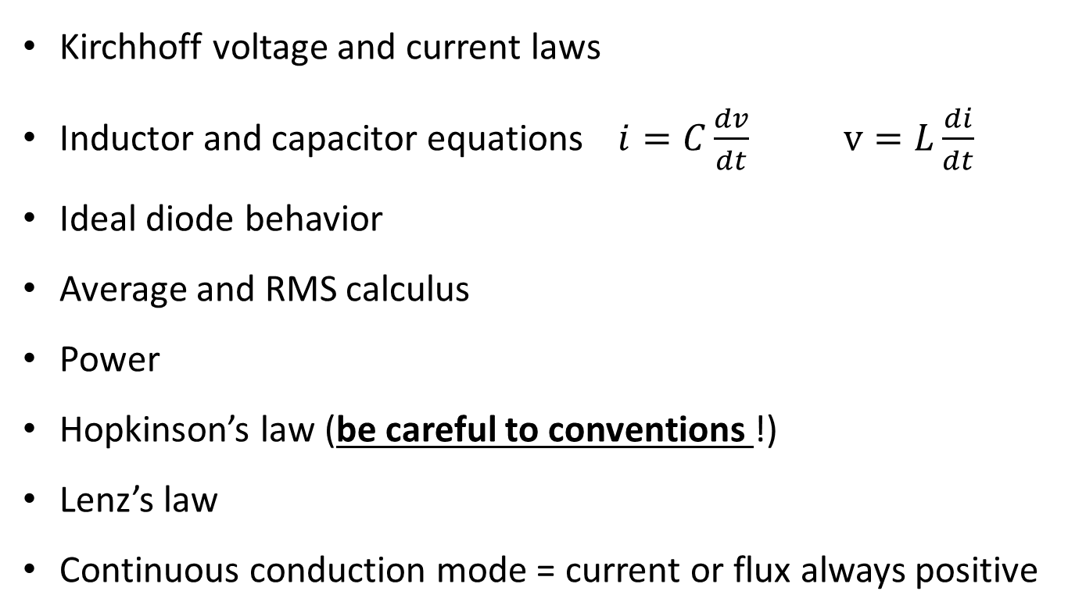
What to learn ?
Converters study
Example of converter
What you need to know ?
Kirchhoff voltage and current laws
Inductor and capacitor equations $i=C\frac{dv}{dt}$ $v=L\frac{di}{dt}$
Ideal diode behavior
Average and RMS calculus
Power
Hopkinson’s law (be careful to conventions !)
Lenz’s law
Continuous conduction mode = current or flux always positive
Alexis MARTIN 3
Notes:
What takes place : passive components and heatsinks

Slide 4
What to learn ?
Converters study
Example of converter
Converters Study

Slide 5
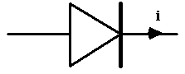
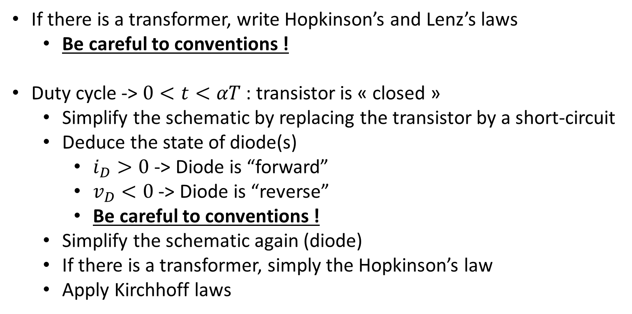

What to learn ?
Converters study
Example of converter
How to study a converter ?
If there is a transformer, write Hopkinson’s and Lenz’s laws
Be careful to conventions !
Duty cycle -> $0<t<αT$ : transistor is « closed »
Simplify the schematic by replacing the transistor by a short-circuit
Deduce the state of diode(s)
$i_{D}>0$ -> Diode is “forward”
$v_{D}<0$ -> Diode is “reverse”
Be careful to conventions !
Simplify the schematic again (diode)
If there is a transformer, simply the Hopkinson’s law
Apply Kirchhoff laws
$$v_{D}$$
Alexis MARTIN 5
Notes:
What takes place : passive components and heatsinks

Slide 6
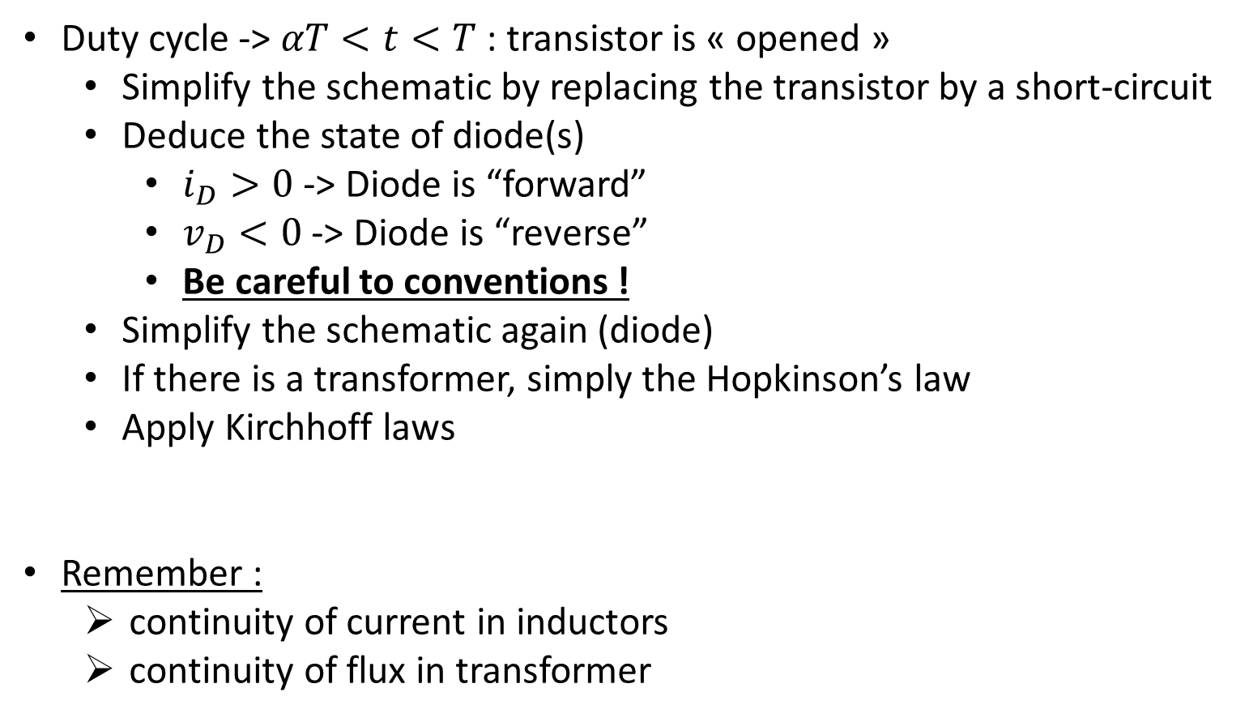
What to learn ?
Converters study
Example of converter
How to study a converter ?
Duty cycle -> $αT<t<T$ : transistor is « opened »
Simplify the schematic by replacing the transistor by a short-circuit
Deduce the state of diode(s)
$i_{D}>0$ -> Diode is “forward”
$v_{D}<0$ -> Diode is “reverse”
Be careful to conventions !
Simplify the schematic again (diode)
If there is a transformer, simply the Hopkinson’s law
Apply Kirchhoff laws
Remember :
continuity of current in inductors
continuity of flux in transformer
Alexis MARTIN 6
Notes:
What takes place : passive components and heatsinks

Slide 7
What to learn ?
Converters study
Example of converter
Why study a converter ?
First components sizing
Simulation with found values + real components (imperfection)
Resize of components
Alexis MARTIN 7
Notes:
What takes place : passive components and heatsinks

Slide 8
What to learn ?
Converters study
Example of converter
Example of a full converter

Slide 9
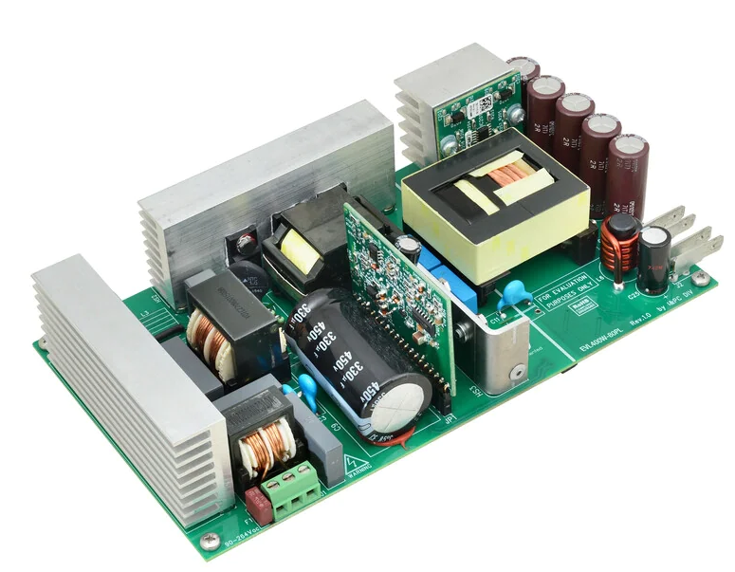
What to learn ?
Converters study
Example of converter
Example: EVL400W-80PL
Alexis MARTIN 9
Notes:
What takes place : passive components and heatsinks

Slide 10
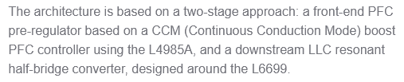
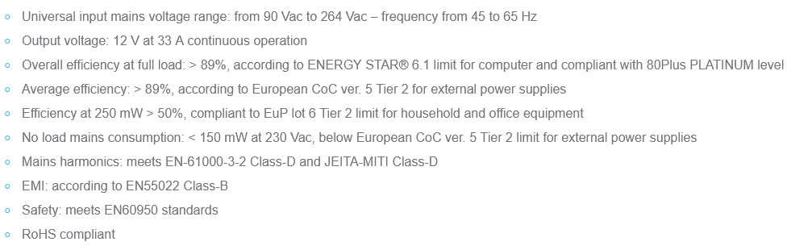
Example: EVL400W-80PL
Alexis MARTIN 10

Slide 11
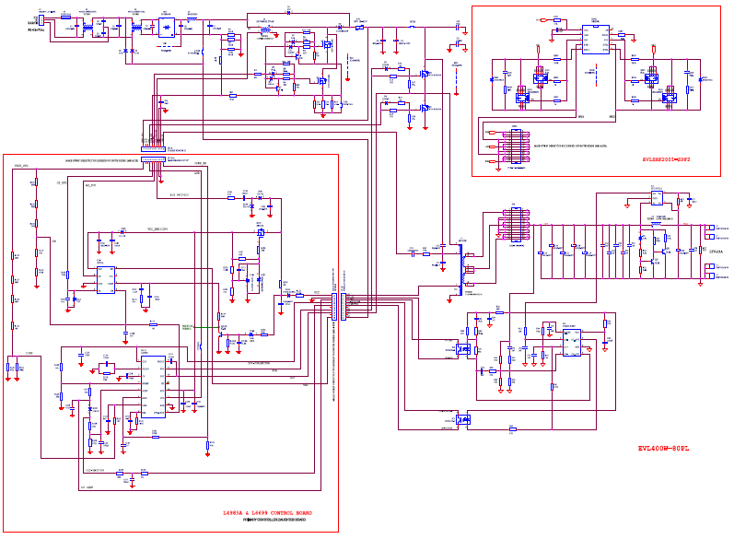
Alexis MARTIN 11

Slide 12
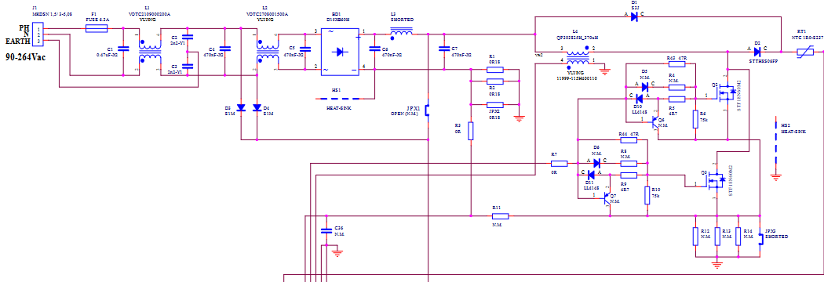
Rectifier
HF filtering
Boost (PFC)
Current measurement (PFC)
Alexis MARTIN 12

Slide 13
Alexis MARTIN 13

Slide 14
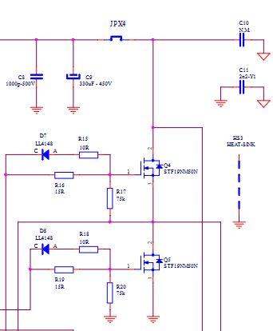
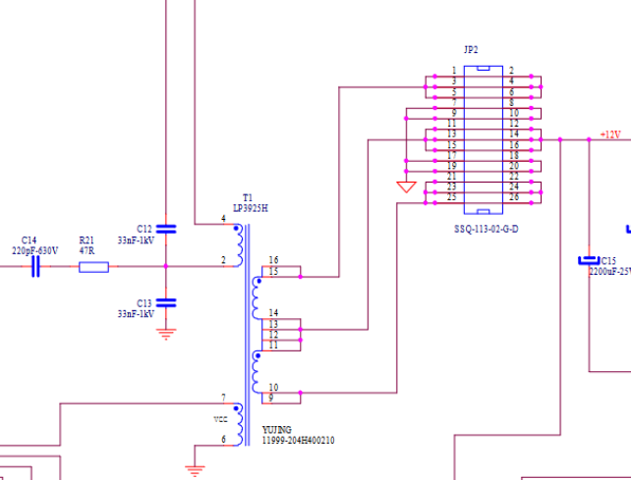
A
B
Half Bridge
LLC
A
B
Alexis MARTIN 14

Slide 15
Synchronous rectifier
(for LLC)
HF filtering + rectifier + Boost (PFC)
Half Bridge
LLC
Boost (PFC)
controller
L4985A
Output filtering
Half Bridge
LLC
controller
L6699D
Output measurement + optocoupler (isolation) for Half Bridge LLC
Alexis MARTIN 15

Slide 16
Synchronous rectifier
(for LLC)
Example: EVL400W-80PL
Output filtering
2 transistors of Boost
Half Bridge
LLC
Rectifier
Half Bridge controller
+
Boost (PFC) controller
HF input filtering + Boost
Alexis MARTIN 16
Notes:
What takes place : passive components and heatsinks
Capacitor = Boost output

Slide 17
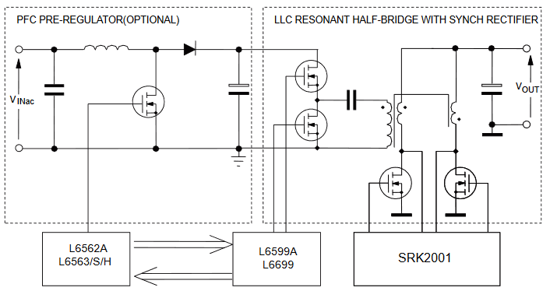
Example: EVL400W-80PL
Alexis MARTIN 17

