Slide 1
TP Buck

Slide 2
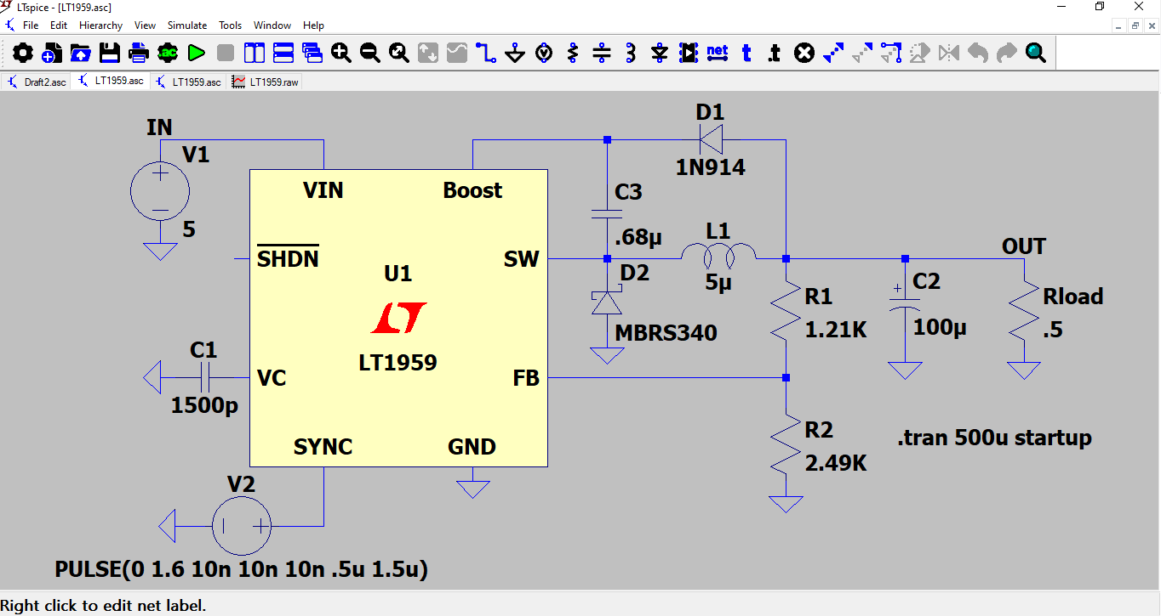
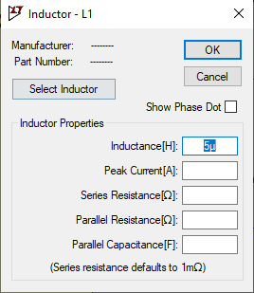
Right-click to
edit component
SPICE code
(simulation type)
Run simulation
Components

Slide 3
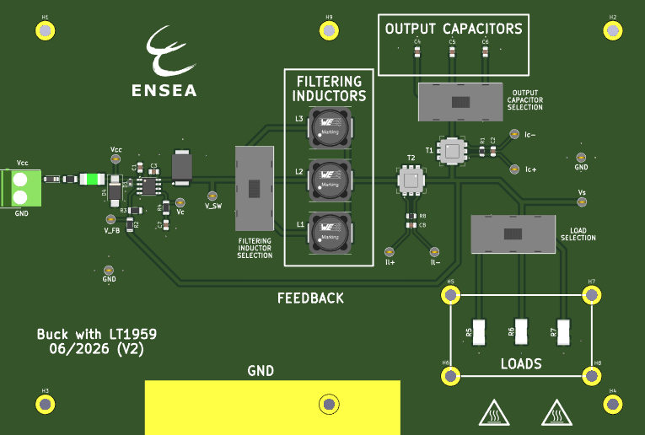
LT1959
Measurement of i_{C1}
Measurement of i_{L1}

Slide 4
TP H4Q

Slide 5











$f1$(t)
$f1$(t)
t
t
0
$$T/2$$
T
$$3T/2$$
$$2T$$
0
$$αT$$
$$T/2$$
T
$$3T/2$$
$$2T$$
f₂(t)
$$αT$$
f₂(t)
t
t
0
0
f₃(t)
f₃(t)
t
t
0
$$αT$$
0
$$αT$$
f₄(t)
f₄(t)
t
t
0
0
u_{m}
u_{m}
t
t
0
0

Slide 6
$f1$(t)
$f1$(t)
t
t
0
$$T/2$$
T
$$3T/2$$
$$2T$$
0
$$αT$$
$$T/2$$
T
$$3T/2$$
$$2T$$
f₂(t)
$$αT$$
f₂(t)
t
t
0
0
f₃(t)
f₃(t)
t
t
0
0
f₄(t)
f₄(t)
t
t
0
0
u_{m}
u_{m}
t
t
0
0

Slide 7
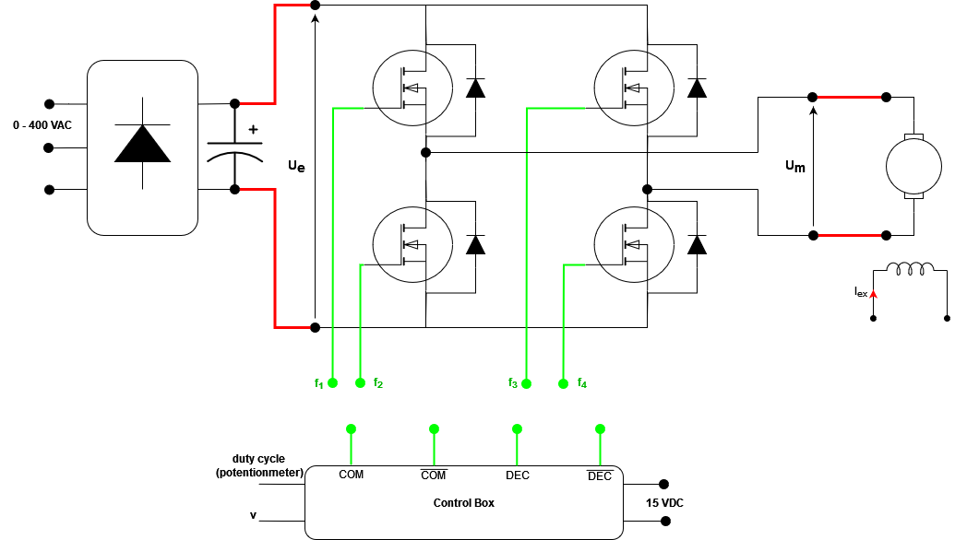
unused for
this lab

Slide 8
TP Flyback

Slide 9





$$Commande$$
t
0
$$T/2$$
T
$$3T/2$$
$$2T$$
ϕ
$$αT$$
t
0
i₁
t
0
i₂
t
0
v₂
t
0

Slide 10
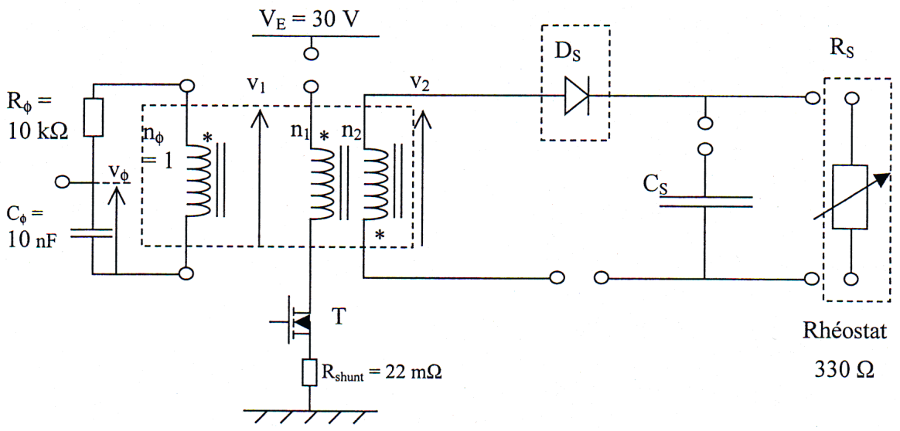
i₁
i₂
n_{φ}=1
v_{spire}
v₁
v₂
v_{flux}

Slide 11
TP Forward

Slide 12
n_{φ}=1
v_{spire}
i₂
v_{flux}
i₃
i₁

Slide 13
$$Commande$$
t
0
$$T/2$$
T
$$3T/2$$
$$2T$$
ϕ
$$αT$$
t
0
i₁
t
0
i₃
t
0
v₂
t
0

