Slide 1

Power Electronics
alexis.martin@ensea.fr
Desk D216

Slide 2
Layout
Non isolated choppers
Introduction
Direct conversion
Buck
Boost
Reversible choppers
Half bridge
H – bridge
Inverter
Energy storage based chopper
Buck-boost
Cuck
SEPIC
Isolated power supplies
Power components
Alexis MARTIN 2

Slide 3
Progress
Lesson : 8 x 2h
Tutorials : 9 x 2h
Labs : 4 x 4h
Buck chopper
Reversible chopper for DC motor
Switch mode power supply Flyback
Switch mode power supply Forward
Marks : Final exam - Labs
Alexis MARTIN 3

Slide 4
Prerequisites
Kirchhoff's circuit laws
Average value of a signal, integral calculus, RMS value
AC and DC real power, power factor, complex representation, phasor
Transformers (magnetic field, flux)
Linear control (Laplace transform, Bode diagram, gain/phase margin, PI controller)
Alexis MARTIN 4

Slide 5
Introduction
Direct conversion
Reversible choppers
Inverters
Closed loop chopper control
Energy storage based chopper
Introduction

Slide 6
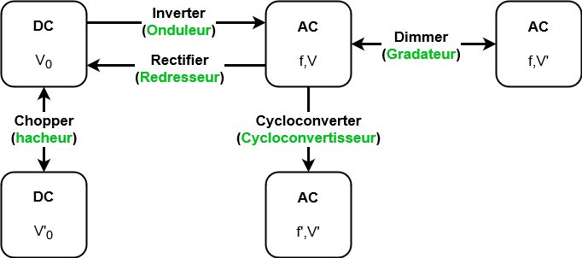
Introduction
Direct conversion
Reversible choppers
Inverters
Closed loop chopper control
Energy storage based chopper
Energy conversion: principles
Alexis MARTIN 6

Slide 7
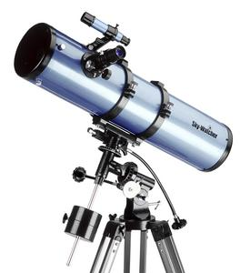
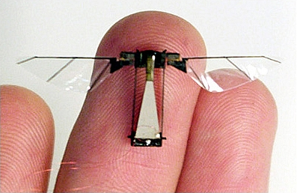
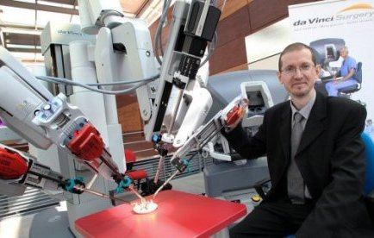
Introduction
Direct conversion
Reversible choppers
Inverters
Closed loop chopper control
Energy storage based chopper
Micro-mechanisms
1-100 W
Alexis MARTIN 7

Slide 8
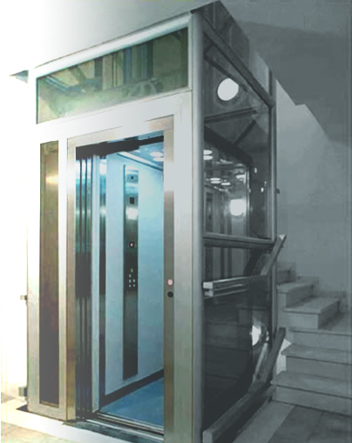
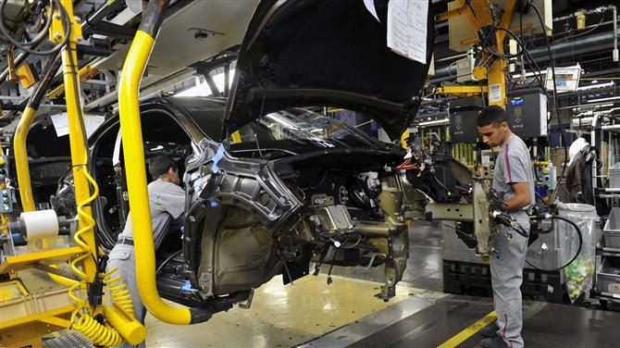
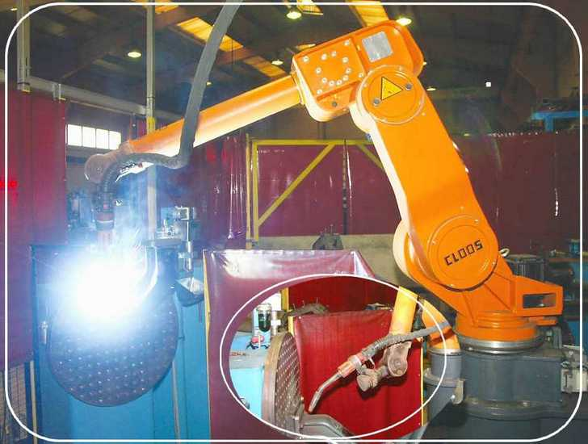
Introduction
Direct conversion
Reversible choppers
Inverters
Closed loop chopper control
Energy storage based chopper
Use : automatisms
0,1 à 10 kW
Alexis MARTIN 8

Slide 9
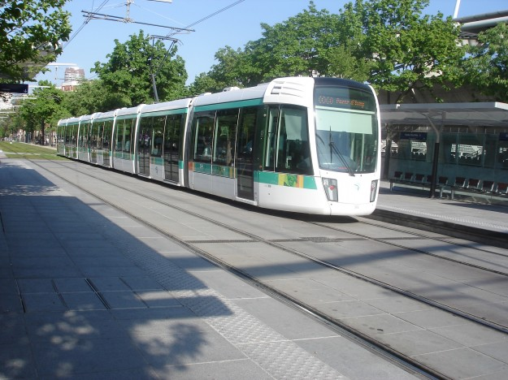
Introduction
Direct conversion
Reversible choppers
Inverters
Closed loop chopper control
Energy storage based chopper
Use : rail traction
100 kW
Alexis MARTIN 9

Slide 10
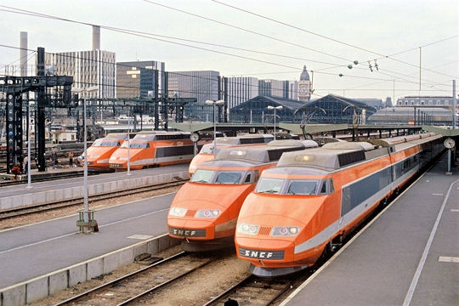
Introduction
Direct conversion
Reversible choppers
Inverters
Closed loop chopper control
Energy storage based chopper
High speed rail traction
10 MW
Alexis MARTIN 10

Slide 11
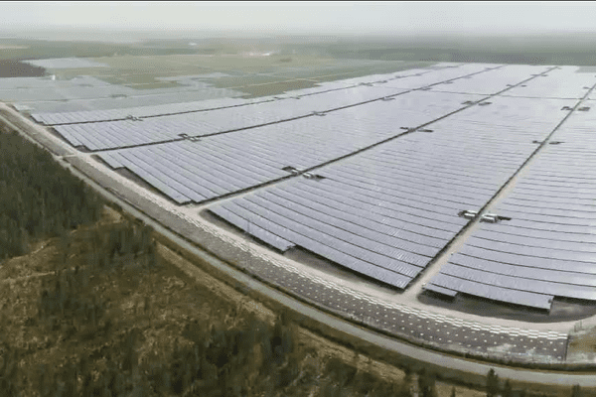
Introduction
Direct conversion
Reversible choppers
Inverters
Closed loop chopper control
Energy storage based chopper
Photovoltaic plant
300 MWc
Alexis MARTIN 11

Slide 12
Introduction
Direct conversion
Reversible choppers
Inverters
Closed loop chopper control
Energy storage based chopper
«Chopper » function : a switching electronic
α
,T
DC source
DC Load
Power transfer
Reversible transfer
Alexis MARTIN 12

Slide 13
Introduction
Direct conversion
Reversible choppers
Inverters
Closed loop chopper control
Energy storage based chopper
Link power sources
Active
(Energy generator)
Voltage Source
Current Source
Passive
(Energy receiver)
Theorem
Only two sources with different category
can be directly connected.
Alexis MARTIN 13

Slide 14
Introduction
Direct conversion
Reversible choppers
Inverters
Closed loop chopper control
Energy storage based chopper
Non reversible chopper
Inductive storage chopper
Voltage
generator
Boost Converter
Hacheur parallèle
Voltage receiver
Buck converter
Hacheur série
Current generator
Current receiver
Capacitive storage chopper
Alexis MARTIN 14

Slide 15
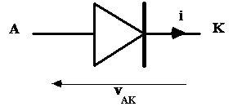
Introduction
Direct conversion
Reversible choppers
Inverters
Closed loop chopper control
Energy storage based chopper
« Perfect » diode
i
V_{AK} = 0
v_{AK}
0
i = 0
v_{AK} = -V_{BR}
Alexis MARTIN 15

Slide 16
Introduction
Direct conversion
Reversible choppers
Inverters
Closed loop chopper control
Energy storage based chopper
Controlled switch
MOSFET
Bipolar
transistor
IGBT
C
B
i
E
v
Thyristor
Alexis MARTIN 16

Slide 17
Introduction
Direct conversion
Reversible choppers
Inverters
Closed loop chopper control
Energy storage based chopper
« Perfect » controlled switch ex : IGBT
i_{C}
v_{CE}
On state: « short circuit »
v_{CE} = 0, i_{C} fixed by circuit
Off state: « open circuit »
i_{C} = 0, v_{CE} fixed by circuit
Alexis MARTIN 17

Slide 18
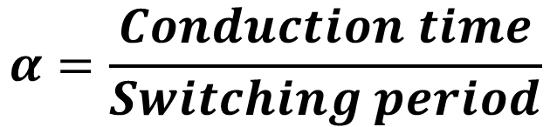
Introduction
Direct conversion
Reversible choppers
Inverters
Closed loop chopper control
Energy storage based chopper
Duty cycle
Switch
“Closed”
Switch
“Opened”
Switch
“Closed”
Switch
“Opened”
Switch
“Closed”
t
Conduction time
Switching period
$$α=\frac{Conduction time}{Switching period}$$
Alexis MARTIN 18

Slide 19
Introduction
Direct conversion
Buck chopper
Boost chopper
Reversible choppers
Inverters
Closed loop chopper control
Energy storage based chopper
Buck Chopper

Slide 20
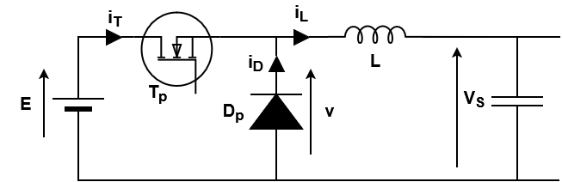
Introduction
Direct conversion
Buck chopper
Boost chopper
Reversible choppers
Inverters
Closed loop chopper control
Energy storage based chopper
Buck chopper : principle
Hypothesis : V_{s} = constant
Alexis MARTIN 20

Slide 21
Introduction
Direct conversion
Buck chopper
Boost chopper
Reversible choppers
Inverters
Closed loop chopper control
Energy storage based chopper
Control
Switching period
T_{p}
“Closed”
T_{p}
“Open”
T_{p}
“Closed”
0
αT
T
t
Conduction time
Alexis MARTIN 21

Slide 22
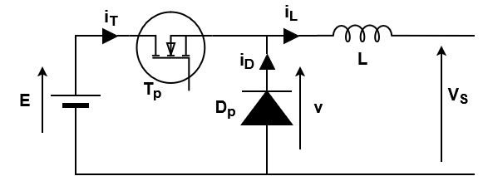
Introduction
Direct conversion
Buck chopper
Boost chopper
Reversible choppers
Inverters
Closed loop chopper control
Energy storage based chopper
Operation
0 < t < αT
αT < t < T
Alexis MARTIN 22

Slide 23
Introduction
Direct conversion
Buck chopper
Boost chopper
Reversible choppers
Inverters
Closed loop chopper control
Energy storage based chopper
Modes
Continuous conduction mode: i_{L} > 0
Discontinuous conduction mode: i_{L}(t₀) = 0 ; t₀ < T
Alexis MARTIN 23

Slide 24
Introduction
Direct conversion
Buck chopper
Boost chopper
Reversible choppers
Inverters
Closed loop chopper control
Energy storage based chopper
Continuous mode
T_{p}
«Closed »
T_{p}
«Opened »
0
αT
T
t
D_{p} reverse
D_{p} forward
Alexis MARTIN 24

Slide 25
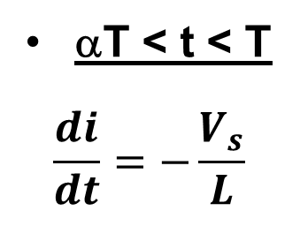
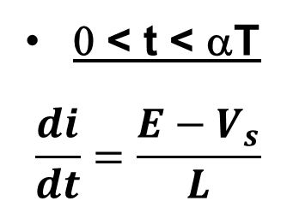
Introduction
Direct conversion
Buck chopper
Boost chopper
Reversible choppers
Inverters
Closed loop chopper control
Energy storage based chopper
Continuous mode: Chronograms
v
E
0 < t < αT
$$\frac{di}{dt}=\frac{{E−V}_{s}}{L}$$
V
s
t
0
α
.T
T
i
L
αT < t < T
$$\frac{di}{dt}=−\frac{V_{s}}{L}$$
t
0
α
.T
T
E > V_{S}
T
p
D
p
Alexis MARTIN 25

Slide 26
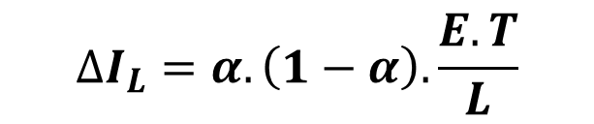
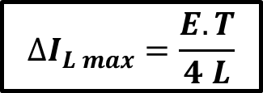
Introduction
Direct conversion
Buck chopper
Boost chopper
Reversible choppers
Inverters
Closed loop chopper control
Energy storage based chopper
Continuous mode (Calculation)
Output voltage
<v> = α.E = V_{s}
Current ripple i_{L}
$$∆I_{L}=α.\left(1−α\right).\frac{E.T}{L}$$
ΔI_{L}
Maximum ripple
$$∆I_{L max}=\frac{E.T}{4 L}$$
α
0
1
Alexis MARTIN 26

Slide 27
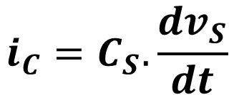
Introduction
Direct conversion
Buck chopper
Boost chopper
Reversible choppers
Inverters
Closed loop chopper control
Energy storage based chopper
Continuous mode: Output filtering principle
i_{L}
I_{S}
ΔI_{L}
i_{C}
t
v_{S}
C_{S}
R_{S}
V_{S}
ΔV_{S}
$$i_{C}=C_{S}.\frac{dv_{S}}{dt}$$
t₁
t₂
Alexis MARTIN 27

Slide 28
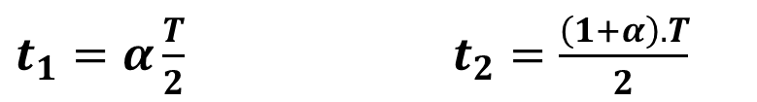
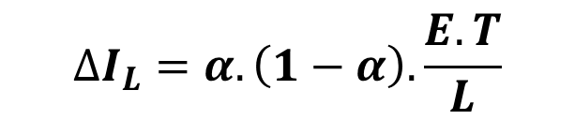
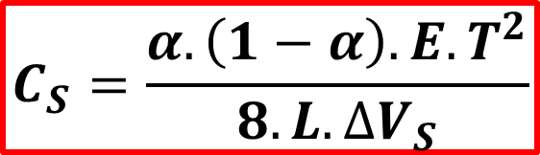
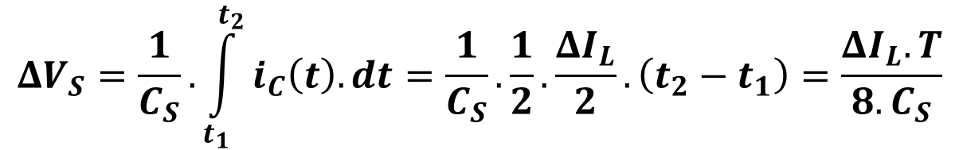
Introduction
Direct conversion
Buck chopper
Boost chopper
Reversible choppers
Inverters
Closed loop chopper control
Energy storage based chopper
Continuous mode: Output filtering calculation
t
$t_{1}=α\frac{T}{2}$ $t_{2}=\frac{\left(1+α\right).T}{2}$
$$∆I_{L}=α.\left(1−α\right).\frac{E.T}{L}$$
t₁
t₂
$$ΔV_{S}=\frac{1}{C_{S}}.\int_{t_{1}}^{t_{2}}{i_{C}\left(t\right).dt}=\frac{1}{C_{S}}.\frac{1}{2}.\frac{ΔI_{L}}{2}.\left(t_{2}−t_{1}\right)=\frac{ΔI_{L}.T}{8.C_{S}}$$
$$C_{S}=\frac{α.\left(1−α\right).E.T^{2}}{8.L.∆V_{S}}$$
Alexis MARTIN 28

Slide 29
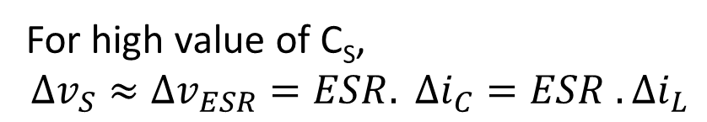
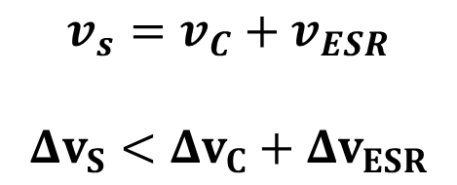
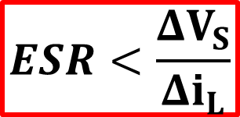
Introduction
Direct conversion
Buck chopper
Boost chopper
Reversible choppers
Inverters
Closed loop chopper control
Energy storage based chopper
Continuous mode: Output filtering calculation
i_{L}
I_{S}
i_{C}
i_{C}
i_{C}
!
C_{S}
v_{C}
v_{S}
C_{S}
v_{S}
v_{S}
C_{S}
R_{S}
ESR
v_{ESR}
$$v_{s}=v_{C}+v_{ESR}$$ $$Δv_{S}<Δv_{C}+Δv_{ESR}$$
t
i_{C}
v_{C}
For high value of C_{S}, $$Δv_{S}≈Δv_{ESR}=ESR. Δi_{C}=ESR . Δi_{L}$$
t₁
t₂
$$ESR<\frac{ΔV_{S}}{Δi_{L}}$$
v_{ESR}
Alexis MARTIN 29

Slide 30
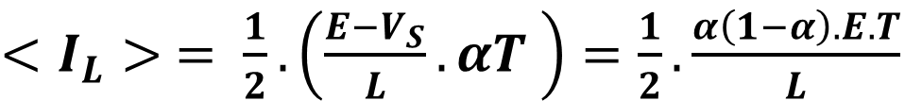

Introduction
Direct conversion
Buck chopper
Boost chopper
Reversible choppers
Inverters
Closed loop chopper control
Energy storage based chopper
Boundary mode
i_{L}
i_{L}(T) = 0
t
αT
T
$<I_{L}> = \frac{1}{2}.\left(\frac{E−V_{S}}{L}. αT \right)=\frac{1}{2}.\frac{α\left(1−α\right).E.T}{L}$
$$V_{S}=α.E$$
Curve of mode
separation (Vs,Is)
Alexis MARTIN 30

Slide 31
Introduction
Direct conversion
Buck chopper
Boost chopper
Reversible choppers
Inverters
Closed loop chopper control
Energy storage based chopper
Discontinuous mode
T_{p}
“Closed”
T_{p}
“Opened”
0
αT
t₀
T
t
D_{p} reverse
D_{p} forward
D_{p} reverse
At t₀ = a ’.T : diode switches to reverse mode
Alexis MARTIN 31

Slide 32
Introduction
Direct conversion
Buck chopper
Boost chopper
Reversible choppers
Inverters
Closed loop chopper control
Energy storage based chopper
Discontinuous mode: Chronograms
Alexis MARTIN 32

Slide 33

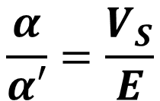
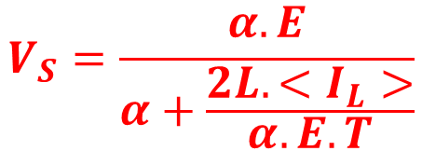
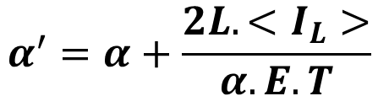
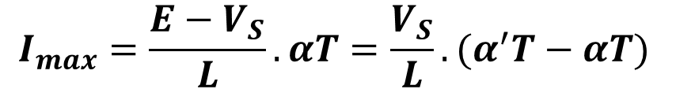
Introduction
Direct conversion
Buck chopper
Boost chopper
Reversible choppers
Inverters
Closed loop chopper control
Energy storage based chopper
Discontinuous mode: calculation
$$I_{max}=\frac{E−V_{S}}{L}. αT=\frac{V_{S}}{L}.(α^{′}T−αT)$$
$$\frac{α}{α′}=\frac{V_{S}}{E}$$
$$<I_{L}> =\frac{1}{2}.I_{max}. α^{′}=\frac{E−V_{S}}{2L}. α. α^{′}.T=\frac{α.E.T}{2L}(α^{′}−α)$$
$$α^{′}=α+\frac{2L.<I_{L}>}{α.E.T}$$
$$V_{S}=\frac{α.E}{α+\frac{2L.<I_{L}>}{α.E.T}}$$
Output current: $<I_{L}> =I_{S}$
Alexis MARTIN 33

Slide 34
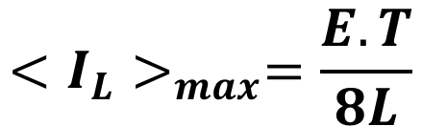

Introduction
Direct conversion
Buck chopper
Boost chopper
Reversible choppers
Inverters
Closed loop chopper control
Energy storage based chopper
Output characteristics
$$V_{S}=\frac{α.E}{α+\frac{2L.<I_{L}>}{α.E.T}}$$
V_{s} = α.E
Discontinuous
mode
Continuous
mode
Boundary
mode
$$<I_{L}>_{max}=\frac{E.T}{8L}$$
Alexis MARTIN 34

Slide 35
Introduction
Direct conversion
Buck chopper
Boost chopper
Reversible choppers
Inverters
Closed loop chopper control
Energy storage based chopper
Example
=
=
Battery
Chopper
Processor
=> DC supply from battery
Alexis MARTIN 35

Slide 36
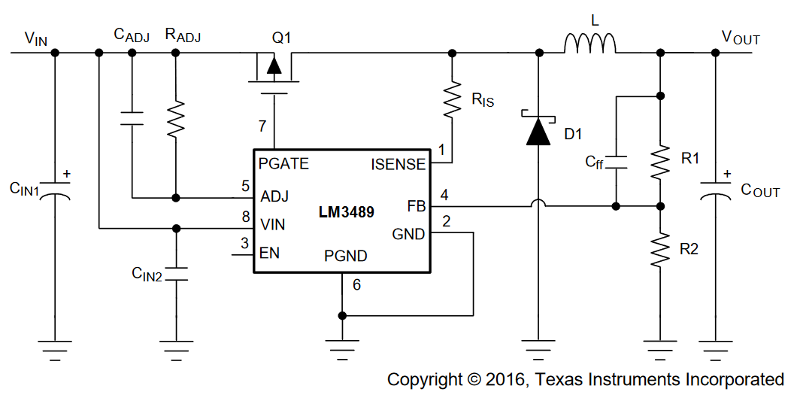
Introduction
Direct conversion
Buck chopper
Boost chopper
Reversible choppers
Inverters
Closed loop chopper control
Energy storage based chopper
Example : LM3489
Alexis MARTIN 36

Slide 37
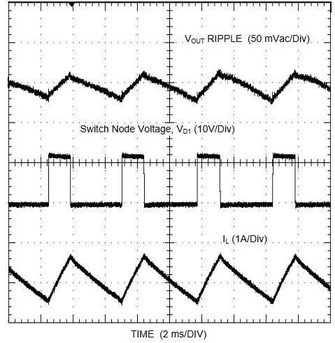
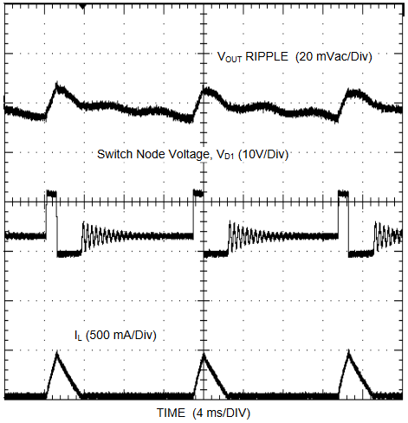
Introduction
Direct conversion
Buck chopper
Boost chopper
Reversible choppers
Inverters
Closed loop chopper control
Energy storage based chopper
Example : LM3489
Alexis MARTIN 37

Slide 38
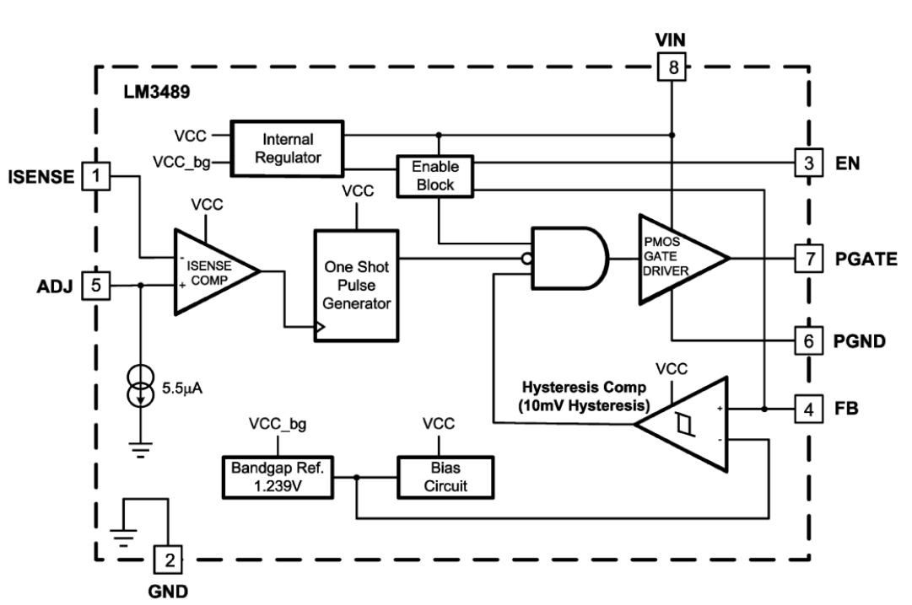
Introduction
Direct conversion
Buck chopper
Boost chopper
Reversible choppers
Inverters
Closed loop chopper control
Energy storage based chopper
Example : LM3489
Overcurrent
protection
Voltage hysteresis control
Alexis MARTIN 38

Slide 39
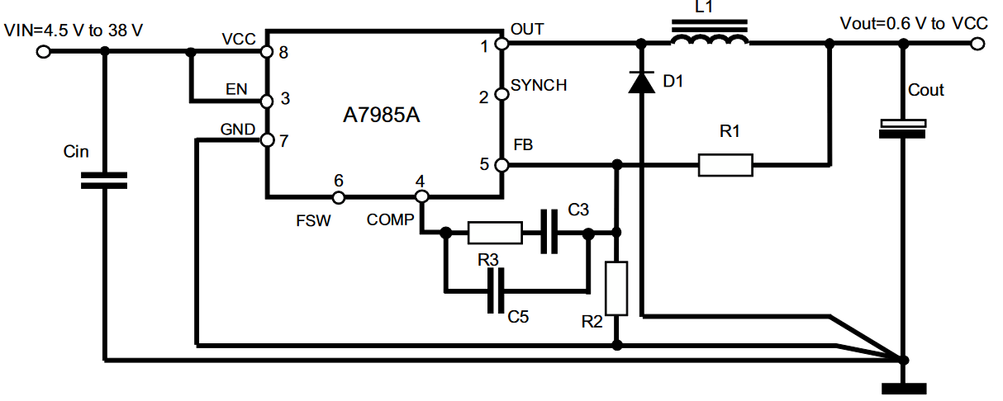
Introduction
Direct conversion
Buck chopper
Boost chopper
Reversible choppers
Inverters
Closed loop chopper control
Energy storage based chopper
Example : A7985A
Alexis MARTIN 39

Slide 40
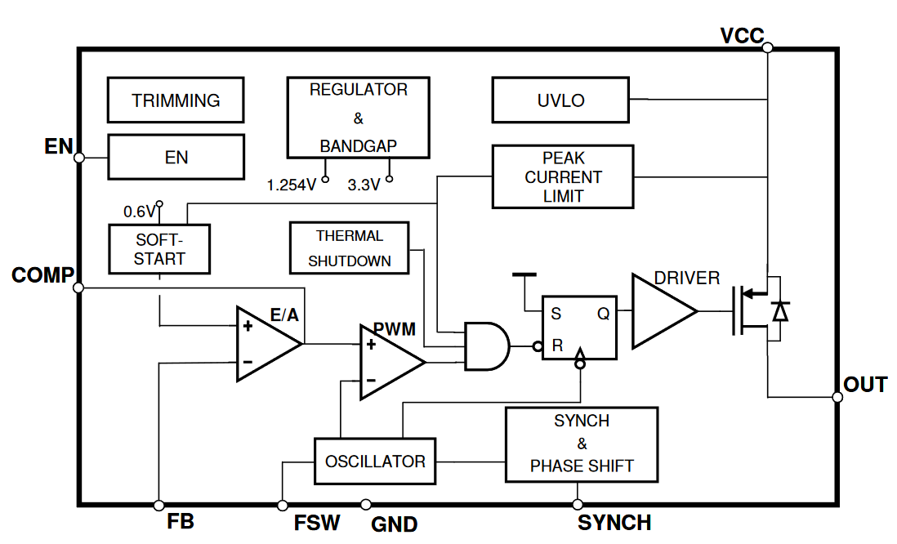
Introduction
Direct conversion
Buck chopper
Boost chopper
Reversible choppers
Inverters
Closed loop chopper control
Energy storage based chopper
Example : A7985A
Overcurrent
protection
Voltage control
Alexis MARTIN 40

Slide 41
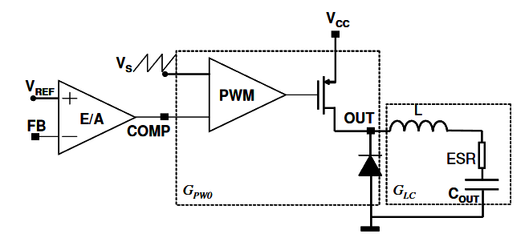
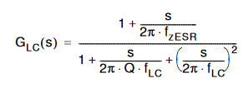



Introduction
Direct conversion
Buck chopper
Boost chopper
Reversible choppers
Inverters
Closed loop chopper control
Energy storage based chopper
Example : A7985A
Usually : $f_{LC}<f_{zESR}$
→ Slightly depends on the load
Alexis MARTIN 41

Slide 42
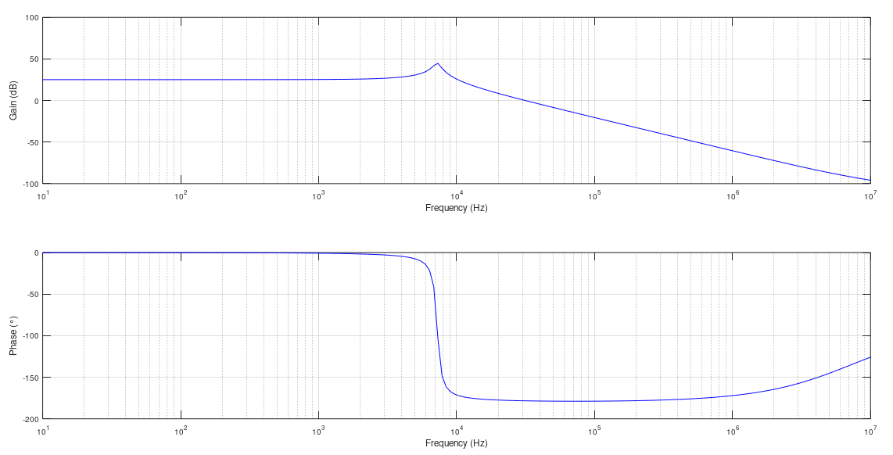
Introduction
Direct conversion
Buck chopper
Boost chopper
Reversible choppers
Inverters
Closed loop chopper control
Energy storage based chopper
Example : A7985A
f_{LC}
f_{ESR}
Alexis MARTIN 42

Slide 43
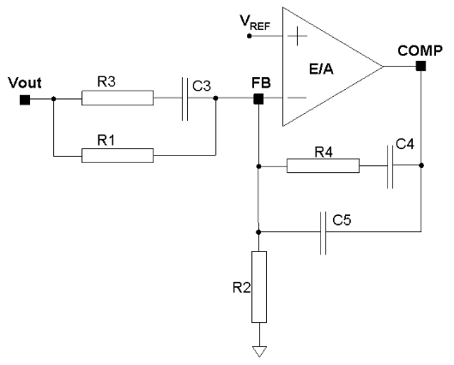

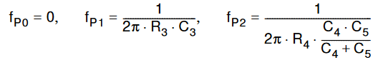
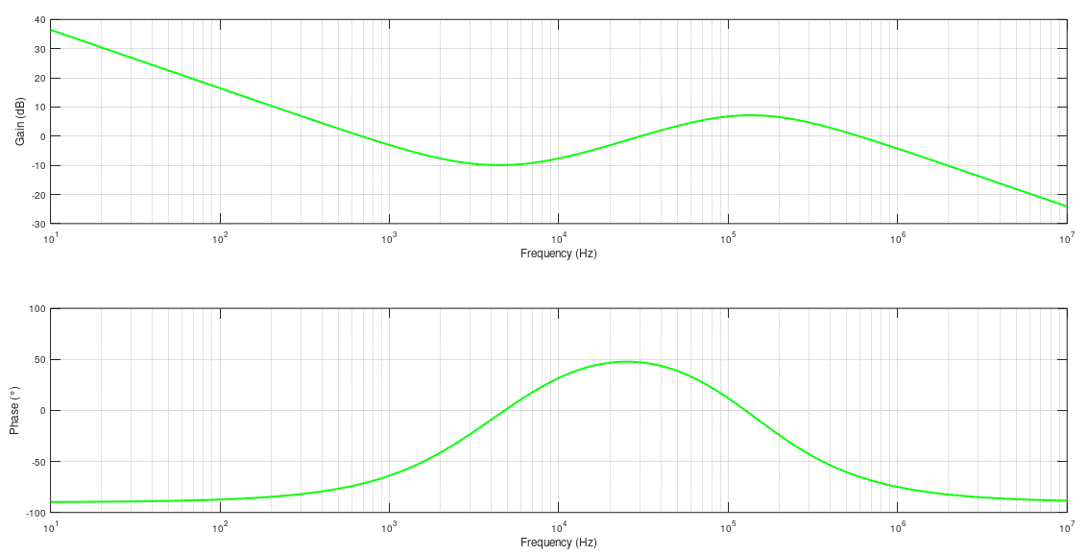
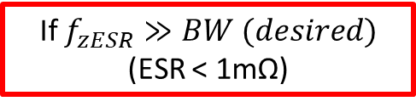
Introduction
Direct conversion
Buck chopper
Boost chopper
Reversible choppers
Inverters
Closed loop chopper control
Energy storage based chopper
Example : A7985A
If $f_{zESR}≫BW (desired)$
(ESR < 1mΩ)
Zeroes :
Poles :
f_{z1}
f_{z2}
f_{p1} & f_{p2}
Alexis MARTIN 43

Slide 44
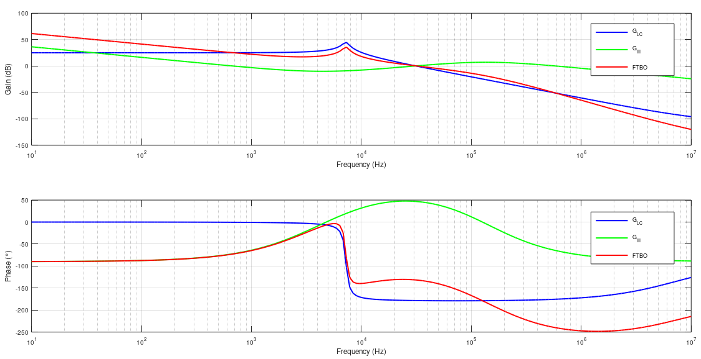
Introduction
Direct conversion
Buck chopper
Boost chopper
Reversible choppers
Inverters
Closed loop chopper control
Energy storage based chopper
Example : A7985A
f_{z1}
f_{z2}
f_{ESR}
f_{LC}
f_{p1} & f_{p2}
f_{z1}
f_{z2}
f_{LC}
f_{p1} & f_{p2}
f_{ESR}
Alexis MARTIN 44

Slide 45
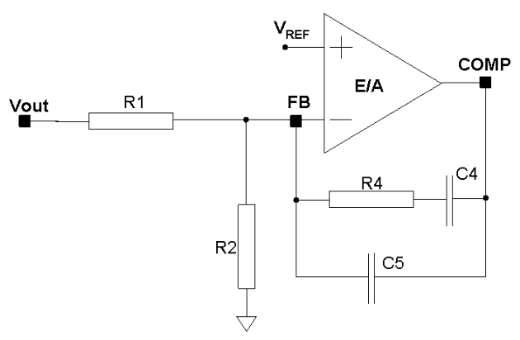


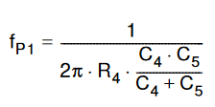
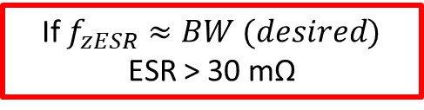
Introduction
Direct conversion
Buck chopper
Boost chopper
Reversible choppers
Inverters
Closed loop chopper control
Energy storage based chopper
Example : A7985A
If $f_{zESR}≈BW (desired)$
ESR > 30 mΩ
→ Use of the zero of ESR to stabilize the loop
Zero :
Poles :
Alexis MARTIN 45

Slide 46
Introduction
Direct conversion
Buck chopper
Boost chopper
Reversible choppers
Inverters
Closed loop chopper control
Energy storage based chopper
Boost Chopper

Slide 47
Introduction
Direct conversion
Buck chopper
Boost chopper
Reversible choppers
Inverters
Closed loop chopper control
Energy storage based chopper
Boost chopper
Buck chopper : Voltage source Current receiver
Boost chopper : Current source Voltage receiver
Current source ⬄ Voltage source + inductor
Voltage receiver ⬄ Battery or capacitive receiver
Alexis MARTIN 47

Slide 48

Introduction
Direct conversion
Buck chopper
Boost chopper
Reversible choppers
Inverters
Closed loop chopper control
Energy storage based chopper
Boost chopper: principle
Hypothesis : V_{s} = constant
Alexis MARTIN 48

Slide 49
Introduction
Direct conversion
Buck chopper
Boost chopper
Reversible choppers
Inverters
Closed loop chopper control
Energy storage based chopper
Control
Switching period
T_{p}
“Closed”
T_{p}
“Opened”
T_{p}
“Closed”
0
αT
T
t
Conduction time
Alexis MARTIN 49

Slide 50
Introduction
Direct conversion
Buck chopper
Boost chopper
Reversible choppers
Inverters
Closed loop chopper control
Energy storage based chopper
Principle
0 < t < αT
αT < t < T
Alexis MARTIN 50

Slide 51
Introduction
Direct conversion
Buck chopper
Boost chopper
Reversible choppers
Inverters
Closed loop chopper control
Energy storage based chopper
Modes
Continuous conduction: i_{L} > 0
Discontinuous conduction: i_{L}(t₀) = 0 ; t₀ < T
Alexis MARTIN 51

Slide 52
Introduction
Direct conversion
Buck chopper
Boost chopper
Reversible choppers
Inverters
Closed loop chopper control
Energy storage based chopper
Continuous mode
T_{p}
“Closed”
T_{p}
“Opened”
0
αT
T
t
D_{p} reverse
v_{D} = - V_{S}
D_{p} forward
Alexis MARTIN 52

Slide 53


Introduction
Direct conversion
Buck chopper
Boost chopper
Reversible choppers
Inverters
Closed loop chopper control
Energy storage based chopper
Continuous mode: Chronograms
0 < t < αT
$$\frac{di}{dt}=\frac{E}{L}$$
αT < t < T
$$\frac{di}{dt}=\frac{{E−V}_{s}}{L}$$
E < V_{S}
BOOST
Alexis MARTIN 53

Slide 54

Introduction
Direct conversion
Buck chopper
Boost chopper
Reversible choppers
Inverters
Closed loop chopper control
Energy storage based chopper
Continuous mode:
Output voltage calculation
$$V_{S}=\frac{E}{1−α}$$
Alexis MARTIN 54

Slide 55


Introduction
Direct conversion
Buck chopper
Boost chopper
Reversible choppers
Inverters
Closed loop chopper control
Energy storage based chopper
Continuous mode:
Current ripple calculation
Current ripple i_{L}
$$ΔI_{L}=α. \frac{E.T}{L}$$
Maximum ripple (a = 1)
$$ΔI_{L max}=\frac{E.T}{L}$$
Alexis MARTIN 55

Slide 56

Introduction
Direct conversion
Buck chopper
Boost chopper
Reversible choppers
Inverters
Closed loop chopper control
Energy storage based chopper
Continuous mode: Output filtering
i_{L}
t
i_{C}
i_{D}
I_{S}
i_{C}
v_{S}
v_{S}
C_{S}
R_{S}
$$i_{C}=C_{S}.\frac{dv_{S}}{dt}$$
Alexis MARTIN 56

Slide 57

Introduction
Direct conversion
Buck chopper
Boost chopper
Reversible choppers
Inverters
Closed loop chopper control
Energy storage based chopper
Continuous mode: Output filtering
t₁
t₂
$$C_{S}=\frac{α.E.T }{(1−α).R_{S}.∆V_{S}}$$
Alexis MARTIN 57

Slide 58
Introduction
Direct conversion
Buck chopper
Boost chopper
Reversible choppers
Inverters
Closed loop chopper control
Energy storage based chopper
Continuous mode: Output filtering
i_{L}
I_{S}
i_{C}
i_{C}
i_{C}
!
C_{S}
v_{C}
v_{S}
C_{S}
v_{S}
v_{S}
C_{S}
R_{S}
ESR
v_{ESR}
i_{L}
$$v_{s}=v_{C}+v_{ESR}$$ $$Δv_{S}<Δv_{C}+Δv_{ESR}$$
t
i_{C}
For high value of C_{S}, $$Δv_{S}≈Δv_{ESR}=ESR. Δi_{C}=ESR . Δi_{L}$$
v_{C}
$$ESR<\frac{ΔV_{S}}{Δi_{L}}$$
v_{ESR}
Alexis MARTIN 58

Slide 59
Introduction
Direct conversion
Buck chopper
Boost chopper
Reversible choppers
Inverters
Closed loop chopper control
Energy storage based chopper
Boundary mode: i_{L}(T)=0
v
t
i_{L}
α
.T
T
t
i_{D}
t
Alexis MARTIN 59

Slide 60
Introduction
Direct conversion
Buck chopper
Boost chopper
Reversible choppers
Inverters
Closed loop chopper control
Energy storage based chopper
Discontinuous mode
T_{p}
“Closed”
T_{p}
“Opened”
0
αT
t₀
T
t
D_{p} reverse
D_{p} forward
D_{p} reverse
At t₀ = a’.T : diode switches to reverse mode
Alexis MARTIN 60

Slide 61
Introduction
Direct conversion
Buck chopper
Boost chopper
Reversible choppers
Inverters
Closed loop chopper control
Energy storage based chopper
Discontinuous mode: Chronograms
Alexis MARTIN 61

Slide 62
Introduction
Direct conversion
Buck chopper
Boost chopper
Reversible choppers
Inverters
Closed loop chopper control
Energy storage based chopper
Discontinuous mode: calculation
Alexis MARTIN 62

Slide 63

Introduction
Direct conversion
Buck chopper
Boost chopper
Reversible choppers
Inverters
Closed loop chopper control
Energy storage based chopper
Discontinuous mode: output characteristics
Discontinuous
mode
Continuous
mode
Boundary
mode
$$<I_{L}>_{max}=\frac{E.T}{8L}$$
Alexis MARTIN 63

Slide 64

Introduction
Direct conversion
Buck chopper
Boost chopper
Reversible choppers
Inverters
Closed loop chopper control
Energy storage based chopper
Example : TPS61170
Alexis MARTIN 64

Slide 65

Introduction
Direct conversion
Buck chopper
Boost chopper
Reversible choppers
Inverters
Closed loop chopper control
Energy storage based chopper
Example : TPS61170
Voltage control
Current Mode Control
Compensation slope (for stabilization)
Alexis MARTIN 65

Slide 66
Introduction
Direct conversion
Buck chopper
Boost chopper
Reversible choppers
Inverters
Closed loop chopper control
Energy storage based chopper
Reminder : buck chopper
Alexis MARTIN 66

Slide 67
Introduction
Direct conversion
Buck chopper
Boost chopper
Reversible choppers
Inverters
Closed loop chopper control
Energy storage based chopper
Reminder : boost chopper
Alexis MARTIN 67

Slide 68
Introduction
Direct conversion
Buck chopper
Boost chopper
Reversible choppers
Inverters
Closed loop chopper control
Energy storage based chopper
Linked sources
I_{S}
=
E
V_{S}
Reversible
source
=
Reversible load
Ex: DC motor
Reversible
Chopper ???
Alexis MARTIN 68

Slide 69
Introduction
Direct conversion
Reversible choppers
Inverters
Closed loop chopper control
Energy storage based chopper
Reversible Chopper

Slide 70
Introduction
Direct conversion
Reversible choppers
2 quadrants chopper
4 quadrants chopper
Inverters
Closed loop chopper control
Energy storage based chopper
Reversible choppers: quadrants
V_{S}
II
I
I_{S}
III
IV
Alexis MARTIN 70

Slide 71

Introduction
Direct conversion
Reversible choppers
2 quadrants chopper
4 quadrants chopper
Inverters
Closed loop chopper control
Energy storage based chopper
Two quadrants reversible chopper
Buck chopper
Boost chopper
Alexis MARTIN 71

Slide 72

Introduction
Direct conversion
Reversible choppers
2 quadrants chopper
4 quadrants chopper
Inverters
Closed loop chopper control
Energy storage based chopper
Two quadrants chopper: control
2 switches => 2 duty cycles
Complementary control
a₁ + a₂ = 1
T₁ closed
T₂ opened
T₂ closed
T₁ opened
0
α₁T
T
t
α₁.T
α₂.T
Alexis MARTIN 72

Slide 73
Introduction
Direct conversion
Reversible choppers
2 quadrants chopper
4 quadrants chopper
Inverters
Closed loop chopper control
Energy storage based chopper
Two quadrants chopper: output voltage
v
v
E
V
s
V_{S} = α₁.E
t
0
α
1
.T
T
Alexis MARTIN 73

Slide 74
Introduction
Direct conversion
Reversible choppers
2 quadrants chopper
4 quadrants chopper
Inverters
Closed loop chopper control
Energy storage based chopper
Two quadrants chopper: output current
D₁
i_{L}
T₁
I_{s}
i_{L}> 0
0
t
T₁ controlled
T₂ ctrl.
i_{L}
0
t
I_{s}
T₂
i_{L}< 0
D₂
Alexis MARTIN 74

Slide 75
Introduction
Direct conversion
Reversible choppers
2 quadrants chopper
4 quadrants chopper
Inverters
Closed loop chopper control
Energy storage based chopper
Two quadrants chopper: Arbitrary output current
v
V
s
t
0
α
1
.T
T
T₁ controlled
T₂ ctrl.
T₁
D₁
I_{S}
t
0
D₂
T₂
Alexis MARTIN 75

Slide 76
Introduction
Direct conversion
Reversible choppers
2 quadrants chopper
4 quadrants chopper
Inverters
Closed loop chopper control
Energy storage based chopper
Two quadrants chopper: Output characteristics grid
α = α₁
Alexis MARTIN 76

Slide 77
Introduction
Direct conversion
Reversible choppers
2 quadrants chopper
4 quadrants chopper
Inverters
Closed loop chopper control
Energy storage based chopper
4 quadrants chopper
Receiver
Alexis MARTIN 77

Slide 78
Introduction
Direct conversion
Reversible choppers
2 quadrants chopper
4 quadrants chopper
Inverters
Closed loop chopper control
Energy storage based chopper
4 quadrants chopper:
Synchronous complementary control
α₁ = α₄ et α₂ = α₃
α₂ = 1 - α₁
T₁ et T₄
controlled
T₂ et T₃
controlled
0
α₁T
T
t
Alexis MARTIN 78

Slide 79
Introduction
Direct conversion
Reversible choppers
2 quadrants chopper
4 quadrants chopper
Inverters
Closed loop chopper control
Energy storage based chopper
4 quadrants chopper:
Synchronous complementary control (chronograms)
u
E
t
0
α
.T
T
-E
i
t
0
D
1
T
1
D
2
T
2
D
4
T
4
D
3
T
3
Alexis MARTIN 79

Slide 80

Introduction
Direct conversion
Reversible choppers
2 quadrants chopper
4 quadrants chopper
Inverters
Closed loop chopper control
Energy storage based chopper
4 quadrants chopper:
Synchronous complementary control (Average output voltage)
$$<u> =\left(2α−1\right).E$$
High voltage ripple: 2.E
Low switching frequency
Alexis MARTIN 80

Slide 81
Introduction
Direct conversion
Reversible choppers
2 quadrants chopper
4 quadrants chopper
Inverters
Closed loop chopper control
Energy storage based chopper
4 quadrants chopper: Output characteristics
V_{S}
α = 1
α = 0,5
I_{S}
α = 0
Alexis MARTIN 81

Slide 82
Introduction
Direct conversion
Reversible choppers
2 quadrants chopper
4 quadrants chopper
Inverters
Closed loop chopper control
Energy storage based chopper
4 quadrants chopper: control of a DC motor
=
Load
Reversible
source
=
DC Motor
4 quadrants
chopper
V_{S} : e.m.f.
I_{S} : motor current
Motor
Power
Generator
Alexis MARTIN 82

Slide 83
Introduction
Direct conversion
Reversible choppers
2 quadrants chopper
4 quadrants chopper
Inverters
Closed loop chopper control
Energy storage based chopper
4 quadrants chopper: working cycle
Ω
Constant speed
Breaking
Acceleration
Stop
Ω > 0
t
C
Ω < 0
Friction
C_{ch} = f.W
P
Alexis MARTIN 83

Slide 84
Introduction
Direct conversion
Reversible choppers
2 quadrants chopper
4 quadrants chopper
Inverters
Closed loop chopper control
Energy storage based chopper
4 quadrants chopper: Operating point
Load
Ω
V_{S}
Constant speed
Breaking
Accelération
C_{m}
I_{S}
Breaking
Accelération
Alexis MARTIN 84

Slide 85
Introduction
Direct conversion
Reversible choppers
2 quadrants chopper
4 quadrants chopper
Inverters
Closed loop chopper control
Energy storage based chopper
4 quadrants chopper: additional control
<u> value
Sign of <u>
U > 0 : T₄
U < 0 : T₂
Switch on T₁ et T₃
Alexis MARTIN 85

Slide 86
Introduction
Direct conversion
Reversible choppers
2 quadrants chopper
4 quadrants chopper
Inverters
Closed loop chopper control
Energy storage based chopper
4 quadrants chopper: additional control
u
i
switch
Sign
E
t
- E
T₁
T₄
D₃
T₄
T₃
T₂
D₁
T₂
Alexis MARTIN 86

Slide 87
Introduction
Direct conversion
Reversible choppers
2 quadrants chopper
4 quadrants chopper
Inverters
Closed loop chopper control
Energy storage based chopper
4 quadrants chopper: additional control
U = +/- a.E
Average value during
a switching time T_{d}
Voltage ripple reduced: E
Switching only on T₁/T₃ : losses reduced
Instabilities around 0V ! !
Alexis MARTIN 87

Slide 88
Introduction
Direct conversion
Reversible choppers
2 quadrants chopper
4 quadrants chopper
Inverters
Closed loop chopper control
Energy storage based chopper
4 quadrants chopper: Shifted complementary control
α₁ = α₄
α₂ = α₃
α₃ = 1 – α₁
α₄ = 1 – α₂
Switching on T₁ and T₃ at t = 0
Switching on T₂ and T₄ at t = T/2
Alexis MARTIN 88

Slide 89
Introduction
Direct conversion
Reversible choppers
2 quadrants chopper
4 quadrants chopper
Inverters
Closed loop chopper control
Energy storage based chopper
4 quadrants chopper: Shifted complementary control
T₂
T₄
T₂
T₄
T₂
T₁
T₃
T₁
T₃
t
0
a₁T
T/2
T
T+a₁T
Alexis MARTIN 89

Slide 90

Introduction
Direct conversion
Reversible choppers
2 quadrants chopper
4 quadrants chopper
Inverters
Closed loop chopper control
Energy storage based chopper
4 quadrants chopper: Shifted complementary control
T₂
T₄
T₂
T₄
T₂
T₁
T₃
T₁
T₃
t
0
a₁T
T/2
T
T+a₁T
U(t)
$$α_{1}<0,5$$
Alexis MARTIN 90

Slide 91
Introduction
Direct conversion
Reversible choppers
2 quadrants chopper
4 quadrants chopper
Inverters
Closed loop chopper control
Energy storage based chopper
4 quadrants chopper: Shifted complementary control
U = (2a-1).E
Voltage ripple reduced: E
High switching frequency
=> PWM
Alexis MARTIN 91

Slide 92
Introduction
Direct conversion
Reversible choppers
2 quadrants chopper
4 quadrants chopper
Inverters
Closed loop chopper control
Energy storage based chopper
4 quadrants chopper: Stepper motor control
Operation principle: full step
For a clockwise rotation, the sequence is:
B1 B2
+I 0
0 +I
-I 0
0 -I
S
B1
S
N
N
B2
Alexis MARTIN 92

Slide 93
Introduction
Direct conversion
Reversible choppers
2 quadrants chopper
4 quadrants chopper
Inverters
Closed loop chopper control
Energy storage based chopper
4 quadrants chopper: Stepper motor control
Operation principle: half step
For a clockwise rotation:
B1 B2
I+ 0
I+ I+
0 I+
I- I+
I- 0
I- I-
0 I-
I+ I-
S
B1
N
S
S
N
N
B2
Alexis MARTIN 93

Slide 94


Introduction
Direct conversion
Reversible choppers
2 quadrants chopper
4 quadrants chopper
Inverters
Closed loop chopper control
Energy storage based chopper
4 quadrants chopper: Stepper motor control
Alexis MARTIN 94

Slide 95
Introduction
Direct conversion
Reversible choppers
Inverters
Closed loop chopper control
Energy storage based chopper
Inverter

Slide 96

Introduction
Direct conversion
Reversible choppers
Inverters
Single phase inverter
Three phase inverter
Three phase motor control
Closed loop chopper control
Energy storage based chopper
Single phase inverter
T
1
D
1
T
2
D
2
i
E
T
3
D
3
T
4
D
4
$$α=\frac{1}{2}+δ_{α}sin⁡(ωt)$$
Alexis MARTIN 96

Slide 97
Introduction
Direct conversion
Reversible choppers
Inverters
Single phase inverter
Three phase inverter
Three phase motor control
Closed loop chopper control
Energy storage based chopper
Single phase inverter: PWM control
u
<u>
E
T_{d}
Alexis MARTIN 97

Slide 98



Introduction
Direct conversion
Reversible choppers
Inverters
Single phase inverter
Three phase inverter
Three phase motor control
Closed loop chopper control
Energy storage based chopper
Three phase inverter
$$α_{2}=\frac{1}{2}+δ_{α}sin⁡(ωt−\frac{2π}{3})$$
T
1
D
1
T
2
D
2
T
3
D
3
i₁
i₂
E
i₃
T
4
D
4
T
5
D
5
T
6
D
6
$$α_{1}=\frac{1}{2}+δ_{α}sin⁡(ωt)$$
$$α_{3}=\frac{1}{2}+δ_{α}sin⁡(ωt+\frac{2π}{3})$$
Alexis MARTIN 98

Slide 99

Introduction
Direct conversion
Reversible choppers
Inverters
Single phase inverter
Three phase inverter
Three phase motor control
Closed loop chopper control
Energy storage based chopper
3 Phases motor control : BLDC
Inverter
Synchronous motor
Current protection
AN899 (Microchip) : Brushless DC Motor Control Using PIC18FXX31 MCUs
Alexis MARTIN 99

Slide 100


Introduction
Direct conversion
Reversible choppers
Inverters
Single phase inverter
Three phase inverter
Three phase motor control
Closed loop chopper control
Energy storage based chopper
3 Phases motor control : BLDC
AN899 (Microchip) : Brushless DC Motor Control Using PIC18FXX31 MCUs
Alexis MARTIN 100

Slide 101
Introduction
Direct conversion
Reversible choppers
Inverters
Closed loop chopper control
Energy storage based chopper
Closed loop chopper control

Slide 102
Introduction
Direct conversion
Reversible choppers
Inverters
Closed loop chopper control
Models
Current control
Speed control
Energy storage based chopper
Closed loop chopper control
Possible control : speed / torque
Voltage / current
Alexis MARTIN 102

Slide 103


Introduction
Direct conversion
Reversible choppers
Inverters
Closed loop chopper control
Models
Current control
Speed control
Energy storage based chopper
i
DC motor model
Electrical equation : $u=e+r.i+L.\frac{di}{dt}$
Mechanical equation : $J\frac{dΩ}{dt}+fΩ=γ_{m}−γ_{r}$
Coupling equations : $e=k_{φ}. Ω$ $γ_{m}=k_{φ}. i$
L
u
r
$τ_{em}=\frac{J.R}{k_{φ}^{2}+R.f}$ electromechanical time constant
$τ_{e}=\frac{L}{R}$ electrical time constant
e
Alexis MARTIN 103

Slide 104
Introduction
Direct conversion
Reversible choppers
Inverters
Closed loop chopper control
Models
Current control
Speed control
Energy storage based chopper
Reversible structure
Alexis MARTIN 104

Slide 105


Introduction
Direct conversion
Reversible choppers
Inverters
Closed loop chopper control
Models
Current control
Speed control
Energy storage based chopper
Chopper model
$$G_{h}\left(p\right)=\frac{U(p)}{α(p)}=2.V_{DC}.e^{− \frac{T_{d}}{2}.p}$$
(Average delay T_{d} /2)
$G_{h}\left(p\right)≈\frac{G_{0}}{1+τ_{h}.p}$ with $τ_{h}=\frac{T_{d}}{2}$ and $G_{0}=2.V_{DC}$
(linearization)
Alexis MARTIN 105

Slide 106
Introduction
Direct conversion
Reversible choppers
Inverters
Closed loop chopper control
Models
Current control
Speed control
Energy storage based chopper
Current control
4 quadrant
Chopper
Torque control of a motor
Alexis MARTIN 106

Slide 107
Introduction
Direct conversion
Reversible choppers
Inverters
Closed loop chopper control
Models
Current control
Speed control
Energy storage based chopper
Current loop
Armature current regulation
Current regulation
Torque control ( G = k_{φ}.I)
Better transient response
Need a high performance sensor
Simple Regulation (P.I.)
Alexis MARTIN 107

Slide 108

Introduction
Direct conversion
Reversible choppers
Inverters
Closed loop chopper control
Models
Current control
Speed control
Energy storage based chopper
Current loop: Current sensor
Resistor = shunt
Hall effect sensor
i
Supply
Linear amplifier
isolated
u = R.i
v_{i}
Supply
Isolated measurement
Alexis MARTIN 108

Slide 109
Introduction
Direct conversion
Reversible choppers
Inverters
Closed loop chopper control
Models
Current control
Speed control
Energy storage based chopper
DC motor: Current control
Alexis MARTIN 109

Slide 110
Introduction
Direct conversion
Reversible choppers
Inverters
Closed loop chopper control
Models
Current control
Speed control
Energy storage based chopper
Current loop
Alexis MARTIN 110

Slide 111
Introduction
Direct conversion
Reversible choppers
Inverters
Closed loop chopper control
Models
Current control
Speed control
Energy storage based chopper
Control criteria
Accuracy : no static error
Speed : time response enhancement
Unconditional stability (high margin)
Alexis MARTIN 111

Slide 112







Introduction
Direct conversion
Reversible choppers
Inverters
Closed loop chopper control
Models
Current control
Speed control
Energy storage based chopper
Current Control
k_{i}
$$Γ_{r}$$
C_{i}(p)
G(p)
U(p)
$$\frac{1}{R+L.p}$$
$$Γ_{m}$$
$$\frac{1}{f+J.p}$$
$$Ω(p)$$
I_{ref}
$$k_{φ}$$
I(p)
E(p)
$$k_{φ}$$
Controller
Chopper
DC motor
= > Controller choice: Ci(p)
Alexis MARTIN 112

Slide 113






Introduction
Direct conversion
Reversible choppers
Inverters
Closed loop chopper control
Models
Current control
Speed control
Energy storage based chopper
P.I. control: simplified chopper
k_{i}
$$Γ_{r}$$
C_{i}(p)
G₀
U(p)
$$\frac{1}{R+L.p}$$
$$Γ_{m}$$
$$\frac{1}{f+J.p}$$
$$Ω(p)$$
I_{ref}
$$k_{φ}$$
I(p)
E(p)
Disturbance (slow variations)
$$k_{φ}$$
=> τ_{i} = τ_{e}
Alexis MARTIN 113

Slide 114
Introduction
Direct conversion
Reversible choppers
Inverters
Closed loop chopper control
Models
Current control
Speed control
Energy storage based chopper
P.I. control: simplified chopper
1st order without error, faster
Alexis MARTIN 114

Slide 115








Introduction
Direct conversion
Reversible choppers
Inverters
Closed loop chopper control
Models
Current control
Speed control
Energy storage based chopper
P.I. control: first order chopper
k_{i}
$$Γ_{r}$$
C_{i}(p)
$$\frac{G_{0}}{1+τ_{h}.p}$$
U(p)
$$\frac{1}{R+L.p}$$
$$Γ_{m}$$
$$\frac{1}{f+J.p}$$
$$Ω(p)$$
I_{ref}
$$k_{φ}$$
I(p)
E(p)
Disturbance (slow variations)
$$k_{φ}$$
=> τ_{i} = max( τ_{h},τ_{e} )
Alexis MARTIN 115

Slide 116


Introduction
Direct conversion
Reversible choppers
Inverters
Closed loop chopper control
Models
Current control
Speed control
Energy storage based chopper
Closed loop
$$H_{CL}\left(p\right)=\frac{1}{1+2m\frac{p}{ω_{0}}+\frac{p^{2}}{ω_{0}^{2}}}$$
$$H_{OL}\left(p\right)=\frac{k_{i}G_{0}/R}{τ_{he}p(1+τ_{he})}$$
Second ordre without error
Choose of m : damping [0,7 .. 1]
Choose of ω₀ : bandwidth
Alexis MARTIN 116

Slide 117

Introduction
Direct conversion
Reversible choppers
Inverters
Closed loop chopper control
Models
Current control
Speed control
Energy storage based chopper
DC motor: Speed / voltage transfer function
$τ_{em}=\frac{J.R}{k_{φ}^{2}+R.f}$ electromechanical time constant
$τ_{e}=\frac{L}{R}$ electrical time constant
Alexis MARTIN 117

Slide 118
Introduction
Direct conversion
Reversible choppers
Inverters
Closed loop chopper control
Models
Current control
Speed control
Energy storage based chopper
Speed loop
Alexis MARTIN 118

Slide 119
Introduction
Direct conversion
Reversible choppers
Inverters
Closed loop chopper control
Models
Current control
Speed control
Energy storage based chopper
Nested loop
Internal loop faster than external loop
Alexis MARTIN 119

Slide 120
Introduction
Direct conversion
Reversible choppers
Inverters
Closed loop chopper control
Energy storage based chopper
Indirect Choppers

Slide 121
Introduction
Direct conversion
Reversible choppers
Inverters
Closed loop chopper control
Energy storage based chopper
Indirect chopper: principle
Inductive storage chopper
Voltage
generator
Boost
chopper
Voltage load
Buck chopper
Current
generator
Current load
Alexis MARTIN 121

Slide 122

Introduction
Direct conversion
Reversible choppers
Inverters
Closed loop chopper control
Energy storage based chopper
Buck-Boost
Cuk
SEPIC
Buck-Boost structure
E > 0
V_{S} > 0
Alexis MARTIN 122

Slide 123
Introduction
Direct conversion
Reversible choppers
Inverters
Closed loop chopper control
Energy storage based chopper
Buck-Boost
Cuk
SEPIC
Buck-boost: Continuous mode (i_{L} > 0)
0 < t < αT : T_{p} closed
v_{Dp} = -E – V_{S} => D_{p} reverse
v_{L} = E = L.di_{L}/dt => i_{L} increasing > 0
v_{Dp}
αT < t < T: T_{p} opened
i_{L} > 0 => D_{p} forward
v_{L} = - V_{S} = L.di_{L}/dt => i_{L} decreasing
Alexis MARTIN 123

Slide 124
Introduction
Direct conversion
Reversible choppers
Inverters
Closed loop chopper control
Energy storage based chopper
Buck-Boost
Cuk
SEPIC
Buck-boost: Continuous mode (chronograms)
E
-V_{S}
<v_{L}> = 0
Inductive storage chopper
T_{p} closed
D_{p} forward
Alexis MARTIN 124

Slide 125
Introduction
Direct conversion
Reversible choppers
Inverters
Closed loop chopper control
Energy storage based chopper
Buck-Boost
Cuk
SEPIC
Buck-boost: Continuous mode (Transfer characteristics)
v
L
E
1
t
α
T
T
-E
2
<v_{L}> = 0
BUCK
BOOST
Alexis MARTIN 125

Slide 126
Introduction
Direct conversion
Reversible choppers
Inverters
Closed loop chopper control
Energy storage based chopper
Buck-Boost
Cuk
SEPIC
Buck-boost: Continuous mode (output filtering)
i_{L}
i_{D}
i_{D}
t
i_{C}
i_{C}
i_{D}
I_{S}
V_{S}
i_{C}
V_{S}
C_{S}
R_{S}
Alexis MARTIN 126

Slide 127





Introduction
Direct conversion
Reversible choppers
Inverters
Closed loop chopper control
Energy storage based chopper
Buck-Boost
Cuk
SEPIC
Buck-boost: Continuous mode (Output filtering)
$$ΔV_{S}=\frac{1}{C_{S}}.\int_{0}^{αT}{i_{C}(t).dt}=\frac{I_{S}.αT}{C_{S}}$$
V_{S}
$$I_{S}=\frac{V_{S}}{R_{S}}=\frac{α.E}{(1−α)R_{S}}$$
$$ΔV_{S}=\frac{ET}{R_{S}C_{S}}.\frac{α^{2}}{1−α}$$
α
T
$$C_{S}=\frac{α^{2}.E.T }{\left(1−α\right).R_{S}.∆V_{S}}$$
Alexis MARTIN 127

Slide 128



Introduction
Direct conversion
Reversible choppers
Inverters
Closed loop chopper control
Energy storage based chopper
Buck-Boost
Cuk
SEPIC
Buck-boost: Continuous mode (Output filtering)
i_{L}
I_{S}
i_{C}
i_{C}
i_{C}
!
C_{S}
v_{C}
v_{S}
C_{S}
v_{S}
v_{S}
C_{S}
R_{S}
ESR
v_{ESR}
V_{C}
$$v_{s}=v_{C}+v_{ESR}$$ $$Δv_{S}<Δv_{C}+Δv_{ESR}$$
α
T
For high value of C_{S}, $$Δv_{S}≈Δv_{ESR}=ESR. Δi_{C}=ESR . Δi_{L}$$
v_{ESR}
$$ESR<\frac{ΔV_{S}}{Δi_{L}}$$
Alexis MARTIN 128

Slide 129
Introduction
Direct conversion
Reversible choppers
Inverters
Closed loop chopper control
Energy storage based chopper
Buck-Boost
Cuk
SEPIC
Buck-boost: “decreasing” load
v
L
E
t
α
T
T
-V_{S}
i
L
I_{L}
t
0
α
T
T
=> Boundary mode
Alexis MARTIN 129

Slide 130




Introduction
Direct conversion
Reversible choppers
Inverters
Closed loop chopper control
Energy storage based chopper
Buck-Boost
Cuk
SEPIC
Buck-boost: Boundary mode
i_{D}
$$V_{S}=E.\frac{α}{1−α}=>α=\frac{V_{S}}{E+V_{S}}$$
$$I_{Lc}=\frac{E}{L}\frac{αT}{2}=\frac{E.V_{S}}{E+V_{S}}.\frac{T}{2L}=\frac{I_{Lmax}}{2}$$
v
L
Average boundary mode I_{S} = <i_{D}>
E
1
t
$$I_{S}=\frac{I_{Lmax}}{2}(1−α)=\frac{E^{2}.V_{S}}{(E+V_{S})^{2}}\frac{T}{2L}$$
α
T
T
-E
2
i
L
i_{D}
$$V_{S}=f(I_{S})$$
I_{L}
t
0
α
T
T
Alexis MARTIN 130

Slide 131


Introduction
Direct conversion
Reversible choppers
Inverters
Closed loop chopper control
Energy storage based chopper
Buck-Boost
Cuk
SEPIC
Buck-boost: Boundary mode (characteristics)
$$I_{S}=\frac{E^{2}.V_{S}}{(E+V_{S})^{2}}\frac{T}{2L}$$
V_{S}
250
E = 100 V
200
Discontinuous mode
Continuous mode
150
100
50
$$\frac{ET}{8L}$$
0
0,1
0
2
4
6
8
10
12
14
16
18
20
I
s
Alexis MARTIN 131

Slide 132
Introduction
Direct conversion
Reversible choppers
Inverters
Closed loop chopper control
Energy storage based chopper
Buck-Boost
Cuk
SEPIC
Buck-boost: Discontinuous mode
v
L
α’T
E
t
αT
T
-V_{S}
i
L
t
0
αT
T
Full study: Switched-mode power supply
Alexis MARTIN 132

Slide 133



Introduction
Direct conversion
Reversible choppers
Inverters
Closed loop chopper control
Energy storage based chopper
Buck-Boost
Cuk
SEPIC
Buck-boost: Discontinuous mode
v
L
α’
T
E
$$<v_{L}>=0=α.E−(α′−α).V_{S}=>α′=α\frac{E+V_{S}}{V_{S}}$$
t
α
T
T
-V_{S}
i
L
i_{D}
$$I_{S}=<i_{D}>=\left(α^{′}−α\right).\frac{I_{Lmax}}{2}=(α^{′}−α)\left(α\frac{ET}{2L}\right)$$
I_{L}
t
0
α
T
T
$$I_{S}=\frac{α^{2}.E^{2}.T}{2L.V_{S}}$$
i_{D}
Alexis MARTIN 133

Slide 134


Introduction
Direct conversion
Reversible choppers
Inverters
Closed loop chopper control
Energy storage based chopper
Buck-Boost
Cuk
SEPIC
Buck-boost: Output characteristics
$$I_{S}=\frac{α^{2}.E^{2}.T}{2L.V_{S}}$$
V_{S}
Boundary mode
Discontinuous mode
E
Continuous mode
$$\frac{ET}{8L}$$
Alexis MARTIN 134

Slide 135
Introduction
Direct conversion
Reversible choppers
Inverters
Closed loop chopper control
Energy storage based chopper
Buck-Boost
Cuk
SEPIC
Capacitive storage chopper
Voltage
generator
Boost
chopper
Voltage load
Buck chopper
Current
generator
Current load
Capacitive storage chopper
Alexis MARTIN 135

Slide 136
Introduction
Direct conversion
Reversible choppers
Inverters
Closed loop chopper control
Energy storage based chopper
Buck-Boost
Cuk
SEPIC
CUK structure
Alexis MARTIN 136

Slide 137
Introduction
Direct conversion
Reversible choppers
Inverters
Closed loop chopper control
Energy storage based chopper
Buck-Boost
Cuk
SEPIC
CUK structure: continuous mode (u_{C}>0)
0 < t < αT : T_{p} closed
v_{Dp} = -u_{c} => D_{p} reverse
i_{c} = - I₂ = C.du_{c}/dt => u_{c} decreases
αT < t < T : T_{p} opened
i_{c} = I₁ = C.du_{c}/dt => u_{c} increases
i_{D} = I₁ + I₂ => Dp forward
Alexis MARTIN 137

Slide 138

Introduction
Direct conversion
Reversible choppers
Inverters
Closed loop chopper control
Energy storage based chopper
Buck-Boost
Cuk
SEPIC
CUK structure: Chronograms
<i_{C}> = 0
$$I_{2}=I_{1}.\frac{1−α}{α}$$
Alexis MARTIN 138

Slide 139
Introduction
Direct conversion
Reversible choppers
Inverters
Closed loop chopper control
Energy storage based chopper
Buck-Boost
Cuk
SEPIC
CUK structure: Transfer characteristic
Alexis MARTIN 139

Slide 140
Introduction
Direct conversion
Reversible choppers
Inverters
Closed loop chopper control
Energy storage based chopper
Buck-Boost
Cuk
SEPIC
SEPIC: Single Ended Primary Inductor Convertor
Current source
Storage
Switch
Storage
Voltage load
Alexis MARTIN 140

Slide 141
Introduction
Direct conversion
Reversible choppers
Inverters
Closed loop chopper control
Energy storage based chopper
Buck-Boost
Cuk
SEPIC
SEPIC: Continuous mode (voltage transfer)
V_{E}
L₁
-V_{S}
L₁
i₁
αT
T
i₂
V_{E}
L₂
-V_{S}
L₂
v_{T}
V_{E} +V_{S}
<v₁> = 0 et <v₂> = 0 => <v_{C}> = V_{E} = Constant
αT
T
v₁
V_{E}
Alexis MARTIN 141

Slide 142
Introduction
Direct conversion
Reversible choppers
Inverters
Closed loop chopper control
Energy storage based chopper
Buck-Boost
Cuk
SEPIC
SEPIC: Continuous mode (coupling capacitor)
i₁
αT
T
i₂
i_{C}
I₂ = I_{S}
i₁
-i₂
v_{C}
Alexis MARTIN 142

Slide 143

Introduction
Direct conversion
Reversible choppers
Inverters
Closed loop chopper control
Energy storage based chopper
Buck-Boost
Cuk
SEPIC
SEPIC: circuit example TPS 61170 – Texas Instrument
Alexis MARTIN 143

Slide 144
Introduction
Direct conversion
Reversible choppers
Inverters
Closed loop chopper control
Energy storage based chopper
Buck-Boost
Cuk
SEPIC
SEPIC: circuit example TPS 61170 – Texas Instrument
Alexis MARTIN 144

Slide 145
Introduction
Direct conversion
Reversible choppers
Inverters
Closed loop chopper control
Energy storage based chopper
Buck-Boost
Cuk
SEPIC
LM3481
Alexis MARTIN 145

Slide 146

Introduction
Direct conversion
Reversible choppers
Inverters
Closed loop chopper control
Energy storage based chopper
Buck-Boost
Cuk
SEPIC
LM3481
Alexis MARTIN 146

Slide 147

Introduction
Direct conversion
Reversible choppers
Inverters
Closed loop chopper control
Energy storage based chopper
Buck-Boost
Cuk
SEPIC
LM3481: internal schematic
Alexis MARTIN 147

