Slide 1

Power Electronics
alexis.martin@ensea.fr
Desk D216

Slide 2
Layout
Non isolated choppers
Switch mode power supplies
Introduction
Flyback
Forward
Push-Pull
Power components
Alexis MARTIN 2

Slide 3
Introduction
Flyback
Forward
Push-Pull
Introduction

Slide 4
Introduction
Flyback
Forward
Push-Pull
Linear isolated power supply principle
Linear mode
=> losses
Linear supply
heavy, large
L.F. filtering
Alexis MARTIN 4

Slide 5
Introduction
Flyback
Forward
Push-Pull
Isolated switched-mode power supply principle
Switching
=> Low losses
Switched-mode power supply
Chopper control
H.F.
filtering
Easy filtering
small, light
Alexis MARTIN 5

Slide 6
Introduction
Flyback
Forward
Push-Pull
Comparison
Element | LINEAR | Switching
Transformer | Large (50 Hz) | Small (H.F.)
Transistor | Linear (losses) | Switching
Output filter | Large (50 Hz) | Simple (H.F.)
Command | autonomous, simple | control, complex
Efficiency | 40 % < < 50 % | 70 % < < 90 %
Control | 0,1 % | 0,5 %
Alexis MARTIN 6

Slide 7
Introduction
Flyback
Forward
Push-Pull
Switched-mode power supply nomenclature
Flyback : energy storage converter
Forward : direct converter
Push-Pull : symmetric converter
(full bridge or half bridge)
Alexis MARTIN 7

Slide 8
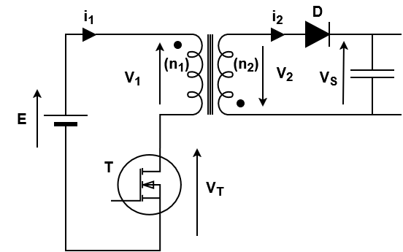
Introduction
Flyback
Forward
Push-Pull
Flyback principle
Partial
demagnetization
Full
demagnetization
Easiness, low power, few components
Alexis MARTIN 8

Slide 9
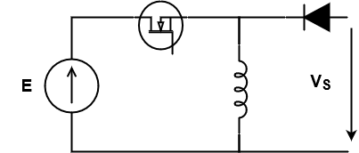
Introduction
Flyback
Forward
Push-Pull
Forward principle
Magnetic component optimized, more components
Alexis MARTIN 9

Slide 10
Introduction
Flyback
Forward
Push-Pull
Symmetric converter
High power, 2 transistors or more
Alexis MARTIN 10

Slide 11
Introduction
Flyback
Forward
Push-Pull
Flyback

Slide 12
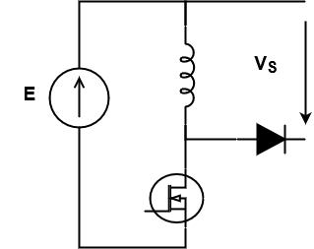
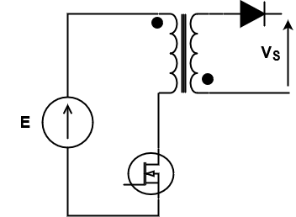
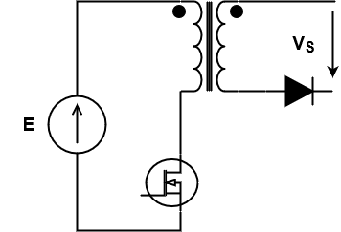
Introduction
Flyback
Forward
Push-Pull
FLYBACK converter study
Buck - Boost
Flyback

Slide 13
Introduction
Flyback
Transformer
Continuous mode
Discontinuous mode
Sizing
Forward
Push-Pull
FLYBACK converter study
Hypothesis : E constant, V_{s} constant, perfect semi-conductors
2 magnetic modes Partial demagnetization (continuous mode)
Full demagnetization (discontinuous mode)
Alexis MARTIN 13

Slide 14
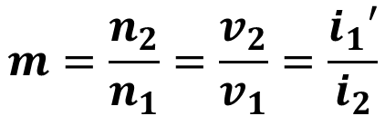
Introduction
Flyback
Transformer
Continuous mode
Discontinuous mode
Sizing
Forward
Push-Pull
Transformer model: convention !
No losses
L : magnetizing inductance (at the primary)
R: Reluctance of the magnetic circuit
$$m=\frac{n_{2}}{n_{1}}=\frac{v_{2}}{v_{1}}=\frac{i_{1}′}{i_{2}}$$
Hopkinson’s law
Alexis MARTIN 14

Slide 15


Introduction
Flyback
Transformer
Continuous mode
Discontinuous mode
Sizing
Forward
Push-Pull
Transformer model: convention !
No losses
$$v_{1}=+n_{1}\frac{dφ}{dt}$$
$$v_{2}=+n_{2}\frac{dφ}{dt}$$
Alexis MARTIN 15

Slide 16
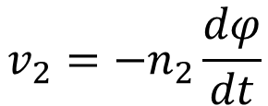
Introduction
Flyback
Transformer
Continuous mode
Discontinuous mode
Sizing
Forward
Push-Pull
FLYBACK transformer model
i
1
i'
1
i
2
m
i
10
v
L
v
1
2
$$v_{2}=−n_{2}\frac{dφ}{dt}$$
Alexis MARTIN 16

Slide 17
Introduction
Flyback
Transformer
Continuous mode
Discontinuous mode
Sizing
Forward
Push-Pull
Magnetizing current
i
1
i'
1
i
10
v
L
1
Magnetizing current⬄ flux in the magnetic circuit
Alexis MARTIN 17

Slide 18
Introduction
Flyback
Transformer
Continuous mode
Discontinuous mode
Sizing
Forward
Push-Pull
FLYBACK equivalent scheme
i
1
i'
1
m
i
10
D
v
1
L
v
2
V_{S}
E
α
,T
i
2
v
ce
Alexis MARTIN 18

Slide 19
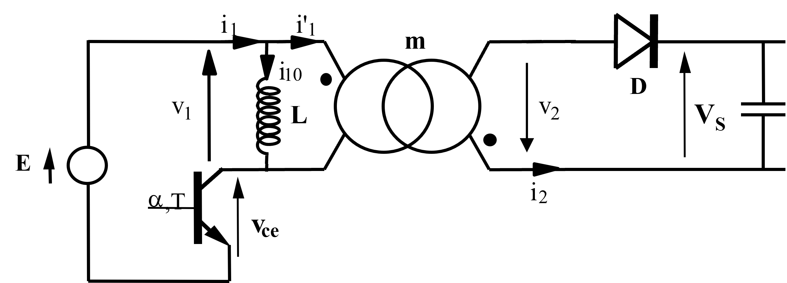
Introduction
Flyback
Transformer
Continuous mode
Discontinuous mode
Sizing
Forward
Push-Pull
Partial demagnetization mode: continuous conduction
0 < t < αT : T_{p} closed
=> v₁ = E => v₂ = m.E
v_{D} =-mE-V_{s} < 0 => D reverse
i₂ = 0 => i’₁ = 0 => i₁ = i₁₀
Energy storing
αT < t < T : T_{p} opened
=> i₁ = 0 => i’₁ = - i₁₀ < 0
=> i₂ < 0 => D forward
v₂ = -V_{S} => v₁ = - V_{S} /m=> ϕ decreases
Energy restitution
Alexis MARTIN 19

Slide 20
Introduction
Flyback
Transformer
Continuous mode
Discontinuous mode
Sizing
Forward
Push-Pull
i
10
ϕ
t
0
α
T
T
i
1
t
0
α
T
T
-i
2
t
0
α
T
T
Output voltage calculation
v
ce
E
v₁
t
0
α
T
T
Alexis MARTIN 20

Slide 21






Introduction
Flyback
Transformer
Continuous mode
Discontinuous mode
Sizing
Forward
Push-Pull
Demagnetization issue
Warning:
If no load connected
-> Output capacitor never discharges
-> Issue
Energy storing
V_{s}
t
Energy restitution
0
$$αT$$
$$T$$
$$T$$
$$+αT$$
$$2T$$
$$2T$$
$$+αT$$
$$3T$$
Alexis MARTIN 21

Slide 22
Introduction
Flyback
Transformer
Continuous mode
Discontinuous mode
Sizing
Forward
Push-Pull
Discontinuous mode: behavior
0 < t < αT : T_{p} closed
=> v₁ = E => v₂ = m.E
v_{D} <0 => D reverse
i₂ = 0 => i’₁ = 0 => i₁ = i₁₀
Energy storage
Unchanged mode
αT < t < α’T : T_{p} opened
=> i₁ = 0 => i’₁ = - i₁₀ < 0
=> i₂ < 0 => D forward and then reverse naturally
v₂ = -V_{S} => v₁ = - V_{S}/m => ϕ decreases
Energy restitution
α’T < t < T : T and D both reverse
All currents are zero
No more energy
=> v₁ = 0 ; v₂ = 0 => ϕ = 0
Alexis MARTIN 22

Slide 23
Introduction
Flyback
Transformer
Continuous mode
Discontinuous mode
Sizing
Forward
Push-Pull
i
ϕ
Discontinuous mode: chronograms
10
t
0
α
T
T
i
1
t
0
α
T
T
-i
2
Output voltage calculation:
Transferred energy
t
0
α
T
T
v
ce
E
v₁
t
0
α
T
α’
T
T
Alexis MARTIN 23

Slide 24
Introduction
Flyback
Transformer
Continuous mode
Discontinuous mode
Sizing
Forward
Push-Pull
Discontinuous mode: output characteristics
V
R_{max} : minimal load
s
V_{smax}
250
Useful area
R_{min} : maximal load
200
150
0,6
100
0,5
0,4
50
0,3
0,2
0
0,1
I_{smax}
I
s
Alexis MARTIN 24

Slide 25
Introduction
Flyback
Transformer
Continuous mode
Discontinuous mode
Sizing
Forward
Push-Pull
Boundary mode: Output filtering
i_{D}
i_{D}
I_{S}
I_{S}
t
i_{C}
αT
T
v_{S}
R_{S}
i_{C}
C_{S}
v_{S}
Δv_{S}
Alexis MARTIN 25

Slide 26
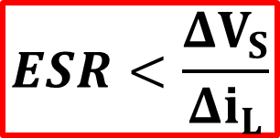
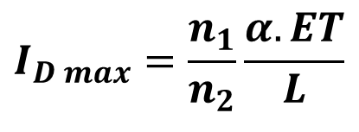
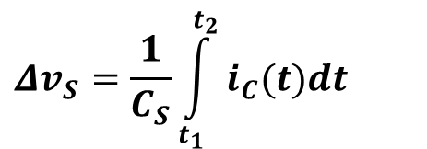
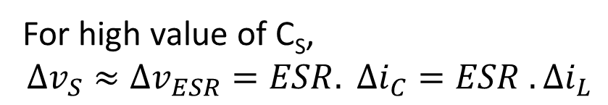
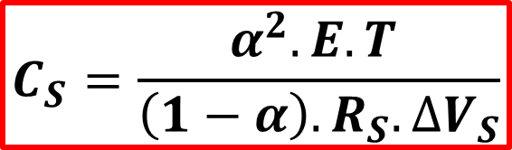
Introduction
Flyback
Transformer
Continuous mode
Discontinuous mode
Sizing
Forward
Push-Pull
Boundary mode: capacitor calculation
v_{S}
Δv_{S}
$$Δv_{S}=\frac{1}{C_{S}}\int_{t_{1}}^{t_{2}}{i_{C}(t)dt}$$
i_{C}
t₁
t₂
t₁ = αT
$$I_{D max}=\frac{n_{1}}{n_{2}}\frac{α.ET}{L}$$
$$C_{S}=\frac{α^{2}.E.T }{\left(1−α\right).R_{S}.∆V_{S}}$$
same as Buck-Boost
For high value of C_{S}, $$Δv_{S}≈Δv_{ESR}=ESR. Δi_{C}=ESR . Δi_{L}$$
$$ESR<\frac{ΔV_{S}}{Δi_{L}}$$
Alexis MARTIN 26

Slide 27
Introduction
Flyback
Transformer
Continuous mode
Discontinuous mode
Sizing
Forward
Push-Pull
Boundary mode: sizing components
i
1
di₁/dt = E/L
t
0
α
T
T
i
2
t
0
α
T
T
ϕ
Non-saturation : ϕ_{max} = A_{e}B_{sat}
t
Alexis MARTIN 27

Slide 28
Introduction
Flyback
Transformer
Continuous mode
Discontinuous mode
Sizing
Forward
Push-Pull
Boundary mode: transformer sizing
< max current density: δ_{max}
S_{B}
< k_{B}. Window area S_{B}
A_{e}
k_{B} = winding coefficient
Alexis MARTIN 28

Slide 29
Introduction
Flyback
Transformer
Continuous mode
Discontinuous mode
Sizing
Forward
Push-Pull
Boundary mode: transformer sizing
With P_{S}
With f
Alexis MARTIN 29

Slide 30
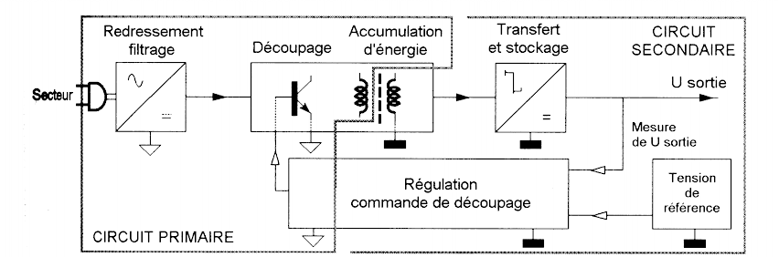
Introduction
Flyback
Transformer
Continuous mode
Discontinuous mode
Sizing
Forward
Push-Pull
Control principle
Rectifying
Filtering
Energy
storage
Transfer
and storage
SECONDARY CIRCUIT
Switching
U output
Supply
U output measurement
Control
Switching command
Reference
voltage
PRIMARY CIRCUIT
Output voltage control
Alexis MARTIN 30

Slide 31
Introduction
Flyback
Transformer
Continuous mode
Discontinuous mode
Sizing
Forward
Push-Pull
Boundary mode holding
zéro
I_{max}
Q
R
S
Alexis MARTIN 31

Slide 32
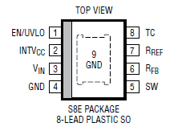
Introduction
Flyback
Transformer
Continuous mode
Discontinuous mode
Sizing
Forward
Push-Pull
Example: LT8302
Alexis MARTIN 32

Slide 33
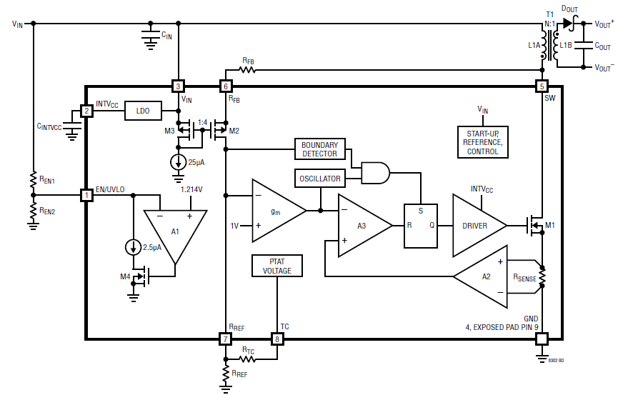
Introduction
Flyback
Transformer
Continuous mode
Discontinuous mode
Sizing
Forward
Push-Pull
Example: LT8302 (internal scheme)
Alexis MARTIN 33

Slide 34
Introduction
Flyback
Transformer
Continuous mode
Discontinuous mode
Sizing
Forward
Push-Pull
Example: LT8302
Alexis MARTIN 34

Slide 35


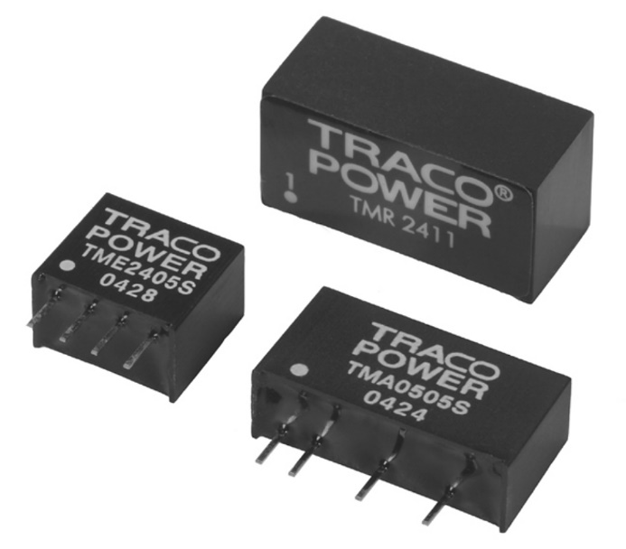
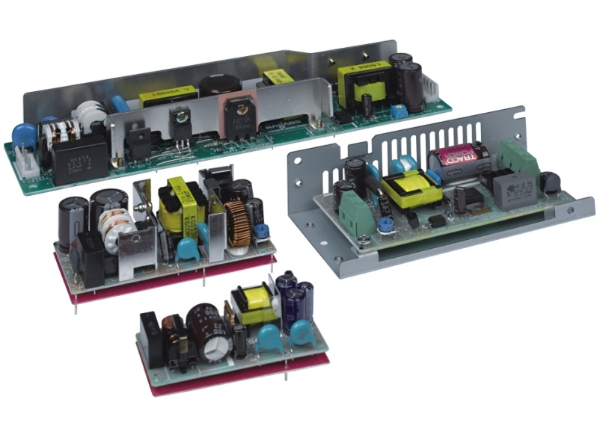
Introduction
Flyback
Transformer
Continuous mode
Discontinuous mode
Sizing
Forward
Push-Pull
Flyback examples
Alexis MARTIN 35

Slide 36
Introduction
Flyback
Forward
Push-Pull
Forward

Slide 37
Introduction
Flyback
Forward
Principle
Continuous mode
Sizing
Push-Pull
Flyback principle
Partial
demagnetization
Full
demagnetization
Easiness, low power, few components
Limited for high power due to energy storage limitations
Alexis MARTIN 37

Slide 38
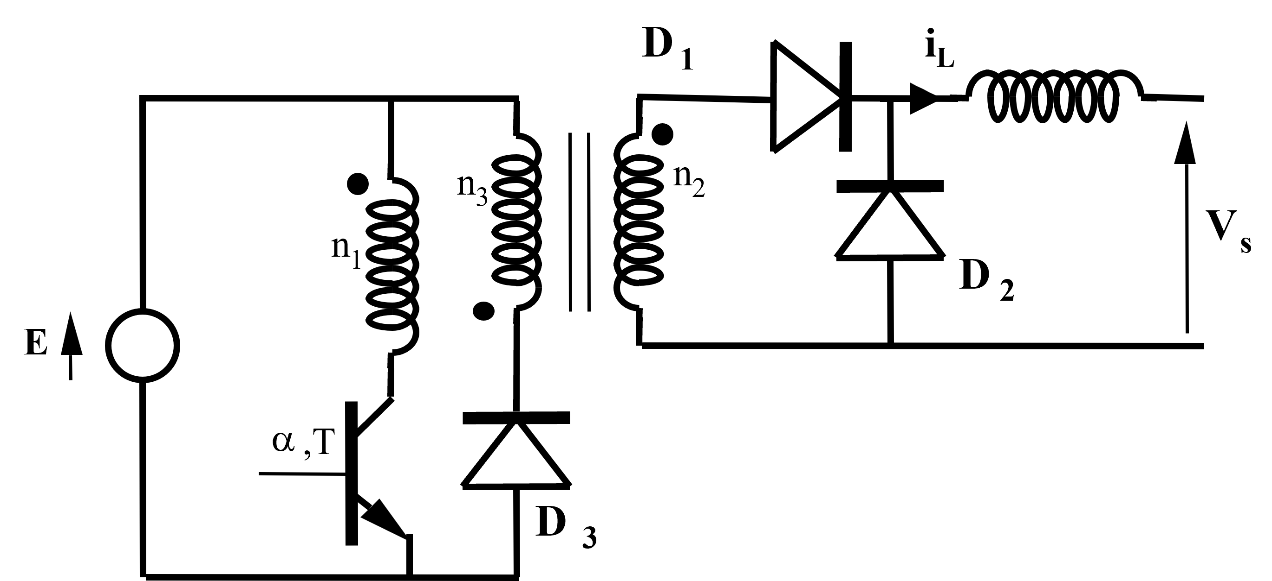
Introduction
Flyback
Forward
Principle
Continuous mode
Sizing
Push-Pull
Forward principle
Magnetic component optimized, more components
Alexis MARTIN 38

Slide 39
Introduction
Flyback
Forward
Principle
Continuous mode
Sizing
Push-Pull
Hopkinson’s law
D
i₂
i_{L}
1
i₁
n
n
2
3
V
n
1
s
D
2
E
i₃
α
,T
D
3
Alexis MARTIN 39

Slide 40
Introduction
Flyback
Forward
Principle
Continuous mode
Sizing
Push-Pull
Continuous mode study: i_{L} > 0
At least one of the two diodes D₁ and D₂ forwards.
0 < t < αT
D
i₂
i_{L}
T_{p} forward.
1
i₁
n
n
2
3
v₂
V
v₁
n
1
s
D
2
D₁ forward, D₂ reverse
i₂ = i_{L} > 0
E
v₃
i₃
α
,T
D
3
D₃ reverse
magnetization
Alexis MARTIN 40

Slide 41
Introduction
Flyback
Forward
Principle
Continuous mode
Sizing
Push-Pull
Continuous mode study
D
i₂
i_{L}
1
T_{p} opened => i₁ = 0
i₁
n
n
2
3
v₂
V
n
1
s
D
2
v₃
E
i₃
i₃ > 0 => D₃ forward
α
,T
demagnetization
D
3
D₁ reverse, D₂ forward
=> i₂ =0
Alexis MARTIN 41

Slide 42
Introduction
Flyback
Forward
Principle
Continuous mode
Sizing
Push-Pull
i
10
ϕ
t
0
α
T
t₀
T
i
L
i₂
t
0
α
T
T
i₁
i₁₀
i₃
t
Full demagnetization if: t₀ < T
0
α
T
mi₂
t₀
T
v_{ce}
v₁
E
t
0
α
T
T
Alexis MARTIN 42

Slide 43
Introduction
Flyback
Forward
Principle
Continuous mode
Sizing
Push-Pull
Continuous mode study: voltage transfer
i
L
t
0
α
T
T
V_{S} = α.m.E
Alexis MARTIN 43

Slide 44
Introduction
Flyback
Forward
Principle
Continuous mode
Sizing
Push-Pull
Continuous mode study: Components sizing
Filtering capacitor: C_{S}
Transformer => Ae.SB
Output inductance => Ae.SB
Alexis MARTIN 44

Slide 45
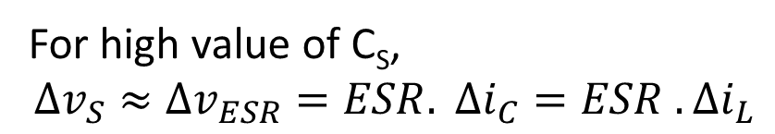
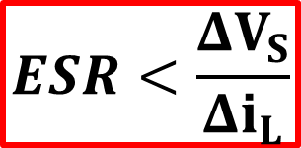
Introduction
Flyback
Forward
Principle
Continuous mode
Sizing
Push-Pull
Continuous mode study: Filtering capacitor
ΔI_{L}
ΔV
Max ripple for a = 0.5
For high value of C_{S}, $$Δv_{S}≈Δv_{ESR}=ESR. Δi_{C}=ESR . Δi_{L}$$
$$ESR<\frac{ΔV_{S}}{Δi_{L}}$$
Alexis MARTIN 45

Slide 46
Introduction
Flyback
Forward
Principle
Continuous mode
Sizing
Push-Pull
Continuous mode study: transformer sizing
i₂
I_{S}
Magnetising current neglected
i₁
αT
T
mI_{S}
ϕ
t
0
α
T
t₀
T
With P_{S}
With f
Alexis MARTIN 46

Slide 47
Introduction
Flyback
Forward
Principle
Continuous mode
Sizing
Push-Pull
Continuous mode study: inductor sizing
D
i₂
i_{L}
1
i₁
L
n
n
2
3
v₂
V
n
1
s
Hold the continuous mode
D
2
E
i₃
α
,T
D
3
i
i
L
L
I_{S}
ΔI_{L}
α
α
T
T
T
0
T
t
0
Alexis MARTIN 47

Slide 48
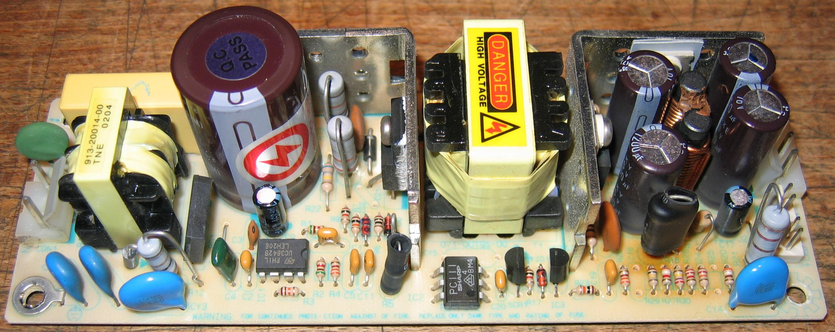
Introduction
Flyback
Forward
Principle
Continuous mode
Sizing
Push-Pull
Example
Manufacturer reference: CI Design Y0-2040AA Input : 100 à 240 Vac Output : 12 Vdc (2 A) 5 Vdc (3 A)
Alexis MARTIN 48

Slide 49
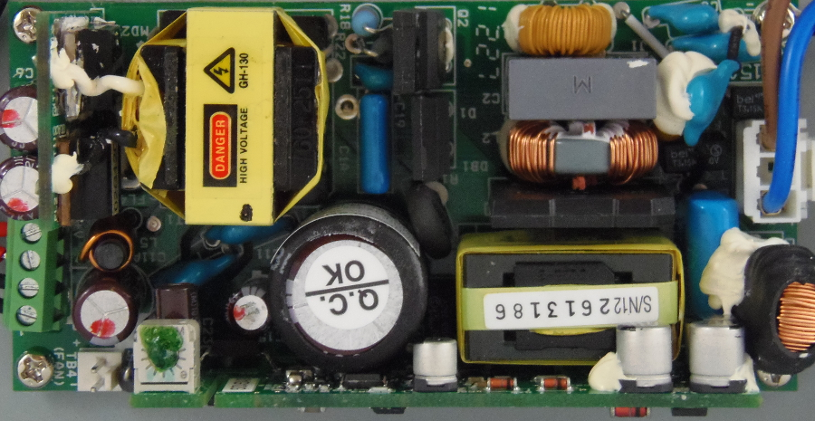
Introduction
Flyback
Forward
Principle
Continuous mode
Sizing
Push-Pull
Example
NuForce
Alexis MARTIN 49

Slide 50
Introduction
Flyback
Forward
Push-Pull
Push-Pull

Slide 51
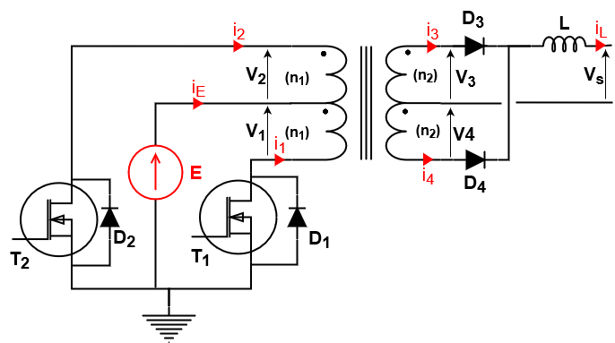
Introduction
Flyback
Forward
Push-Pull
Push-Pull
T₁
“Closed”
T₂
“Closed”
t
0
αT
T/2
Τ/2+αT
T
Alexis MARTIN 51

Slide 52

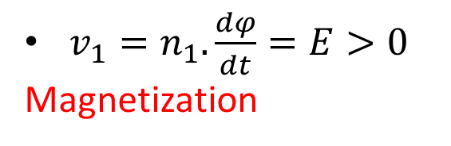
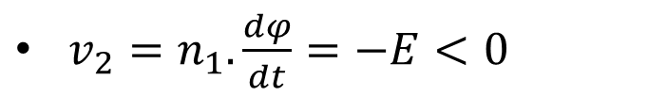



Introduction
Flyback
Forward
Push-Pull
No laod study
Continuous mode
Other structures
No load study : i_{L} = 0
0 < t < αT: T₁ “closed”, T2 “open”
$v_{1}=n_{1}.\frac{dφ}{dt}=E>0$
Magnetization
$v_{2}=v_{1}=E>0$
D₂ « reverse »
$${−n}_{1}.i_{1}=𝓡. φ$$
αT < t < T/2: T₁ & T₂ “open”
ϕ
T/2
+αT
$𝓡. φ=− n_{1}.i_{1}+n_{1}. i_{2}>0$
αT
T/2
T
D₂ « forward », D₁ « reverse »
v₁
$𝓡. φ=n_{1}. i_{2}>0$
$v_{2}=n_{1}.\frac{dφ}{dt}=−E<0$
Demagnetization

Slide 53
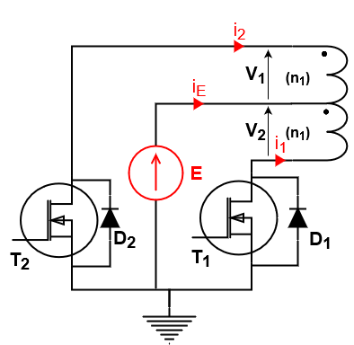



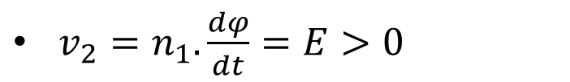


Introduction
Flyback
Forward
Push-Pull
No laod study
Continuous mode
Other structures
No load study : i_{L} = 0
T/2 < t < T/2+αT: T₁ “open”, T2 “closed”
$v_{1}=n_{1}.\frac{dφ}{dt}=−E<0$
Magnetization
$v_{2}=v_{1}=−E<0$
D₁ « reverse »
$$n_{1}.i_{2}=𝓡. φ$$
T/2+αT < t < T: T₁ & T₂ “open”
ϕ
T/2
+αT
$𝓡. φ=− n_{1}.i_{1}+n_{1}. i_{2}<0$
αT
T/2
T
D₁ « forward », D₂ « reverse »
v₁
$𝓡. φ=−n_{1}. i_{1}<0$
$v_{2}=n_{1}.\frac{dφ}{dt}=E>0$
Demagnetization

Slide 54
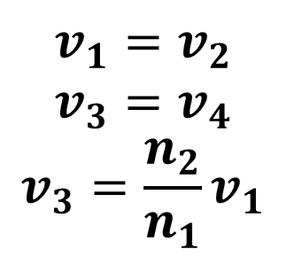
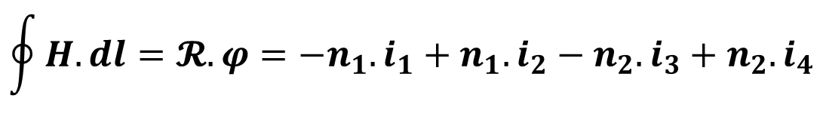

Introduction
Flyback
Forward
Push-Pull
No laod study
Continuous mode
Other structures
General properties
Hypothesis:
$$i_{L}≫i_{10}$$
$$v_{1}=v_{2}$$
$$v_{3}=v_{4}$$
$$v_{3}=\frac{n_{2}}{n_{1}}v_{1}$$
T₁ “closed” : D₃ “forward”, i₃ = i_{L}
T₂ “closed” : D₄ “forward”, i₄ = i_{L}
Hopkinson’s law
$$\oint{H.dl}=𝓡. φ=−n_{1}.i_{1}+n_{1}. i_{2}−n_{2}. i_{3}+n_{2}. i_{4}$$
Alexis MARTIN 54

Slide 55
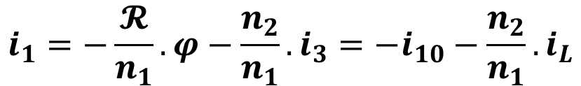

Introduction
Flyback
Forward
Push-Pull
No laod study
Continuous mode
Other structures
αT
Continuous mode study: magnetization
0
T₁
t
v₂
ϕ
i_{L}
0 < t < αT:
T₁ “closed”, T₂ “open”
D₃ “forward”, D₂ & D₄ “reverse”
i₁₀
$v_{1}=n_{1}.\frac{dφ}{dt}=E>0$ Magnetization
-i₁
$$−n_{1}.i_{1}−n_{2}. i_{3}=𝓡. φ$$
$$i_{1}=−\frac{𝓡}{n_{1}}. φ−\frac{n_{2}}{n_{1}}. i_{3}=−i_{10}−\frac{n_{2}}{n_{1}}. i_{L}$$
Alexis MARTIN 55

Slide 56
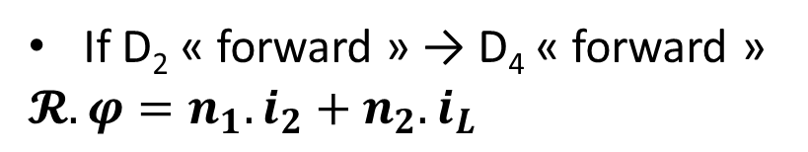



Introduction
Flyback
Forward
Push-Pull
No laod study
Continuous mode
Other structures
T₁
αT
t
0
Continuous mode study: second phase
v₂
ϕ
i_{L}
i₁₀
αT < t < T/2:
T₁ & T₂ “open”
i₃
$$𝓡. φ=−n_{1}.i_{1}+n_{1}. i_{2}−n_{2}. i_{3}+n_{2}. i_{4}>0$$
If D₂ « forward » → D₄ « forward »
$$𝓡. φ=n_{1}. i_{2}+n_{2}. i_{L}$$
D₂ “reverse”
i₄
$$𝓡. φ=−n_{2}. i_{3}+n_{2}. i_{4}>0$$
D₃ & D₄ “forward”
$${v_{2}=v}_{3}=v_{4}=0$$
$$φ=cst$$
Alexis MARTIN 56
Notes:
If D2 forward so D3 forward (voltage negative) and D4 reverse -> not possible because il>>i0
D4 forward because flux positive and D3 forward because il>>i0

Slide 57
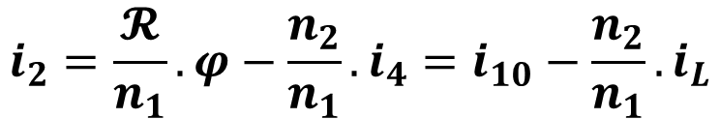

Introduction
Flyback
Forward
Push-Pull
No laod study
Continuous mode
Other structures
0
T₁
T₂
Continuous mode study: demagnetization
αT
T/2
v₁
ϕ
i_{L}
i₁₀
T/2 < t < T/2+αT:
T₁ “open”, T₂ “closed”
D₄ “forward”, D₁ & D₃ “reverse”
i₃
$v_{2}=n_{1}.\frac{dφ}{dt}=−E<0$ Demagnetization
$$n_{1}.i_{2}+n_{2}. i_{4}=𝓡. φ$$
i₄
$$i_{2}=\frac{𝓡}{n_{1}}. φ−\frac{n_{2}}{n_{1}}. i_{4}=i_{10}−\frac{n_{2}}{n_{1}}. i_{L}$$
Alexis MARTIN 57

Slide 58

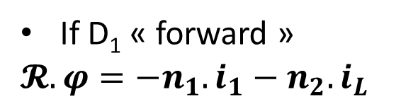
Introduction
Flyback
Forward
Push-Pull
No laod study
Continuous mode
Other structures
0
T₁
T₂
Continuous mode study: fourth phase
v₁
αT
T/2
T
ϕ
i_{L}
i₁₀
T/2+αT < t < T:
T₁ & T₂ “open”
i₃
$$𝓡. φ=−n_{1}.i_{1}+n_{1}. i_{2}−n_{2}. i_{3}+n_{2}. i_{4}<0$$
If D₁ « forward »
$$𝓡. φ=−n_{1}. i_{1}−n_{2}. i_{L}$$
D₁ “reverse”
i₄
$$𝓡. φ=−n_{2}. i_{3}+n_{2}. i_{4}<0$$
D₃ & D₄ “forward”
$${v_{2}=v}_{3}=v_{4}=0$$
$$φ=cst$$
Alexis MARTIN 58
Notes:
If D1 forward so D4 forward (voltage positive) and D3 reverse -> not possible because il>>i0
D3 forward because flux negative and D4 forward because il>>i0

Slide 59
Introduction
Flyback
Forward
Push-Pull
No laod study
Continuous mode
Other structures
-i₁
Continuous mode study: chronograms
0
αT
T
0
T₁
T₂
T
-i₂
αT
v₁
i_{L}
ϕ
i₃
i₁₀
i₄
Alexis MARTIN 59

Slide 60
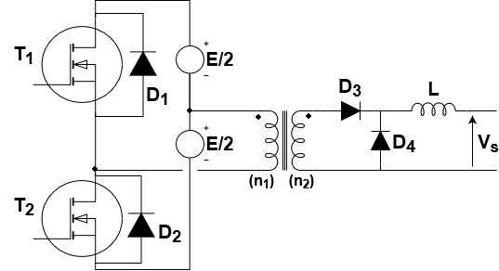
Introduction
Flyback
Forward
Push-Pull
No laod study
Continuous mode
Other structures
Other symmetrical structures : Half Bridge Forward
Same behavior as Push-Pull
Only on primary and secondary winding
Transformer simpler (so cheaper)

Slide 61
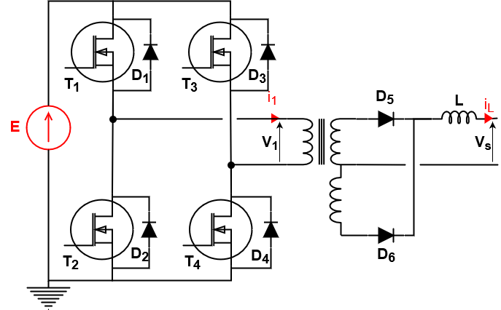
Introduction
Flyback
Forward
Push-Pull
No laod study
Continuous mode
Other structures
Other symmetrical structures: Full Bridge Forward
Same behavior with
no-load and full load
Control with the shift
between the two arms
T₄
T₃
T₄
T₃
T₄
T₁
T₂
T₁
T₂
t
0
αT
T/2
T
3T/2

