Slide 1

Energy Conversion I
alexis.martin@ensea.fr
Desk D216

Slide 2
Layout
Non isolated choppers
Switch mode power supplies
Power components
Passive components
Inductor
Transformer
Capacitor
Active components
Diodes
Transistors
Protections
Fuses
Thermistors
ESD protection
Alexis MARTIN 2

Slide 3
Passive components
Active components
Protections
Passive components

Slide 4
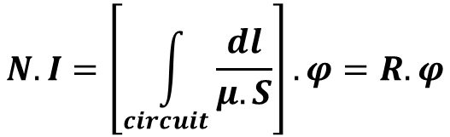
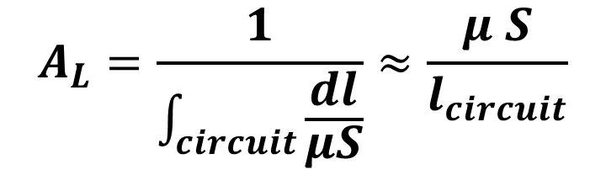
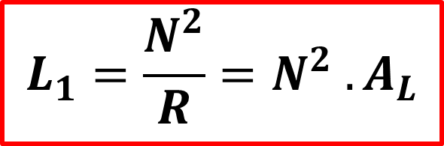
Passive components
Inductor
Transformer
Capacitor
Active components
Protections
Iron core Inductor
$$N.I=\left[\int_{circuit}^{ }{\frac{dl}{μ.S}}\right]. φ=R. φ$$
ϕ= B.S : elementary flux (real flux)
Φ = N.ϕ = L.I : “total flux” (sawn by the electrical circuit)
$$L_{1}=\frac{N^{2}}{R}=N^{2} . A_{L}$$
$$A_{L}=\frac{1}{\int_{circuit}^{ }{\frac{dl}{μS}}}≈\frac{μ S}{l_{circuit}}$$
Alexis MARTIN 4

Slide 5
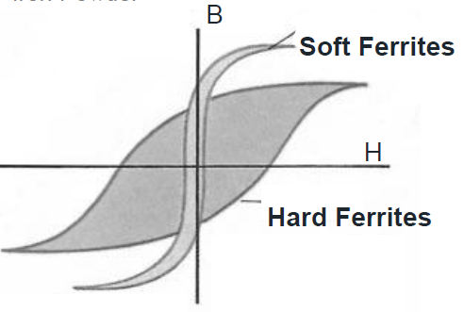
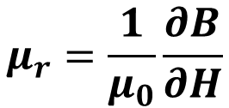
Passive components
Inductor
Transformer
Capacitor
Active components
Protections
Hysteresis
B
H
Ideal
Characteristic
$$μ_{r}=\frac{1}{μ_{0}}\frac{∂B}{∂H}$$
EMC BASICS, Würth Elektronik
Alexis MARTIN 5

Slide 6
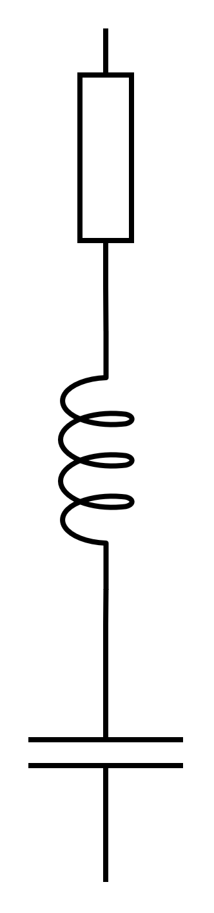
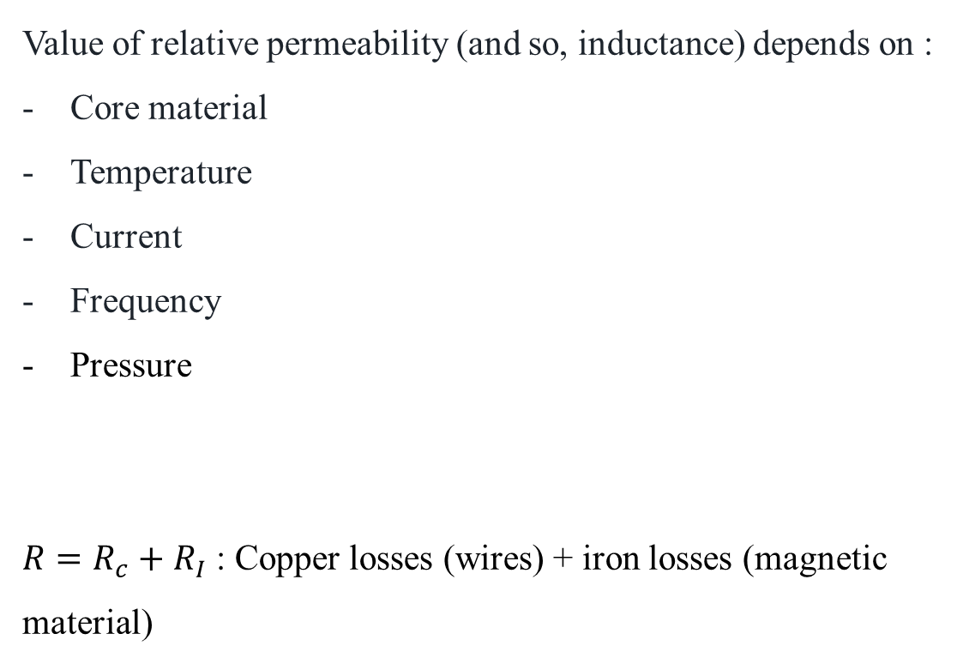
Passive components
Inductor
Transformer
Capacitor
Active components
Protections
Losses
Value of relative permeability (and so, inductance) depends on :
Core material
Temperature
Current
Frequency
Pressure
$R=R_{c}+R_{I}$ : Copper losses (wires) + iron losses (magnetic material)
r
L
Alexis MARTIN 6

Slide 7
Passive components
Inductor
Transformer
Capacitor
Active components
Protections
Iron core Inductor
Core material
Typical value ranges
Iron powder (Fe): 𝜇_{r} = 50 … 150
Nickel-zinc ferrite (Ni𝑥Zn1−𝑥Fe2O4): 𝜇_{r} = 50 … 1500
Manganese-zinc ferrite (Mn𝑥Zn1−𝑥Fe2O4): 𝜇_{r} = 2000 … 10000
Nanocrystalline material (Fenc): 𝜇_{r} = 5000 … 95000
EMC BASICS, Würth Elektronik

Slide 8
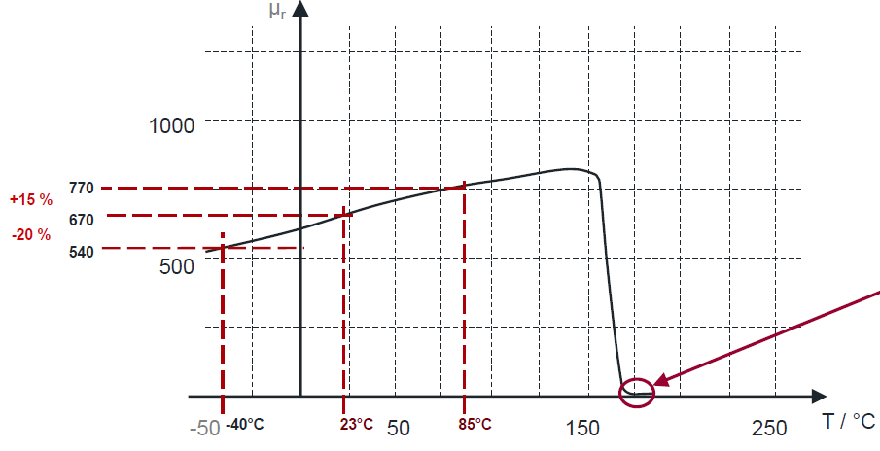
Passive components
Inductor
Transformer
Capacitor
Active components
Protections
Iron core Inductor
Temperature
Curie temperature
EMC BASICS, Würth Elektronik

Slide 9
Passive components
Inductor
Transformer
Capacitor
Active components
Protections
Iron core Inductor
Current
Safe Operation Area
Critical Operating Area
Total Saturation Area
POWER INDUCTOR SELECTION , Würth Elektronik

Slide 10
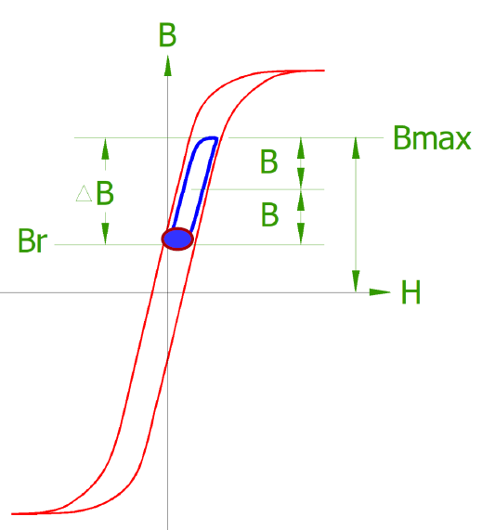
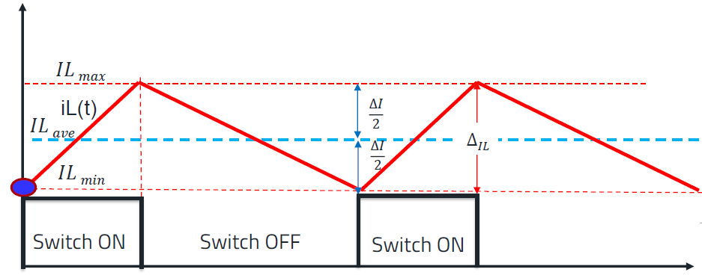
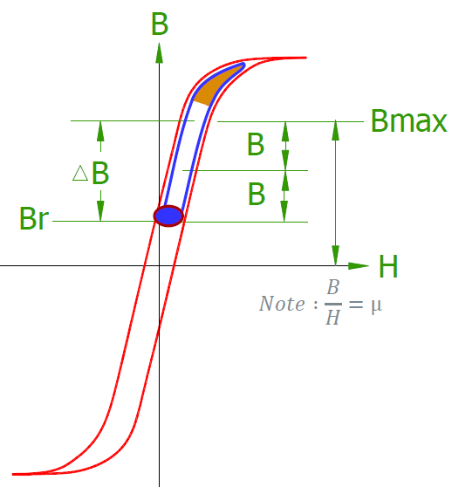
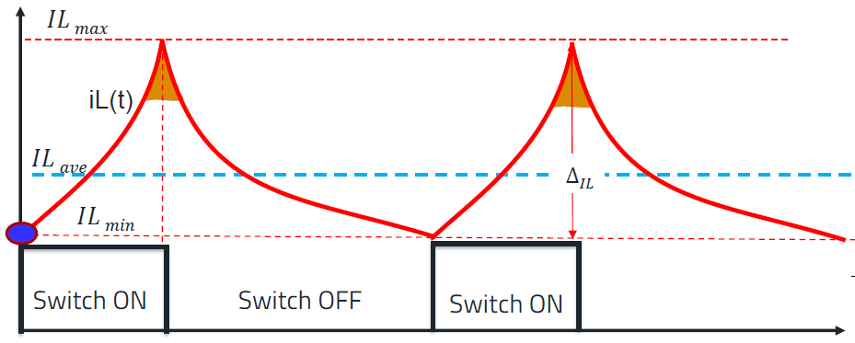
Passive components
Inductor
Transformer
Capacitor
Active components
Protections
Iron core Inductor
Current
POWER INDUCTOR SELECTION , Würth Elektronik

Slide 11
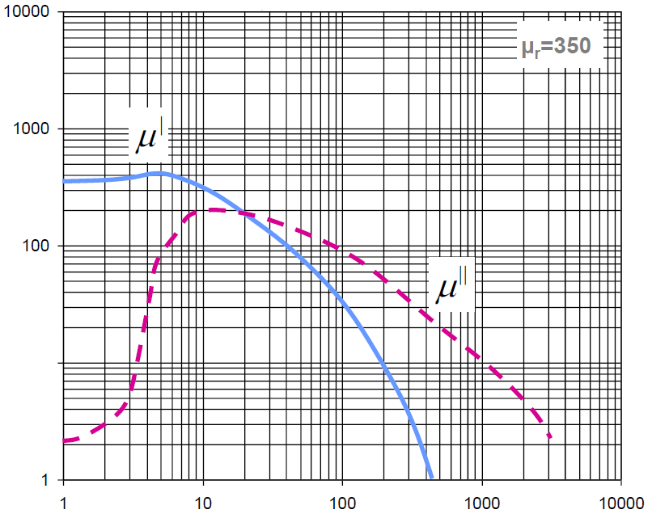



Passive components
Inductor
Transformer
Capacitor
Active components
Protections
Iron core Inductor
Frequency
$$R=R_{c}+R_{i}$$
$$R_{i}=ωL_{o}μ′′$$
$$L=L_{o}μ′$$
EMC BASICS, Würth Elektronik

Slide 12
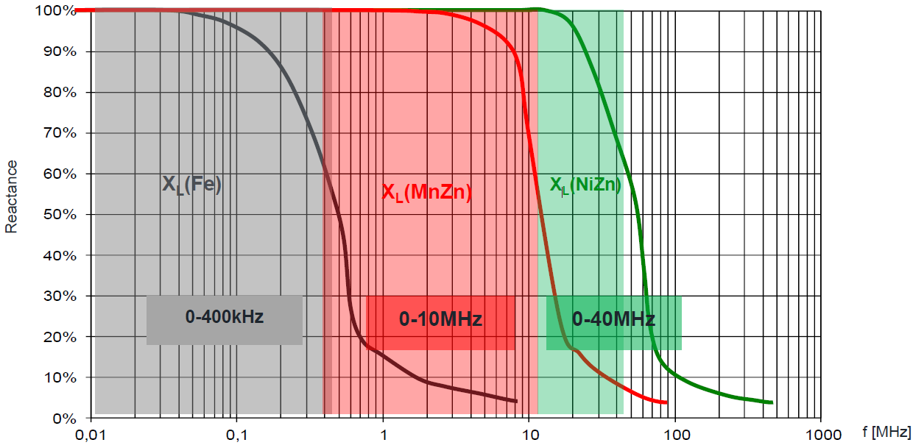
Passive components
Inductor
Transformer
Capacitor
Active components
Protections
Iron core Inductor
Frequency
EMC BASICS, Würth Elektronik

Slide 13
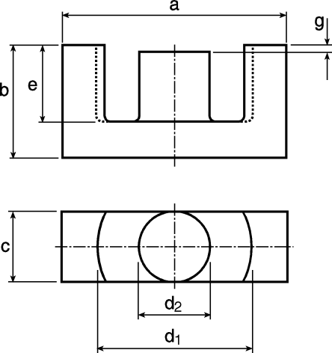
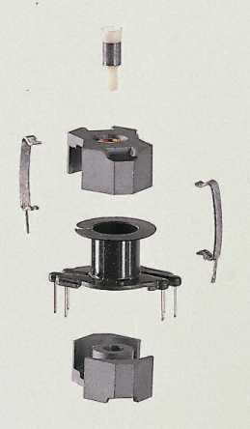
Passive components
Inductor
Transformer
Capacitor
Active components
Protections
Magnetic circuit example
ETD series
Alexis MARTIN 13

Slide 14
Passive components
Inductor
Transformer
Capacitor
Active components
Protections
Magnetic circuit example
Toroidal coil
Solenoid coil
Solenoid coil + Shielding
Multilayer (low current)
POWER INDUCTOR SELECTION , Würth Elektronik
Alexis MARTIN 14

Slide 15
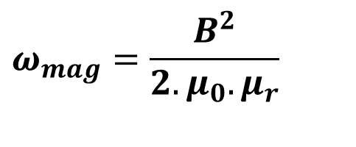
Passive components
Inductor
Transformer
Capacitor
Active components
Protections
Stored energy – Air-gap
$$ω_{mag}=\frac{B^{2}}{2.μ_{0}.μ_{r}}$$
Magnetic energy density stored
Example : Ferrinox B52
B = 0,4 T
= μ₀.μ_{r} = 2,5 10⁻³ H.m⁻¹
ω_{mag} = 32 J/m³
Air-gap : μ0 = 4π.10⁻⁷ H.m-1
ω_{mag} = 65 kJ/m³
Store energy in the air-gap
Alexis MARTIN 15

Slide 16
Passive components
Inductor
Transformer
Capacitor
Active components
Protections
With air-gap
Air-gap
window
Alexis MARTIN 16

Slide 17
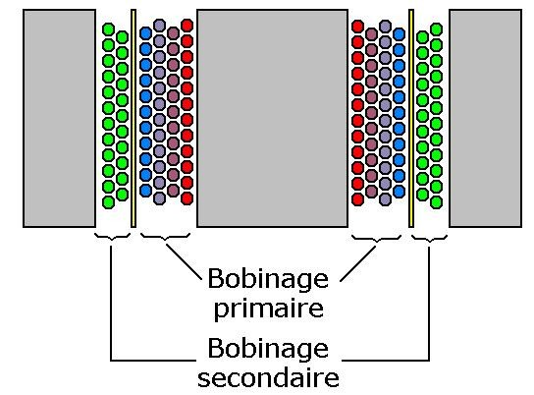
Passive components
Inductor
Transformer
Capacitor
Active components
Protections
Closed core
Primary
winding
Secondary
winding
Alexis MARTIN 17

Slide 18
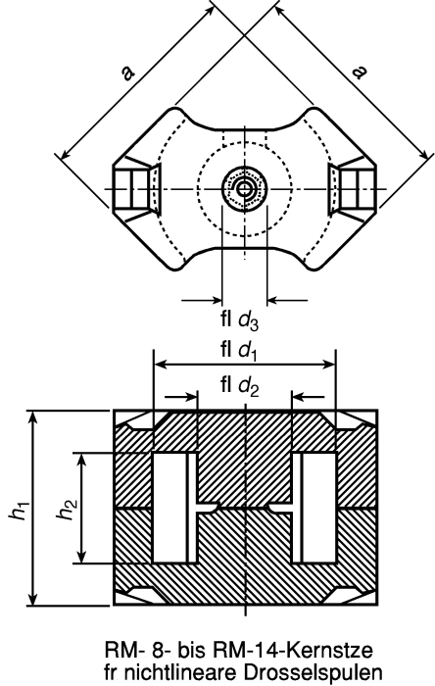
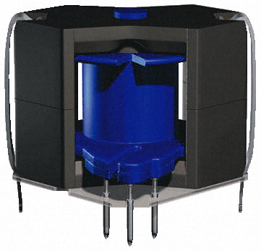
Passive components
Inductor
Transformer
Capacitor
Active components
Protections
Magnetic pot core
RM series
Alexis MARTIN 18

Slide 19
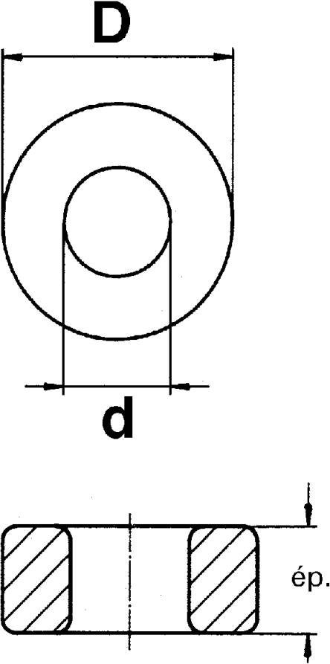
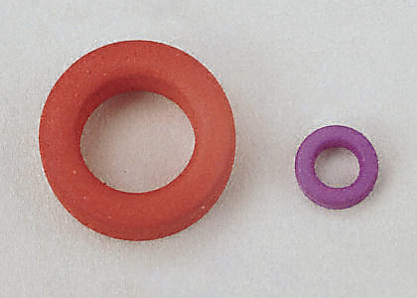
Passive components
Inductor
Transformer
Capacitor
Active components
Protections
Torus
Alexis MARTIN 19

Slide 20
Passive components
Inductor
Transformer
Capacitor
Active components
Protections
Magnetic circuits parameters
Winding Area
S_{b}
Effective area
A_{e}
Air-gap
e
Inductance factor: A_{L} = Inductance obtained with ONE loop
Alexis MARTIN 20

Slide 21
Passive components
Inductor
Transformer
Capacitor
Active components
Protections
Critical constraints
Induction in the material: B < B_{sat}
0,2 to 0,5 T for classical materials
Current density in the winding: δ < δ_{max}
5 A/mm² for copper
Sizing : product A_{e}.S_{b}
Alexis MARTIN 21

Slide 22



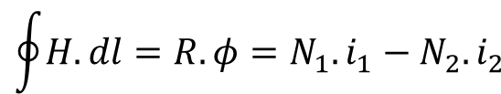
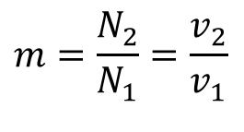
Passive components
Inductor
Transformer
Capacitor
Active components
Protections
Transformer
i₁
i₂
Primary : N₁ turns
Secondary : N₂ turns
v₁
v₂
$$v_{1}=N_{1}.\frac{dφ}{dt}$$
$$v_{2}=N_{2}.\frac{dφ}{dt}$$
$$m=\frac{N_{2}}{N_{1}}=\frac{v_{2}}{v_{1}}$$
Winding direction
$$\oint{H.dl=R.φ=N_{1}.i_{1}−N_{2}.i_{2}}$$
Magnetizing current i₁₀ : Hopkinson’s law
$$i_{1}−m.i_{2}=i_{10}$$
Alexis MARTIN 22

Slide 23
Passive components
Inductor
Transformer
Capacitor
Active components
Protections
Transformer : equivalent scheme
r
i
1
i'
1
i
2
m
i
10
v
v
1
L₁
R_{f}
2
λ
L₁ : Magnetizing inductance (at primary side)
R_{f} : ferromagnetic losses
r : Joule loss (or ohmic loss)
λ : leakage inductance
Alexis MARTIN 23

Slide 24
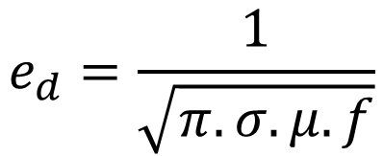
Passive components
Inductor
Transformer
Capacitor
Active components
Protections
Skin effect
$$e_{d}=\frac{1}{\sqrt{π.σ.μ.f}}$$
r
e_{d} : skin depth thickness
σ : conductivity
μ : permeability
f : frequency
Alexis MARTIN 24

Slide 25
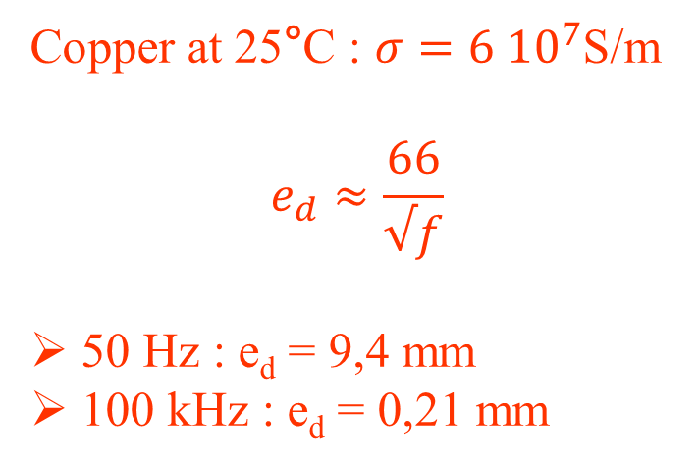
Passive components
Inductor
Transformer
Capacitor
Active components
Protections
Skin effect
Copper at 25°C : $σ=6 {10}^{7}$S/m
$$e_{d}≈\frac{66}{√f}$$
50 Hz : e_{d} = 9,4 mm
100 kHz : e_{d} = 0,21 mm
r
e_{d}
=> Multi strand wire (Litz wire)
For AC part of current !
Alexis MARTIN 25

Slide 26
Passive components
Inductor
Transformer
Capacitor
Active components
Protections
Winding
k_{B} = 0,7
Alexis MARTIN 26

Slide 27
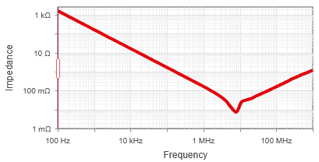
Passive components
Inductor
Transformer
Capacitor
Active components
Protections
Capacitors
r
Losses in the capacitor
u
L
C
Rated voltage: U_{eff}
r : ESR (Equivalent Series Resistor)
L : ESL (Equivalent Series Inductor)
Multiple technologies : depends on the frequency
Redexpert (Würth Elektronik)
Alexis MARTIN 27

Slide 28
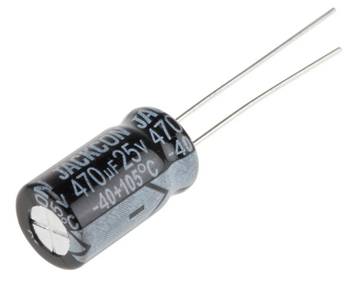
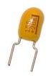
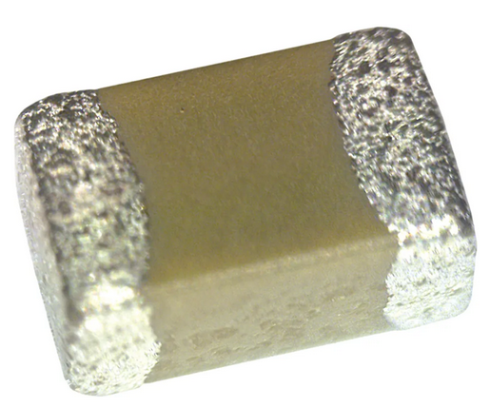
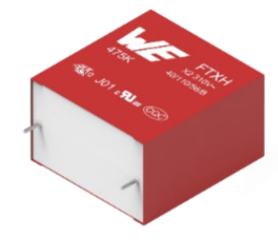
Passive components
Inductor
Transformer
Capacitor
Active components
Protections
Capacitors
Polarized |  | Unpolarized
Aluminum | Solid Tantalum | MLCC : Multilayer ceramic capacitors | Film
High value |  | High voltage
High capacitance |  | Small size | Self healing
Lifetime depends on temperature | More expensive | Low ESR & ESL
 | Small size | “lower” capacitance
Capacitor Selection Guidelines for Analog Devices Fundamentals of Capacitor Technology and their Applications (Würth Elektronik) Capacitor Selection Guide (Murata)
Alexis MARTIN 28
Notes:
Autocicatrisation : apparition d’un arc qui vaporise le film métallique puis apparition d’oxyde isolant

Slide 29
Passive components
Inductor
Transformer
Capacitor
Active components
Protections
Capacitors
MLCC :
Class I ceramic capacitor (NP0, C0G …)
Made from ceramic material not sensitive to temperature (TiO2 …)
Low permittivity -> low capacitance value
Next to no aging
Class II ceramic capacitor (X5R, X7R, Y5V …)
Made from ceramic materials that are derived from a barium titanate (BaTiO₃) base : sensitive to temperature
High permittivity : high capacitance value
High voltage dependency
MLCC Application Notes (TDK) Fundamentals of Capacitor Technology and their Applications (Würth Elektronik)
Alexis MARTIN 29

Slide 30
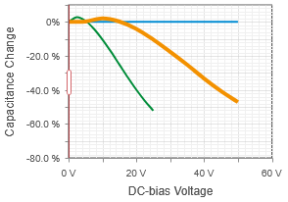
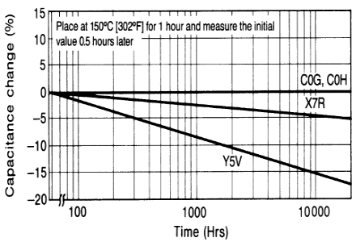
Passive components
Inductor
Transformer
Capacitor
Active components
Protections
Capacitors
MLCC :
NP0
X7R
X5R
MLCC Application Notes (TDK) Fundamentals of Capacitor Technology and their Applications (Würth Elektronik)
Alexis MARTIN 30

Slide 31
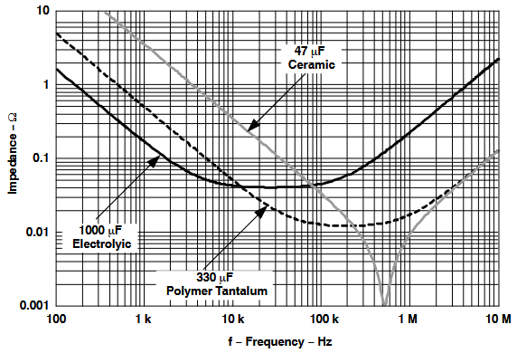
Passive components
Inductor
Transformer
Capacitor
Active components
Protections
Capacitors
ESR and ESL variations
Input and Output Capacitor Selection (Texas Instrument)
Alexis MARTIN 31
Notes:
On voir les variations de l’ESR et ESL en fonction de la technologie

Slide 32
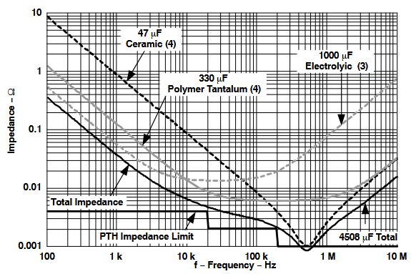
Passive components
Inductor
Transformer
Capacitor
Active components
Protections
Capacitors
Multiple technologies in parallel
Input and Output Capacitor Selection (Texas Instrument)
Alexis MARTIN 32
Notes:
Utilisation de technologies différentes pour sommer les avantages : valeur de capa élevé + faible ESR / ESL au global

Slide 33
Passive components
Active components
Protections
Active components

Slide 34
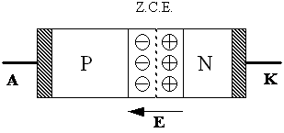
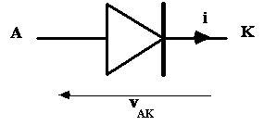
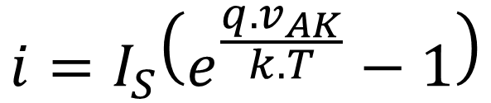
Passive components
Active components
Diodes
MOS transistor
IGBT transistor
Protections
Active components
PN junction
Diode
$$i=I_{S}\left(e^{\frac{q. v_{AK}}{k.T}}−1\right)$$
Alexis MARTIN 34

Slide 35
Passive components
Active components
Diodes
MOS transistor
IGBT transistor
Protections
Diode : static characteristic
I₀ : Average forward current, or I_{F}, I_{AV}
I_{FM} : Peak forward current
I_{FSM} : Peak forward surge current
I_{RRM} : Reverse repetitive current
i
I
0
V
v
BR
0
AK
I
s
V
0
V₀ : Forward voltage or V_{FM}
V_{BR} : Breakdown reverse voltage
V_{RRM} : Peak repetitive reverse voltage
Alexis MARTIN 35

Slide 36
Passive components
Active components
Diodes
MOS transistor
IGBT transistor
Protections
Diode : simplified static characteristics
i
V_{AK} = r_{on}.i + V₀
Linearized characteristic
3 segments
v_{AK}
0
Conduction loss calculation
P_{c} = r_{on}.I_{eff}² + V₀. I_{av}
i = 0
v_{AK} = V_{BR}
Alexis MARTIN 36

Slide 37
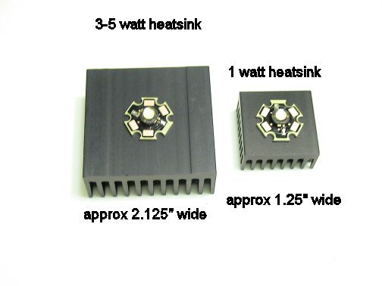
Passive components
Active components
Diodes
MOS transistor
IGBT transistor
Protections
Heat sink
Rth_{j/c}
θ_{c}
θ_{j}
Rth_{c/a}
P
θ_{a}
P = P_{c} + P_{b}
Rth_{c/a} calculation
θ_{j} < θ_{jmax}
Alexis MARTIN 37

Slide 38
Passive components
Active components
Diodes
MOS transistor
IGBT transistor
Protections
Specific diode
Low threshold diode: Schottky diode
High voltage diode
Power Zener diodes (« Transient-voltage-suppression diode »)
Fast diodes (low Q_{R})
Light-emitting diodes (high threshold)
Alexis MARTIN 38

Slide 39
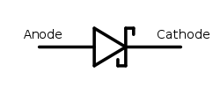
Passive components
Active components
Diodes
MOS transistor
IGBT transistor
Protections
Schottky diode
Low V_{F} -> Low conduction losses
Used as diodes in converters (instead of PN diodes)
“low” voltage (max ̴100V)
Alexis MARTIN 39

Slide 40
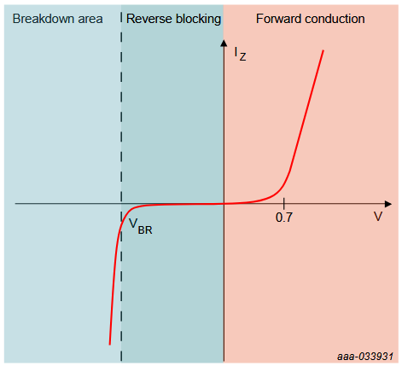
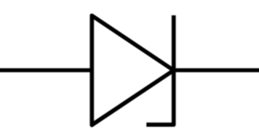
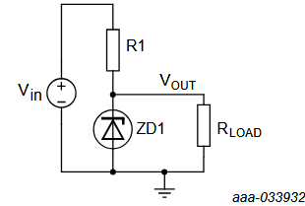
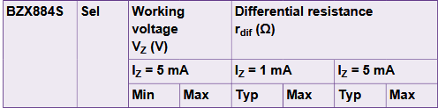

Passive components
Active components
Diodes
MOS transistor
IGBT transistor
Protections
Zener diode
anode
cathode
Stable V_{BR}
Low-cost stabilized voltage
Signal overvoltage clamping
( low reverse current)
I-V characteristic of a Zener diode
AN90031 (Nexperia)
Alexis MARTIN 40

Slide 41
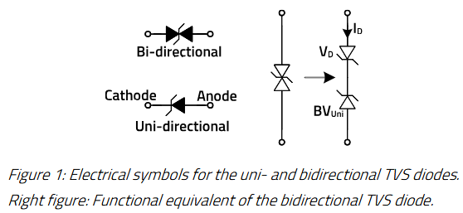
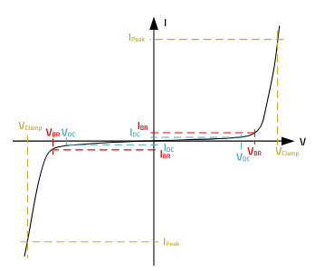
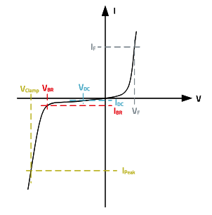
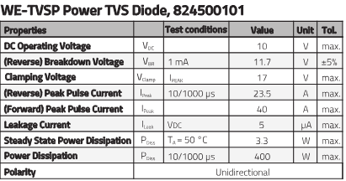
Passive components
Active components
Diodes
MOS transistor
IGBT transistor
Protections
TVS diode
TVS : Transient Voltage Suppressors
Protection against high voltage spikes
ESD protection (USB …)
Overvoltage clamping (high peak pulse current)
ANP143 (Würth Elektronik)
Alexis MARTIN 41

Slide 42




Passive components
Active components
Diodes
MOS transistor
IGBT transistor
Protections
LED diode
LM301B (Samsung)
« White » LED
Alexis MARTIN 42

Slide 43

Passive components
Active components
Diodes
MOS transistor
IGBT transistor
Protections
Power MOSFET
Designing with power MOSFETs (Infineon)
Alexis MARTIN 43

Slide 44
Passive components
Active components
Diodes
MOS transistor
IGBT transistor
Protections
MOSFET characteristics
Variable
Linear
resistance
i_{D}
Linear area
v_{GS2}
v_{GS1}
Off state
v_{DS}
V
BRDSS
Alexis MARTIN 44

Slide 45
Passive components
Active components
Diodes
MOS transistor
IGBT transistor
Protections
MOS safety area
Alexis MARTIN 45

Slide 46

Passive components
Active components
Diodes
MOS transistor
IGBT transistor
Protections
Control specificity
µC
Low V_{gs} => high losses
µC
Alexis MARTIN 46

Slide 47



Passive components
Active components
Diodes
MOS transistor
IGBT transistor
Protections
MOSFET Gate Driver LTC7065 (Analog Devices)
10-LEAD MSOP Package
Alexis MARTIN 47

Slide 48
Passive components
Active components
Diodes
MOS transistor
IGBT transistor
Protections
Power IGBT
Alexis MARTIN 48

Slide 49


Passive components
Active components
Diodes
MOS transistor
IGBT transistor
Protections
Modules
1200 V – 39 A at 25°C – t_{f} < 200ns
1200 V – 231 A at 25°C – t_{f} < 500ns
Alexis MARTIN 49

Slide 50
Passive components
Active components
Diodes
MOS transistor
IGBT transistor
Protections
Control specificity
Alexis MARTIN 50

Slide 51



Passive components
Active components
Diodes
MOS transistor
IGBT transistor
Protections
IGBT Gate Driver MC33153 (Onsemi)
Alexis MARTIN 51

Slide 52
Passive components
Active components
Protections
Protections

Slide 53





Passive components
Active components
Protections
Fuses
Thermistors
ESD protection
Fuses
Overcurrent protection
MAXI Series Blade Fuses – Rated 32V (Littlefuse)

Slide 54
Passive components
Active components
Protections
Fuses
Thermistors
ESD protection
Fuses
Depending on the reaction time needed, five classes are available on the market (IEC 60127-1 standard):
FF: very quick acting
F: quick acting
M: medium time-lag
T: time-lag / time delay
TT: long time-lag
Fast acting | Time lag / time delay
No intentional time-delay feature Fast acting Hundreds of milliseconds acting Non inductive loads | Few seconds delay (motor start …) Motor and general protection
How to Select the Right Fuse (Vishay) + Fuse Fundamentals (Littlefuse)

Slide 55




Passive components
Active components
Protections
Fuses
Thermistors
ESD protection
NTC thermistors
NTC : Negative Temperature Coefficient
Commonly referred to as Inrush Current Limiters (ICLs)
Technical Note ELX1247 (Eaton) + NTC Inrush Current Limiters Application notes (TDK)
Alexis MARTIN 55

Slide 56


Passive components
Active components
Protections
Fuses
Thermistors
ESD protection
PTC thermistors
PTC : Positive Temperature Coefficient
Overcurrent protection
Temperature sensing
High voltage
PTC Thermistors Application notes (TDK)
Alexis MARTIN 56

Slide 57




Passive components
Active components
Protections
Fuses
Thermistors
ESD protection
PPTC thermistors
PPTC : Polymeric Positive Temperature Coefficient
Also known as polyfuse
Application notes K1467 (Bourns) + POLY-FUSE® and PolySwitch® SMD PPTC Application (Littlefuse)
+ Applications of PPTC in Circuit Protections (Yageo)
Alexis MARTIN 57

Slide 58

Passive components
Active components
Protections
Fuses
Thermistors
ESD protection
ESD protection
ANP143 (Würth Elektronik)
Alexis MARTIN 58

