Slide 1
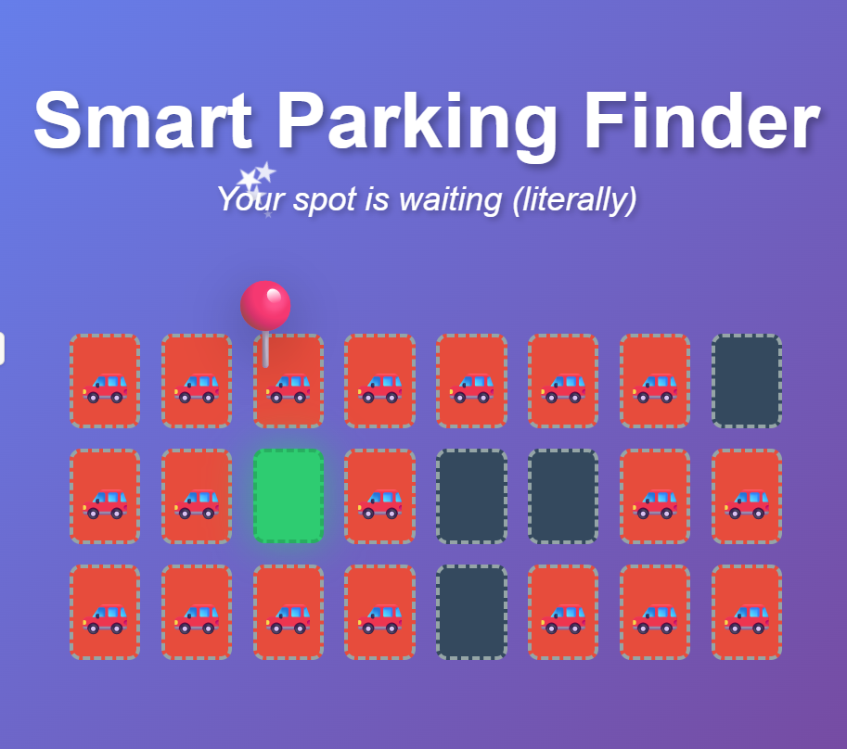
Product name: Smart Parking Finder

Slide 2
Problem → Solution
Searching for parking in busy areas is frustrating
Drivers waste valuable time circling for a spot
An AI-powered app that detects open spaces in real time
Users are instantly shown available spots near them

Slide 3
How AI Improves Smart Parking Finder
- Real-time spot detection from camera/sensor data
- Predictive parking based on usage patterns
- Smart routing to nearest available spot
- Adaptive learning from user behavior and city data
- Benefits: less circling, lower fuel use, reduced stress

Slide 4
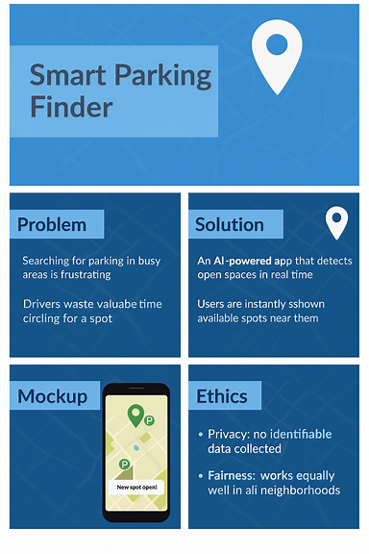
Mockup: Mobile app interface showing nearby open parking spots

Slide 5
Marketing Strategy for Smart Parking Finder
- Target audience: commuters, city drivers, campuses, event-goers
- Value proposition: “Find parking fast — save time, fuel, and stress.”
- Channels: social media, city/campus partnerships, app store optimization
- Promotions: free trial, referrals, short demo videos
- Brand message: Smart, fast, stress-free parking powered by AI.

Slide 6
Ethics
Content:
Privacy: No identifiable data collected
Fairness: Works equally well in all neighborhoods
Transparency: Explains how spots are found to users

