Slide 1
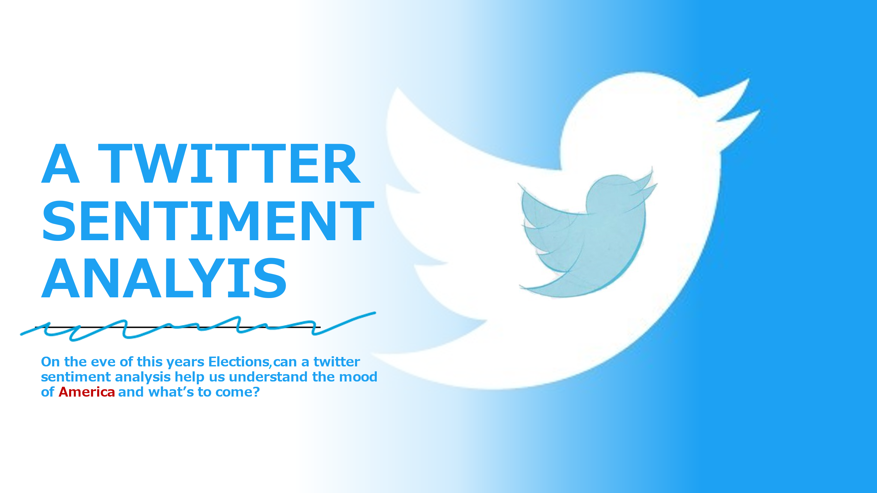

Slide 2


A Twitter
Sentiment
Analysis
On the eve of the 2020 Elections, can a Twitter Sentiment Analysis help us understand the mood of America and what’s to come?

