Slide 1
MLB Game Winner Predictor
UCSD Data Science Bootcamp Project 1, 1/11/2020
Alexis Perumal
Venkateswarlu Pinnika
Young You

Slide 2
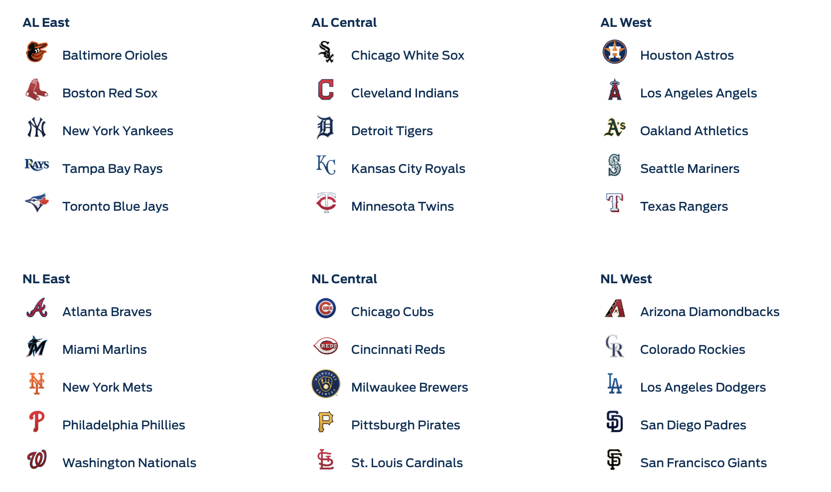
MLB
American League
National League
162 games for each of the 30 teams
played over approximately six months
a total of 2,430 games, plus the postseason

Slide 3
Project Objective
Build a predictor for the winner of baseball games (visitor or home)
with > 50% prediction accuracy, with statistical accuracy.
Analysis will be done by season,
looking at all the regular season games of a given year
with each days' game predicted based on info up to,
but not including that day.

Slide 4
Strategy
Build a dataframe of games (rows) and factors to build a regression model for visiting net points, and by extension, predict the winner of each game (visitor or home).
Explore candidate factors with regression analysis (T-stat, F-stat, p-value) build
optimize a simple LSR model using a training set through the 2017 Season.
Plot the results.
Ultimately, apply the model to the 2018, then 2019 seasons.
Datasets used:
SeanLahman.com
-provides rich baseball game outcome for every MLB game going back to 1881.
-It includes game outcomes, player data, at bats, pitches.
-It is available as a CSV file
https://www.retrosheet.org/
The information used here was obtained free of charge from and is copyrighted by Retrosheet. Interested parties may contact Retrosheet at "www.retrosheet.org".

Slide 5
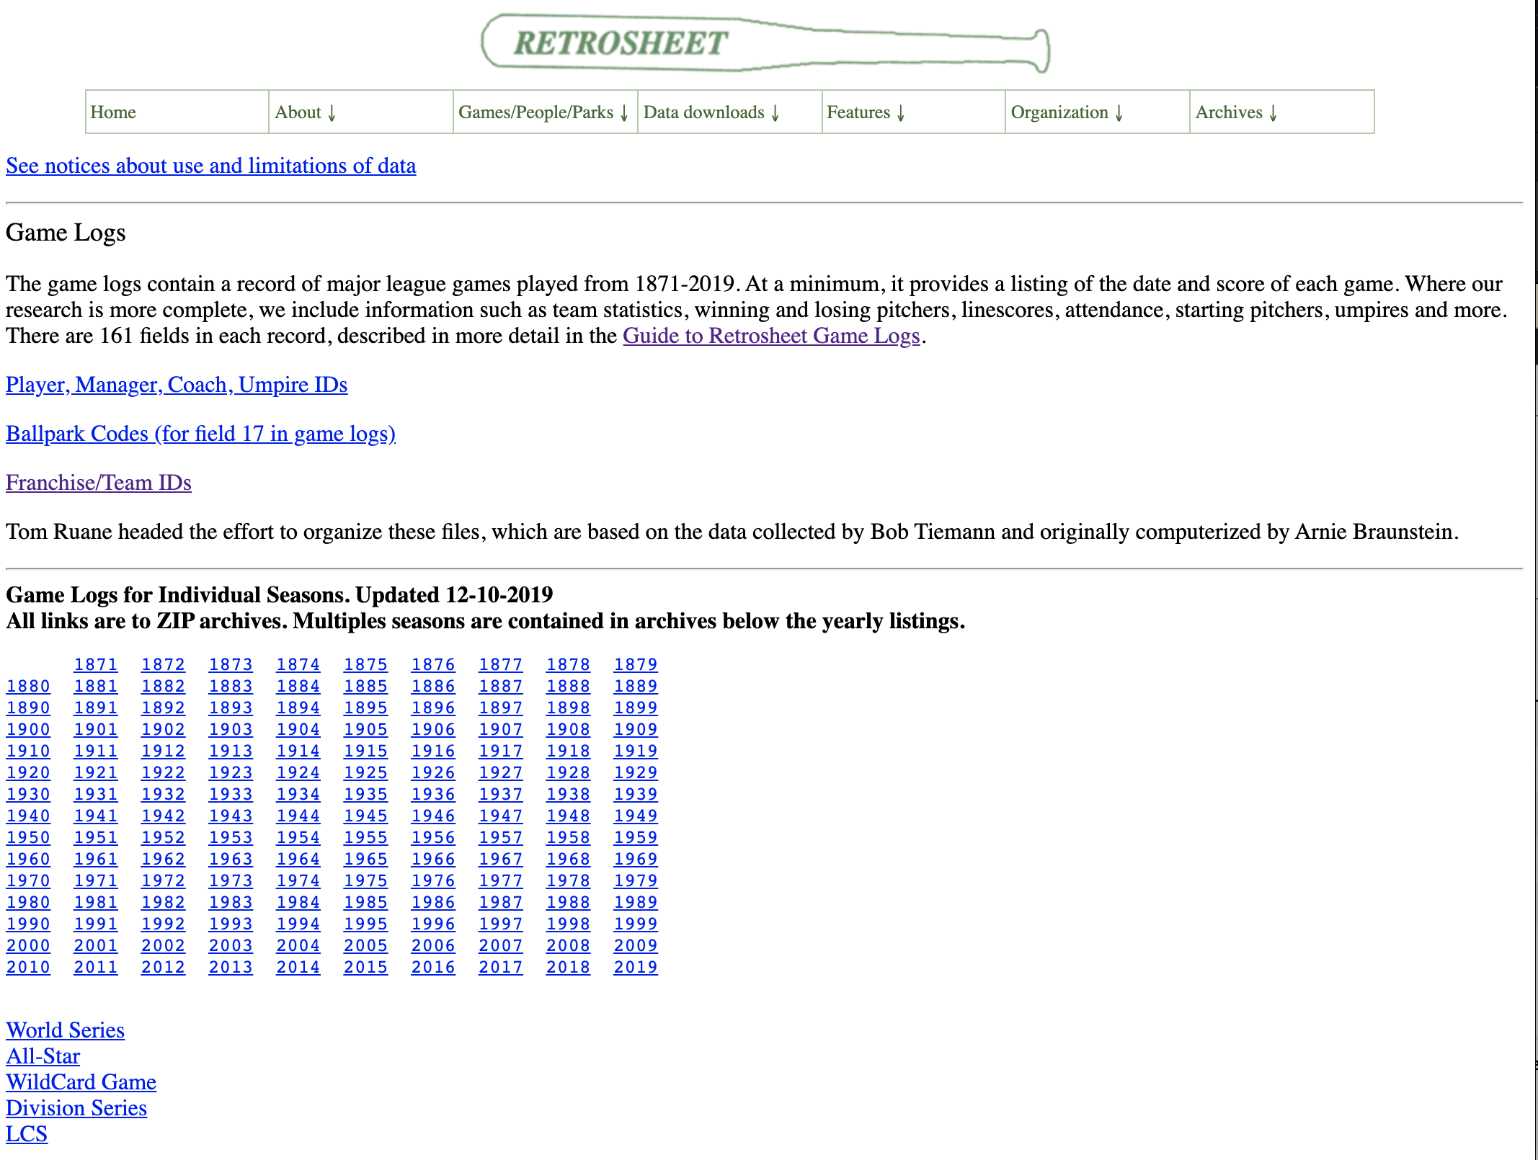
Retrosheet.org

Slide 6
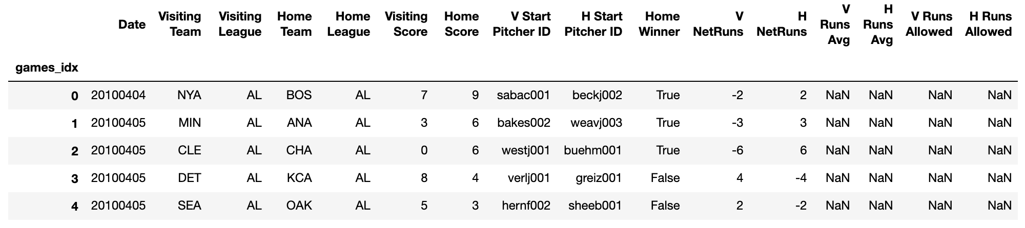
Dataset Dataframe
Field(s) Meaning
1 Date in the form "yyyymmdd"
2 Number of game:
"0" -- a single game
"1" -- the first game of a double (or triple) header
including seperate admission doubleheaders
"2" -- the second game of a double (or triple) header
including seperate admission doubleheaders
"3" -- the third game of a triple-header
"A" -- the first game of a double-header involving 3 teams
"B" -- the second game of a double-header involving 3 teams
3 Day of week ("Sun","Mon","Tue","Wed","Thu","Fri","Sat")
4-5 Visiting team and league
Field(s) Meaning
6 Visiting team game number
For this and the home team game number, ties are counted as
games and suspended games are counted from the starting
rather than the ending date.
7-8 Home team and league
9 Home team game number
10-11 Visiting and home team score (unquoted)
12 Length of game in outs (unquoted). A full 9-inning game would
have a 54 in this field. If the home team won without batting
in the bottom of the ninth, this field would contain a 51.
13 Day/night indicator ("D" or "N")

Slide 7
Our progression…
Individual Predictors:
Hello, World – single game predictor based on V/H Net Point Avg
Head to Head
Starting Pitcher
Net Wins
Code Structure
Simple Jupyter Notebook
3 Parts: Predictor in .py, Harness notebook, analysis/plot notebook
Cleaner Jupyter Notebook
Python Statistical Analysis
Rolling Windows: Nested for -> rolling/shift dataframes
Prediction averages across seasons
Hyper Parameter Tuning
Single Parameter Regression
Multiple Regression
Logistic Regression
Tools
Python/Jupyter
Pandas/Matplotlib/
Git
Statsmodel package

Slide 8
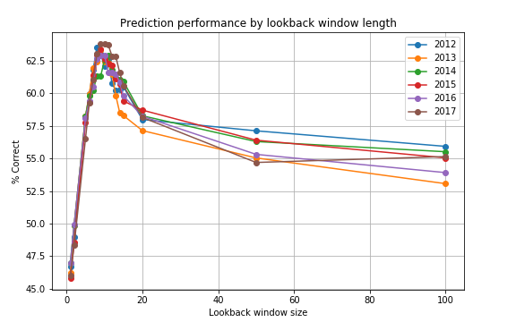
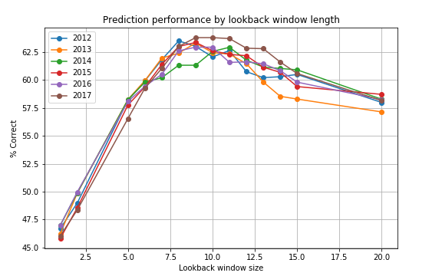
Hyper Parameter Tuning
Prediction Performance by Lookback Window Length
day
day

Slide 9
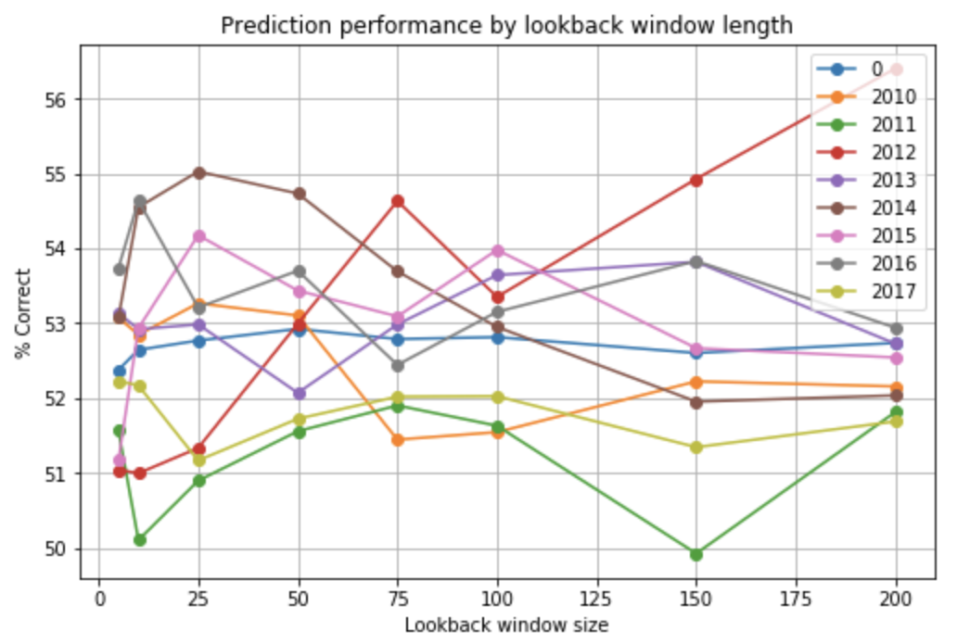
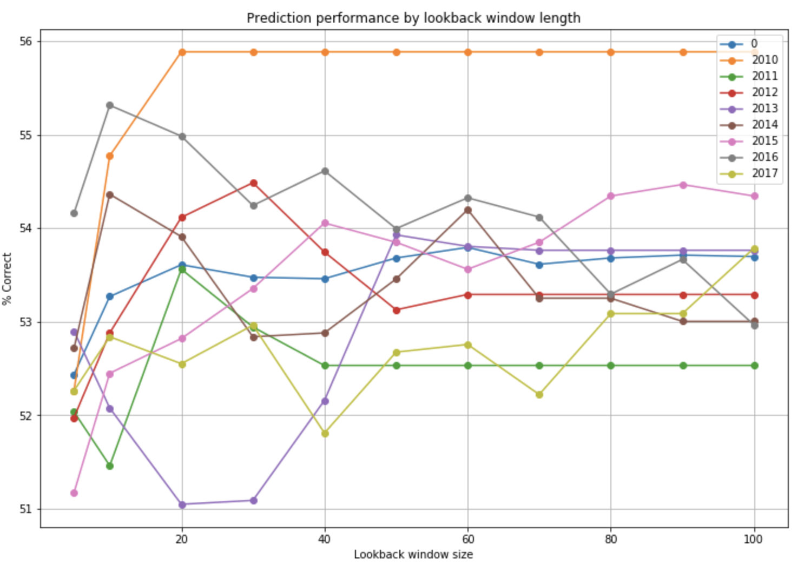
Prediction Performance by Lookback Window Length
game
game
Dataset loaded with 19437 games
2010-04-04 - 2017-10-01 [2010, 2011, 2012, 2013, 2014, 2015, 2016, 2017]
# of games before dropping lookback window: 19437
# of games after dropping lookback window: 17027
slope: 0.474, int: 4.289, r2: 0.503, p-value: 0.0 , std : 0.0036

Slide 10
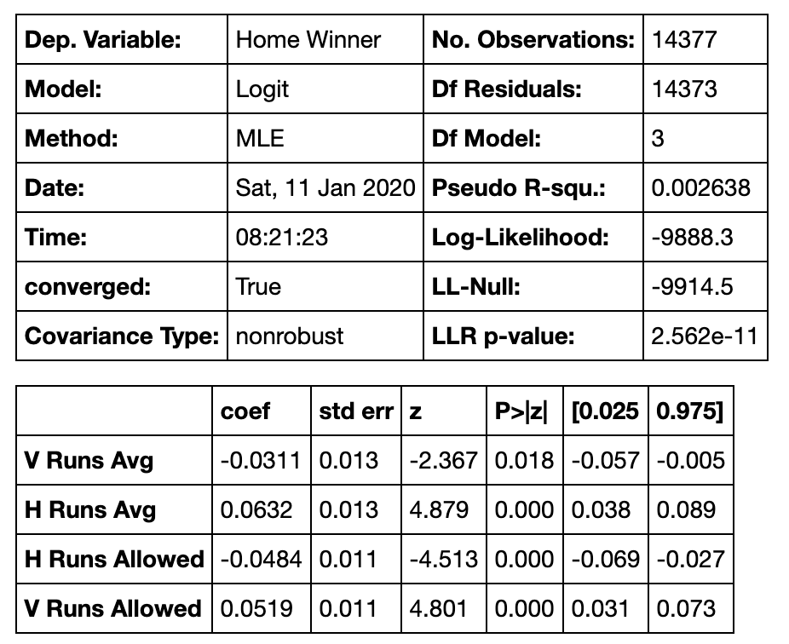
Logistic Regression: Used to predict binary outcomes
Baseline results: 14377 games, 7793 home wins = 54.2046%
Prediction results: 14377 games, 7798 predicted correctly = 54.2394%

Slide 11
Conclusions
It is hard to predict the outcome of a baseball game with meaningful uplift over 50% accuracy.
We built a model based on historical team runs scored and starting pitcher runs allowed which was correct 54.24% of the time across the 2010-2017 (14,377 games)
Simply picking the Home Team to win was correct 54.20% of the time!
Future Study
Test additional factors (e.g. Home Runs, other factors).
Run a proper training set/test set.
Test using other statistical/prediction models.
Complete season analysis.
Pull in prior seasons

Slide 12
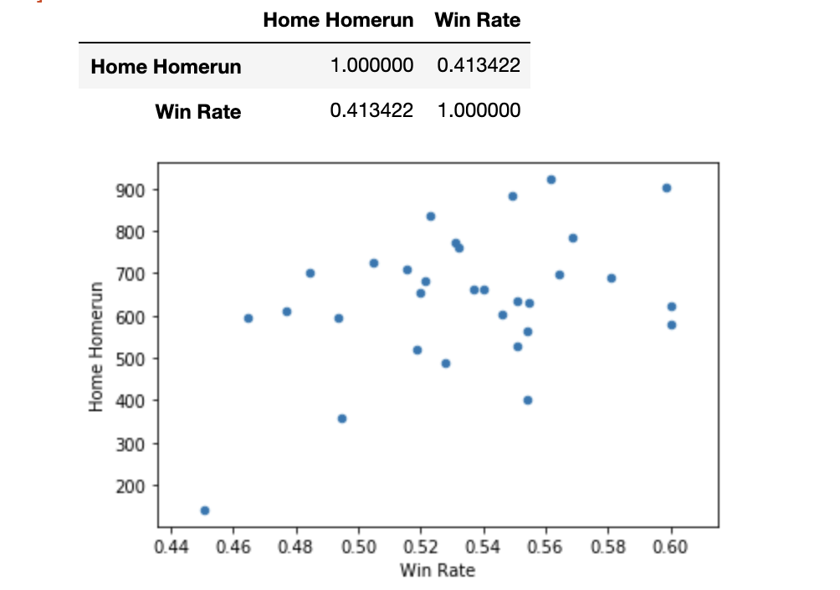
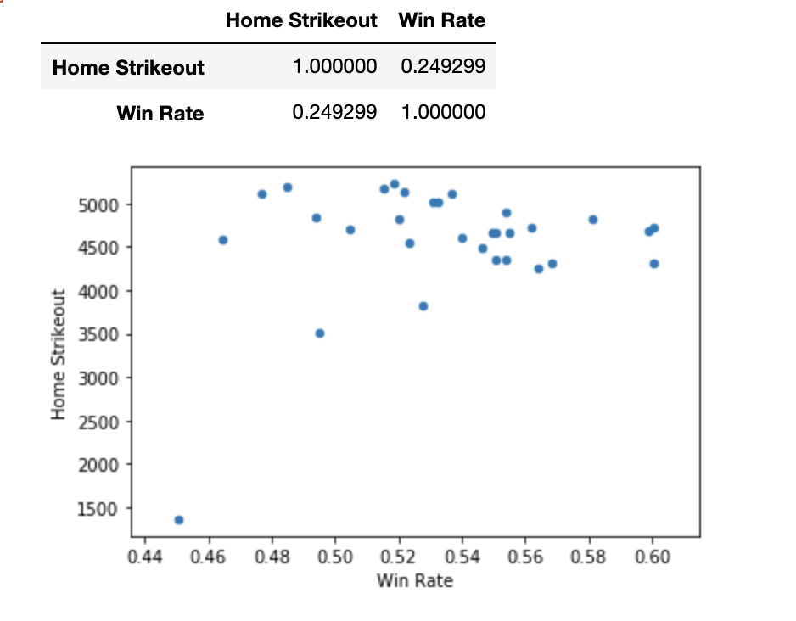
Home Run & Strike Outs vs Win Rate

