Slide 1

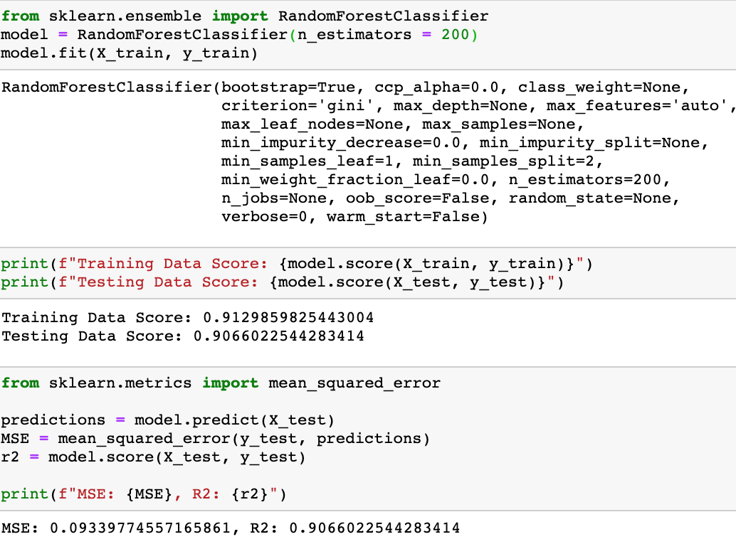
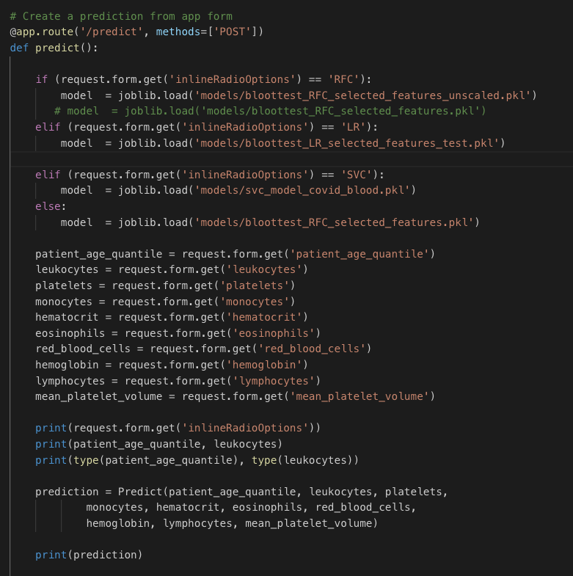
Machine Learning COVID-19 Prediction Models Based ON Lab Tests
The Story
Data, Preprocessing, Model
FS Deployment of the models
UCSD Data Science and Visualization Boot Camp, May13, 2020

Slide 2
Team Members
Alexis Perumal
Arundhati Chakraborty
David Jaimes
Grant Thompson

Slide 3
Story:
We set out to determine if we can reasonably predict COVID-19 test results based on standard laboratory tests (blood, urine, etc) since these tests a more accessible.
We took the data from the Kaggle https://www.kaggle.com/einsteindata4u/covid19, created by the Hospital Israelita Albert Einstein in São Paulo, Brazil.
Total data of 5,644 patients were taken consisting of over 100 columns of patients Laboratory test results, out of which top 10 columns were selected based on the model scores. In this project we have used several models( Logistic Regression, Random Forest Classifier, SVC etc ) for possible prediction of the test result for COVID-19 (positive/negative) based on the below listed column features:
- patient_age_quantile
- leukocytes
- platelets
- monocytes
- hematocrit
- eosinophils
- red_blood_cells
- lymphocytes
- hemoglobin
- mean_platelet_volume

Slide 4
Libraries, Packages and Platforms
ML Analysis: SciKit-Learn (Classifiers and Regressors), Pandas, SimpleImputer, TensorFlow (neural networks), Jupyter Notebooks, Python
Server: flask, flask-sqlalchemy, flask-marshmallow, marshmallow-sqlalchemy
Visualization: html, bootstrap, css
Database: SQLite
Postman (collaboration platform for API development.)

Slide 5
Project Structure

Slide 6
Pre-processing the data
After downloading the csv files from :
https://www.kaggle.com/einsteindata4u/covid19
- The Initial columns used : ["patient_id","patient_age_quantile","sars_cov_2_exam_result","hematocrit","hemoglobin","platelets","mean_platelet_volume","red_blood_cells","lymphocytes","mean_corpuscular_hemoglobin_concentration_mchc","leukocytes","basophils","mean_corpuscular_hemoglobin_mch","eosinophils","mean_corpuscular_volume_mcv","monocytes","red_blood_cell_distribution_width_rdw","serum_glucose"]
-There were many rows of missing data, we implemented models using both dropping the NaNs and by filling up the missing data using Imputer library by ‘mean’
Based on the model score for each column we selected top 10 features/Tests to save our final models :
['patient_age_quantile', 'leukocytes', 'platelets', 'monocytes', 'hematocrit', 'eosinophils', 'red_blood_cells', 'lymphocytes', 'hemoglobin', 'mean_platelet_volume’]
- We didn’t use standardization/Normalization and fitting for any of our models since the above feature data was within the same range

Slide 7
Machine Learning COVID-19 Prediction Models Based ON Lab Tests
Data, Processing, Models
FS Deployment of the models
The Story
Data, Preprocessing, Model
UCSD Data Science and Visualization Boot Camp, May13, 2020

Slide 8
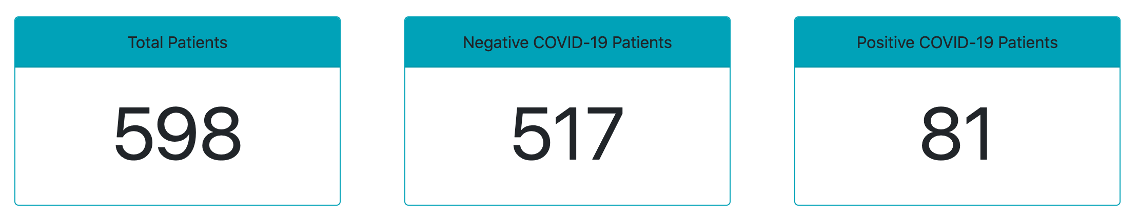
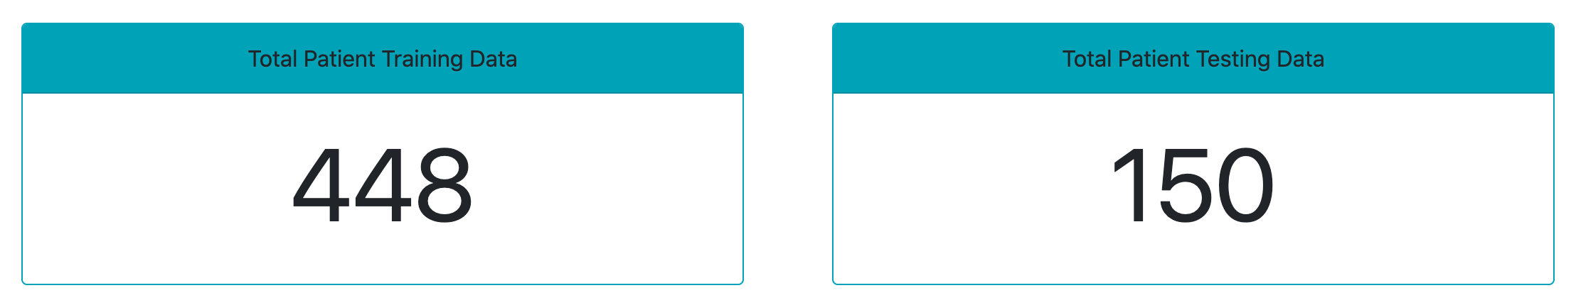
Logistic Regression Model
PROS
Most popular, simple, and efficient.
Binary classification and discrete outcome.
No scaling required for x inputs.
CONS
Can’t solve non-linear problems.
Outperformed by other complex algorithms.
Vulnerable to overfitting.

Slide 9
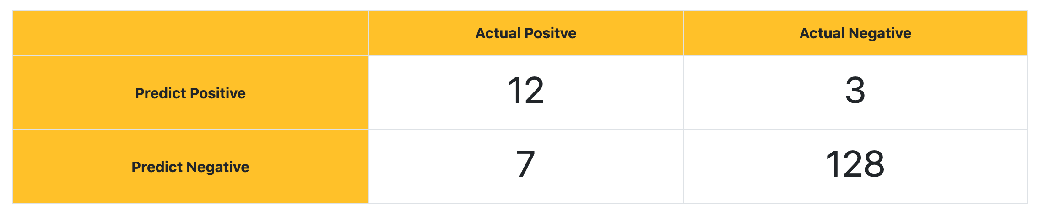
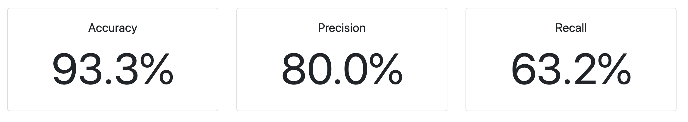
Logistic Regression Model

Slide 10

Random Forest Classifier Model
It is an ensemble tree-based learning algorithm. The Random Forest Classifier is a set of decision trees from randomly selected subset of training set. It aggregates the votes from different decision trees to decide the final class of the test object.

Slide 11
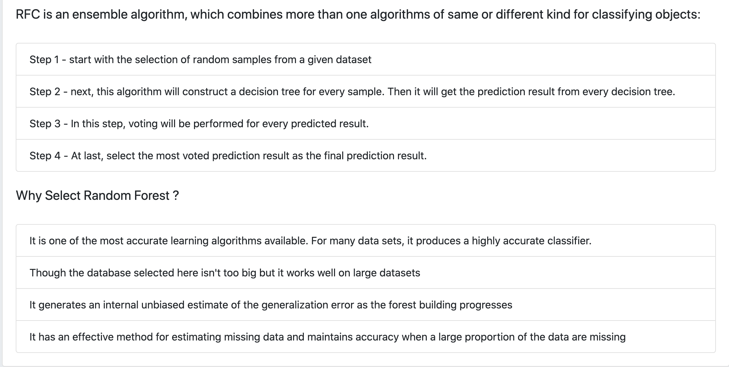
Random Forest Classifier Model Continued

Slide 12
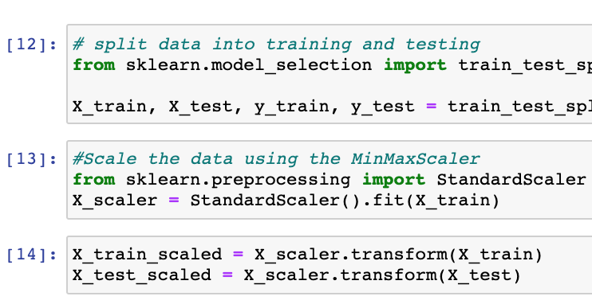
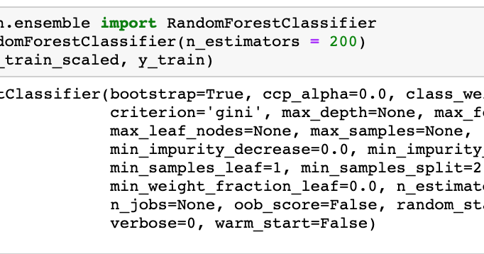
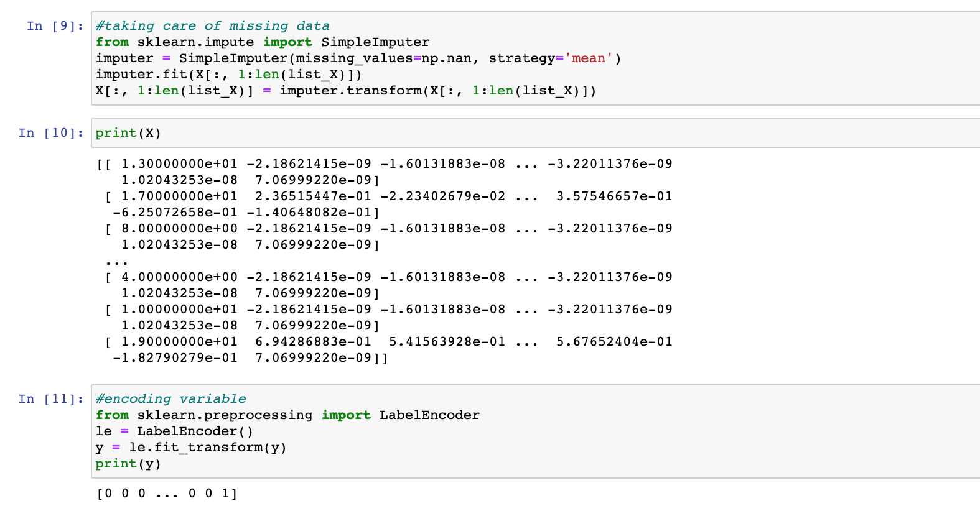
Random Forest Classifier Model Continued, Steps :
1.Importing Python libraries and Loading our dataset, preprocessing
2. Splitting our dataset into training set and test set
3. Creating a Random Forest Regression model and fitting it to the training data
4. Predicting the test set results and making the Confusion matrix
5. Further tuning of the model based on top 10 scoring features that contributes to the prediction :
param_grid = {
'n_estimators': [200, 600, 1200, 1400],
'max_features': ['auto', 'sqrt', 'log2'],
'max_depth': [14, 15, 16, 17, 18, None]
}

Slide 13
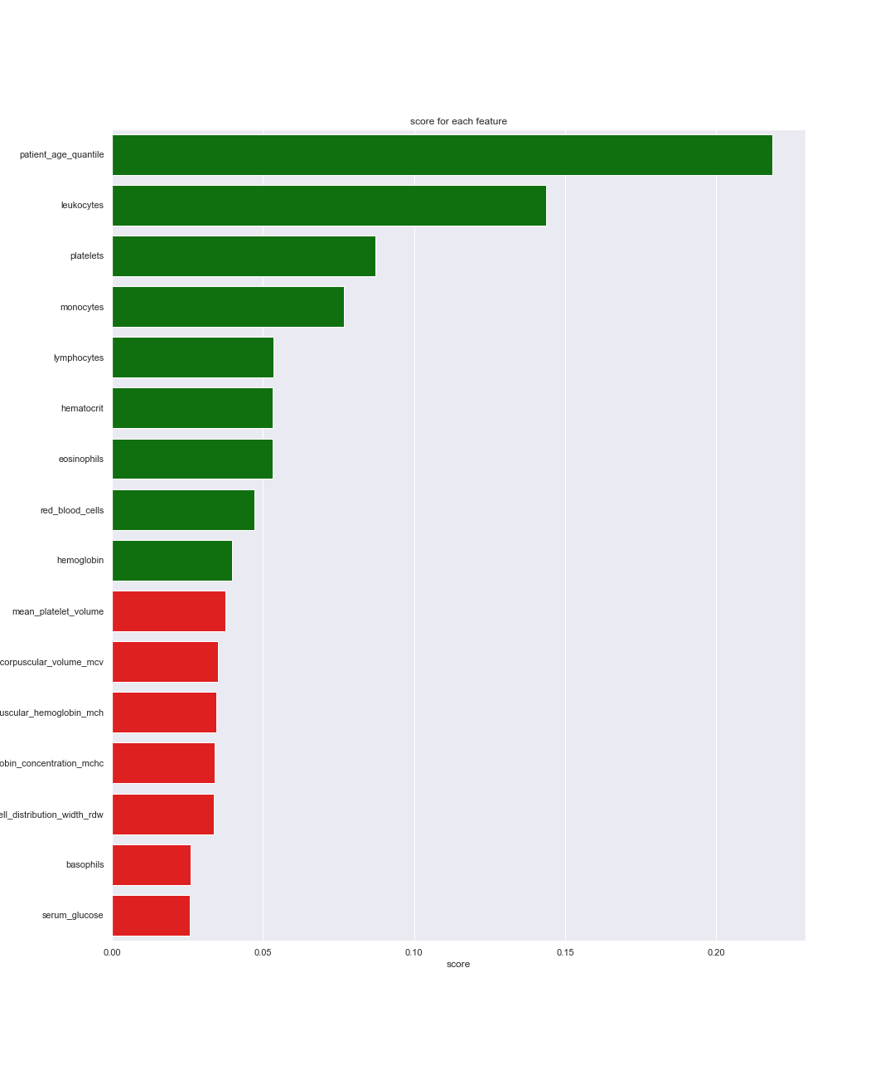
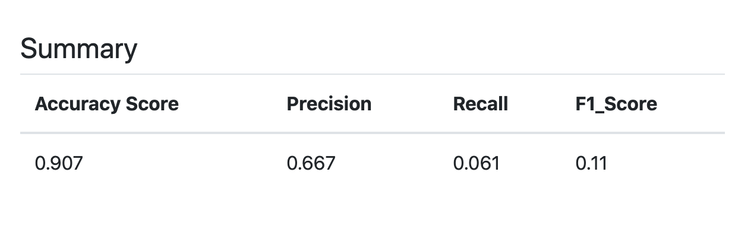
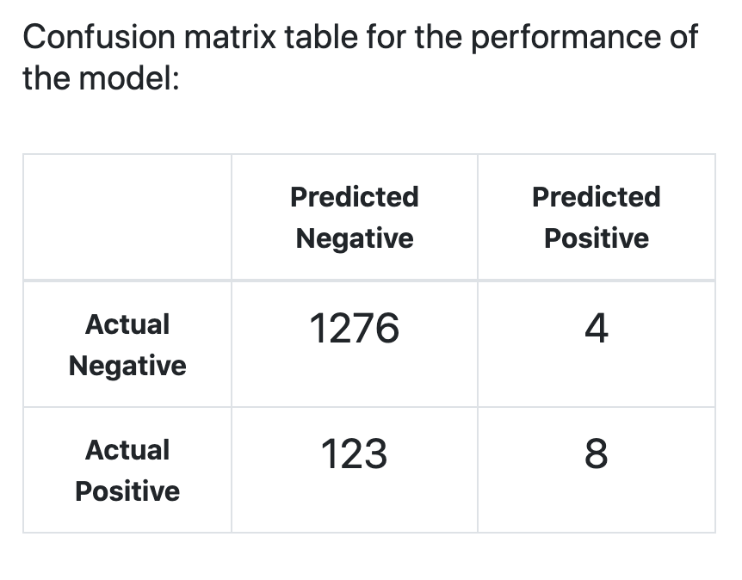
Random Forest Classifier Model Continued, Summary :
Random Forest Classifier Model Continued, Summary:

Slide 14
SVC Model

Slide 15
Comparison
Model | True Negative | True Positive | False Positive | False Negative | Total
LR | 128 | 12 | 3 | 7 | 150
RFC | 1276 | 8 | 4 | 123 | 1411
SVC | 1270 | 7 | 3 | 131 | 1411
Note: LR model excludes rows with missing data. RFC and SVC models fill in empty rows with column mean.

Slide 16
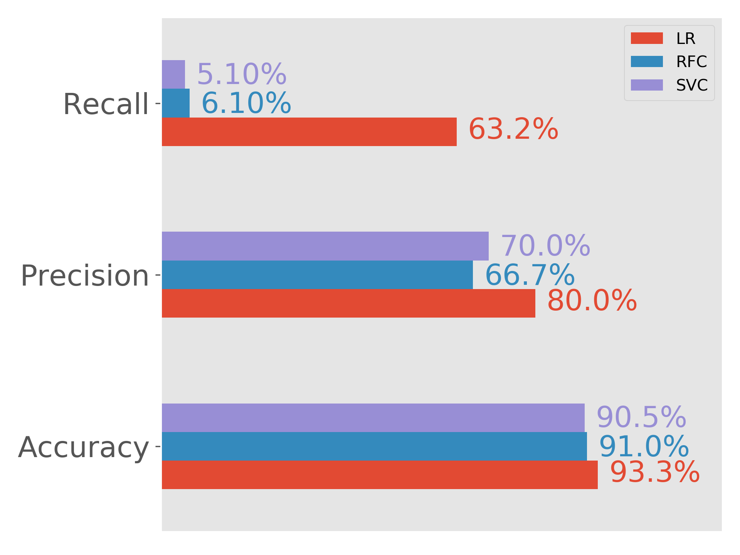
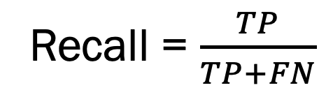
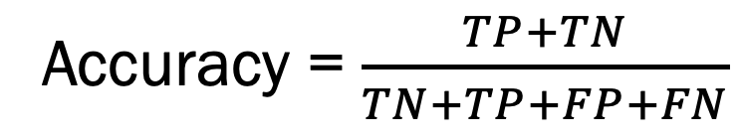
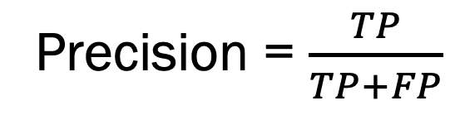
Comparison
Recall = $\frac{TP}{TP+FN}$
Precision = $\frac{TP}{TP+FP}$
Accuracy = $\frac{TP+TN}{TN+TP+FP+FN}$

Slide 17
Machine Learning COVID-19 Prediction Models Based ON Lab Tests
Data, Processing, Models
FS Deployment of the models
The Story
Data, Preprocessing, Model
UCSD Data Science and Visualization Boot Camp, May13, 2020

Slide 18
Building the server and Routes
To Deploy our models for predictions we are using Python Flask that interact with ORM SQLAlchemy classes and flask-marshmallow /marshmallow-sqlalchemy for serializing and deserializing the data, render the html page that contains our Model related details. Our database is SQLite which we use to store user entered form data using Post Rest APIs

Slide 19
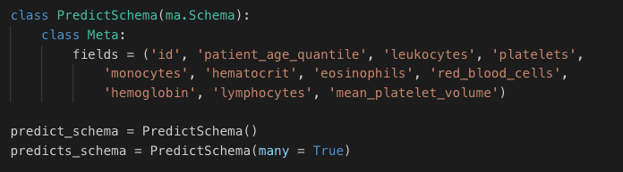
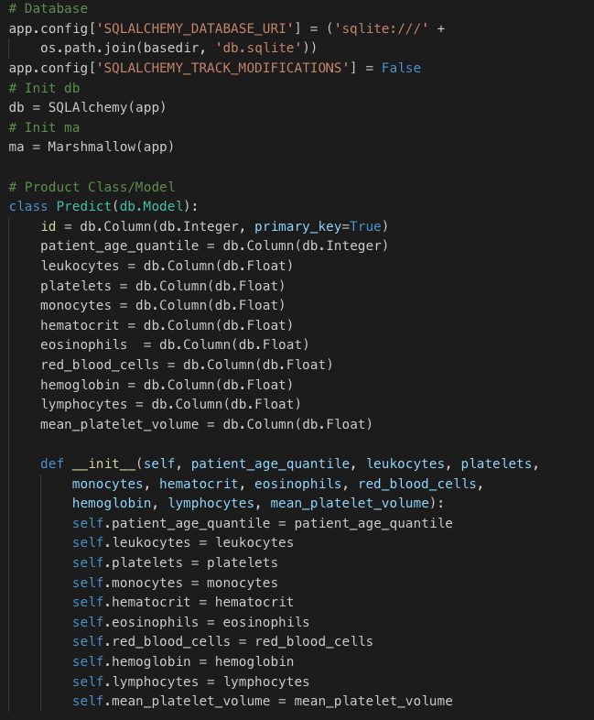
Building the ORM classes, SQLite database
We are using Python Flask for building a server that interact with ORM SQLAlchemy classes and flask-marshmallow /marshmallow-sqlalchemy for serializing and deserializing the data, render the html page that contains our Model related details. Our database is SQLite which we use to store user entered form data using Post Rest APIs

Slide 20
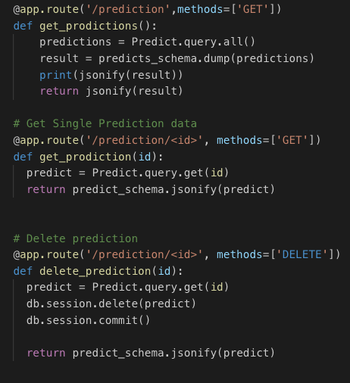
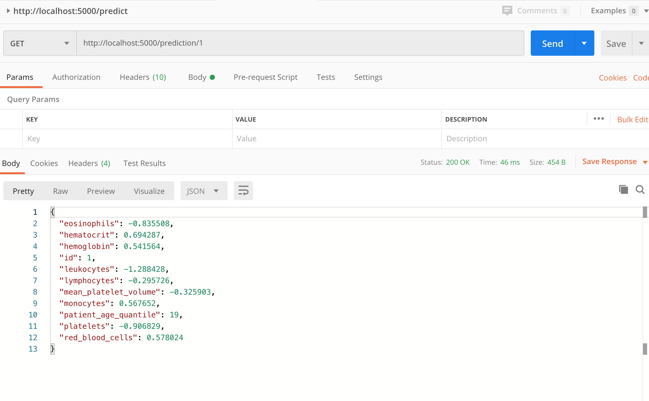
Rest APIs : Post,Get, Get(id), Delete(id)
Though we need just Post rest api to create each prediction form entry per patient, we created other rest apis Get all, Get(id), Delete(id) etc…. To interact with our SQLite database for completeness and we tested these APIs using Postman (collaboration platform for API development.)

Slide 21
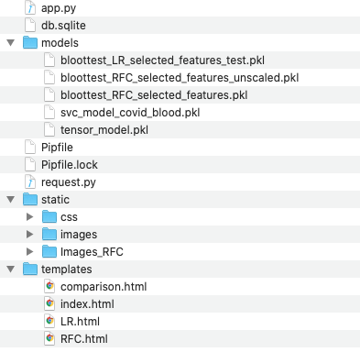
Front-end side preparation, Folder structure
Now that we have the server side code and datbase.
We connect our models to the prediction form
We will also be using Bootstrap for responsiveness, CSS for styling to display each page

Slide 22

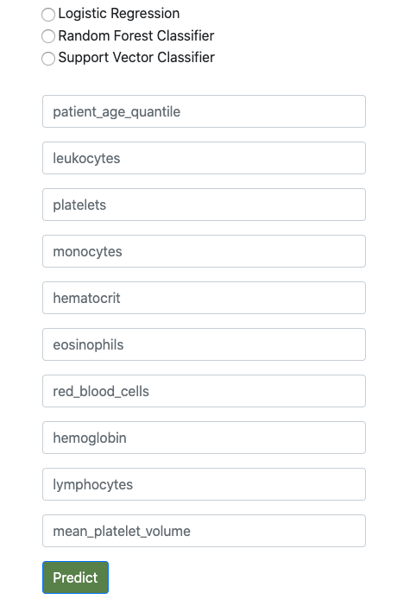
Prediction Front End Form Page

Slide 23
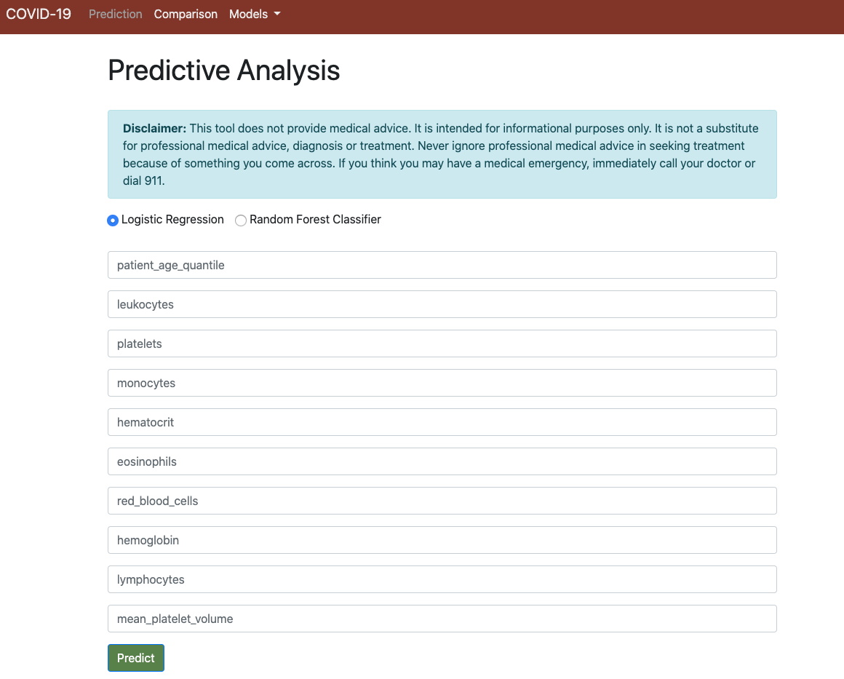
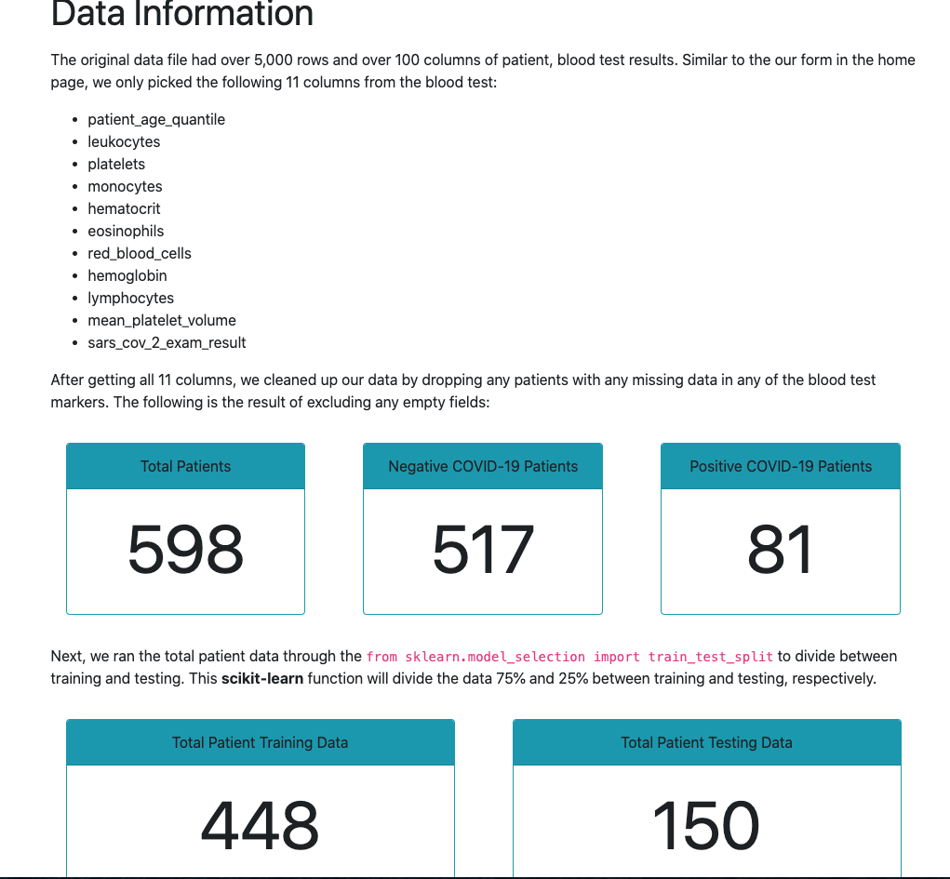
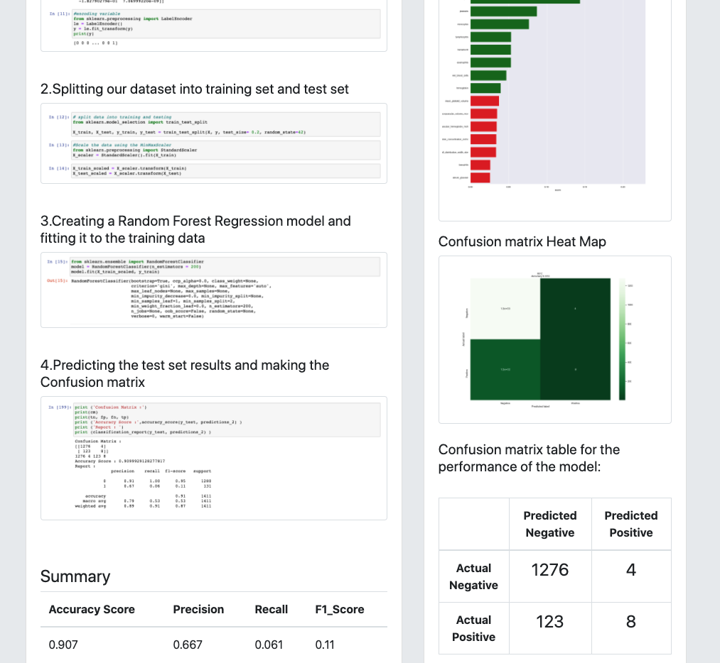
Other pages

Slide 24
Conclusion

Slide 25
Questions

Slide 26
Thank You

