Slide 1

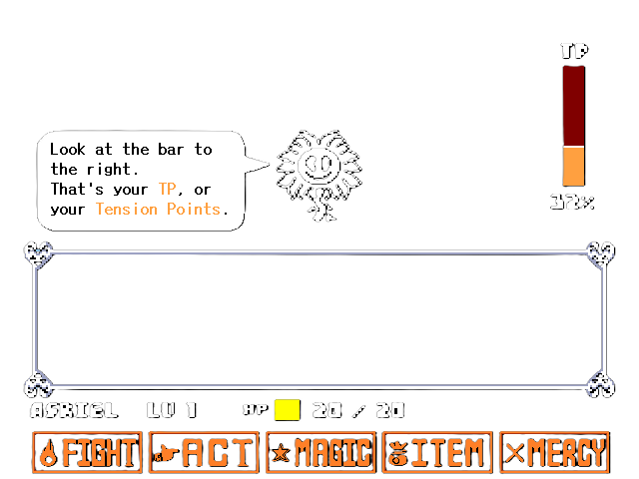
I’m snow excited for winter!

Slide 2
Snow doubt about it, I’m chillin’.

Slide 3
Snow way, that’s hilarious!

Slide 4
Snow excited to see you!

Slide 5
Snowbody compares to you.

Slide 6
Chill vibes only.

Slide 7
Cold enough to pun yet?

Slide 8
Snow kidding around.

Slide 9
Ice to see your jokes.

