Slide 1


White bullets deal one damage and are the most common types of bullets.
Blue bullets deal one damage when the player is moving.
Orange bullets deals one damage when the player isn’t moving.
Green bullets heal one hp when the player is touching them.

Slide 2
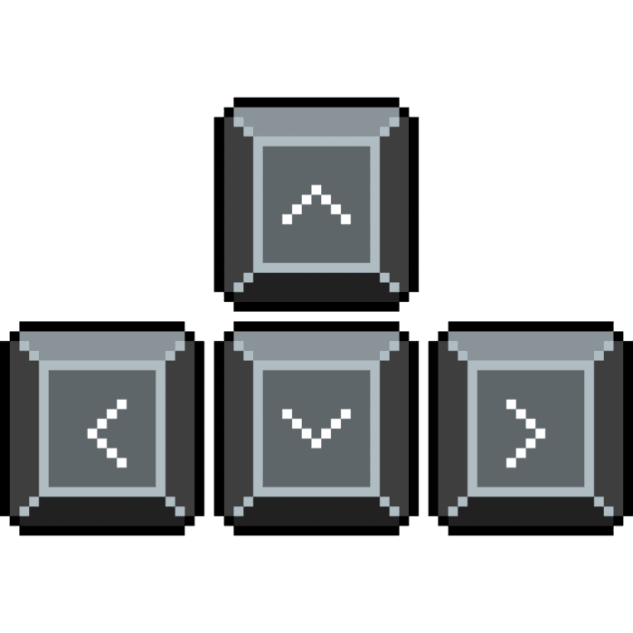
Use the arrow keys to move.
Survive for as many patterns as you can!
Press Escape to return to the menu.

Slide 3
Tips 1 :
Stay close to the middle of the screen to have more time to see the attacks arriving!

Slide 4
Tips 2 :
Try to collect the most amount of green bullets! You never know when you will need it!

Slide 5
Tips 3 :
Don’t die!

Slide 6
Tips 4 :
Have fun!

