Slide 1
readmission-story
File created on: 11/19/19 9:08:06 PM EST

Slide 2
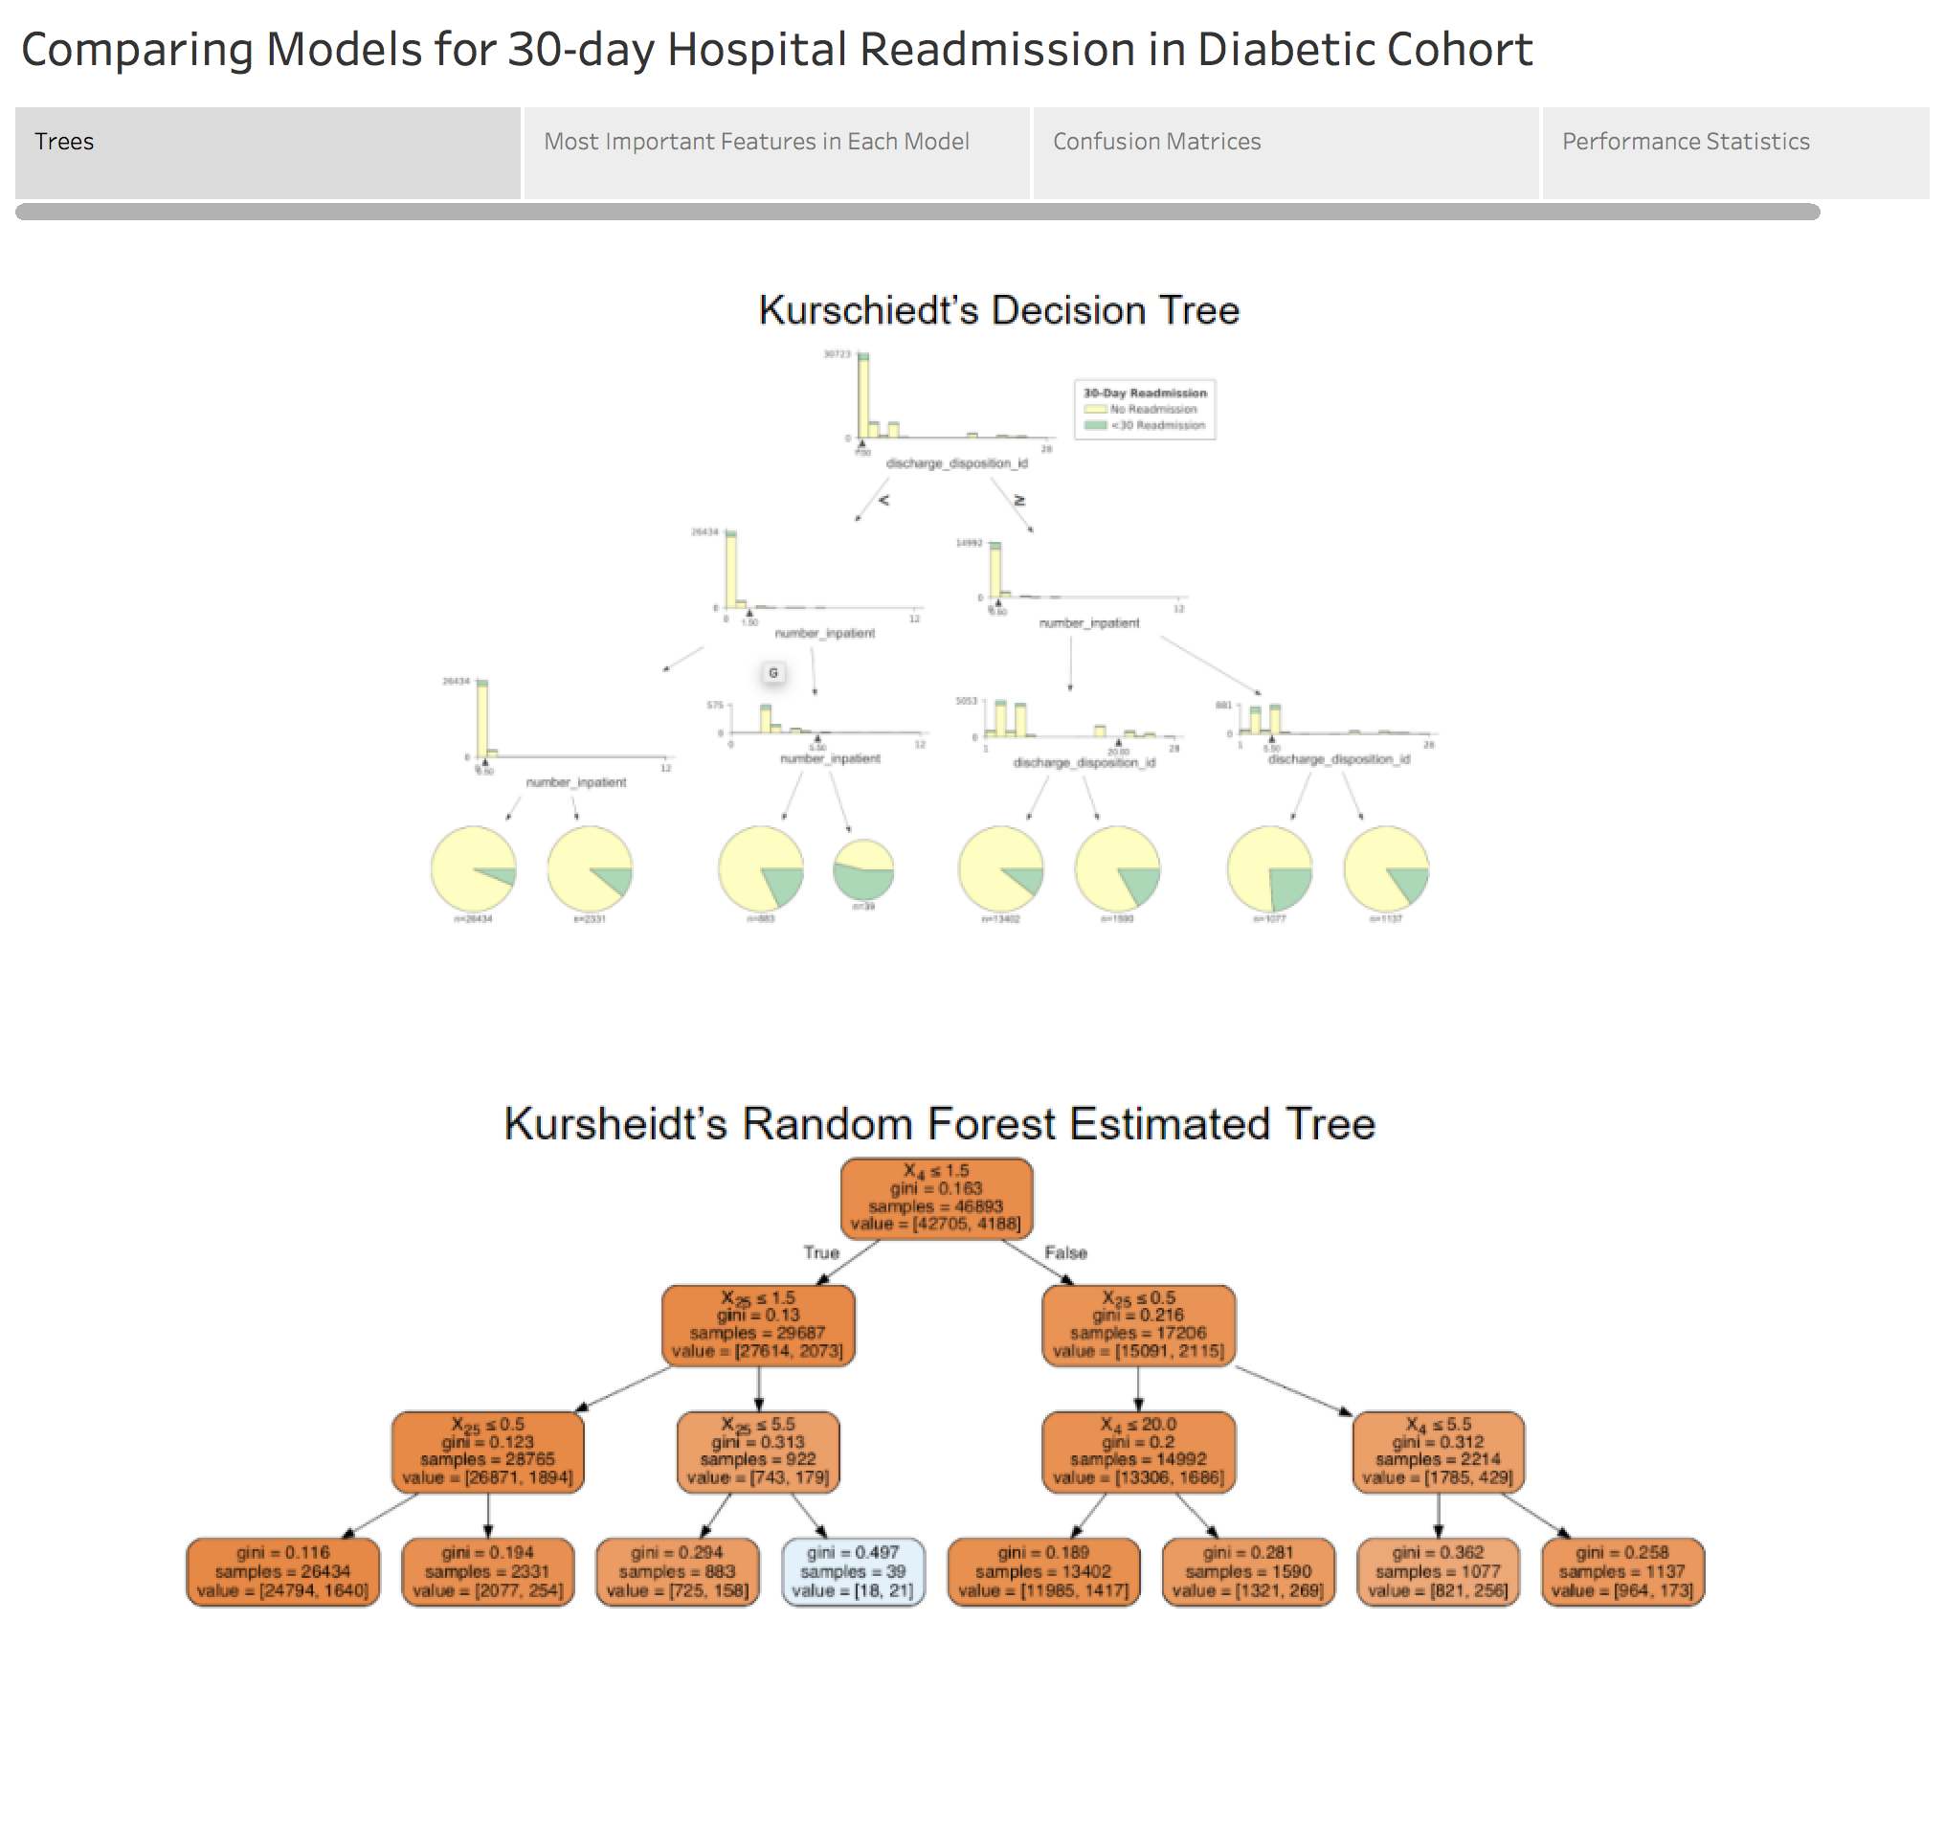

Slide 3
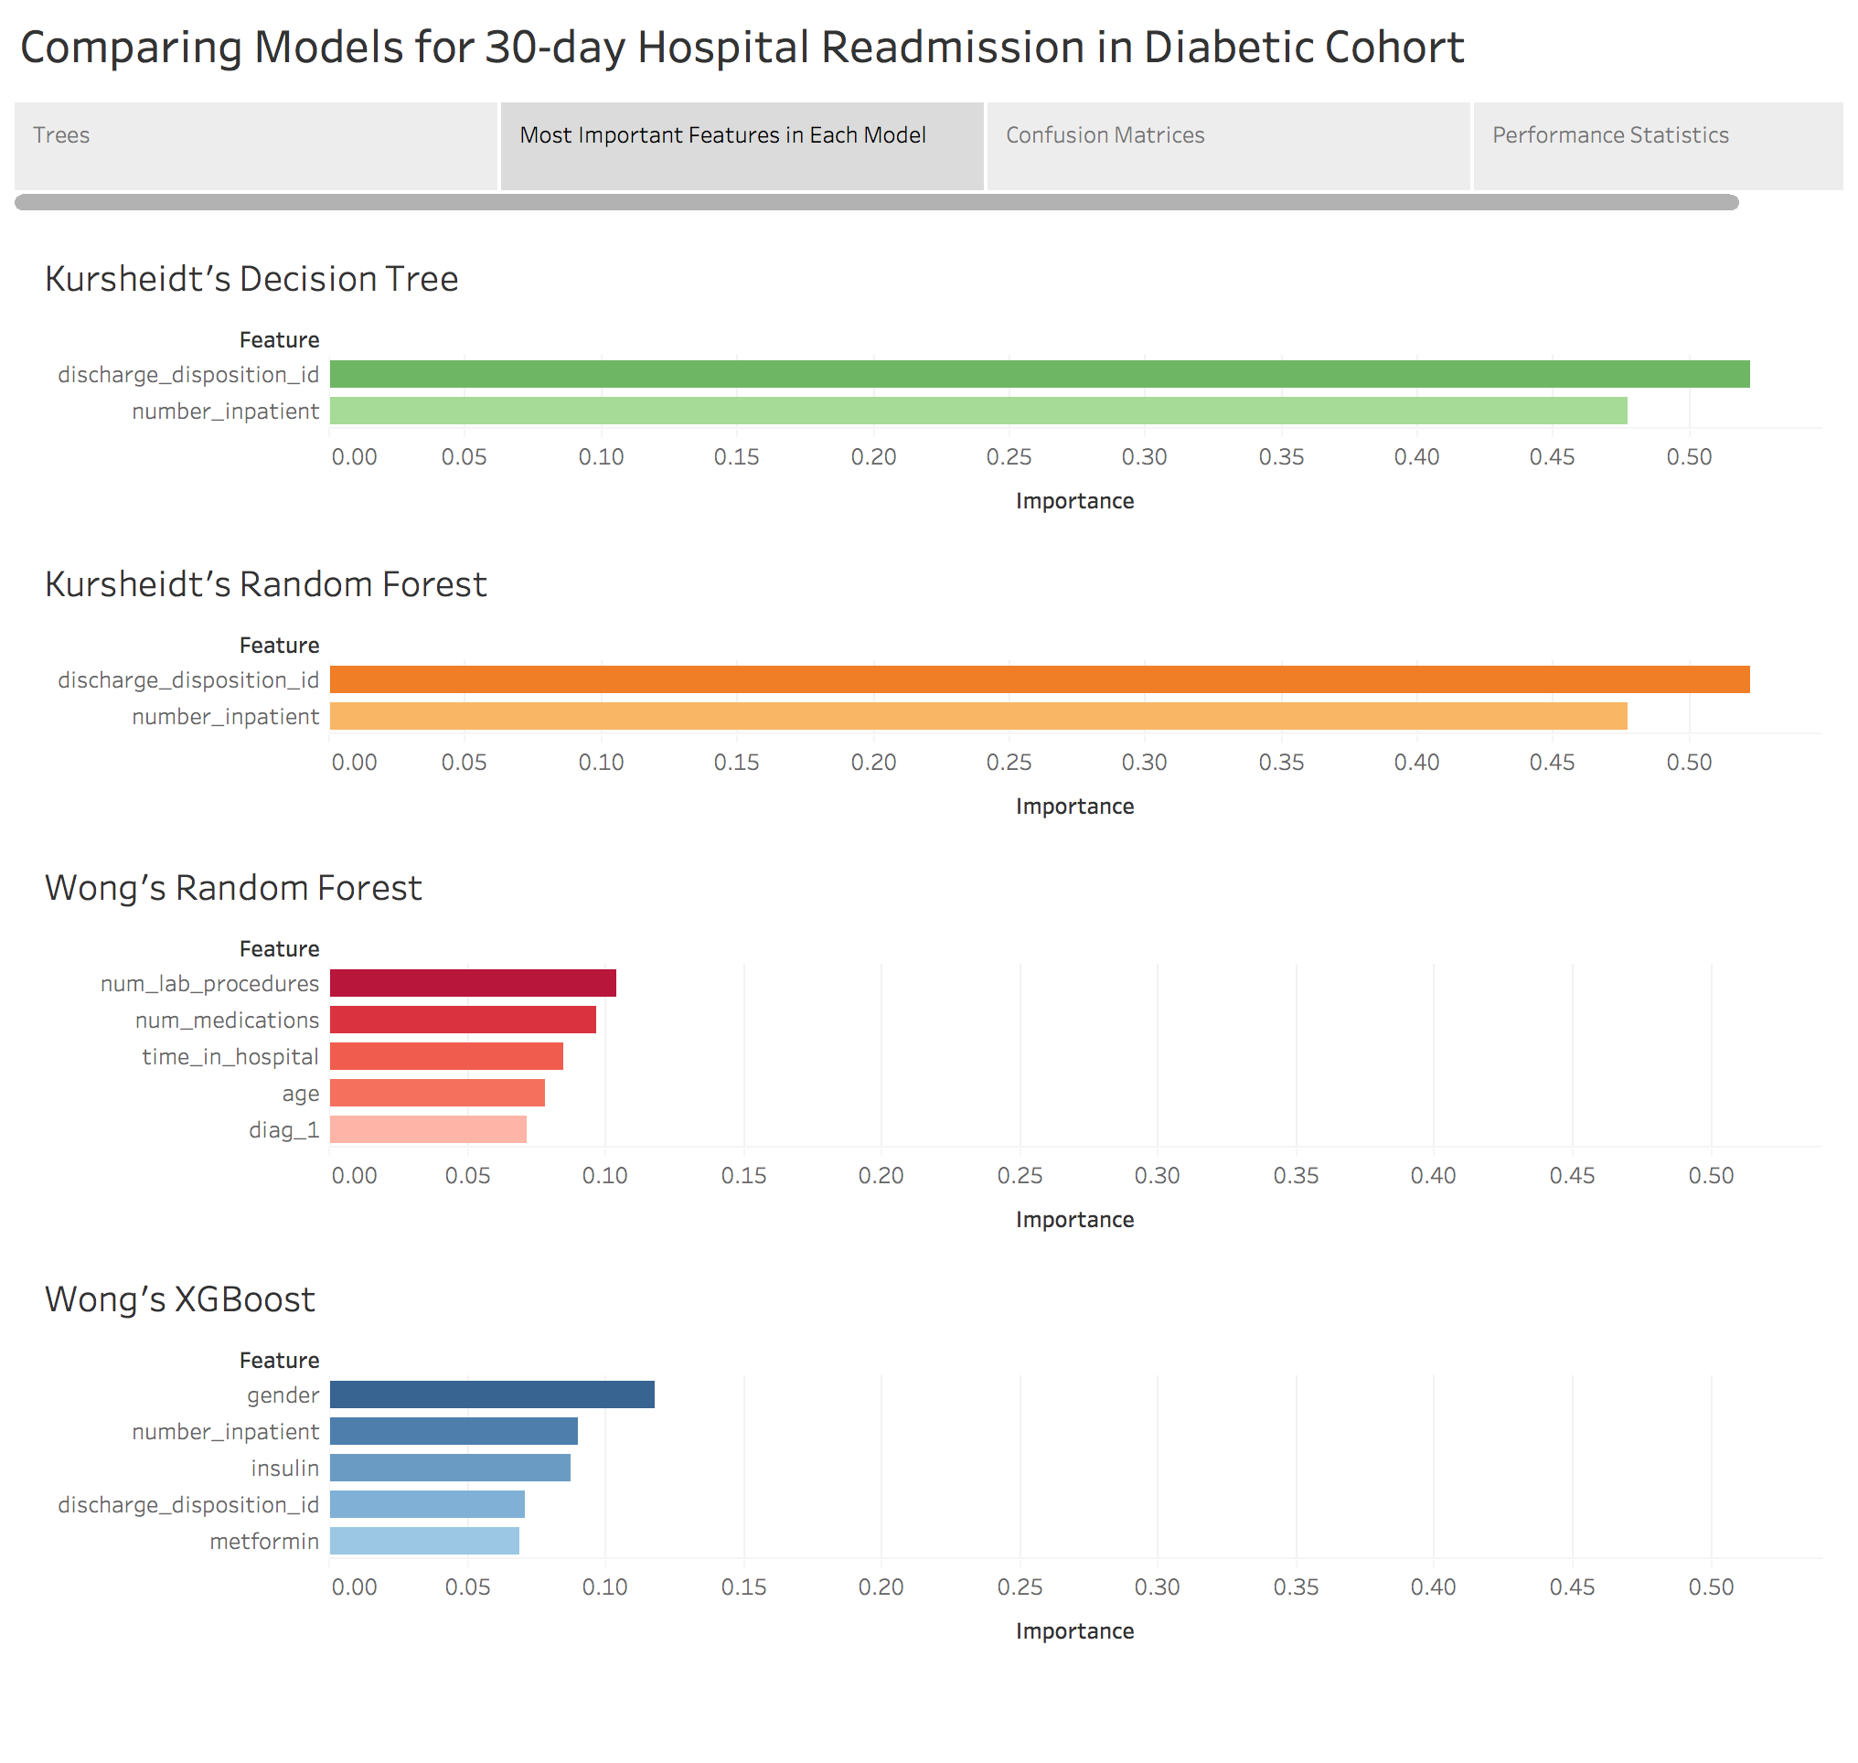

Slide 4
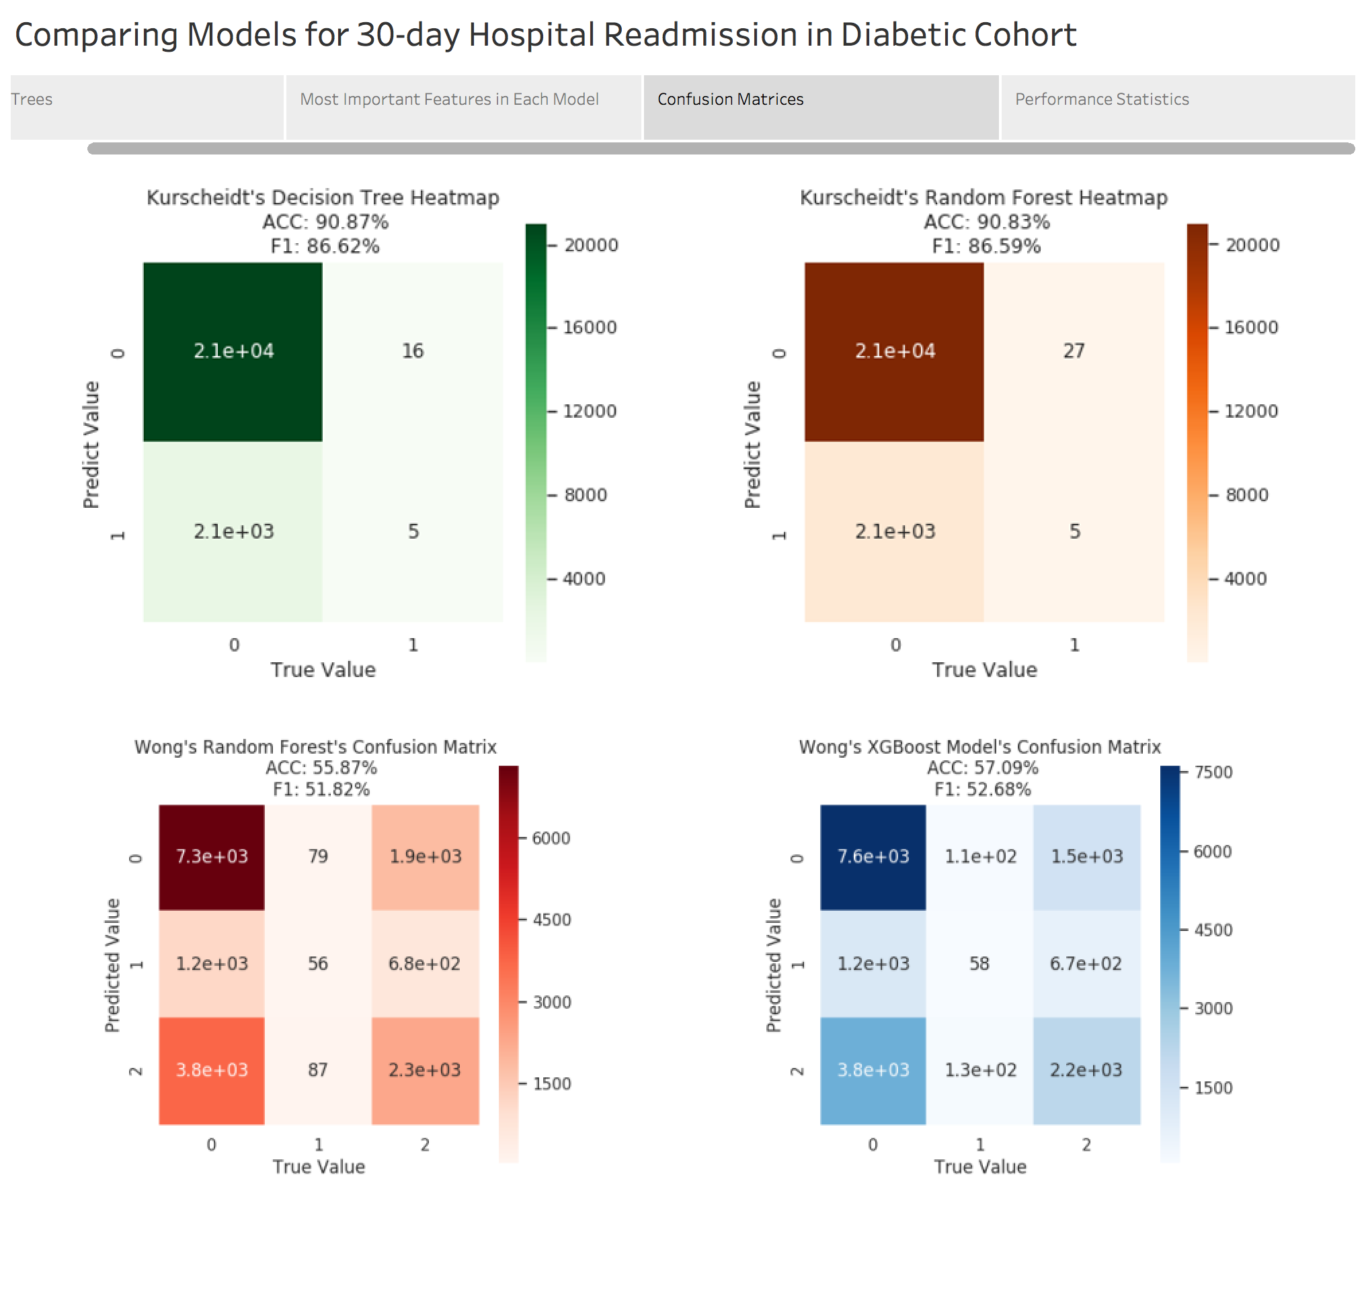

Slide 5
