Slide 1

Vision
Our vision is for Affamato to be a smart-cooking and health assistant. Affamato is a web application that helps users do a multitude of food-related tasks.
It allows users to:
Create grocery lists
Track their food inventory and perishability
Recommend recipes based on many different categories.
The purpose of Affamato is to help people save money, reduce their food waste, organize their food stock, and broaden their palates.
Notes:
Note: 5 MINUTE LIMIT ON PRESENTATION
Presentation Info: http://users.ece.utexas.edu/%7Emeberlein/ee461L/ZFR.html
Intro: Justin “we are the falcon group, I’m Justin…<everyone introduces selves>. We would like to introduce a web application for food, affamato.
Vision: Julia and Alex
Alex-Affamato is our idea for an assistant that helps with cooking and eventually health-related tasks. The website can help do things like track your grocery lists and food inventory.
Julia - in addition to what Alex mentioned, Affamato allows you to search for recipes based on ingredients you already have on hand, so that you can learn new ways to cook with familiar items, and be able to use items before they expire. Affamato will even remind you of items that will soon expire, and make recommendations for recipes that use those items. Tips will pop up for how to store and dispose of food, as well as take care of kitchen appliances.
Alex-We believe that the functionalities that Affamato has will help people become more organized, save money, reduce food waste, and broaden their palates

Slide 2
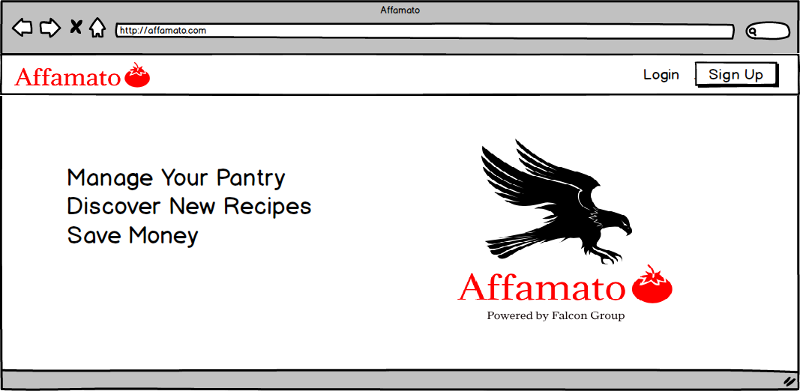
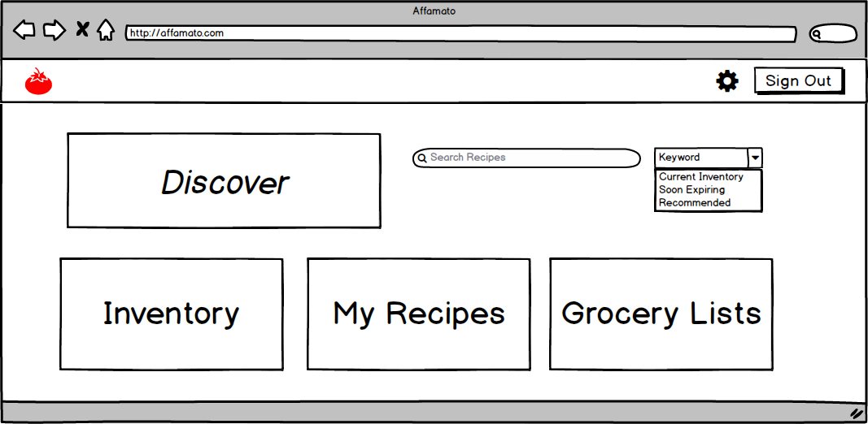
UI
Login Page
Home Page
Notes:
Interface: Samir

Slide 3
Requirements
Feasibility
Save user’s money.
Reduce food waste.
Calorie counter: lose weight, focusing on calories.
Tries new recipes (For example, wanting cuisine type X).
Based off of the availability of APIs
Food APIs for Calories, Nutrition, Expiration, and Allergy Information
Recipe APIs to have a sizeable database of recipes and interface with our ingredients database
Call Allowances/Cost effectiveness so we can access data for scraping and demoing
Implementation of Search and Suggestion Algorithms
Lack of experience in Full Stack web development
Notes:
Requirements: Cameron
Affamato offers functionality for a variety of things. It will help someone who wants to save money by not purchasing items they already own, and keeping better track of what they need.
Feasibility: Rooshi
Most of the feasibility issues that come with our project is the availability of APIs
First we’re going to need a Food API that contains a lot of ingredients and information including Nutrition, Expiration Times, and Allergies
We also need an API that has access to recipes given
“In conclusion, with Affamato we hope to combine the pantry and the recipe book to improve the overall experience of buying and consuming food for users. Any questions?” - Justin

