Slide 1


December 2020
Heuristic Build Tool Comparison
Dylan Bray, Alex Issa

Slide 2
Project
We proposed to evaluate different build tools on representative Java codebases, comparing their performance when handling different types of changes in the codebase
This evaluation considered Maven, Gradle, and Bazel - a new, high-performance tool that claims to handle incremental builds especially well
The evaluation compared each build tool’s time to completion, CPU usage, and memory usage

Slide 3
Contributions & Observations
Create reusable scripts to launch build tools and monitor CPU/memory
Script tracks single-process (Maven) and multi-process applications (Gradle, Bazel) across entire build execution lifecycle
Build tools over-advertise portability and ease of change
Found consistent behavior across multiple identical test runs
Found differences in build tool behavior between hot and cold starts
Gradle is more optimal than Bazel because Bazel is often overkill

Slide 4
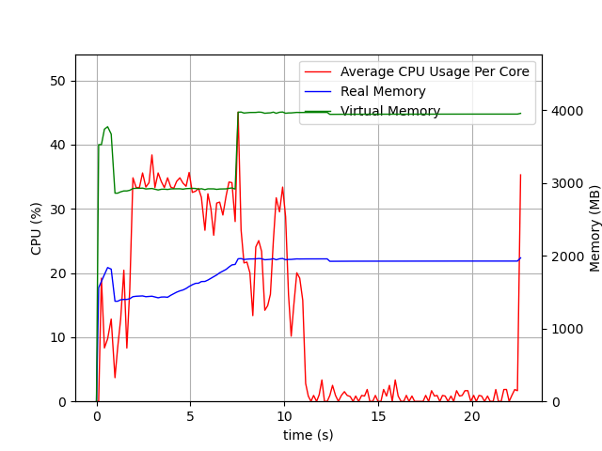
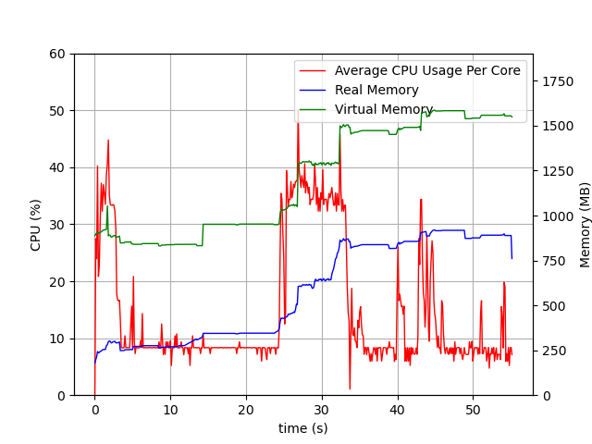
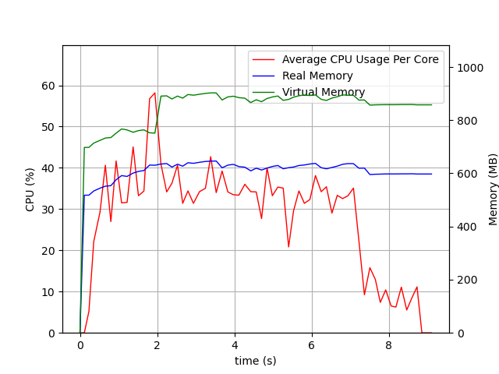
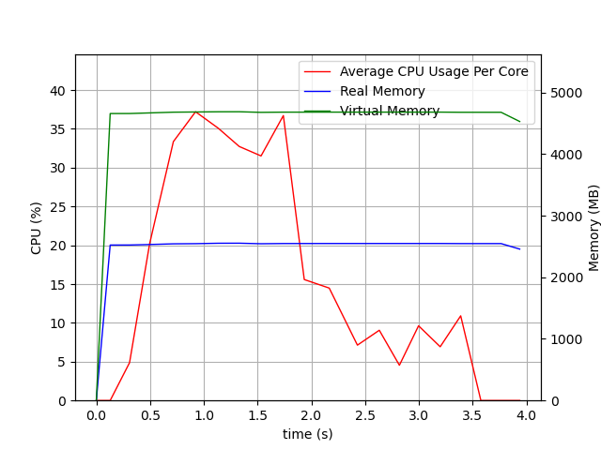
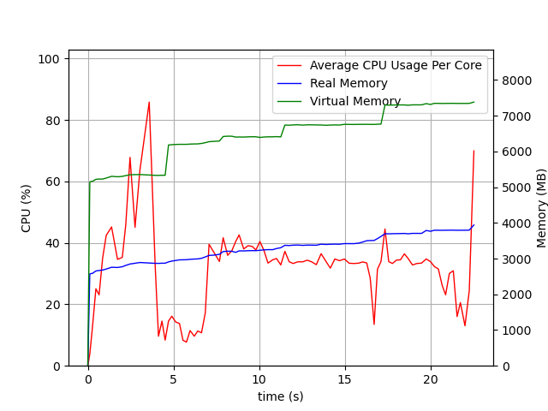
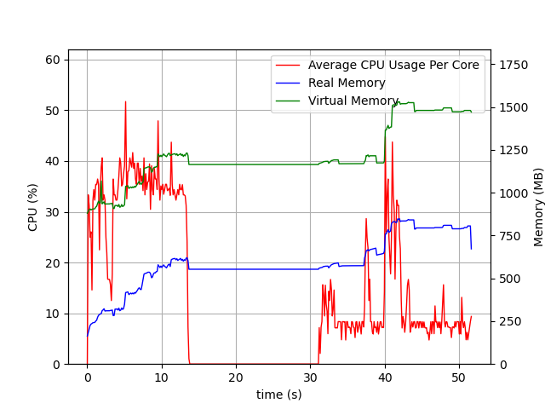
Key Results
Bazel Scratch Build of Guava
Maven Scratch Build of Guava
Gradle Scratch Build of Guava
Maven Incremental Build of Guava
Gradle Incremental Build of Guava
Bazel Incremental Build of Guava

