Slide 1
PMOD2BNC

Slide 2
1. Cross talk
2. Difficulty of manufacturing

Slide 4
Voltage Shift Select
BNC
ArtyS7
IO Select
3.3V to 5.0V
DC-DC Conveter
Voltage
Regulator
Isolator
Transciever
PMOD
Pin Header
Voltage Shift Select
BNC
IO Select
3.3V to 5.0V
DC-DC Conveter
Voltage
Regulator
Isolator
Transciever
PMOD
Pin Header
Voltage Shift Select
BNC
IO Select
3.3V to 5.0V
DC-DC Conveter
Voltage
Regulator
Isolator
Transciever
PMOD
Pin Header
Voltage Shift Select
BNC
IO Select
3.3V to 5.0V
DC-DC Conveter
Voltage
Regulator
Isolator
Transciever
PMOD
Pin Header

Slide 5
Cable

Slide 6
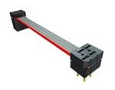
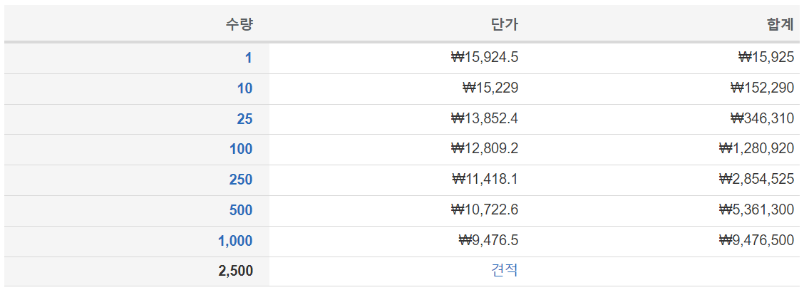
Samtec IDMD-06-T-03.00-C
https://www.mouser.kr/ProductDetail/Samtec/IDMD-06-T-03.00-C?qs=EjauVauIYjrv1YuvePIALA%3D%3D

Slide 7
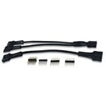
Digilent 240-021-2
https://www.mouser.kr/ProductDetail/Digilent/240-021-2?qs=raqtESnDWsATIKIS9jF%252B9Q%3D%3D

Slide 8
BNC

Slide 9
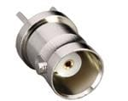
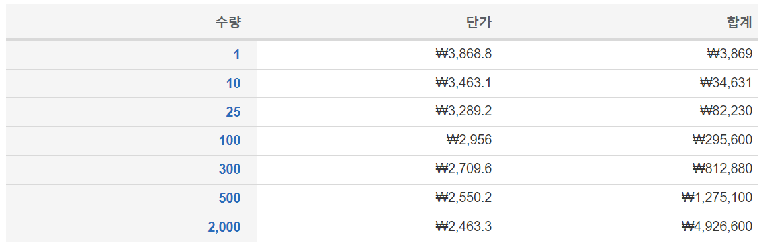
CONBNC001
https://www.mouser.kr/ProductDetail/Linx-Technologies/CONBNC001?qs=doiCPypUmgHczHAGaJs8Lg%3D%3D

Slide 10
EXT
PWR
3V3 TO 5V0
(1779205111)
Regulator
Diode
Voltage SPDT
IO SPDT
Impedance SPDT
Isolator
2->2
(SI8620BB-B-IS)
Transciever
2<->2
(74LVCH2T45DC-Q100H)
Transistor
(LIB_NTGD4167CT1G)
Isolator
2->2
(SI8620BB-B-IS)
157.14Ohm
Molex
Pin Header
(87911-1207)
BNC
(031-6575)
Transciever
2<->2
(74LVCH2T45DC-Q100H)
Isolator
2<-2
(SI8620BB-B-IS)
73.33Ohm
Invertor
(NLVHC1G14DFT1G)
Transistor
(LIB_NTGD4167CT1G)
Isolator
2<-2
(SI8620BB-B-IS)

