Slide 1
PMOD2BNC

Slide 2
1. Cross talk
2. Difficulty of manufacturing

Slide 4
lower side
upper side
3.3V to 5.0V
DC-DC Conveter
Voltage
Regulator
Ribbon
Cable
Voltage Shift Select
Bypass Select
ArtyS7
Voltage shifter
PMOD
PMOD
SPDT
PMOD
PMOD
BNC
Pin Header

Slide 5
Cable

Slide 6
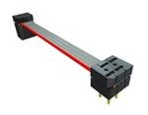
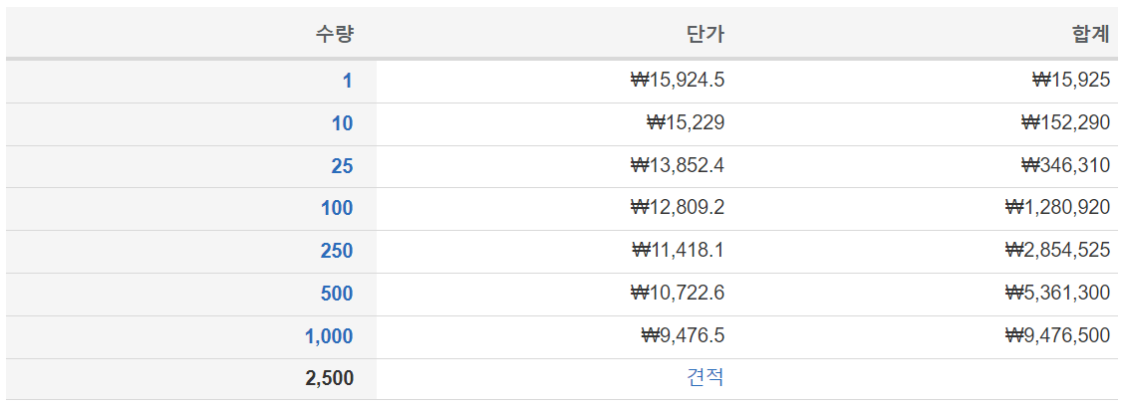
Samtec IDMD-06-T-03.00-C
https://www.mouser.kr/ProductDetail/Samtec/IDMD-06-T-03.00-C?qs=EjauVauIYjrv1YuvePIALA%3D%3D

Slide 7
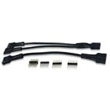
Digilent 240-021-2
https://www.mouser.kr/ProductDetail/Digilent/240-021-2?qs=raqtESnDWsATIKIS9jF%252B9Q%3D%3D

Slide 8
BNC

Slide 9
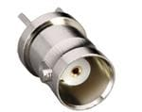
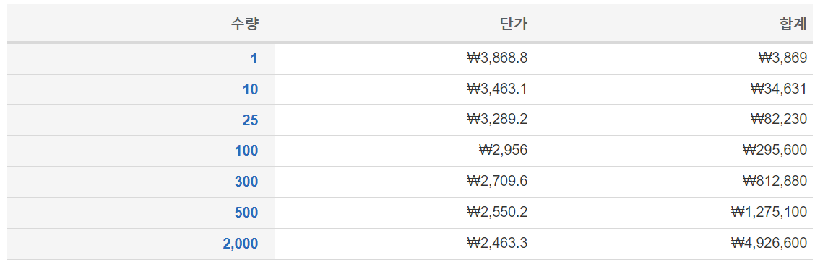
CONBNC001
https://www.mouser.kr/ProductDetail/Linx-Technologies/CONBNC001?qs=doiCPypUmgHczHAGaJs8Lg%3D%3D

Slide 10
3V3 TO 5V0
Regulator
Voltage SPDT
IO SPDT
Impedance SPDT
Isolator
4->4
Transistor
Transciever
157.14Ohm
Molex
Pin Header
BNC
Isolator
4<-4
73.33Ohm
Transistor

