Slide 1
PMOD2BNC
ArtyS7 Peripheral PCB Design

Slide 2
Problem
1. Crosstalk
2. Impedance Matching
4. Voltage of Logic
3. Difficulty of manufacturing device

Slide 3
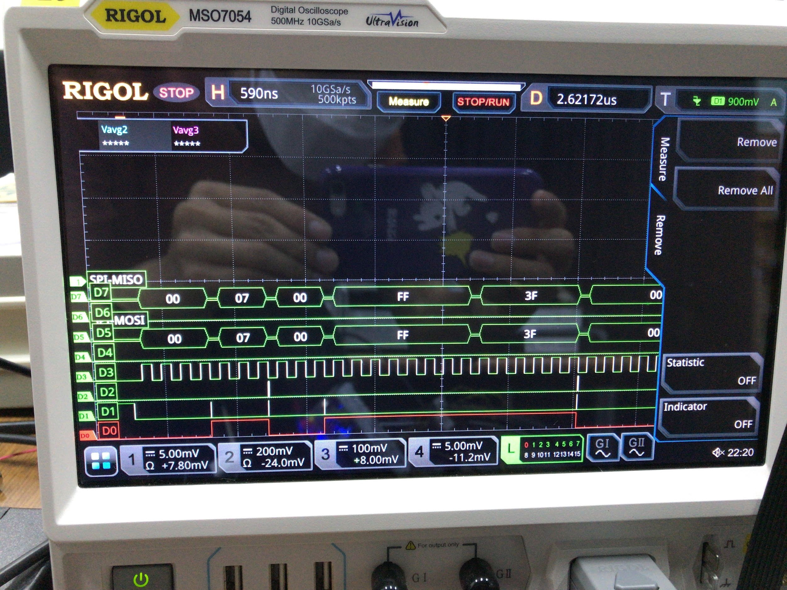
Crosstalk
Crosstalk between two port
Meaured at AD9910 FPGA test

Slide 4
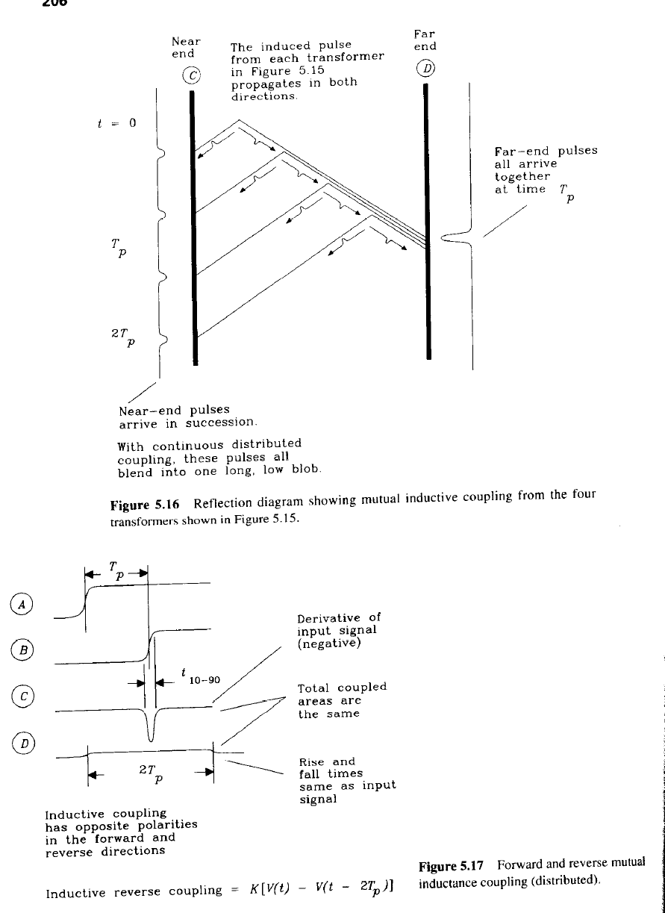
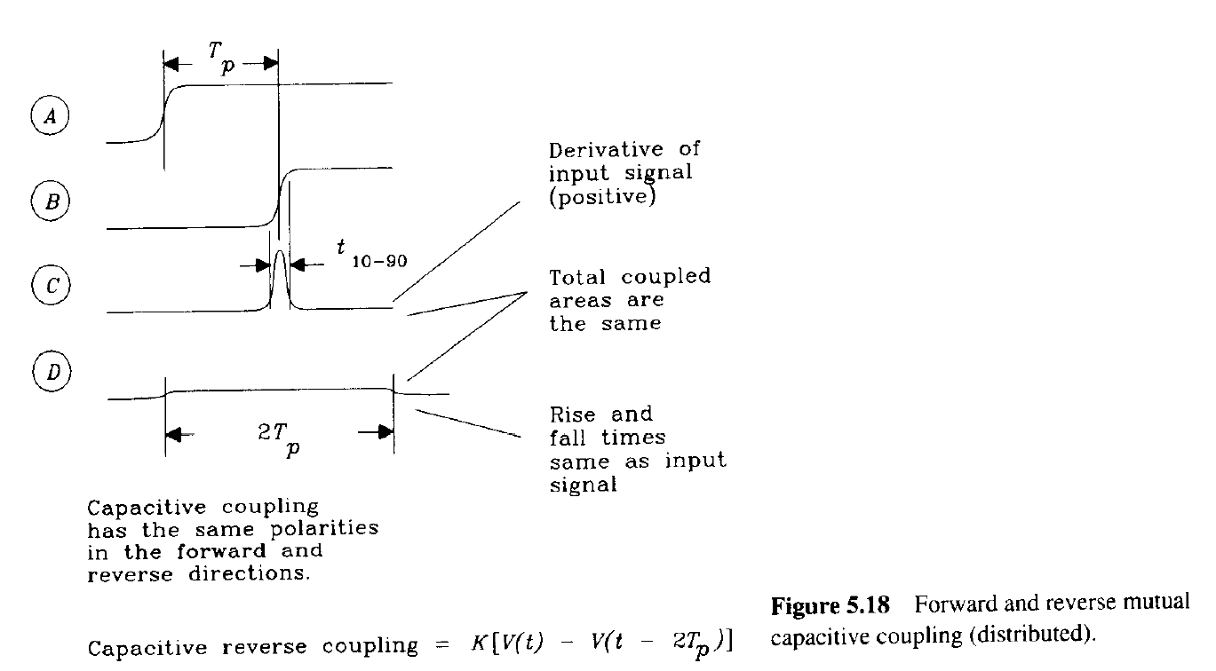
Crosstalk

Slide 5
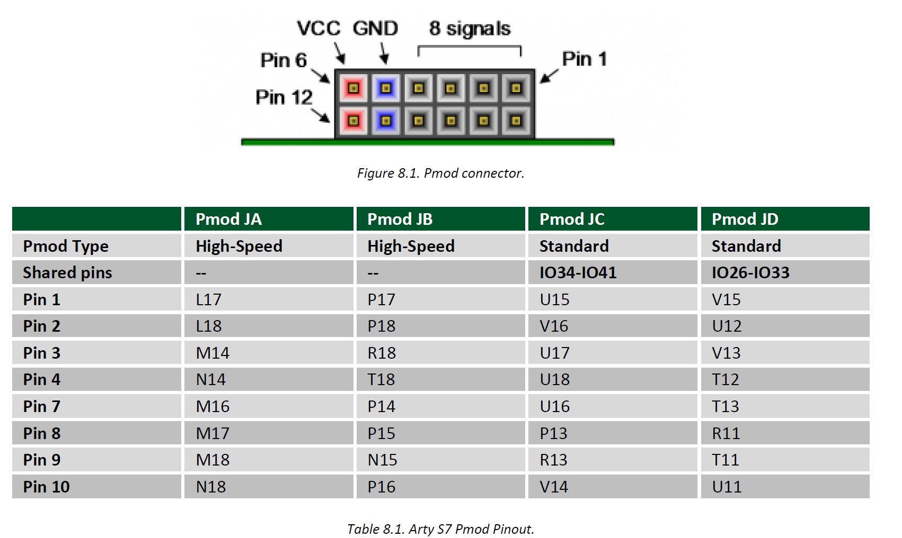
ArtyS7 PMOD

Slide 6
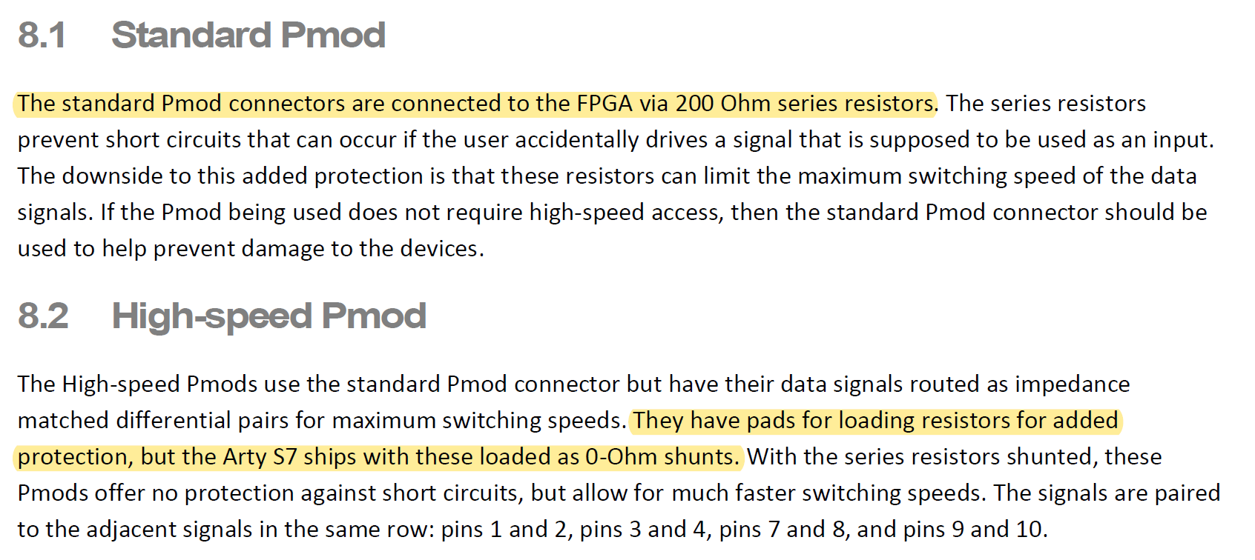
PMOD Impedance
I
200Ohm
I
0Ohm

Slide 7
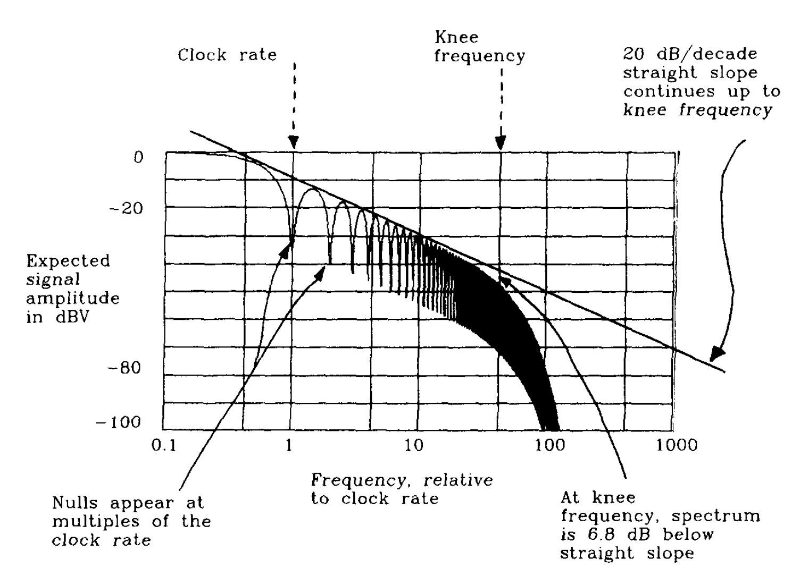
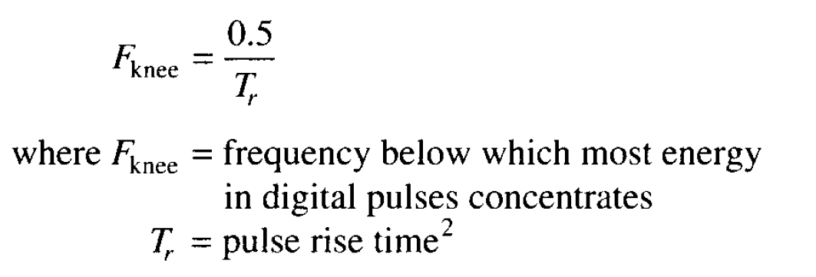
Knee Frequency

Slide 8
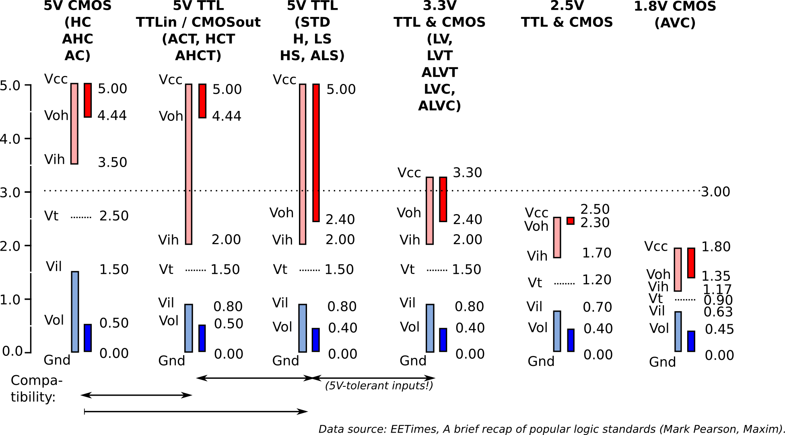
Voltage of Logics

Slide 9
Simple architecture
lower side
upper side
3.3V to 5.0V
DC-DC Conveter
Voltage
Regulator
Ribbon
Cable
Voltage Shift Select
ArtyS7
Bypass Select
PMOD
PMOD
Voltage shifter
SPDT
PMOD
PMOD
BNC
Pin Header

