Slide 1
PMOD2BNC
PMOD2BNC PCB Procedure

Slide 2
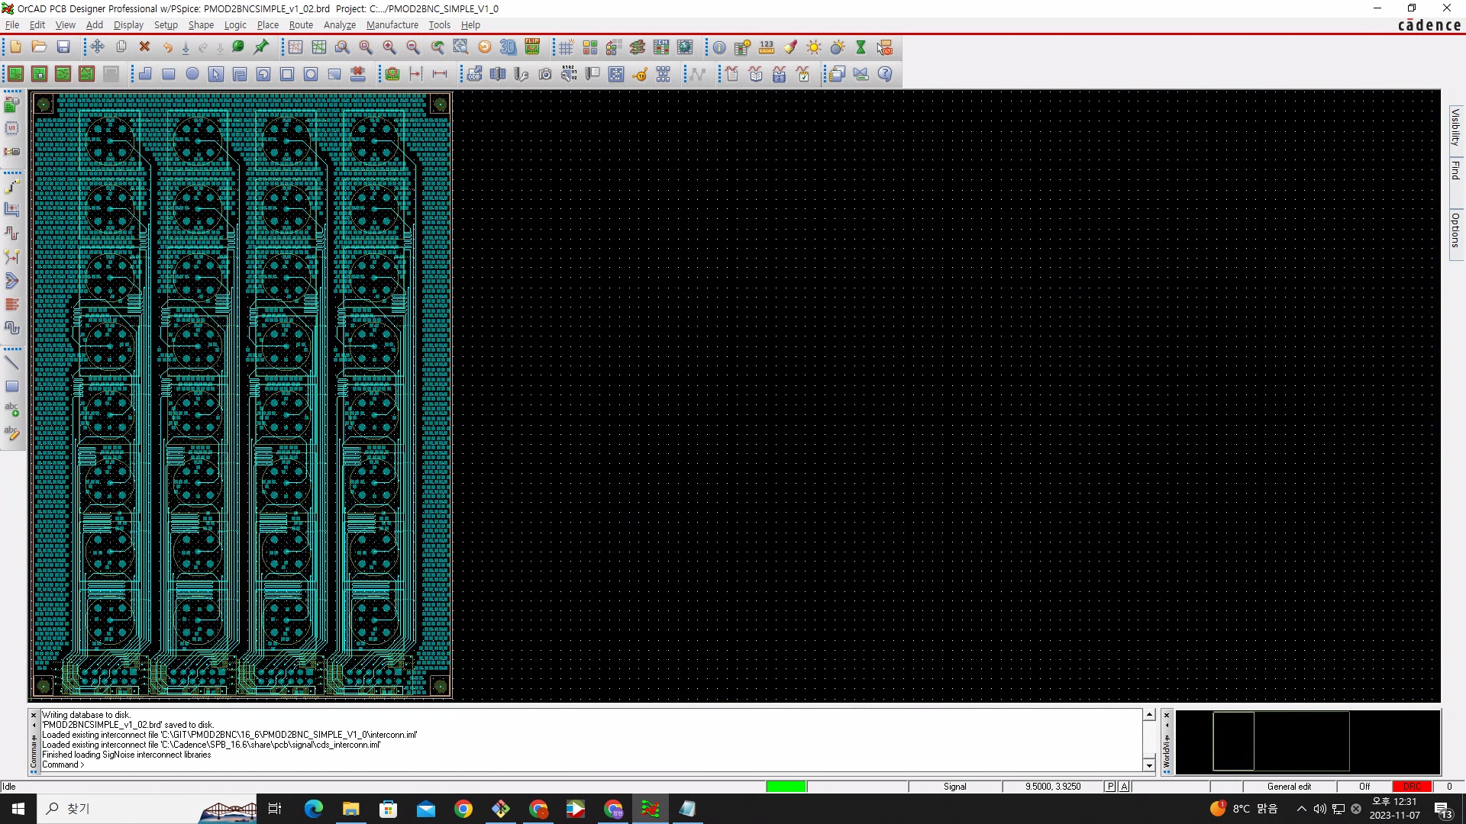
PCB Procedure Summary
Done
-PCB Routing done
-ORCAD 16.6
-BNC based
-All delay is matched to 0.8ns
( mismatch ~0.03ns)
-4 layers(stripline)
-Direct Connection is possible
ToDo
-Trace width setting
-Make gerber file
ArtyS7
PCB

