Slide 1
PMOD2BNC

Slide 2
1. Cross talk
2. Difficulty of manufacturing

Slide 4
Voltage Shift Select
BNC
ArtyS7
IO Select
3.3V to 5.0V
DC-DC Conveter
Voltage
Regulator
Isolator
Transciever
PMOD
Pin Header
Voltage Shift Select
BNC
IO Select
3.3V to 5.0V
DC-DC Conveter
Voltage
Regulator
Isolator
Transciever
PMOD
Pin Header
Voltage Shift Select
BNC
IO Select
3.3V to 5.0V
DC-DC Conveter
Voltage
Regulator
Isolator
Transciever
PMOD
Pin Header
Voltage Shift Select
BNC
IO Select
3.3V to 5.0V
DC-DC Conveter
Voltage
Regulator
Isolator
Transciever
PMOD
Pin Header

Slide 5
PMOD

Slide 6
Cable

Slide 7
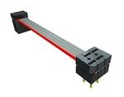
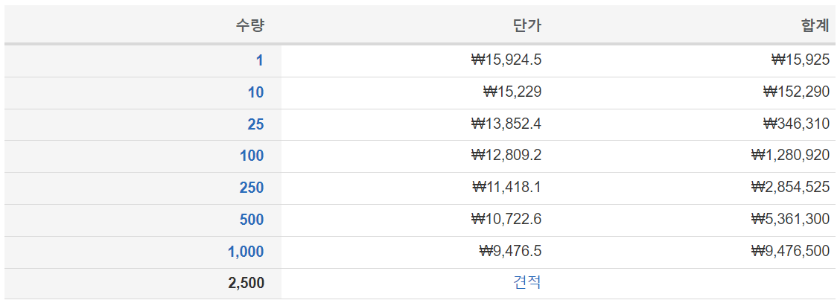
Samtec IDMD-06-T-03.00-C
https://www.mouser.kr/ProductDetail/Samtec/IDMD-06-T-03.00-C?qs=EjauVauIYjrv1YuvePIALA%3D%3D

Slide 8
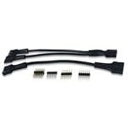
Digilent 240-021-2
https://www.mouser.kr/ProductDetail/Digilent/240-021-2?qs=raqtESnDWsATIKIS9jF%252B9Q%3D%3D

Slide 9
BNC

Slide 10
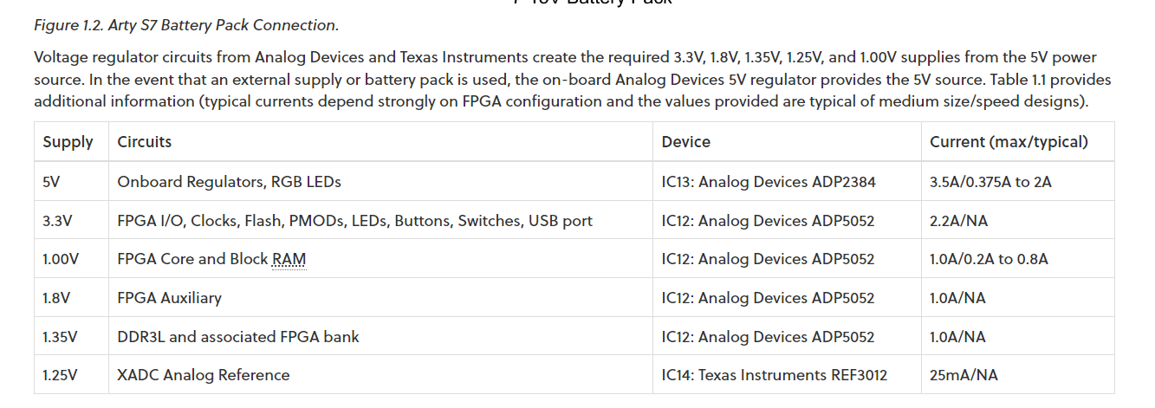

Slide 11
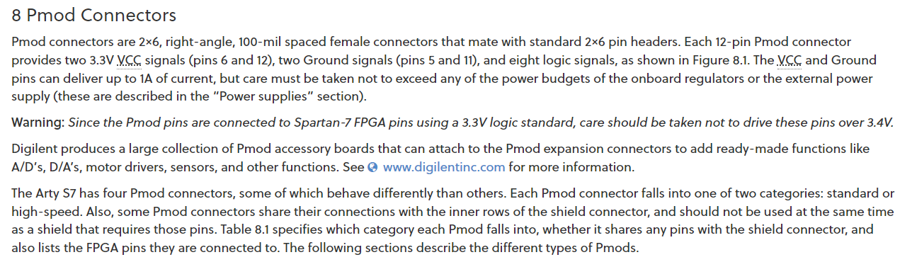

Slide 12
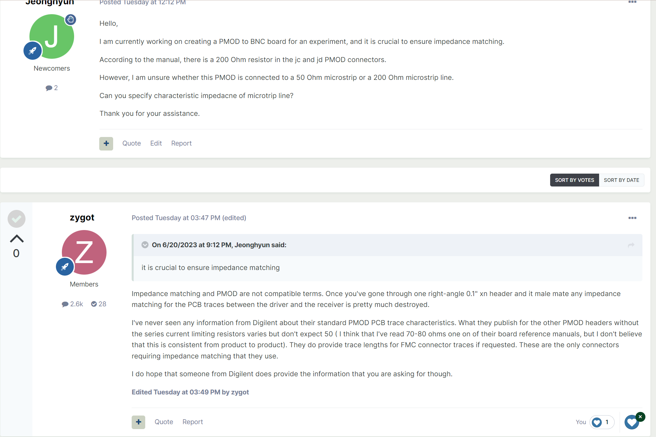

Slide 13
Rev 1
The maximum output current for the 3.3V output of the Arty S7 board is 2.2A.
EXT
PWR
3V3 TO 5V0
(1779205111)
Regulator
X2
Diode
Voltage SPDT
IO SPDT
Impedance SPDT
2.2+5.3+3.1+8.8
=19.4mA, 150mW
Transciever
2<->2
(74LVCH2T45DC-Q100H)
100mA, 250mW
Isolator
2->2
(SI8620BB-B-IS)
Transistor
(LIB_NTGD4167CT1G)
Isolator
2->2
(SI8620BB-B-IS)
157.14Ohm
Molex
Pin Header
(87911-1207)
BNC
(031-6575)
Transciever
2<->2
(74LVCH2T45DC-Q100H)
Isolator
2<-2
(SI8620BB-B-IS)
73.33Ohm
Invertor
(NLVHC1G14DFT1G)
Transistor
(LIB_NTGD4167CT1G)
Isolator
2<-2
(SI8620BB-B-IS)

Slide 14
Rev 2
Regulator 12V0 TO 5V0
(LD29150DT50R)
LED Diode
(598-8260-107F)
EXT PWR PIN
(462071104)
Voltage SPDT
Regulator 12V0 TO 3V3
(LD29150DT33R)
LED Diode
(598-8260-107F)
Zener Diode
X2
IO SPDT
Impedance SPDT
Ground Isolation
2.2+5.3+3.1+8.8
=19.4mA, 150mW
Transciever
2<->2
(74LVCH2T45DC-Q100H)
100mA, 250mW
Isolator
2->2
(SI8620BB-B-IS)
Transistor
(LIB_NTGD4167CT1G)
Isolator
2->2
(SI8620BB-B-IS)
157.14Ohm
(ERA-8AEB1580V)
Molex
Pin Header
(71764-0112)
BNC
(031-6575)
Transciever
2<->2
(74LVCH2T45DC-Q100H)
Isolator
2<-2
(SI8620BB-B-IS)
73.33Ohm
(RP73PF2A73R2BTDF)
Invertor
(NLVHC1G14DFT1G)
Transistor
(LIB_NTGD4167CT1G)
Isolator
2<-2
(SI8620BB-B-IS)

Slide 15
Rev 3
Regulator 12V0 TO 3V3
(LD29150DT33R)
Regulator 12V0 TO 5V0
(LD29150DT50R)
Voltage
Switch
EXT PWR PIN
(462071104)
LED Diode
(598-8260-107F)
LED Diode
(598-8260-107F)
12V0 ESD
(PE3212M1Q_R1_00001)
X2
2.2+5.3+3.1+8.8
=19.4mA, 150mW
NFET
(NVR4501NT1G)
IO SPDT
Impedance SPDT
Ground Isolation
3V3 ESD
(UCLAMP3301H.TCT)
5V0 ESD
(PRTR5V0U2X,215)
3.3V Source
Isolator
2->2
(SI8620BC-B-IS)
Transciever
2<->2
(74LVCH2T45DC-Q100H)
100mA, 250mW
Transistor
(LIB_NTGD4167CT1G)
Digital SPDT
(74LVC1G3157GW,125)
Isolator
2->2
(SI8620BC-B-IS)
157.14Ohm
(ERA-8AEB1580V)
Molex
Pin Header
(71764-0112)
50Ohm
BNC
(031-6575)
Transciever
2<->2
(74LVCH2T45DC-Q100H)
Digital SPDT
(74LVC1G3157GW,125)
Isolator
2<-2
(SI8620BC-B-IS)
73.33Ohm
(RP73PF2A73R2BTDF)
Invertor
(NLVHC1G14DFT1G)
Transistor
(LIB_NTGD4167CT1G)
Isolator
2<-2
(SI8620BC-B-IS)

Slide 16
SPDT Structure
SPDT
(DS04-254-2-04BK-SMT)
X4
10KOhm
(RNCP1206FTD10K0)
100nF
(MSRLJ103SB5104MFNA01)

Slide 17
LED
1KOhm
(RNCP1206FTD1K00)
LED Diode
(598-8260-107F)

Slide 18
Voltage Switch
PFET
(NTR3A052PZT1G)
Switch
(DS04-254-2-01BK-SMT-TR)
Invertor
(NLVHC1G14DFT1G)
PFET
(NTR3A052PZT1G)
10KOhm
(RNCP1206FTD10K0)
100nF
(MSRLJ103SB5104MFNA01)

Slide 19
Decoupling Capacitor (@ IC VCC pin)
10uF (Electro)
(MAL215375109E3)
Sizes should considered!!! in 100 nF (8501 ... etc)
Look : https://www.renesas.com/us/en/document/apn/an1325-choosing-and-using-bypass-capacitors
-> L effect considered
1uF (Ceramic)
(KAM03CT70J105KH)
100nF (Ceramic)
(MSRLJ103SB5104MFNA01)
10nF (Ceramic)
(MAASL063SB7103MFCA01)

Slide 20
Bypass Capacitor (@ power source)
1nH(Ferrite Bead)
(BLM18PG121SN1D)
1uF (Ceramic)
(KAM03CT70J105KH)
100nF (Ceramic)
(MSRLJ103SB5104MFNA01)
10nF (Ceramic)
(MAASL063SB7103MFCA01)

