Slide 1
PMOD2BNC

Slide 2
1. Cross talk
2. Difficulty of manufacturing

Slide 4
Voltage Shift Select
BNC
ArtyS7
IO Select
3.3V to 5.0V
DC-DC Conveter
Voltage
Regulator
Isolator
Transciever
PMOD
Pin Header
Voltage Shift Select
BNC
IO Select
3.3V to 5.0V
DC-DC Conveter
Voltage
Regulator
Isolator
Transciever
PMOD
Pin Header
Voltage Shift Select
BNC
IO Select
3.3V to 5.0V
DC-DC Conveter
Voltage
Regulator
Isolator
Transciever
PMOD
Pin Header
Voltage Shift Select
BNC
IO Select
3.3V to 5.0V
DC-DC Conveter
Voltage
Regulator
Isolator
Transciever
PMOD
Pin Header

Slide 5
PMOD

Slide 6
Cable

Slide 7
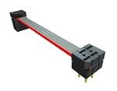
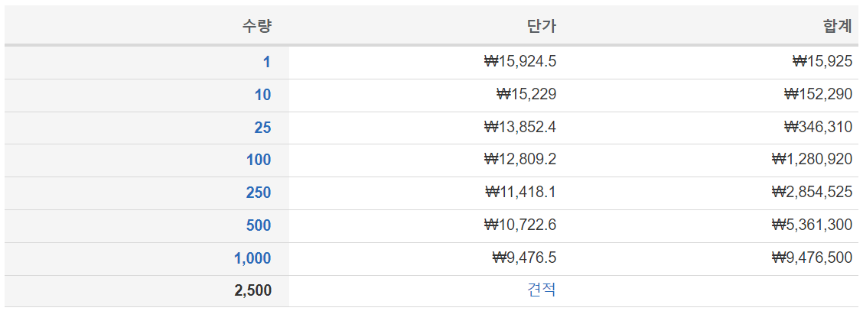
Samtec IDMD-06-T-03.00-C
https://www.mouser.kr/ProductDetail/Samtec/IDMD-06-T-03.00-C?qs=EjauVauIYjrv1YuvePIALA%3D%3D

Slide 8
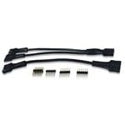
Digilent 240-021-2
https://www.mouser.kr/ProductDetail/Digilent/240-021-2?qs=raqtESnDWsATIKIS9jF%252B9Q%3D%3D

Slide 9
BNC

Slide 10
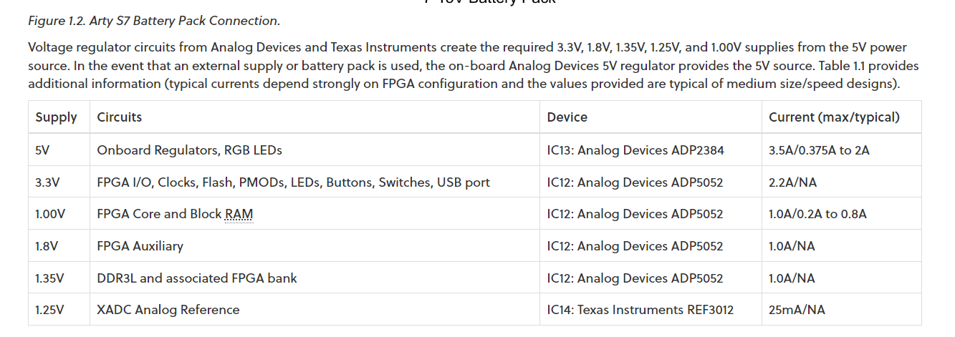

Slide 11
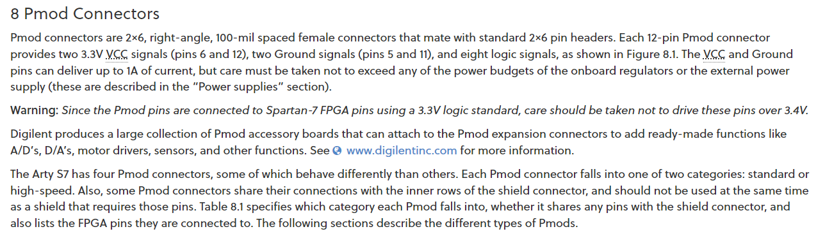

Slide 12
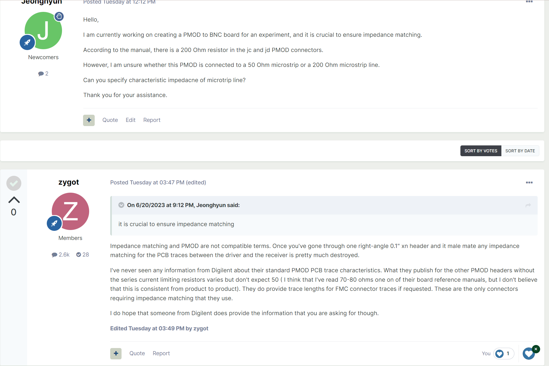

Slide 13
The maximum output current for the 3.3V output of the Arty S7 board is 2.2A.
EXT
PWR
3V3 TO 5V0
(1779205111)
Regulator
X2
Diode
Voltage SPDT
IO SPDT
Impedance SPDT
2.2+5.3+3.1+8.8
=19.4mA, 150mW
Transciever
2<->2
(74LVCH2T45DC-Q100H)
100mA, 250mW
Isolator
2->2
(SI8620BB-B-IS)
Transistor
(LIB_NTGD4167CT1G)
Isolator
2->2
(SI8620BB-B-IS)
157.14Ohm
Molex
Pin Header
(87911-1207)
BNC
(031-6575)
Transciever
2<->2
(74LVCH2T45DC-Q100H)
Isolator
2<-2
(SI8620BB-B-IS)
73.33Ohm
Invertor
(NLVHC1G14DFT1G)
Transistor
(LIB_NTGD4167CT1G)
Isolator
2<-2
(SI8620BB-B-IS)

Slide 14
Regulator 12V0 TO 5V0
(LD29150DT50R)
LED Diode
Voltage SPDT
EXT PWR PIN
(462071104)
Regulator 12V0 TO 3V3
(LD29150DT33R)
LED Diode
X2
Diode
IO SPDT
Impedance SPDT
2.2+5.3+3.1+8.8
=19.4mA, 150mW
Transciever
2<->2
(74LVCH2T45DC-Q100H)
100mA, 250mW
Isolator
2->2
(SI8620BB-B-IS)
Transistor
(LIB_NTGD4167CT1G)
Isolator
2->2
(SI8620BB-B-IS)
157.14Ohm
(ERA-8AEB1580V)
Molex
Pin Header
(71764-0112)
BNC
(031-6575)
Transciever
2<->2
(74LVCH2T45DC-Q100H)
Isolator
2<-2
(SI8620BB-B-IS)
73.33Ohm
(RP73PF2A73R2BTDF)
Invertor
(NLVHC1G14DFT1G)
Transistor
(LIB_NTGD4167CT1G)
Isolator
2<-2
(SI8620BB-B-IS)

