Slide 1
현대물리실험 발표
수소 원자 스펙트럼에 대한 이론적 분석

Slide 2
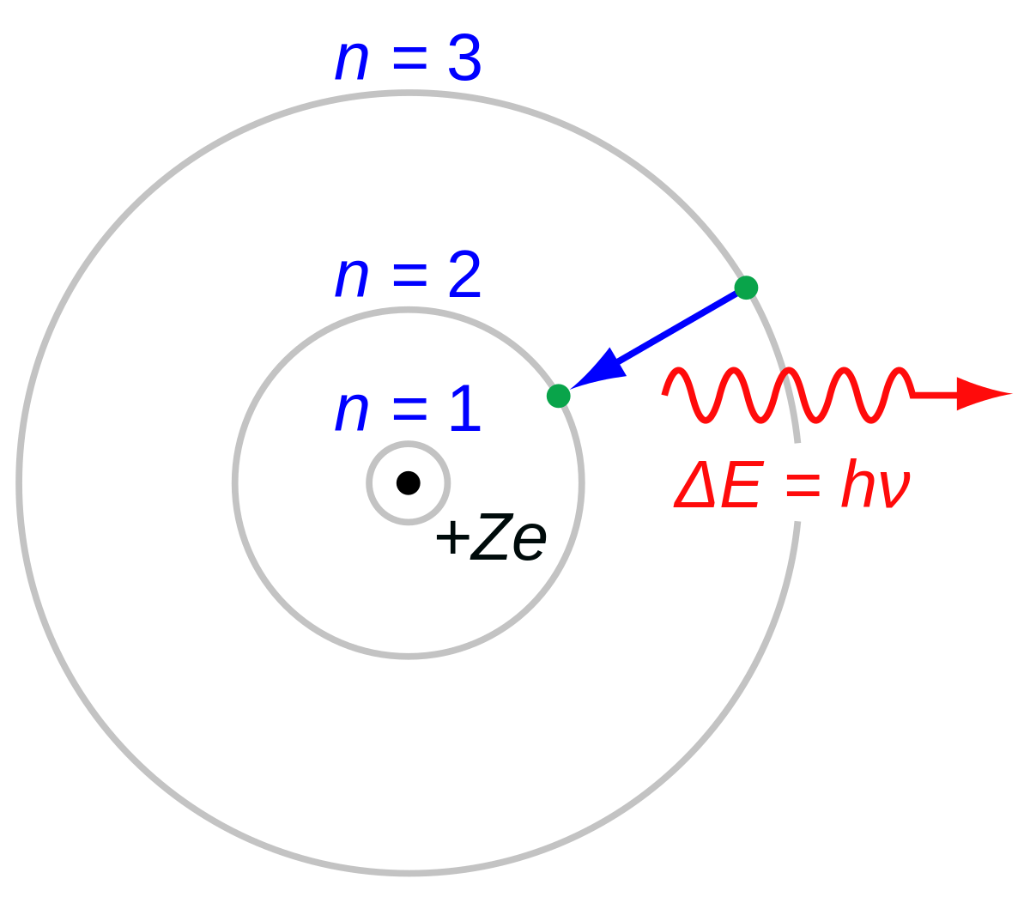
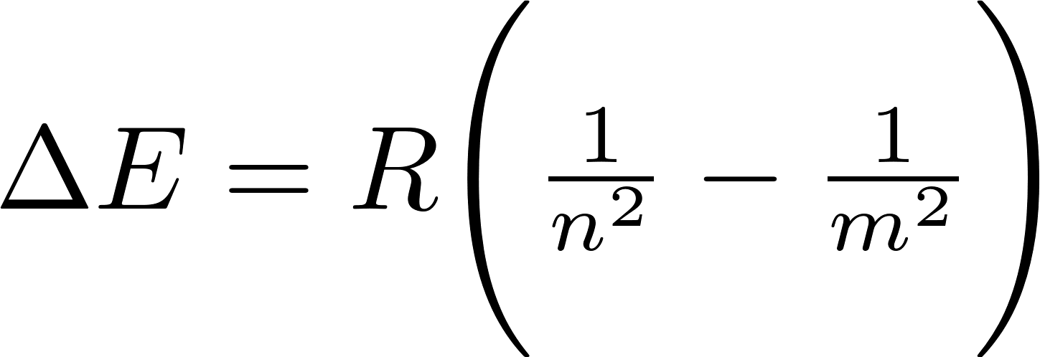
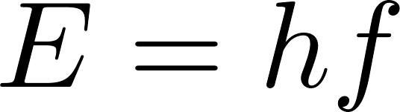
Hydrogen Atom
What we want to show
Well known
(shown by photoelectric effect)
-> "Something" is quantum[1]
If we measure quantized spectrum, then what is quantum?
We must use Frank Hertz Experiment result
Quantized atomic level
-> Quantized measured value = atomic level
[1]Gerry, C., Knight, P., & Knight, P. L. (2005, January 1). Introductory Quantum Optics. Cambridge University Press.

Slide 3
Experiment Setup:Discharging Tube
Atom
e
Atom
e
Atom
e
e
e
Atom
e
e
e
Atom
e
e
Atom
e
electron avlanche
->towndown discharge

Slide 4
Experiment Setup:Spectrometer
PC
DischargingTube
What we expect

Slide 5
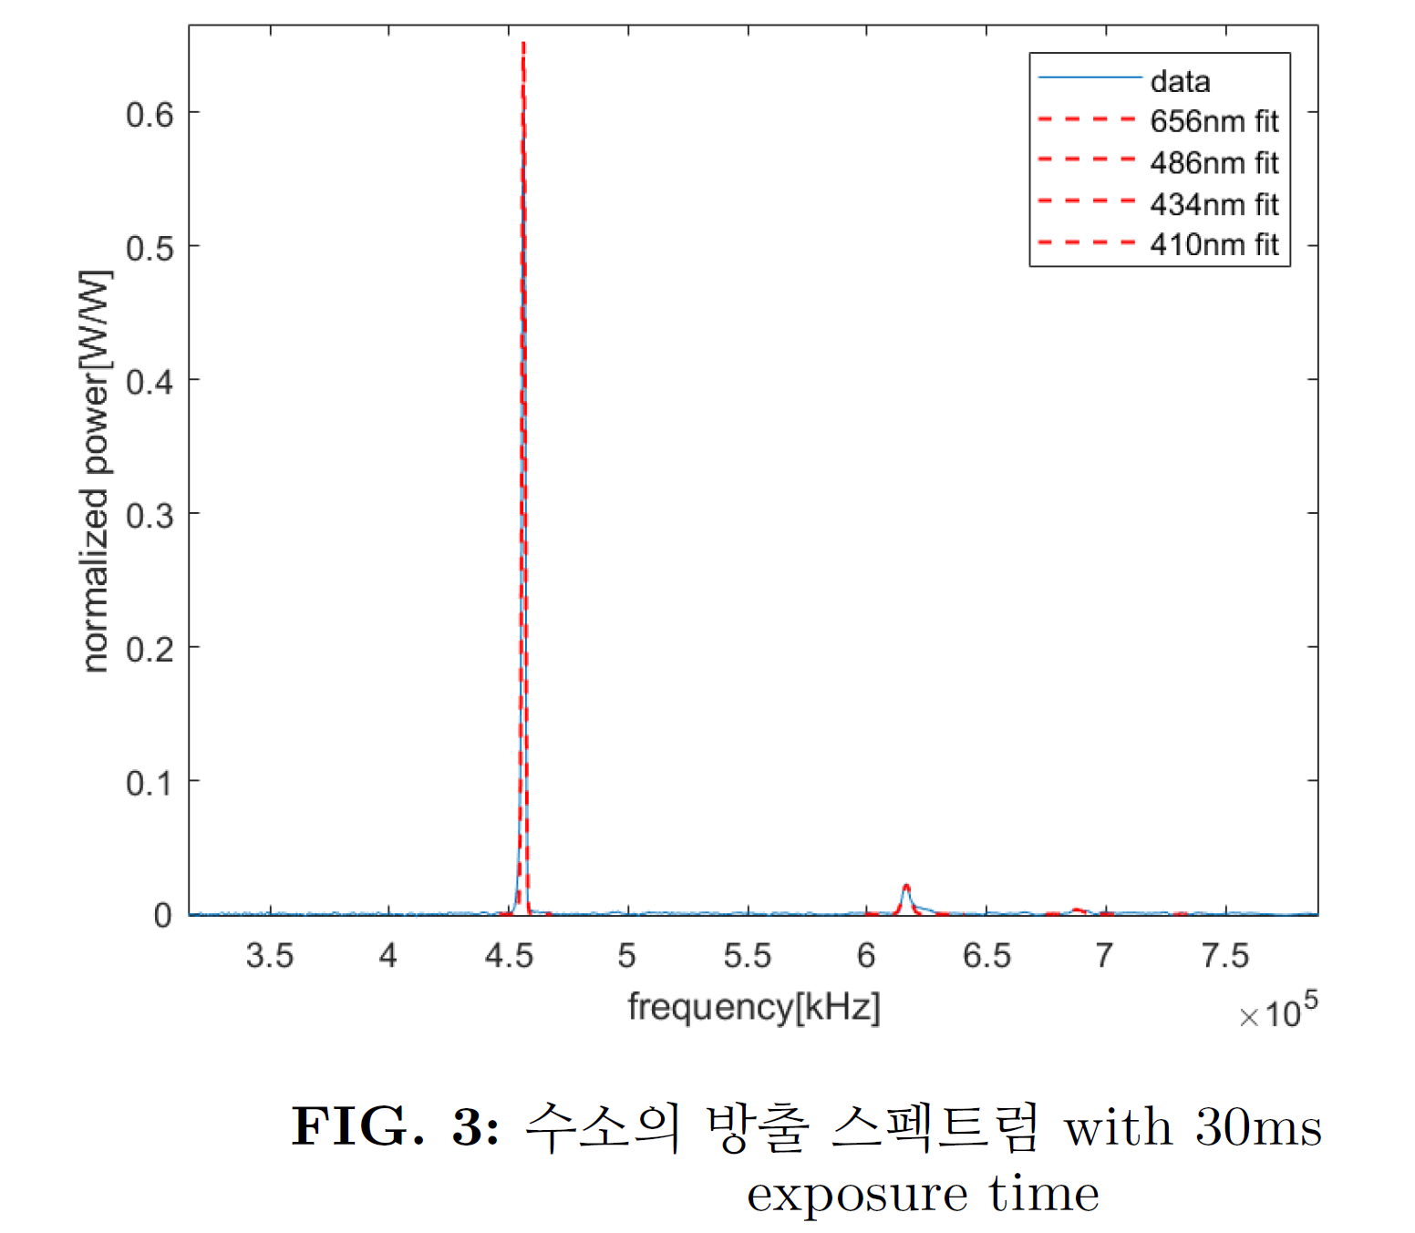
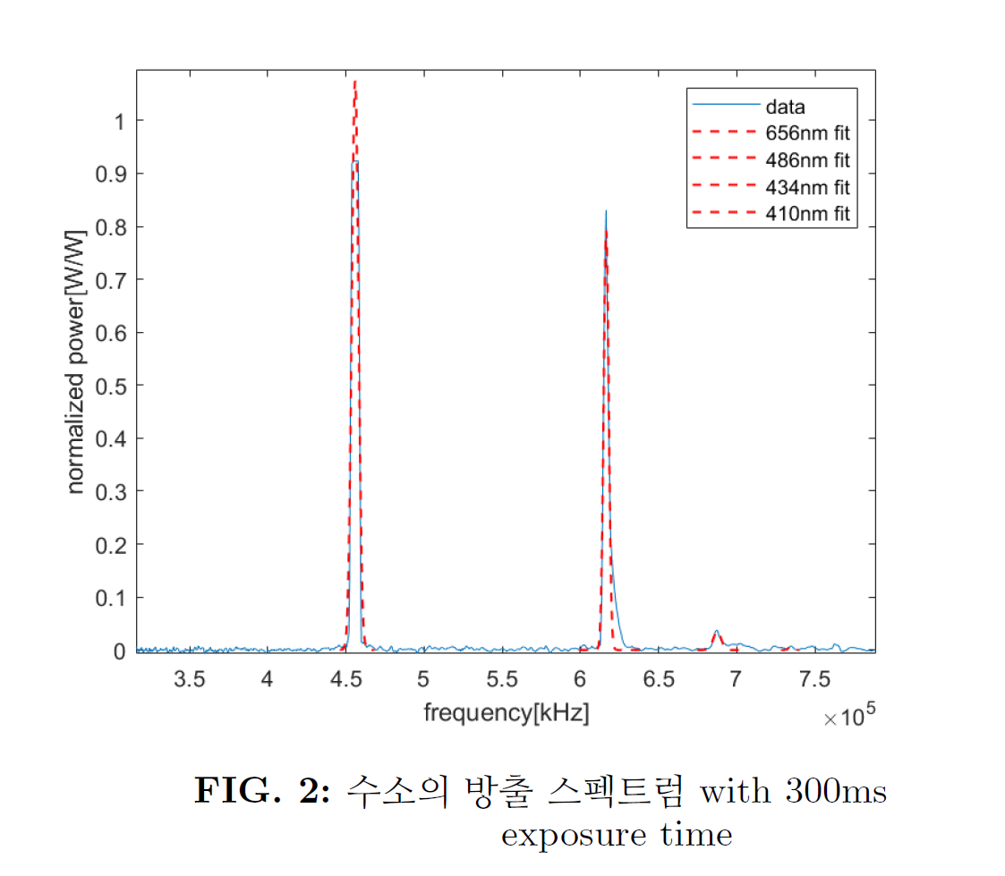
Result:Hydrogen
1. Why population decrease?
2. energy is quantized but why there is linewidth?
1. Boltzman distribution? but dynamic equilibrium
2. doppler shift? model can be made?

Slide 6
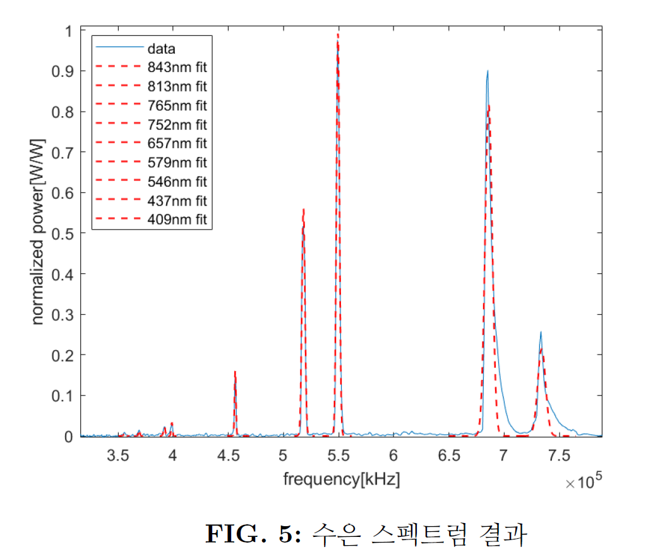
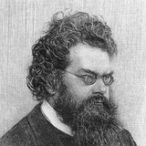
Result:Mercury
?
Boltzman wrong?

Slide 7
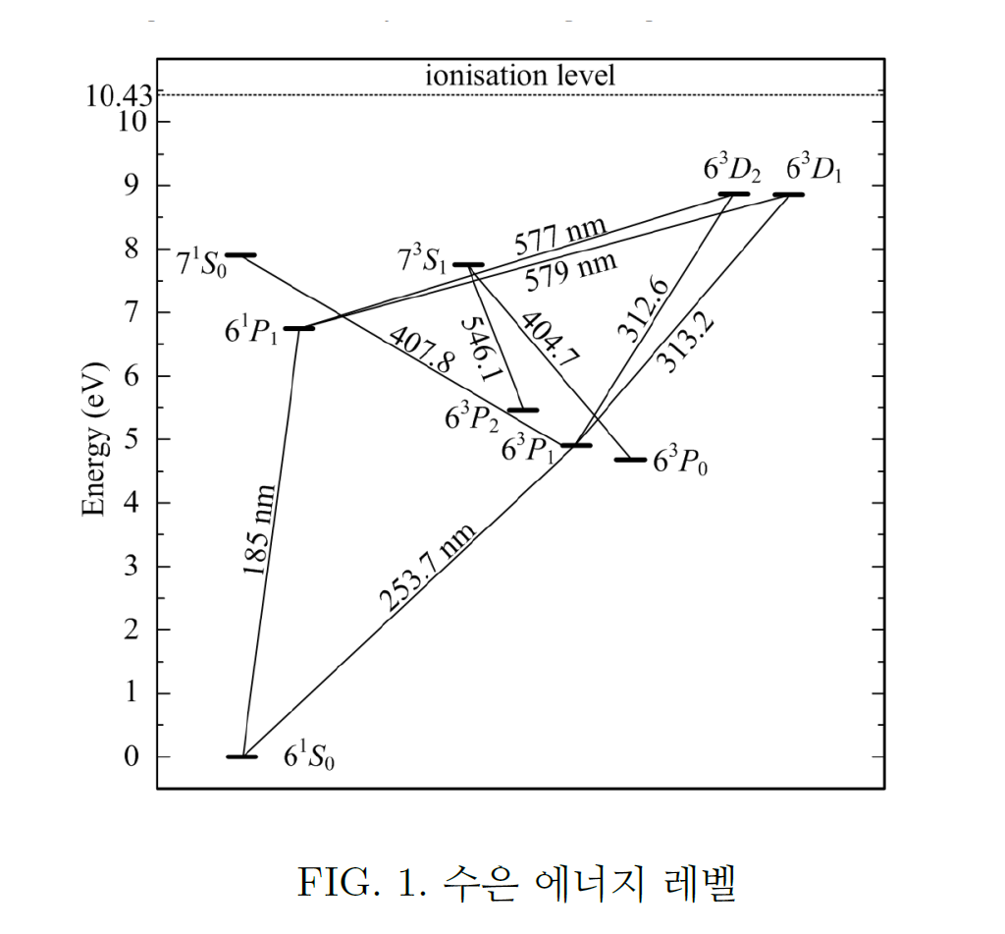
Mercury energy level
[2]Kotov, M. A., Shemyakin, A. N., Solovyov, N. G., & Yakimov, M. Y. (2022, January 10). Symmetrization and Amplification of Germicidal Radiation Flux Produced by a Mercury Amalgam UV Lamp in Cylindrical Cavity with Diffusely Reflective Walls. Symmetry, 14 (1), 125. https://doi.org/10.3390/sym14010125

Slide 8
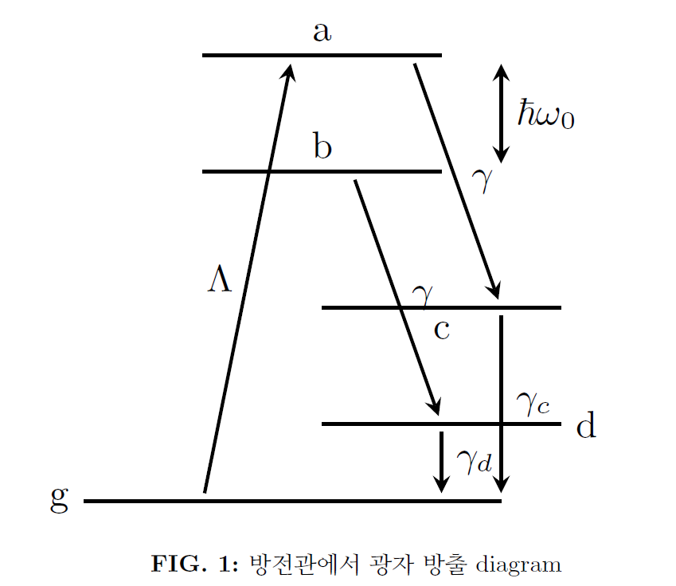
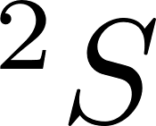
Physical Model
Now, we know there is many atom level
-> select two specific level
-> similar to laser
Selected two level
atom excitation by
electron scattering
intermediate state(due to selection rule)
ground state

Slide 9
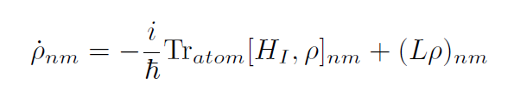
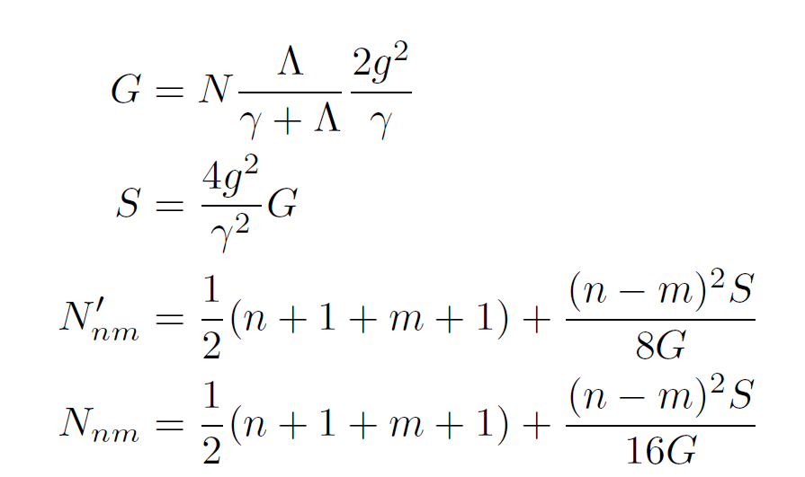
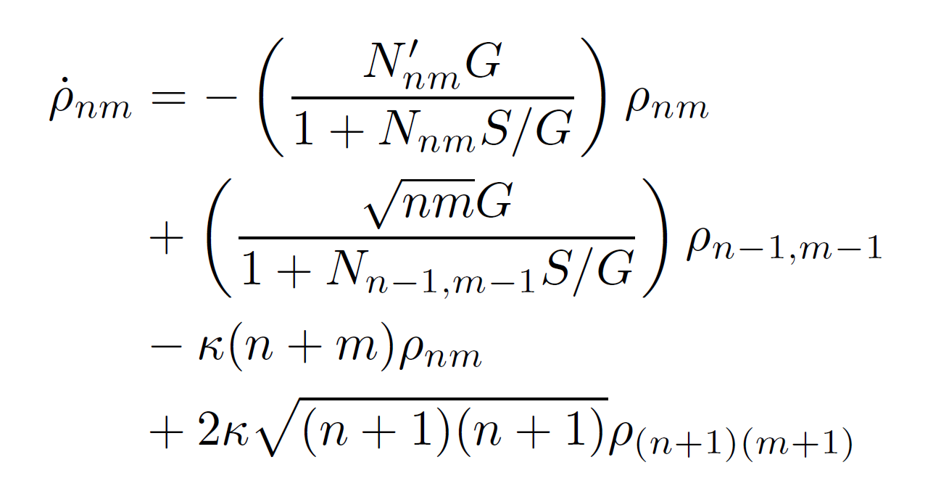
Calculation
Master equation of model
Atom
evolution of atom
by interaction
decay of system
e
Atom

Slide 10
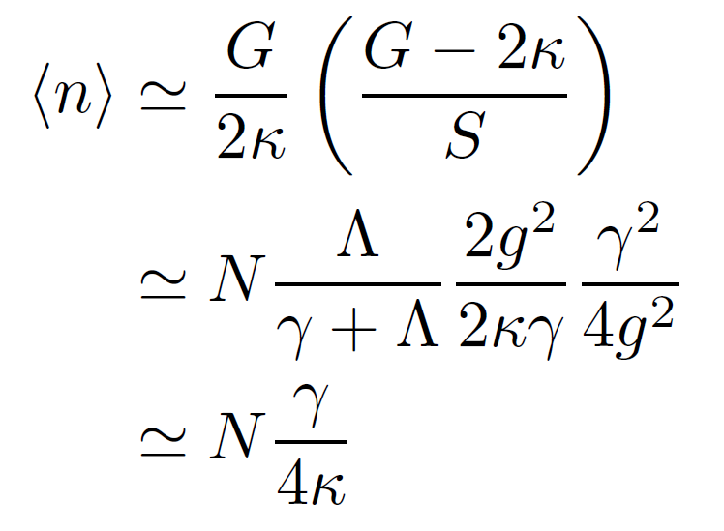
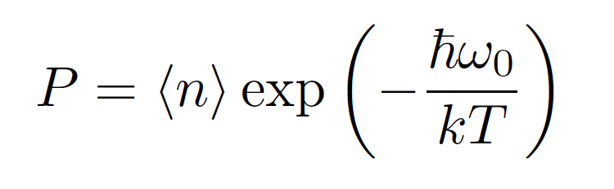
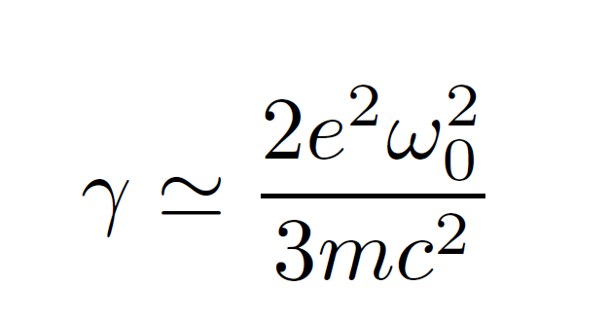
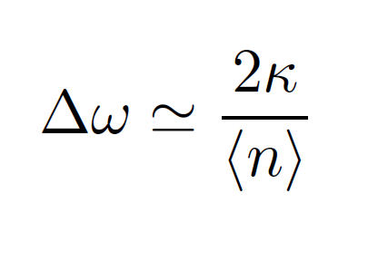
Calculated Result

Slide 11
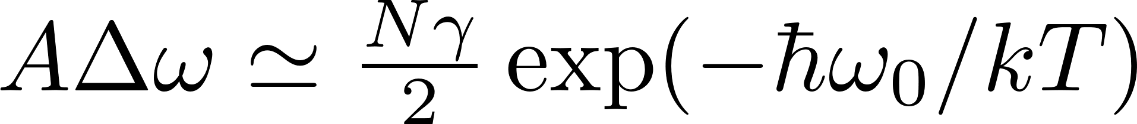

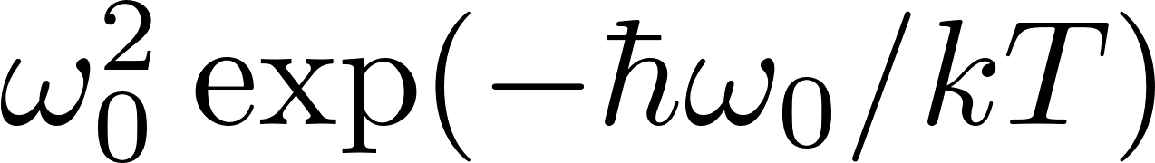
How can we see our result is correct?
Measured amplitude A :
Measured linewidth:
Product of amplitude and linewidth :
If there is only ideal spontaneous decay, then follows

Slide 12
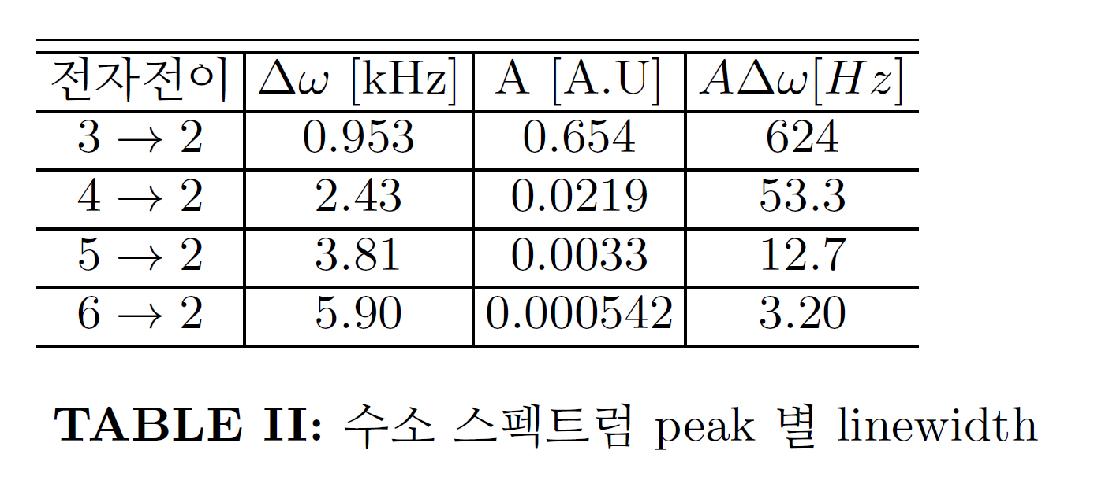
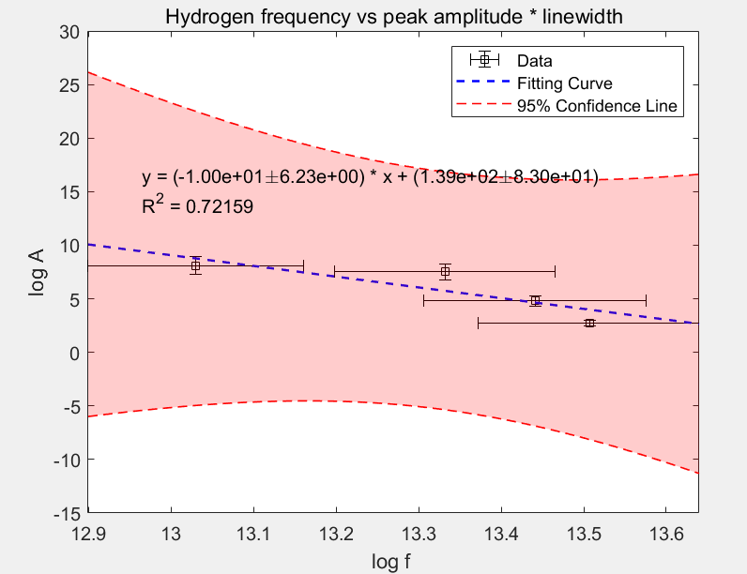
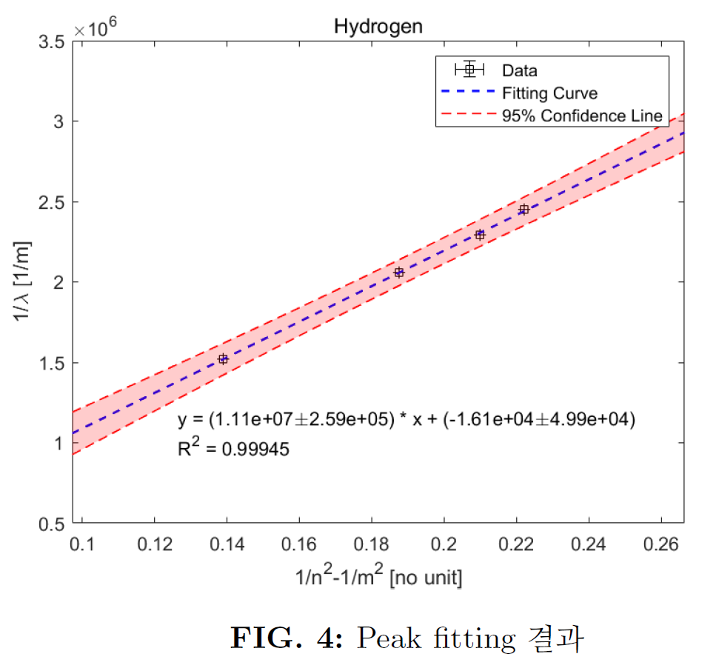
Result:Hydrogrn

Slide 13
Result:Mercury
Wave[nm] | Amp*linewidth
843 | 8.8689
813 | 13.1591
765 | 27.3842
752 | 29.0280
657 | 146.1608
578 | 1.1078e+03
546 | 1.9307e+03
437 | 3.7464e+03
409 | 1.0894e+03

Slide 14
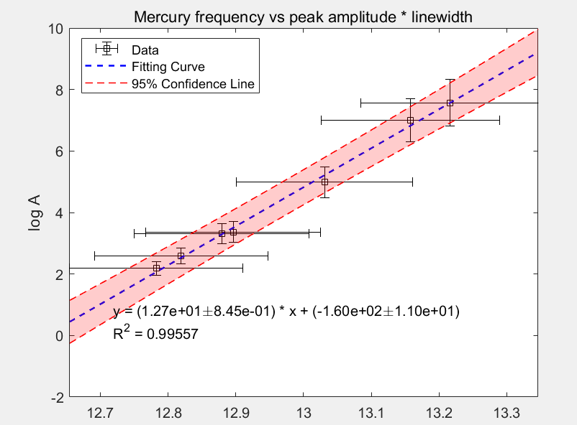

Mercury frequency peak dependence
peak follows power of 12th of frequency
-> has frequency dependency?-> Maybe not
-> need more accurate model to show this dependency

Slide 15

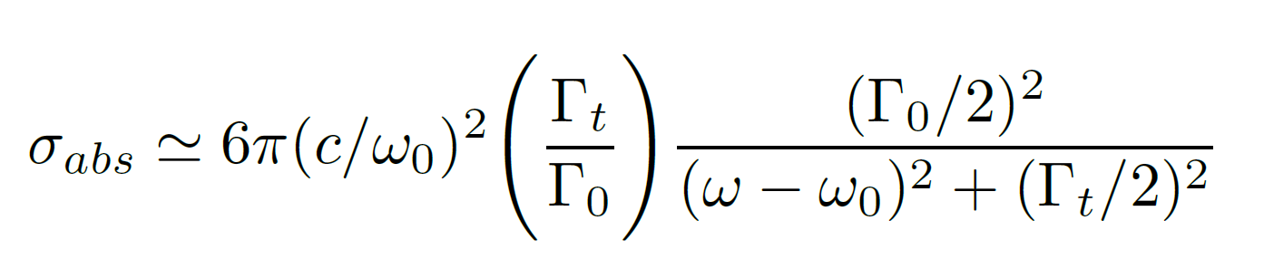
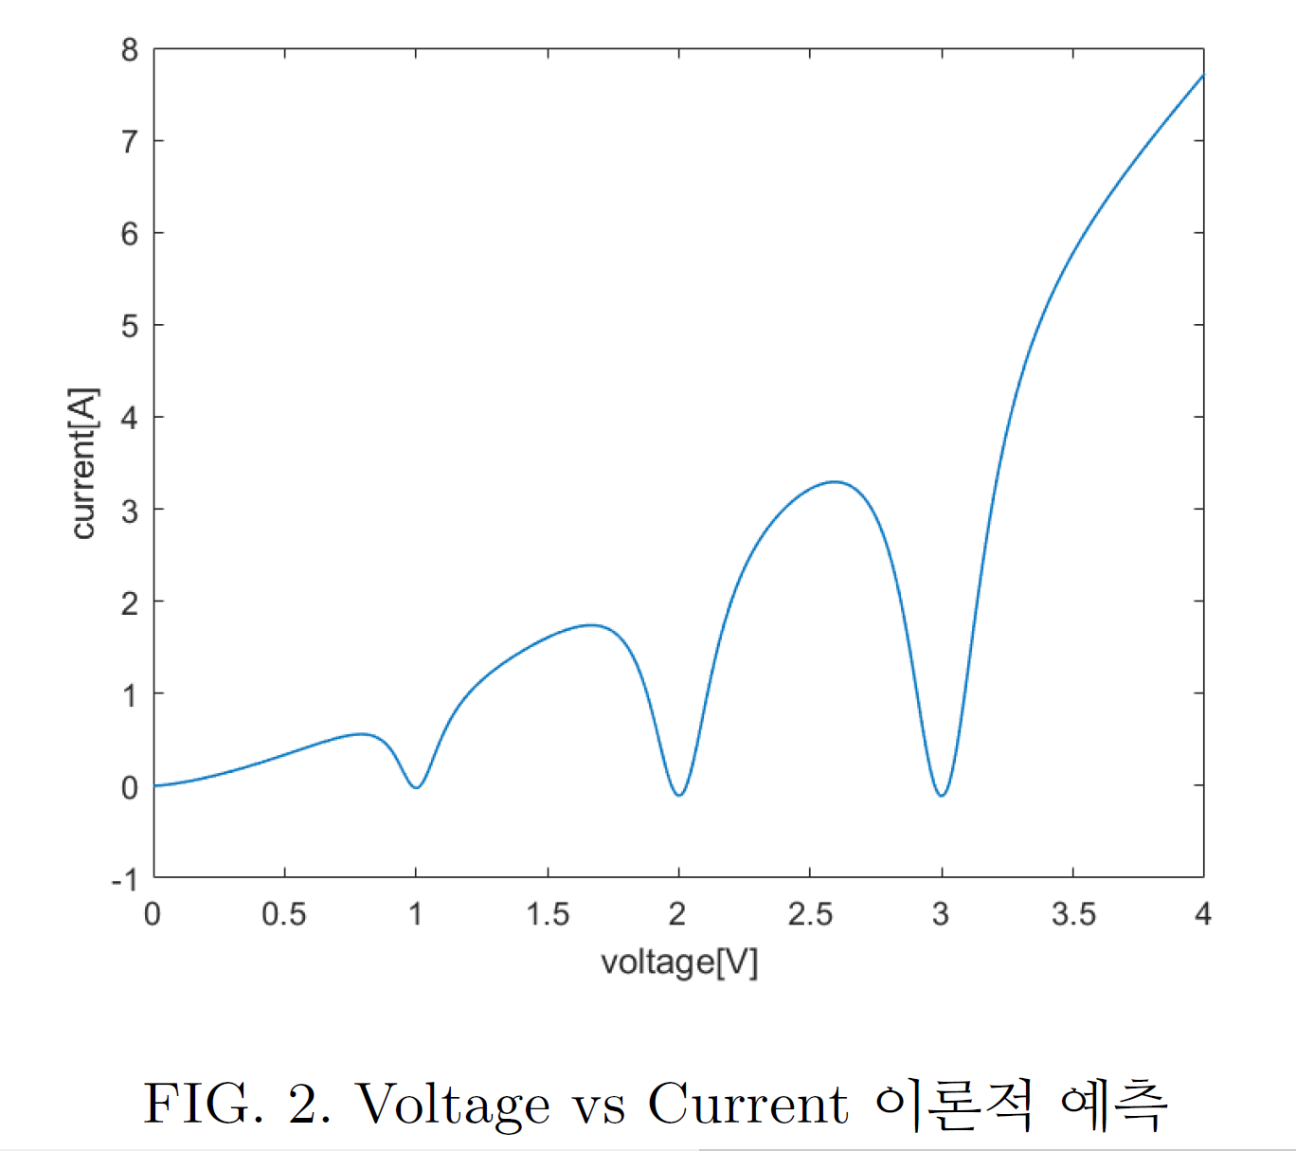
Discussion
We assumed is fixed constant in our model.
But, if discharge tube has a fixed voltage, then will show
lorentzian shape (e.g. Frank Hertz experiment)

Slide 16
Thank you!
Q&A

