Slide 2
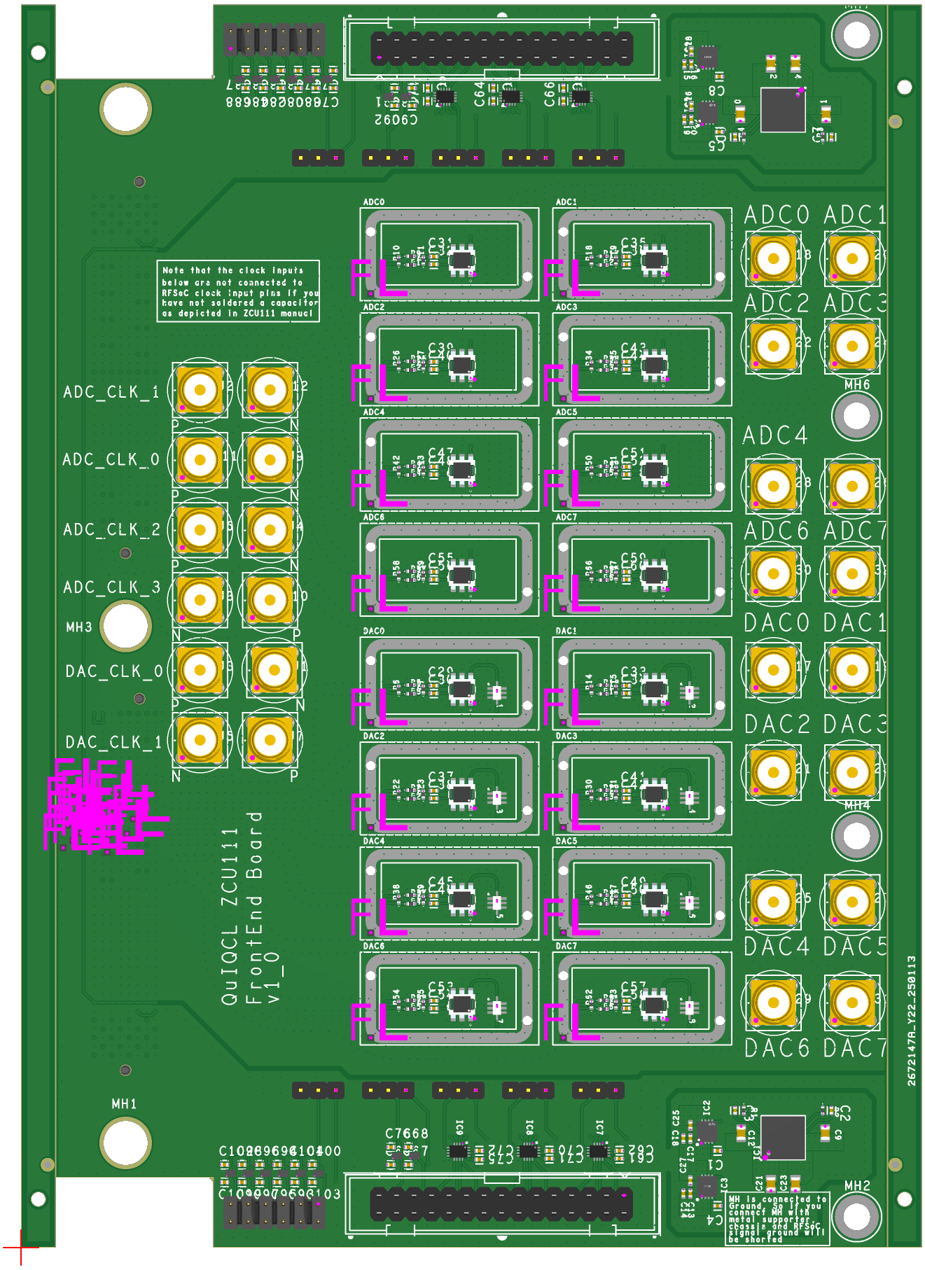
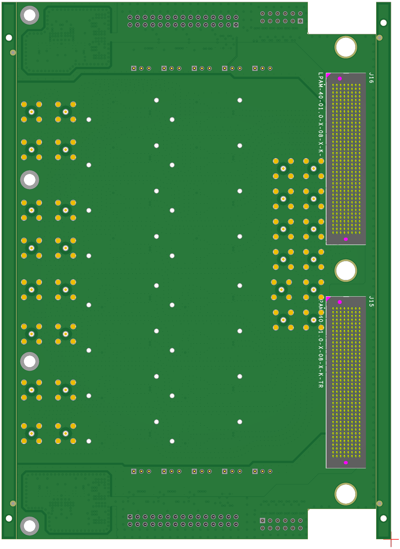
8
7
E
D
F
3
1
6
5
4
2
B
9
A
C
6
5
F
E
D
8
7

Slide 3
Callout Number | Function
1 | RFMC connector
2 | DAC(RF) output
3 | ADC(RF) input
4 | RF clk input
5 | Quad channel voltage translator direction selection
6 | Single channel voltage translator direction selection
7 | Quad channel output
8 | Single channel output
9 | Balun (analog differential to single ended)
A | 1GHz LPF
B | PI attenuator
C | EMC shield can
D | Quad channel voltage translator
E | Single channel voltage translator
F | Single channel voltage translator

Slide 4
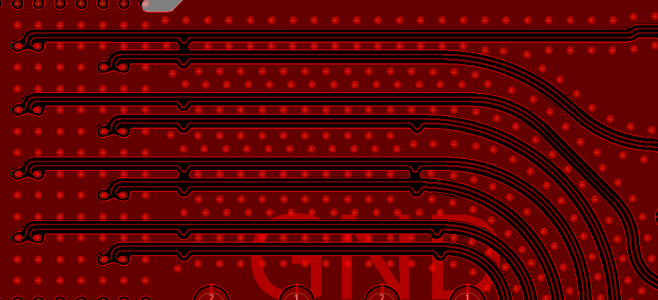

Slide 5

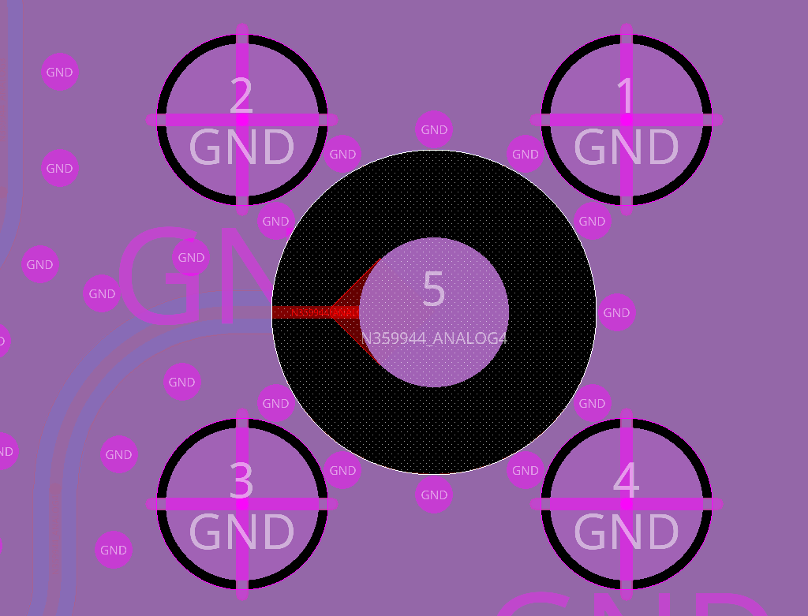

Slide 6
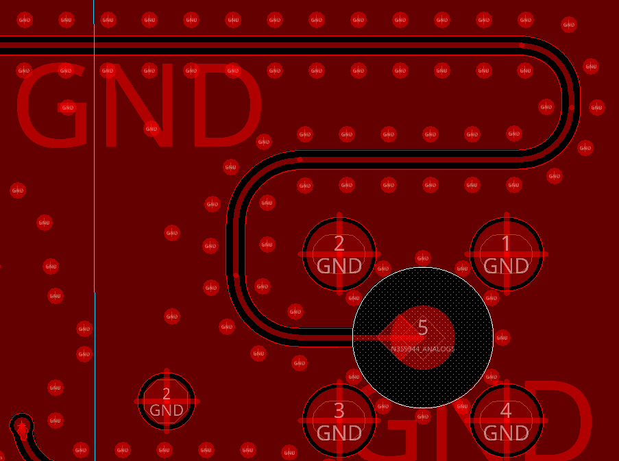

Slide 7
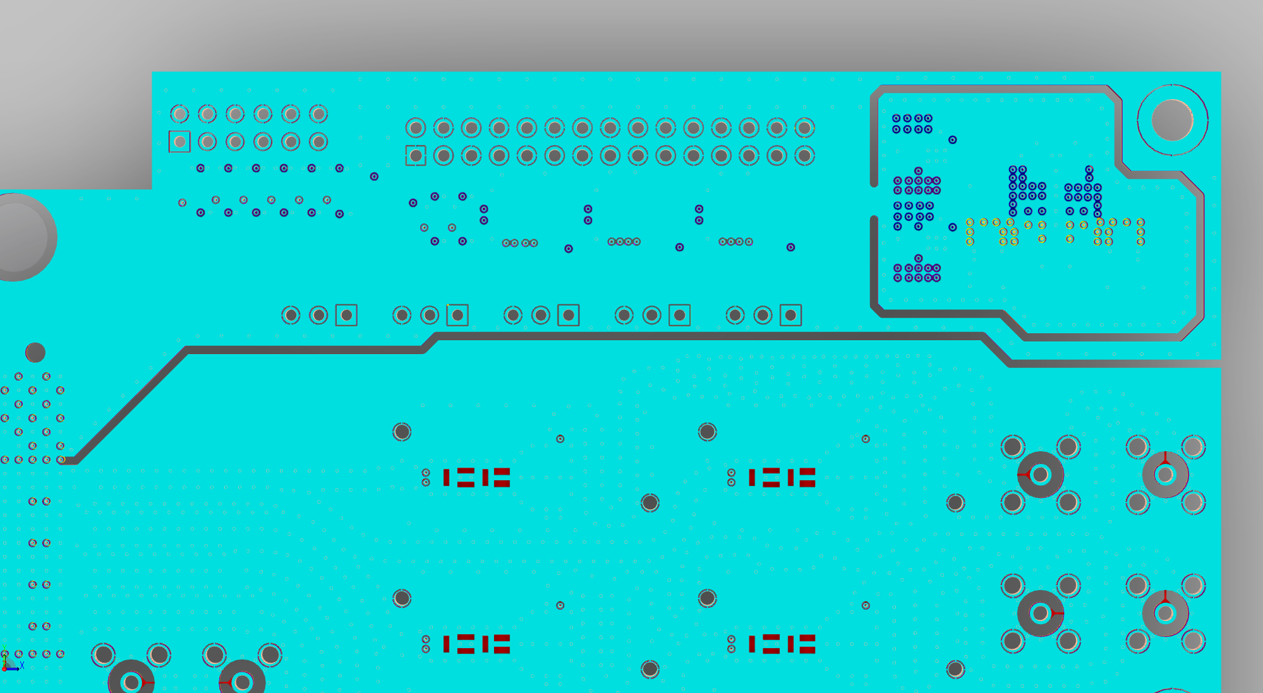
Digital Region
Power Region
Analog Region

