Slide 1

How to Play
Don’t use the arrow keys!
Click on the answers and clues to move forward
Choose wisely… wrong answers may lead you to a dead end
Good luck escaping!

Slide 2

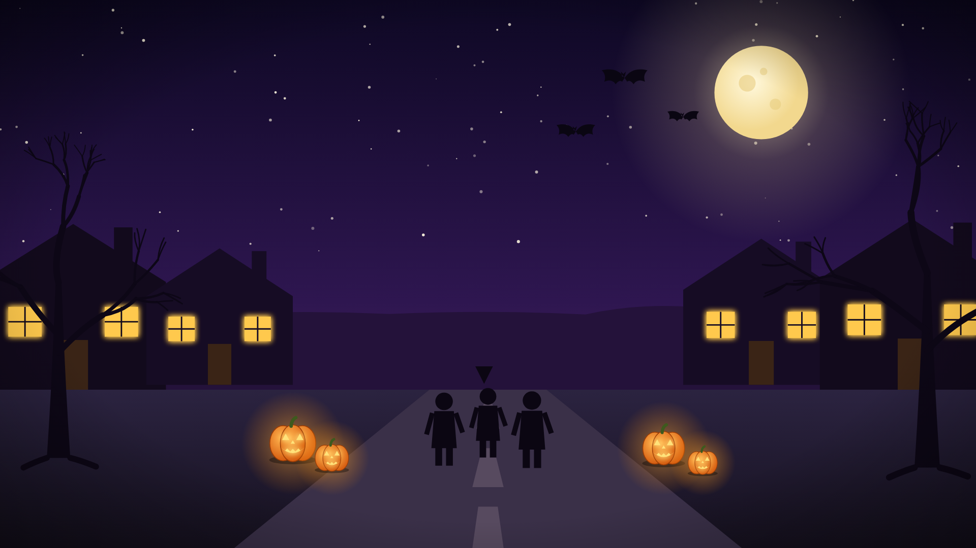
Trick-or-treating on Hollow Hill Lane…
when a spooky fog rolls in!
Mischievous ghosts have hidden the street signs behind fraction puzzles!
Solve each challenge to make the fog lift so you can get home again

Slide 3
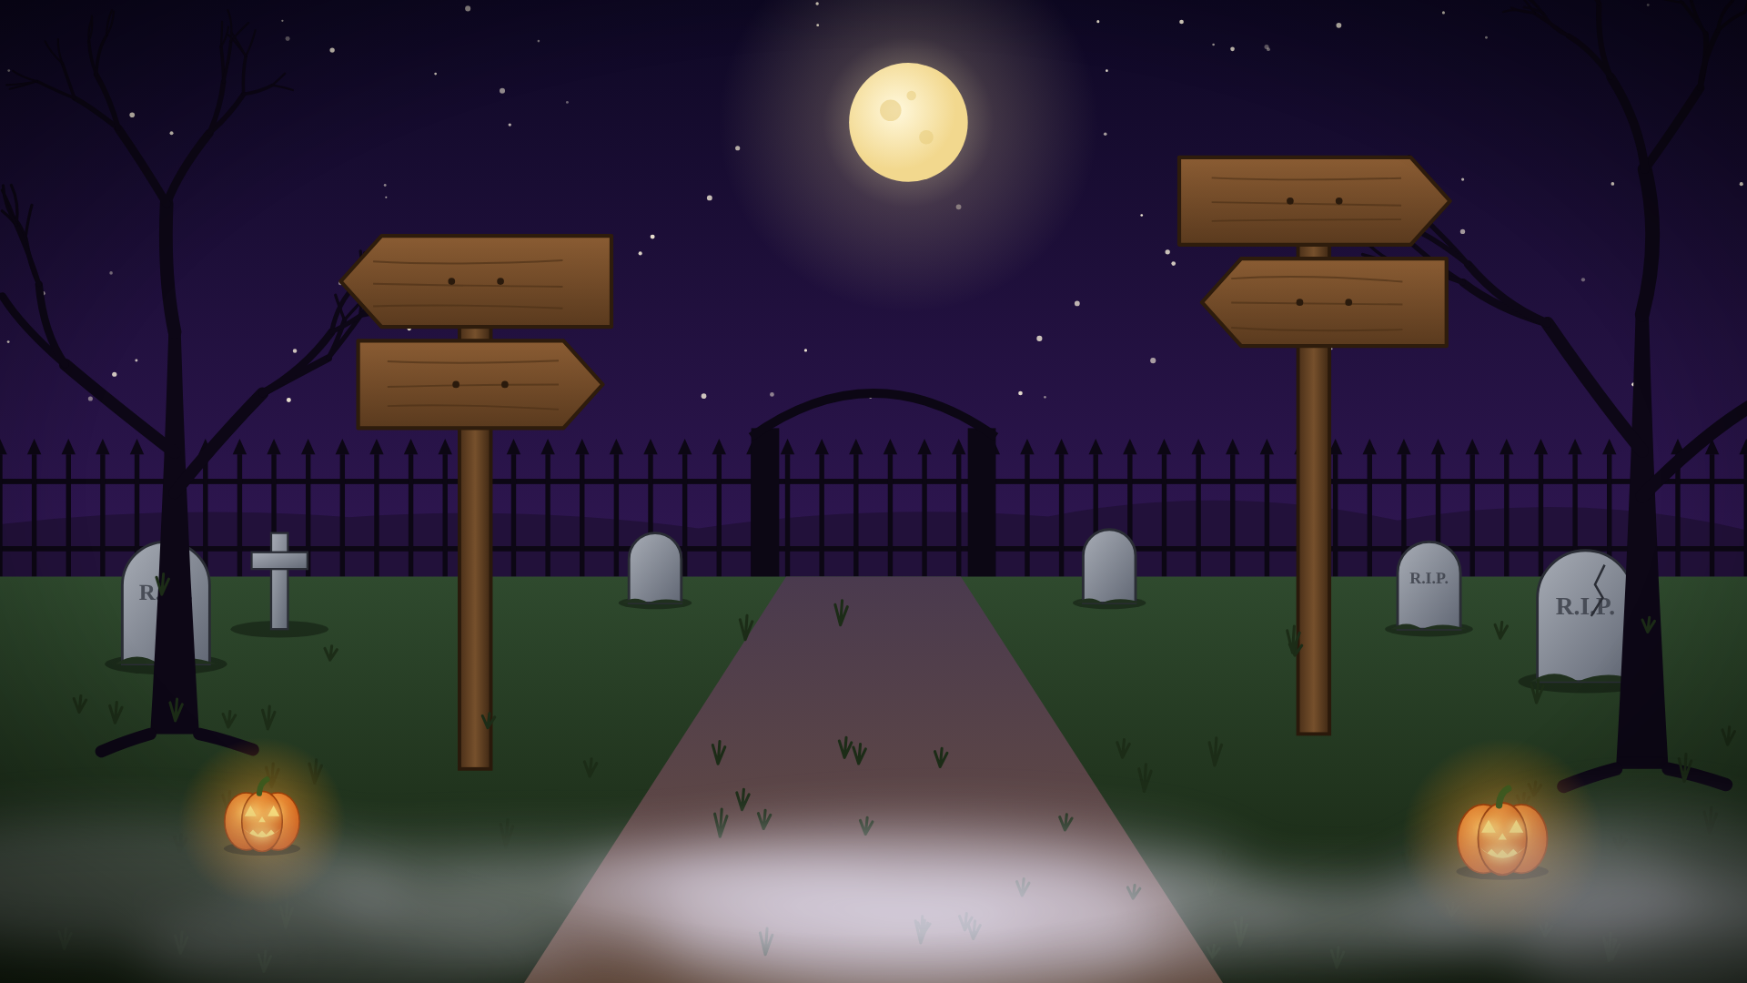
At the cemetery gate, you find crooked signposts with fractions carved into the wood.

Slide 4
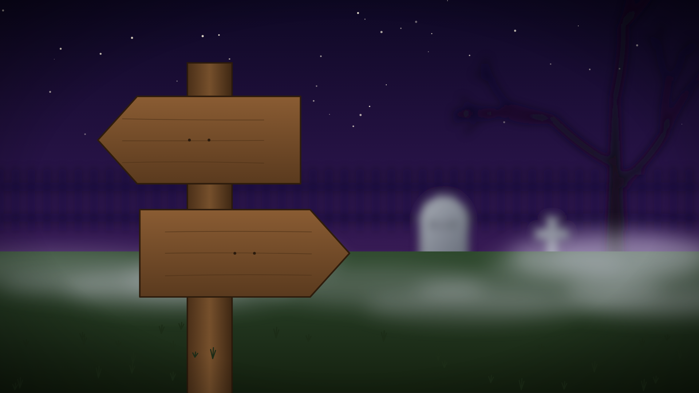
4/6
5/10

Slide 5
At the cemetery gate, you find crooked signposts with fractions carved into the wood.

Slide 6
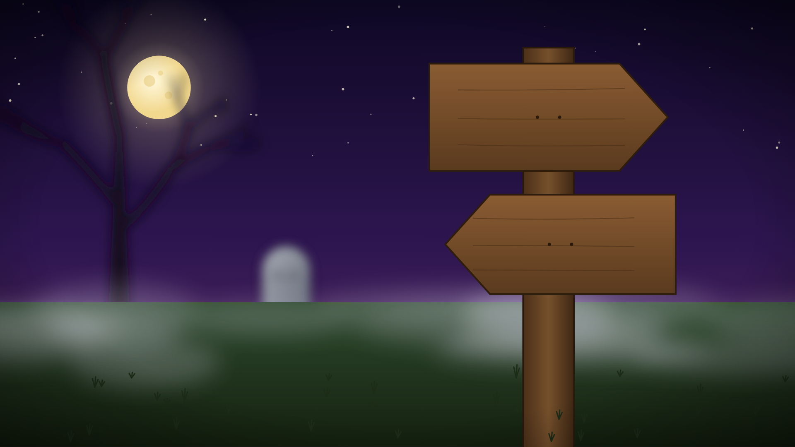
8/12

Slide 7
Write the numerators of the matching pairs and add them together.
That total is your first lock number
1
2
3
4
5
6
7
8
9
0

Slide 8
Write the numerators of the matching pairs and add them together.
That total is your first lock number
1
2
3
4
5
6
7
8
9
0

Slide 9
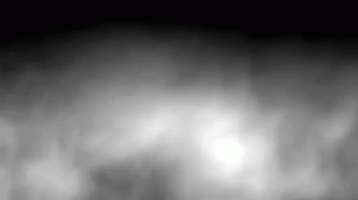
Incorrect! A ghost blocks your way…
Click here to try again

Slide 10
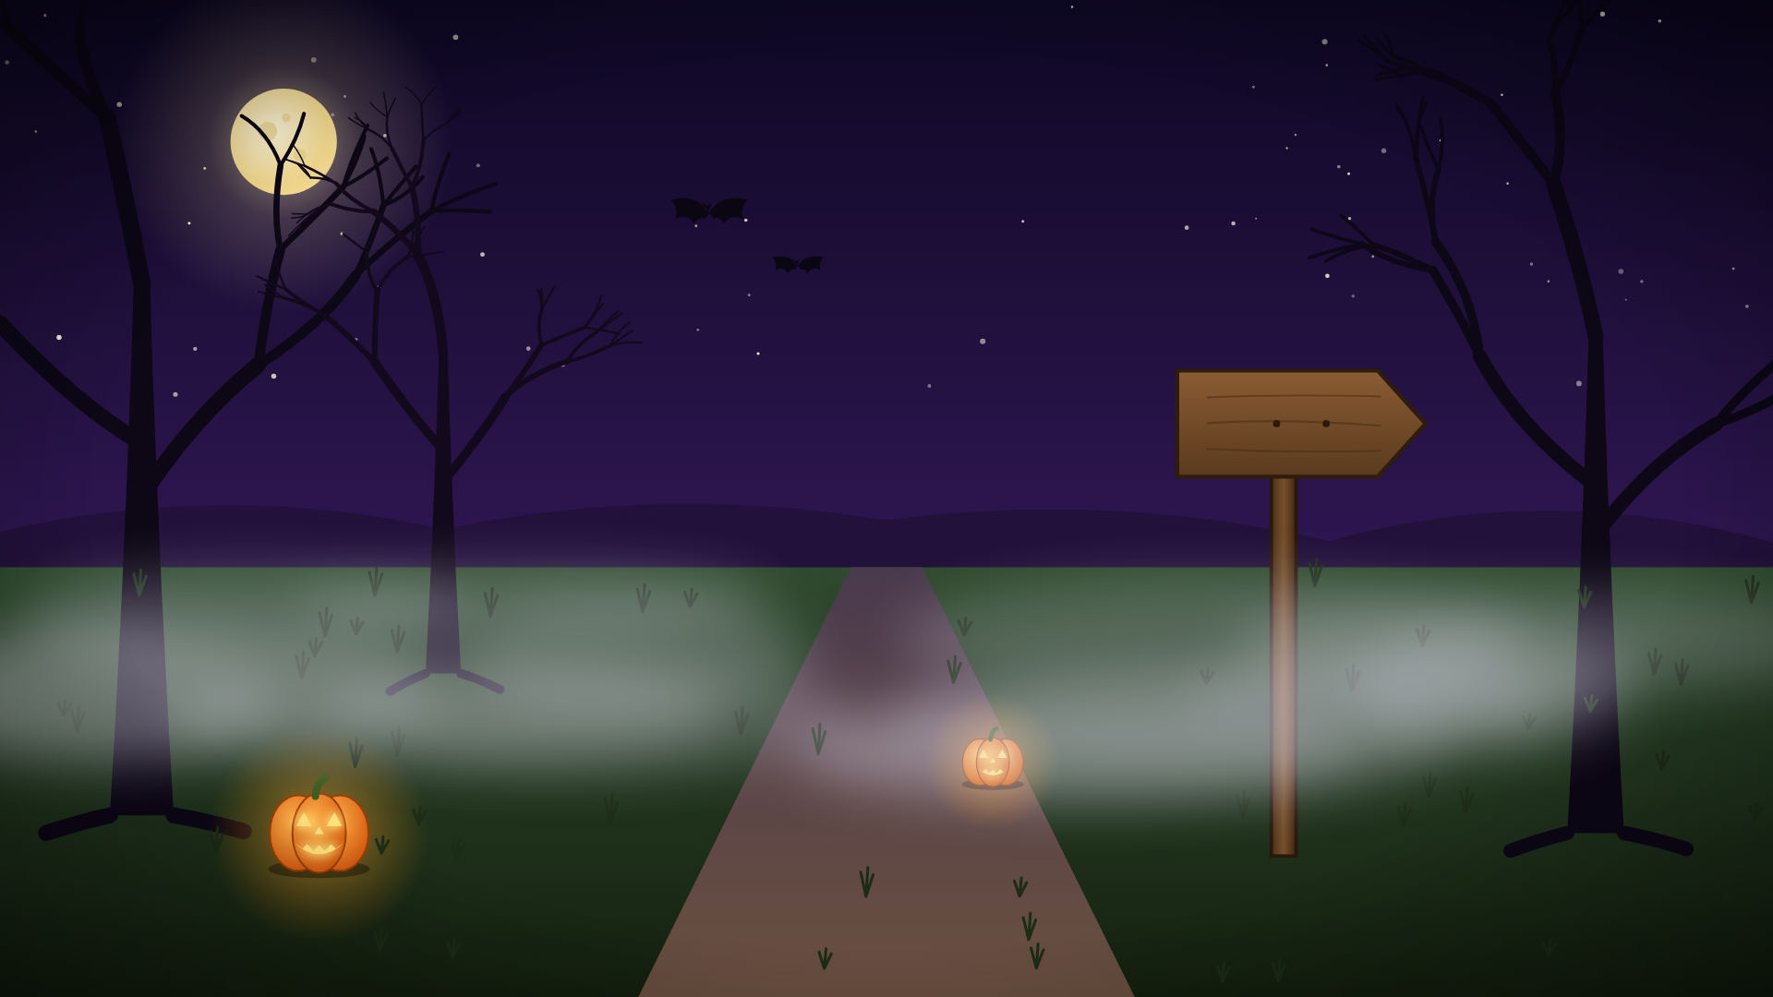
6/10

Slide 11
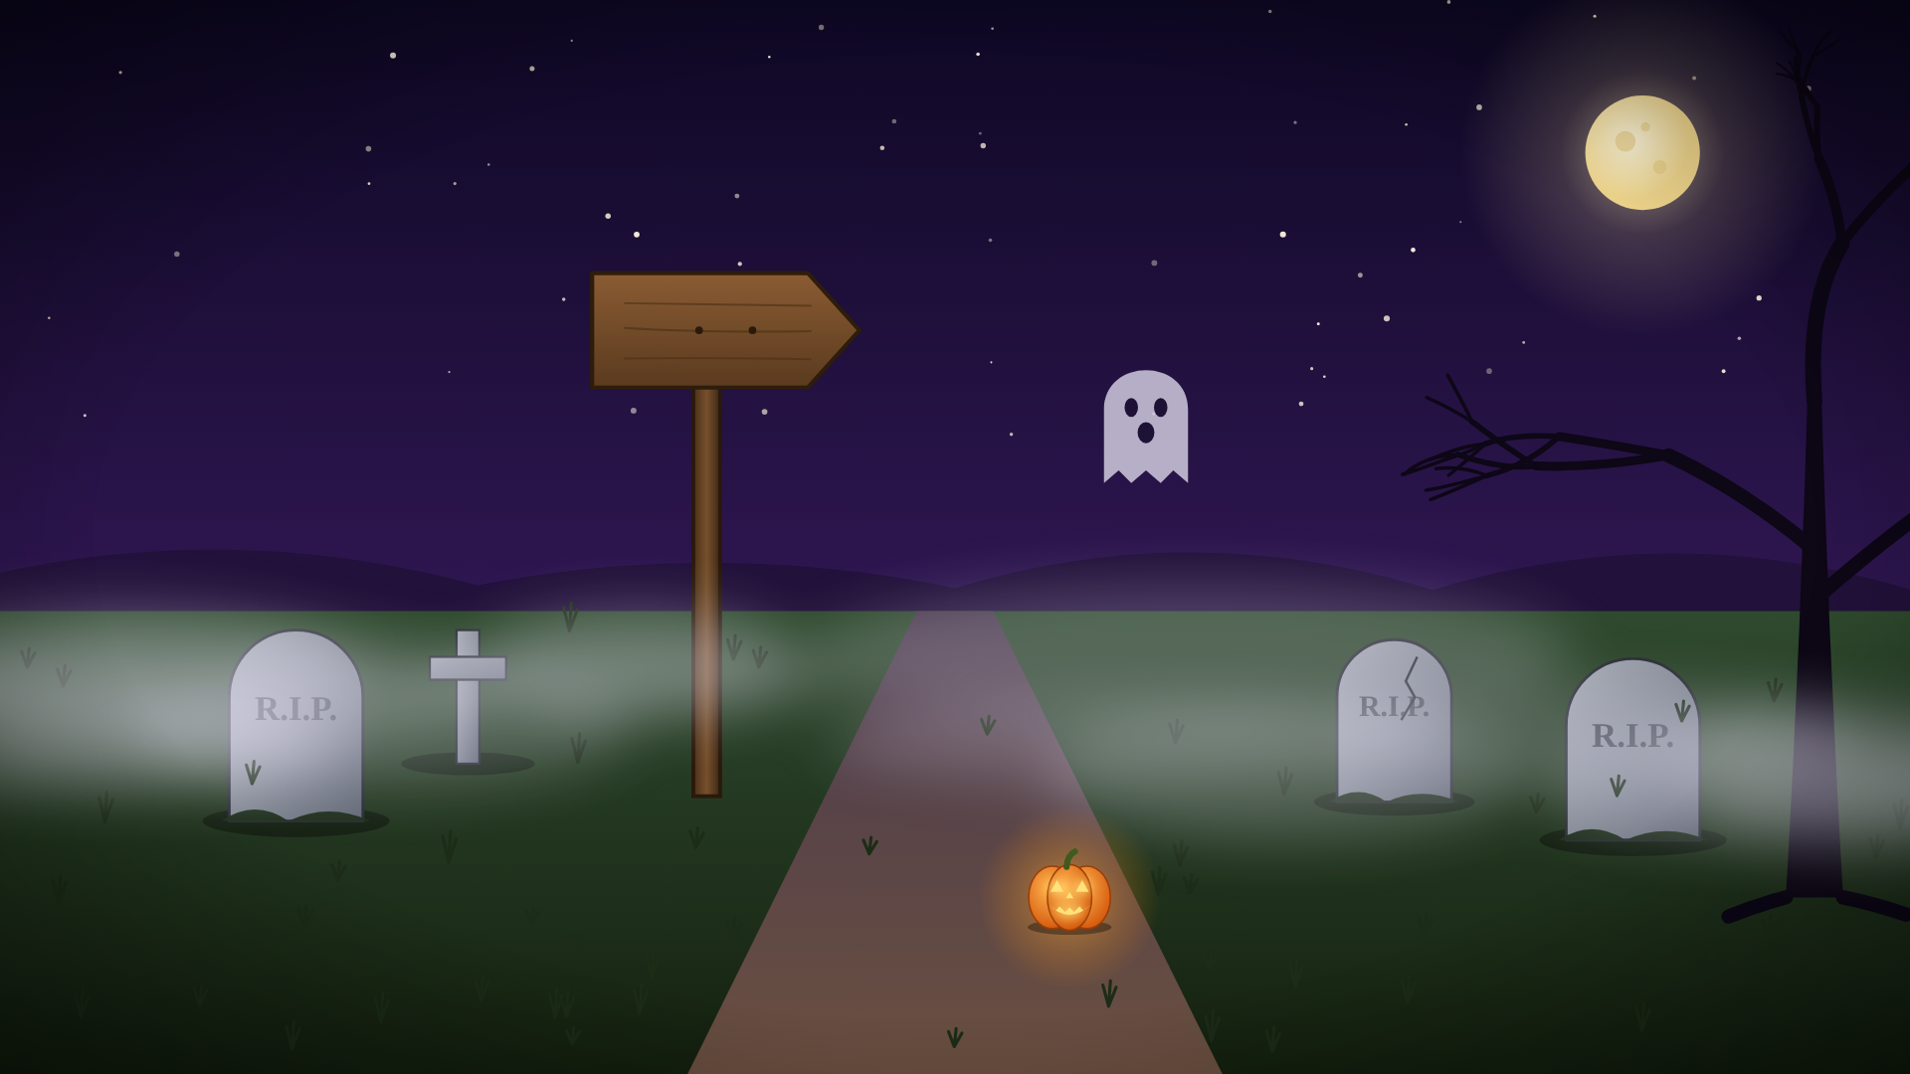
6/15

Slide 12
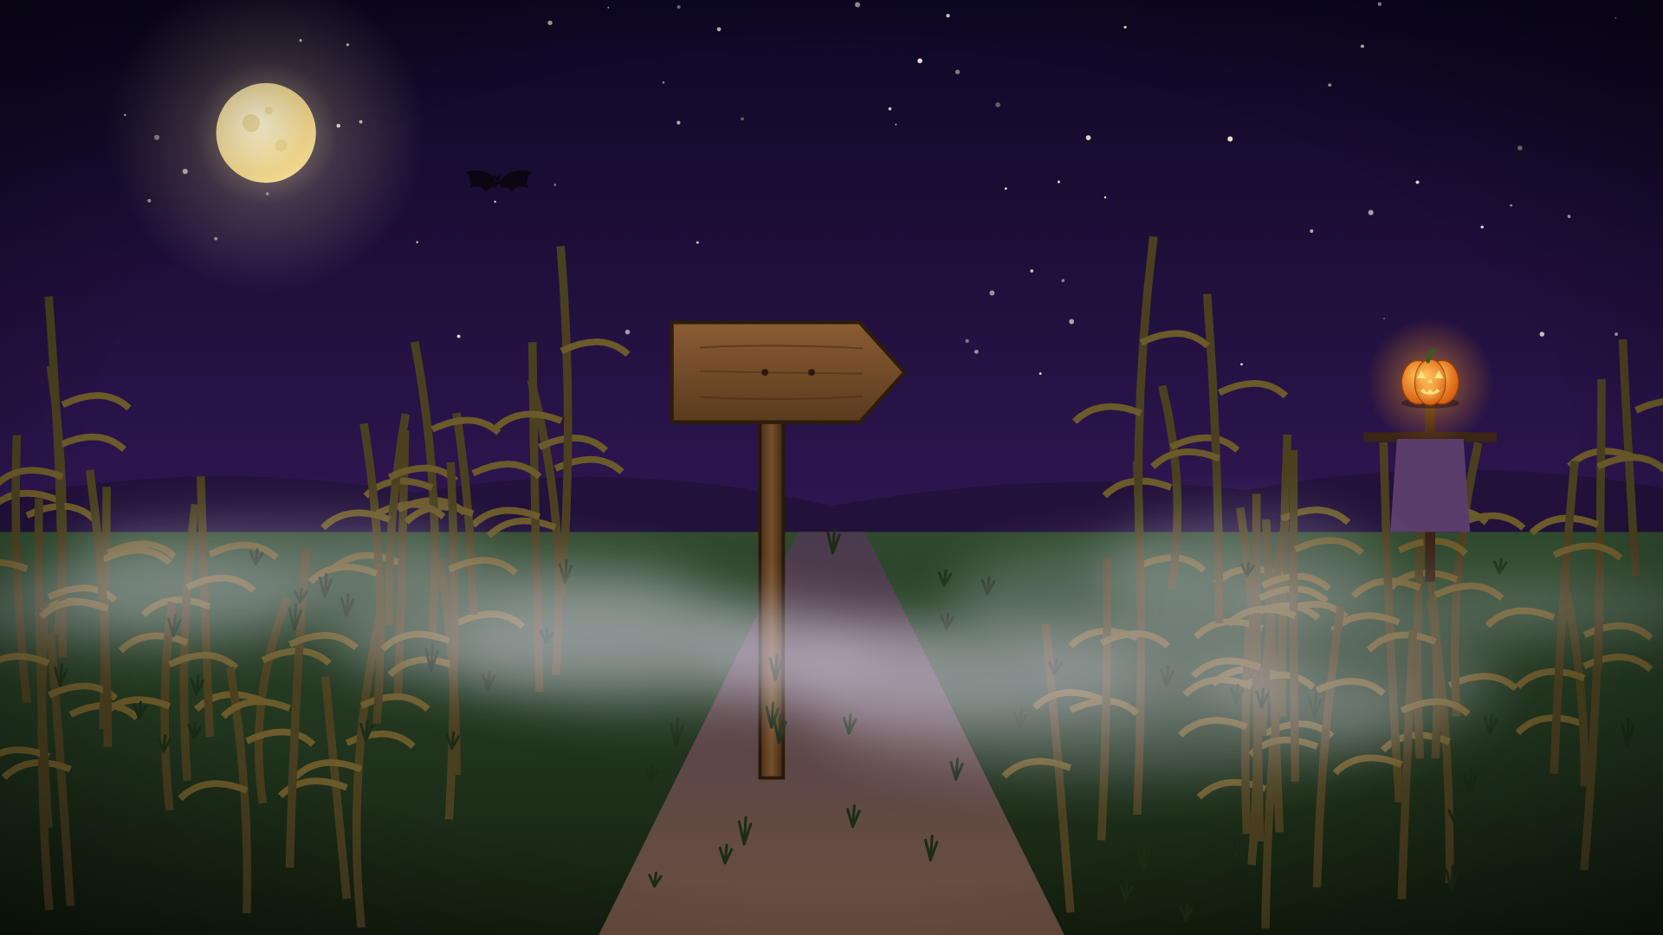
4/10

Slide 13
Click on the path that is not equivalent to 2/5
6/15
4/10
6/10

Slide 14
Incorrect! A ghost blocks your way…
Click here to try again

Slide 15
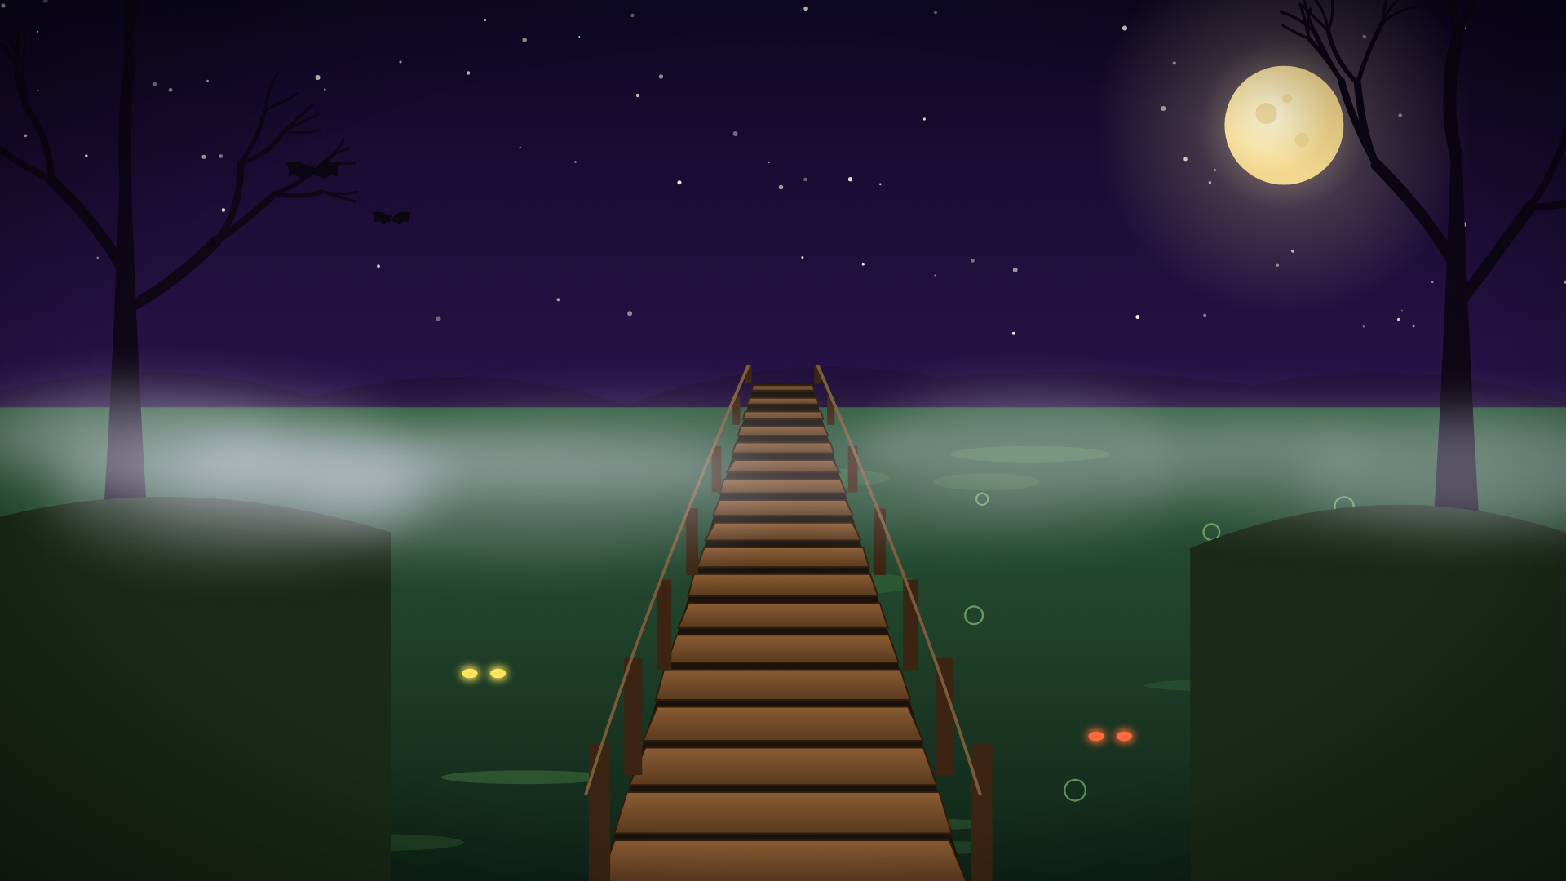
A rickety bridge crosses a bubbling swamp. Each plank is labeled with a fraction. Cross them from smallest to largest or the bridge will collapse!
1/3
1/5
7/10
5/6
3/5

Slide 16
Correct!
1/3
1/5
7/10
5/6
3/5

Slide 17
Well done!
1/3
1/5
7/10
5/6
3/5

Slide 18
Keep going!
1/3
1/5
7/10
5/6
3/5

Slide 19
Last Step!
1/3
1/5
7/10
5/6
3/5

Slide 20
Incorrect! A ghost blocks your way…
Click here to try again

Slide 21
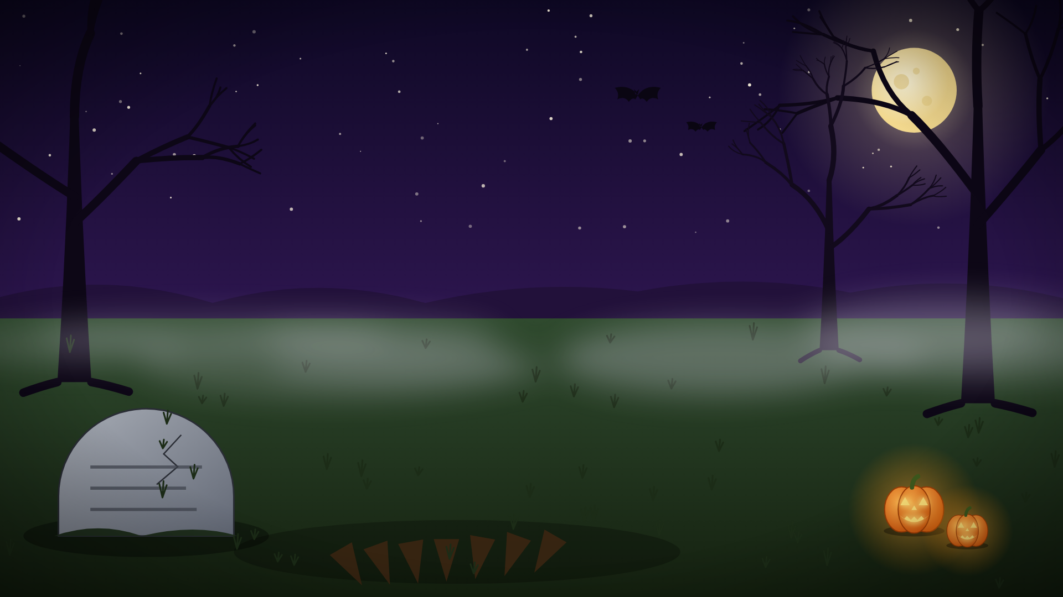

Green smoke from the witch's cauldron hides a tombstone. Solve its riddle to reveal the next clue

Slide 22
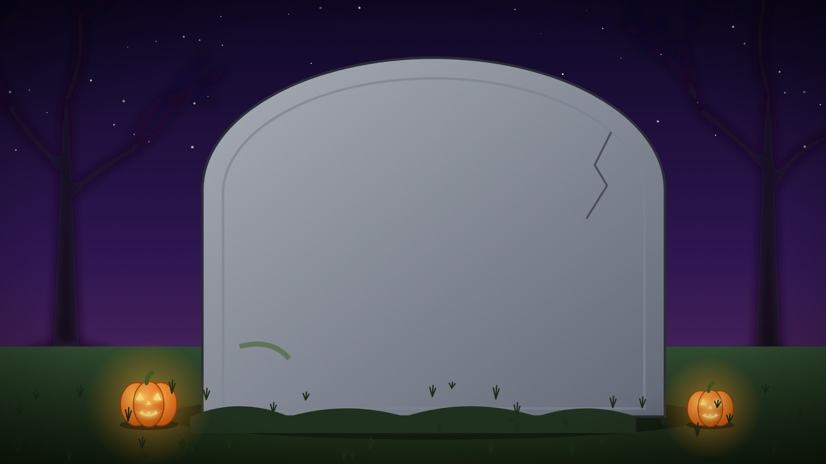
You collected ⅚ of a pound of candy before dinner and ¾ of a pound after dinner. How much candy in all?

Slide 23
1 7/24
8/10
1 7/12
1 1/12
1 5/12
1/12
2 1/12

Slide 24
Incorrect! A ghost blocks your way…
Click here to try again

Slide 25
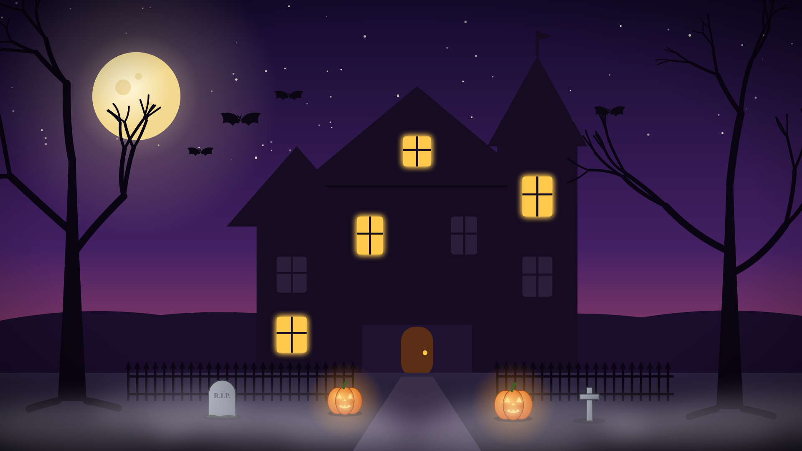
There seems to be a haunted house…

Slide 26
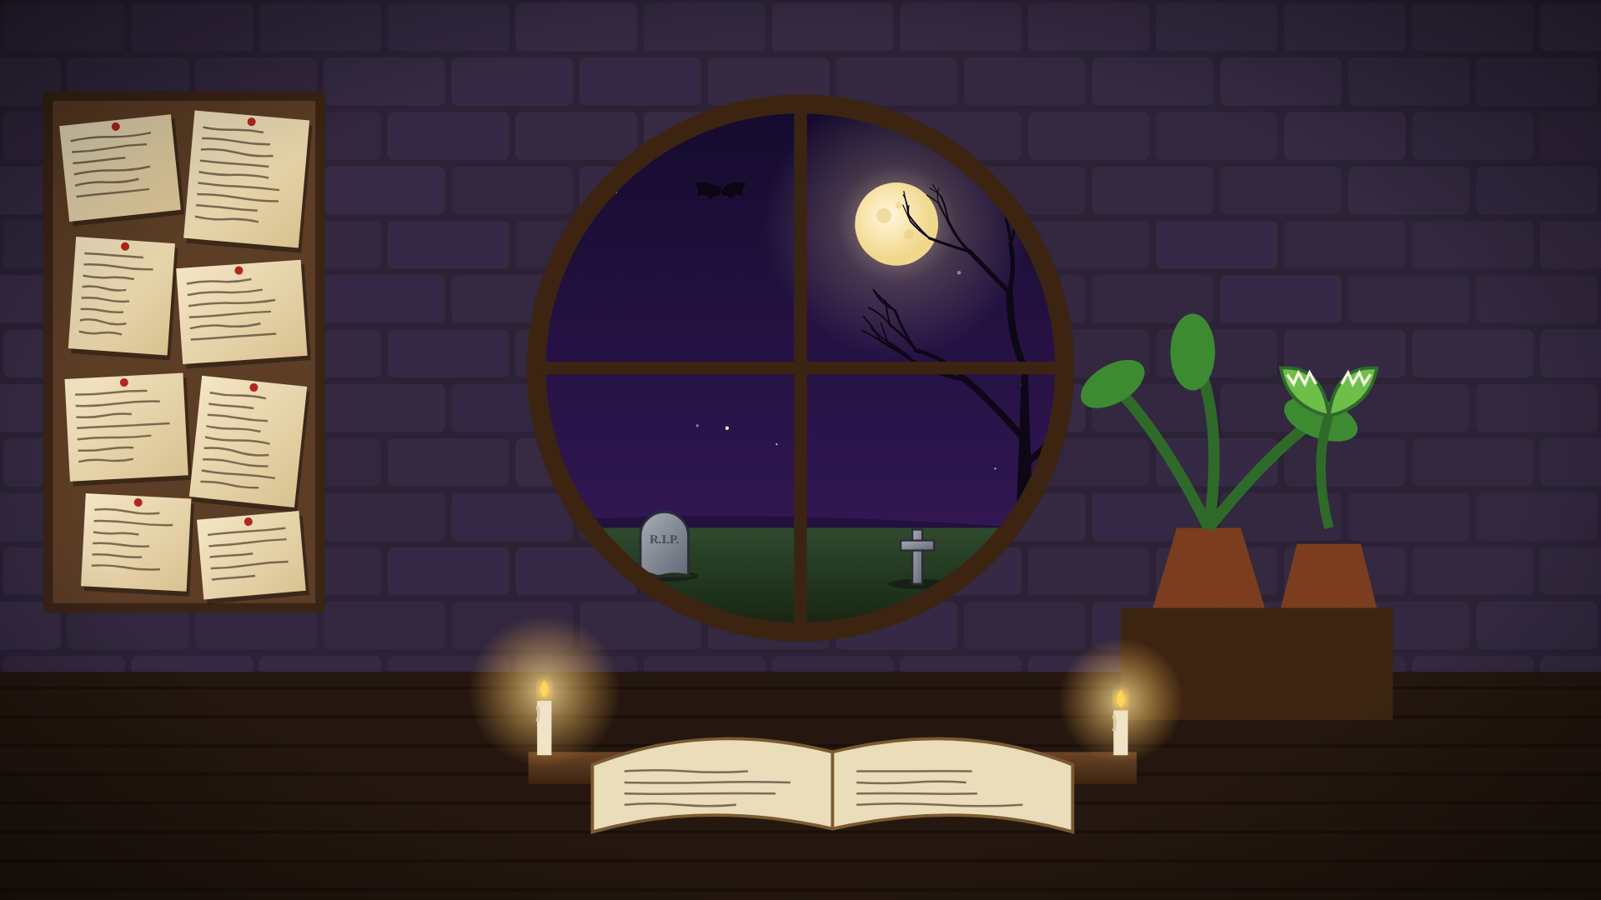
Click around to find a clue

Slide 27
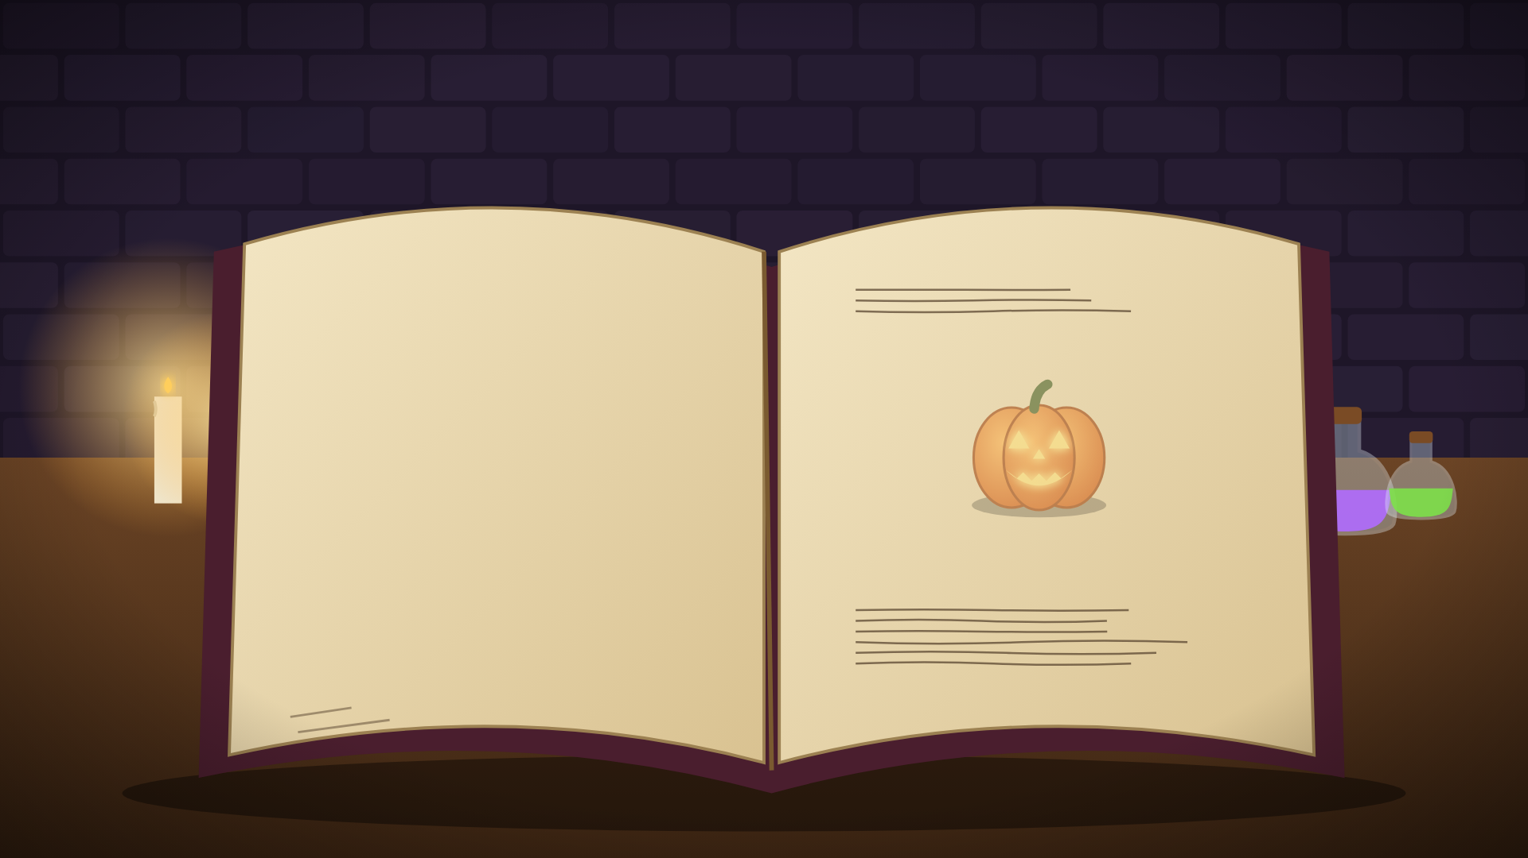
A spell book sits open. Each page lists mixed-number ingredients.
Potion :
1 3/4 cups + 1 3/4 cups = ?
Candy bars:
1 1/4 + 3/4 = ?

Slide 28
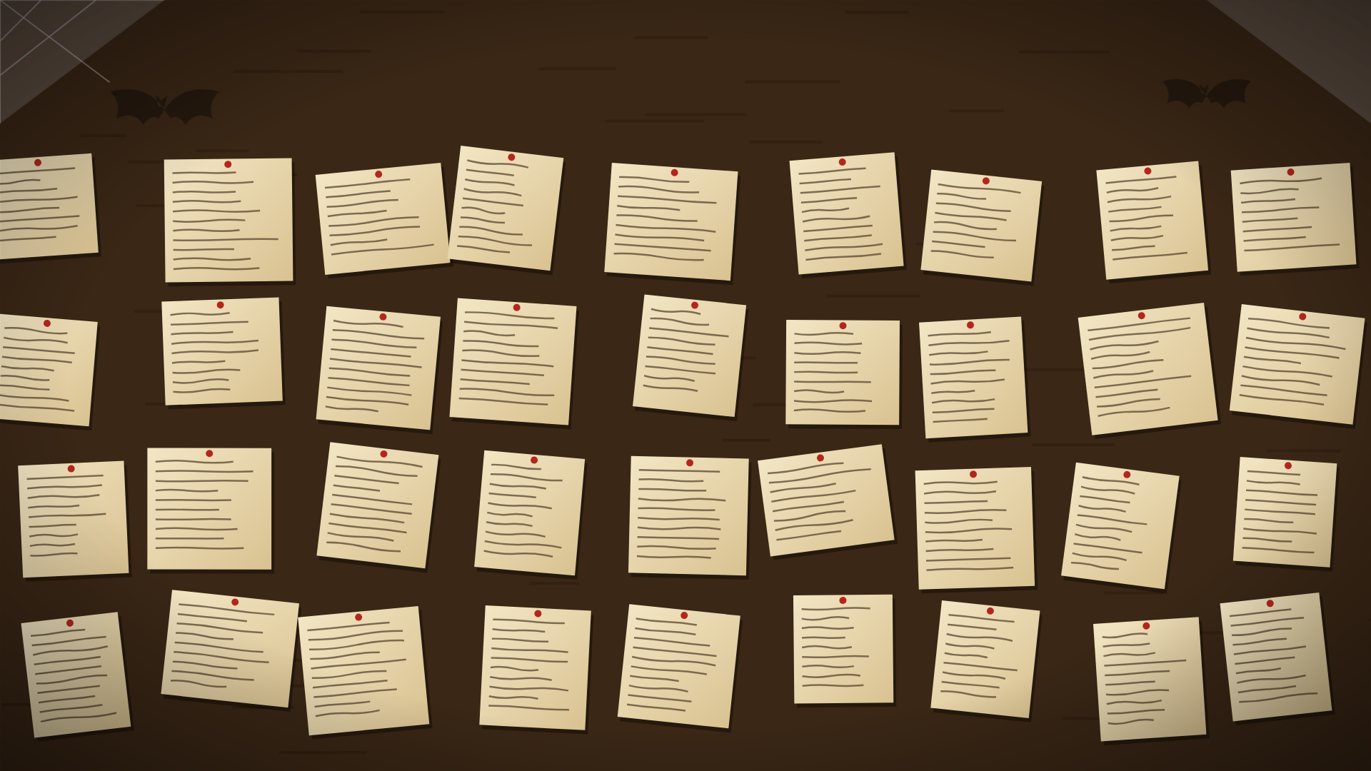
These are just old spell notes… Can’t make out what they say though

Slide 29
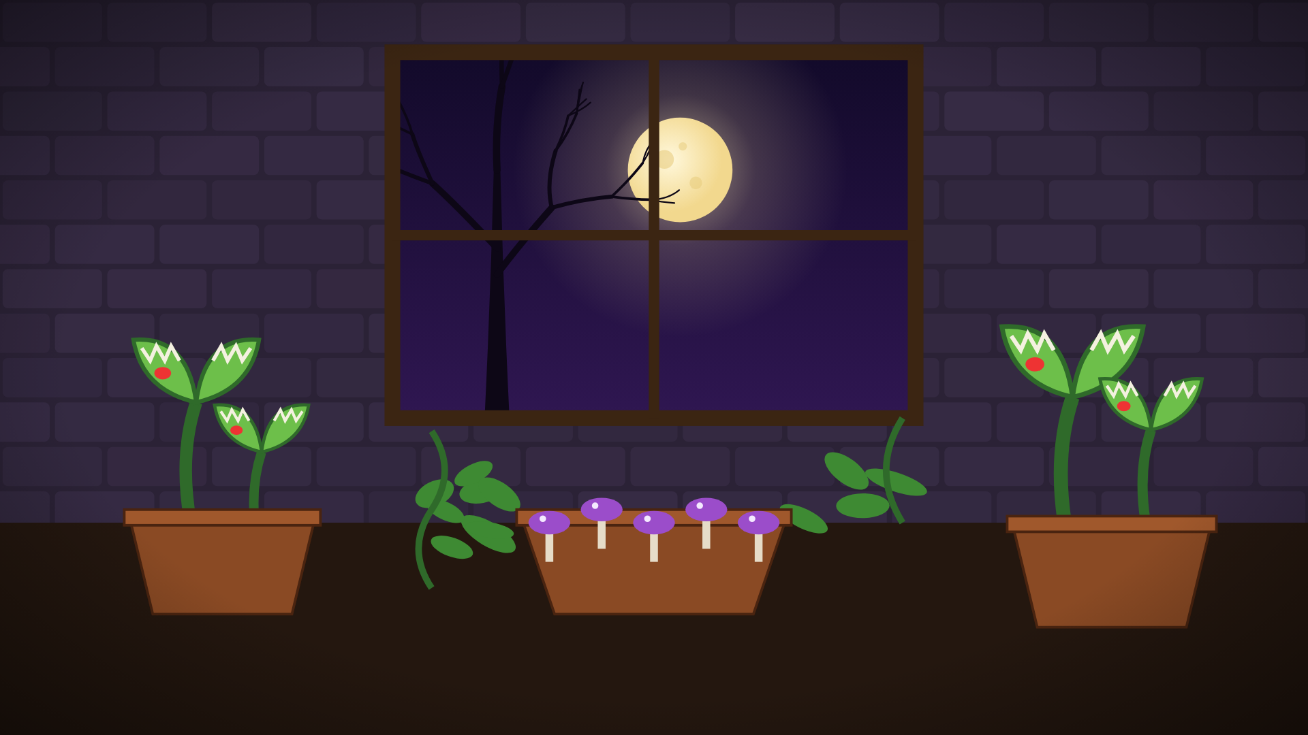
Some creepy plants sit in the corner…

Slide 30
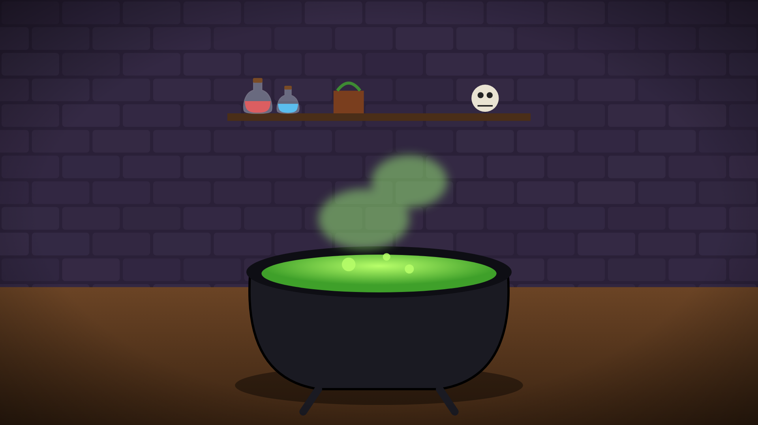
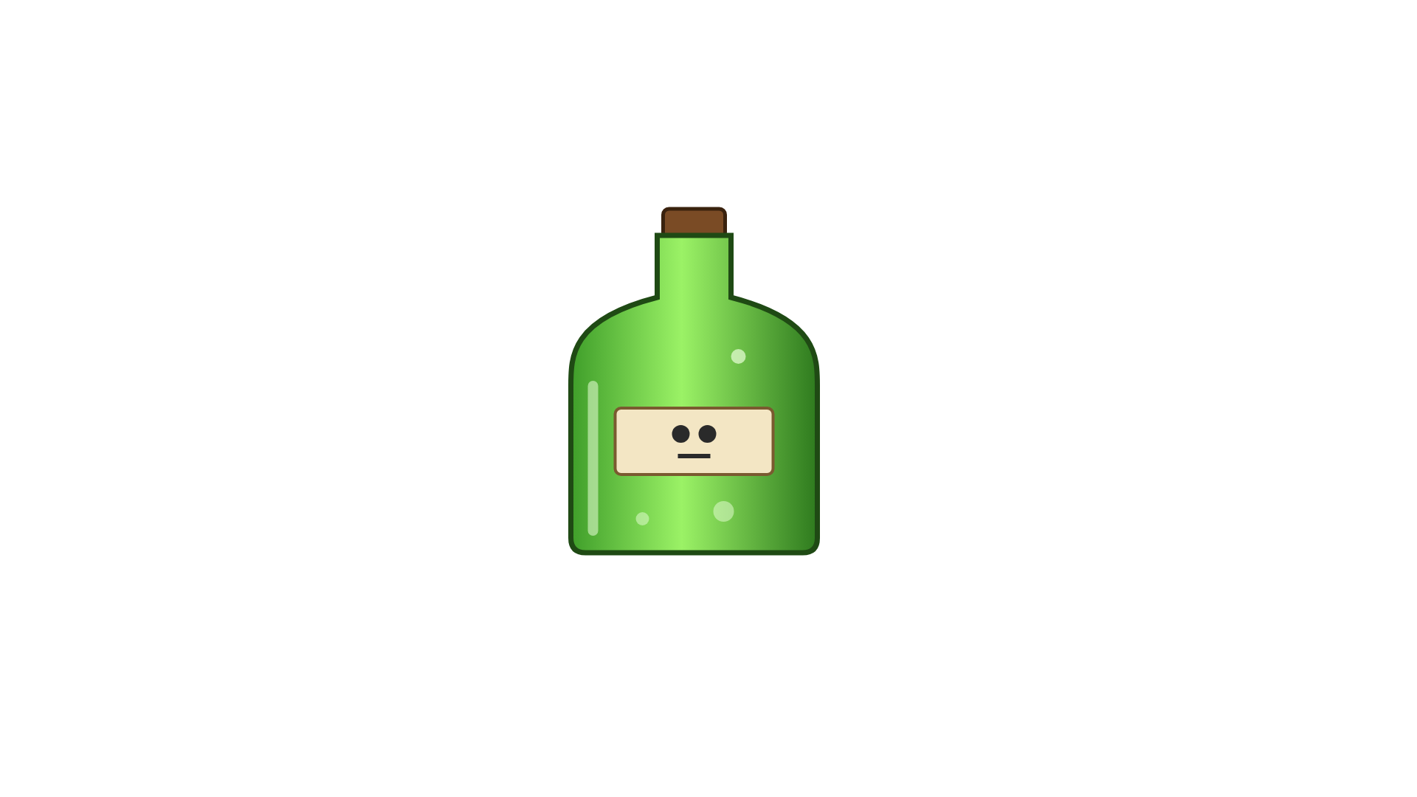
Pour in the correct amount of potion…

Slide 31
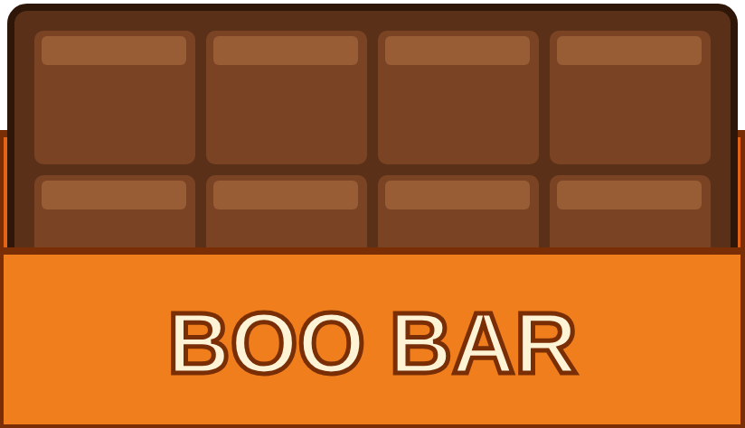
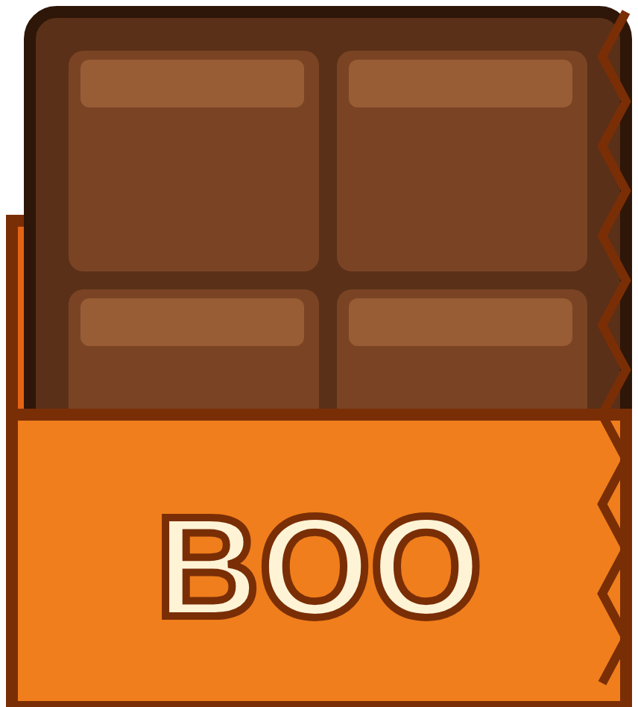
Put in the correct number of candy bars

Slide 32
Incorrect! A ghost blocks your way…
Click here to try again

Slide 33
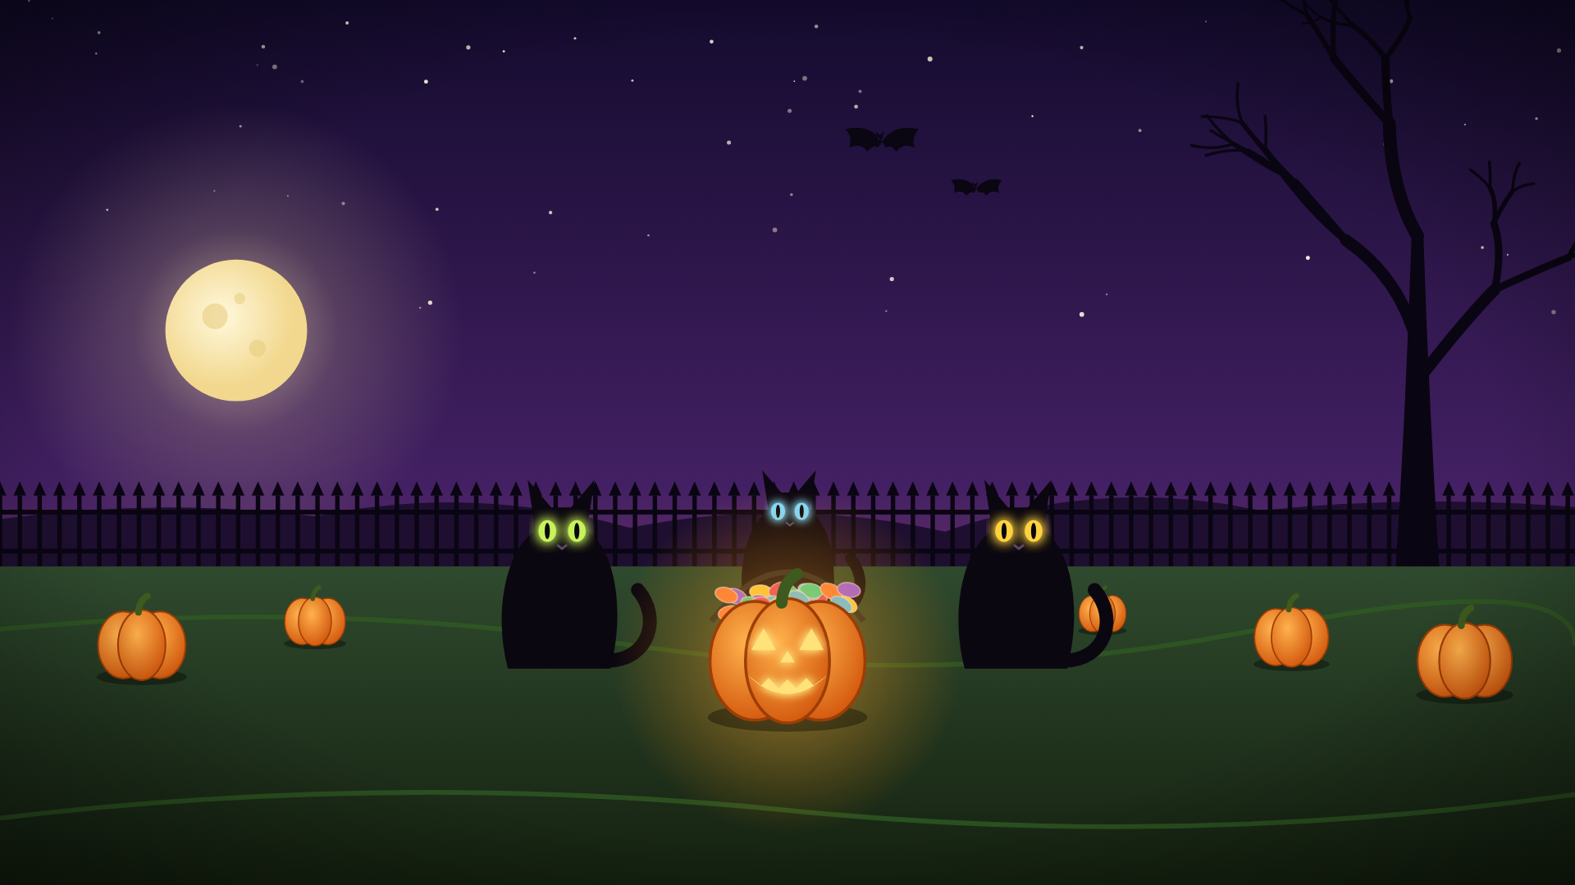
In the pumpkin patch, three black cats guard a bucket of candy.
¾ of the 28 candies are chocolate. How many are chocolate?
1
2
3
4
5
6
7
8
9
0

Slide 34
In the pumpkin patch, three black cats guard a bucket of candy.
¾ of the 28 candies are chocolate. How many are chocolate?
1
2
3
4
5
6
7
8
9
0

Slide 35
Incorrect! A ghost blocks your way…
Click here to try again

Slide 36
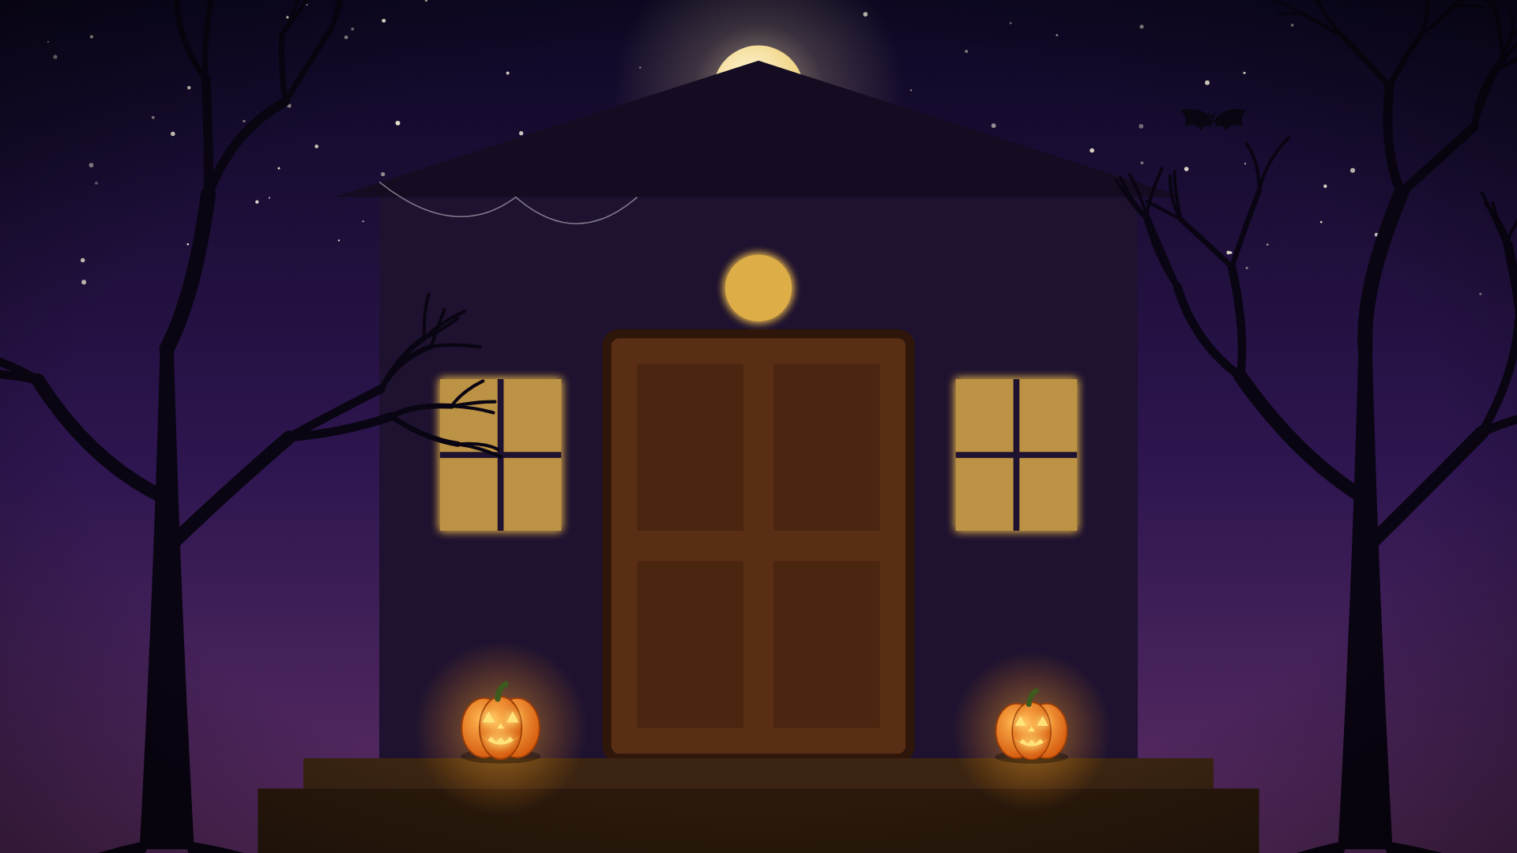


0.2
0.6
Back home, the front door lock glows with jack-o'-lantern light. Match each fraction key to its decimal lock
0.25
0.07
2/5
0.7
0.4

Slide 37
0.2
0.6
Back home, the front door lock glows with jack-o'-lantern light. Match each fraction key to its decimal lock
0.25
0.07
7/10
0.7
0.4

Slide 38
0.2
0.6
Back home, the front door lock glows with jack-o'-lantern light. Match each fraction key to its decimal lock
0.25
0.07
1/4
0.7
0.4

Slide 39
0.2
0.6
Back home, the front door lock glows with jack-o'-lantern light. Match each fraction key to its decimal lock
0.25
0.07
3/5
0.7
0.4

Slide 40
Incorrect! A ghost blocks your way…
Click here to try again

Slide 41
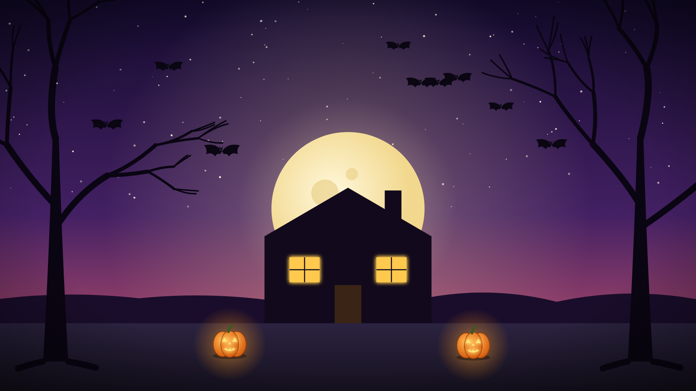
Congratulations
You have escaped

