Slide 1
Finding attractors in asynchronous boolean networks using an SMT
Alexis Tricot
LS2N – 12/06/2018

Slide 2
Finding attractors in asynchronous boolean networks using an SMT
Finding basins of attraction in asynchronous boolean networks by static analysis
(and sometimes with an SMT)
Alexis Tricot
LS2N – 12/06/2018

Slide 3
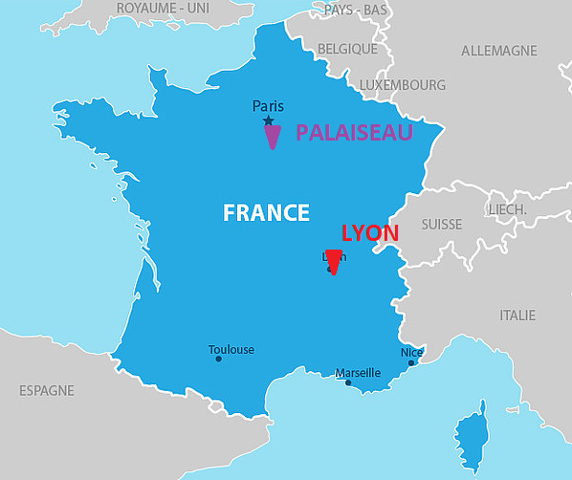
About me
I’m from Lyon
3rd year student in Ecole Polytechnique, in Palaiseau
Engineer specialized in bioinformatics

Slide 4
Summary
The model : automata network
A few remarks on attractors and basins of attraction
Finding « rules » creating basins
General principle of the algorithm
What’s next

Slide 5
The Model : automata network
Our network is both :
Boolean
Asynchronous
Our transitions look like this :
There is a given initial state
a : 0 → 1 when b = 0 and c = 1 and e = 1 a : 0 → 1 when b = 0 and c = 0 a : 0 → 1 when e = 0 and f = 0

Slide 6
A few remarks on attractors and basins of attraction
Let E be the set of the global states of our automata network (AN).
A subset A of E is an attractor iff:
- A is terminal : from an element of A, only elements of A are reachable.
- A is strongly connected : from an element of A, all elements of A are reachable.
A basin of attraction, however, only needs to be terminal.
We are thus looking for subsets of E from which you cannot get out, ie stable subsets.

Slide 7
A few remarks on attractors and basins of attraction
Knowing the basins gives a lot of information about the dynamics of the graph

Slide 8
Finding « rules » creating basins
1. A special type of basin
a : 0 → 1 a : 1 → 0 never
→ gives us the basin { a₁ ; * }
a : 1 → 0 when b = 0 b : 1 → 0 when a = 0
→ gives us the basin { a₁ ; b₁ ; * }
In a general manner, we will be looking for basins of the form { C ; * },
where C = { a₁ ; b₁ ; d₀ ; … } is a set of conditions realized in the basin.
Issue : In an AN with n automata, there is 3^{n} such sets C.

Slide 9
Finding « rules » creating basins
2. Transition density in the graph
To find local states (or combinations of local states) from which it is impossible to get out, we start by looking for states from which it is difficult to get out.
In order to do that, for each transition k → 1-k we want to know how many times it is realized in the graph, ie how many global states verify the condition of the transition.
Activity : White board calculus
In practice, we will stop the calculus after the fourth term.
We will denote the number obtained (normalized) as f(k→1-k).
We can do the same operation under some constraints C.
We will then denote it as f(k→1-k)_{|C}

Slide 10
Crucial remark
If f(k→1-k)_{|C} = 0 for k in C, then { C ; * } is a basin of attraction.

Slide 11
General principle of the algorithm
Select a₀ which minimizes f(k →1-k).
Set of conditions C = { a₀ }.
Step A(a₀) : Select candidate k from conditions of a₀ →a₀ which minimizes
f(a₀ →a₁)_{|C} + f(k →1-k)_{|C}
Let this candidate be b₀. Add b₀ to C.
If f(a₀ →a₁)|C ≠ 0, restart A(a₀). Else, restart A(k) for each k in C for which
f(k →1-k)_{|C} ≠ 0. Here, the first one will be A(b₀) for example.
The algorithm stops either :
- when all terms f(k →1-k)_{|C} are null. Then we have found a basin.
- when for all k in C s.t. f(k →1-k)_{|C} ≠ 0, all the conditions of k → 1-k are already in C.

Slide 12
What’s next
How to restart the algorithm after the first run
Going down (and up) in the dependencies of basins
Removing conditions we’ve already dealt with
(Maybe) Use the SMT (SMCHR) to locate more complex basins
Right now starting from a point it just checks if it is a stable set.

