Slide 1




DATA NATIONAL HACKATHON
LULUS2021
M. FARHAN TANDIA IVAN SURYA HUTOMO
(MASTER STUDENT, NYCU)

Slide 2

OUTLINE
DATA NATIONAL HACKATHON
1
2
3
4
5
Background
Overview & EDA
Data Preprocessing
Modeling
& Evaluation
Conclusion
& Suggestions
Business Understanding
Data Understanding
Data Preparation
Model Design
Closing
2

Slide 3

BACKGROUND
BUSINESS UNDERSTANDING
01
3

Slide 4
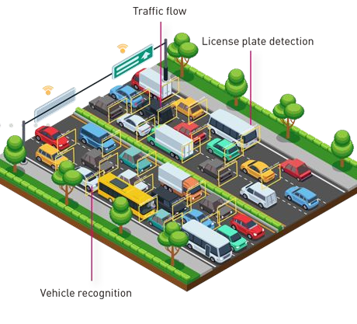
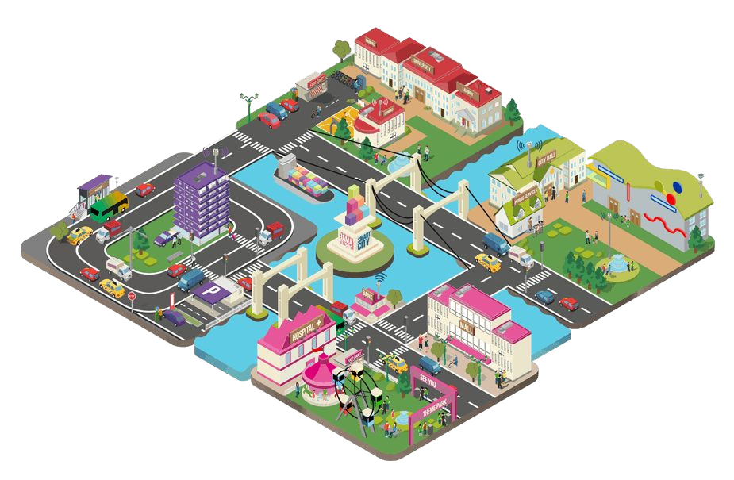
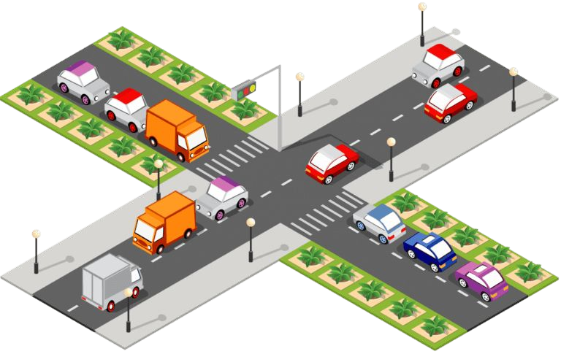
Smart Cities In Indonesia
Starting with better trafﬁc and data driven solutions
Forecasting the Future with Data
Province/cities are said to be a complex network of human interactions, laced with infrastructure and systems that drive progress for common good.
We need greater use of data for city planning to alleviate traffic congestion and making smart decisions on where to invest funds so as to reduce traffic on its roads.
We should building Machine Learning-based models to predict which sectors will have high reports in certain hours. With this prediction, we could deliver better governance and efficient decision.
4

Slide 5
OVERVIEW & EXPLORATORY DATA ANALYSIS
DATA UNDERSTANDING
02

Slide 6

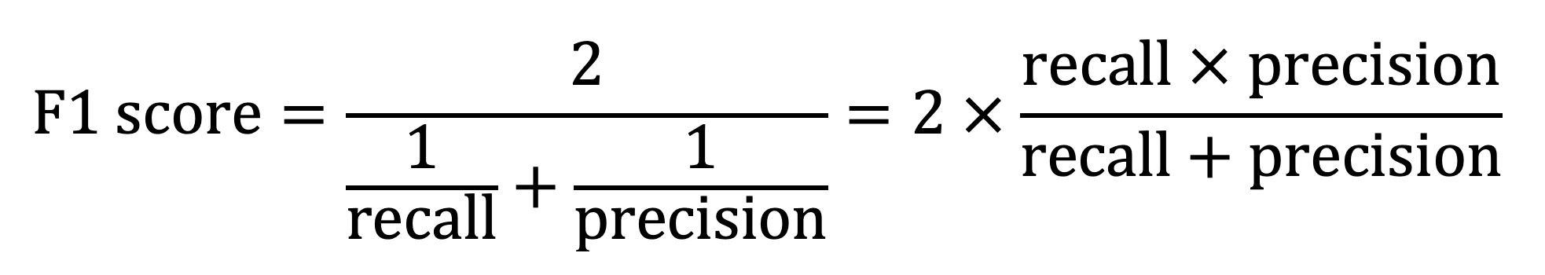
OVERVIEW
TASK
Using trafﬁc data provided by the JDS, predict high jam reports in certain sectors at certain dates and hours of a few cities in West Java.
DATASET
1 Alert Report and 1 Irregularities Report
Data train 71366 rows
Data test 13841 rows
Target Variable: Labels (True/False)
EVALUATION METRICS

Slide 7
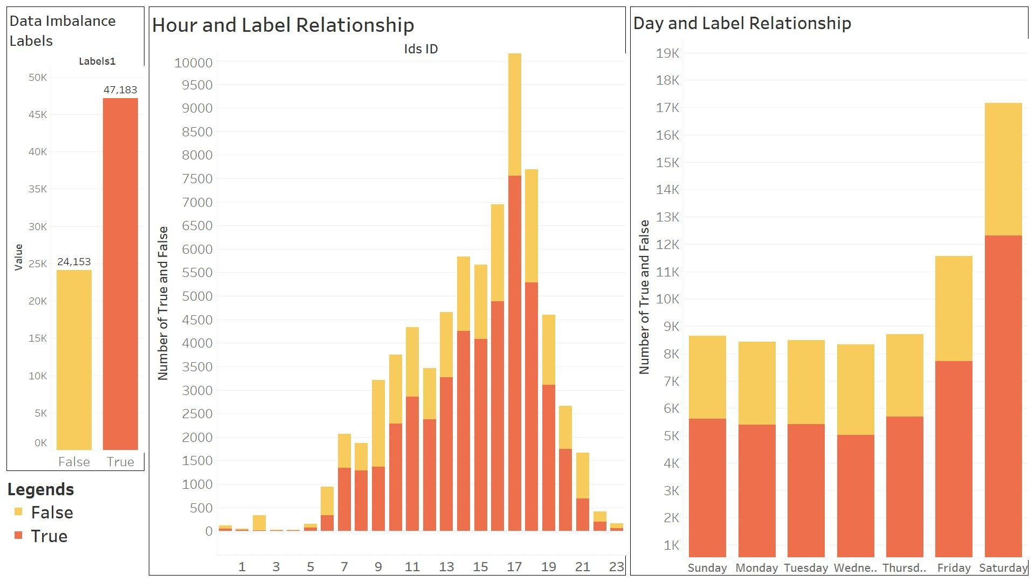

EXPLORATORY DATA ANALYSIS

Slide 8
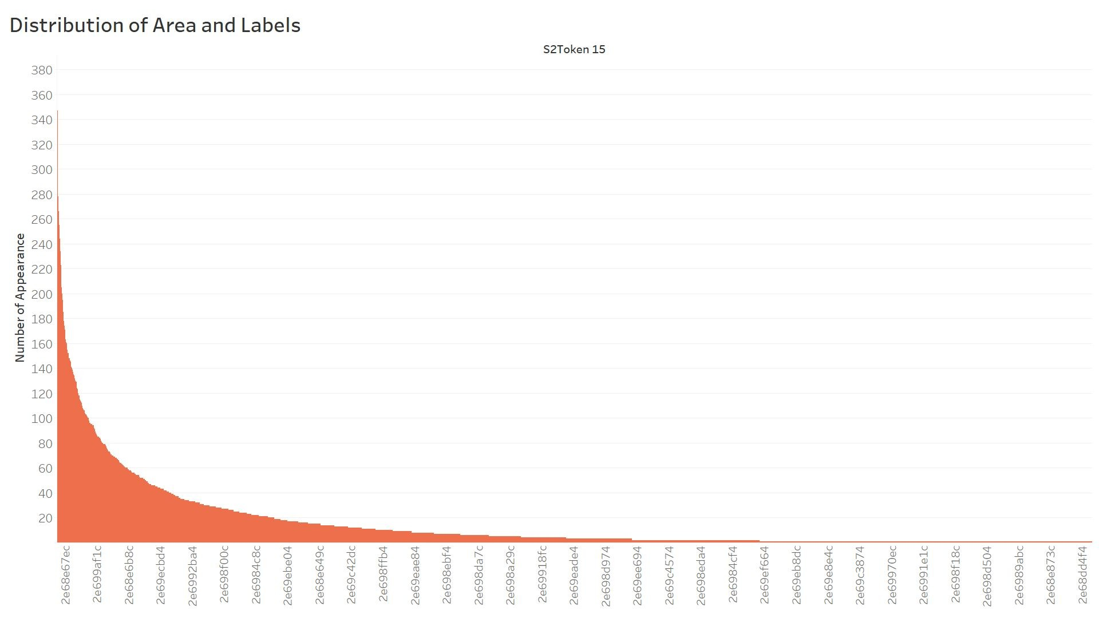
EXPLORATORY DATA ANALYSIS

Slide 9
DATA PREPROCESSING
DATA PREPARATION
03

Slide 10




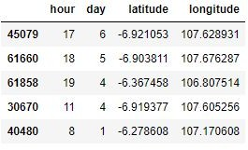


Data Preprocessing Pipeline
Start
RAW Train Data / Raw Test Data
Encode Labels to Boolean Representation
Split “s2token_15” to s2token, date, and hour
Convert Date to Days
Convert s2token to Latitude and Longitude using s2cell library
Encode “Hours” and “Days” to categorical integer
Drop unnecessary column
Reduce Data Frame memory usage to speed up training later
Final Train / Test Data
End

Slide 11
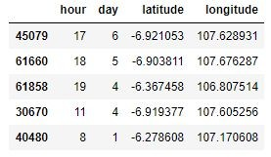
Data Preprocessing Pipeline
4 Features vs 12 Features Data Training
We focused to only used 4 features in our model because when we tried to use 12 features like below, our model could not give us better result. Based on our EDA, those 4 features already represent dataset behavior.

Slide 12
MODELING & EVALUATION
MODEL DESIGN
04

Slide 13

Modeling Pipeline
NO
Higher Evaluation Score?
Start
YES
End
Machine Learning Model
NO
Higher Validation Score?
Train Data
Data Preprocessing
Hyper Parameter Tuning, Model Selection, Feature Selection
Submission
YES
Test Data
Preprocessing and Model Predict

Slide 14
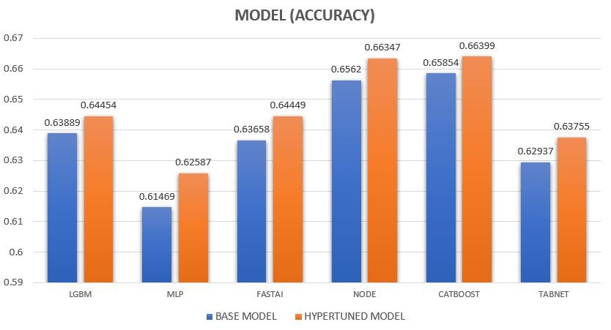
Model Selection
We did an extensive experiment with machine learning models
Data Split :
80% Train
20% Validation
MLP
4 Hidden Layers
(64,128,128,64)
After Hyper Tuned: 6 Hidden Layers
(64,128,128,64,64,4)
Hyper Parameter Tuning
OPTUNA
NODE : Neural Oblivious Decision Ensembles
TABNET : Attentive Interpretable Tabular Learning
14

Slide 15
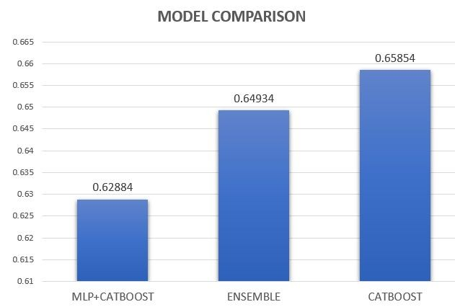
Model Selection
We built some machine learning techniques to compete CATBOOST
Multi Layer Perceptron + CATBOOST
Train using multilayer perceptron then take the intermediate layer output to train again in catboost.
We have 4 outputs from intermediate layer and make those outputs as our inputs for catboost training.
Stacking Ensemble Learning
EXTRA TREES
RANDOM FOREST
LGBM
CATBOOST
Logistic Regression
Base Model
Meta Model
K-FOLD Cross Validation = 3
15

Slide 16
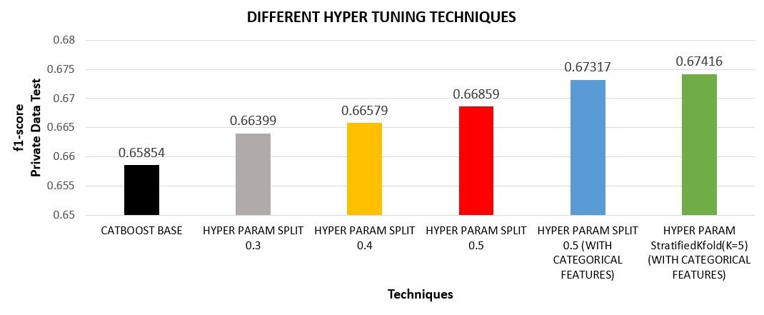
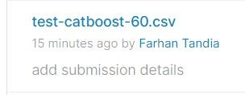
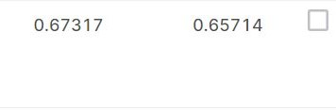
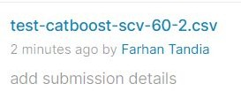

Model Evaluation
HYPER PARAMETER :
On Leaderboard
iterations=10000,
learning_rate=0.01,
l2_leaf_reg=3.5,
colsample_bylevel= 0.063808,
depth= 3, boosting_type= "Plain",
eval_metric='Logloss',
use_best_model=True,
random_seed=42,
bootstrap_type= "Bernoulli",
subsample= 0.55086.
threshold prediction = 0.6
IMBALANCE HANDLING |  | ACCURACY
SPLIT 0.3 | CATBOOST + REWEIGHTING + HYPER PARAM | 0.62737
 | CATBOOST + UNDERSAMPLING + HYPER PARAM | 0.64607
 | CATBOOST + OVERSAMPLING + HYPER PARAM | 0.64042
Private
Public
16

Slide 17
CONCLUSIONS & SUGGESTIONS
CLOSING
05
17

Slide 18
CONCLUSIONS
SUGGESTIONS
As we know that the highest peak of trafﬁc jam occurred in the evening and in the weekends.
CATBOOST has the highest accuracy among all the models.
CATBOOST has beneﬁt on the robustness of using categorical data features.
Only using 4 features, our technique/model is able to achieved a fast yet high and comparable accuracy on leaderboard.
Not much features could be used rawly. To get higher accuracy In the future, Well feature engineering is required to apply on dataset.
This model prediction could become consideration for government to create new public transportation route and schedule that match with where and when traffic jam occured.
For people, let’s make used of public transportation more than individual vehicles, it’ll not only reduce the trafﬁc jam rate but also makes environment cleaner and healthier.
Always check the trafﬁc condition via waze or map applications and decide your transportation vehicle wisely.
18

Slide 19



DATA SCIENCE WEEKEND 2021
#DSW2021
“Rebalancing The Power”
LULUS 2021!
THANK YOU!
Powered by
Supported by
19

