Slide 1

ECE 0302: Data Structures and Algorithms
Midterm Review
Azime Can-Cimino
University of Pittsburgh
Swanson School of Engineering
Department of Electrical and Computer Engineering
Notes:
Instructions for editing school and department titles:
Select from menu: View > Master > Slide Master
Click on each text area you wish to edit. Text will become editable.

Slide 2
Outline
Part #1: Multiple Choice Questions
Part #2: True/False
Part #3: Short Answer Questions
Part #4: CPP Implementation

Slide 3
Multiple Choice
Part #1

Slide 4
Part #1
Chapter 11
1. In the worst case, a binary search is ______.
O(n)
O(1)
O(log₂ n)
O(n²)

Slide 5
Module #1
Chapter 11
2. Given the following array:
4 15 8 3 28 21
which of the following represents the array after the second swap of the selection sort?
4 3 8 15 21 28
4 15 8 3 21 28
3 4 8 15 21 28
21 4 3 8 15 28

Slide 6
Module #1
Chapter 10
3. Algorithm analysis should be independent of all of the following EXCEPT ______.
the programming style used in the implementation of the algorithm
the computer used to run a program which implements an algorithm
the number of significant operations in an algorithm
the test data used to test a program which implements an algorithm

Slide 7
Module #1
Chapter 10
4. Assuming a linked list of n nodes, the C++ statements
Node *cur = head;
while (cur != null)
{ cout << curr->item << endl;
cur = cur->next;
} // end while
require ______ assignment(s).
n
n – 1
n + 1
1

Slide 8
Module #1
Chapter 10
5. Consider an algorithm that contains loops of this form:
for (i = 1 through n )
{ for (j = 1 through i)
{ for (k = 1 through 10)
{ Task T
}
}
}
If task T requires t time units, the loop on j requires ______ time units.
10 * t
(10 * t) + i
10 * t * i
t * i

Slide 9
Chapter 10
6. Which of the following growth-rate functions grows the fastest in value?
1
n
n²
log₂ n

Slide 10
Module #1
Chapter 9
7. A pointer variable whose sole purpose is to locate the first node in a linked list is called ______.
the list’s top
the node’s link
the list’s link
the list’s head

Slide 11
Module #1
Chapter 9
8. To remove a node N from a linear linked list, you will need to ______.
set the pointer next in the node that precedes N to point to the node that follows N
set the pointer next in the node that precedes N to point to N
set the pointer next in the node that follows N to point to the node that precedes N
set the pointer next in N to point to the node that follows N

Slide 12

Module #1
Chapter 9
9. What list operation does this depict?
deleting an item in the list
inserting an item in the list
expanding the array to make it larger
counting the number of items in the list

Slide 13
Module #1
Chapter 9
10. Given the following pseudocode logic:
if ( the insertion position is 1 )
Add the new node to the beginning of the chain
else
Ignore the first node and add the new node to the rest of the chain
What does this describe?
recursive addition of a node to the list
iterative addition of a node to the list
addition of a node to the beginning of the list
adding a node to the end of the list

Slide 14
Module #1
Chapter 7
11. When is an array based implementation of the ADT stack not a better choice?
the stack can be large, but often is not
the stack does not exceed the fixed size of the array
the stack is most always right around 80 characters
the stack represents the number of students in a typical class

Slide 15
Module #1
Chapter 7
12. Given the following code:
template < class ItemType>
ItemType ArrayStack<ItemType>::doSomething() const
{
assert (!isEmpty());
return items[top];
}
What method is this?
pop()
peek()
default constructor
copy constructor

Slide 16
Module #1
Chapter 7
13. Why would a stack be a poor choice for implementing an ADT bag?
it might fill up
you couldn’t account for duplicates
you need to be able to look through all the elements in the bag, not just the top of the stack
actually, it would be a good choice

Slide 17
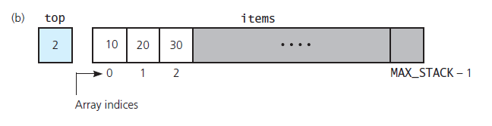
Module #1
Chapter 7
14. Given this graphic of an array-based stack.
What would be returned by a call to the method peek()
2
10
20
30

Slide 18
Module #1
Chapter 6
15. What behavior does the ADT stack exhibit?
first in, first out
first in, never out
last-in, first-out
last in, last out

Slide 19
Module #1
Chapter 6
16. Which of the following is the postfix form of the infix expression: (a + b) * c / d
a b + c * d /
a b * c / d +
a + b * c / d
a b + c d * /

Slide 20
Module #1
Chapter 6
17. A stack is initially empty, then the following commands are performed:
push 5, push 7, pop, push 10, push 5, pop
which of the following is the correct stack after those commands (assume the top of the stack is on the left)?
5 10 7 5
5 10
7 5
10 5

Slide 21
Module #1
Chapter 5
18. Given the infix expression a + (b * c) Which of the following is the equivalent prefix expression?
a b c * +
c * b + a
a b c * +
+ a * b c

Slide 22
Module #1
Chapter 5
19. What program sees whether a given string is a member of the language?
The compiler
A word processor
An encryption program
A text editor

Slide 23
Module #1
Chapter 4
20. In a link-based implementation, what node is the only one to which we have direct access?
The last
All are equally direct access
The one at nullPtr
The first

Slide 24
Module #1
Chapter 4
21. Which of the following are a good reason for using a link-based implementation of a bag?
A link list is fixed size.
You can access nodes directly with equal access time
A link-based implementation is good choice for a small bag
Linked chains do not have a fixed size

Slide 25
Module #1
Chapter 3
22. Which of the following provides a way to enforce the wall of an ADT?
Implement the ADT as a C++ class
Always use public fields
Never use private records together methods
Link records together

Slide 26
Module #1
Chapter 3
Why should we prevent a client’s direct access to a data structure?
To protect the job security of the systems analyst
It is a federal law
Most computer languages do not allow it
The client could possibly damage the ADT’s data

Slide 27
Module #1
Chapter 2
24. In a recursive solution, the ______ terminates the recursive processing.
local environment
pivot item
base case
recurrence relation

Slide 28
Module #1
Chapter 2
25. What happens if a recursive function never reaches a base case?
the function returns the correct value
the function returns an incorrect value
the function terminates immediately
an infinite sequence of recursive calls occurs

Slide 29
Module #1
Chapter 1
26. Data structures are part of an ADT’s ______.
definition
implementation
specifications
usage

Slide 30
Module #1
Chapter 1
27. To ______ an exception means to deal with the error condition.
declare
catch
implement
try

Slide 31
True/False
Part #2

Slide 32
For large arrays, the insertion sort is prohibitively inefficient.
True
Insertion sort can be implemented as in-place sort.
True
Low-order terms in an algorithm’s growth-rate function can be ignored.
True
If the value of the head pointer is NULL, the linked list is empty.
True
A link based implementation of the ADT List imposes a maximum length on the list.
False
Lists contain items of the same type.
True

Slide 33
In an array-based implementation of a stack, the stack can grow and shrink dynamically.
False
A stack has a first in, first out property.
False
The following expression is a prefix expression + a b – c d
False
Access time is a constant for an array-based implementation.
True
Choices made during the implementation process have no effect on execution time of your code.
False
A recursive solution can have more than one base case.
True

Slide 34
Short Answers
Part #3

Slide 35
Module #1
Chapter 11
What is the drawback of the merge-sort with respect to storage?
The merge-sort requires an auxiliary array whose size equals the size of the original array. For languages, such as C++, that store the actual data items in the array, this requirement might not be acceptable in situations where storage is limited, and the items are large.

Slide 36
Module #1
Chapter 10
What does an algorithm’s growth rate measure?
An algorithm’s growth rate measures how fast an algorithm’s time requirement grows as a function of the problem size.

Slide 37
Module #1
Chapter 9
What high level steps are required in the link based implementation of ADT List to insert a new item?
Create a new node and store the data in it, determine the point of insertion, connect the new node to the linked chain by changing pointers.

Slide 38
Module #1
Chapter 8
What two characteristics are important for the entries in an ADT list?
The entries have position, and they are ordered
Describe what happens when we insert a new item into the middle of the list.
All items that had position numbers greater or equal to the position to which we insert it must have their position numbers increased by 1 after the insertion. In effect they must be shifted one step higher in the list.

Slide 39
Module #1
Chapter 6
What is the difference between the stack pop and peek operations?
The pop operation removes the top of the stack. The peek operation retrieves the top of the stack but does not remove it.

Slide 40
Module #1
Chapter 4-5-6
Evaluate this prefix expression + 6 * - 3 2 4
Answer: 10
What are the contents of a node?
Answer: data and a link or reference to another node
What operations were identified for the ADT Stack?
See whether the stack is empty
Add a new item
Remove from the stack the item that was added most recently
Get the item that was added to the stack most recently (without removing)

Slide 41
Module #1
Chapter 1-2-3
How can we keep a method from being able to alter a class’s data members?
Answer: Make it a const method
What is a base case?
Answer: A base case is a special case of a recursive function whose solution you know. A base case enables the recursive processing to terminate.
What is functional abstraction?
Answer: Functional abstraction is a design principle that separates the purpose and use of a module from its implementation.

Slide 42
C++ Implementation
Module #4

Slide 43
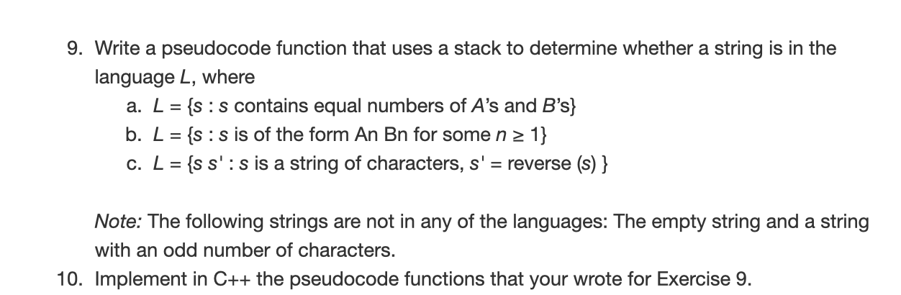
Module #1
Algorithm Implementation
This exercise is from Chapter 6 Exercises (Page 217)
For more clarification you may read 6.2.2 Recognizing strings in a language (Page 201)
Data Structure Implementation
Design a Data structure to...
support following specifications/operations

Slide 44
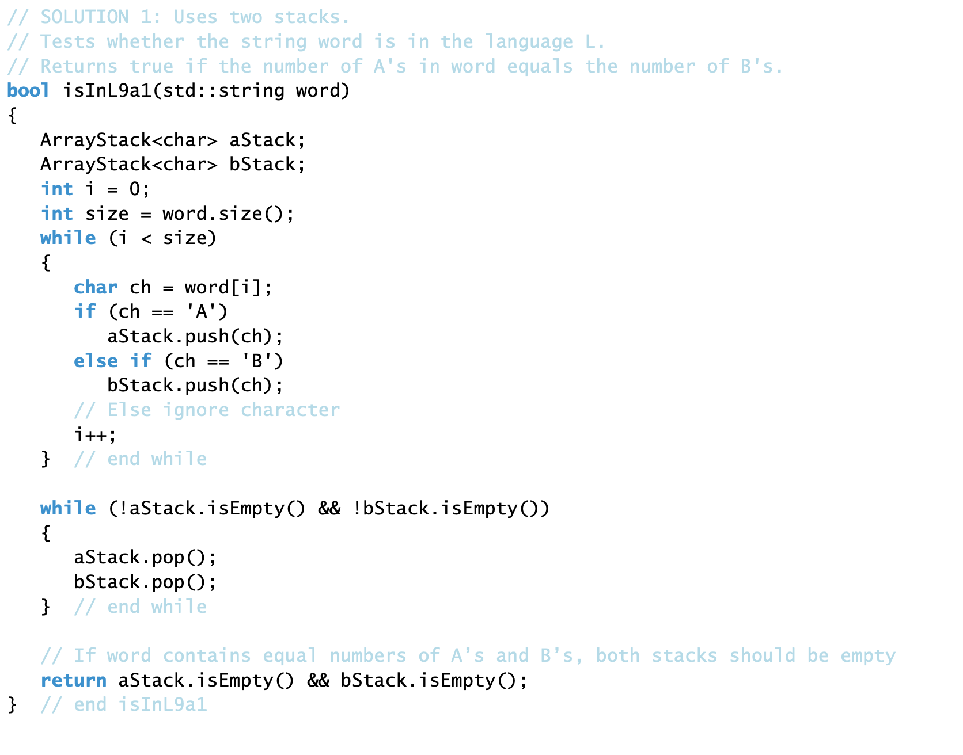

Slide 45
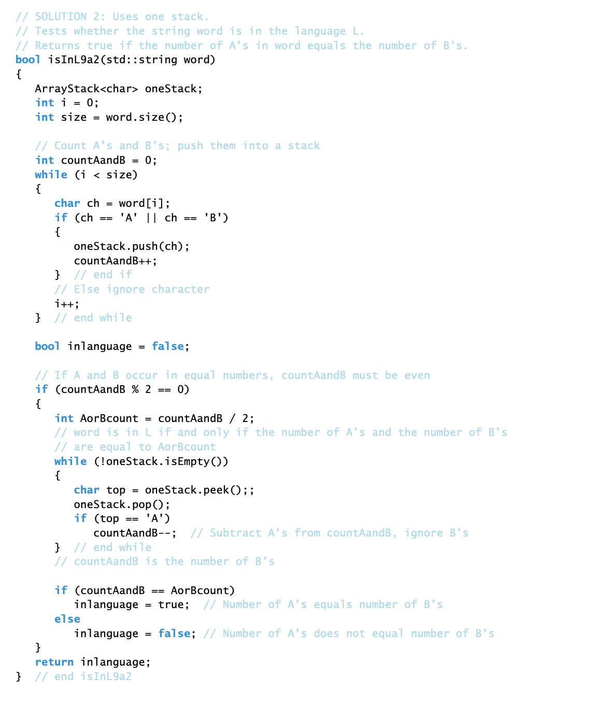

Slide 46
