Slide 1
Demand is
not need.
FOUR QUESTIONS, ONE STORY
MINNEMUDAC 2026 · GRADUATE DIVISION · THE FOOD GROUP
1
Need
Q1 · Q6: Does activity match need?
2
Money
Q4 · Q5: Prices and SNAP
3
Forecast
Q7: August 2026 by county
Where Minnesota's food shelf demand comes from, and where it misses the people who need it most
4
Access
Q8: Food deserts and the network
636,610
+62%
food-insecure Minnesotans, 2024
people served since 2022
Brian · Suji · Akbar · Vishesh · Alex
Notes:
~25 sec. Open with the tension: 636,000 Minnesotans are food insecure, and the same food shelves now serve 62% more people than in 2022. But the people walking in are not a direct read of who needs help. One idea runs through the talk: demand is not need. Demand follows money (prices and SNAP) and access (where shelves are). We will show each piece, then what The Food Group can do about it.

Slide 2
Four moves for The Food Group
Executive Summary
MinneMUDAC 2026 · The Food Group
1
Allocate
2
Reach
3
Advocate
4
Prepare
94 lb
117
$49M
Aug
Shift food to rural food deserts
Mobile stops rural; hours or delivery urban
Show what a SNAP cut does
Stock and staff for the peaks
per person a year there, vs 172 nearby
tracts with no shelf within USDA distance
a month lost in 2023; visits +18–26%
and Oct–Nov; Aug 2026: 236k visits
Q6 · Q8
Q8
Q5
Q4 · Q7
So what
Demand is not need: traffic follows money and access more than need.
2 · Each move is backed by the evidence that follows
Notes:
~30 sec. Lead with the answer. Our one idea: demand is not need. Food shelf traffic follows money and access more than it follows need. That gives four moves: shift pounds to rural food deserts; reach the 117 tracts with no nearby shelf, by mobile stop in the country and by hours or delivery in the city; defend SNAP with numbers, because a 49-million-dollar-a-month cut lifted visits 18 to 26 percent; and staff and stock for the August and fall peaks, using our county forecast. Then: here is the evidence, question by question.

Slide 3
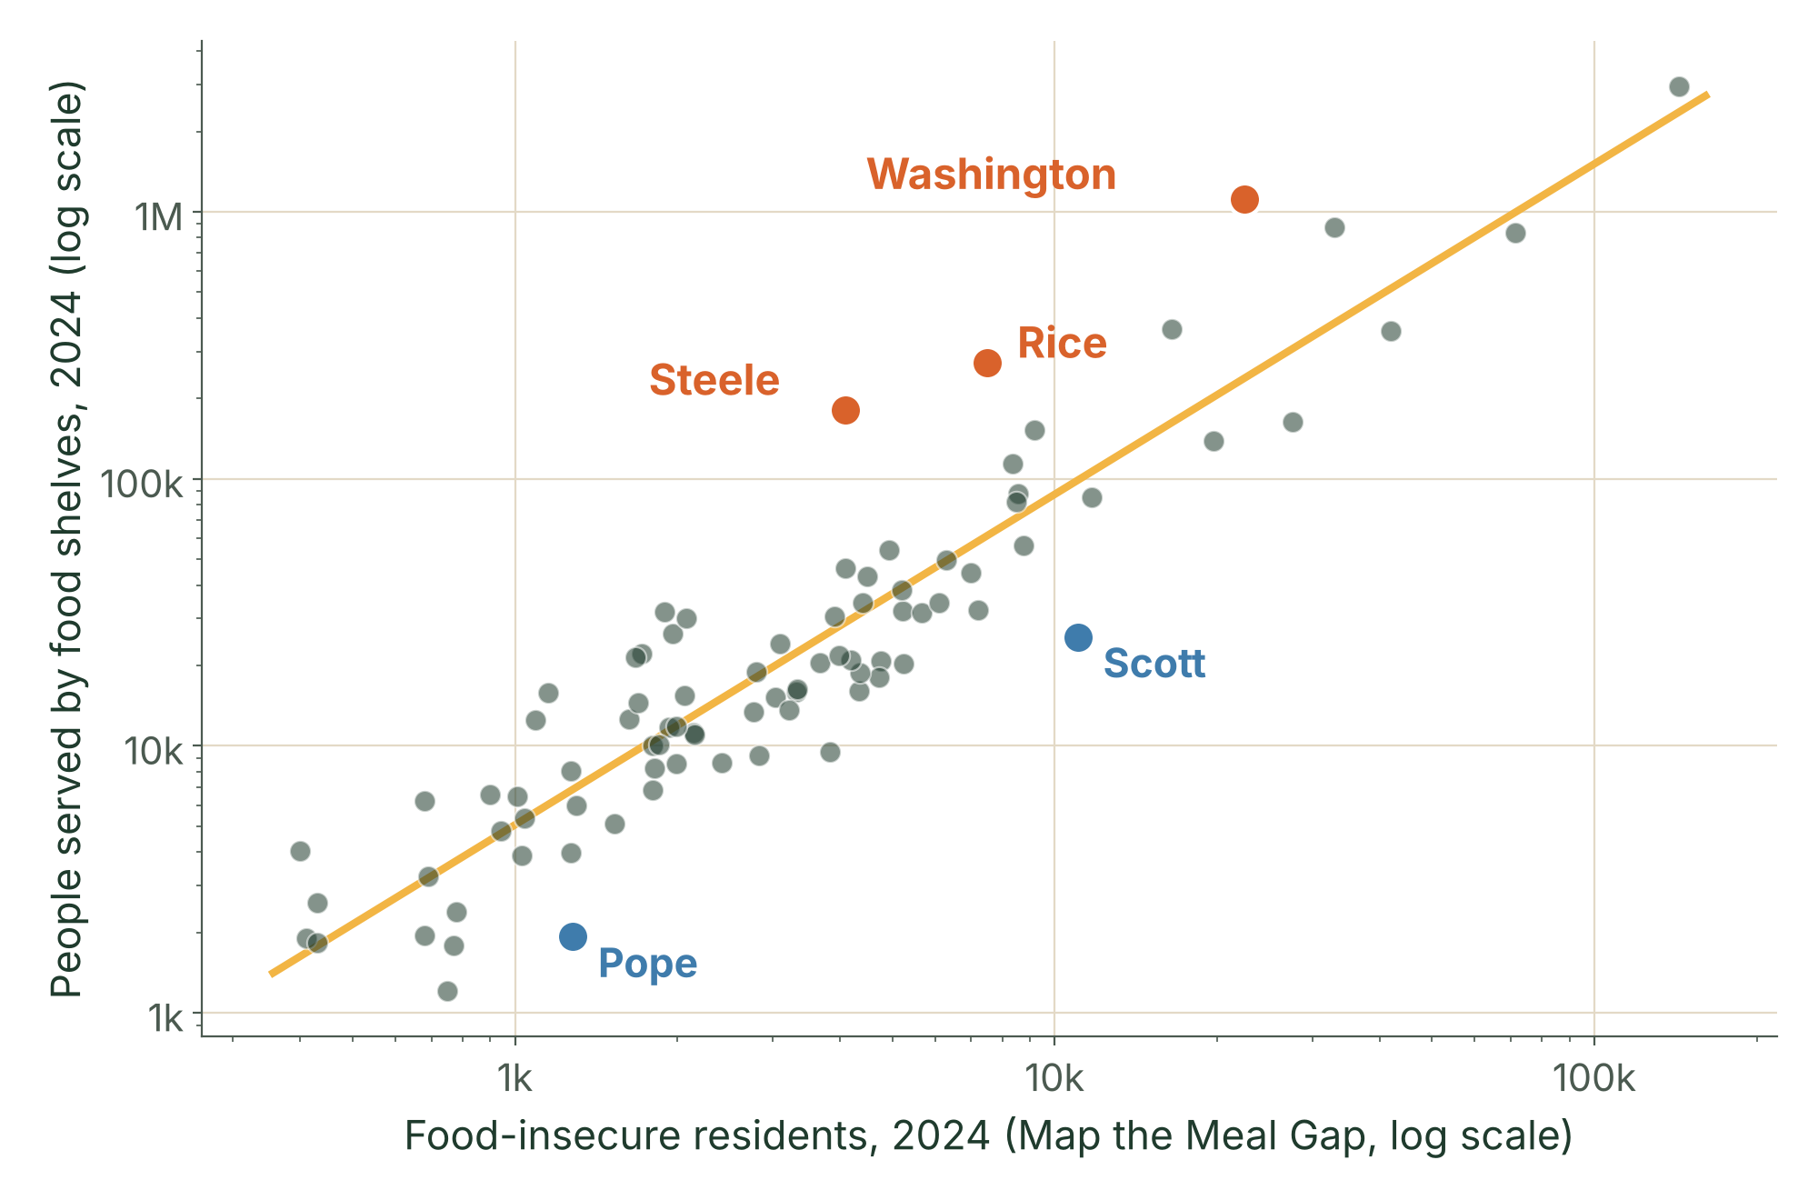
Activity follows county size, not need
Q1 · Need Estimates vs Food Shelf Activity
MinneMUDAC 2026 · The Food Group
0.92
correlation with need, 86 counties, 2024
pounds 0.93 · people 0.92 · visits 0.92
3 hubs
Steele, Rice, Washington: above need
one Steele site is 95% of its activity
0 records
for Wilkin's 810 food-insecure people
Scott and Pope also fall below need
So what
Per resident the link is weak. Among county traits only distance matters: +2.2 mi to a shelf, 18% fewer served than need predicts.
3 · Sources: Feeding America, Map the Meal Gap 2026; The Food Group 2024
Notes:
~50 sec. Q1: do Feeding America's need numbers and food shelf activity tell the same story? Mostly yes. Each dot is a county; more food-insecure people, more people served, correlation 0.92, and pounds, visits and individuals agree within a point (pounds slightly strongest). Where it breaks down: Steele, Rice and Washington sit far above the line because regional hub sites serve people from other counties. Scott and Pope sit below it. Wilkin has 810 food-insecure people and no records at all. Among county traits, only distance to the nearest food shelf explains the gap. Theme: demand is not need.

Slide 4
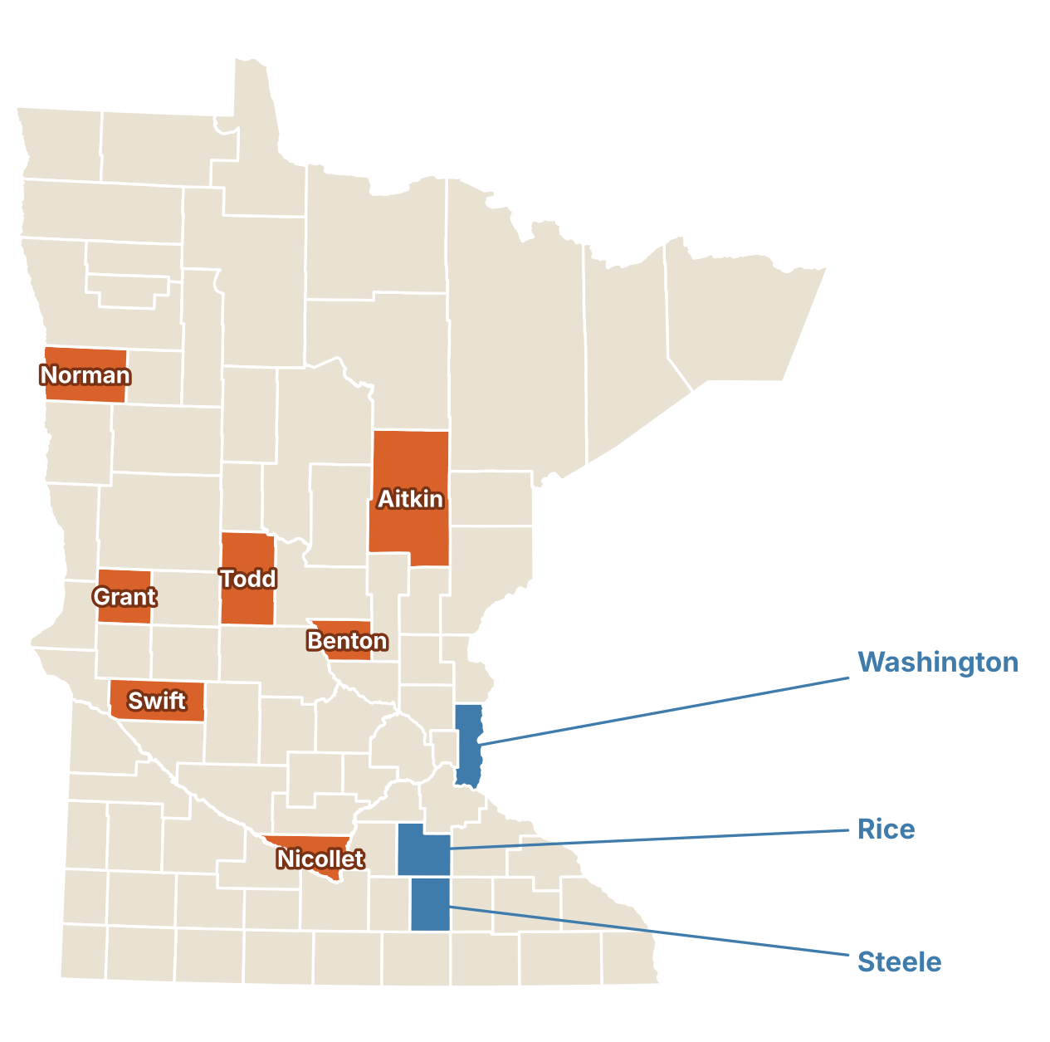
Hidden need clusters in thin rural networks
Q6 · A Falsifiable Measure of Need
MinneMUDAC 2026 · The Food Group
7 counties
need above activity in all 3 years
Swift · Grant · Todd · Benton · Aitkin · Norman · Nicollet
3 hubs
activity above need
Rice · Steele · Washington: regional catchments
52%
of the index is the food-insecurity rate
falsifiable: rejected if the rest added nothing; it holds
So what
Need = food-insecurity rate + meal cost + share below the SNAP limit, none from food shelves. Need vs activity per resident: r ≈ 0. Rurality drives the gap.
4 · Sources: Feeding America, Map the Meal Gap 2022–2024; The Food Group; Census
Notes:
Bridge from Q1: if activity only follows need in totals, we need a separate measure of need. ~55 sec. Q6: food shelf data shows where people arrive, not where they need help and do not get it. Our need index combines three county measures, none from food shelves: the food-insecurity rate, the local cost of a meal, and the share of food-insecure people below the SNAP income limit. Comparing it with all three activity metrics, seven small rural counties (orange) sit below their need every year; Swift has one food shelf for the whole county. The blue counties are the Q1 hubs. It is falsifiable: we would reject it if it added nothing beyond the food-insecurity rate; we tested that and the rate explains only about half of it. And need barely lines up with per-resident activity at all, which is our theme in one number.

Slide 5
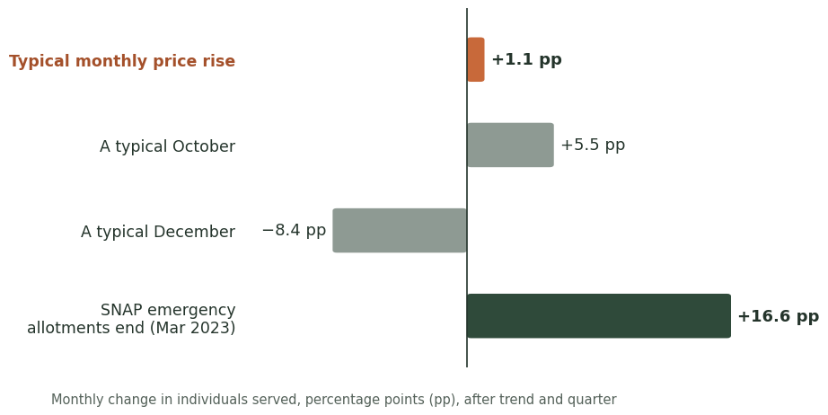
Grocery prices lift food-shelf demand slowly; the calendar moves it more
Q4 Food Prices
MinneMUDAC 2026 · The Food Group
MORE PEOPLE WHEN PRICES RISE?
Yes, modestly. +1 pt food inflation → +3.4 pts faster yearly growth in people served.
AT ONCE OR DELAYED?
Not at once. No same-month link; it builds over several months.
ALL THREE METRICS?
Yes, same direction in households, people and pounds; clearest in people served.
OTHER CYCLES?
Yes, and larger: peaks in Aug and Oct–Nov; lows Dec–Feb.
So what
Food shelves: plan stock and staff on the calendar
Donors: when inflation stays high, expect faster demand growth over the year
5 · Sources: BLS CPI-U food at home, Midwest (CUUR0200SAF11, monthly) via FRED · TFG food-shelf data
Notes:
Bridge: if demand does not simply follow need, what moves it? Money, starting with prices. ~35 sec. Q4: do more people come when grocery prices rise? Yes, but modestly. Each bar is the extra monthly change in people served after trend and season are removed. A typical month's food price rise adds only about one point. It does not happen at once: there is no same-month link, and the effect builds over several months. Over a year, one point more food inflation goes with about 3.4 points faster growth in people served. All three metrics move the same way; people served shows it most clearly, and pounds least, because pounds also depends on supply. The calendar matters more than prices: a typical October adds five and a half points and December takes away eight, with peaks in August and October to November. The biggest bar is the end of SNAP emergency allotments, which is the next slide. So what: food shelves should plan stock and staff on the calendar, and donors should expect demand to grow faster while food inflation stays high.

Slide 6
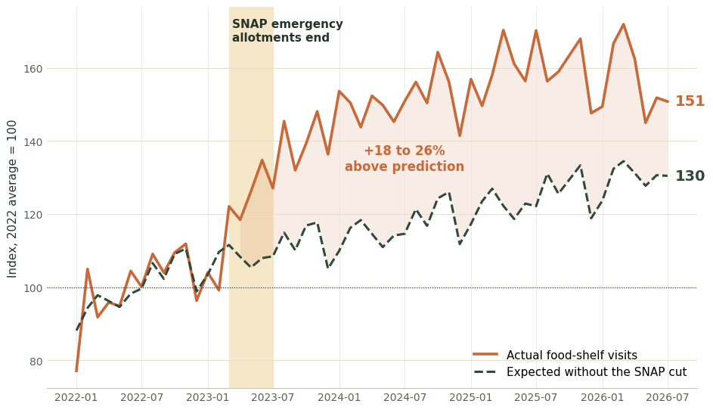
SNAP cuts, more than grocery prices, drove the 2023 surge
Q5 SNAP Enrollment and Food-Shelf Use
MinneMUDAC 2026 · The Food Group
$49M
a month in SNAP lost, spring 2023
benefit per person $260 → $160 (−38%)
+18 to 26%
visits above trend, prices, season
placebo test picks spring 2023
−10% → +5%
SNAP per person vs visits over time
across counties they rise together
So what
Lawmakers: SNAP cuts land on food shelves, which cannot fully absorb them, and hit rural counties hardest
6 · Sources: MN DCYF SNAP dashboard · Census county population · BLS CPI food at home, Midwest · TFG
Notes:
~40 sec. Q5: SNAP and food shelves. The shaded band is spring 2023, when SNAP emergency allotments ended: about 49 million dollars a month left Minnesota grocery budgets, and benefit per person fell from about 260 to 160 dollars. The orange line is actual food shelf visits; the dashed line is what trend, prices and season predict without the cut. Visits ran 18 to 26 percent above that prediction, and a placebo test that tries every month as the break point picks spring 2023. Do SNAP and food shelves move together or replace each other? Both. Over time they replace each other: 10 percent less SNAP per person goes with about 5 percent more visits. Across counties they rise together, because both follow need. By location, there is no metro difference, and small counties were hit hardest per resident. So what for lawmakers: a SNAP cut lands on food shelves, which cannot fully absorb it.

Slide 7
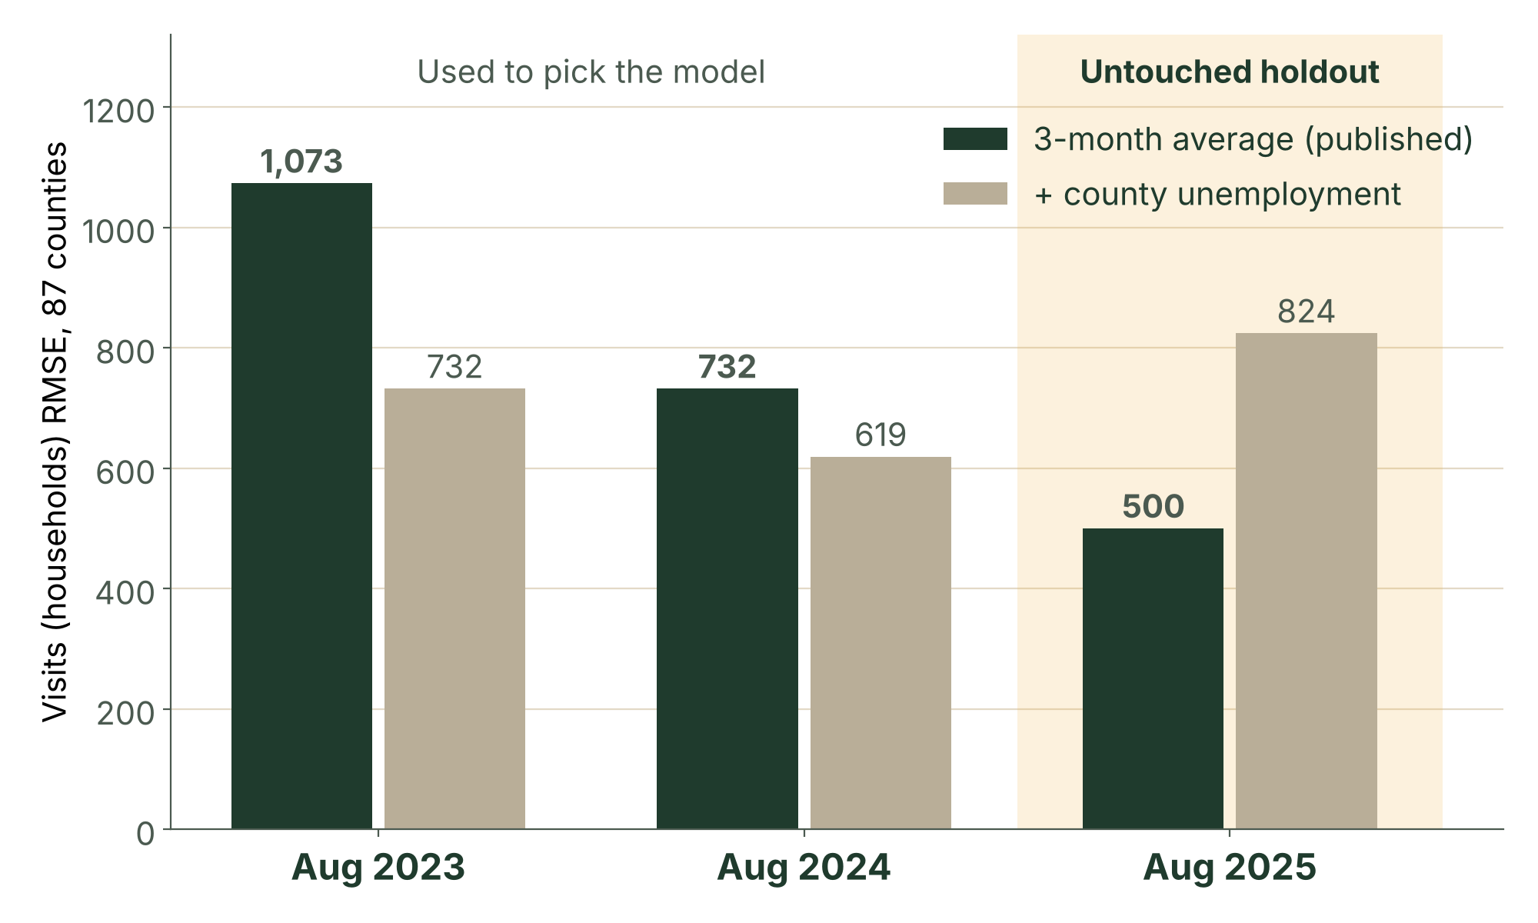
The simple model beat the clever one
Q7 · August 2026 forecast
MinneMUDAC 2026 · The Food Group
236,148
visits forecast for August 2026
past Augusts’ range 229k–263k
5.6%
of statewide visits, held-back Aug 2025 (WAPE)
RMSE about 500 visits per county
12.3M lb
pounds; 730k people served
children 258k · adults 387k · seniors 85k
So what
Each county's August ≈ its May–July average; adding unemployment failed the holdout. 3 counties decide the result when scored on county RMSE.
7 · Model picked on Aug 2023–24, scored once on Aug 2025; the range uses all four Augusts; inputs end July 2026
Notes:
Bridge: once we know what moves demand, we can predict it. ~50 sec. Q7 is scored by forecast error across counties, so we built the test to match: use only data through July, predict August, compare, for three past Augusts. Why does the model say what it says? Each county's August forecast is simply its average of May, June and July. We also tried adjusting for each county's change in unemployment from the Bureau of Labor Statistics. It looked better on the two years we used to choose, then lost badly on August 2025, which we had held back as a final exam, so we did not trust it. The simple average was 5.6% off on visits. Our August 2026 forecast: about 236,000 visits statewide (range 229,000 to 263,000), 12.3 million pounds and 730,000 people. No input goes past July 2026.

Slide 8
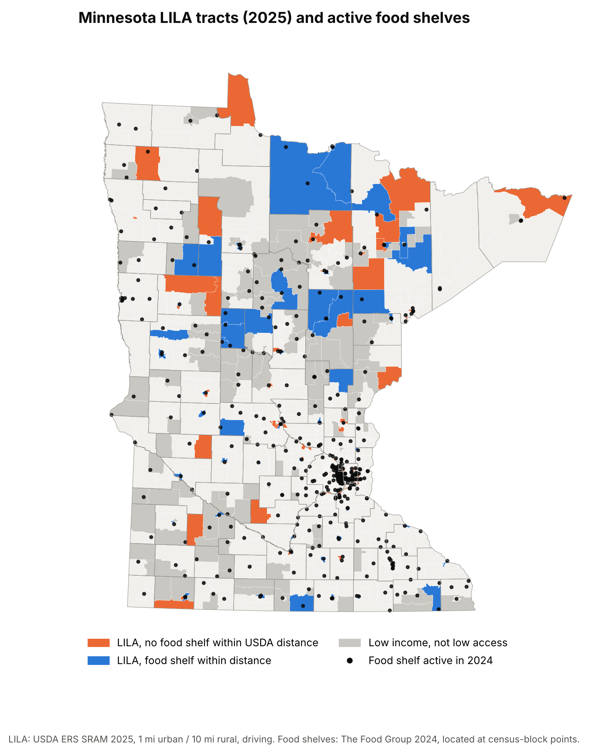
Rural food shelves repeat the grocery gap
Q8 · Low-Income, Low-Access Areas
MinneMUDAC 2026 · The Food Group
65% vs 72%
near a shelf: food deserts vs other low-income
241 vs 290 lb of food reachable per person a year
94 lb
per person a year in rural food deserts
vs 172 nearby; tribal areas 118 vs 280
117 tracts
with no shelf within USDA distance, 57k in poverty
28 rural (12.6 mi) · 89 urban (1.5 mi, few cars)
So what
Rural: grocery 2× farther → shelf 76% farther. Cities: no link. Holds in 10 of 10 tests.
8 · Sources: USDA ERS Retailer Access Map 2025, Food Access Atlas 2019; USDA FNS; Census
Notes:
Bridge: a forecast says how many will come; Q8 asks who cannot reach a shelf at all. ~65 sec. Q8. USDA calls a census tract low-income, low-access, a food desert, when incomes are low and the nearest supermarket is more than a mile away in town or ten miles in the country. Does the food shelf network reach them? Less well: 65% of people in poverty in these tracts have a food shelf within USDA's distance, against 72% in other low-income tracts, and rural food deserts can reach 94 pounds of food a year per person, about half of other rural poor tracts. Does it fill the retail gap or repeat it? In cities there is no link. In rural Minnesota, where the grocery is twice as far, the food shelf is about 76% farther: the network repeats the retail pattern. The orange tracts are the 117 gaps: 28 rural tracts a median 12.6 miles from a shelf, and 89 urban tracts a mile and a half away where many families have no car. It holds in all ten definitions we tried. Limits: straight-line distance, partner sites only.

Slide 9
Back to the four moves, now with the evidence
Recommendations, Revisited
MinneMUDAC 2026 · The Food Group
1
Allocate
2
Reach
3
Advocate
4
Prepare
94 lb
117
+18–26%
236k
per person a year in rural food deserts, vs 172 nearby
food-desert tracts with no shelf within USDA distance
visits after the 2023 SNAP cut
visits forecast for August 2026
Takes: current allocation formula
Takes: existing routes; gap list ready
Takes: staff time; free DCYF data
Takes: monthly forecast re-run
So what
Each move uses staff, partners and data The Food Group already has.
9 · Limits and robustness checks: Appendix A22
Notes:
~40 sec. Close the loop: these are the four moves from the opening, now with the evidence the judges have just seen, and each is something The Food Group can act on with what it has today. Allocate: rural food deserts reach about 94 pounds per person a year, half of nearby areas, and the Q6 counties are the same thin rural networks, so shift pounds there and plan in pounds per person, not visits. Reach: the 117 gap tracts are two problems, a truck stop in the country and evening hours or delivery in the city; the gap list is ready to use. Advocate: we put a number on a SNAP cut, 49 million dollars a month and an 18 to 26 percent jump in visits. Prepare: August and October to November are the peaks every year; re-run the simple county forecast monthly and watch the SNAP dashboard. Close with: demand is not need.

Slide 10
Thank you
MINNEMUDAC 2026 · GRADUATE DIVISION
Demand is not need. Questions?
Brian · Suji · Akbar · Vishesh · Alex
DATA CREDITS
The Food Group · Feeding America (Map the Meal Gap) · USDA Economic Research Service · USDA Food and Nutrition Service · U.S. Bureau of Labor Statistics · U.S. Census Bureau · MN Dept. of Children, Youth, and Families
TEMPLATE SOURCES
Layout after "Business Proposal Ppt Template", Business Layout Lab (Pinterest, pin 1130685050261813191) · built with Claude's Slides artifact type (Anthropic) · fonts Source Serif 4 and Source Sans 3 (Adobe, via Google Fonts, SIL Open Font License 1.1)
Notes:
~10 sec. Thank the judges, repeat "demand is not need", and open for questions. Point to the appendix for detail on any question.

Slide 11
Appendix contents
Appendix
MinneMUDAC 2026 · The Food Group
A
A1
Sources: competition data
12
A9
Q6 need index, counties
20
A17
Q7 model and holdout
28
A2
Sources: prices and SNAP
13
A10
Q6 falsifiable definition
21
A18
Q8 definition and method
29
A3
Sources: population, jobs
14
A11
Q6 drivers, robustness
22
A19
Q8 reach, fill or repeat
30
A4
Sources: food access
15
A12
Q4 results
23
A20
Q8 gap tracts
31
A5
Sources: geography
16
A13
Q4 method and checks
24
A21
Q8 robustness
32
A6
Data cleaning decisions
17
A14
Q5 results
25
A22
Limits and checks
33
A7
Q1 correlations, outliers
18
A15
Q5 tests: together or replace
26
A8
Q1 county characteristics
19
A16
Q5 tests: shock, locations
27
11 · Sources A1–A5 · cleaning A6 · Q1 A7–A8 · Q6 A9–A11 · Q4 A12–A13 · Q5 A14–A16 · Q7 A17 · Q8 A18–A21
Notes:
Not presented. Jump here during Q&A.

Slide 12
Competition data
Appendix A1 · Sources: competition data
MinneMUDAC 2026 · The Food Group
A1
Publisher · exact series | Geography | Time · vintage | Why this, not an alternative | Used
The Food Group · org_FSStats: HouseholdsReg (visits), IndividualsReg, PoundsReg, Children/Adults/SeniorsReg | Food shelf site → county | Monthly, Jan 2022 – Jul 2026 | Required data; the Reg fields the brief names | All
The Food Group · Organization: partner type, status, county, 2020 census block | Site, census block | Snapshot, Sep 2026 | Only source of site type and location | Q1 Q5 Q8
Feeding America · Map the Meal Gap 2026 and 2025: food-insecure persons, rate, meal cost, % below SNAP limit | County (87) | Annual, 2022–2024 | Required; compared within a year, per its FAQ | Q1 Q6
CREDIT
Feeding America (2026). Map the Meal Gap 2026: county food insecurity and food cost in the United States in 2024.
12 · Households served is the brief's visit field (~28% of published visit totals)
Notes:
Appendix A1, backup for Q&A. Households served is the brief's visit field and equals about 28% of The Food Group's published visit totals, so we report changes, not absolute visits.

Slide 13
Prices and SNAP
Appendix A2 · Sources: prices and SNAP
MinneMUDAC 2026 · The Food Group
A2
Publisher · exact series | Geography | Time · vintage | Why this, not an alternative | Used
U.S. Bureau of Labor Statistics via FRED · CPI-U Food at Home, Midwest Urban (CUUR0200SAF11), not seas. adj. | Census Midwest region | Monthly to Jul 2026; ~2-week lag | Minneapolis CPI is only bimonthly | Q4 Q5
MN Dept. of Children, Youth, and Families · SNAP Food Assistance Dashboard: cases, persons, net benefits | County or Tribal Nation (88) | Monthly, 2016 – Jul 2026; ~1-month lag | Monthly and county-level; DHS reports are annual | Q5
MN DCYF · same dashboard, statewide totals | Statewide | Monthly, 2016 – Jul 2026 | Checks county sums; statewide time series | Q5
NO AUGUST DATA
Both downloads ran into August 2026 and were trimmed to July before loading (accessed 2026-09-28).
13 · fred.stlouisfed.org/series/CUUR0200SAF11 · dcyf.mn.gov/snap-food-assistance-minnesota
Notes:
Appendix A2, backup for Q&A. SNAP source, grain and lag as Q5 asks: DCYF dashboard, county or Tribal Nation by accounting month, about one month lag. Tribal Nations are folded into Mille Lacs, Beltrami and Mahnomen.

Slide 14
Population and jobs
Appendix A3 · Sources: population, jobs
MinneMUDAC 2026 · The Food Group
A3
Publisher · exact series | Geography | Time · vintage | Why this, not an alternative | Used
U.S. Census Bureau, Population Estimates Program · County Population Totals, Vintage 2025 | County (87) | Annual (July 1); released Mar 2026 | Latest official count each year; ACS 5-year lags | Q1 Q5 Q6
U.S. Bureau of Labor Statistics · Local Area Unemployment Statistics, county rate (LAUCN27…03) | County (87) | Monthly, 2022 – Jul 2026 | Only monthly county labor series; tested, rejected | Q7
LINKS
census.gov/data/tables/time-series/demo/popest/2020s-counties-total.html (accessed 2026-10-09) · api.bls.gov, LAUS (accessed 2026-10-11)
14 · Unemployment rows after July 2026 dropped before use
Notes:
Appendix A3, backup for Q&A. Census population turns counts into rates per 1,000 residents. BLS county unemployment was tried as a Q7 input and rejected on the holdout year.

Slide 15
Food access
Appendix A4 · Sources: food access
MinneMUDAC 2026 · The Food Group
A4
Publisher · exact series | Geography | Time · vintage | Why this, not an alternative | Used
USDA Economic Research Service · Food Access Research Atlas 2019: LILA flags (1 & 10, ½ & 10, 1 & 20, vehicle) | 2010 tract → 2020 | 2010 Census, ACS 2014–18, 2019 stores | The brief's named source; kept as a check | Q8
USDA ERS · SNAP-authorized Retailer Access Map 2025: driving and straight-line LILA flags, tract traits | 2020 tract (1,502) | 2020 Census, ACS 2020–24, 2025 stores | Current, 2020 tracts, driving distance | Q8 Q1
USDA Food and Nutrition Service · Historical SNAP Retailer Locator 2005–2025 | Store point | Snapshot, 1 Jul 2024 | Dated list matching 2024 activity | Q8
15 · Definition and pipeline in Appendix A18
Notes:
Appendix A4, backup for Q&A. Main LILA flag: SRAM 2025, driving distance, 1 mile urban and 10 miles rural. The 2019 Atlas, which the brief names, is the check.

Slide 16
Geography
Appendix A5 · Sources: geography
MinneMUDAC 2026 · The Food Group
A5
Publisher · exact series | Geography | Time · vintage | Why this, not an alternative | Used
U.S. Census Bureau · 2020 Centers of Population by tract | Tract point | 2020 Census | Where people live, not a tract's middle | Q8
U.S. Census Bureau · 2010–2020 Tabulation Block Relationship File, Minnesota | Census block | 2010 to 2020 | Moves the 2019 Atlas to 2020 tracts | Q8
U.S. Census Bureau · TIGER/Line 2024: tracts and 2020 tabulation blocks | Tract, block | 2024 release | Locates shelves; draws the maps | Q8 Q6
16 · Crosswalk weighted by shared land area
Notes:
Appendix A5, backup for Q&A. The crosswalk uses shared land area because block populations for both vintages are not in the relationship file.

Slide 17
Q1 and Q6 rules; Q7 cleaned separately, differences noted
Appendix A6 · Data cleaning decisions
MinneMUDAC 2026 · The Food Group
A6
Issue | Decision | Affects
Date of record | DateForSearch used; _Year/_Month disagree on 26 rows | All
63 duplicate site-months | Keep the larger row, never sum (matches each site's normal month) | All
Waseca, Jul 2023 | 273,385 households for 646 people → 311, midpoint of Jun and Aug | All
98 impossible rows | Households above individuals rebuilt from the site's ratio | All
Split county labels | Hennepin and Ramsey sub-labels mapped to their county | All
Unlocatable sites | 39 sites flagged, not dropped; ~1% of activity has no county | Q1 Q6 Q8
Coverage gaps | Becker, Beltrami under 35% coverage; Wilkin has no rows | Q1 Q6
USDA 2025 low-income count | Fails a consistency check (r = −0.80 with poverty); not used | Q8
17 · Waseca entry, duplicates and the Wilkin gap to be flagged to The Food Group
Notes:
Appendix A6, backup for Q&A. The Waseca unit error alone would create a fake statewide spike. Per the code of conduct, operational data problems go back to The Food Group, assuming positive intent.

Slide 18
In totals activity tracks need; per resident it does not
Appendix A7 · Q1 correlations, outliers
MinneMUDAC 2026 · The Food Group
A7
Metric, 86 counties, 2024 | r (log scale)
Pounds distributed | 0.93
Individuals served | 0.92
Household visits | 0.92
PER 1,000 RESIDENTS
The link disappears
higher food-insecurity rates do not bring higher visit rates
Steele
1,588 vs 358 visits per 1,000, actual vs predicted (t = 6.1); one hub is 95% of it
READ IT CAREFULLY
Strong in all three years, but mostly county size: big counties have more of everything.
Wilkin
810 food-insecure residents, no food shelf records at all
18 · Feeding America, Map the Meal Gap 2025–2026; The Food Group 2022–2024 · team notebook Q1_clean_and_analysis
Notes:
Appendix A7, backup for Q&A. All three metrics correlate about 0.92 to 0.93 with Feeding America counts, pounds slightly strongest. That is mostly size; per resident the link is weak. The outliers are about the network: regional hubs and missing coverage.

Slide 19
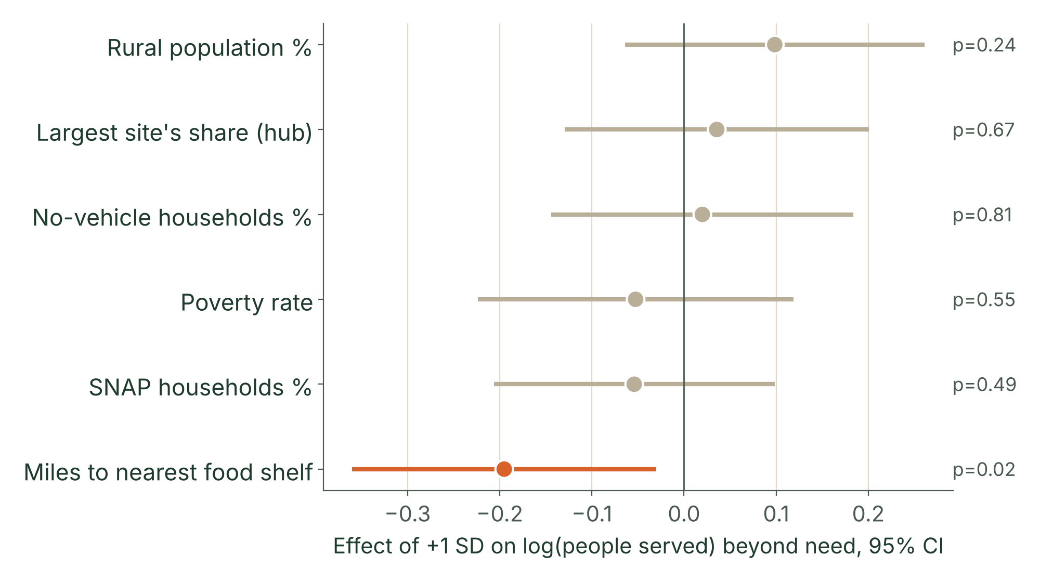
Distance to a food shelf explains the gap
Appendix A8 · Q1 county characteristics
MinneMUDAC 2026 · The Food Group
A8
PER +2.2 MILES (1 SD)
−18%
people served vs need, p = 0.02
METHOD
Residual of log people served on log food-insecure persons, on six z-scored traits; robust SE; 86 counties, 2024
READING
R² = 0.09: county traits explain little; most mismatch is site-level (hubs, coverage)
19 · USDA ERS Retailer Access Map 2025 tract traits (population-weighted); Q8 distances; Map the Meal Gap 2026
Notes:
Appendix A8, backup for Q&A. Q1 asks for county characteristics. Poverty, SNAP share, no-vehicle share, rural share and hub concentration are not significant; distance to the nearest shelf is.

Slide 20
Need index and the counties where it diverges
Appendix A9 · Q6 need index, counties
MinneMUDAC 2026 · The Food Group
A9
Need index
Divergence
Average of three within-year z-scores from Map the Meal Gap: food-insecurity rate, cost per meal, share of food-insecure people below the SNAP limit
Demand index (visits, people, pounds per 1,000) minus need index, for every county in 2022, 2023 and 2024
NEED ABOVE ACTIVITY, ALL 3 YEARS
ACTIVITY ABOVE NEED
Swift · Grant · Todd · Benton · Aitkin · Norman · Nicollet
Rice · Steele · Washington
Swift: one food shelf, the most rural code in the state
regional hubs serving beyond county lines
20 · Feeding America, Map the Meal Gap 2022–2024; Census population · team notebook Q6_need_divergence
Notes:
Appendix A9, backup for Q&A. Wadena and Chippewa also rank under-served in 2 of 3 years. Wilkin cannot be scored: it has need but no rows at all.

Slide 21
Falsifiable definition, in four parts
Appendix A10 · Q6 falsifiable definition
MinneMUDAC 2026 · The Food Group
A10
Addendum item | Our answer
1 · Definition | Need = average of within-year z-scores of three Map the Meal Gap county measures: food-insecurity rate, cost per meal, and share of food-insecure people below the SNAP income limit.
2 · Need, not demand | No input comes from food shelf activity; Map the Meal Gap models need from Census survey data and county economics. Demand enters only at the comparison.
3 · Reject it if | It adds nothing beyond the food-insecurity rate. Tested, not rejected: the rate explains 52% (r = 0.72); meal cost and poverty depth add the rest.
4 · Revise it if | The Food Group defines need to include access, or an outside source moves counties a lot. Rurality and shelf density act as explanations, so they stay outside.
21 · Team notebook Q6_need_divergence, section 6
Notes:
Appendix A10, backup for Q&A. The four items the addendum requires, stated plainly. The index is an extension of the food-insecurity rate, not a replacement.

Slide 22
Drivers and robustness of the need index
Appendix A11 · Q6 drivers, robustness
MinneMUDAC 2026 · The Food Group
A11
DRIVERS · 258 COUNTY-YEARS
WEIGHTING CHECK · 5 VERSIONS
Rurality
Stable
−0.141 per step on the 1–9 scale (p < .001); shelves per 10k food-insecure +0.015 (p = .04); R² = 0.12
rank r 0.81–0.98; rural cluster keeps 6–9 of 9 counties when a part is dropped, 4 of 9 on the rate alone
NEED VS EACH ACTIVITY METRIC, PER 1,000 RESIDENTS
r from −0.15 to 0.29 across 2022–24, while the three activity metrics agree with each other (r 0.85–0.96). Activity is consistent; it just does not follow need.
22 · Standard errors clustered by county · team notebook Q6_need_divergence, sections 2b, 4b, 4c
Notes:
Appendix A11, backup for Q&A. Rurality is the strongest driver of hidden need; shelf density adds a little. The extra components matter: on the food-insecurity rate alone, five of the nine cluster counties drop out.

Slide 23
Prices nudge demand; the calendar and SNAP move it far more
Appendix A12 · Q4 results
MinneMUDAC 2026 · The Food Group
A12
Typical monthly price rise (+0.22%)
≈ +1 pt
per month
Seasonal swing (Aug, Oct–Nov peaks)
±5 to 7 pts
every year
SNAP allotments end (Mar 2023)
+16 to 19 pts
Same month
Over a year
Donor number
No effect: r ≈ 0 once the shared trend is removed
Move together (r 0.33–0.55); no precise lag survives the falsification test
+1 pt food inflation ≈ +3.4 pts faster growth in people served (CI 2.2–4.6)
23 · BLS CPI-U Food at Home, Midwest Urban, via FRED; The Food Group · team notebook Q4_FINAL
Notes:
Appendix A12, backup for Q&A. Answer Q4 directly: yes, modestly; not at once; the calendar and SNAP shocks are bigger. Activity peaks in August and October to November every year.

Slide 24
Method, lags and robustness
Appendix A13 · Q4 method and checks
MinneMUDAC 2026 · The Food Group
A13
DATA
METHOD
FALSIFICATION
Statewide monthly totals, Jan 2022 – Jul 2026 (55 months), vs Midwest food-at-home CPI
Detrended monthly changes; lag correlations −3 to +3 months; yearly growth; calendar effects
Activity leading CPI by 2 months correlates as strongly, so no fixed delay is claimed
Metric | Response to prices
Individuals | Strongest: lag-1 link significant in every check, incl. fixed-site panel
Households | Present in full data; weakens in the fixed-site panel
Pounds | Weakest: pounds is also supply, and prices cut what shelves can buy
24 · Checks: fixed sites; mobile, Tribal, campus sites added; missing pounds imputed; late reporting
Notes:
Appendix A13, backup for Q&A. Individuals respond most consistently; pounds least, because pounds reflects supply as well as demand.

Slide 25
When SNAP shrank, shelves absorbed it with less food per visit
Appendix A14 · Q5 results
MinneMUDAC 2026 · The Food Group
A14
+18–26%
EMERGENCY ALLOTMENTS END
visits above prediction
$49M a month
lost (−41%); benefit per person $260 → $160
−10% → +5%
less SNAP per person, more visits
ACROSS COUNTIES
FOOD PER VISIT
LOCATIONS
+1% SNAP participation → +0.30% visits (p = .01): both follow need
Visits doubled, pounds +50%: about ¼ less food each
No metro difference; small counties lost most per resident
25 · MN DCYF SNAP dashboard; BLS CPI; Census Vintage 2025; The Food Group 2022–2026 · team notebook Q5_FINAL
Notes:
Appendix A14, backup for Q&A. Move together or replace? Both: across counties they rise together because both follow need; over time SNAP money replaces food shelf trips.

Slide 26
Three tests for "together or replace"
Appendix A15 · Q5 tests: together or replace
MinneMUDAC 2026 · The Food Group
A15
Test | Specification | Result
Across counties | Log SNAP participation vs shelf rates per 1,000 | +1% → +0.30% visits (p = .01), +0.30% individuals, +0.22% pounds
Over time | Statewide benefit per person; trend, CPI, season controlled | 10% lower benefit → +5% visits, +6% individuals, +3.5% pounds
Within county | County fixed effects, balanced vs all sites | Sign flips between samples: not interpreted
26 · Team notebook Q5_FINAL, sections 5–6 and 8
Notes:
Appendix A15, backup for Q&A. Together across places, replacing over time; no robust month-to-month link inside one county.

Slide 27
The 2023 shock, its placebo and its geography
Appendix A16 · Q5 tests: shock, locations
MinneMUDAC 2026 · The Food Group
A16
Test | Specification | Result
Benefit change | Interrupted time series at the Apr 2023 EA end, CPI-controlled | Visits +18–26%, individuals +26–30%, pounds +14–18%
Placebo | Try a break at every month, mid-2022 to mid-2025 | Best four fits: Mar–Jun 2023
Dose-response | EA dollars lost per resident ($3 to $18) | ≈ 0 (p = .71): rise was statewide
Locations | Metro interactions; small, mid, large counties | No metro gap (p .15–.74); small counties hit hardest
27 · MN DCYF SNAP dashboard (county × month, lag ≈ 1 month) · team notebook Q5_FINAL
Notes:
Appendix A16, backup for Q&A. How we know it was SNAP and not prices: CPI is controlled, prices were flat after April 2023, and the placebo scan picks March to June 2023.

Slide 28
Model choice, holdout check and forecast
Appendix A17 · Q7 model and holdout
MinneMUDAC 2026 · The Food Group
A17
Target | Pick error: avg / +unemp | 2025 error: avg / +unemp | Aug 2025 WAPE | Band hit | August 2026 Forecast (past-August Range)
Visits | 902 / 676 | 500 / 824 | 5.6% | 88% | 236,148 (229k–263k)
Pounds | 46,950 / 47,299 | 61,245 / 59,372 | 11.1% | 66% | 12.26M (12.47M–13.70M)
Children | 1,331 / 1,093 | 269 / 615 | 4.1% | 77% | 258,020 (260k–294k)
Adults | 1,584 / 1,320 | 525 / 1,095 | 4.5% | 84% | 386,891 (377k–434k)
Seniors | 257 / 214 | 392 / 340 | 8.7% | 81% | 85,216 (85k–94k)
Individuals | 3,030 / 2,462 | 575 / 1,541 | 3.3% | 81% | 730,121 (723k-822k)
MODEL
DECISION RULE
ALSO CHECKED
Each county's May–July 2026 average; Wilkin, with no site, forecast at 0
Unemployment won 4 of 5 picks, then lost 3 on the holdout: rejected
An August seasonal factor made 4 of 6 targets worse. A uniform August multiplier, fit on prior years, made county RMSE worse in 10 of 12 backtests. Both were trying to model one event: 88% of our 2025 pounds error is one Ramsey site’s single month.
28 · Errors are county RMSE · team script forecast_august.py; backtest_metrics.csv; summary.json
Notes:
Appendix A17, backup for Q&A. If asked why not fancier: unemployment looked better on the years used to choose and lost on the held-back year, which is the overfitting the holdout exists to catch. Pounds is hardest: 11% error, because pounds also depends on supply; past Augusts ran above the May–July average, so its range sits above the point.

Slide 29
How we measured reach, capacity and fill or repeat
Appendix A18 · Q8 definition and method
MinneMUDAC 2026 · The Food Group
A18
USDA LILA DEFINITION
Pipeline · 1,502 tracts
Low income: poverty ≥ 20%, or family income ≤ 80% of the area median. Low access: 500+ people or 33% live over 1 mile (urban) or 10 miles (rural) from a supermarket.
Food shelves active in 2024 at their census-block point · groceries = supermarket, super store, large grocery on 1 Jul 2024 · straight-line miles from where residents live · capacity = pounds within 10 mi per person in poverty, 2-step catchment · compared with low-income tracts that are not low-access · fill or repeat = weighted log–log slope with a density control
VINTAGES
Main: Retailer Access Map 2025, driving: 141 tracts. Check: Food Access Atlas 2019: 164 tracts.
29 · USDA ERS; USDA FNS; Census 2020 centers of population · team notebooks Q8_01 and Q8_02
Notes:
Appendix A18, backup for Q&A. Comparison group holds income roughly constant, so the difference is grocery access. The two-step catchment avoids double-counting a shelf shared by several tracts.

Slide 30
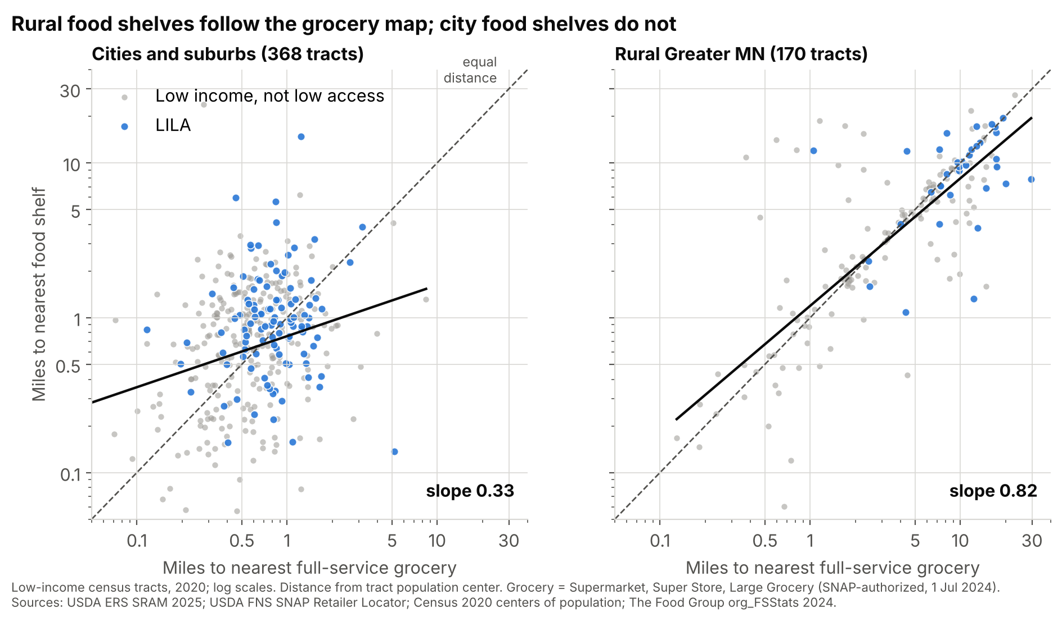
Reach is lower, and rural shelves follow the grocery map
Appendix A19 · Q8 reach, fill or repeat
MinneMUDAC 2026 · The Food Group
A19
65%
vs 72%
people in poverty within USDA distance of a shelf
241
vs 290 lb
food reachable per person a year (10 mi)
0.82
rural slope
0.55 with density control; cities 0.07–0.33
30 · Weighted by people in poverty; comparison = low-income, not low-access tracts
Notes:
Appendix A19, backup for Q&A. Slope 1 means the network repeats the retail map; 0 means independent; below 0 means it fills the gap. Rural Minnesota is close to repeating.

Slide 31
117 gap tracts, two different problems
Appendix A20 · Q8 gap tracts
MinneMUDAC 2026 · The Food Group
A20
URBAN · 89 TRACTS
RURAL · 28 TRACTS
48,000
12.6 mi
people in poverty; shelf 1.5 mi away, few cars
median to a shelf; up to 27 mi in Beltrami
Rural LILA tracts
reach 94 lb per person a year vs 172 in other rural low-income tracts
Tribal areas
118 lb vs 280 elsewhere (tribal food programs are not in this data)
St. Cloud
holds 5 of the 15 largest gap tracts
31 · Gap list: q8_gap_tracts.csv (LILA 2025 or 2019, no shelf within 1 mi urban / 10 mi rural)
Notes:
Appendix A20, backup for Q&A. Two problems: a mobile stop in the country, hours, delivery or transit in the city. The gap list is ranked by people in poverty.

Slide 32
Holds in 10 of 10 definitions for reach, 9 of 10 for food
Appendix A21 · Q8 robustness
MinneMUDAC 2026 · The Food Group
A21
Variant | LILA tracts | Near a shelf: LILA vs other | lb per person
Main: 2025, 1 & 10 mi, driving | 141 | 65% vs 72% ✓ | 241 vs 290 ✓
2025, straight-line | 49 | 50% vs 71% ✓ | 193 vs 283 ✓
2025, ½ & 10 mi | 291 | 58% vs 86% ✓ | 271 vs 284 ✓
2025, 1 & 20 mi | 106 | 66% vs 71% ✓ | 262 vs 281 ✓
2025, vehicle access | 104 | 65% vs 72% ✓ | 288 vs 271 ✗
2019 Atlas (brief's source) | 164 | 60% vs 74% ✓ | 226 vs 298 ✓
Fixed sites only | 141 | 63% vs 69% ✓ | 241 vs 290 ✓
Capacity within 5 mi | 141 | 65% vs 72% ✓ | 260 vs 279 ✓
Capacity within 20 mi | 141 | 65% vs 72% ✓ | 249 vs 291 ✓
Weights: 2019 low-income | 141 | 61% vs 70% ✓ | 93 vs 125 ✓
32 · q8_robustness.csv, team notebook Q8_02 section 4 · the vehicle-access definition reverses capacity
Notes:
Appendix A21, backup for Q&A. The coverage gap appears every time; capacity reverses only under the vehicle-access definition. The 2019 Atlas gives the same answer.

Slide 33
Limits we name, checks we passed
Appendix A22 · Limits and checks
MinneMUDAC 2026 · The Food Group
A22
Limits
CHECKS
• Households served are not visits (~28% of published totals)
• Partner network only; 39 sites unlocated
• Straight-line distance, not drive time
• One big SNAP shock to learn from
• Meal cost not comparable before 2023
• Q4: lag failed falsification, so not claimed
• Q5: placebo picks spring 2023
• Q6: index beats the rate alone
• Q7: holdout year rejected the fancier model
• Q8: holds in 10 of 10 definitions
33 · Cleaning decisions in Appendix A6
Notes:
Appendix A22, backup for Q&A. Judges reward honesty about limits. Left: what our data cannot tell you. Right: how we tried to prove ourselves wrong.

