Slide 1
Problem 1 Alex Janosi
flight
flight_no
flight_date
flight_time
source_aprt
destination
domestic
seats
seat_no
class
seat_type
exit_row
aircraft
type_code
company
model
flying
flt_seat

Slide 2
Problem 2 Alex Janosi
customer
customer_id
name
first_name
last_name
email
{ phone } (at least one)
total
traveler
passport
citizenship
emergency_contact
emerg_name
emerg_phone
frequent_flyer
purchaser
payment
card_no
exp_date
veri_code
purchase
purchase_id
purchase_time
conf_number
purchased

Slide 3
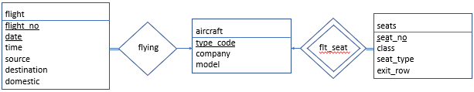
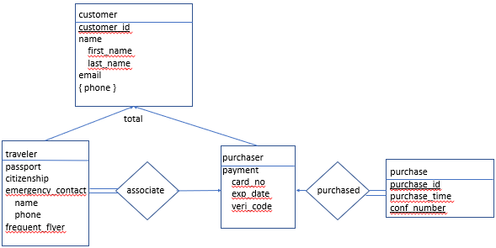
Problem 3 Alex Janosi
ticket
ticket_id
sale_price

