Slide 1
LINCOLN ED THROUGHPUT BENCHMARK · CMS PUBLIC DATA · JUNE 2026
Bryan absorbs Lincoln's ED demand faster than its competitor — at higher volume.
The open question is how much headroom remains as Medicaid coverage losses arrive.
TESTABLE BUSINESS QUESTION
Does Bryan's ED network show measurably better throughput than its Lincoln competitor and Nebraska acute-care peers in public CMS data — and does that finding hold after controlling for volume class and facility type?
Alex Jardine · alexjardinedata.github.io
Notes:
0:00–0:30. Lincoln is a two-system town, and Bryan is the region's pressure-release valve — a Level II trauma center absorbing demand the rest of the region can't. I wanted to know how much of that story is visible in public data, so I built an ED throughput benchmark from CMS hospital quality files — every Medicare-certified hospital in Nebraska, including all of Bryan's network and its competitor. The question I set up was deliberately testable: better throughput, and does it survive controls.

Slide 2
Three findings — every slide after this supports one of them
117 vs 162
3 of 3
0.0%
MEDIAN ED MINUTES — BRYAN VS. ST. ELIZABETH
BRYAN ACUTE FACILITIES UNDER THE NE ACUTE AVG (141.6)
LEFT WITHOUT BEING SEEN — ALL BRYAN FACILITIES
45 min (~28%) faster than the only Lincoln competitor — while operating in a higher ED volume class (“very high” vs. “medium”).
Network-wide, not a flagship outlier: Grand Island 105, Kearney 108, Bryan 117 — facilities acquired in 2019 and 2022 run the same playbook.
A second, independent indicator agrees. St. Elizabeth: 1.0%. Statewide acute average: 1.24%. Walkouts are demand exceeding capacity, made visible.
Answer to the business question: yes — and it holds after both controls.
Notes:
0:30–1:30. Three things came out of the data. One: Bryan moves ED patients 45 minutes faster than St. Elizabeth, despite a higher volume class. Two: that speed holds across the whole acute network — all three facilities beat the state acute average. Three: a second indicator confirms it — essentially zero patients leave Bryan EDs without being seen. So the answer to the question I posed is yes, and it survives the controls. Now the evidence behind each.

Slide 3
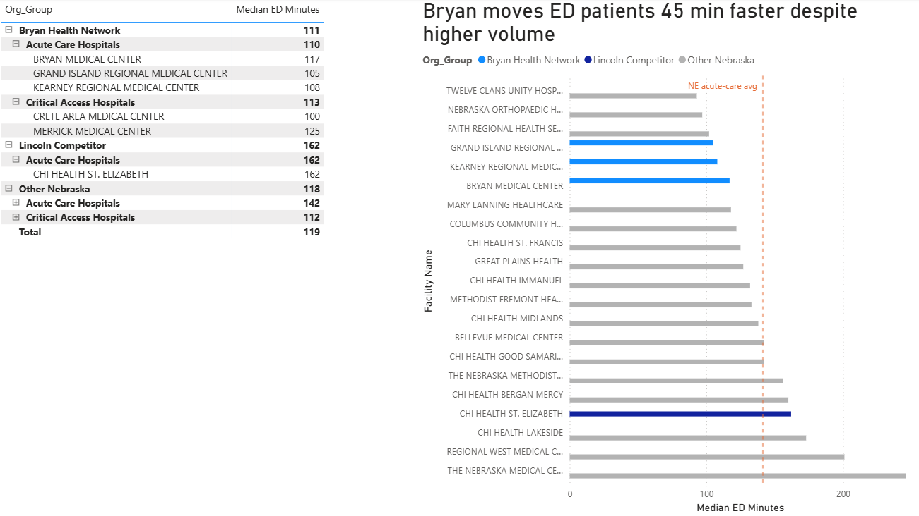
Source: CMS Timely & Effective Care, OP_18b, Nebraska subset, June 2026 · Power BI
Notes:
1:30–2:30. Every bar is a hospital; blue is Bryan's network, orange is the Lincoln competitor, gray is the benchmark. The honest benchmark matters: the raw statewide average looks like 118, but that's diluted by 62 small critical-access hospitals. Like-for-like, acute vs acute, the average is 141.6 — and Bryan sits at 117, with its regional facilities at 105 and 108. And Bryan does this as one of only three very-high-volume EDs in the state. Choosing the right comparison set is part of the analysis.

Slide 4
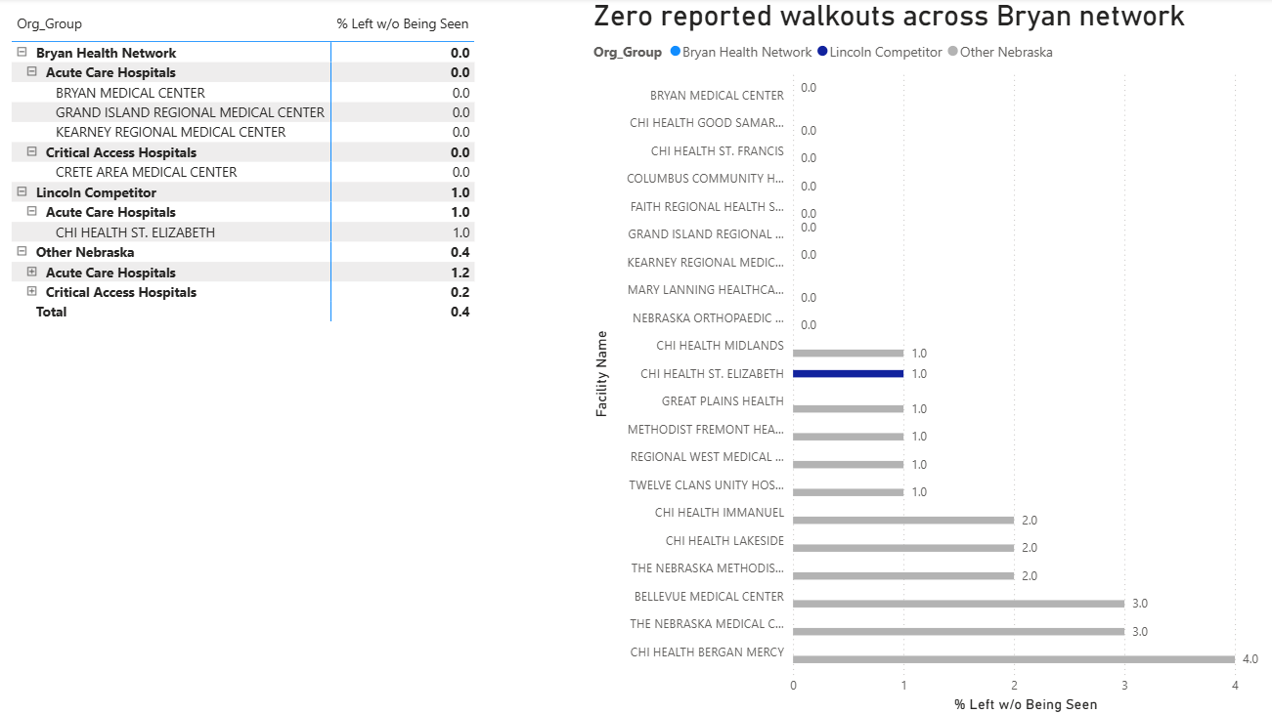
CMS-reported 0.0% may round from a small true rate — would validate against internal registration data. Source: CMS OP_22, NE subset, June 2026.
Notes:
2:30–3:15. One metric can mislead, so I checked a second, independent indicator: the share of patients who leave before being seen — that's demand exceeding capacity made visible. CMS reports zero across every Bryan facility, against 1.0% at St. Elizabeth and 1.24% for acute hospitals statewide. I present it as CMS-reported zero — it may round from a small true rate, and the first thing I'd do internally is validate it against registration data.

Slide 5
Built end-to-end and validated twice — and honest about what public data can't see
CMS raw CSV
Power Query
Star schema
Power BI + DAX
Validated
mixed types, “Not Available”, footnotes, leading-zero keys
→
typed, documented cleaning pipeline
→
hospital dimension + long-format fact table
→
explicit measures, unit-correct formats
→
identical results, Excel ↔ Power BI
WHAT PUBLIC DATA CANNOT SEE
Medians cover discharged ED patients only — boarding of admitted patients is invisible
Behavioral-health holds, diversion hours, and door-to-provider times exist only in Epic
No facility reports the full measure set; absence often means “not applicable,” not failure — Merrick (critical access) reports the least
Bryan East and West share one CMS certification number — campus-level analysis needs internal data
Notes:
3:15–4:00. Quick method note: the raw CMS files are genuinely messy — numeric and categorical values mixed in one column, Not Available strings, footnoted suppression, and leading-zero facility IDs that are the join key. I built a typed, documented pipeline in Power Query, modeled it as a star schema, wrote explicit DAX measures, and validated identical results in Excel and Power BI. And the honest limit: these are discharged-patient medians. Boarding, behavioral-health holds, diversion — none of it is public. That's exactly where I'd go next.

Slide 6
Three questions I'd take to internal data first
Coverage loss doesn't reduce demand — it converts scheduled care into unscheduled ED visits. Bryan is the region's catch basin.
Quantify behavioral-health boarding
1
What share of boarding hours is driven by BH holds? Needs Epic ADT + psych census. Produces the denominator for any capacity investment case.
Coverage-loss early-warning monitor ▸ ties to Medicaid work-requirement exposure
2
Are Medicaid disenrollments (projected 16–30K) arriving as ED demand? Track payer mix weekly against disenrollment waves — a leading indicator, weeks ahead of the income statement.
Forecast census 7–14 days out ▸ ties to Medicaid work-requirement exposure
3
Predict census by service line to flex staffing proactively. Same forecasting problem I solved for athlete availability — constrained capacity, seasonal demand, individualized risk.
Notes:
4:00–5:00. Public data shows Bryan absorbing Lincoln's demand efficiently. The strategic question is how much headroom remains — Nebraska's Medicaid work requirements took effect May 1, projected to disenroll 16 to 30 thousand people, and that demand converts to uninsured, unscheduled ED visits. So three things I'd build first: quantify behavioral-health boarding from Epic ADT data; a coverage-loss early-warning monitor tracking payer mix against disenrollment waves; and a 7-to-14-day census forecast to flex staffing — which is structurally the athlete-availability forecasting problem I solved for ten years, in a new domain. Success looks like fewer premium-labor hours at equal or better throughput.

