Slide 1
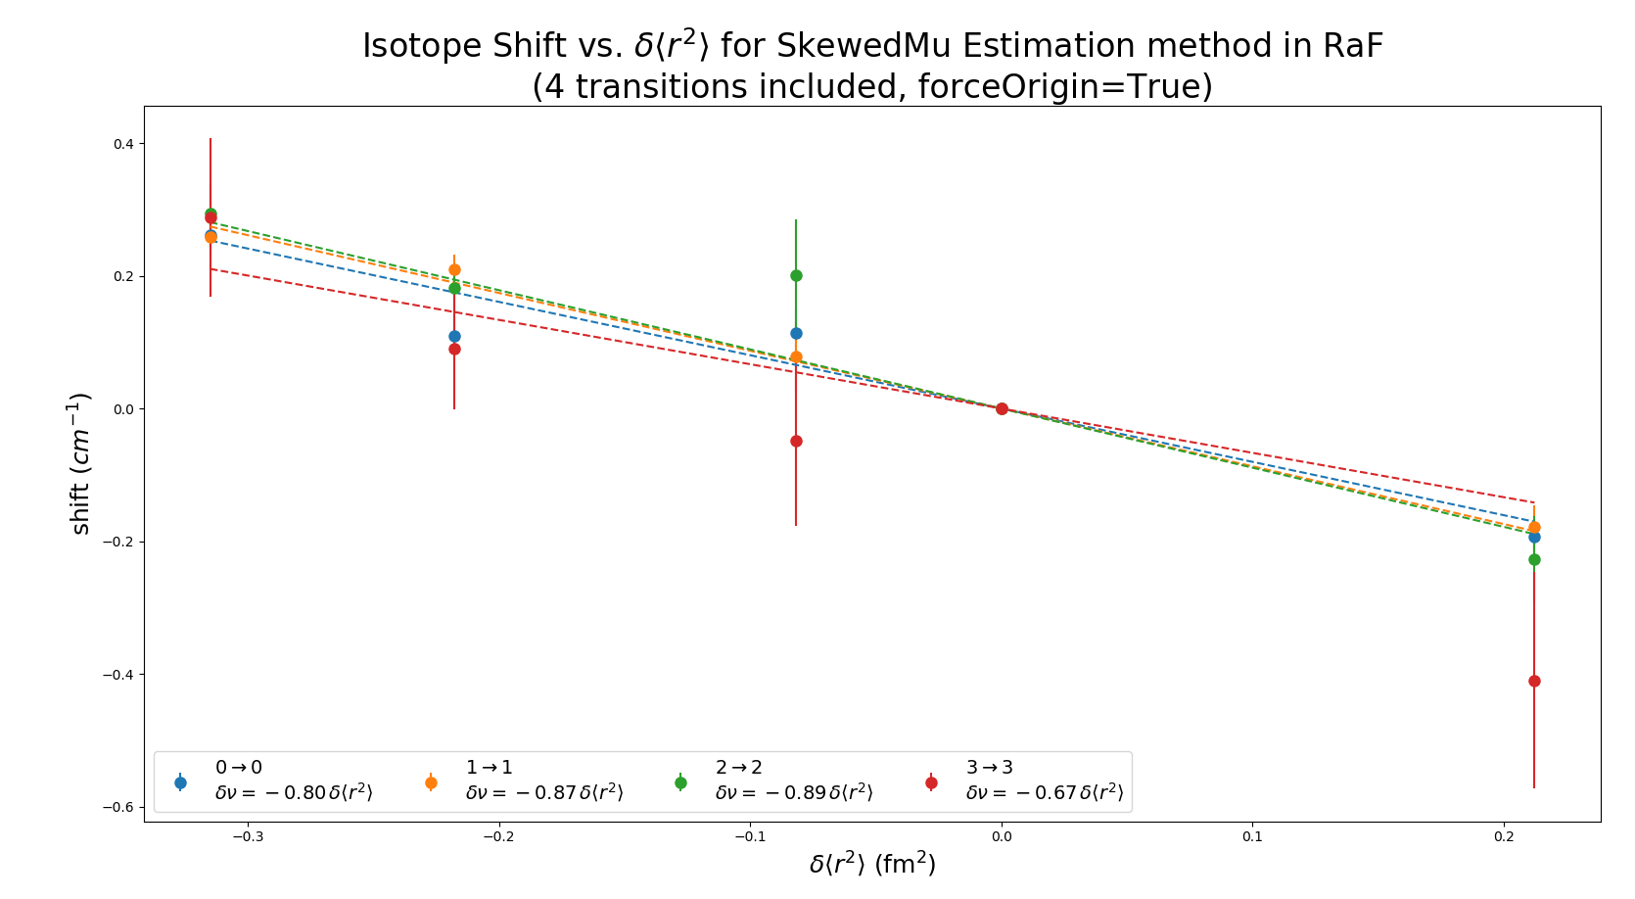

Slide 2
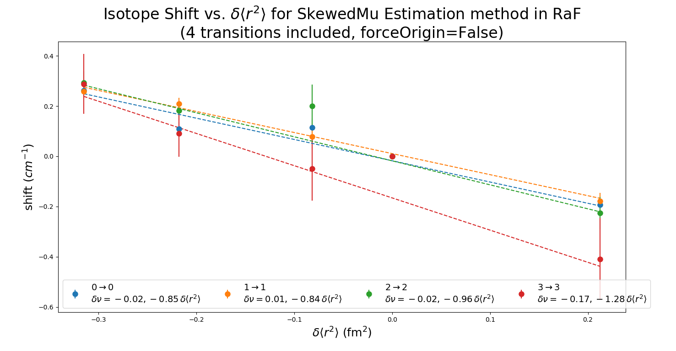

Slide 3
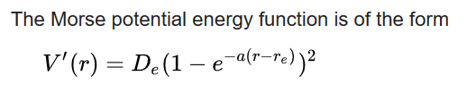
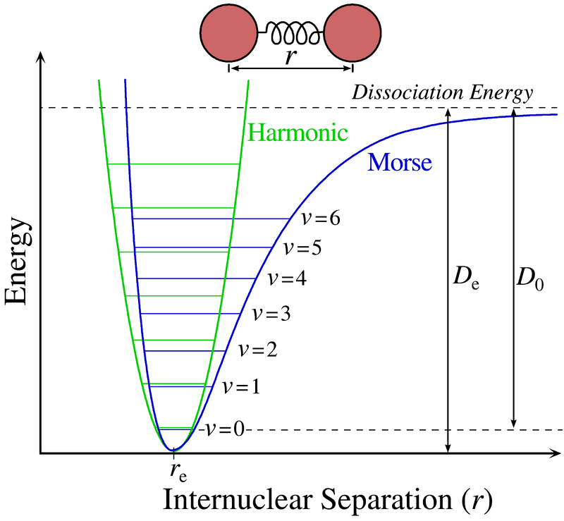
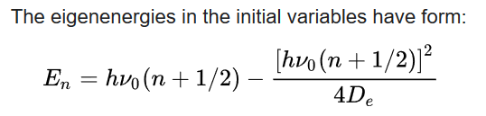

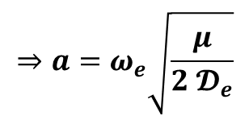
Morse Potential
$$⇒a=ω_{e}\sqrt{\frac{μ}{2 𝓓_{e}}}$$
Notes:
Here r is the distance between the atoms, r_e is the equilibrium bond distance, D_e is the well depth (defined relative to the dissociated atoms), and a controls the 'width' of the potential (the smaller a {\displaystyle a} is, the larger the well). The dissociation energy of the bond can be calculated by subtracting the zero point energy E 0 {\displaystyle E_{0}} from the depth of the well.

Slide 4
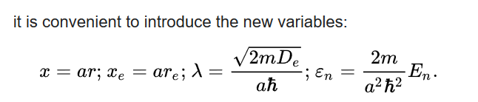
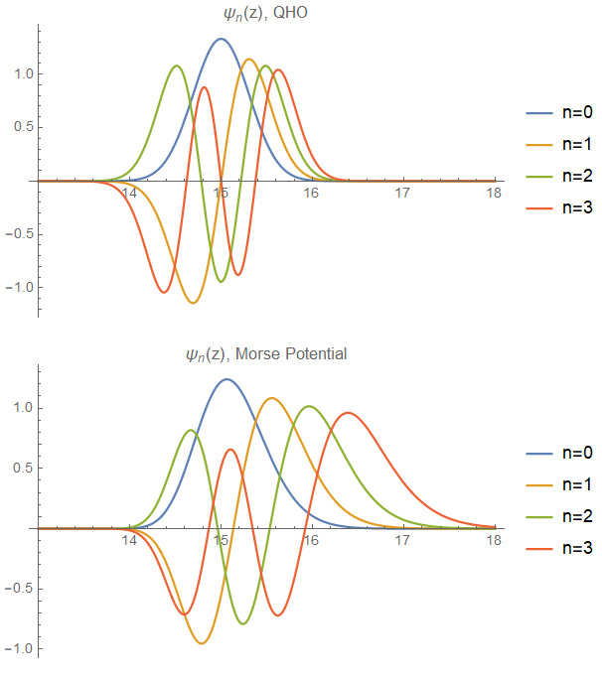
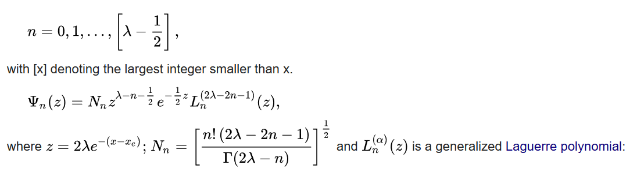
Eigenfunctions

Slide 5
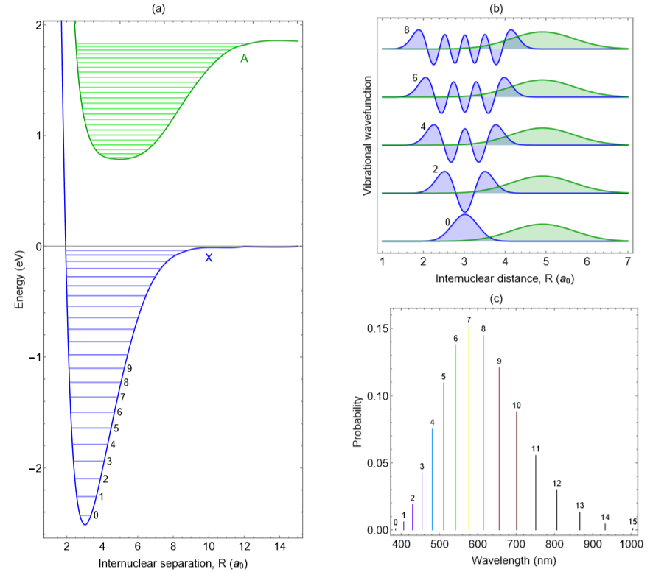
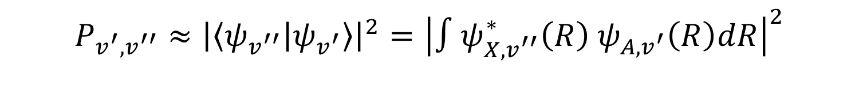
Frank Condon Factors
$$P_{v^{′},v^{′′}}≈{\left|\left\langle ψ_{v^{′′}} | ψ_{v^{′}}\right\rangle \right|}^{2}={\left|∫ψ_{X,v^{′′}}^{∗}\left(R\right) ψ_{A,v^{′}}\left(R\right)dR\right|}^{2}$$

Slide 6
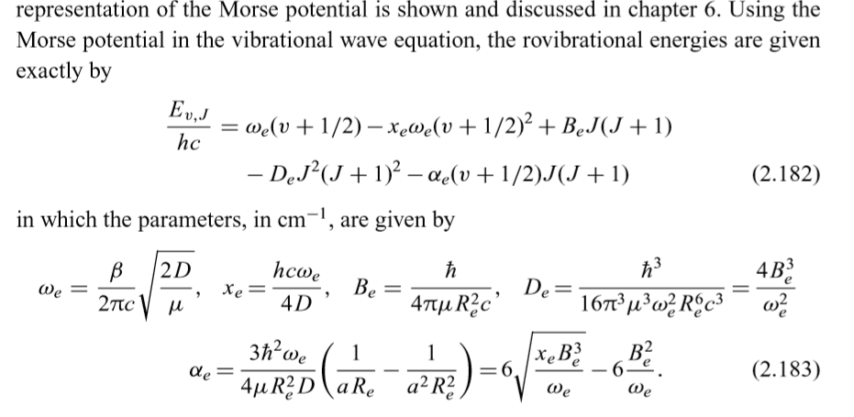
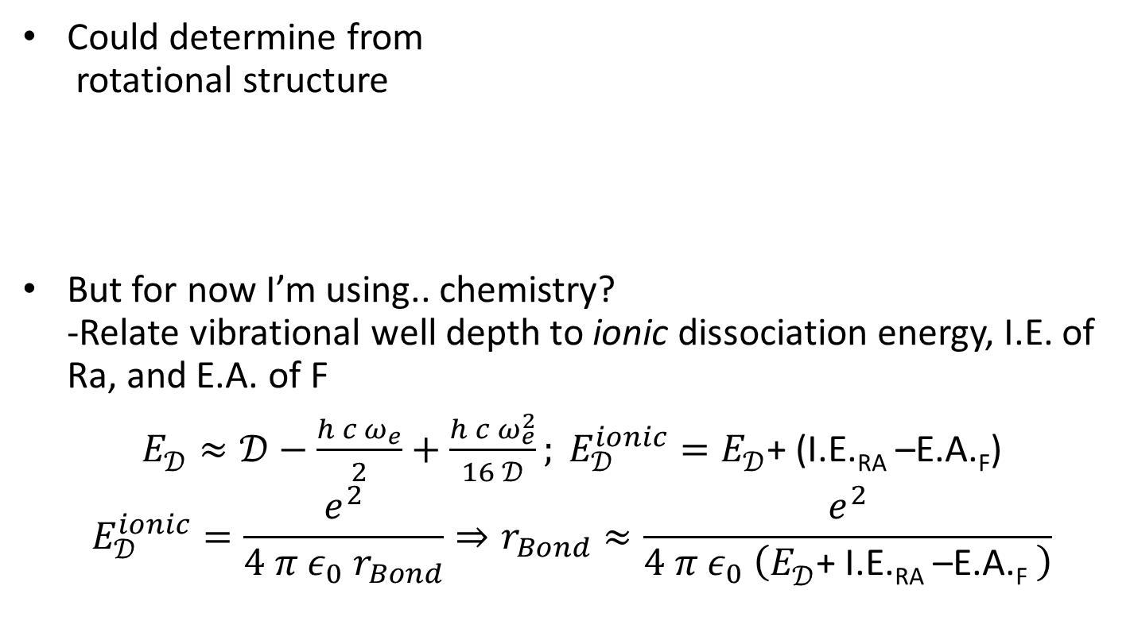

Great… but what’s $r_{e}$?
Could determine from
rotational structure
But for now I’m using.. chemistry?
-Relate vibrational well depth to ionic dissociation energy, I.E. of Ra, and E.A. of F
$E_{𝒟}^{}≈𝒟−\frac{h c ω_{e}}{2}+\frac{h c ω_{e}^{2}}{16 𝒟}; E_{𝒟}^{ionic}=E_{𝒟}^{}$+ (I.E._{RA} –E.A._{F})
$$E_{𝒟}^{ionic}=\frac{e^{2}}{4 π ε_{0} r_{Bond}}⇒r_{Bond}≈\frac{e^{2}}{4 π ε_{0} \left(E_{𝒟}^{}\text{+ }\text{I}\text{.}\text{E}\text{.}\text{RA}\text{ –}\text{E}\text{.}\text{A}\text{.}\text{F} \right)}$$

Slide 7
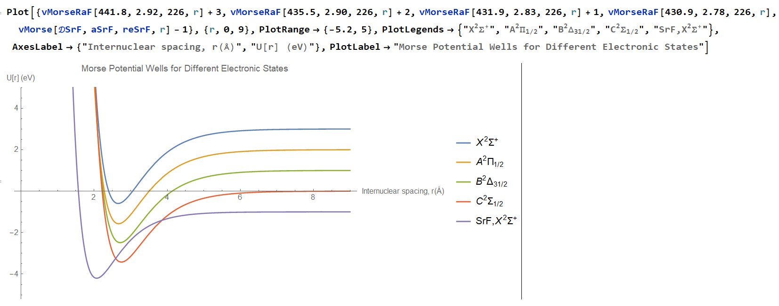
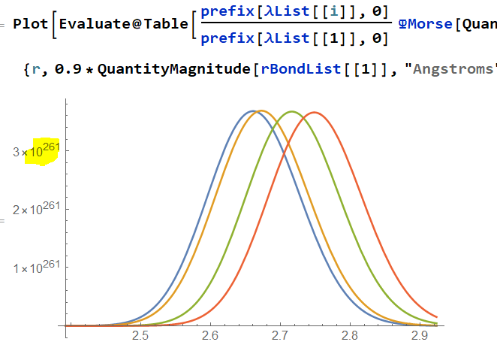
Putting it all together

Slide 8
