Slide 1
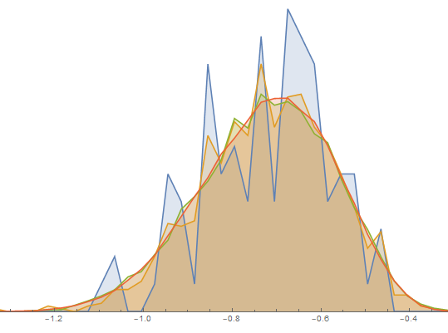

Why my analysis felt like a garbage fire
(and how it’s getting better)

Slide 2
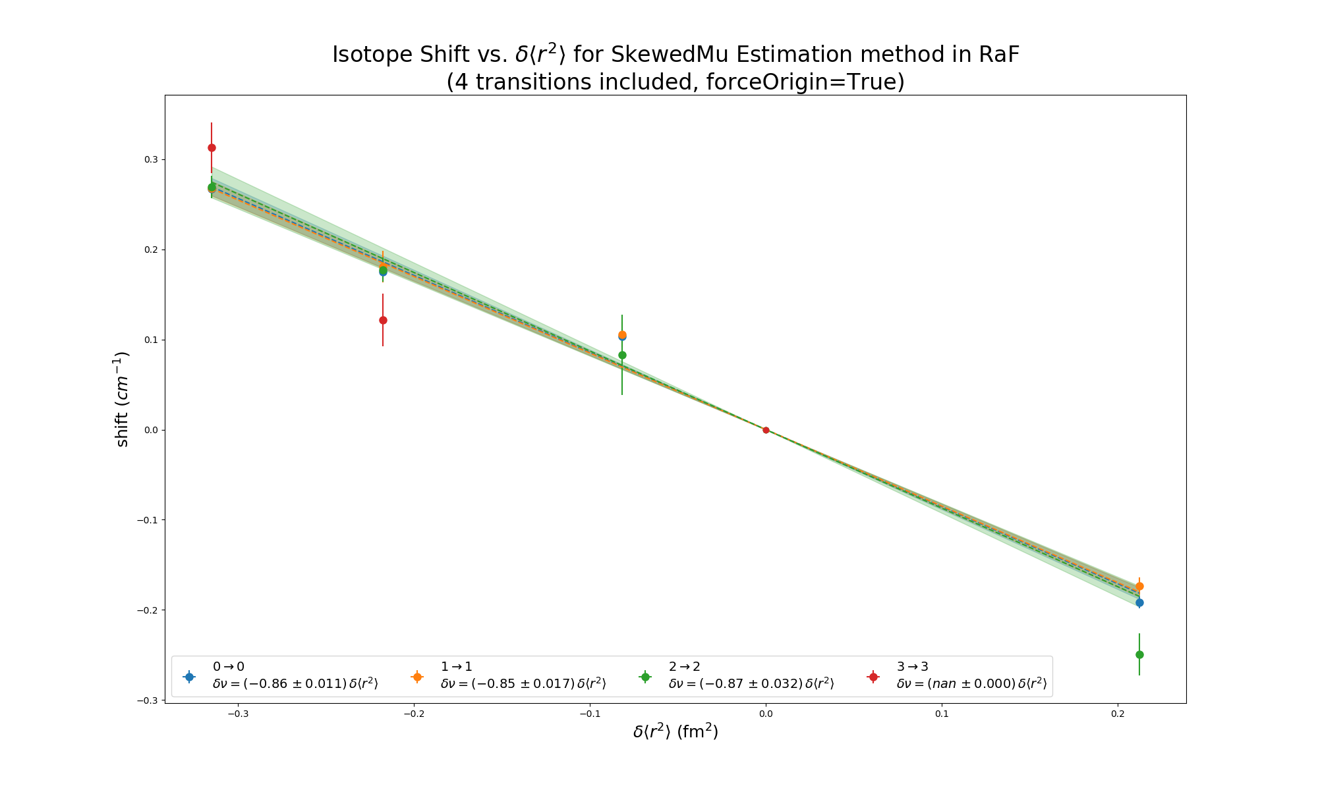
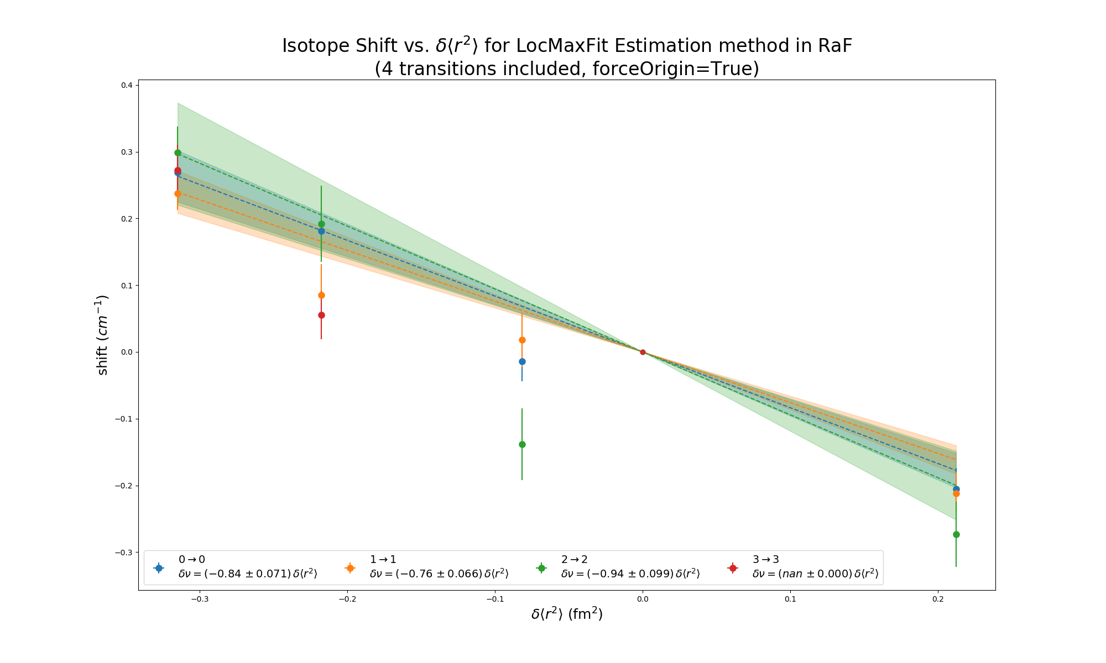

Slide 3
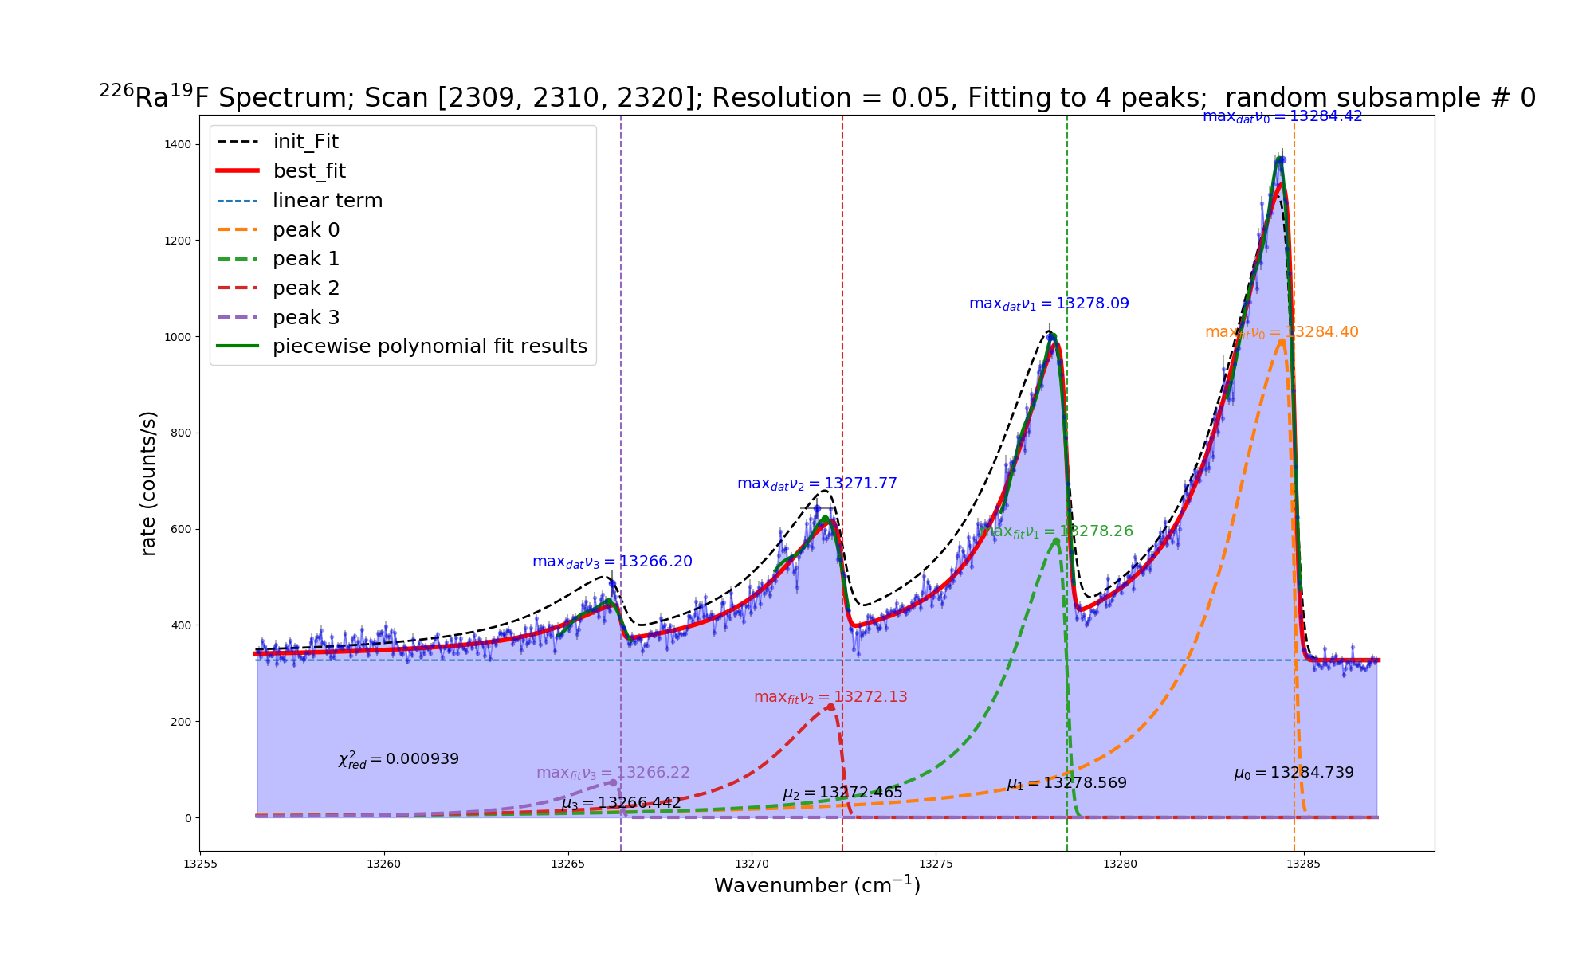

Slide 4
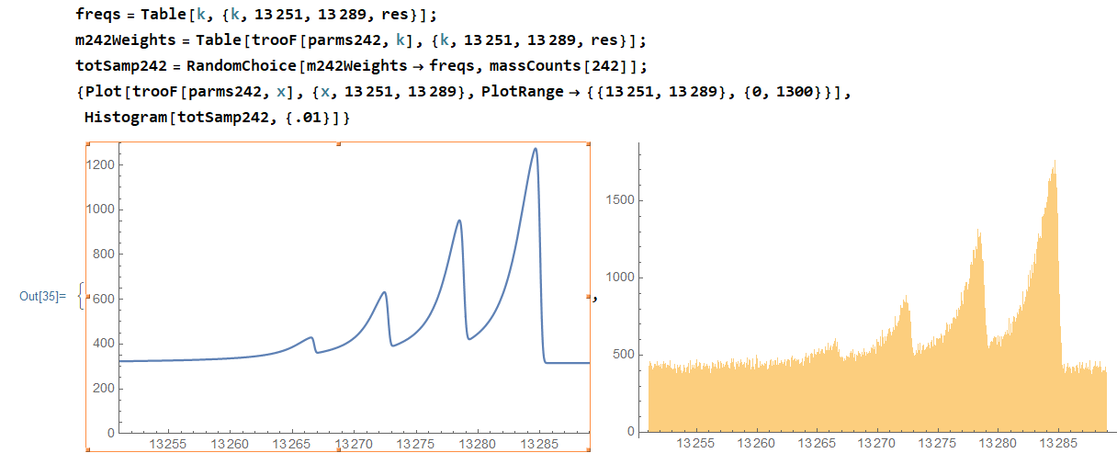
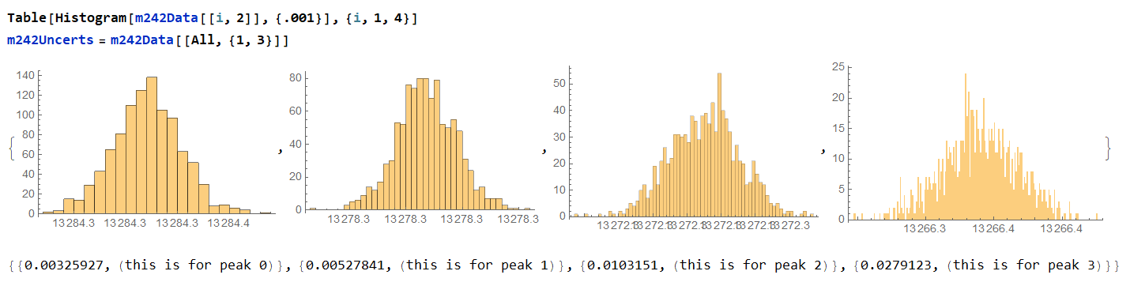
Fit Local Max as a Random Process

Slide 5
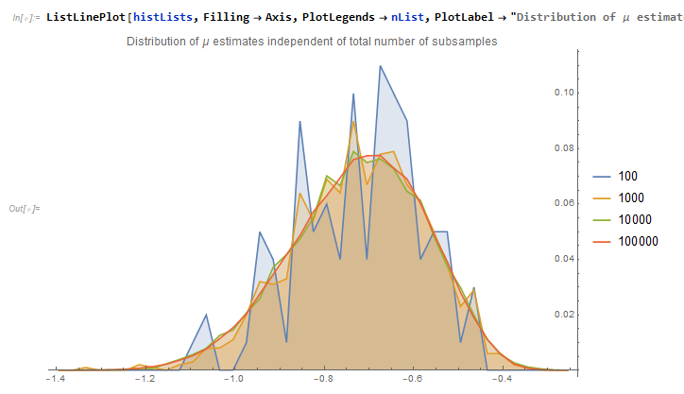

Slide 6
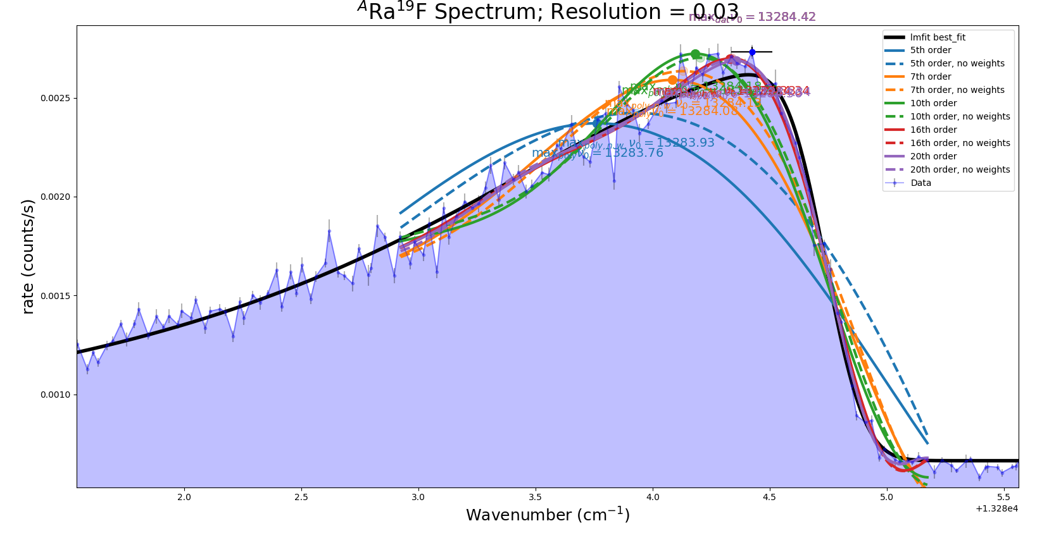
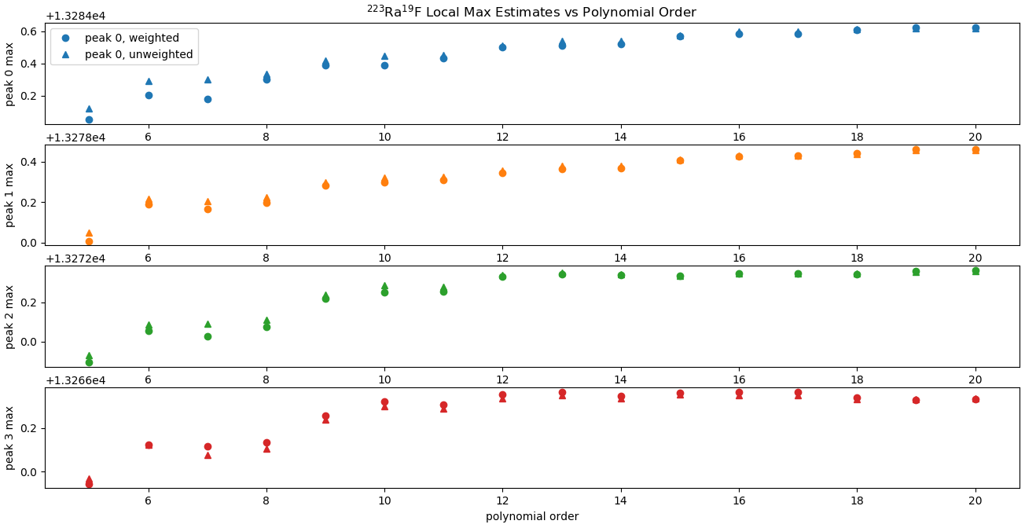
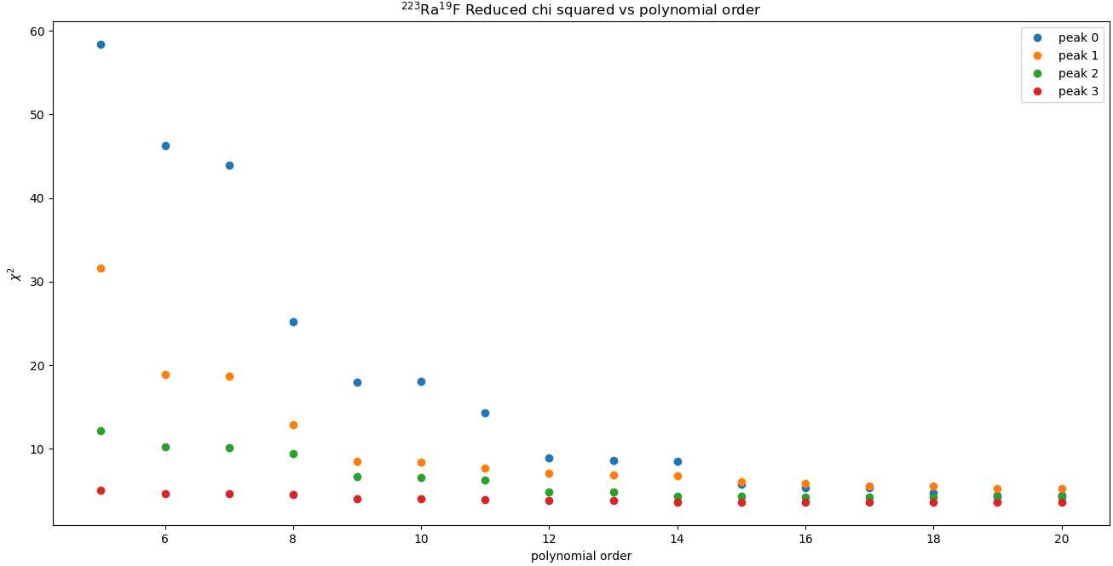
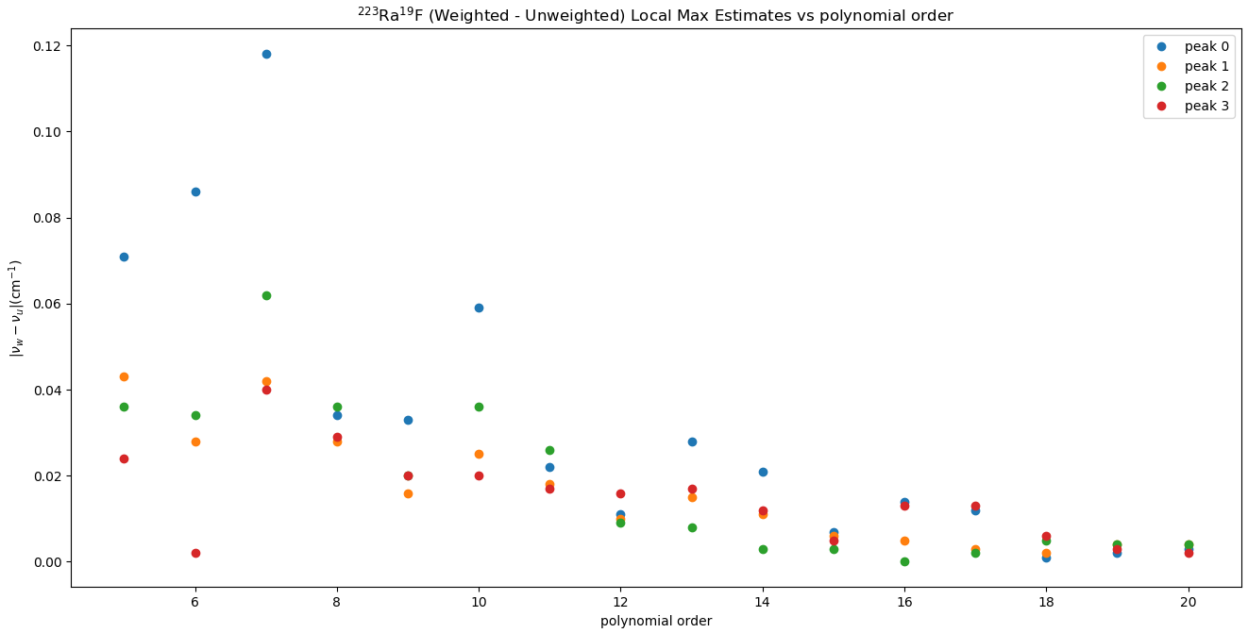
Additional Sources of Error
Dependence on polynomial order
Dependence on weighting of residuals

Slide 7
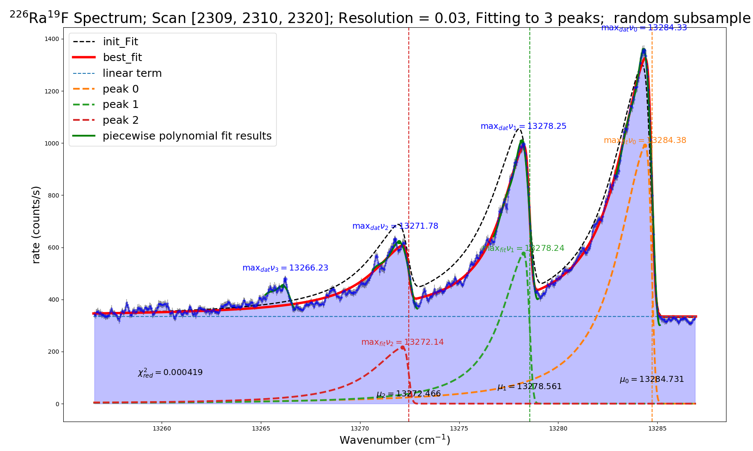
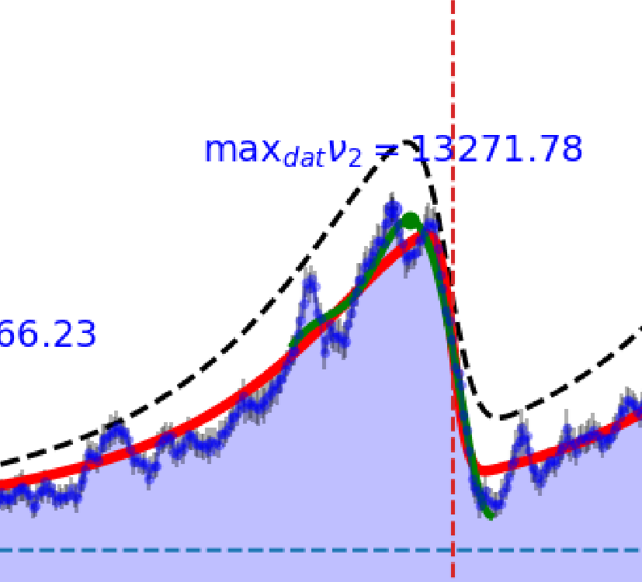
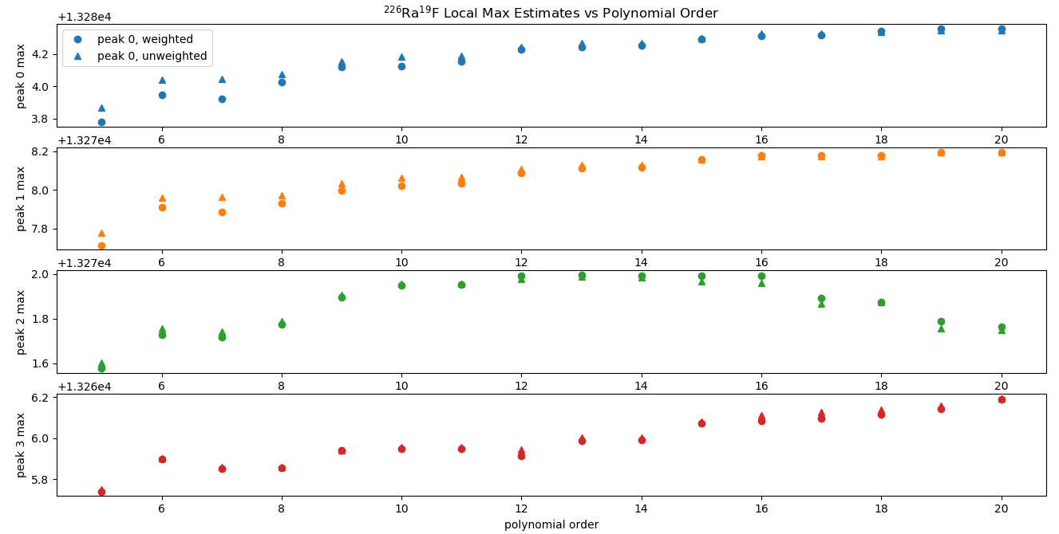
Mass 245 Being Weird

Slide 8
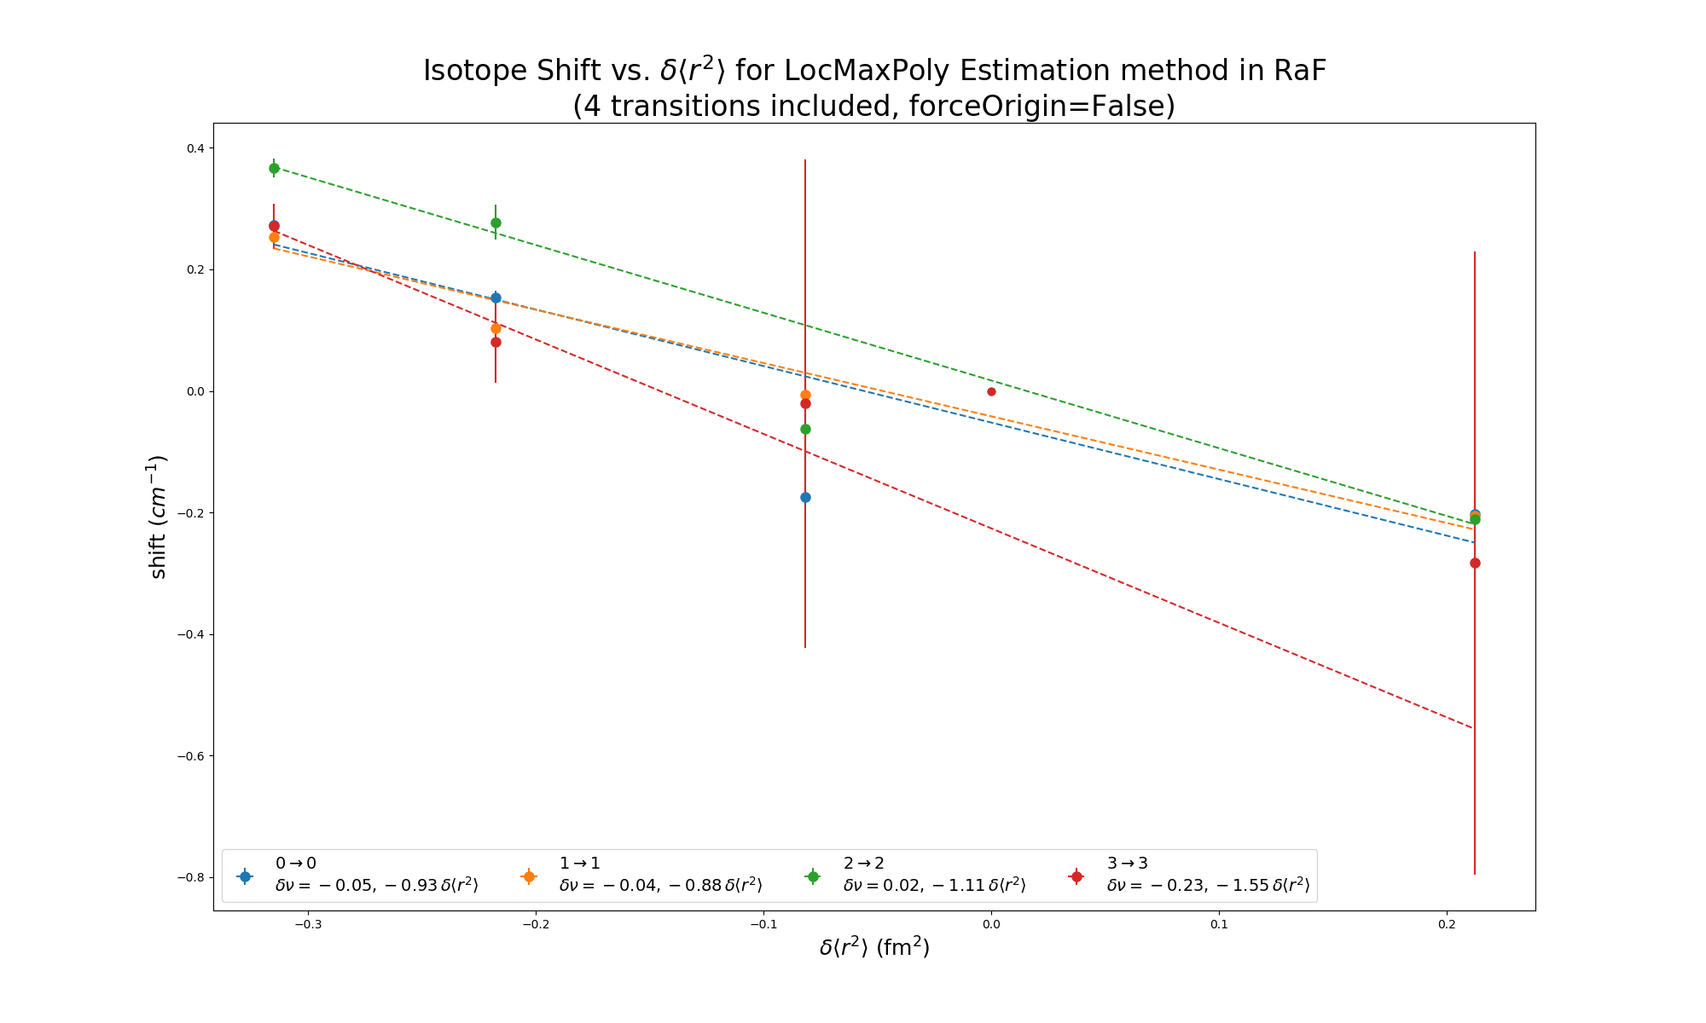
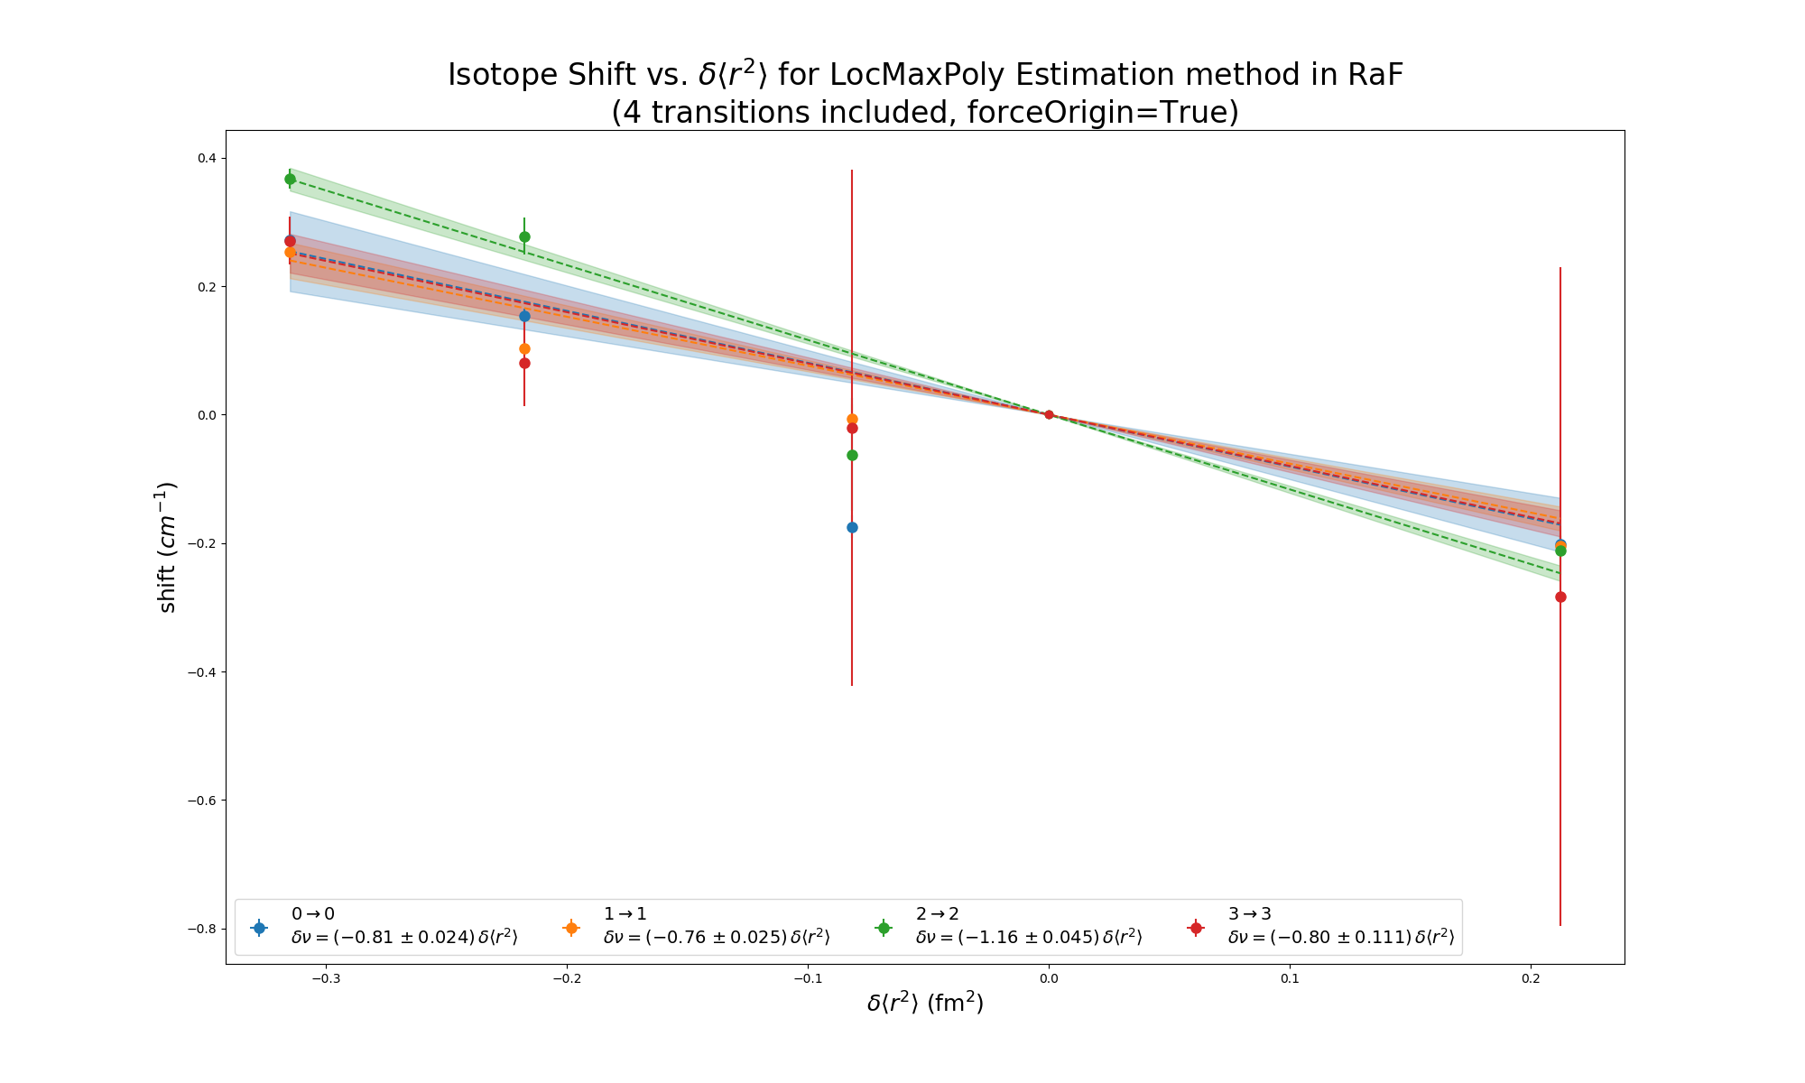
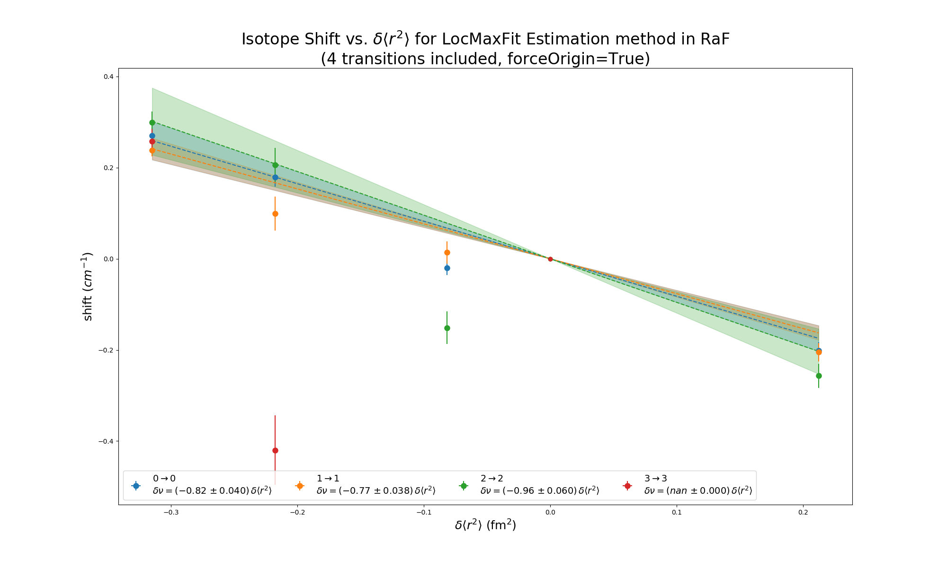
2->2 Not Fitting In

Slide 9
Arguments in favor of pursuing Polynomial approach
Independent estimates are good
Want to extract peak positions - don’t care need to model entire spectrum
Linear fits are fast – can incorporate in random process and actually get statistics

Slide 10
Next Steps
Fix/understand 2->2 estimate for mass 245
Finish characterizing uncertainty on estimates from polynomial fits

Slide 11
